Slide 1
Suicide Assessment and Response for K-12 Populations
Erin Briley, M.S., NCSP
Mountain Plains MHTTC Technical Trainer
Western Interstate Commission for Higher education, Mental Health Program WICHE BHP
ebriley@wiche.edu
303-541-0229

Slide 2
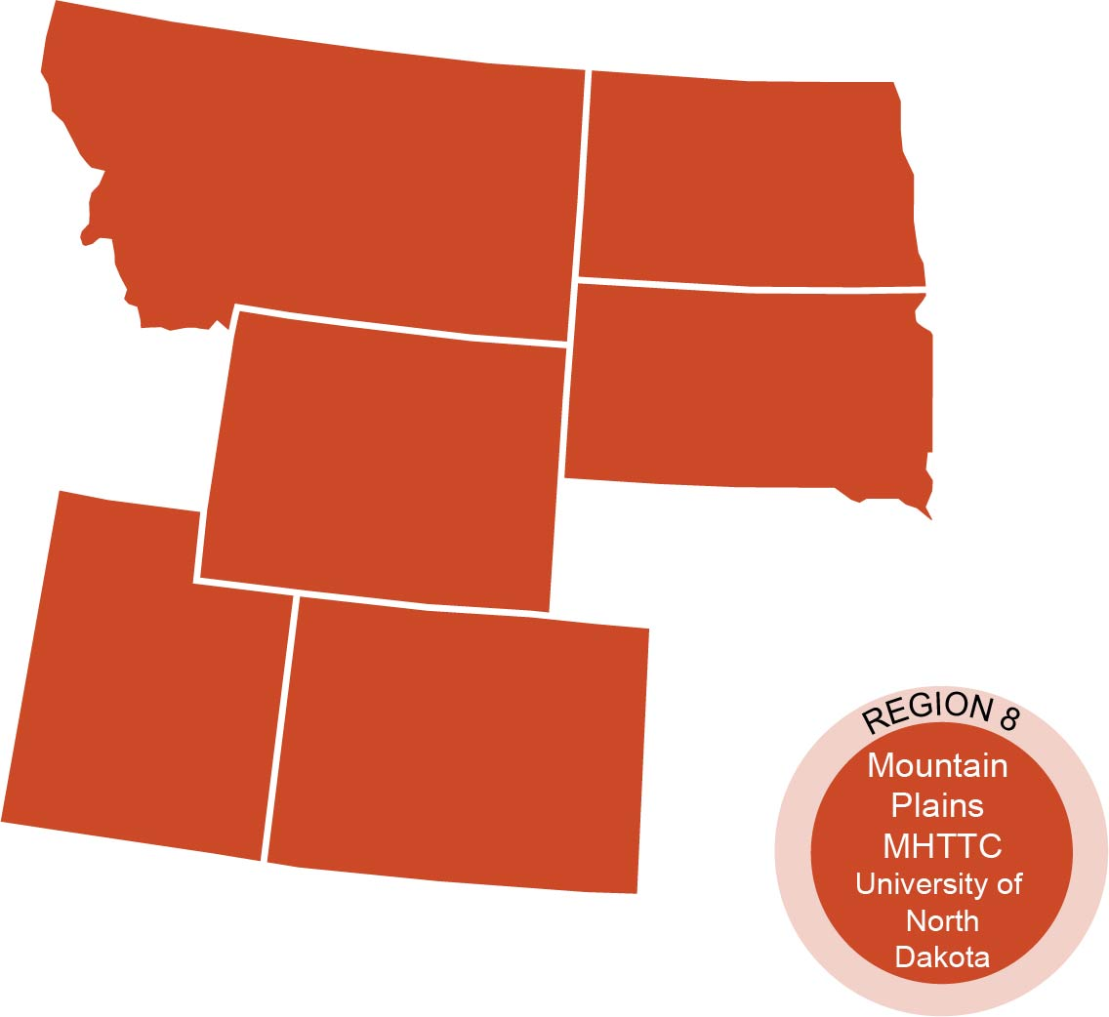
The Mountain Plains Mental Health Technology Transfer Center
The Mountain Plains Mental Health Technology Transfer Center (Mountain Plains MHTTC) provides training and technical assistance to individuals who serve persons with mental health concerns throughout Region 8 (Colorado, Montana, North Dakota, South Dakota, Utah and Wyoming). We belong to the Technology Transfer Center (TTC) Network, a national network of training and technical assistance centers serving the needs of mental health, substance use and prevention providers. The work of the TTC Network is under a cooperative agreement by the Substance Abuse and Mental Health Service Administration (SAMHSA).
Notes:
David will cover to here

Slide 3
Disclaimer and Funding Statement
This presentation was prepared for the Mountain Plains Mental Health Technology Transfer Center (Mountain Plains MHTTC) under a cooperative agreement from the Substance Abuse and Mental Health Services Administration (SAMHSA). All material appearing in this presentation, except that taken directly from copyrighted sources, is in the public domain and may be reproduced or copied without permission from SAMHSA or the authors. Citation of the source is appreciated. Do not reproduce or distribute this presentation for a fee without specific, written authorization from the Mountain Plains MHTTC. For more information on obtaining copies of this presentation please email david.v.terry@und.edu.
At the time of this presentation, Elinore F. McCance-Katz served as SAMHSA Assistant Secretary. The opinions expressed herein are the views of Erin Briley and do not reflect the official position of the Department of Health and Human Services (DHHS), or SAMHSA. No official support or endorsement of DHHS, SAMHSA, for the opinions described in this presentation is intended or should be inferred.
The work of the Mountain Plains MHTTC is supported by grant H79SM081792 from the Department of Health and Human Services, Substance Abuse and Mental Health Services Administration.
Notes:
David

Slide 4
This in-service is not intended to replace advanced training in suicide response and risk assessment. Please refer to resources at the end of this training for programs

Slide 5
Definitions
Suicide: Death by self-directed injurious behavior with an intent to die
Suicide Attempt: Non-fatal self-directed (potentially) injurious behavior with an intent to die
Suicidal Ideation: Thoughts of suicide. May or may not include a plan

Slide 6
Putting It Into Perspective
17% of high schoolers report seriously considering suicide in 2017; rates increase significantly for LGBTQ (47.7%) ² and other ethnic groups.
Suicide is ranked as the 10th leading cause of death in 2017 for all age ranges⁷ but is second among youth ages 10-24⁶.
In 2017, suicide nearly tripled for youth aged 10-14; increased 76% for ages 15-19; and increased 36% for ages 20-24 as compared to 2007⁵.

Slide 7
Putting It Into Perspective
For American Indian and Alaska Native youth and young adults ages 15-34, the suicide rate is 1.5 times that of the national average³
The rate for males is nearly three times higher than females for ages 15-19¹³

Slide 8
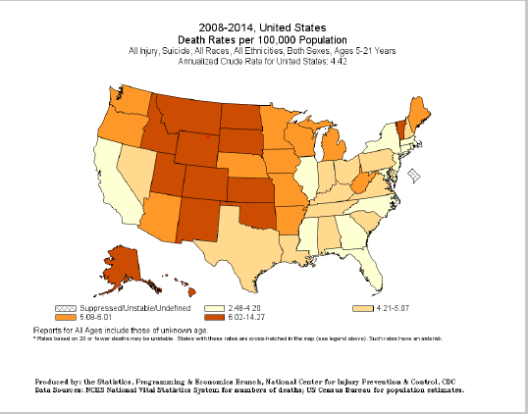

Slide 9
Contributing Factors to High Suicide Rates in Mountain States
While it is impossible to know the exact cause of the increased rates of suicide in this region, several things have been proposed as contributing risk factors. Some possible reasons for the higher rates of suicide may include:
Decreased access to mental health resources
Easier access to firearms due to higher rates of gun ownership
Increased tendency to not access resources due to stigma
Increased economic stressors related to stressful work and decreased employment options

Slide 10
Risk Factors (Characteristics associated with increased risk. Risk increases with multiple factors)
Individual Risk Factors¹⁵:
Previous suicide attempts
Non-suicidal self-injury such as cutting
Mental illness, hopelessness, low self-esteem
Impulsive or risk-taking tendencies
Poor problem-solving or coping skills
Low stress and frustration tolerance
Social alienation or isolation, non-conforming

Slide 11
Risk Factors (Characteristics associated with increased risk. Risk increases with multiple factors)
Risky Behaviors¹⁵:
Alcohol or drug use
Delinquency
Aggressive/violent behavior
Risky sexual behavior
Exposure to suicidal behavior of others via media or other

Slide 12
Risk Factors (Characteristics associated with increased risk. Risk increases with multiple factors)
Family Characteristics:¹⁴
Family history of suicide
Parental mental health problems
Family stress and dysfunction
Stressful life event/loss or a situational crisis (breakups, abuse, divorce, death of a loved one, etc.)

Slide 13
Risk Factors (Characteristics associated with increased risk. Risk increases with multiple factors)
Environmental Factors:¹⁴
Exposure to suicidal behavior of others
Negative social and emotional environment at school
Expression and acts of hostility
Lack of respect and fair treatment
Limitations in school physical environment, including lack of safety and security
Access to lethal means
Exposure to stigma & discrimination

Slide 14
Signs of Depression in Youth⁹
Young Children | Other Children/Teens
* Frequent tantrums, intense irritability Often talks about fears or worries Somatic complaints Very active except with TV or videogames Sleeps too much/little. Frequent nightmares or seems sleepy during the day Little interest playing with others or trouble making friends Struggles academically or recent decline in grades | Loss of interest in things previously enjoyed Fear of gaining weight; diet or exercise excessively Periods of highly elevated energy/activity; requires much less sleep Sleeps too much/little. Seems sleepy throughout the day. Low energy Increased isolation; avoids social activity Self-harm behaviors (e.g., cutting or burning their skin) Risky or destructive behaviors. Substance use

Slide 15
General Warning Signs^{15,16} (Observable behaviors signaling suicidal thinking)
Warning Signs: Changes in behaviors, feelings, & beliefs about self. Most signs last 2+weeks, but can occur impulsively
Anxiety, agitation, dramatic mood changes
Reckless or engaging in risky activities
Unable to sleep or sleeping all the time
Increased alcohol or drug use
Withdrawal from friends, family, and society
Feeling trapped, like there’s no way out
Rage, uncontrolled anger, seeking revenge

Slide 16
Warning Signs for Youth (<25 yrs) ¹⁶
Talking about or making plans for suicide
Hopeless about the future
Severe or overwhelming emotional pain or distress
Worrisome behavioral cues or marked behavioral change:
* Withdrawal or changes in social connections
* Changes in sleep (increased or decreased)
* Anger that seems out of character or context
* Recent increased agitation or irritability

Slide 17
Acute Warning Signs¹⁶
Threatening to hurt or kill self or talking about wanting to die (sometimes this is seen as verbal clues)
Looking for ways to kill self by seeking access to lethal items
Talking or writing about death, dying, or suicide
- Is there a detailed plan for attempt (how, where, when)?
Note: Be cautious of sudden improvement after a period of being very sad and withdrawn because a decision may have been made to escape problems by ending life

Slide 18
Warning Signs for Youth (<25 yrs) ¹⁶
The risk for Suicide increases if the warning sign is:
New and/or
Has increased, and
Possibly related to an anticipated or actual painful event, loss, or change

Slide 19
Protective Factors¹⁴
Protective factors don’t shield a child from risk if they are already actively suicidal, but they are very helpful in safety planning
Individual Characteristics
Emotional well-being and emotional intelligence
Adaptability, resilience, internal control of one’s environment
Strong problem-solving, coping, conflict resolution skills
Frequent, vigorous exercise or participation in sports
Spiritual faith. Cultural beliefs that affirm life
Frustration tolerance and emotional regulation
Body image, care, and protection

Slide 20
Protective Factors¹⁴
Social Supports
Connections. Close supportive bonds with family, caring adults, and peers. Parental involvement.
Parental pro-social norms
Family support for school

Slide 21
Protective Factors¹⁴
School Supports
Positive school experiences- safe and respectful climate
Adequate or better academic achievement
Connectedness to school. Part of a close school community
Consider:
Internal: ability to cope with stress, religious beliefs, frustration tolerance
External: responsibility to others, positive therapeutic relationships, social supports

Slide 22
Why is Understanding This Important?
Increasing mental health education and suicidal awareness, including the ability to identify & understand risk factors, protective factors, and warning signs for suicide can help to decrease rates of suicide
National trend towards teaching youth and teachers suicide awareness and referral steps at a school-wide level as a universal type of intervention.
Allows us to be proactive and intervene much earlier, before a situation becomes a crisis and get students the help they deserve

Slide 23
“Research shows that a brief screening tool can identify individuals at risk for suicide more reliably than leaving the identification up to a clinician’s personal judgment or by asking about suicidal thoughts using vague or softened language.”⁷

Slide 24
When is a Screener Used?
Suicide Screening: A standardized instrument or protocol to identify suicide risk. Can be done universally or selectively.
Conducted when:
1. Student inform of attempt, thoughts, or plans
2. Peer or staff learn of an attempt
3. Staff believes student is at risk
Suicide Assessment: A comprehensive evaluation done by a clinician to confirm risk, estimate immediate danger, and determine the course of treatment

Slide 25
Basic Guidelines
Defer to your school’s crisis protocol!
1. Refer to staff trained to recognize & respond: (E.g., School Counselors, Behavioral Health Specialists, School Psych., Clinical Psych., School Social Workers)
2. If unable to locate, alert administration and determine if crisis team needs to be called to assess for imminence. If yes, call parents
3. In emergencies, alert administration, call 9-1-1, and parents
4. Ensure school staff are aware of referral/response protocol and basic guidelines

Slide 26
What to Explore in a Risk Assessment¹²
Identify risk factors. Pay attention to those that can be reduced. Explore if they’ve made past attempts at suicide or if there is a family history.
Identify and mobilize protective factors
- Is there anything that could stop them? E.g., younger siblings, pets, religious beliefs, …

Slide 27
What to Explore in a Risk Assessment¹²
3. Conduct suicide inquiry
a) Ideation. How long have they been thinking about suicide
(frequency, intensity, duration).
- Be direct. Be developmentally appropriate.
- Prompt Questions: “Are you thinking of suicide?”; “Have you thought about suicide in the last two months?”; “Have you ever attempted to kill yourself?”
- Be specific. Avoid vague terminology like “hurt”

Slide 28
What to Explore in a Risk Assessment¹²
Suicide Inquiry (cont.)
b) Plan. Is there a plan? How would they do it if they could? Get specifics.
c) Access. Are there means to carry through?
d) Intent. Have they made plans to follow through? If imminent (within next 24 hours, obtain immediate assistance or emergency response. Send to ER)
- Note: Asking about intent to kill oneself is not correlated with suicidality

Slide 29
What to Explore in a Risk Assessment¹²
Determine risk level and if crisis team should be contacted.
Document, document, document!

Slide 30
Or… Use a Developed Suicide Screener
Columbia-Suicide Severity Rating Scale (C-SSRS)
SAFE-T
Yes, you can screen remotely!

Slide 31
Columbia-Suicide Severity Rating Scale (C-SSRS)⁴
Brief screener (4-6 questions) for ideation severity within the last month and behaviors within the last 3 months
Combine results with clinical judgement to determine risk level and make clinical decisions about care
Population: All age ranges (6+) and special populations in different settings. Also available for very-young children/cognitively impaired
Administration Requirements: Any professional or self-report. MH background not required
Additional: Evidence-supported. Includes a follow-up screener. Endorsed by: SAMHSA, NIH, DOD, National Action Alliance for Suicide Prevention, Zero Suicide Initiative.
Cost: Free

Slide 32
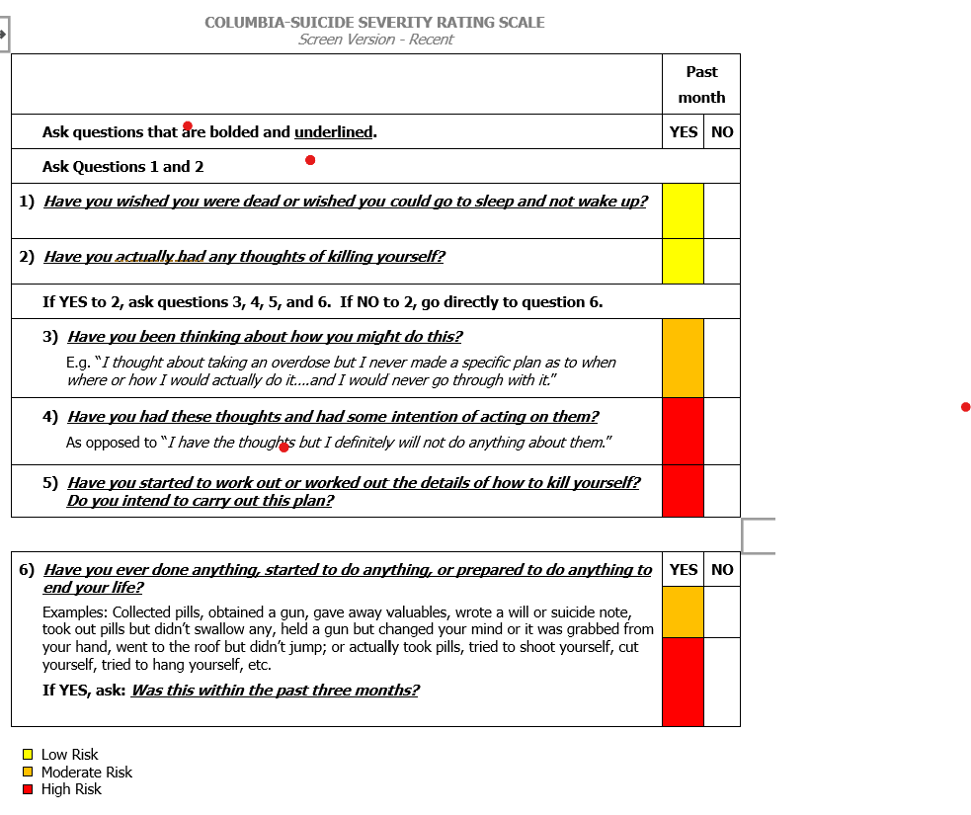
C-SSRS⁴

Slide 33
SAFE-T¹⁴
Description: Interview-format to gather information related to suicide risk
Explores: 1) Ideation within last 48 hours, past month, and worst ever; 2) Plan (timing, location, lethality, availability, preparatory acts); 3) Behaviors (past and aborted attempts, rehearsals versus non-suicidal self-injurious actions); 4) Intent
Additional: Mobile App available. Endorsed by SAMHSA, SPRC
Cost: Free

Slide 34
High Levels of Risk¹²
Risk/Protective Factor: Psychiatric disorders with severe symptoms or acute precipitating event; protective factors not relevant
Suicidality: Potentially lethal suicide attempt or persistent ideation with strong intent or suicide rehearsal
Possible Interventions: Contact crisis team. Suicide precautions

Slide 35
Moderate Levels of Risk¹⁰
Risk/Protective Factor: Multiple risk factors, few protective factors
Suicidality: Suicidal ideation with plan, but no intent
Possible Interventions: May need to contact crisis team dependent on risk factors. Develop crisis plan. Provide resources

Slide 36
Low Levels of Risk¹⁰
Risk/Protective Factor: Modifiable risk factors, strong protective factors
Suicidality: Thoughts of death, no plan, intent, or behavior
Possible Interventions: Outpatient referral, symptom reduction, provide resources.

Slide 37
Levels of Risk¹⁰
Risk Level | Risk/Protective Factor | Suicidality | Possible Interventions
High | Psychiatric disorders with severe symptoms or acute precipitating event; protective factors not relevant | Potentially lethal suicide attempt or persistent ideation with strong intent or suicide rehearsal | * Contact crisis team* Suicide precautions
Moderate | Multiple risk factors, few protective factors | Suicidal ideation with plan, but no intent | May need to contact crisis team dependent on risk factors. Develop crisis plan. Provide resources
Low | Modifiable risk factors, strong protective factors | Thoughts of death, no plan, intent, or behavior | Outpatient referral, symptom reduction, Provide resources.

Slide 38
Problems with Levels of Risk
Suicidality is dynamic. Meaning, a variety of factors (personal events, availability of resources, etc.) can influence the level of severity at any point in time.⁷
Other factors that should be explored when determining severity of risk includes: a) the patient’s current available and accessible resources; b) foreseeable changes (events and stressors) which can influence risk; c) and, comparing the patient’s current risk state to their baseline or worst-point state ¹²
Be a critical thinker!

Slide 39
Helping Suicidal Youth
Show you care – Listen carefully – Be genuine.
“I’m concerned about you…about how you feel.”
Ask the question –Be direct, caring and non-confrontational.
“Are you thinking about suicide?”
Get help – Do not leave him/her alone.
“You are not alone. I will help you get the help you need.”
Emphasize protective factors that provide a reason for living (e.g., favorite pets, younger siblings or close relationships with others, future plans/dreams)

Slide 40
Screening & Telehealth During the Pandemic ¹
Increase check-ins with students presenting with emotional needs prior to the pandemic, especially if they’ve experienced suicidal ideation in the past
Have student’s contact information and address on hand in case you get disconnected or if emergency services need to be contacted
Know in advance whom to refer to if you require consult or if student requires increased supports or emergency response
Consider the emotional impact of this pandemic on suicide risk due to increased stressors (e.g., increased: isolation, familial conflict, financial concerns, anxiety and fear, disruption of routines; decreased social support, etc.) and inquire as appropriate

Slide 41
Screening & Telehealth During the Pandemic ¹
Consider increased access to lethal means (e.g., stockpiles of meds, etc.)
Increase check-ins and contacts until risk decreases
Identify people in student’s current environment that can help monitor suicidal ideation and behaviors in-person and remotely
Consider researching tele-health options available for insured and non-insured students

Slide 42
What’s Not Helpful?
Ignoring or dismissing the issue indicates you don’t hear their message, believe them, or care about their pain.
Acting shocked or embarrassed.
Panicking, preaching, or patronizing.
Challenging, debating, or bargaining. You can’t win a power struggle with someone thinking irrationally.
Giving harmful advice such as suggesting the use of drugs or alcohol to “feel better”.
Promising to keep a secret. The suicidal person is sharing his/her feelings hoping someone will help their pain, even though they may verbally contradict this.

Slide 43
Positive Screening- General Next Steps
FOLLOW YOUR DISTRICT’S CRISIS PROTOCOL
Keep safe and don’t leave alone, even for a minute!
Restrict access to lethal means. Suicides typically occur with little planning when experiencing a short-term crisis so ,⁵
Assess the need to contact the crisis team available at your school district. Call 9-1-1 if necessary
Notification – Notify administrator and guardians
Provide all students with any degree of suicidal ideation the number to the National Suicide Prevention Lifeline (1-800-273-TALK/8255), local crisis, local behavioral health resources, and peer support contacts
Determine follow-up monitoring plan and behavioral health supports

Slide 44
Positive Screening- Next Steps- High Risk
Don’t leave alone, even for a minute. Call for back-up
Remove dangerous objects from immediate area
Notify administrator and guardians. Ask guardians to come to school.
Contact crisis team, or 911 if necessary.
Release only to parent or crisis responder
Obtain written consent to consult with outside providers
Alert appropriate school officials
Conduct re-entry meeting to create safety plan & school safety plan on current recommendations, concerns, supervisory and monitoring needs. Invite outside provider or obtain input (with consent). Note: some schools require documentation from a mental health provider that the student is no longer a danger to themselves or other.
Document assessment results, whom contacted, plan of action

Slide 45
Positive Screening- Next Steps- High Risk
Assign a staff to be the primary point of contact
Daily check-ins for the first couple of weeks
Temporarily increase counseling supports or phone check-ins if not in school
Ensure relevant staff understand warning signs, triggers, side effects of medications, and next steps of action/referral steps
Arrange for makeup work or work extensions without penalty
Arrange for safety provisions. Can they leave class without an escort for safety? How many minutes can they be gone without the office being alerted due to safety concerns?

Slide 46
Positive Screening- Next Steps- Moderate Risk
Notify administrator and contact guardians
Provide crisis/emergency and local resources.
Refer to community provider. Obtain written consent to consult.
Contract crisis team if necessary
Release only to parent or crisis responder
Create safety plan for home and school
If student left school, implement re-entry procedures and complete school safety plan
Document assessment results, whom contacted, plan of action

Slide 47
Positive Screening- Next Steps- Low Risk
Contact parent/guardians
Create safety plan
Provide crisis/emergency and local resources
Document assessment results, whom contacted, plan of action

Slide 48
SAFETY PLANNING
What a safety plan is:
A plan developed collaboratively with student and family to reduce suicide risk
Serves as a reference point and support if thoughts of suicide occur
What safety planning is not:
Political or moral discussion
Discussion of permanent removal of means
Special notes:
Create the safety plan after the crisis, when the person isn’t experiencing intense suicidal thoughts and when they can think clearly.

Slide 49
Safety Plan Components¹⁶
Identify warning signs/cues and triggers of potential crises. What are triggering stressors? E.g., anniversaries, losses,...
Identify coping strategies. What can they use on their own and with others?
Distracting from the crisis. What can be done to distract from their feelings or thoughts?
Identify supports – family, peers, supportive adults, etc. the student can talk with to help resolve a crisis
Identify emergency/crisis numbers and local behavioral health resources to contact during a crisis
Identify how to keep the environment safe. Reduce access to lethal means.
Review periodically

Slide 50
School Safety Planning¹²
At School: | Remotely:
Has your district created a crisis protocol for this? If so, follow it!
1. Screen if trained or refer to staff trained to recognize & screen (e.g., behavioral health staff). If unable to locate trained staff, alert admin (if at school) who will determine next steps or if crisis services needs to be called. If remote, locate trained staff/consultation or call crisis services if they can’t be located. Parents should be notified for both circumstances.
2. Screen. If positive, determine if crisis team needs to be contacted based on risk level. Err on the side of caution if unsure. Alert parents & admin. Do NOT leave alone until help arrives or initiates contact
3. In emergencies, call 9-1-1, inform admin, & notify parents. Safety first!
4. Develop safety plan (this may be done later if student is currently in crisis) and provide crisis/emergency/ local resources. Determine follow-up monitoring plan and behavioral health supports. Document assessment results, whom contacted, and plan of action

Slide 51
Parent Notification¹⁴
Notify guardians as soon as student is identified as at-risk for suicide, & request to come to school (immediately for high risk). Review potential lethal means at home and the need to temporarily remove them.
For low/moderate risk that don’t require hospitalization, provide with community behavioral health resources.
If you believe student is danger of self-harm and parent refuses to seek services, a report of negligence to child protective services may be mandated
If imminent risk of suicide is related to parental abuse, notify protective services
Follow-up with parents in a few days to see if an outside provider has been secured. If not, discuss why and offer to help.
Document each and every contact.
Some schools have parents sign an acknowledgement form stating they’ve been informed of their child’s risk and received referrals

Slide 52
Confidentiality¹⁴
Positive school experiences- safe and respectful climate
Do not share clinical information on details related to their suicidal behavior.
Only share information with staff necessary to preserve student safety such as that related to their treatment and support needs.
General classroom discussions violate confidentiality, so avoid these.
FERPA does allow us to disclose student information without consent, to appropriate parties if that information is necessary to protect the health and safety of the student. If we have a student that is suicidal or expressed suicidal thoughts, then school officials may interpret this as a significant threat to health or safety

Slide 53
Don’t Be Negligent! ¹⁴
A review of literature by SAMHSA (2012) found schools sued for negligence due to the following:
Failure to notify parents if their child appears suicidal
Failure to get assistance for a student at risk of suicide
Failure to adequately supervise a student at risk of suicide
Also, remember that all reports of suicidal thoughts should be taken seriously

Slide 54
Resources for Schools Without a Mental Health Emergency Response Plan
First, Contact your district administrators to see if a plan or protocol does exist.
If no plan exists, discuss options for developing a collaborative district-wide plan.
Ensure you have adequately trained staff members identified ahead of an emergency who can effectively respond should a mental health emergency arise.
Coordinate with outside agencies, such as mental health crisis teams or law enforcement, to ensure continuity of care. Possible resources to explore
Refer to references at the end of this powerpoint for additional information

Slide 55
RESOURCES

Slide 56
24/7 National Crisis Support Lines
National Suicide Prevention Lifeline 1-800-273-TALK (8255) or 1-888-628-9454 (Spanish)
Crisis Text Line Text HOME to 741-741
Trevor Lifeline (For LGBTQ Youth) 1-866-488-7386
Trans Lifeline 1-877-565-8860 or translifeline.org

Slide 57
Advanced Training in Risk Assessment
Applied Suicide Intervention Skills Training (ASIST) A workshop designed for caregivers of individuals at risk of suicide. http://www.livingworks.net/programs/asist
Assessing and Managing Suicide Risk (AMSR) A one-day workshop focusing on core competencies to assessing and managing suicide risk. http://www.sprc.org/training-events/amsr or amsr@edc.org.
Recognizing and Managing Suicide Risk (RRSR)
QPRT Suicide Risk Assessment and Risk Management Training Program
Zero Suicide http://zerosuicide.sprc.org/resources/suicide-care-training-options.

Slide 58
In-Service Training for Other Staff
Kognito At-Risk for High School Educators – 1-hour, online, interactive gatekeeper training program that teaches how to identify signs of psychological distress; approach students to discuss concerns; and make referrals to school support services. https://highschool.kognito.com
Mental Health First Aid - 8-hour course that builds mental health literacy, and helps to identify, understand, and respond to signs of mental illness. https://www.mentalhealthfirstaid.org
SafeTALK Curriculum– a 4-hour workshop that teaches how to prevent suicide by recognizing signs, engaging someone, and connecting them to an intervention resource for further support https://www.livingworks.net
Question, Persuade, Refer (QPR)- evidence-based gatekeeper training program that teaches individuals the warning signs of a suicide crisis and how to respond. https://qprinstitute.com/

Slide 59
Safety Plans
Suicide Prevention Resource Center. Safety Planning Guide: A quick guide for clinicians. http://www.sprc.org/resources-programs/safety-planning-guide-quick-guide-clinicians
Suicide Prevention Resource Center. Patient safety plan template. http://www.sprc.org/resources-programs/patient-safety-plan-template
Safety Plan App iOS: https://apps.apple.com/us/app/stanley-brown-safety-plan/id695122998
Safety Plan App Android: https://play.google.com/store/apps/details?id=com.twopenguinsstudios.safetyplanningguide&hl=en_US

Slide 60
Creating a District/School Mental Health Emergency Response Plan
American Foundation for Suicide Prevention, American School Counselor Association, National Association of School Psychologists & The Trevor Project (2019). Model School District Policy on Suicide Prevention: Model Language, Commentary, and Resources (2nd ed.). New York: American Foundation for Suicide Prevention- https://www.thetrevorproject.org/wp-content/uploads/2019/09/Model_School_Policy_Booklet.pdf
Cowan, K. C., Vaillancourt, K., Rossen, E., & Pollitt, K. (2013). A framework for safe and successful schools [Brief]. Bethesda, MD: National Association of School Psychologists. - http://www.nasponline.org/SCHOOLSAFETYFRAMEWORK
Substance Abuse and Mental Health Services Administration (2012). Preventing Suicide: A Toolkit for High Schools. - https://store.samhsa.gov/product/Preventing-Suicide-A-Toolkit-for-High-Schools/SMA12-4669

Slide 61
General Resources
National Center for the Prevention of Youth Suicide – preventyouthsuicide.org
National Institute of Mental Health – www.nimh.nih.gov
Rural Health Information (RHI) Hub - https://www.ruralhealthinfo.org/toolkits/suicide
Substance Abuse and Mental Health Services Administration- www.samhsa.gov
Suicide Prevention Resource Center – http://www.sprc.org
Zero Suicide – zerosuicide.edc.org

Slide 62
Supports for Caregivers and Educators During COVID-19
MHTTC. Mental Health Resources for K-12 Educators during COVID-19-
https://mhttcnetwork.org/centers/mountain-plains-mhttc/product/mental-health-resources-k-12-educators-during-covid-19
MHTTC. Mental Health Resources for Parents and Caregivers during COVID-19 - https://mhttcnetwork.org/centers/mountain-plains-mhttc/product/mental-health-resources-parents-and-caregivers-during-covid
National Association of School Psychologists. COVID-19 Family and Educator Resources. https://www.nasponline.org/resources-and-publications/resources-and-podcasts/covid-19-resource-center/family-and-educator-resources

Slide 63
References
Center for Practice Innovations of Columbia Psychiatry. New York State Psychiatric Institute (n.d.) Telehealth Tips: Managing Suicidal Clients During the COVID-19 Pandemic. Retrieved from: http://zerosuicide.edc.org/resources/telehealth-tips-managing-suicidal-clients-during-covid-19-pandemic
Centers for Disease Control and Prevention (n.d.). High School Youth Risk Behavior Survey. CDC. https://www.cdc.gov/healthyyouth/data/yrbs/index.htm
Centers for Disease Control and Prevention (2015). Suicide: Facts at a glance. Retrieved from: https://www.cdc.gov/violenceprevention/pdf/suicide-datasheet-a.pdf
The Columbia Lighthouse Project (2016). Columbia-Suicide Severity Scale (C-SSRS). Retrieved from http://cssrs.Columbia.edu
Curtin, SC, Heron, M. (2019). Death rates due to suicide and homicide among persons aged 10–24: United States, 2000–2017. NCHS Data Brief, no 352. Hyattsville, MD: National Center for Health Statistics.
6. Heron, M. (2019). Deaths: Leading causes for 2017. National Vital Statistics Reports; vol 68 no 6. Hyattsville, MD: National Center for Health Statistics.

Slide 64
References (Cont.)
7. The Joint Commission (2016). Detecting and treating suicide ideation in all settings. Sentinel Event Alert, (56). Retrieved from http://www.jointcommission.org/assets/1/18/SEA_56_Suicide.pdf
8.Kochanek, KD, Murphy, SL, Xu, JQ, Arias, E. (2019). Deaths: Final data for 2017. National Vital Statistics Reports; vol 68 no 9. Hyattsville, MD: National Center for Health Statistics.
9. National Institute of Mental Health. (May 2019). Child and Adolescent Mental Health. Retrieved from https://www.nimh.nih.gov/health/topics/child-and-adolescent-mental-health/index.shtml
10. National Suicide Prevention Lifeline (2009). Suicide Assessment Five-Step Evaluation and Triage for Mental Health Professionals. Retrieved from https://www.integration.samhsa.gov/images/res/SAFE_T.pdf
11. Pisani, A.R., Murrie, D.C., & Silverman, M.M. (2016). Reformulating Suicide Risk Formula: From Prediction to Prevention. Acad Psychiatry 40, 623-629 (2016). https://doi.org/10.1107/s40596-015-0434-6

Slide 65
References (Cont.)
12. Sheftall, A.H., Asti, L., Horowitz, L.M., Felts, A., Fontanella, C.A., Campo, J.V., & Bridge, J.A. (2016). Suicide in Elementary School-Aged Children and Adolescents. Pediatrics, Volume 138, Issue 4, DOI: https://doi.org/10.1542/peds.2016-0436
13. Substance Abuse and Mental Health Services Administration (2012). Preventing Suicide: A Toolkit for High Schools. Retrieved from https://store.samhsa.gov/product/Preventing-Suicide-A-Toolkit-for-High-Schools/SMA12-4669
14. Substance Abuse and Mental Health Services Administration (2009). SAFE-T: Suicide Assessment Five-Step Evaluation and Triage for Clinicians. Retrieved from https://store.samhsa.gov/product/SAFE-T-Pocket-Card-Suicide-Assessment-Five-Step-Evaluation-and-Triage-for-Clinicians/sma09-4432?referer=from_search_result
15.Western Interstate Commission for Higher Education Mental Health Program (WICHE MHP) & Suicide Prevention Resource Center (SPRC). (2017). Suicide prevention toolkit for primary care practices. A guide for primary care providers and medical practice managers (Rev. ed.). Boulder, Colorado: WICHE MHP & SPRC. Retrieved from http://www.sprc.org/resources-programs/suicide-prevention-toolkit-rural-primary-care and http://www.wiche.edu/pub/suicide-prevention-toolkit-for-primary-care-practices.
16. Youth Suicide Warning Signs(2013). Retrieved from https://www.youthsuicidewarningsigns.org

Slide 66
Thanks for coming!
Erin Briley, M.S., NCSP
Mountain Plains MHTTC Technical Trainer
Western Interstate Commission for Higher Education, Mental Health Program WICHE BHP
ebriley@wiche.edu
303-541-0229

