Slide 1
Naming and Taming Overwhelm During The Pandemic
Sarri Gilman, LMFT

Slide 2
guiding principles for today
Respecting different views
Confidentiality
Listening
Open and Close

Slide 3
Agenda
● Understand the impact of widespread overwhelm, symptoms, and how to reduce overwhelm.
● Learn the key strategies that are most helpful during widespread overwhelm.
● Examine Expectations/ Needs/ Vulnerability /Strengths

Slide 4
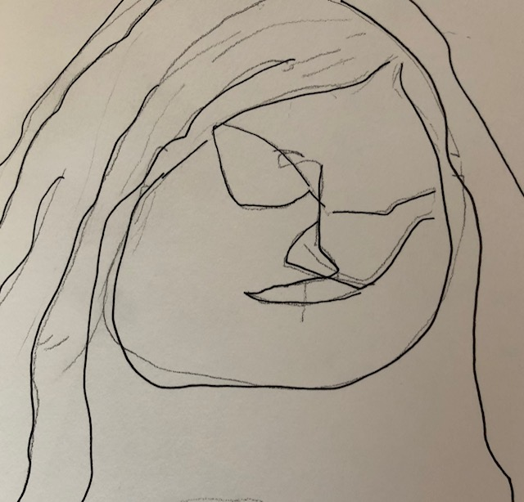

Slide 5
Two things I noticed 2008
Several losses all at once
Unusual rates of illness and onset of chronic illness.
Notes:
Share how Long I’ve been tracking this Octopus for a couple of years. 2004, then in 2008-2009
In 2008 - Economic Recession/ depression/ global collapse
2 Things I noticed:
Significant losses all at once for people
Unusual rates of illness when people are overwhelmed Research in 2009 Helped me understand this a bit better
In a 2009 report by University of Albany sociologist Kate W. Strully in the journal Demography,17 “Strully found that losing a job when a business closes increased the odds of fair or poor health by 54 percent among workers with no preexisting health conditions, and increased by 83 percent the odds of new health conditions likely triggered by job loss—stress-related conditions such as stroke, hypertension, heart disease, arthritis, diabetes, and emotional and psychiatric problems.”

Slide 6
In a 2009 report by University of Albany sociologist Kate W. Strully in the journal Demography,17 “Strully found that
losing a job when a business closes increased the odds of fair or poor health by 54 percent among workers with no preexisting health conditions, and
increased by 83 percent the odds of new health conditions likely triggered
by job loss—stress-related conditions such as stroke, hypertension, heart disease, arthritis, diabetes, and emotional and psychiatric problems.”

Slide 7
Is overwhelm unusual or is it our new norm?
Notes:
It is almost 10 years later , what seemed like an unusual occurence has become more and more our norm.
How many of you have felt overwhelmed in the past month
What is overwhelm? I notice a lot of people are using the word

Slide 8
You are On the front lines of historical trauma, intergeneration trauma, racial trauma, institutional trauma, climate and Environmental trauma, political trauma, National trauma, Economic, and pandemic trauma Disruption and Transformation.
The enormity of this, and deep ongoing nature of this.

Slide 9
And you may have other Big things going on in your life
Photo by Jazmin Quaynor at Unsplash

Slide 10
Essential Worker
Expectations/ Needs
Vulnerabilities/ Strengths
Photo by Daniel Bosse at Unsplash

Slide 11
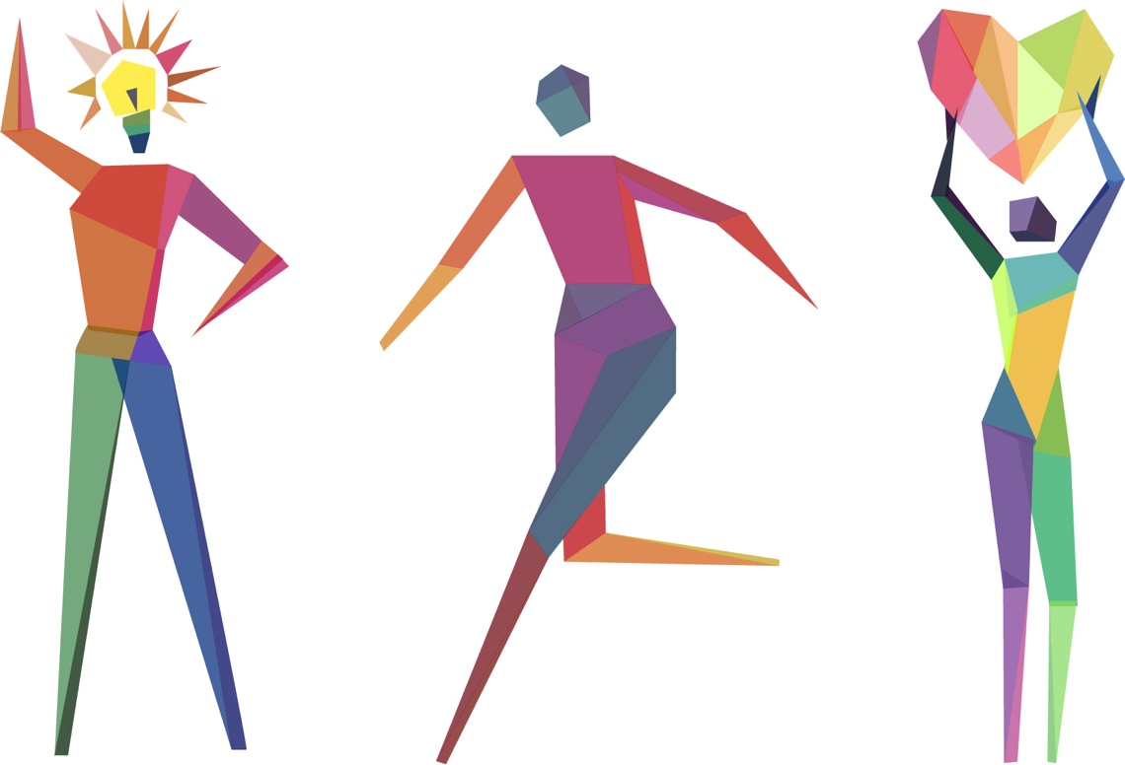
WHAT IS IT ?
Notes:
It is a full on attack on the mind, body, emotions, spirit, toomany things to manage at once
Prefrontal Cortex: This part of your brain is your adult, thinking, planning, decision making, helps you cope with emotions.
Dr. Deepak Chopra, endocrinologist, former chief medical officer New England memorial Hospital: Notes on The Immune system – emotions and cells.
There are receptors in your cells for every thought, feeling, desire, instinct, or drive. We used to think those receptors were only in your brain. But as scientists looked at immune cells to protect us from cancer and infection, (t-cells) they found those same receptors in those cells.

Slide 12
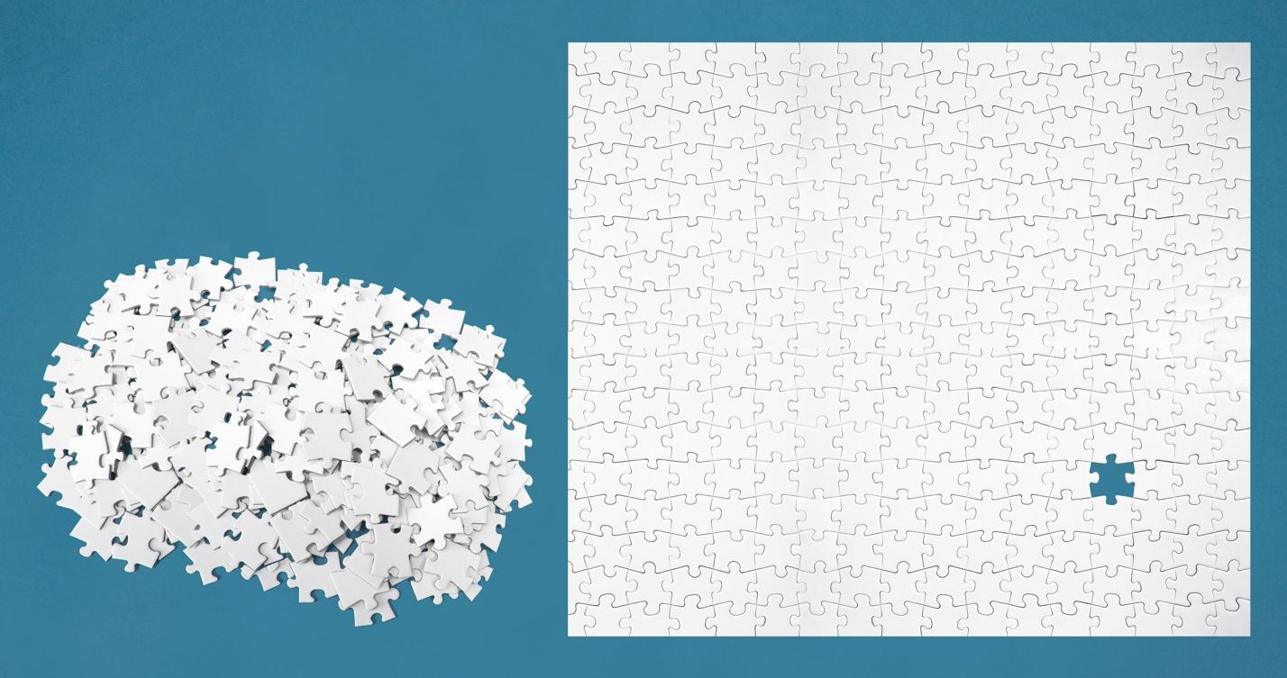
Notes:
Overwhelm can feel like a thousand piece puzzle, you have 15 minutes to solve. Except, it’s real people-the pieces ARE real people’s lives. (have a puzzle piece)
It is really hard to solve of figure out the puzzle. I think this is becoming our new norm. As a therapist I look at patterns, Overwhelm in 2017 is definitely spreading and on the rise. The fields of healthcare and human services, and Education, are on the front line of helping people deal with impact of being overwhelmed.

Slide 13
Seeing yourself while caring for others
In healthcare, we focus on others so much, we can lose touch with where we are.

Slide 14
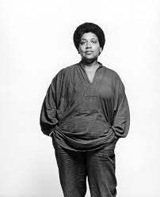
“Caring for myself is not self-indulgence.
It is self-preservation, and that is an act of
political warfare.”
AUDRE LORDE

Slide 15
Take a few minutes to list your core values

Slide 16
Knowing where you are
Safe
Challenge
Overwhelm

Slide 17
Overwhelm Recovery Process

Slide 18
Step 1: Aware & Responding to you
What do I need?

Slide 19
STEP 2: Opening and closing

Slide 20
Step 3: Listening
Have a solid reliable listening post.
Support, Mentor, Supervisor
Is there time to listen?
Is it reliable?
How are you doing with this?
Notes:
Describe what that is. How do they reach you, what is the code for response? What can they count on as regular check in?
This is a relationship and you are their lifeline.
Is supervision to clogged with administrative tasks?
Is there time to listen?

Slide 21
Step 4: stop problem solving or reduce load?
Evaluate and keep an eye on problem solving.
Close.
Stressed brain and body.
What are the signs?
8-page letter to staff
Nonresponsive to communications.
Notes:
Avoid Blame. There ware ways to talk about that create shame and blame and ways to talk about tit that don’t. The self-care message.
If you see their overload, can you streamline your communication and not be overwhelming. 8 page letter. Nonresponsive to email.

Slide 22
Step 5:
Create a container to share the feelings YOU experience. My morning ritual is writing in my journal.
Notes:
Our work is emotionally dense. And they can’t talk to others really.

Slide 23
Step 6: self-care on the job and off
What does self-care on the job look like?

Slide 24
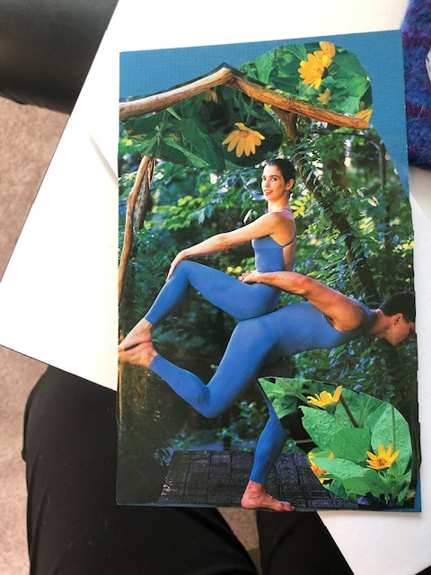
Head and Neck stretch

Slide 25
Overwhelm Impact on Systems and Leadership
This has been a test
Notes:
This morning we’re going to spend a little time with my subject matter
. I think of Overwhelm as an Octopus- lots of tentacles reaching out all over the place.
Interesting for those of you are fans of the octopus, I heard they have 3 hearts. So when you work with people who are overwhelmed or become overwhelmed yourself, I think of us as also having lots of heart.

Slide 26
Widespread overwhelm Bring your Caring to the job + Many Overwhelmed patients + Overwhelmed org and supervisors

Slide 27
Moral Injuries
Moral Injury breaks the spirit.
It makes people question their ability to do the right thing and leaves them contaminated with the feeling that they're "bad,"
Moral Injury often leads to self-harm. People turn to alcohol, drugs, and self-isolation to avoid the pain of their feelings.
The War Inside may leave some emotionally numb. (VOA MORAL INJURY PROJECT)

Slide 28
Moral Injuries
Additions by Sarri
It may also be a feeling that you are causing harm to others or helpless to save or help. “I can’t do anything”
It is also when there is a moral contract/ expectation such as having personal protective equipment and the failure of not getting that. A moral injury from employers not prepared for a deadly pandemic and expecting you to work as if you were not in harms way.

Slide 29
Tending to Your Grief Feeling it for your clients For your families For Your community For our world For you How are You grieving?
Notes:
I am not going to tell you that it is your job to deal with it all. Today, we are going to focus on what is doable and what will will reduce overwhelm.

Slide 30
Resiliency Myths and Madness
You are Human, NOT Superhuman
Notes:
Harnessing Resiliency: definition from Catherine Panter-Brick; medical anthropologist, teaches at Yale, research focused on critical risks to health across key stages of human development.
“Resilience is the process to harnessing biological, psychosocial, structural and cultural resources to sustain wellbeing.”

Slide 31
The importance of self-compassion
Acknowledging what you feel
Responding to you with kindness
Opening and closing as you need

Slide 32
Next week: Working with others who are overwhelmed and Your self-Care Plan Session 3 is a discussion group about session 1 and 2.

Slide 33
Sign up for free weekly boundary tips
sarrigilman.com
I have books and other resources for you

