Slide 1
Addressing Rural Mental Health, Session One: Rural Mental Health Disparities and Workforce Implications
Webinar: Mountain Plains MHTTC
University of North Dakota
April 25, 2019
1:00 PM CDT
Presented by:
Thomasine Heitkamp, LCSW, Professor
Shawnda Schroeder, PhD, Assistant Professor
Matt Bruflodt, MA, Information Specialist
Notes:
Thomasine Open

Slide 2
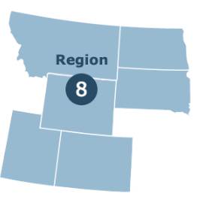
Mountain Plains MHTTC
The Mountain Plains MHTTC serves the states of Colorado, Montana, North Dakota, South Dakota, Utah, and Wyoming (HHS Region 8). The primary focus of the center is to provide training, resources, and technical assistance to individuals serving persons with mental health disorders, especially those with serious mental illness or a serious emotional disturbance.
Subscribe to Our Mailing List:
https://mhttcnetwork.org/centers/mountain-plains-mhttc/subscribe
Notes:
Thomasine:
Introduction of the MHTTC and Purpose and Funding
Encourage signing up for the listserv
The goal of the MHTCC is to serve persons with serious mental illness (SMI) which the NIMH defines as “a mental, behavioral, or emotional disorder resulting in serious functional impairment, which substantially interferes with or limits one or more major life activities”. Our focus is providing expertise on rural mental health. (MHTTC Web page)
Another category is any mental illness (AMI) defined as “a mental, behavioral, or emotion disorder with varying ranges of impairment from mild to severe”.

Slide 3
Mental Illness in the U.S.
Mental illnesses are more common than cancer, diabetes, or heart disease
Nearly one in five US adults lives with a mental illness (46.6 million in 2017)
NIMH states that “only half of the people with mental illness in United States receive treatment”
Fewer rural than urban residents access treatment for a host of reasons
Notes:
Thomasine:
Brief intro into the need to address mental illness – prevalence and concern

Slide 4
Today’s Webinar
First in a series addressing Rural Mental Health
Introduce the Mountain Plains MHTTC Focus Area
Present epidemiological trends in rural health and rural mental health
Present relative to providing mental healthcare with a limited workforce
Share additional information and resources on rural mental health
Notes:
Thomasine:
Outline the plan for the day

Slide 5
Area of Focus: Rural Mental Health
Our rural mental health vision is to support increased access to providers of behavioral health services for the more than 60 million Americans living in rural communities.
To achieve this vision, the Mountain Plains MHTTC develops and promotes training and technical assistance which supports the rural behavioral health workforce in HHS Region 8.
Rural Mental Health, Area of Focus:
https://mhttcnetwork.org/centers/mountain-plains-mhttc/area-focus
Notes:
Thomasine:
Discuss what our rural mission/vision is briefly
Why are WE the Rural MHTTC? – next slides

Slide 6
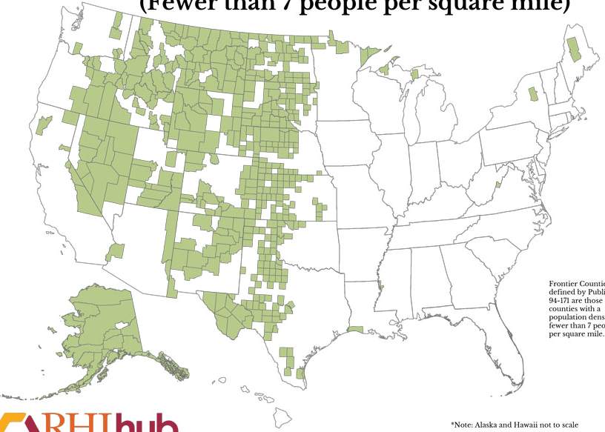
Region 8 has a large proportion of counties identified as “Frontier” – Frontier Counties as defined by Public Law 94-171 are those counties with a population density of fewer than 7 people per square mile.
Notes:
Thomasine:
Discuss what our rural mission/vision is briefly
Why are WE the Rural MHTTC? – next slides

Slide 7
Rural Demographics
Notes:
Shawnda

Slide 8
Age, Income, and Health Status
Variable definitions of “rural”
Regardless of the applied definition, rural health researchers, advocates, policymakers, communities, and programs generally describe rural populations as older, sicker, and poorer than urban
Rural communities outperform urban on other measures of health, but it is important to understand disparities in age, health status, and income and how this may influence access and utilization of mental health services
Notes:
Shawnda:
Brief discussion on definition of rural
Regardless of the definition, research describes rural communities as older, sicker, and in poorer health than urban counterparts.

Slide 9
Age and Income
Age | Rural | Urban
Median age (2015) | 51 | 45
Life expectancy (2009) | 76.8 | 78.8
% under age 18 (2015) | 22.3% | 23.5%
% age 65+ (2016) | 18.4% | 14.5%
% age 85+ (2016) | 1.8% | 2.0%
Using the Census division definition, rural residents report an older median age and have a larger proportion of residents ages 65 and older
Income | Rural | Urban
Median household income (2016)⁶ | $46,000 | $62,000
Poverty rate (2016)⁷ | 16.9% | 13.6%
Food insecure (2013)⁴ | 15.8% | 14.5%
Notes:
Shawnda:
Using the Census division definition, rural residents report an older median age (51) than their urban counterparts (45).1 Rural communities also have a larger proportion of residents ages 65 and older than do urban, and report a slightly smaller proportion of children. However, the oldest old (85+) make up more of urban areas (2%) than they do rural (1.8%).
Rural households report a lower median income than urban and have a greater proportion of the population reporting food insecurity. In 2010, rural adults were more likely than those in urban areas to begin the year with incomes below 138% of the federal poverty level, particularly in states that did not expand Medicaid. Similarly, the 2016 poverty rate was higher in rural (nonmetro) communities than in urban (metro) with greater disparities in the South and West. Although rural communities have a smaller proportion of residents under the age of 18 than do urban, rural areas have a higher percentage of children living in poverty. This proportion of children living in poverty or low income families has increased across the decade.
Because of lower incomes, older populations, higher poverty rates, and less access to employer-sponsored insurance, rural people are less likely than their urban counterparts to have health insurance. In 2014, prior to implementation of the Patient Protection and Affordable Care Act, rural people were more likely to be covered by Medicaid (21%) or other public insurance (4%) than were urban (16% and 3% respectively). This pattern continued into 2015 and 2016. Among Medicare beneficiaries ages 85 and older, rural residents were more likely than urban to be covered by both Medicare and Medicaid (dual eligible) (28.3% compared to 22.4%). Rural residents have also been found to forgo medical care due to cost more often than urban residents.

Slide 10
Health Status | Rural | Urban
Age-adjusted, all-cause mortality per 100,000 (2014) | 830.5 | 703.5
Mortality: Suicide (2014) | 16.8 | 12.4
Mortality: Unintentional injury | 54.4 | 38.3
Mortality: Drug poisoning | 15.6 | 14.7
Physically inactive (2012) | 27.8% | 22.3%
2-3 chronic conditions (2015) | 22.2% | 18.2%
4+ chronic conditions (2015) | 5.8% | 4.3%
High cholesterol (2013) | 42.4% | 38.8%
Hypertension (2013) | 38.1% | 32.6%
Arthritis (2013) | 31.1% | 25.1%
Diabetes (2013) | 12.0% | 10.4%
Heart disease (2013) | 8.6% | 6.5%
COPD (2013) | 8.7% | 6.3%
Notes:
Shawnda:
Overall, rural residents have a shorter life expectancy than urban residents.² Some variables that may influence life expectancy include increased rates of chronic disease and physical inactivity among rural residents. Compared to urban residents, a greater proportion of rural residents report having 2-3 and 4 or more chronic conditions. Rural (nonmetro) residents report a higher age-adjusted mortality rate per 100,000 population for all causes (830.5 for rural and 703.5 for urban).Rural communities also have higher mortality rates than urban (metro) for suicide (16.8 compared to 12.4), unintentional injury (54.4 compared to 38.3), and drug poisoning (15.6 compared to 14.7). Similarly, diabetes mortality is consistently higher in increasingly rural areas of the U.S. Across various age groups, fewer rural residents were found to utilize preventative health services. For example, among Medicaid enrollees ages 85 and older, rural beneficiaries reported lower annual medical and dental visit rates and higher rates of outpatient visits and prescription medication use. Among pediatric patients, those in rural communities reported fewer preventive dental visits and worse oral health.

Slide 11
Rural Mental Health
Information taken from:
Rural Health Information Hub (RHIhub)
Rural Health Research Gateway
Substance Abuse and Mental Health Services Administration
Centers for Disease Control and Prevention
Health Resource Service Administration
PEW Research Center
Western Interstate Commission for Higher Education – Behavioral Health Program
National Council for Behavioral Health
Notes:
Shawnda –
Will provide links and citations at the end of the PPT

Slide 12
Rural Health Disparities
2010-11, nonmetropolitan counties reported a higher percentage of residents with AMI (19.5%) than metropolitan counties (17.8%)
Nationally, 4% reported SMI, though rates rose with increasing rurality
4.9%, or nearly 1.7 million, of residents of nonmetropolitan counties experienced serious thoughts of suicide during the year (2017)
Rural counties consistently had higher suicide rates than metropolitan counties from 2001-2015
Notes:
19.1% of residents aged 18 or older of nonmetropolitan counties had any mental illness (AMI) in 2017, approximately 6.8 million people.
During 2010-2011, nonmetropolitan counties reported a higher percentage of residents with AMI (19.5%) than metropolitan counties (17.8%). The highest rate of AMI (22.5%) occurred among rural residents in the western U.S. region. Nationally, 4% reported a serious mental illness, though rates rose with increasing rurality. Rural micropolitan residents in the western U.S. region reported the highest percentage of serious mental illness (6.8%). The lowest rate occurred in large central counties in the southern region of the U.S. (2.7%)

Slide 13
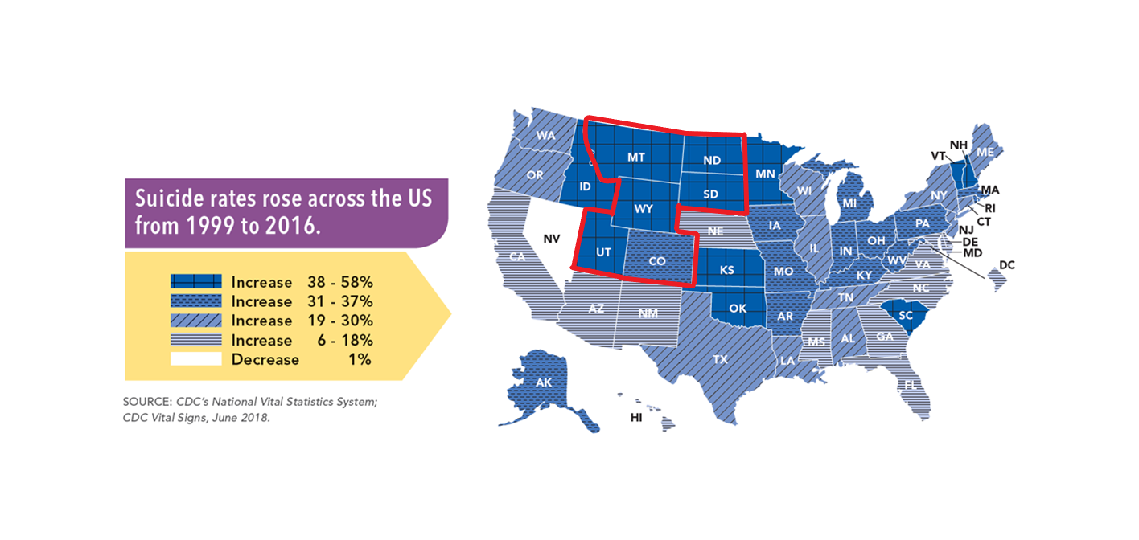
Rural Suicide Rates
5 of 6 states in Region 8 recorded an increase in suicide rate of 38% or more
Image Source: https://www.cdc.gov/vitalsigns/suicide/infographic.html#graphic1
Notes:
Thomasine
Speak to Rural Suicide Rates ND have a 66% increase in deaths by suicide from 1999 to 2014

Slide 14
Rurality as a Culture
Rural areas - 90% of the land mass and 25% population
Fewer than 10% of the population live on farms
Non-farm income accounts for 80% of the job – often seasonal work
Factors that Shape Rural – No One Size Fits All
Agricultural production
The weather – increased disasters
Agricultural heritage
Diversity
Proximity to Urban Area
Notes:
Thomasine:
Rurality is a culture – it is a separate culture relative to consideration of multiculturalism.
Factors shape rural culture – what they harvest, the weather, agricultural heritage, diversity, proximity to urban areas with health care.
Coping with the rural environment is not to be underestimated. Climate change has made the weather even more unpredictable. Flooding and crop failure
No personal privacy combined with stigma makes access a problem.
(1) No One-Size Fits – Rural areas house pockets of ethnic groups and indigenous populations and a notable increase in Hispanic populations. (2) Rural America has 90% of the land mass and 25% of the population (3) fewer than 10% of the population live on farms (4) non-farm income accounts for 80% - rural jobs that are often seasonal

Slide 15
Rural Barriers to Mental Health Services
Accessibility: Rural residents may have limited access to mental healthcare due to cost of services, insurance coverage, lower behavioral health literacy which allows mental health concerns to go unrecognized and/or untreated, and the remote nature of living rural may require residents to travel long distances to receive services.
Notes:
Shawnda

Slide 16
Rural Barriers to Mental Health Services
Availability: County-Level Estimates of Mental Health Professional Shortage in the United States reports that higher levels of unmet need for mental health professionals exist in counties that were more rural and had lower income levels.
Notes:
Shawnda:
Nearly every county in the Mountain Plains MHTTC Region 8 states are designated as whole county mental health professional shortage areas.

Slide 17
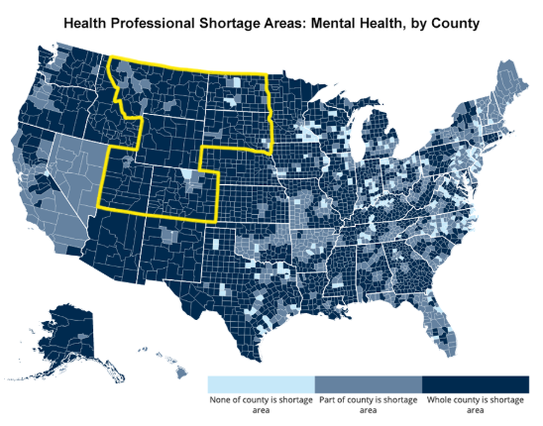
Notes:
Shawnda

Slide 18
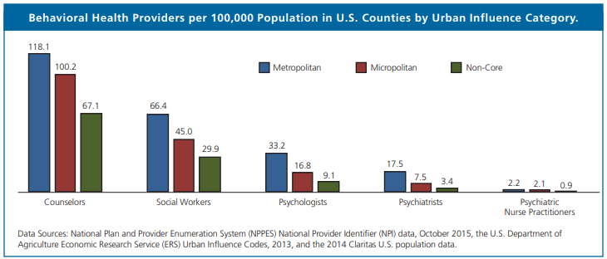
Notes:
Shawnda
Taken from the WWAMI RHRC: http://depts.washington.edu/fammed/rhrc/wp-content/uploads/sites/4/2016/09/RHRC_DB160_Larson.pdf

Slide 19
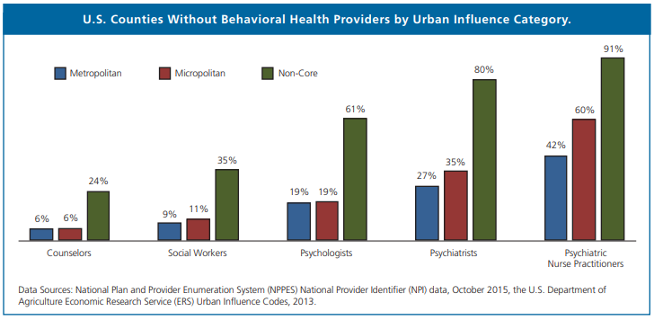
Notes:
Shawnda

Slide 20
Rural Barriers to Mental Health Services
Acceptability: Rural residents are likely to experience self-stigma, fear or embarrassment related to seeking out mental healthcare due to internal beliefs. When implementing rural mental health programs, community members and mental health care providers should consider how stigma may impact access and use of mental health services among rural residents. Lower health literacy and not recognizing the signs of various mental health issues can also serve as barriers to behavioral healthcare access in rural areas.
Notes:
Shawnda

Slide 21
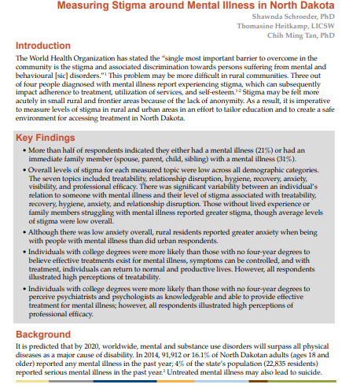
Low stigma overall
Gender and age variation in stigma
Individuals with mental illness or who have an immediate family member with mental illness held less stigma
Notes:
Shawnda

Slide 22
Strategies for Addressing Rural Mental Illness with a Limited Workforce
Notes:
Thomasine

Slide 23
Strategies
Address Digital Divide
58% of rural residents believe access to high speed internet is a problem in their area – in contrast to 13% in urban areas and 9% in suburbs
Rural areas are less likely to be wired for broadband
Fewer broadband providers
Access to high-speed internet is a concern among all economic backgrounds and education
Notes:
Thomasine

Slide 24
Strategies
Support and fund pathways out of poverty
Put investment in rural people and communities - including expanding educational opportunities, mentoring (peers) and access to better broadband
Use tele-health to provide services with reimbursements that are seamless across state borders (portable licenses)
Access federal resources to expand workforce in behavioral health including, but not limited to, Behavioral Health Workforce Education and Training (BHWET) and National Health Services Corps
Use technology to advance evidence based practices
Notes:
Thomasine

Slide 25
Strategies
Use existing screening tools in for depression and substance use (SAMHSA – HRSA Center for Integrated Health Solution Screening tools) engage local FQHC and VA
Integrate trauma informed care practices using SAMHSA principles.
Over a half of all rural residents have experienced some kind of trauma or Adverse Childhood Experience (ACE)
Conduct community specific assessments – Strategic Prevention Framework (SAMHSA)
Integrate faith-based and natural helpers
Notes:
Thomasine

Slide 26
Strategies
Streamline billing practices to CMS and insurance providers
Expand training on mental health first aid (expands access to risk factors and warning signs of mental health problems)
Apply principles of integrated care (behavioral health and primary care) to assist in eliminating stigma
Notes:
Thomasine

Slide 27
Strategies
Implement the National CLAS standards - with understanding of rural
Develop plans with knowledge of health disparities
Use grant funded resources, like MHTTC, to support workforce
Work collaboratively with community and tribal colleges
Notes:
Thomasine

Slide 28
Rural Training and TA Needs
Notes:
Shawnda
Present findings from our needs assessment

Slide 29
Training Topic Priorities | Rural | Urban
Mental health and substance abuse co-occurring disorders | 92% | 91%
Trauma-informed care | 89% | 91%
Compassion fatigue | 89% | 89%
Crisis de-escalation | 89% | 90%
Strength-based approaches to treatment | 89% | 90%
Crisis management | 89% | 89%
Risk assessment tools | 88% | 90%
Suicide prevention | 88% | 91%
Suicide assessment | 87% | 90%
Working with diverse populations | 85% | 86%
Based on a survey of 482 individuals in HHS Region 8 who serve persons with mental illness
Notes:
Shawnda
Present findings from our needs assessment

Slide 30
Top 5 Rural Priority Populations Based on % of Respondents
Rural (83%)
Lesbian, Gay, Bisexual, Transgender, Queer/Questioning (LGBTQ) (54%)
Individuals with serious mental illness (SMI) (53%)
American Indian / Alaska Natives (50%)
Individuals with serious emotional disturbance (SED) (50%)
Roughly 48% of urban participants indicated they wanted more information on mental health services for rural populations
Notes:
Shawnda
Present findings from our needs assessment

Slide 31
Additional Rural Mental Health Resources
Notes:
Shawnda

Slide 32
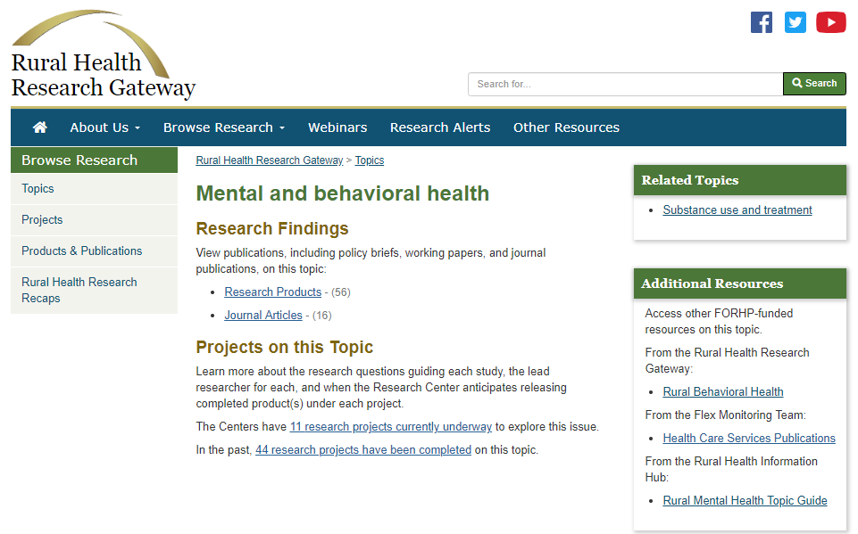
Rural Health Research Gateway
ruralhealthresearch.org
Notes:
Shawnda

Slide 33
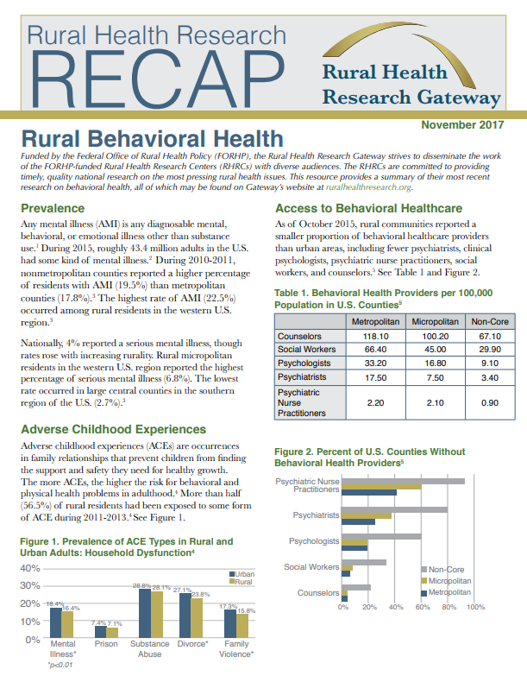
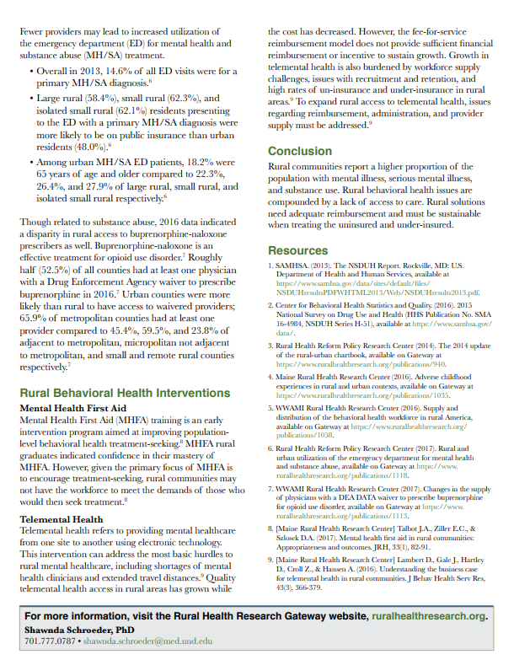
Notes:
Shawnda

Slide 34
Finding Resources to Support
Mental Health Services

Slide 35
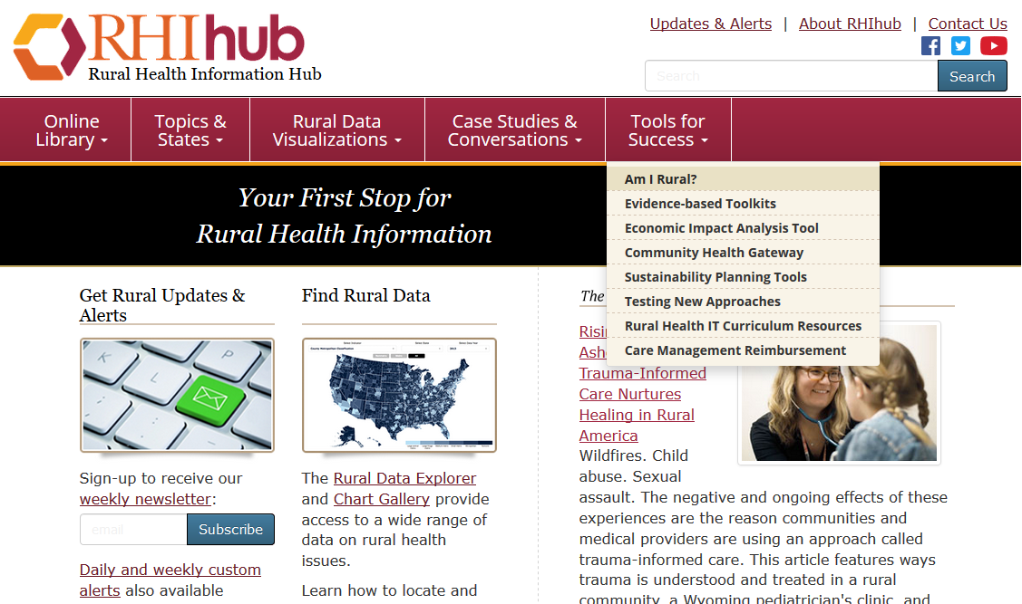

Slide 37
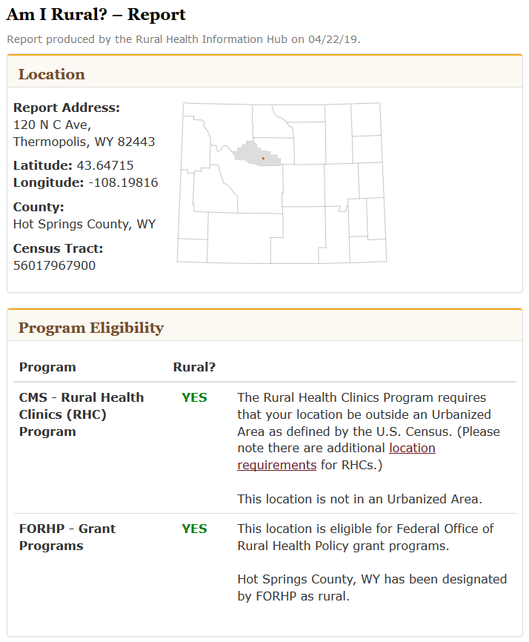
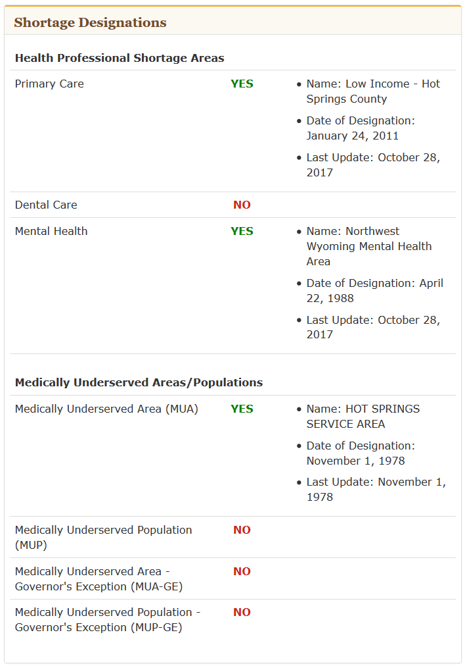

Slide 38
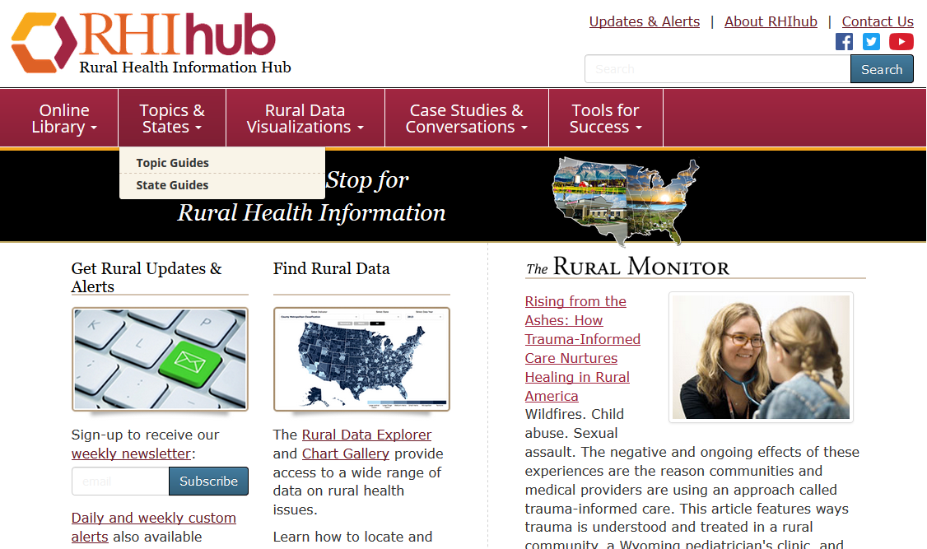
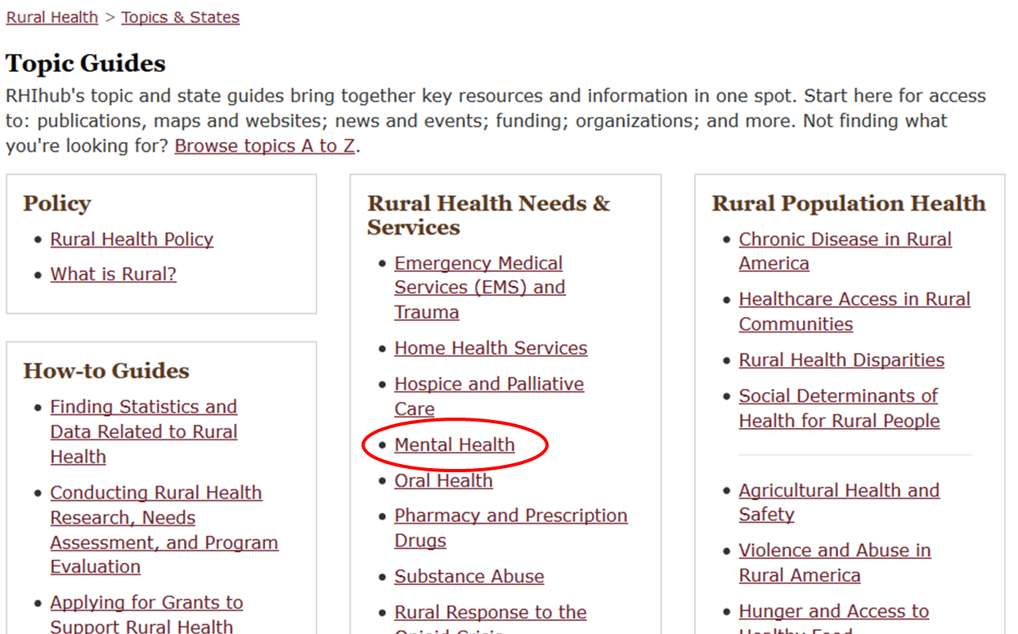

Slide 39
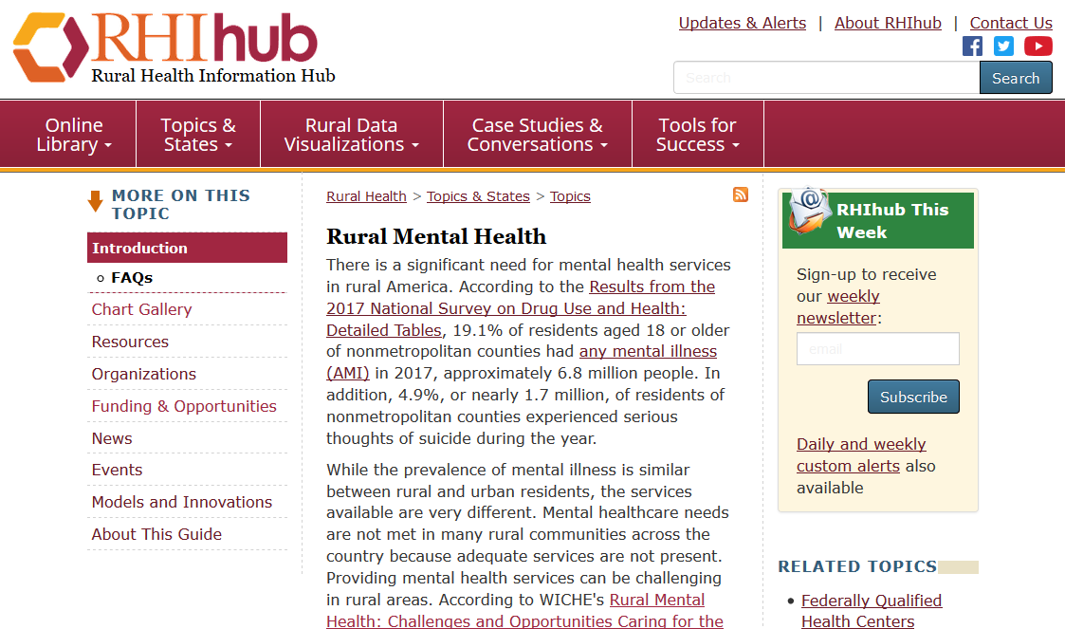
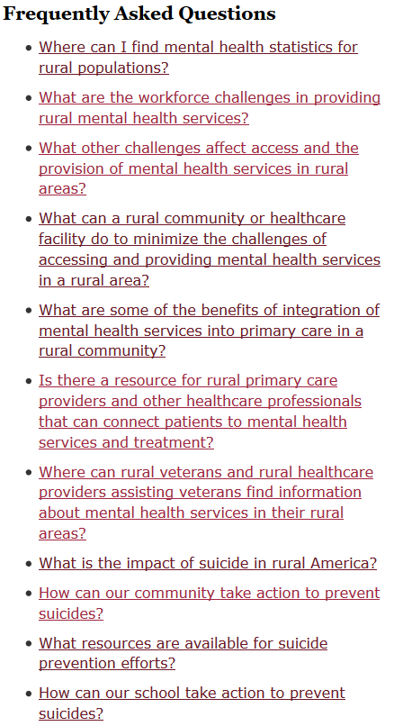

Slide 40
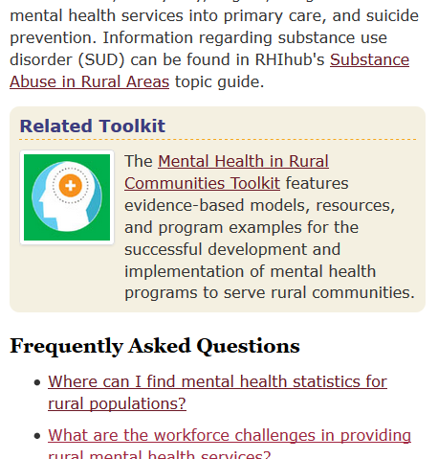

Slide 41
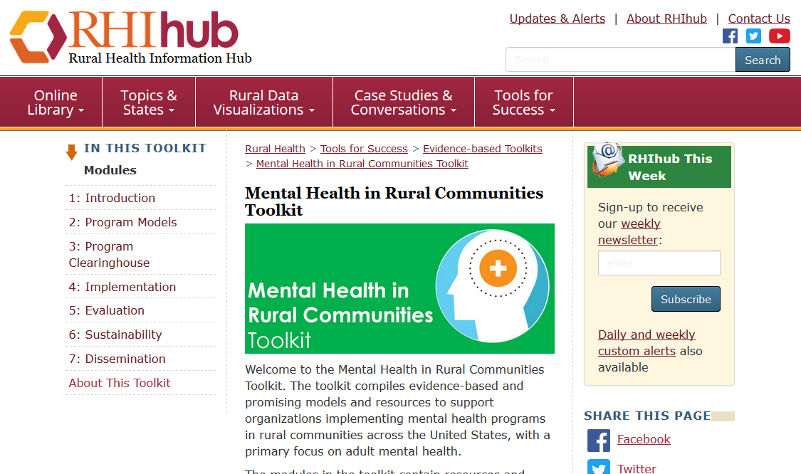
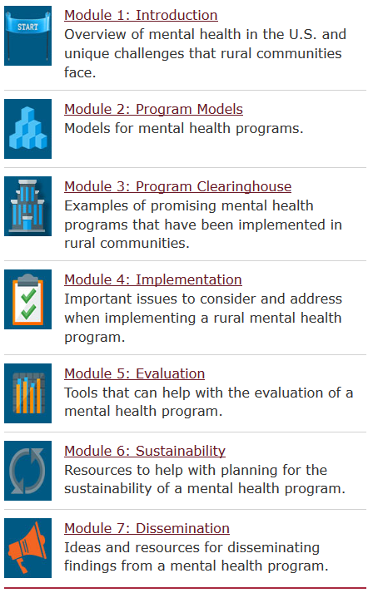

Slide 42
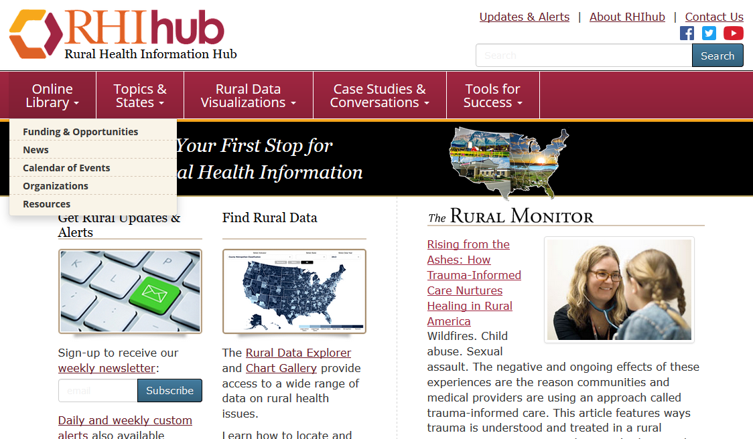
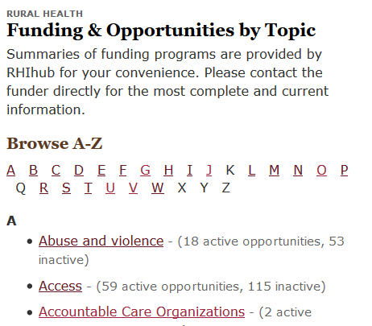
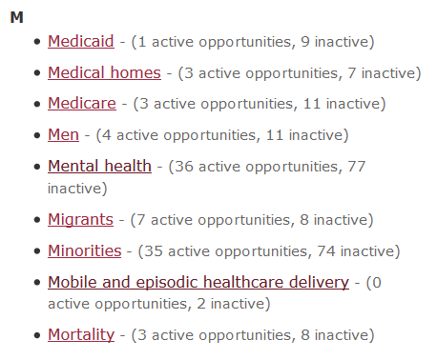
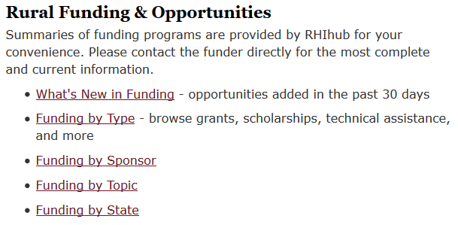

Slide 43
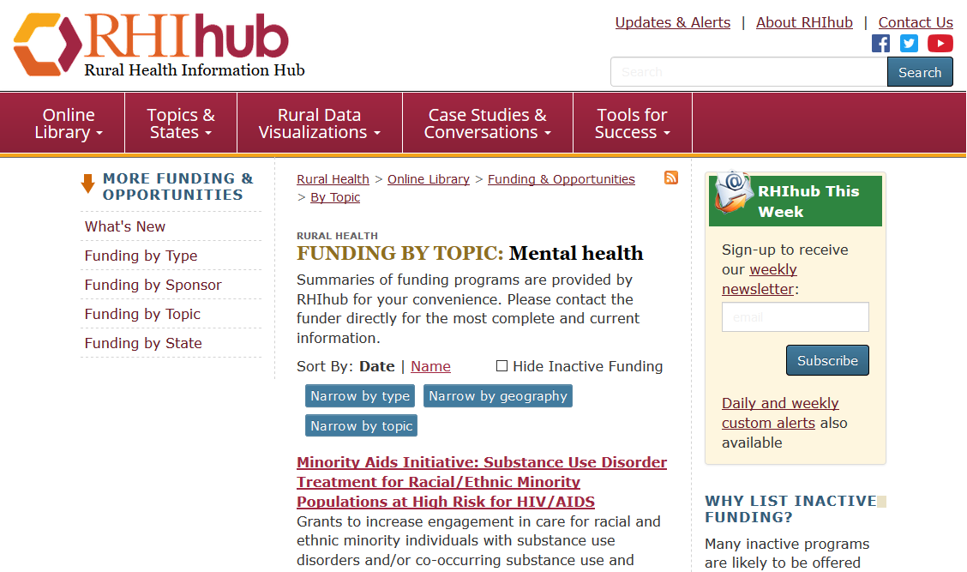

Slide 44
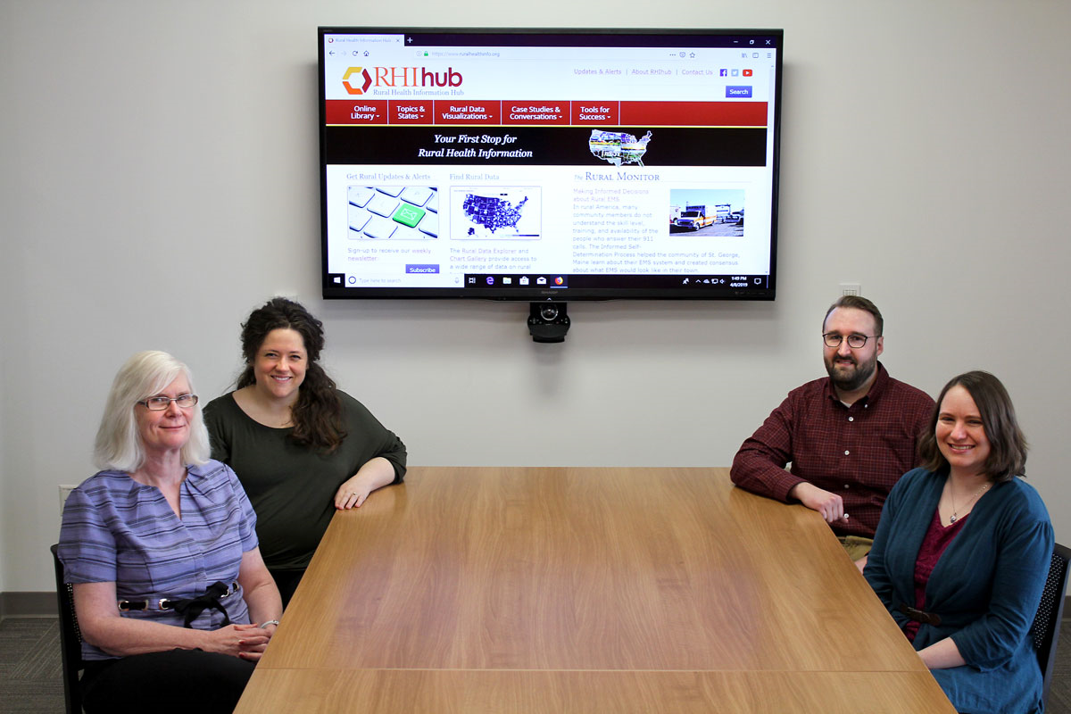
Resource & Referral Service
Free customized assistance related to:
Funding & opportunities
Statistics
Experts
Research
More
1-800-270-1898 info@ruralhealthinfo.org
Our Information Specialists are ready to take your call!

Slide 45
Additional Rural Mental Health Resources
National Institute of Mental Health, Office of Rural Mental Health Research: https://www.nimh.nih.gov/about/organization/od/office-of-rural-mental-health-research-ormhr.shtml
Substance Abuse and Mental Health Services Administration: https://www.samhsa.gov/
Health Resources Services Administration https://www.hrsa.gov/
Kaiser Family Foundation: https://www.kff.org/
Centers for Disease Control and Prevention: https://www.cdc.gov/
Centers for Medicare & Medicaid Services, Rural Health Council: https://www.cms.gov/About-CMS/Agency-Information/OMH/equity-initiatives/rural-health/rural-health-council.html
Notes:
(National Institute of Mental Health – Office of Rural Mental Health Research (ORMHR) conduct research on improving the delivery of services in rural areas, disseminate information to appropriate entities. Examine mental health disparities in rural communities.
SAMHSA
Kaiser Permanente - Kaiser Family Foundation
Center for Disease Control
CMS Rural Health Council
Source of quantitative data is often the Behavioral Risk Surveillance Systems (BRFSS) (telephone household survey)

Slide 46
Additional Mental Health Resources
Digital Gap between Rural and Non-rural America Persists https://www.pewresearch.org/fact-tank/2017/05/19/digital-gap-between-rural-and-nonrural-america-persists/
Behavioral Risk Factor Surveillance Systems (BRFSS): https://www.cdc.gov/brfss/data_tools.htm Pew Research Center survey

Slide 47
References
Larson EH, Patterson DG, Garberson LA, Andrilla CHA. Supply and Distribution of the Behavioral Health Workforce in Rural America. Data Brief #160. Seattle, WA: WWAMI Rural Health Research Center, University of Washington, Sep 2016. http://depts.washington.edu/fammed/rhrc/wp-content/uploads/sites/4/2016/09/RHRC_DB160_Larson.pdf
National Institute of Mental Health (NIMH): Mental Health Information, Statistics. https://www.nimh.nih.gov/health/statistics/mental-illness.shtml
Schroeder, S. Rural Communities: Age, Income, and Health Status. https://www.ruralhealthresearch.org/recaps/5
Schroeder, S. Rural Behavioral Health. https://www.ruralhealthresearch.org/recaps/1
U.S. Department of Health & Human Services. U.S. Surgeon General’s Priorities. https://www.surgeongeneral.gov/priorities/index.html
Notes:
SHAWNDA NEEDS TO UPDATE THIS SLIDE

Slide 48
Contact Information
Thomasine Heitkamp, LISW
Professor
Mountain Plains MHTTC
College of Nursing and Professional Disciplines
University of North Dakota
701-777-4950
Thomasine.heitkamp@UND.edu
Shawnda Schroeder, PhD
Research Associate Professor
Center for Rural Health
University of North Dakota School of Medicine & Health Sciences
701-777-0787 shawnda.schroeder@UND.edu
Matt Bruflodt, MA
Information Specialist
Rural Health Information Hub
Center for Rural Health
University of North Dakota School of Medicine & Health Sciences
701-777-6029
Matthew.brufoldt@UND.edu

