Slide 1
The Farm Crisis and Mental Health:
Responding to the New Farm Crisis
Charles Griffin
June 19, 2019
Notes:
Place your title on this first slide and include any subtitle.
DO NOT CHANGE THE FORMAT OF THIS TEMPLATE. If you are creating MHTTC-branded slides, you must use this template. If you move around boxes, make sure to check the reading order. If you widen any boxes they must not overlap any other box.
IF YOU ADD ANY GRAPHICS, you will need to add ALT TEXT and check READING ORDER.

Slide 2
The Farm Crisis of the 1980’s
Increasing production, large grain stockpiles
Opening up global markets/exports
High debt loads, farm expansion
1980 grain embargo, crash in commodity prices
Rising fuel prices and petroleum related inputs
Tightening of Federal Reserve policies – 1976 interest rates increased (prime rate 6.8 – 21.5%)
Decrease in land values
Increased bank lending oversight
Mental health/behavioral health impact

Slide 3
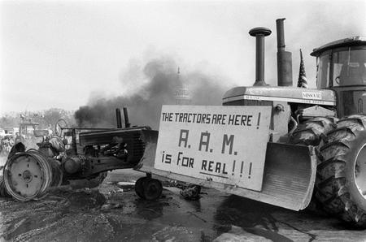
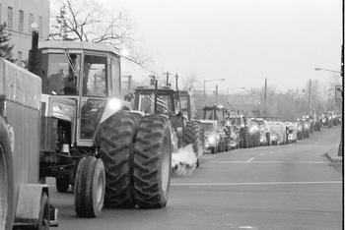
Tractorcade to Washington DC, 1979

Slide 4
The New Farm Crisis of the 20-Teens

Slide 5
Farm Income – Production - Expense
Notes:
$585,568 Farm Production $522,624 farm expense $62,944 net Farm Income

Slide 6
Net Farm Income 2011 -2018
2011 | $166,375
2012 | $159,352
2013 | $140,356
2014 | $128,731
2015 | $6,744
2016 | $43,161
2017 | $62,944
2018 | $100,000

Slide 7
Net KS Farm Income 2012-2018

Slide 8
Family Living Expense

Slide 9
Net Farm Income less Family Living Expense

Slide 10
Net Farm Income less Family Living
Year | Family Living Expense |  | Net Farm Income less Family Living
2011 | $64,567 |  | $101,808
2012 | $70,242 |  | $89,110
2013 | $71,614 |  | $68,742
2014 | $74,447 |  | $54,284
2015 | $70,546 |  | -$63,802
2016 | $70,385 |  | -$27,224
2017 | $68,936 |  | -$2,372
2018 | $70,065 |  | $29,935

Slide 11
The New Farm Crisis
Substantial rise is delinquent farm loans
USDA's dour predictions for net farm income in 2018: U.S. net farm income is forecast to decline $5.4 billion (8.3 percent)
Government payments are forecast to decline $2.3 billion (20.0 percent)
Global overproduction, major decline in commodity prices
Severe drought in west/Midwest last year, now floods
Impact of Tariffs???

Slide 12
Why are America's farmers killing themselves in record numbers?
The Guardian – December 6, 2017
Debbie Weingarten

Slide 13
Farmer suicide rate is concerning, but resources are available
It’s a rough time economically in agriculture. There’s no doubt about it, everyone is feeling it. Within the past three years, farm income levels have hit their lowest point since 1985. From 2014 to 2015, farm income dropped 95% and farm debt levels have increased by 25%. The price of wheat has also dropped an alarming 55% since 2013.
-Jordan Hildebrand, High Plains Journal, Feb 21, 2018

Slide 14
Why suicide?
Weakening of the social safety net
Both formal and informal
Increasing income disparity and sudden change
Cultural dissolution
Hopeless, helpless, powerless
Identity loss
Despair, grief

Slide 15
CDC Morbidity and Mortality Weekly Report June 8, 2018
54% who suicide – no history of MH conditions
Among those w/o, more likely to have
Relationship problems
Life stressors
Recent/impending crises

Slide 16
Sowing the Seeds of Hope 1999-2010
A project supported by grants from the U.S. Department of Health and Human Services Office of Rural Health Policy, Bureau of Primary Health Care, state and federal appropriations and private contributions. AgriWellness, Inc., a nonprofit organization, provided administrative services. Minnesota, Iowa, Wisconsin, South Dakota, North Dakota, Nebraska, and Kansas.
The SSoH model was selected as a “best practice model” included in Rural Healthy People 2010: A Companion Document to Healthy People 2010.

Slide 17
Lessons learned from the 80’s?
Telephone hotlines
Access to counseling (on phone, vouchers)
Community outreach
Education/awareness
Farm family retreats
Partnering with ag organizations and others
Provider education in culturally appropriate delivery
Establishment of peer helper training and professional support
Continuum of care
Integrated delivery (BH, financial, legal, farm management)
Public awareness and marketing
Support groups

Slide 18
My Lessons learned from the 80’s
I learned to:
Talk about options, resources, possible solutions that they can utilize
Talk about the difference between depression and grief/sadness/loss, and yes, even shame and desperation
Talk about why they farm/farmed – family (goals, priorities, values, principles)
Identify skills and knowledge
Talk about receiving after a life of giving
Not to diagnose, label and pathologize, but to identify coping skills and resilience that can carry them through this crisis

Slide 19
Preparing for the New Farm Crisis
A new acceptance of behavioral health support
New partners and collaborators
A new world of outreach and education- online delivery
Support groups…..Social media

Slide 20
2018 Farm Bill Farm Stress Assistance?
House: Stress Act – Rep. Tom Emmer (R, Minnesota)
Senate: Farmers First
Sen. Tammy Baldwin (WI) and Sen. Joni Ernst (IA)
Section 7511: Farm and Ranch Stress Assistance Network
$10 million each year 2019 – 2023
Allows states’ Research and Extension to initiate or award grants to other partners including non-profit organizations
RFA information to come very soon. Watch for House: Stress Act – Rep. Tom Emmer (R, Minnesota)
RFA to be released very soon following review and sign off. Watch for it on NIFA.GOV and Grants.GOV. Applicant webinar to follow within 1-2 weeks.

Slide 21
CONTACT INFORMATION
Charlie Griffin, M.S., Research Assistant Professor Emeritus
School of Family Studies and Human Services
Phone: 785-477-0827 Email: cgriffin@k-state.edu
Kansas State University
Manhattan, KS 66506

