Slide 1
Affordable Housing 101 for rural behavioral health providers
Jenn Lopez, Project Moxie
jennglaulopez@gmail.com
Notes:
Place your title on this first slide and include any subtitle.
DO NOT CHANGE THE FORMAT OF THIS TEMPLATE. If you are creating MHTTC-branded slides, you must use this template. If you move around boxes, make sure to check the reading order. If you widen any boxes they must not overlap any other box.
IF YOU ADD ANY GRAPHICS, you will need to add ALT TEXT and check READING ORDER.

Slide 2
Jenn’s introduction
National Affordable Housing Consultant (Project Moxie, Ethos Development, and the Athena Group)
19 years of experience in the Southwest
13 of the 19 years was working in local and state government
Have worked on programs across the housing continuum (homeless to homeownership)
My passion is rural housing projects and programs
Current clients: The Colorado Health Foundation, New Mexico Coalition to End Homelessness, Interfaith Alliance of Colorado, Mono County Behavioral Health (CA), City and County of Durango Colorado.

Slide 3
Presentation Goals
Provide a brief overview of affordable housing challenges nationally
Provide a comprehensive overview of affordable housing players and existing programs (rural)
Discuss best practice housing models
Provide tips for connecting to housing resources in rural communities.

Slide 4
Affordable housing defined
By federal definitions: Households at or below 80% of the area median income (AMI) that are cost burdened.
Households are cost burdened if they are spending more than 30% of their annual income on housing costs (including utilities)
Median income is defined by county: HUD Median Income Data Sets

Slide 5
Affordable housing nationally
The U.S. has a shortage of seven million rental homes affordable and available to extremely low-income renters, whose household incomes are at or below the poverty guideline or 30% of their area median income. Only 37 affordable and available rental homes exist for every 100 extremely low-income renter households.
Here is a link to see the affordable housing gap in your state:
https://reports.nlihc.org/gap

Slide 6
Housing Continuum: 30% - 60% AMI
Affordable Housing
Incomes range from $16,000 to $43,000 per year
Subsidized rents range from $607/month to $1,215/month
(Denver Metro Example)
Slide provided by CHFA
Notes:
This is what we typically call “affordable”
These units have many resources used in the financing: LIHTC, CDBG, HOME, Trust Fund, DOH
Restricted units typically serve at, or below, the 60% AMI range
HUD Rents in Denver Metro area
Note: Denver Metro Example for 2 bdr unit
36% of Colorado households are renter households
CO minimum wage = $10.20; a minimum wage worker working full-time (1 person household) at 34% AMI or higher in all parts of the state
Example is a 2 person HH income (simgle person ranges from $14,000-$22,000) Two-thirds of CO renter households are 1 or 2 person HHs
Rents are being subsidized so that they are affordable…
Median Denver Metro market rent for 2 br = $1,427 (Q4 2017)
25% of Colorado renters are between 30% and 60% AMI

Slide 7
Housing Continuum: 61% to 120% AMI
Market Rate housing also called Attainable or Workforce
Incomes range from $37,800 to $86,400 per year
Affordable rents range from $1,012/month to $2,430/month
Slide provided by CHFA
Notes:
For a two person household; two bedroom apartment –
In Metro Denver, that particular income band includes people earning between $37,800 per year ($18.53/hour) and $86,400per year ($42.35/hour), for a two person household.
There are very few resources available to finance multifamily units in this income band, and very little inventory of properties available to persons in this income band ($150,000-$310,000 mortgage max)
Market rate rents used to be at 60% AMI…and now market rate is at 90% AMI

Slide 8
The Affordable Housing Crisis today is from……
Significant pressures on the housing market including the fact that seniors are living longer and staying in their homes; the slow down in development after the 2008 crash; millennials entering the market etc.
Federal housing policy slowed investments in public housing the 1960’s and we never caught up again. Our national federal housing policy is nonexistent.
Construction costs and labor are higher today and growing and land is a finite resources where market development rules the day.
https://www.curbed.com/2019/5/15/18617763/affordable-housing-policy-rent-real-estate-apartment
Zoning increases costs to develop and decreases number of units annually

Slide 9
Affordable housing in Colorado
One in four Colorado renters spends more than 50 percent of their income on housing. A full 40 percent of Colorado's renters now spend more than a third of their income on housing.
More than 100,000 people moved to Colorado in 2015 while builders added only 25,000 homes to the housing stock (2015 census)
Colorado cost-burdened households, earning less than $50,000 annually, account for $2 billion less spending each year on consumer goods. This dampens local business, stalls economic potential and compromises state and local governments who rely heavily on sales tax revenue.
(stats provided by ULI Colorado Affordable Housing Report 9-30-16 and liveaffordably.org)

Slide 10
Key housing challenges in rural communities
There are several different types of “rural” communities but let’s look at these for examples:
Distressed Rural (eastern plains, Co, rural midwest communities, Appalachia etc.)
Rural Resort (Sedona, Az, Mammoth Lakes, Ca, Durango, Co etc.)
Rural/suburban (ie Castle Rock, Co; Loveland, Co, Bernalillo, New Mexico
In some of these communities housing exists but is in poor condition or there is a shortage of affordable housing because of local market conditions or limited infrastructure for development,
Mobile Home Parks are in poor condition, landlords charging high rents or conversion of mobile home parks displacing households,
Many rural communities have limited services for persons experiencing homelessness and are challenged to provide crisis response services (shelter, service navigation, etc)

Slide 11
Key Challenges in rural communities
Federal and state rental subsidies such as Housing Choice Vouchers are not available or there are long waitlists
Existing affordable housing does not have adequate infrastructure/water and sewer.
Homeownership services are limited; families don’t know how to buy a home or households need help addressing credit issues, qualifying for a mortgage or accessing affordably priced homes
Its difficult to build new affordable rental housing and also challenging to find developers interested in working in rural communities.
In Rural resort communities there is extremely limited affordable housing and households often are commuting as much as an hour one way to work in these communities where they can’t afford to live.

Slide 12
Who pays for affordable housing opportunities and how does it work?
Affordable housing programs focus on subsidizing either the household directly or a housing unit for a time period of 20-30 years. The majority of affordable housing programs are funded by Federal, State or Local government.
When governments fund households directly it take the form of a rental subsidy (there are several out there and they all have awful acronyms) or the government will provide down payment assistance, or a discounted mortgage.

Slide 13
Who pays for affordable housing opportunities and how does it work continued
If the government subsidizes a housing unit it takes the following forms:
an operating subsidy for a specific property;
Tax credit equity to buy down the costs of constructing a unit;
grant funding to lower the cost of providing a housing unit;
or a lower cost loan product that reduces costs of development with savings passing through to the eventual resident of the property.

Slide 14
Who pays for affordable housing? Colorado example
The level of federal housing rent subsidy annually in Colorado (last data in 2016) is $501,000,000, helping 60,000 households.
In comparison,
The State agencies have approximately $130 million for housing and homeless programs annually.
And local: typically only rural resort areas tend to have local housing resources from local taxes, mill levies, or zoning requirements (ranging between 100,000 and 5 million in more advanced resort areas)

Slide 15
State level affordable housing programs
Each state has a housing finance agency and some have two agencies; one that is quasi-governmental and one that manages state and federal funding as a government department.
Each state agency is governed by a board of directors.
On a regular basis these state agencies set funding priorities.
What types of housing resources and how easy they are to access varies greatly from state to state.
Each state also typically has an annual housing conference: this is a great way to get information on programs in your state and make connections.

Slide 16
Housing to address needs across the continuum
The following slides will cover typical housing programs for each segment of the income segments from 0% AMI up to 120% of AMI. (AMI stands for Area Median Income and is a measure used by HUD to define income brackets and which incomes need and can qualify for federal housing assistance.
I will also provide information about who typically provides these programs and how to get more information.
I will also spotlight a best practice when one is available.

Slide 17
Behavioral health partnerships: Housing plus services
Over the last several years housing programs have evolved to recognize that the lowest income households, and those with special needs or disabilities must be offered housing with wrap-around supportive services in order to be successful and remain housed.
These programs are often designed in partnership with local behavioral health providers to increase access to services for the intended housing residents.
The partnerships are often necessary since HUD funds very few services with its housing resources.

Slide 18
0-30% AMI: Homeless programs/crisis response programming
Homeless shelters; both low and high barrier
Navigation centers and day centers (storage, showers, resources, food services)
Faith-based programs such as family promise
Hotel and motel vouchers,
Managed camping programs
Tiny home villages
Legal car camping

Slide 19
Crisis response programs-challenges and opportunities
Challenges:
Fewer dedicated dollars at the federal and state level for this type of programming.
Burden for capital and operating falls on local communities.
Emergency programs can overwhelm and distract from programs to rapidly rehouse people, however, they are needed to provide basic needs and increase safety for those unhoused.
Opportunities:
Faith-based groups are doing more in this space to fill the government funding gaps.
There is an increased recognition for innovative models like organized camping, tiny home villages and more national models in this space.
Emergency responses, if well designed, can heighten awareness and support for housing at the local level.

Slide 20
Program spotlight: camp Hope: Las Cruces
Camp Hope is a tent city for the homeless located on the Community of Hope campus which provides a safe place for homeless residents to stay while they transition to housing. Campground amenities include full service bathroom, kitchen and 3-sided structures on 50 tent pad sites.
For more information, follow this link:
http://www.mvcommunityofhope.org/what-we-do/programs/

Slide 21
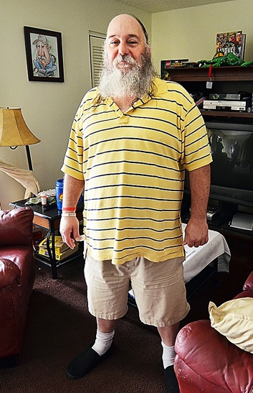
0-30% AMI: Transitional Housing
Works for people with minimal barriers who may just need temporary support to get back on their feet
Works for people who can/will comply with high threshold service requirements.
Works for people who do not struggle with complex addiction or mental health issues.
Typical program is up to 24 months of subsidized housing, case management and employment services.

Slide 22
Transitional Housing challenges and opportunities
Challenges:
Not easy to fund with federal or state funds. Hard to transition folks into permanent affordable housing, section 8 waitlists 3-5 years long. Wages outpaced by housing costs.
Has started to be replaced by rapid rehousing programming.
Opportunities:
Works well for populations that are truly in transition (parolees, youth exiting foster care system).
Several states are funding this type of housing for specific populations.
Several programs do exist statewide, performance data is collected by COC’s.

Slide 23
Program spotlight: ready to work in CO
Ready to Work is a “work-first” approach to addressing homelessness.
Ready to Work offers 1 year of housing, employment and support for adults experiencing homelessness. Ready to Work is the only holistic model in Colorado focused on addressing homelessness through social enterprise and employment combined with housing.
This program was piloted in Boulder but the agency is looking to expand the model into non-metro communities.
For more info: https://boulderbridgehouse.org/what-we-do/

Slide 24
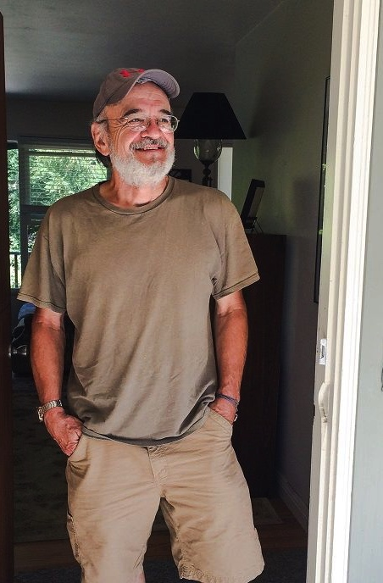
0-30% AMI: Rapid rehousing
This is a Housing First Intervention which:
Rapidly connects families and individuals experiencing homelessness.
Provides a tailored package of services and supports.
Resolves immediate challenges and barriers to housing.
Links households to a larger set of community resources.
Essentially helps individuals transition in place.

Slide 25
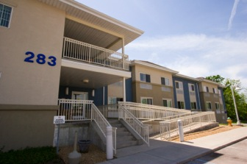
Rapid rehousing challenges and opportunities
Challenges:
There is not a lot of data yet as to whether this intervention prevents homelessness over the long-term, but early research is promising.
Federal and state agencies fund these programs but we have not seen a lot of private sector funding in this space.
Case management services are critical and hard to fund in this model.
This intervention does not work for the hardest to serve but can work for many at-risk populations.
Opportunities:
This is a prevention strategy and much more cost-effective than homeless services or PSH. Average costs of rapid rehousing is $2500-$5000 per client. PSH is $13,000-$20,000 per client.

Slide 26
Spotlight: COR3 Volunteers of America
COR3 applies the Rapid Rehousing + Care model to effectively serve individuals with prior or current justice involvement presenting with identified behavioral health issues. Rapid Rehousing + Care effectively serves individuals with multiple, co-occurring and significant barriers to housing. Principles of the Rapid Rehousing + Care Model include:
Adherence to baseline nationally recognized Rapid Rehousing standards
Additional financial assistance dollars per household
Slightly extended lengths of stay (9- to 18-month average) in the program to promote housing retention
Prioritization of connection to employment and mainstream public benefits in support of housing objectives
Integration of/direct connection to behavioral healthcare into rapid rehousing service teams for gap service provision

Slide 27
0-30% AMI: Permanent Supportive Housing
Combining affordable housing with access to support services like case management, employment training, and mental health treatment, supportive housing is a nationally recognized best practice which gives vulnerable individuals and families the opportunity to live stable, autonomous, and dignified lives.
This model can be single site, or scattered site but relies heavily on robust case management services. This is an expensive intervention but an evidence-based practice to house the hardest to serve households experiencing homelessness.
Notes:
Zoe

Slide 28
Permanent supportive housing Cont.
Challenges
This is a resource intensive model that is also complex to develop.
Although a proven model, it is a newer model in some rural communities and it is difficult to ensure program fidelity once these PSH buildings are operational.
Both capital and operating funds are available for projects but service dollars are difficult to obtain and Medicaid billing and state behavioral health funds have proven complex systems to access.
Opportunities
There is significant awareness and support for PSH in many states.
There are more rural models emerging that can serve as examples.

Slide 29
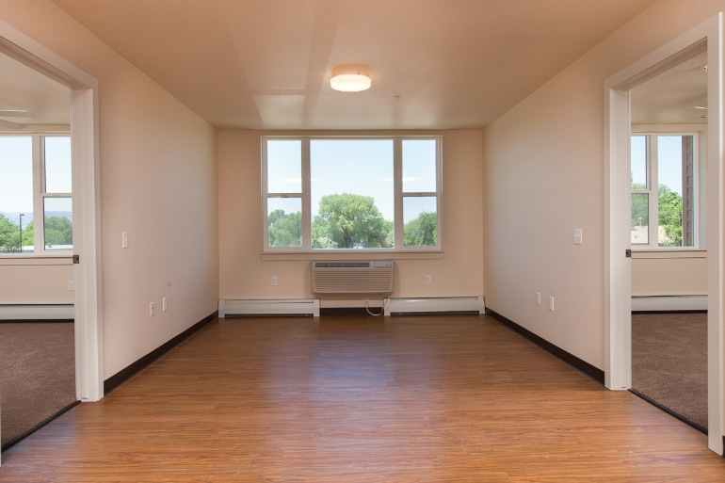
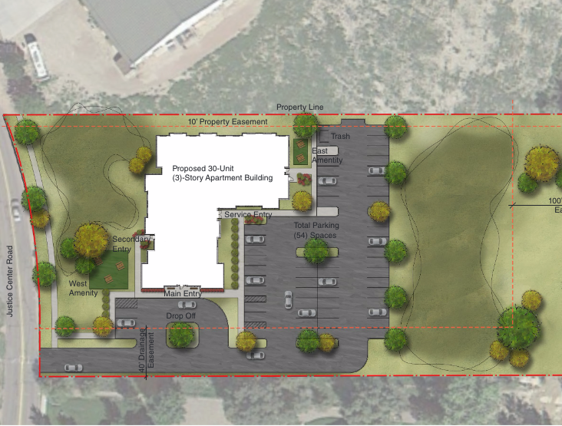
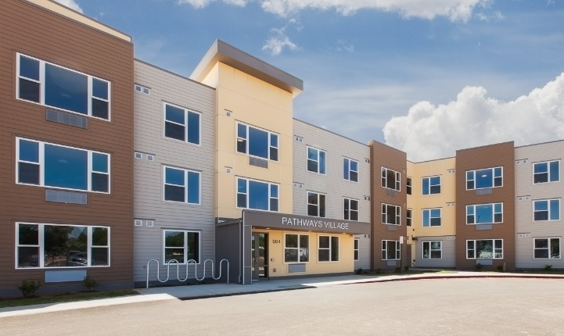
Spotlight: Pathways Village Grand Junction

Slide 30
Recovery housing: Oxford houses
Oxford HouseTM is a concept and system of operations based on the experience of recovering alcoholics and drug addicts who learned that behavior change is essential to recovery from alcoholism and drug addiction.
An Oxford House provides a living environment that could help residents become comfortable enough with abstinent behavior to stay clean and sober without relapse.
These are group living homes, self-governed and managed based on a nationally recognized model and charter.

Slide 31
Oxford houses cont.
Oxford Houses have a fairly high success rate for clients interested in getting sober:
(1) have no time limit for how long a resident can live in an Oxford House;
(2) follow a democratic system of operation;
(3) utilize self-support to pay all the household expenses; and
(4) adhere to the absolute requirement that any resident who returns to using alcohol or drugs must be immediately expelled. Oxford House provides the missing elements needed by most alcoholics and drug addicts to develop behavior to assure total long-term recovery. It provides the time, peer support and structured living environment necessary for long-term behavior change to take hold.

Slide 32
Native American housing models
It is more difficult to provide or access affordable housing programs for Native Americans due to a number of issues such as:
Federal government housing programs are difficult to access and work with, especially on reservation land.
Off-reservation housing programs are equally challenging as it requires significant coordination and capacity to provide services in urban or border town settings.
Even with these challenges, there are several successful models to look at both on and off reservation.
Spotlight: GIMAAJII

Slide 33
GIMAAJII in Duluth, Minnesota
We are, all of us together, beginning a good life. AICHO's headquarters at 202 W. 2nd Street in Duluth. Gimaajii features 29-units of permanent, supportive housing utilizing the “housing first” model. On-site services include assessment, advocacy, limited case management, and limited programming. Case management and mental health services are provided through a partnership with White Earth Mental Health.
Gimaajii also provides a place for people who have a common history and culture to come together, to learn from others, and to share that culture with others. In the traditional manner of respecting elders, life-long learning is encouraged throughout the Gimaajii.

Slide 34
Gimaajii: Duluth MN

Slide 35
0-30% AMI: Tiny Homes (Villages)
Challenges
This is a very popular form of affordable housing now because it can be much less expensive to provide and they can be mobile.
A major challenge of this model for people experiencing homelessness is the extensive onsite services needed to help people be successful in a group living setting and there is not an obvious funding source to operate these villages long-term.
Siting these villages is also a challenge and its difficult to do so within an established city; many are being developed outside of the community in unincorporated areas.

Slide 36
Tiny Homes Cont.
Opportunities:
They are much less expensive; ranging from 15,000-70,000 a unit (depending on whether bathrooms and kitchens are available)
This model lends itself to partnering with the faith community to help identify funding, volunteer supports and resources including a potential site.
States and local governments are getting more comfortable with the model and providing funding for it.
These can be developed more quickly than a new rental apartment complex.
There is controversy as to whether tiny homes should be considered transitional or permanent housing options (depends on size, programming, ect)

Slide 37
Spotlight: Colorado Village Collaborative
This village began in Denver and was sited on public land. The program has been proven successful and the team is now looking to replicate this model in rural Colorado.
This model has been primarily funded by individuals (crowd funding) and foundations but in our work to replicate in rural Colorado we anticipate accessing state resources.
There is data, research and details about the model at this link: https://www.coloradovillagecollaborative.org/beloved-community-village

Slide 38
0-60% AMI: Hud (Housing and Urban Development) voucher programs
Created in 1974 with the enactment of the Housing and Community Development Act and subsidizes rent for income eligible families in the private market.
Families pay 30 % of their income in rent and the voucher pays the difference ensuring landlord receives a fair market rent.
The largest HUD voucher program is referred to as the Housing Choice Voucher or Section 8 Voucher. There are also several vouchers targeting special needs populations such as VASH for homeless veterans and 811 for persons with disabilities.
This is one of the most successful housing subsidy programs in the history of our country but is a limited resource. For every four families in need only 1 has access to affordable housing opportunities such as Section 8.

Slide 39
0-60% AMI: Housing choice voucher Challenges and Opportunities
Challenges
This is an extremely popular subsidy program and has been shown to be effective at alleviating poverty; however for every voucher that is allocated, three other households go without.
In hot rental markets it can be extremely difficult to find a unit for these voucher holders.
Voucher programs for special needs populations such as VASH and 811 require case management to be successful.
Rural communities often do not have capacity or cannot afford to manage vouchers; admin fees allowed do not match actual costs of program administration.
Opportunities
This is a major federal policy issue and we have seen some traction in DC with small budget increases to these critical programs.
State are starting to self-fund voucher programs for special needs populations.

Slide 40
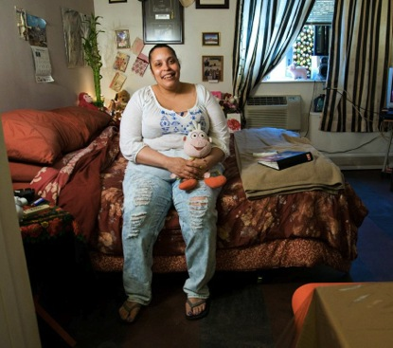
Voucher programs Overall
Most vouchers are administered by local housing authorities or state housing agencies.
Knowing if your state funds specialized housing vouchers can also be an important strategy for your clients.
Housing authorities make great partners and are often looking for services or service provider partners.
In rural communities the housing authorities are often regional in nature.

Slide 41
0-80% AMI: Rental housing-tax credits
Low Income Housing Tax Credits: this is the most powerful federal program for affordable housing creation.
This federal credit is allocated to State Housing Finance Agency’s for allocation to projects through a competitive process.
Each state receives an amount of credits annually based on population.
Credits are used for 10 years but projects often have longer affordability periods in order to be competitive in the application process (3o year period is common).
There are 2 different credit levels, 4% is less competitive but results in less equity for a project. 9% credits are very competitive but allow for much deeper subsidy per unit.
Investors earn dollar for dollar credit against their federal tax liability.

Slide 42
Tax Credit projects cont.
Tax credit projects serve a broader range of incomes and they are beautiful properties because they are built in partnership with national investors.
They are complex to develop and own and, therefore, experienced developers can cherry pick where they want to develop.
They are hard to use in depressed areas because they rely on the private market and demand for housing.
Tax credits are a powerful tool, however, they are extremely difficult to use in rural communities except for rural/resort areas where market demand is strong and market rents are high.

Slide 43
0-60% AMI HUD and USDA rental properties
These are more common in rural communities as they are 100% subsidized by the government and can serve the lowest incomes (not funded by investors)
The challenge is the funding for these types of small rental projects have mostly gone away and existing properties are not always well maintained.
However, if these properties exist in your area they can be an excellent resource.
Some service providers have started looking to acquire and own these smaller properties in order to improve their quality and ensure the asset for their clients and the larger community.
To find these properties HUD and/or the state often have listings for affordable housing properties by state.

Slide 44
0-60% AMI Eviction Prevention Programs
Some states are starting to pass or already have tenant protection laws in place.
More and more nonprofit housing agencies are beginning to provide eviction prevention programming.
This programming typically includes emergency funding for rental assistance, counseling and access to legal representation.
These services are becoming more critical in our strategies to prevent homelessness from happening in the first place.

Slide 45
0-80% AMI Mobile Home park opportunities and challenges
Challenges:
Mobile homes are considered naturally occurring affordable housing (unsubsidized).
Most mobile home parks are privately owned and not always maintained well or providing pads at an affordable rate.
In rural resort areas they are being redeveloped and residents are being displaced.
Some even have public health issues due to inadequate infrastructure within the park causing additional concerns for existing tenants.

Slide 46
Mobile Home Parks Continued
Opportunities:
There are some models nationally, such as ROC USA, that is helping to organize tenants and provide financing to convert mobile home parks into cooperatives.
This is a complex process but is gaining momentum due to the significant need to preserve parks as a form of affordable housing.
If an individual client is struggling with the quality of their home or their park, many of the nonprofits that provide rental, assistance, eviction prevention or housing rehab services may have resources to assist them.

Slide 47
50-120% AMI Homeownership Programs
Homebuyer training programs
Down payment assistance programs
Below market mortgages (CHFA, USDA)
Sweat equity programs-habitat for humanity and USDA programs
Foreclosure prevention programs
Inclusionary zoning programs
Community land trusts

Slide 48
Homeownership Challenges and opportunities
Challenges
Programs have different struggles in different markets. In rural, economically depressed communities it can be difficult to find habitable homes for sale or find qualified buyers (ie. Silverton Colorado)
In hot markets the down payment assistance is not enough to gap the affordability with the local market (Steamboat, Durango etc.)
Sweat equity programs are successful but extremely hard to scale.
Below market mortgages scale very well but only provide a minimum amount of subsidy and truly serve moderate and middle income homebuyers versus low-income.
Land trusts can help mitigate expensive land costs but are complex to administer and work best in higher cost markets where affordable housing options are minimal.

Slide 49
Homeownership challenges and opportunities
Opportunities
Homeownership programs can be tailored to the unique needs of a region or rural community; assuming there is a program provider in the area.
There are significant resources for homeownership programs and many states have nonprofit agencies that specialize in providing these services to rural communities.
Many of our clients may not be able to apply for homeownership but this is also a great resource to know for our staff working in rural communities who might need assistance buying a home.

Slide 50
30-60% AMI Housing Rehabilitation and Energy Improvement Programs
These programs provide services to improve the conditions of existing homes and are very popular and critical to rural communities.
These programs are funded by a number of government sources and provide contractors and low-interest funding to upgrade existing homes that are in fair to poor condition.
Often times these programs also provide energy upgrade services as well.
Some of these programs also are beginning to use Medicaid dollars to make modifications to homes to help older clients stay in their homes longer.

Slide 51
Strategies for accessing housing resources for your clients
Identify what types of housing services your clients need access to based on their services needs and the local housing market.
Reach out to your regional housing authorities, housing nonprofit agencies and regional homeless services providers. If you don’t know who they are contact your state housing agency and ask for introductions.
Start from a place of offering a mutually beneficial partnership: consider offering your case management and other services in exchange for access to housing programs.
Get involved in local housing advocacy efforts and be a strong ally to access additional resources.

Slide 52
Specific housing “asks”
You can ask for trainings for your staff so that they can be more familiar with local and regional housing resources.
Ask to do a pilot for a specific subset of your clientele; housing agencies may or may not be familiar with working with behavioral health clients and you may need to start small and develop a collaborative model.
Ask what they need help with; often times they are serving behavioral health clients but do not have access to case management services and end up with challenging tenants.
Ask if they are willing to be more lenient in their tenant selection criteria or even be willing to give a preference for people with disabilities that have access to services (such as your clients).

Slide 53
Getting into the housing business directly
Some agencies are working on their own housing programs which may include:
Managing their own voucher programs; many states are beginning to fund behavioral health vouchers;
Some agencies hire consultants to develop full scale housing strategies that help to connect them to existing resources….
And some have decided to develop housing directly. This can be done by hiring a housing consultant or by partnering with a mission driven developer to develop special needs housing using a a variety of federal and state housing subsidies.
If you decide to get more involved in housing you should hire a housing consultant to guide the way and protect your interests and organization from missteps, and financial and legal challenges etc.

Slide 54
Questions?
Jenn lopez
jennglaulopez@gmail.com

