Slide 1
Suicide Risk Assessment Tools and How to Talk to Patients about Suicide
Presented by:
Andrew J. McLean, MD, MPH
Chair, Psychiatry and Behavioral Science, UNDSMHS
andrew.mclean@und.edu

Slide 2
Objectives
At the end of the presentation, the participant will be able to:
1) Identify common screening tools for suicide risk
2) Define the basic elements of suicide risk assessment
3) Recognize general risk and protective factors re: suicide

Slide 3
Note
Our Panel experts and the particular population groups discussed:
American Indians
Children and Adolescents
LGBTQ+
Veterans

Slide 4
Definitions
Suicide is defined as death caused by self-directed injurious behavior with intent to die as a result of the behavior.
A suicide attempt is a non-fatal, self-directed, potentially injurious behavior with intent to die as a result of the behavior. A suicide attempt might not result in injury.
Suicidal ideation refers to thinking about, considering, or planning suicide
National Institute of Mental Health

Slide 5
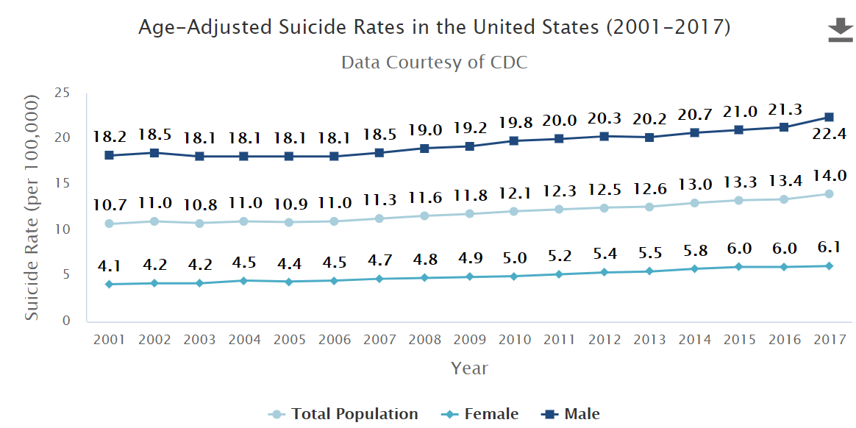

Slide 6
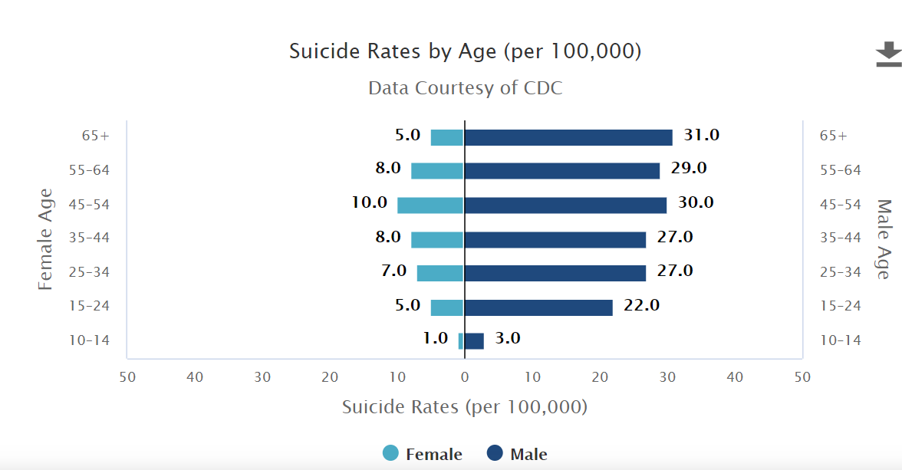
2017

Slide 9
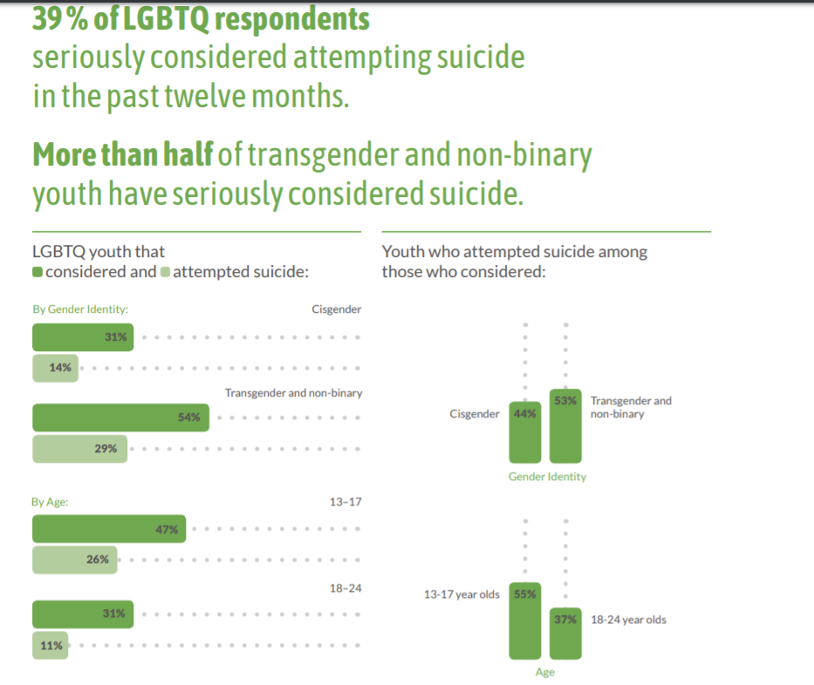
2019 Trevor Project National Survey (34,000)

Slide 10
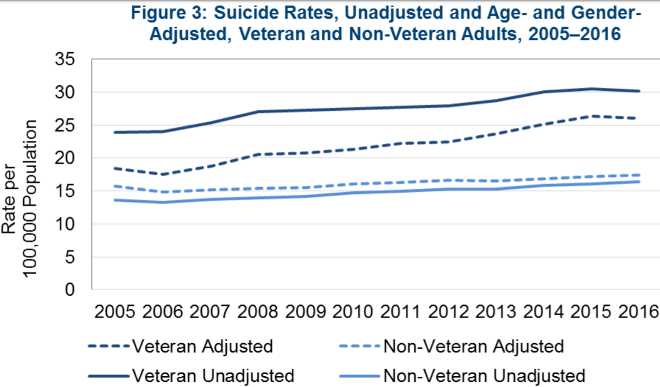
Veterans
VA National Suicide Data Report 2005-2016. Office of Mental Health and Suicide Prevention. September 2018

Slide 11
VA National Suicide Data Report 2005-2016. Office of Mental Health and Suicide Prevention. September 2018

Slide 12
Screening-Specific to Health Sciences Professionals
What is the context? (are you in a hospital/clinic/home?)
Is there indication of mental illness or substance use issues?
Any change/onset of serious medical condition?
Any recent stressors or losses?
Feelings of hopelessness?
Suicidal ideation?
Fiedorowicz JG, Weldon K, Bergus G. J Fam Pract. 2010 May;59(5):256-60

Slide 13
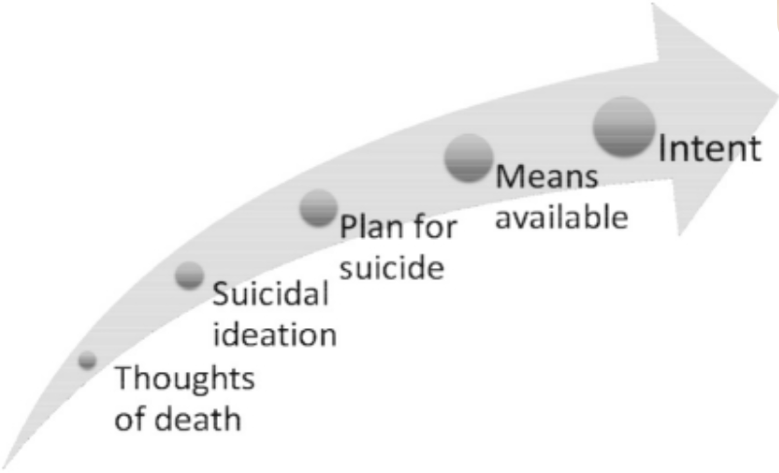
Hierarchy of Suicide Assessment
McDowell A, Lineberry T, Bostwick J. Mayo Clin Proc. 2011 Aug; 86(8): 792–800

Slide 14
Many tools
Common:
Patient Health Questionnaire (PHQ-9)
Columbia Suicide Severity Rating Scale (C-SSRS)
SAFE-T pocketcard

Slide 15
Screening
Screening means screening, not assessment!
Not diagnostic

Slide 16
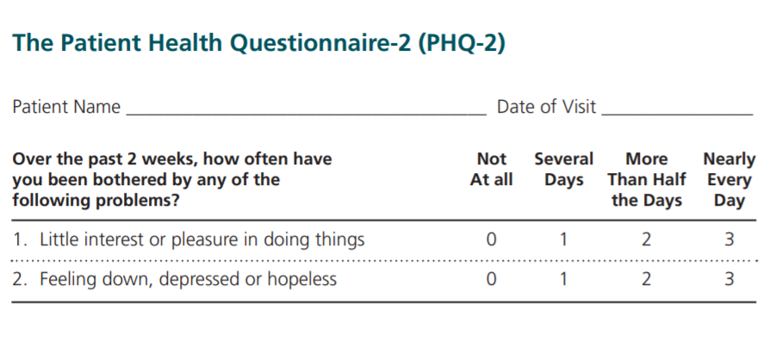
PHQ 2 and 9 (Patient Health Questionnaire)

Slide 17
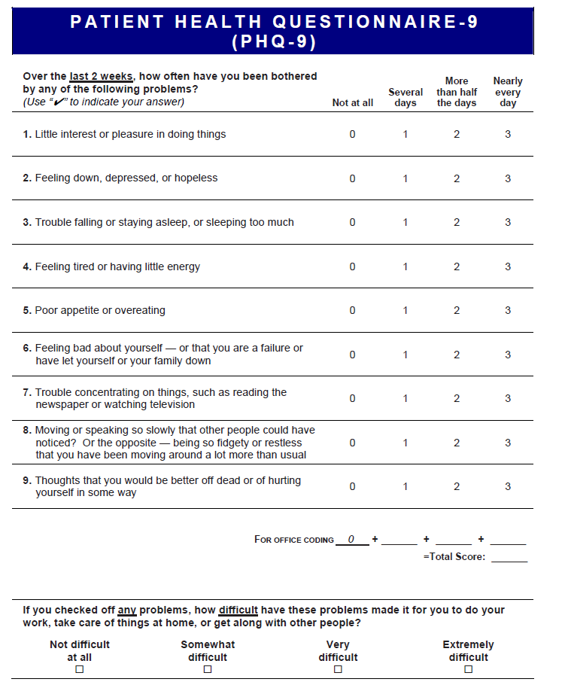

Slide 18
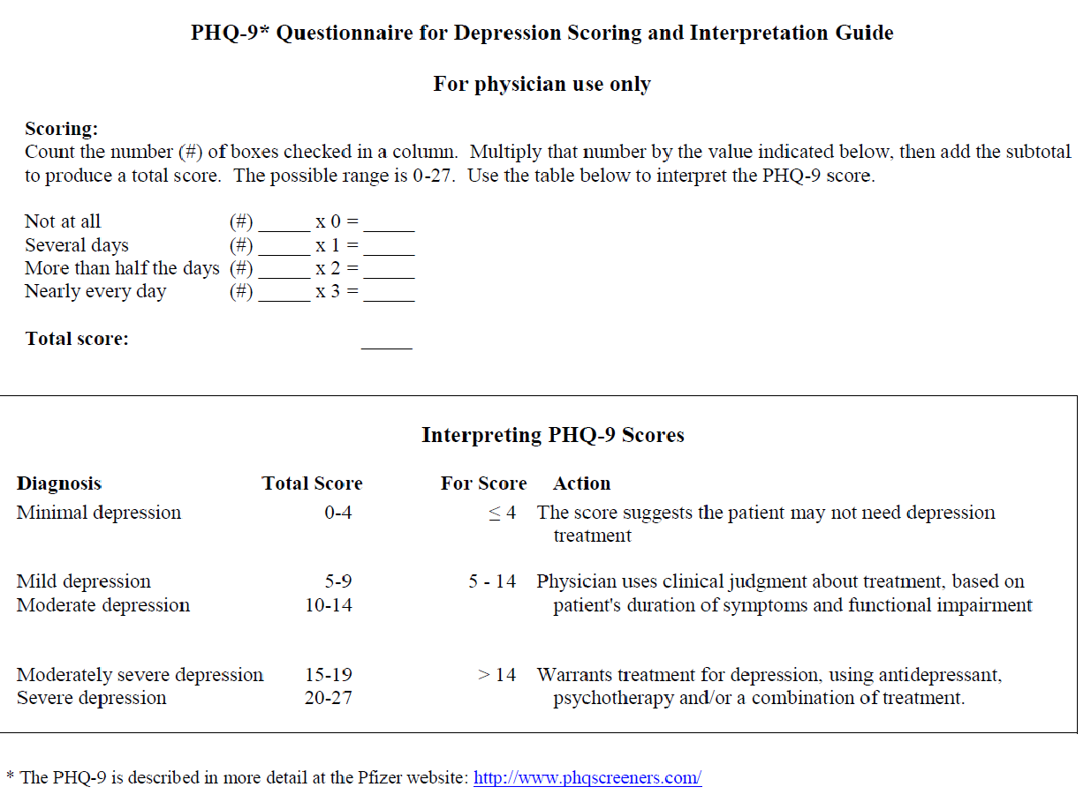
See any issues with this?

Slide 19
The Columbia Lighthouse Project: C-SSRS
Columbia-Suicide Severity Rating Scale
http://cssrs.columbia.edu/

Slide 20
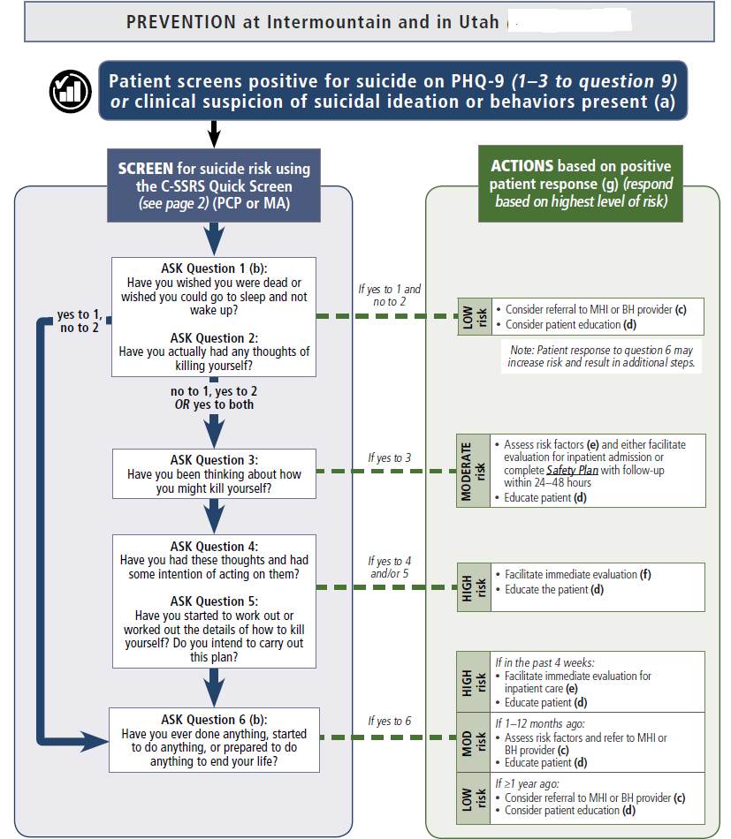
From Intermountain Healthcare
https://intermountainhealthcare.org/ckr-ext/Dcmnt?ncid=526742474

Slide 21
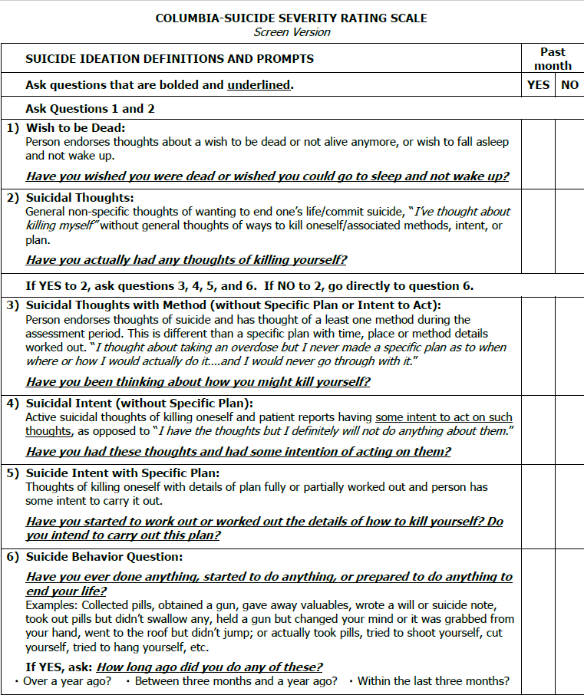

Slide 22
Example: C-SSRS for EMTs in field

Slide 23
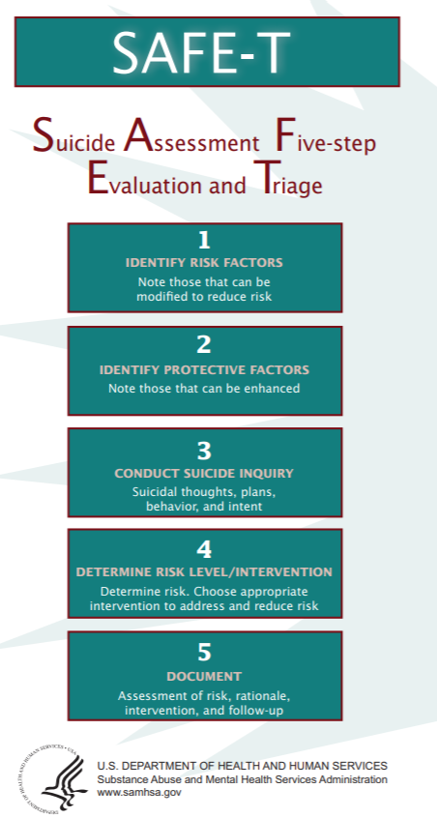

Slide 24
Static and Dynamic Factors (not all-inclusive)
Static Risk Factors
Dynamic Risk Factors
Prior Attempt(s)
Suicide in first degree relatives
Chronic physical illness (esp. one that causes pain)
Anxiety (“psychic angst”)
Hopelessness
Command Hallucinations
Impulsiveness/aggression
Severe Insomnia
Degree of suicidality
Plan
Access to means
Lethality/intent

Slide 25
Protective Factor examples
Employment
Religious belief
Reason to live (children in home…)
Psychosocial supports
Individual psychological strengths

Slide 26
Case
85 year old recent widower
Significant COPD
Living alone

Slide 27
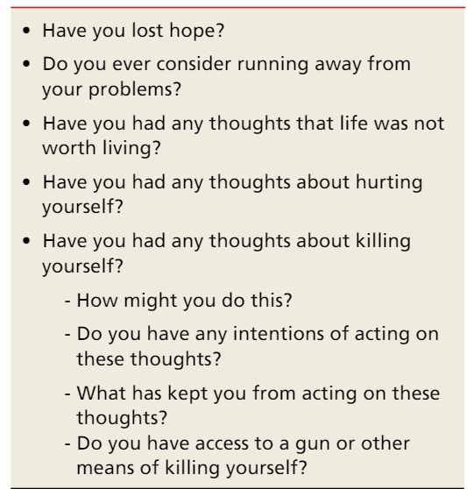
How does one ask these questions? Some examples…
Be:
Empathic
Non-judgmental
Direct
Example of a poor question: “You’re not thinking of killing yourself, are you?”
Fiedorowicz JG, Weldon K, Bergus G. J Fam Pract. 2010 May;59(5):256-60

Slide 28
Steps
Therapeutic Alliance
Safety
Treatment Setting
Treatment Plan
Coordination/Collaboration

Slide 29
Don’t
Do
Lie
Use the term
“patient contracted for safety.”
Let them know you will assist them in getting help
Document how you came to your decision re: risk (low/medium/high)
and disposition.

Slide 30
When Stuck…
Expand the Field!!

Slide 31
So…
We talked about screening
We talked about a hierarchy of risk
We talked about interventions
We talked about how to talk…

