Slide 1

Best Practices in School Mental Health
2019 Annual Conference on Advancing School Mental Health
Austin, TX
11/07/19
Stefanie Winfield, MSW
Sarah Younggren, LCSW

Slide 2
Disclosure
This presentation was prepared for the Mountain Plains Mental Health Technology Transfer Center (TTC) Network under a cooperative agreement from the Substance Abuse and Mental Health Services Administration (SAMHSA).
At the time of this presentation, Elinore F. McCance-Katz, served as SAMHSA Assistant Secretary. The opinions expressed herein are the views of Stefanie Winfield, MSW and Sarah Younggren, LCSW and do not reflect the official position of the Department of Health and Human Services (DHHS), SAMHSA. No official support or endorsement of DHHS, SAMHSA, for the opinions described in this presentation is intended or should be inferred.
Notes:
SW

Slide 3

The Mountain Plains Mental Health Technology Transfer Center
Provides training and technical assistance on evidence-based practices to the mental health providers of Region 8 (North Dakota, South Dakota, Montana, Wyoming, Colorado, and Utah). We are funded by the Substance Abuse and Mental Health Service Administration (SAMHSA)
Co-hosted by:
The University of North Dakota
and
The Western Interstate Commission for Higher Education (WICHE)
Notes:
SW
Free training, technical assistance to support the mental health workforce.
Specific school focus on trauma and rural
Evaluations allow us to offer these opportunities free. So please fill out the evaluation at the end.

Slide 4
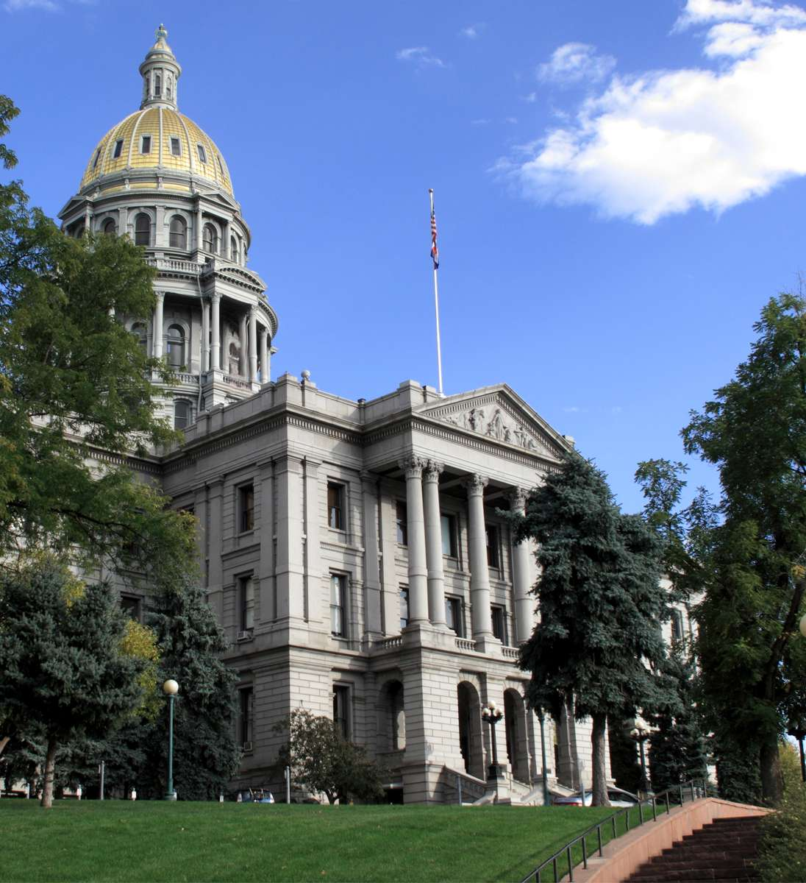
Mental Health Colorado
Mental Health Colorado advocates for the more than one million Coloradans who experience a mental health or substance use disorder each year.
We engage policymakers, providers, the public, and the press to promote early intervention, expand access to affordable services, and eradicate stigma and discrimination.
Our efforts range from the Capitol to the classroom.
Notes:
SY
Mental Health Colorado is an affiliate of Mental Health America.
We are a non-profit policy and advocacy organization. We advocate for the more than one million Coloradans who experience a mental health or substance use disorder each year. We engage policymakers, providers, the public, and the press to promote early intervention, expand access to affordable services, and eradicate stigma and discrimination. Our efforts range from the Capitol to the classroom.
We work on policies, research, and strategic initiatives that:
Increase the availability of high-quality mental health and substance use care for children and their families
Reduce the suicide rate in Colorado
Ensure equitable treatment and coverage of mental health and substance use in the health care system
Expand the capacity of mental health and substance use services statewide
Strengthen systems of care for people with severe mental illness and substance use disorders, including individuals with complex or co-occurring conditions
Ensure families receive the mental health and substance use care they need before, during, and after pregnancy

Slide 5


Agenda
Introductions
History of Toolkit Development
Review the Sections of the Toolkit
How to use the Toolkit
Next Steps
Notes:
SW
Introductions- who we are, why we are here
Who are you, why are you here (roles, location)
Funders
Rose community Foundation
Caring for Colorado Foundation
Partners
Colorado Association of School Executives (CASE)
Colorado Rural Schools alliance
Colorado Association of School Boards
Colorado Department of Education
Colorado Association for School-Based Health Care
History of toolkit development- WICHE/MHC partnership
Who is it for-
Community members, school and local leaders and districts to help you make the case for school to implement mental health practices such as screenings, suicide prevention and wellness plans. Talk more about why and how it was development and how it supports school districts in planning and implementation efforts for school mental health.

Slide 6
Objectives
Understand the importance of school mental health
Describe strategies for advocating for school based mental health
Learn about best practices in schools and what implementation in schools looks like in practice
Review funding strategies for school-based mental health services.
Notes:
SW

Slide 7
Notes:
SY
And these same youth, ages 12 to 25 years, have by far the worst levels of access to mental health care across the whole lifespan.
Emerging research indicates that intervening early can interrupt the negative course of some mental illnesses and may, in some cases, lessen the long-term progression and impact of a mental illness.
Untreated child and youth mental health conditions are linked to higher rates of school absence and reduced rates of timely grade completion and graduation.
In some cases, schools may also serve as a venue for providing health services, including mental health care, and they can also be the key to effective need identification, referral, and linkage to services provided in the community.
Schools that have a system of mental health services and supports in place can help identify and address the mental health concerns of students and staff promptly, before they intensify and result in decreased academic performance and success and increased absenteeism and disciplinary issues.
Creating an environment that is conducive to learning and maximizes student potential requires efforts to recognize and take steps to meet the emotional needs of students and staff.

Slide 8

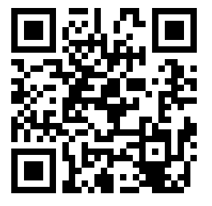
School Mental Health Toolkit
Notes:
SY
Now that we know that mental health conditions can tend to develop during early years without support and prevention, we understand that schools can be important places for prevention and support.
Mental Health Colorado, the Colorado affiliate of Mental Health America, worked in partnership with Western Interstate Commission for Higher Education Mental Health Program to develop a school mental health toolkit. In consultation with providers, districts, families, and community advocates, the best practices for providing school mental health services were developed, as well as resources regarding what's currently being implemented and working well throughout the state. A critical foundation for this work was the Colorado Framework for School Behavioral Health Services developed by the Colorado Education Initiative and their related resources.
Based off of the CDC’s WS WC WC framework.
The School Mental Health Toolkit was developed as a guide to support schools and mental health advocates to use a comprehensive approach to school mental health, and improve the availability of mental health and substance use prevention and intervention in K-12 schools. The Toolkit provides strategies to support ALL students. It is not a curriculum or a program, but instead a guide for districts, schools, community partners, and advocates to take inventory of how they’re implementing best practices, and provide tools, advocacy tips, and funding strategies to make change.
Share update about next version of toolkit

Slide 9

Toolkit Structure
Notes:
SY
5 sections
What do I need to know?
We know that school should not do this work alone, so the toolkit was also written to support community advocates. It includes facts and talking points to help advocates communicate the importance of services for mental wellness in schools
What works?
Which school mental health and social emotional initiatives, programs, services and approaches really work. Our top 10 approaches
How do I make changes?
An overview of what success looks like, partners who might be involved with making change and how to get your message heard by the right people at the right time
How can initiatives be funded?
Learn about sources of funding for different types of programs, initiatives and supports and how to set the wheels of funding in motions
Where can I find more resources?
Additional resources about best practices in school-based mental health prevention and intervention
What's covered in each section

Slide 10
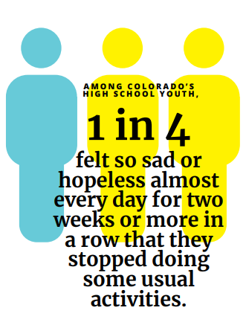
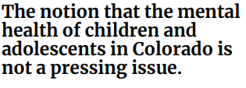
What do I need to know?
Why does this matter?
How does data help?
Facts and figures- to raise awareness and use as talking points
Notes:
SY
Research supports the importance of mental health services in schools. Yet, we know there are gaps that exist in meeting students’ needs, including…
Schools lack mental health providers in schools
Schools lack adequate mental health and social emotional learning training for teachers and school staff
Access to mental health services due to transportation or lack of services
Ask group how this resonates with their experience?
So, the 1st step to close those gaps is to advocate for change whether you are district leadership, school counselor, parent, or a community advocate. Talking points with data to build your case… Show example. Common challenges you may face and data to engage in the conversation.

Slide 11










What works? 10 Best Practices
Mental health as part of overall health & wellness
Teacher wellness programs and support
Screening, identification, and referral systems
Stigma reduction
Social & emotional learning and resilience
Positive behavior interventions & supports
School-based health centers supporting mental health
Trauma-informed practice
Partnerships with mental health professionals
Suicide prevention initiatives
11
Notes:
SW
There are school based mental health best practices that evidence shows can positively impact student performance and mental health.
Mental Health Colorado in concert with others in the field developed a set of best practices that are based on research, focus groups, expert opinion, experience, and interviews.
We will review them and share a few examples of each, knowing that are so many more. This is one of the sections being updated for the new version to include more national and regional examples.

Slide 12


1. Make mental health part of an overall wellness strategy.
Communities That Care
Center for Rural School Health and Education
Youth Mental Health First AID
Notes:
SW
Talk about incorporating MH curriculum into everyday health curriculum.
Too often we think of health and wellness about nutrition and physical exercise, let’s change this dialogue.
Examples -SY
MH professional on wellness committee
integrating into every day

Slide 13

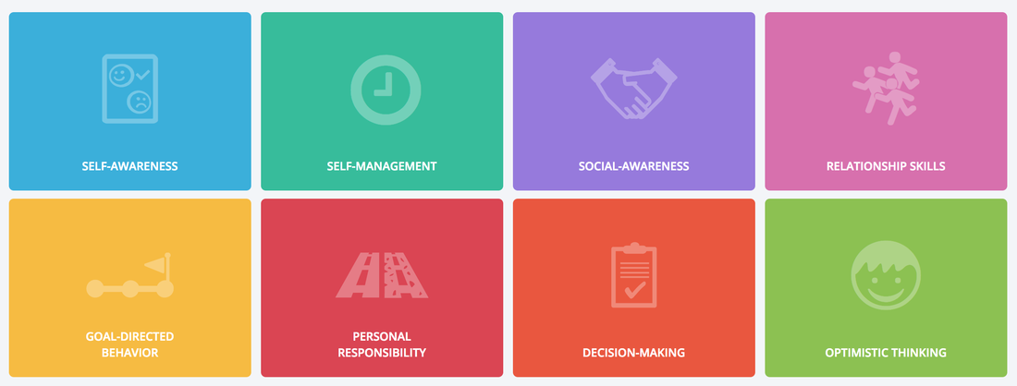
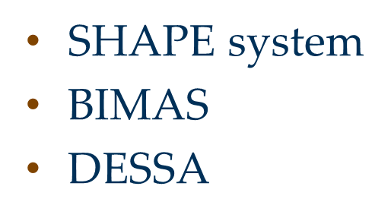
2. Screen for and identify issues to refer students for needed services.
CEI universal screening tool kit
Notes:
Universal screening, as a Tier 1 intervention is gold standard. It can help identify students that need more support for Tier 2 or 3 but can also be used universally for Tier 1 to inform SEL curriculum choices.
SHAPE system- not an individual screener but gives info to schools to make programmatic decisions
Sarah give an example of BIMAS- Share Canon City example.

Slide 14
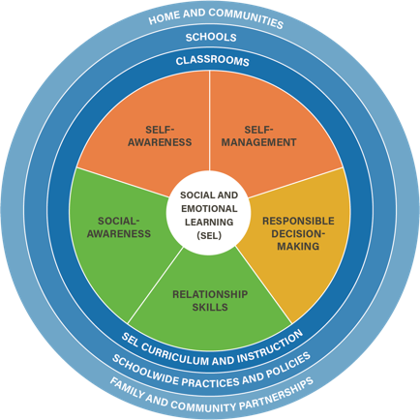
3. Incorporate social and emotional learning (SEL) and resilience concepts.
Collaborative for Academic, Social and Emotional Learning (CASEL)
SEL programs (variety, free, online, in person)
Notes:
CASEL’s Program Guides. Framework for evaluating programs and best practice strategies on how to select the right program for your school or grade. It provides implementation guidance and a list of EB SEL programs.
Talk about tools for selecting programs that are a good fit for your population.
Through my work with districts, many schools are implementing this BP. It is so important however, that the program is meeting the SE needs of the student population. If you have a curriculum that is designed to work of sound decision-making skills, but children are lacking self-regulation and self-advocacy skills with peers, this may not be the best fit to meet the needs of every student and be proactive and preventative in nature.

Slide 15

4. Establish and use school-based health centers (SBHCs) for mental health and substance use services.
School Based Health Alliance
RHIhub-Rural Services Integration Toolkit
Notes:
School based mental health alliance- data, advocacy, resources, training
The Kentucky Family Resource and Youth Services Centers help improve the school performance of academically at-risk students by addressing social and health-related barriers to learning. Centers can adapt the programs they offer in order to meet the specific needs of students and families in the community. Centers can offer a wide range of services, including: child care, referrals to health and social services, and family crisis and behavioral health counseling.
The Santa Cruz County Adolescent Wellness Network (AWN) in Nogales, Arizona has developed a school-linked health program to increase access to care for students in kindergarten through 12th grade in their rural U.S.-Mexico Border community. Services include referrals to a primary care provider, education, and case management provided by community health workers, and trainings for teachers and school administration.
The West Tennessee Delta Consortium, which provides health screenings through a mobile clinic and classroom health education on healthy behaviors, adapted its curriculum to align with the Common Core Standards to help gain access to schools concerned about losing class time.

Slide 16

5. Create partnerships with mental health professionals.
4 Strategies
Project TEACH
Project ECHO
Notes:
4 strategies to foster community partnerships
Schools contract or collaborate with providers from an outside agency who deliver school- based services
School-base mental health center employ providers on site
School develop a referral system to outside providers who provide services at their own sites
Schools provide their own school supported mental health model and ensure parents/student consent for communication with other health care providers
Project TEACH: Connecting Primary Care with Child Psychiatry
Primary care physicians (PCPs) such as pediatricians and family practice doctors are often the first place families go to seek help or information about emotional or behavioral concerns with their children. PCPs provide mental health support and can prescribe medications, but they may not have access to consultation or the training needed to make decisions for children with mental health needs.
Project TEACH provides rapid consultation, education and training, and referral/ linkage services to pediatric primary care providers (PCPs) statewide who provide care for children and adolescents with mental health disorders. Additionally, other prescribers who are providing ongoing treatment to children, such as Child and Adolescent Psychiatrists, General Psychiatrists and Psychiatric Nurse Practitioners, may request a second opinion through consultation.

Slide 17

6. Emphasize teacher wellness
Employee Assistance
Programs
Happy Teacher Revolution
Listening sessions
Notes:
Happy teacher revolution- kind of like support group with teachers trained to lead groups at their own schools
It takes a village to raise a child but who is taking care of the village
EAP- The message it gives to teachers about their health and wellness

Slide 18

7. Reduce stigma
Make it OK
Active Minds
Let’s Talk CO
Parent education nights
.
Notes:
Talk about rural vs. urban.

Slide 19
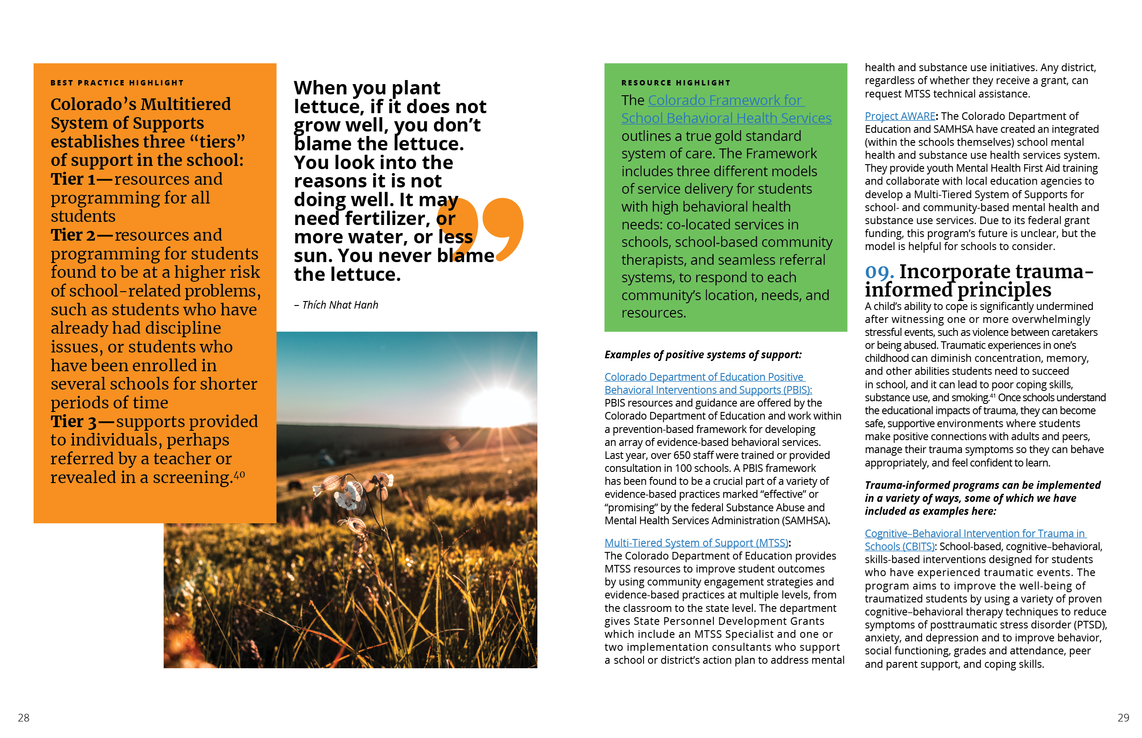
8. Use Positive Behavioral Intervention and Supports (PBIS)
State Offices of Positive
Interventions and supports
State offices of Multi-Tiered
System of Support
Notes:
PBIS is most effective when done in combination with social emotional and mental health supports. It is about setting strengths-based, universal expectations. It is more of a behavioral approach, but when go in tandem with social, emotional supports.
Removed Project Aware to talk about during the federal funding

Slide 20
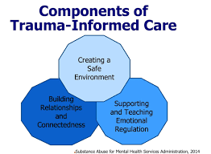
9. Incorporate trauma-informed principles
Cognitive –Behavioral Intervention for Trauma in Schools (CBITS)
National Child Traumatic Stress Network
National Center on Supportive Learning Environments- Building Trauma Sensitive Schools
Restorative Justice Practices
Notes:
I would add free online resources that I think are more practical if that’s ok.
RJ aligns with trauma informed
Sarah add stats about ACESs

Slide 21


10. Prioritize suicide prevention
Sources of Strength
Signs of Suicide
ASIST
SAMHSA SAFE-T
Notes:
Once we get to this point, 90% of these other things should have happened. Suicide prevention is not done in and of itself
ASIST and SAFE-t are assessment tools
SAFE-t suicide assessment using 5 step evaluation and triage plan SAMHSA
ASIST training to be able to provide suicide first aid

Slide 22

Notes:
SW
SY
Set priorities- can't do all of these things all a once
This tool can help sort what you are already doing well and what areas to focus on or prioritize.
How schools use this

Slide 23
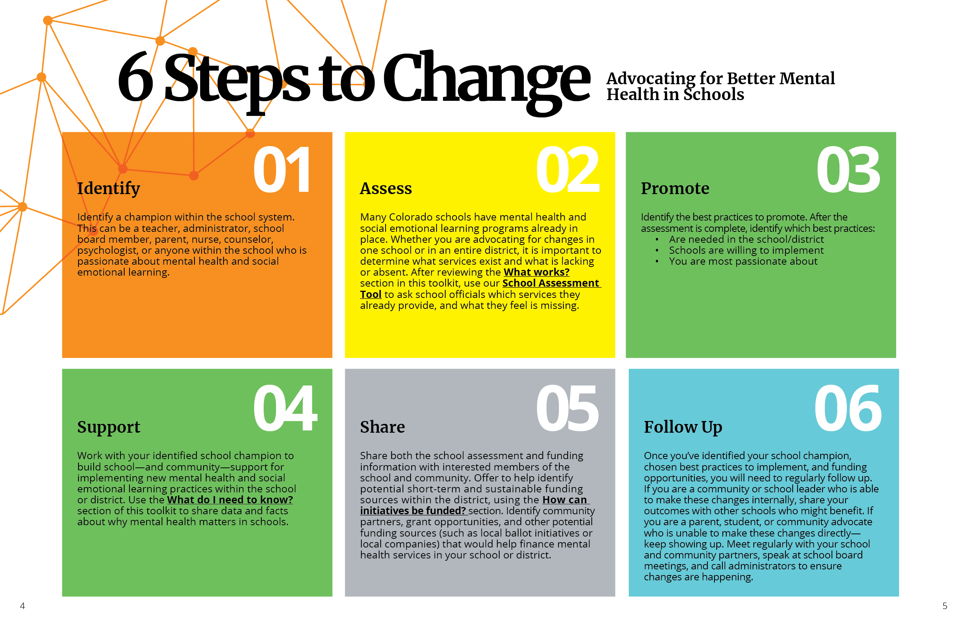
How do I Make Changes
Notes:
SW
Steps for advocacy
The toolkit was designed to be used by a wide audience. Anyone, list…, who will champion the work.
5 Points on Success
Collaboration between schools and organizations
Implement school-based series in an effective and sustainable way
Engage community and resources
Involve students
Collect and report on outcome data

Slide 24

How to Find Funding
Local ballot measures
State legislature
State tax initiative
Federal funding
Medicaid
Grant funding
Community partner funding
School district funding
Notes:
SY
Grant funding can support new programs, staff training, purchase of a curriculum, mental health consultation, & research on effectiveness
Community partner funding can support school-based staff and services such as mental health screenings, wellness programs, & training
School district funding can support adoption of social emotional curricula, positive behavioral intervention and supports, & district-wide trainings such as Youth Mental Health First Aid
Project Aware-SW
Project AWARE (Advancing Wellness and Resiliency in Education) State Education Agency Grants
increase awareness of mental health issues among school-aged youth;
provide training for school personnel and other adults who interact with school-aged youth to detect and respond to mental health issues; and
connect school-aged youth, who may have behavioral health issues (including serious emotional disturbance [SED] or serious mental illness [SMI]), and their families to needed services.

Slide 25
Where can I find more resources?
SAMSHA
Mental Health Technology Transfer Center Network
Blueprints for Healthy Youth Development
SHAPE System
State Departments of Education, Public Health, Human Services
Notes:
What else is in the toolkit- terminology and roles.

Slide 26
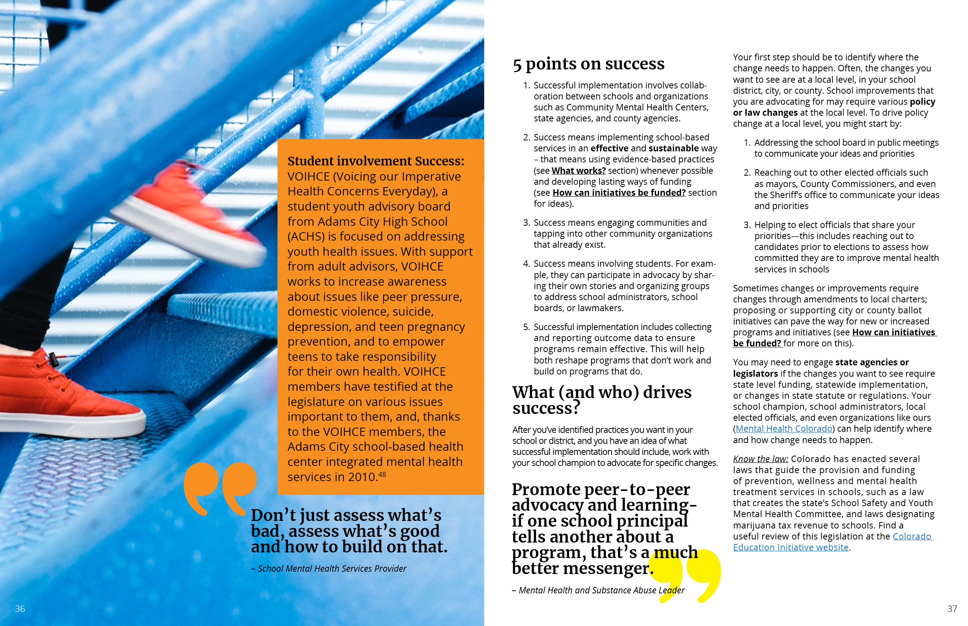
Challenges and Lessons Learned
There is a need for a comprehensive approach
Share resources
School, community, family partnerships
District knowledge sharing
Take advantage of federal funding
Plan for sustainability
Notes:
Given challenges talked about earlier there is a need fir a comprehensive approach
Sustainability – initiative fatigue, must be comprehensive and embedded
Common challenges and attitudes
Youth mental health is not a pressing issue
School isn’t the place to address mental health
Stigma around mental health
School administrations don’t see ROI for prevention, wellness, and mental health services
Not enough providers, especially in rural areas
Stigma- lack of conversations, students afraid to ask for help
How would you counter/address this attitudes? What do you still need to make a strong argument for school mental health?

Slide 27
Questions???
Question and answers
Next steps:
How do you plan to use this toolkit?
What do you need to put a plan in action?
Notes:
What additional information do you need?

Slide 28
Closing
Contact info
Stefanie Winfield
  swinfield@wiche.edu
Sarah Younggren syounggren@mentalhealthcolorado.org
Evaluations
https://ttc-gpra.org/P?s=717160

