Slide 1
Mountain Plains - Mental Health Technology Transfer Center
This Presentation is Provided by:
Sarah Nielsen
Susan Bazyk
Tanja Brown
Thomasine Heitkamp
Funded by:

Slide 2
MHTTC Background
Substance Abuse and Mental Health Services Administration Grant Project
Serves: CO, MT, ND, SD, UT, & WY
5 year funding plus year-to-year school supplemental funding
PI: Thomasine Heitkamp, LCSW
Collaborators: University of North Dakota and the Western Interstate Commission for Higher Education (WICHE)

Slide 3
Aim of School Supplement
Assist rural schools to implement best-practice approaches to address mental health needs of training and technical assistance
Students
Promoting Positive Mental Health in Rural Schools
Self-paced courses
Communities of Practice
National school curriculum
Advancing Trauma Sensitive Schools
https://mhttcnetwork.org/centers/mountain-plains-mhttc/home

Slide 4
Building Capacity of Rural School Personnel To Address the Mental Health Needs of Students Sarah Nielsen, PhD, OTR/L, MP-MHTTC Susan Bazyk, PhD, OTR/L, FAOTA, Every Moment Counts Director Tanja Brown, Divide County Elementary Principal Thomasine Heitkamp, LCSW, Director MP-MHTTC

Slide 5
Unique Features of Rural Schools
Acceptability of mental health issues and stigma
Availability and accessibility of service providers
Affordability of services
(Wilger, nd)

Slide 6
Implementation Science in Action
Evidence-based curriculum (Bazyk , 2015)
Multi-tiered Approach (WHO, 2001)
Interdisciplinary Teams
Community of Practice (Barwick, 2009)
Lyon,(n.d.). Implementation Science and Practice in the Educator Sector. SAMHSA: Project Aware

Slide 7
Spring and Fall 2019 CoP Cohorts
14 CoPs participated
Each school formed an interdisciplinary CoP
ND | SD | MT | WY
2 SPED 3 Districts | 3 Districts | 3 Districts | 2 Districts

Slide 8
Building Capacity of School Personnel to Address the Mental Health Needs of Students
5 Sessions – Completed by Interdisciplinary School CoP one time per month via Zoom

Slide 9
Aim → Create Change Leaders committed to addressing the mental health needs of all children & youth
Service providers with the knowledge and confidence empowered to change practice based on current knowledge.
Bazyk, S., et al. (2015).

Slide 10
The strategic building capacity process promotes the application of knowledge to practice
Within a Community of Practice (CoP)
People who share a common interest and commit to working together over time (Wenger, McDermott, & Snyder, 2002)
Focus on knowledge translation
Read → Reflect → Dialogue → Plan → Implement Change
Results in integrating new knowledge into practice
Move from knowing to doing
Bazyk, S., et al. (2015).
Notes:
.

Slide 11
5 Sessions The process & materials
Facilitation Guide
Guidelines for facilitating the CoP Session
Foster – reflection, discussion, interdisciplinary collaboration
Build community
Webinar (range 30 – 60 min.)

Slide 12
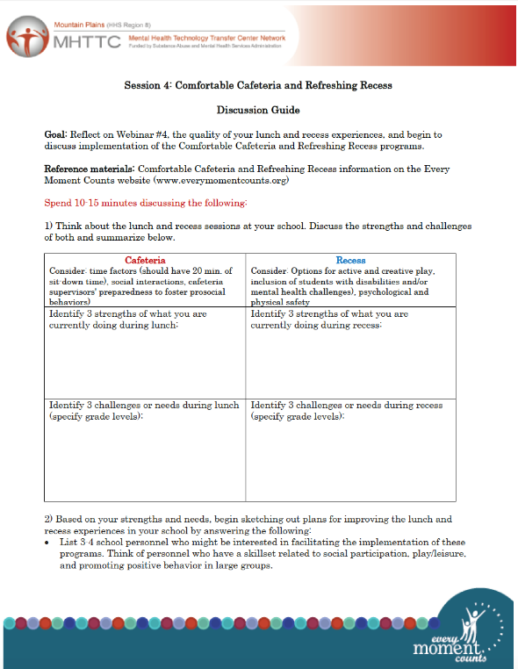
Session Materials
Readings
Chapters, monographs
EMC website
Current literature
Discussion Guides –
After viewing webinar to foster discussion and application

Slide 13
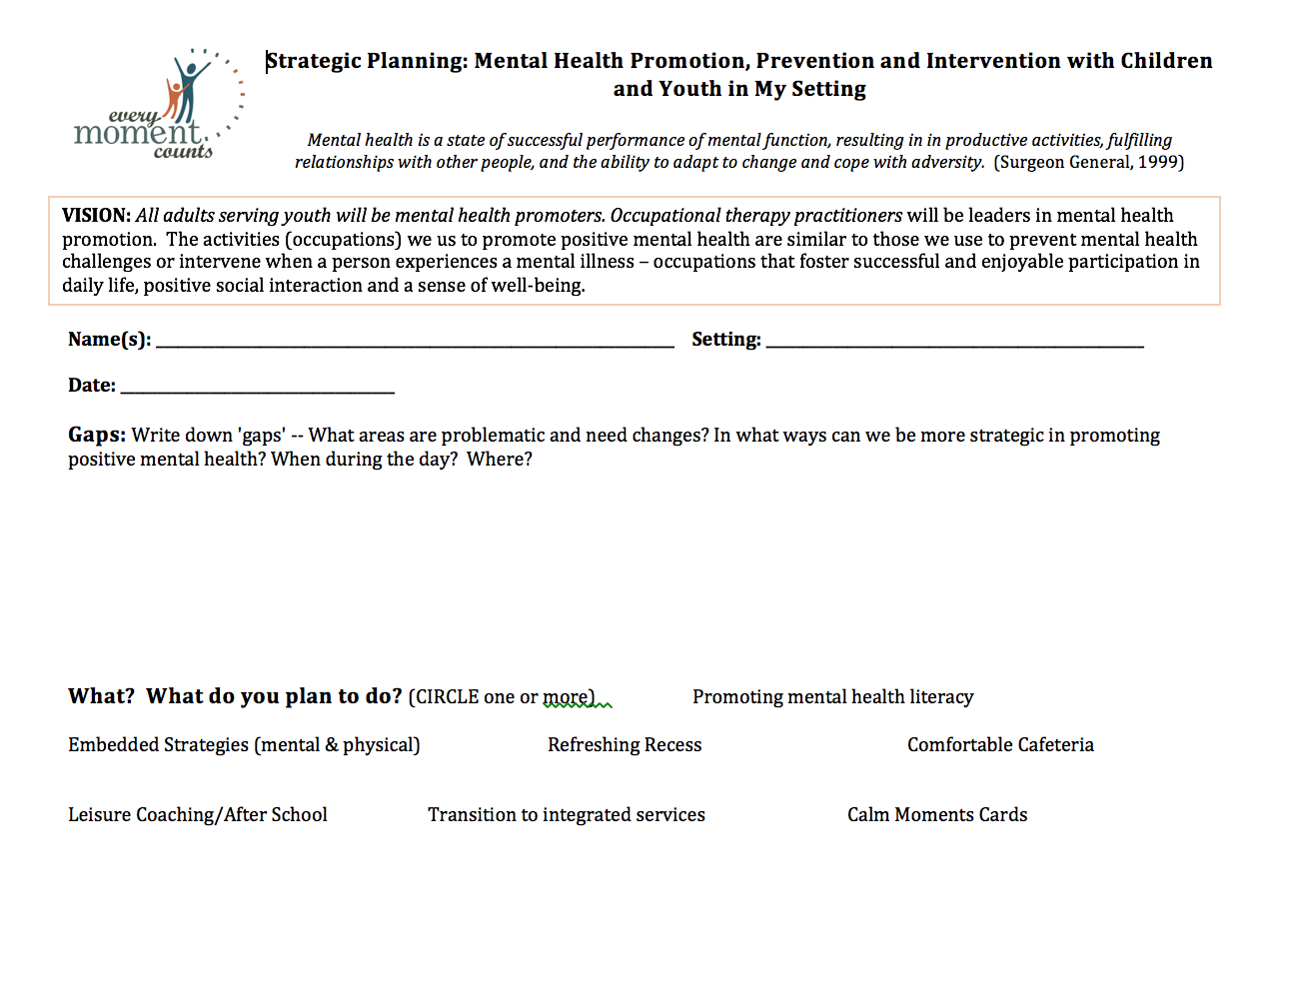
Session Materials
CoP Strategic Planning Document
(fill out before or after Session 5)

Slide 14
Content Overview Building Capacity: Session 1
An understanding of positive mental health based on positive psychology
Public health approach to mental health
Tier 1/universal mental health promotion strategies for ALL
Tier 2/targeted prevention strategies for those at risk
Tier 3/individualized interventions and supports for students with identified mental health challenges
An overview of Every Moment Counts: Promoting Mental Health Throughout the Day
A multi-pronged mental health promotion initiative
Provides practical strategies and embedded programs that can be implemented by all school personnel to promote participation and mental health in all students

Slide 15
Building Capacity: Sessions 2 → 5
Session 2: Embedded Strategies - Integrated and interdisciplinary services focusing on mental health promotion, prevention, and intervention
Session 3: Calm Moments Cards Program: Recognizing and reducing stress and enhancing emotional well-being
Session 4: Promoting participation and emotional well-being during non-academic times - Comfortable Cafeteria & Refreshing Recess
Session 5: Embedding strategies and interactions to support children and youth with identified mental health challenges and Making Leisure Matter

Slide 16
Follow-Up and Sustainability
On-site visits
Strategic plans
Technical assistance

Slide 17
Results
Six CoP’s submitted strategic plans
38 facilitators were trained
1 CoP has completed training with staff (26 staff); the remainder are still finishing training and implementation this fall

Slide 18
Strategic Planning Themes
Relationships to current mental health programming | Implementation of Every Moment Counts Programs
5/6 strategic plans connected EMC programs to SEL and Character programs | Calm Moments Cards – 5
6/6 strategic plans identified an additional gap for onsite training | Comfortable Cafeteria – 5 Refreshing Recess – 4
5/6 Mental Health Literacy | Embedded Strategies – 5
Notes:
.

Slide 19
Pre-Post Survey
One survey containing:
Demographics
School Practice--Knowledge and Perceived Ability to Apply Public Health Approach (Bazyk, 2015)
Calm Moments Card Survey (Bazyk, 2016)
Open-ended question about application

Slide 20
There were 38 people who took the post test. Of those 9 (23.7%) did not have matching pre-test IDs and couldn’t be used in comparisons.
27 (96.4%) were female and 23 (82.1%) were from North Dakota (one from SD, 4 from MT).
16 (57.1%) were in teaching, 4 (14.3%) were paras, 2 (7.1%) were counselors, and there was one each of special education, administration, school psychologist, OT, SLP, and other.
The average years worked was 13.1 (S.D. 10.4) with 9 (32.1%) 0 to 5 years, 10 (35.7%) 6 to 19 years, and 9 (32.1%) 20 or more years.

Slide 21
28 respondents responded to 5-point Likert scale items both pre and post.
Three subscales, knowledge, attitudes, and beliefs were created.
Average scores for each subscale and the total score were compared pre to post using paired t-tests.

Slide 22
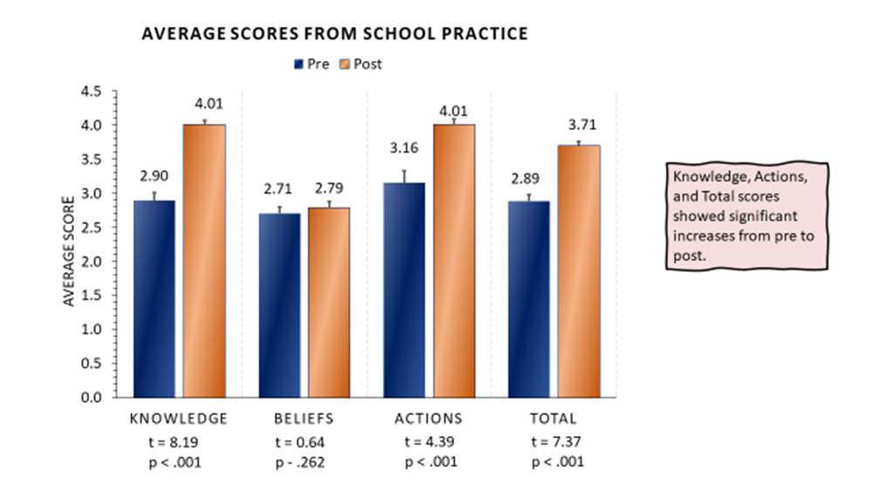

Slide 23
Knowledge, Beliefs, Actions, and Total scores showed significant increases from pre to post.
t = 4.35
p < .001
t = 2.82
p < .004
t = 4.69
p < .001
t = 4.49
p < .001

Slide 24
Of minor interest:
Average scores for respondents in years of work groups. Knowledge and total have very similar changes pre to post. Actions has slightly more increase in the 20-42 (green) group. Beliefs has strong increase in the 0-5 age group, but not the others.

Slide 25
Average Scores from Calm Moments Cards
By Years of Work
Of minor interest:
Average scores for respondents in years of work groups. Knowledge , actions, and total have very similar changes pre to post. Beliefs has strong higher pre and post in the 0-5 age group.
Knowledge
Beliefs
Actions
Total

Slide 26
Divide County Elementary Reflections
Image from Bing

Slide 27
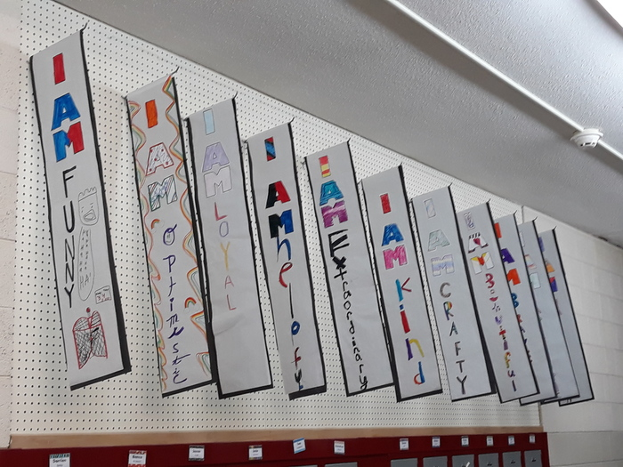
Spring 2019 Actions
Establish Buy-In
Interdisciplinary CoP Trainings
Full Staff Trainings
Implementing Ideas
Discussion & Planning
Strategic Plan

Slide 28
Strategic Plan
Considerations
Embedded strategies
Support other school initiatives
Realistic, sustainable
Staff input
Priorities
Promoting mental health literacy
Teaching positive mental health strategies
Identification of students needing additional support

Slide 29
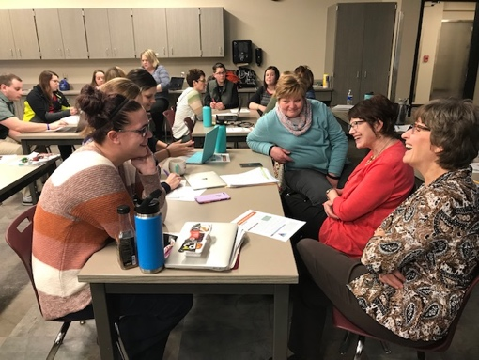
Strengths
CoP Approach
Full Staff Training
Collaboration with MHTTC and Every Moment Counts
Resources
Flexibility
On-Site Training

Slide 30
Challenges
Training
Simultaneous
One group at a time
So many ideas…
Positive
Challenge
Standards & Evaluation
NDMTSS SEL Goals & SEL Student Friendly Scales
http://www.ndrea.org/index.php?id=103

Slide 31
Next Steps
Data collection and analysis as CoPs finish and implement
Minor changes to this years CoP cohort training
Self-study course

Slide 32
Pilot Project with Coaching
What? Coaching OTs and other school practitioners to
Complete the 5 Sessions
Facilitate a CoP in their setting
Monthly coaching calls
When? Sept → Feb. 2020
Who? ~45 interdisciplinary school providers
Representing 14 states in US
Response? Enthusiasm!
Notes:
.

Slide 33
Questions and Please and Thank You!
We need feedback to keep our grant. Please consider taking the short survey.

Slide 34
References
Barwick, M.A., & Peters, J., & Boydell, K. (2009). Getting to uptake: Do communities of practice support the implementation of evidence-based practice? Journal of the Canadian Academy of Child and Adolescent Psychiatry, 18, 16-29.
Bazyk, S., et al. (2015). Building capacity of occupational therapy practitioners to address the mental health needs of children and youth: Mixed methods study of knowledge translation. American Journal of Occupational Therapy. 69, 6906180060.
Bazyk, S. (2016). Calm Moments Cards research outcomes. Retrieved from https://everymomentcounts.org/view.php?nav_id=230
Wilger, S. (Nd). Special considerations for mental health services in rural schools. SAMHSA Now is the Time Technical Assistance Transfer Center. Retrieved from https://rems.ed.gov/docs/resources/SAMHSA_Mental_Health_Services_Rural_Schools.pdf
World Health Organization. (2001). The World Health report: Mental health: New understanding, new hope. Geneva: Author

Slide 35
Mountain Plains - Mental Health Technology Transfer Center
Contact Our Co-Directors
Thomasine Heitkamp
thomasine.heitkamp@und.edu
(701) 777-4950
Dennis Mohatt
dmohatt@wiche.edu
(303) 540-0256
For more information, visit the Mountain Plains MHTTC Website
Work supported by H79SM081792 from the
U.S. Department of Health and Human Services, SAMHSA

Slide 36
Disclaimer
This presentation was prepared for the Mountain Plains Mental Health Technology Transfer Center (TTC) Network under a cooperative agreement from the Substance Abuse and Mental Health Services Administration (SAMHSA). All material appearing in this presentation, except that taken directly from copyrighted sources, is in the public domain and may be reproduced or copied without permission from SAMHSA or the authors. Citation of the source is appreciated. Do not reproduce or distribute this presentation for a fee without specific, written authorization from the Mountain Plains Mental Health Technology Transfer Center. For more information on obtaining copies of this presentation, call 701-777-6367.
At the time of this presentation, Elinore F. McCance-Katz, served as SAMHSA Assistant Secretary. The opinions expressed herein are the views of Sarah Nielsen, PhD, OTR/L, Thomasine Heitkamp, LICSW, Tanja Brown, & Susan Bazyk do not reflect the official position of the Department of Health and Human Services (DHHS), SAMHSA. No official support or endorsement of DHHS, SAMHSA, for the opinions described in this document is intended or should be inferred.

