Slide 1
Introduction to Farm Stress: Mental Health Needs Among Diverse Farm Populations
November 25, 2019
Presented by:
Shawnda Schroeder Research Associate Professor, Center for Rural Health
Thomasine Heitkamp Director, Mountain Plains MHTTC and ATTC
Matt Perdue Agricultural & Policy Strategist, North Dakota Farmers Union

Slide 2
Agenda
Farming demographics: Who are our U.S. producers?
Describe farm stress.
Present contributing factors.
Mental health needs and suicide rates among farm families.
Mental health resources for providers, communities, and farm families.

Slide 3
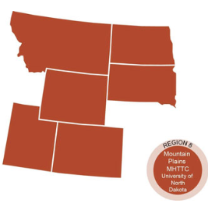
Mountain Plains Mental Health Technology Transfer Center
Provide free training, resources, and technical assistance to individuals serving persons with mental health disorders, especially those with serious mental illness or a serious emotional disturbance.
Funded by the Substance Abuse and Mental Health Services Administration (SAMHSA)

Slide 4
Rural Focus
Address rural barriers around mental healthcare accessibility, availability, and acceptability in Region 8. The Mountain Plains MHTTC will develop and provide training and technical assistance that:
Reaches students, entry level professionals, and established providers in rural communities.
Highlights the appropriate use of technologies for the existing rural mental health workforce.
Covers effective practice in rural communities. Many established models for delivery of behavioral healthcare do not account for the unique challenges presented by rural communities.
https://mhttcnetwork.org/centers/mountain-plains-mhttc/home

Slide 5
Disclosure
This presentation was prepared for the Mountain Plains Mental Health Technology Transfer Center (TTC) Network under a cooperative agreement from the Substance Abuse and Mental Health Services Administration (SAMHSA).
At the time of this presentation, Elinore F. McCance-Katz, served as SAMHSA Assistant Secretary. The opinions expressed herein are the views of Shawnda Schroeder, Thomasine Heitkamp, and Matt Perdue and do not reflect the official position of the Department of Health and Human Services (DHHS), SAMHSA. No official support or endorsement of DHHS, SAMHSA, for the opinions described in this presentation is intended or should be inferred.

Slide 6
Who are our U.S. Producers?

Slide 7
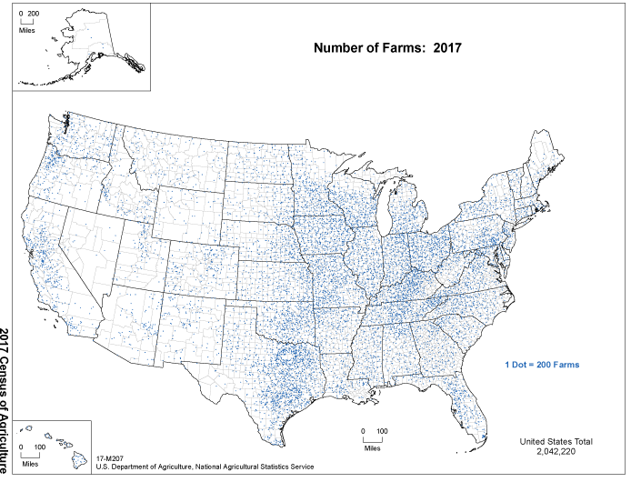
Notes:
2.04 million farms and ranches (down 3.2% from 2012) with roughly 3.4 million farmers.

Slide 8
Farming Populations: 2017 Ag Census
2.04 million farms and ranches (down 3.2% from 2012) with roughly 3.4 million farmers.
Male: 2.17 million
Female: 1.23 million
96% of farms and ranches are family owned.
75.4% of farms have internet access.
Average age: 57.5 (continual increase since 1980).
https://www.nass.usda.gov/Quick_Stats/CDQT/chapter/1/table/52/state/US/year/2017

Slide 9
Farming Populations: 2017 Ag Census
One in four producers is a beginning farmer with 10 or fewer years of experience.
56% of all farms have at least one female decision maker.
Percent of producers where farming is the primary occupation is highest in the Midwest.
NEED to recognize regional differences in order to develop resources and provide care.
Notes:
recognize regional differences in order to develop resources and provide care. Next slides present the variable demographics of farm communities across the U.S.

Slide 10
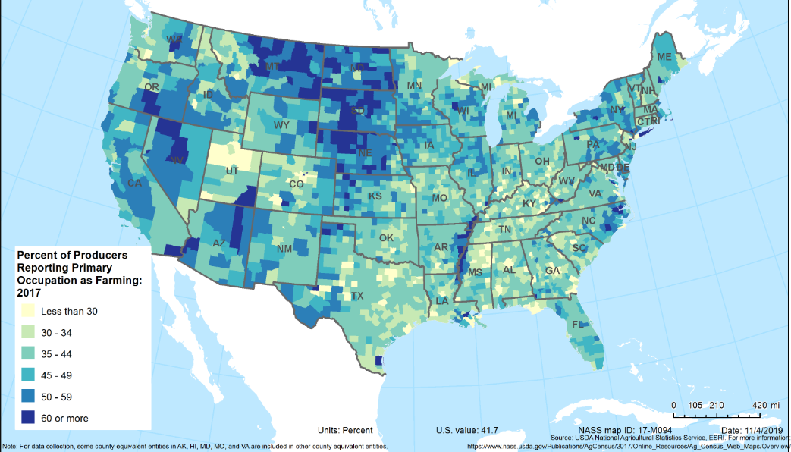
% Reporting Farming as Primary Occupation, 2017
Source: USDA National Agricultural Statistics Services, ESRI: nass.usda.gov/Publications/AgCensus/2017/Online_Resources/Ag_Census_Web_Maps/index.php
Notes:
Farming is a primary occupation more commonly in the upper Midwest and less common in the southeast

Slide 11
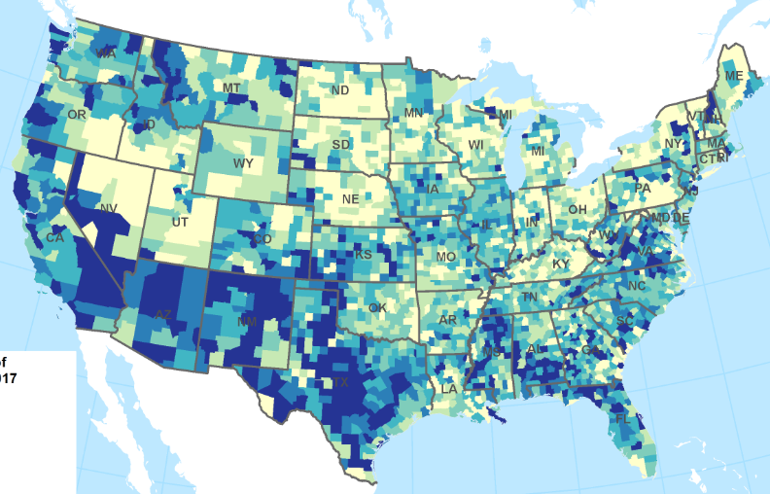
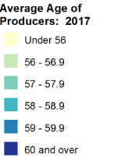
Average Age of Producers, 2017
Source: USDA National Agricultural Statistics Services, ESRI: nass.usda.gov/Publications/AgCensus/2017/Online_Resources/Ag_Census_Web_Maps/index.php
Notes:
Older producers are in the south and southwest – younger in the Midwest

Slide 12
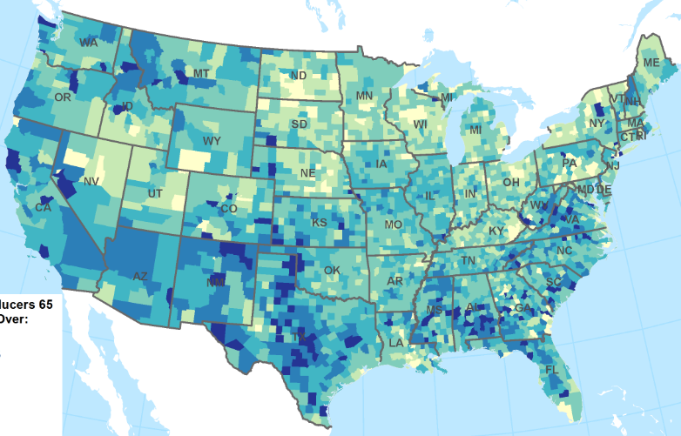
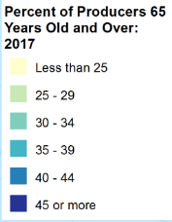
% of Producers 65 or Older, 2017
Source: USDA National Agricultural Statistics Services, ESRI: nass.usda.gov/Publications/AgCensus/2017/Online_Resources/Ag_Census_Web_Maps/index.php
Notes:
Southeast and south west have greater proportion of producers age 65 and older

Slide 13
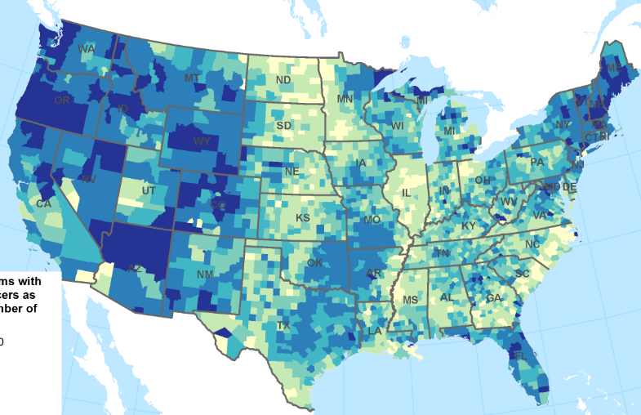
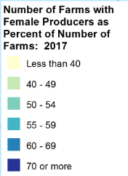
Female Producers, 2017
Source: USDA National Agricultural Statistics Services, ESRI: nass.usda.gov/Publications/AgCensus/2017/Online_Resources/Ag_Census_Web_Maps/index.php
Notes:
Female producers more common on the coasts – also were more likely to have smaller profits

Slide 14
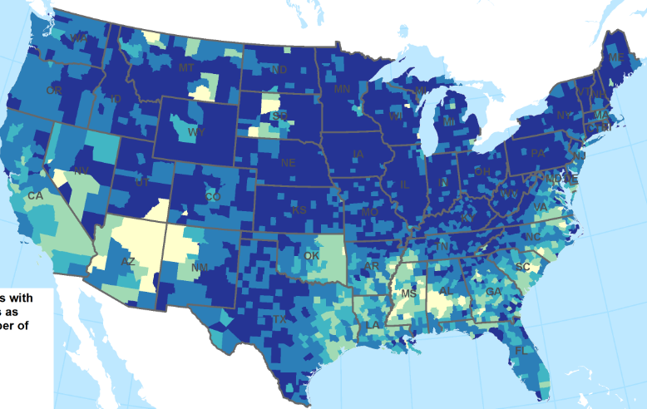
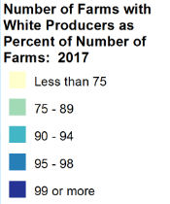
White Producers, 2017
Source: USDA National Agricultural Statistics Services, ESRI: nass.usda.gov/Publications/AgCensus/2017/Online_Resources/Ag_Census_Web_Maps/index.php
Notes:
Southwest is larger proportion of Hispanic, Latino and Spanish origin, and the south east is African American

Slide 15
Understanding Farm Stress

Slide 16
Defining “Farm Stress”
Majority of resources conceptualize as financial (it is not, though finance is a contributing factor).
Farm stress can be experienced by the farmer/producer, agricultural workers, and farm families.
Farm stress is the stress experienced by farmers and their families as a result of the unique agricultural work environment.

Slide 17
Contributing Factors
Uncertainty and lack of control over outside forces:
Weather and natural disasters.
Tariffs and commodity pricing.
Financial pressure among owners.
Debt load, equipment repairs or upgrades, product value.
Extreme outdoor work conditions.
Fatigue or excessive workload.
Stigma around help-seeking, and lack of mental health resources.
Notes:
Mental health professionals point to the nature of farming as one likely cause — it is a business largely influenced by factors that are beyond farmers’ control, including weather, disease, pests, prices and interest rates, and which can come and go without warning. Farmers can be isolated, geographically and socially, since they often work alone.

Slide 18
Contributing Factors
Access to Relevant Care
Lack of behavioral health workforce in rural areas.
Lack of preparation for primary care providers on the topics of:
Depression vs. toxic reaction to farm chemicals.
Agricultural medicine (currently six textbooks).
Agricultural behavioral health (no textbooks).

Slide 19
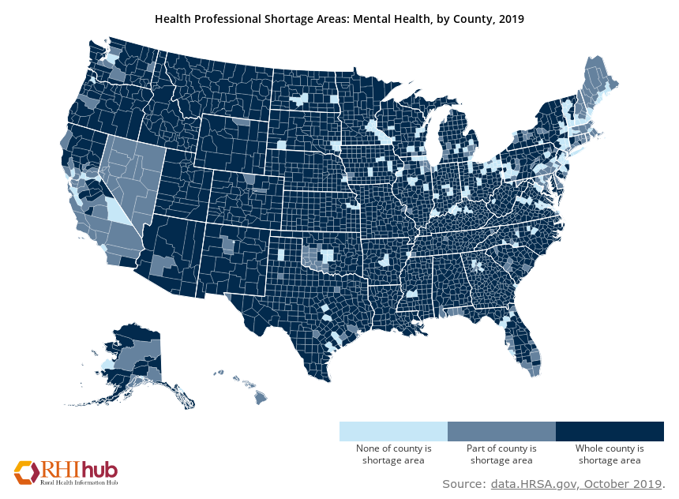

Slide 20
Contributing Factors
Not all farm stress is the same.
Farmers/owners experience variable stress compared to agricultural workers or a seasonal workforce.
One region is facing drought while other regions experience flooding.
The daily stress of milk production or the seasonal stress of crop management or calving.

Slide 21
Physical Symptoms of Farm Stress
Muscles are tighter or tense.
Aching head.
Upset stomach.
Shortness of breath.
Excessively low energy or fatigue.
High blood pressure.
Increased heart rate.
Poor sleep patterns.
Increase in illness.
Ulcers.
Notes:
https://fyi.extension.wisc.edu/agsafety/stress/stress-and-depression/
https://www.ag.ndsu.edu/publications/kids-family/farm-stress-fact-sheet-stress-symptoms
https://fyi.extension.wisc.edu/farmstress/2019/06/22/farm-stress-decision-makingduring-challenging-times/

Slide 22
Behavioral and Emotional Symptoms
Low self-esteem.
Memory loss.
Lack of concentration.
Inability to make decisions.
Sadness, depression, anger, bitterness.
Loss of spirit and/or humor.
Acting out.
Withdrawal from friends and family.
Increased irritability.
Anxiety.
Drastic change in eating habits.
Using substances or increasing use (to include tobacco or alcohol).
Difficulty controlling emotions.
Impatient.
Notes:
https://www.canr.msu.edu/resources/how-stress-affects-you

Slide 23
Signs of Clinical Depression
If these symptoms last for longer than two weeks, interfere with your work, or if feeling suicidal seek help.
Persistent sad, anxious or “empty” mood.
Feelings of hopelessness, pessimism.
Feelings of guilt, worthlessness, helplessness.
Loss of interest or pleasure in hobbies and activities.
Decreased energy, fatigue, being “slowed down”.
Difficulty concentrating, remembering, making decisions.
Difficulty sleeping, early-morning awakening or oversleeping.
Appetite and/or weight changes.
Thoughts of death or suicide, suicide attempts.
Restlessness, irritability.
Persistent physical symptoms.
National Institute of Mental Health (2016). Depression. Retrieved from https://www.nimh.nih.gov/health/topics/depression

Slide 24
Two Question Self-Assessment
If yes to either of these questions, consider talking to your health care provider about future assessment
During the past two weeks, have you often been bothered by feeling down, depressed, or hopeless?
During the past two weeks, have you often been bothered by little interest or pleasure in doing things?

Slide 25
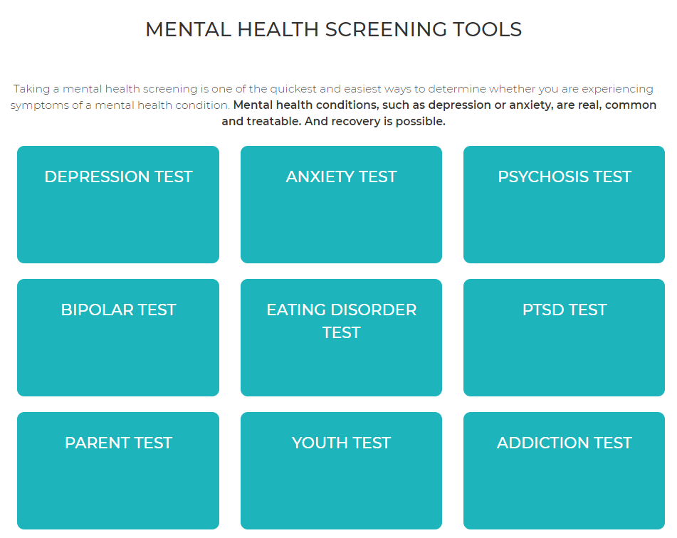
Additional self-assessment tools available through Mental Health America https://screening.mhanational.org/screening-tools

Slide 26
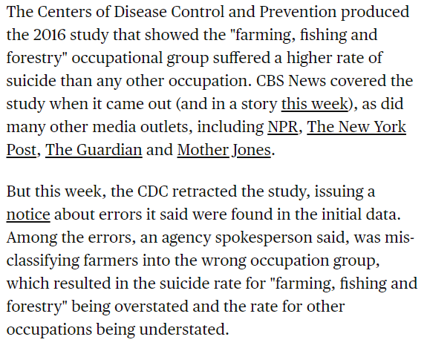
Farm Stress Suicides
Media reported suicide risk for farmers higher than any other occupation based on CDC report:
Data were retracted and revised.
Notes:
https://newfoodeconomy.org/farmer-suicide-crisis-cdc-study/
https://www.cbsnews.com/news/cdc-retracts-study-that-found-farmers-had-highest-suicide-rates-of-any-occupation/
https://retractionwatch.com/2018/11/15/in-a-first-u-s-cdc-retracts-replaces-study-about-suicide-risk-in-farmers/

Slide 27
Notes about the Revised CDC Data
Only provides a snapshot for the years 2012 and 2015.
Limited to 17 states that participated in the National Violent Death Reporting System.
Those 17 states represent about ¼ of our nation’s farms.
The “Triple-F” major occupational group (farming, fishing and forestry) includes agricultural workers but doesn’t include self-employed farmers and ranchers or agricultural managers.
Farmers and ranchers are included in the “Management” major group, along with CEOs, elementary principals, and other management.

Slide 28
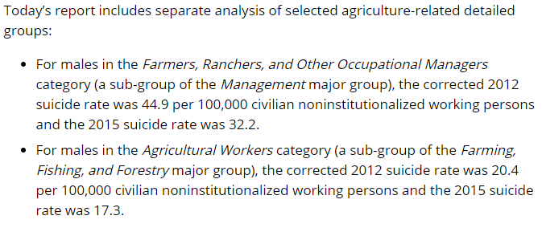
Updated CDC Report
https://www.cdc.gov/media/releases/2018/p1115-Suicide-american-workers.html

Slide 29
Farm Suicide Rates Still High
No longer number one occupation for suicide. All males 2015, top three were:
Construction and extraction,
Arts, design, entertainment, sports, and media, and
Installation, maintenance, and repair.
No increase in suicide rate among farmers from 2012 to 2015.
Suicide rate STILL much higher for famers than for all working aged adults.

Slide 30
Farm Suicide Rates Still High
From 2000 to 2015, the U.S. suicide rate among working aged (16–64 years) adults increased 34% from 12.9 per 100,000 population to 17.3.
For males in the Farmers, Ranchers, and Other Occupational Managers category the 2012 suicide rate was 44.9 per 100,000 civilian working persons compared to 32.2 in 2015.
For males in the Ag. Worker category (a sub-group of the “Triple F” major group), the 2012 suicide rate was 20.4 per 100,000 working persons compared to 17.3 in 2015.
https://www.cdc.gov/media/releases/2018/p1115-Suicide-american-workers.html

Slide 31
Warning Signs: Suicide
Talk of suicide and history of suicide in family.
Increase use of drugs and alcohol.
Giving away possessions.
Obtaining firearms.
Withdrawal from family.
Aggressive and disruptive behavior.
Stop taking medications.
Preoccupation with death.
Notes:
https://extension.umaine.edu/agrability/wp-content/uploads/sites/15/2019/07/Mental-Health-Resource.pdf

Slide 32
Public Response to Farm Stress and Available Resources

Slide 33
Resources
Suicide hotline: 1-800-273-TALK or 1-800-SUICIDE
suicidepreventionlifeline.org
Avera farm stress hotline: 1-800-691-4336
FarmAid: 1-800-FARM-AID
National Farmers Union: nfu.org
National Farmers Union: Farm Crisis Center: farmcrisis.nfu.org
Rural Advancement Foundation International: rafiusa.org
AgriSafe Network: www.agrisafe.org

Slide 34
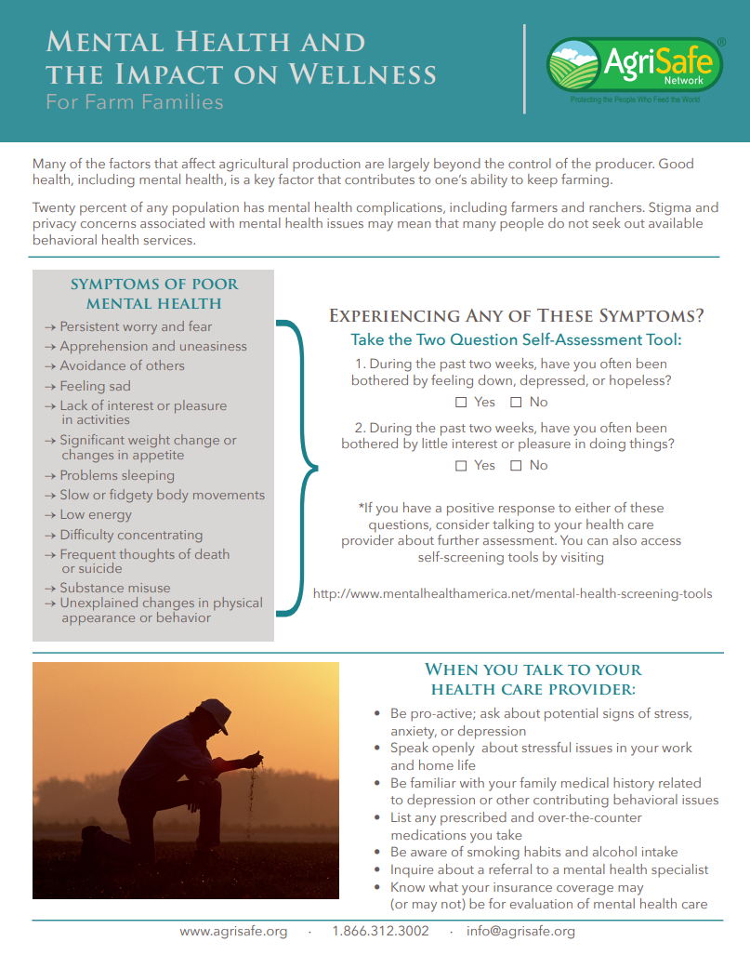
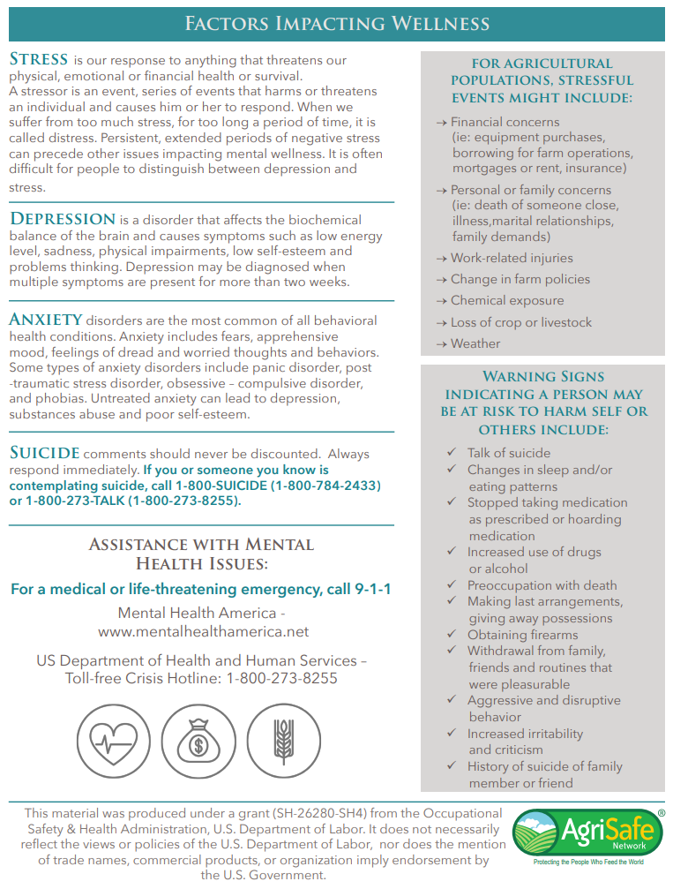
https://extension.umaine.edu/agrability/wp-content/uploads/sites/15/2019/07/Mental-Health-Resource.pdf

Slide 35
Resources: Extension Offices
State and County Extension Offices add behavioral health resources and products on farm and family stress.
Provide warning signs of stress or risk of suicide.
Tips for managing stress.
Financial planning tools.
Tips for families and signs of family stress.
Hotlines or chat resources.
Videos of coping, managing, and warning signs.

Slide 36
https://extension.sdstate.edu/news/sdsu-extension-supports-farmers-ranchers-during-stressful-time

Slide 37
https://extension.usu.edu/news_sections/home_family_and_food/five-tips-for-busting-stress

Slide 38
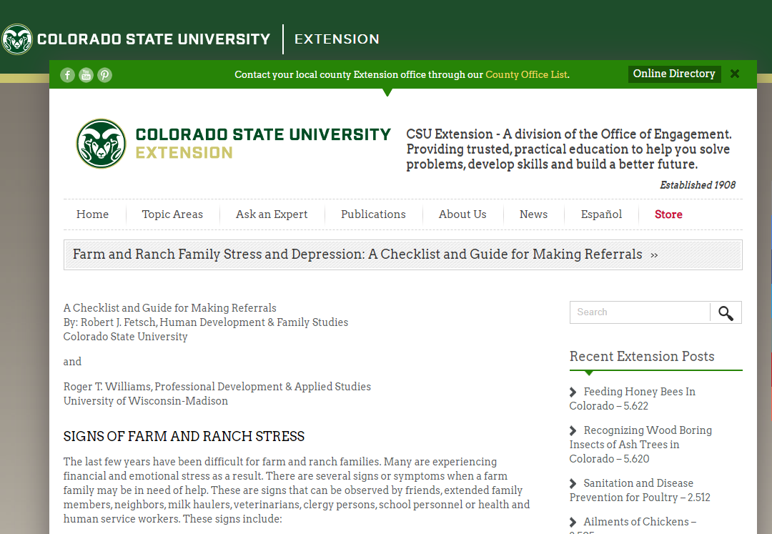
https://extension.colostate.edu/disaster-web-sites/farm-and-ranch-family-stress-and-depression-a-checklist-and-guide-for-making-referrals/

Slide 39
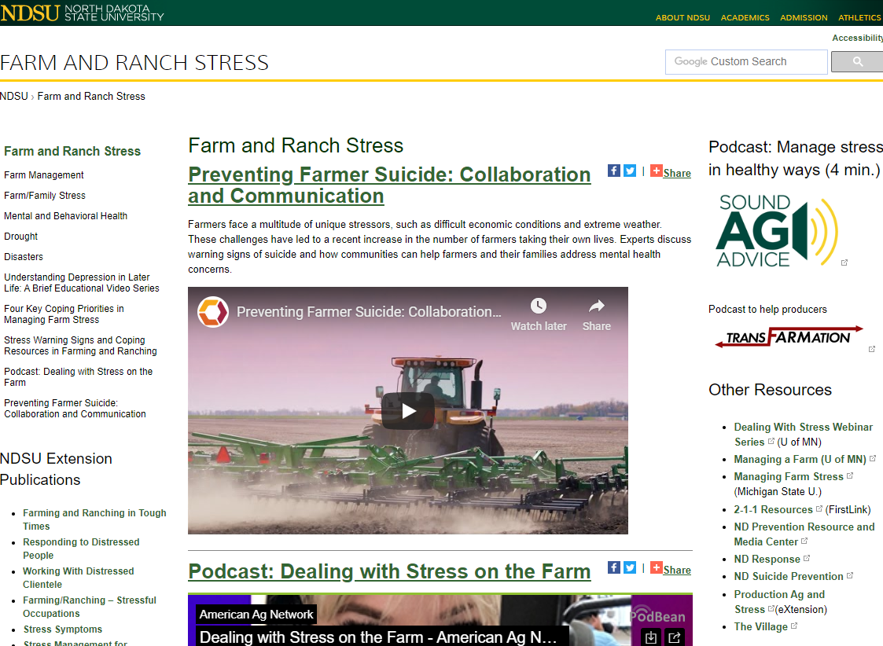
https://www.ag.ndsu.edu/farmranchstress

Slide 40
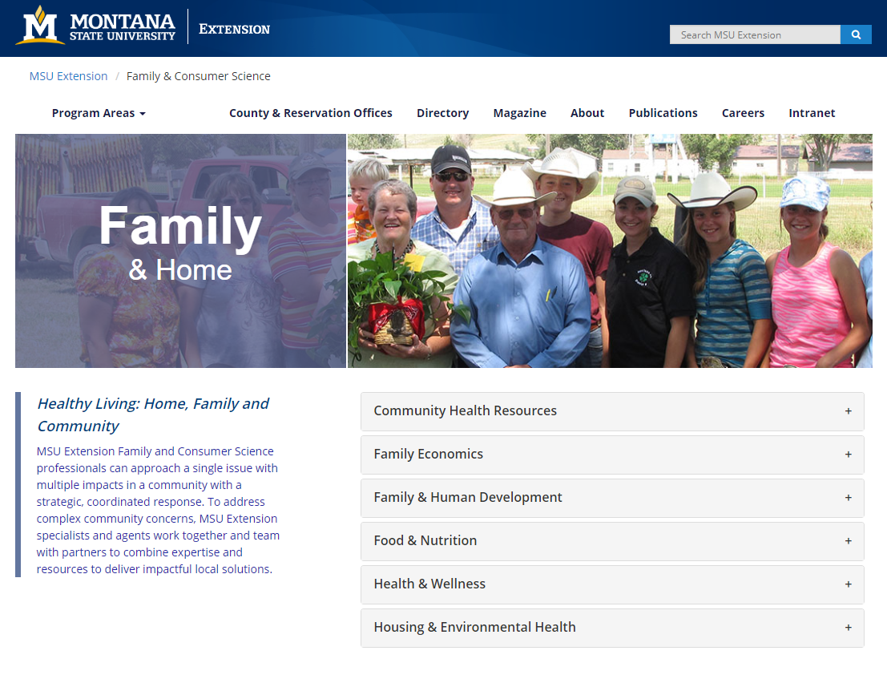
https://www.msuextension.org/family/

Slide 41
https://extension.umn.edu/rural-stress

Slide 42
https://www.canr.msu.edu/managing_farm_stress/

Slide 43
https://www.apa.org/members/content/farmer-mental-health

Slide 44
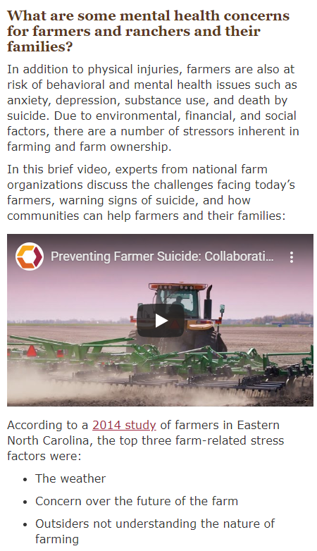
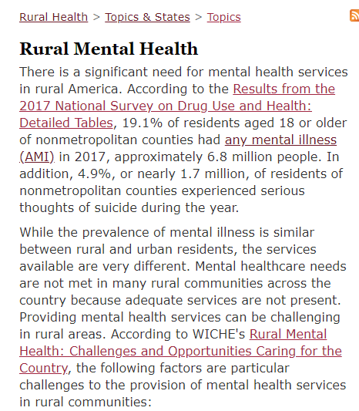
https://www.ruralhealthinfo.org/topics/agricultural-health-and-safety#mental-health

Slide 45
Farm and Ranch Stress Assistance Network
Funded through the USDA, the purpose of FRSAN is to establish a network that connects individuals who are engaged in farming, ranching, and other agriculture-related occupations to stress assistance programs. The establishment of a network that assists farmers and ranchers in time of stress can offer a conduit to improving behavioral health awareness, literacy, and outcomes for agricultural producers, workers and their families.
https://nifa.usda.gov/program/farm-and-ranch-stress-assistance-network-frsan

Slide 46
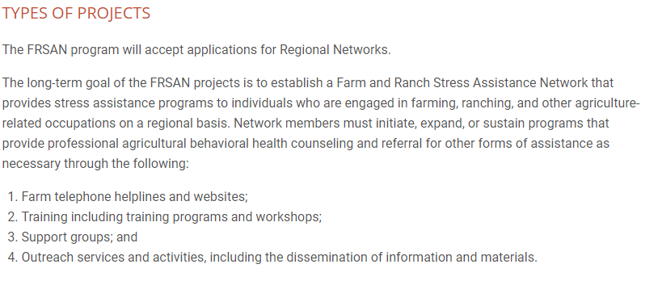

Slide 47
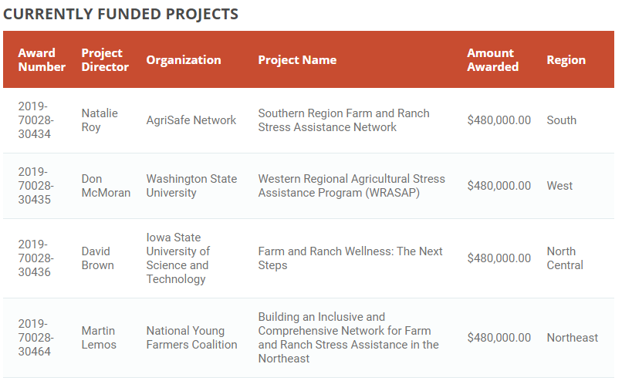
Currently Funded Projects
https://nifa.usda.gov/program/farm-and-ranch-stress-assistance-network-frsan

Slide 48
Gaps and Unmet Needs
Suicide hotlines are not farm-specific.
Lack of behavioral health providers.
Stigma and low mental health literacy.
Resources are not meeting farmers where they are at.
Primary care and mental health providers are not all prepared or trained to meet specific mental health needs of farm producers and their families.
Existing resources are hard to find and muddied in resources for financial stress and assistance.

Slide 49
Moving Forward
Fund local solutions and provide help where they are.
Prepare community members and families to identify signs of farm stress, and offer coping strategies and referral resources.
Develop farm population specific resources (ex. suicide hotlines or chats specifically for farm populations).
Work with farmers regionally to identify primary needs, and how best to share resources.
Train counselors on farm stress.
Develop local support groups.

Slide 50
Moving Forward
Provide social emotional supports for family members.
On the spot access to assistance (weekends and evenings).
Support development of integrated care approaches.
Host community events.
Training for financial advisors/bankers who work with farm communities.
Provide education on talk radio and other media that farmers listen to.
Talk openly about stigma.
Engage faith-based communities.

Slide 51
Upcoming Trainings from Mountain Plains MHTTC
Economics of Farm Stress, December 9, 12:00 pm – 1:00 pm CT
Hands on Tools and Strategies to Assist Providers Working with Farmers, December 16
Farm Stress and Compassion Fatigue, Early 2020, TBD
Farm Families Mental Health: Faith Based Responses, Early 2020, TBD
Subscribe to our e-mail list to be notified of future trainings and resources: https://mhttcnetwork.org/centers/mountain-plains-mhttc/subscribe

Slide 52
Contact Information
Shawnda Schroeder
Research Associate Professor
Center for Rural Health
Shawnda.Schroeder@UND.edu
Thomasine Heitkamp
Professor and Program Director
Mountain Plains MHTTC and ATTC
Thomasine.Heitkamp@UND.edu
Matt Perdue
Agricultural & Policy Strategist
North Dakota Farmers Union
mperdue@NDFU.org

