Slide 1


Economics of Farm Stress
Presented by
David Flynn, PhD
Department Chair, Professor, University of North Dakota Department of Economics and Finance

Slide 2
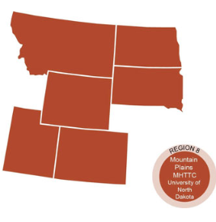
The Mountain Plains Mental Health Technology Transfer Center
Provides training and technical assistance on evidence based practices to the mental health providers of Region 8 (North Dakota, South Dakota, Montana, Wyoming, Colorado, and Utah). We are funded by the Substance Abuse and Mental Health Service Administration (SAMHSA)
Co-hosted by:
The University of North Dakota
and
The Western Interstate Commission for Higher Education (WICHE)

Slide 3
Disclaimer
This presentation was prepared for the Mountain Plains Mental Health Technology Transfer Center (TTC) Network under a cooperative agreement from the Substance Abuse and Mental Health Services Administration (SAMHSA). All material appearing in this presentation, except that taken directly from copyrighted sources, is in the public domain and may be reproduced or copied without permission from SAMHSA or the authors. Citation of the source is appreciated. Do not reproduce or distribute this presentation for a fee without specific, written authorization from the Mountain Plains Mental Health Technology Transfer Center. For more information on obtaining copies of this presentation, call 701-777-6367.
At the time of this presentation, Elinore F. McCance-Katz, served as SAMHSA Assistant Secretary. The opinions expressed herein are the views of Dr. David Flynn, Ph.D. and do not reflect the official position of the Department of Health and Human Services (DHHS), SAMHSA. No official support or endorsement of DHHS, SAMHSA, for the opinions described in this document is intended or should be inferred.

Slide 4
Overview

Slide 5
“Farm stress is the stress experienced by farmers and their families as a result of the unique agricultural work environment.”

Slide 6
“Unique aspects”
Many farming/ranching concerns are a blend of family and business.
  This can be very different from wage labor or other industries.
  There are often inheritance aspects to consider with family farms that impact the viability of the farm as a business.
Most farming/ranching activity occurs in more rural areas.
  This requirement can introduce other factors that increase farm stress.
  This compounds issues of access to services such as counseling and general medical service.

Slide 7
General Problem
There seems to be a conflation of what farm stress is, with what causes farm stress.
Farm stress related to financial & economic concerns but is not exactly the same.
Economic stresses exist in all industries and occupations.
At a very real level it is unlikely you can ever completely get rid of it.
However we need to help people better manage these issues as they add to human costs.

Slide 8
Outline
An overview of the economic landscape starts with a brief look at the big picture trends in agriculture/ranching.
Against this backdrop we can move on to the issues surrounding commodity production and pricing.
There is the added issue of economic policy, which of late introduced a new source of volatility into agricultural production.
A significant discussion point, along the way or at the end, will be ways the economic issues can be seen as potential leading indicators for farm stress.

Slide 9
The reason for this approach
When we boil stress down to purely financial concerns it ends up making it seem like solving price problems removes the issue.
The nature of agricultural production, and our working definition of stress, make price policy, at best, a partial solution.
For example, if we remove price concerns there will still be farm stress, and it will possibly be more difficult to identify sources and solutions.

Slide 10
Agriculture Economy in Numbers

Slide 11
Declining and concentrating
What we see is fewer individuals employed in agriculture over a long period of time.
  Economics of scale (+)
  Productivity enhancing technology (+/-)
  Changes in demand for products (?)
At the same time, the concentration of people and production is changing as well.

Slide 12
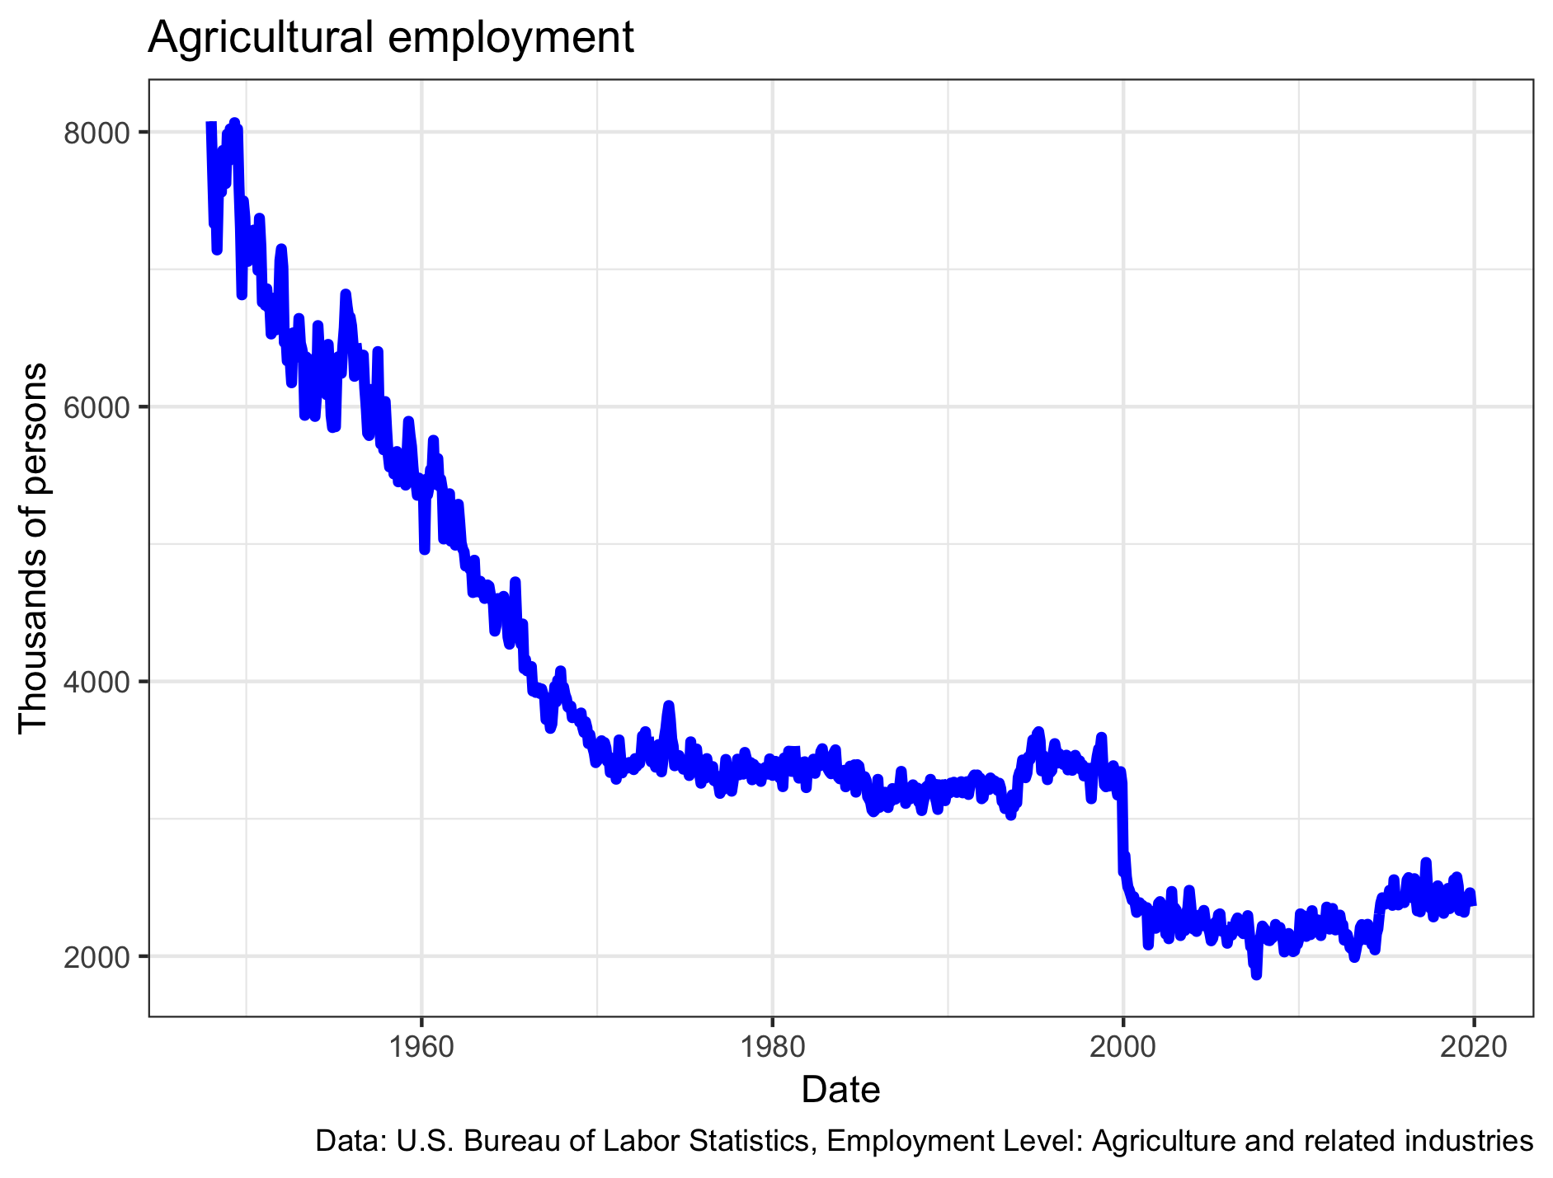
Over time fewer people in farming

Slide 13
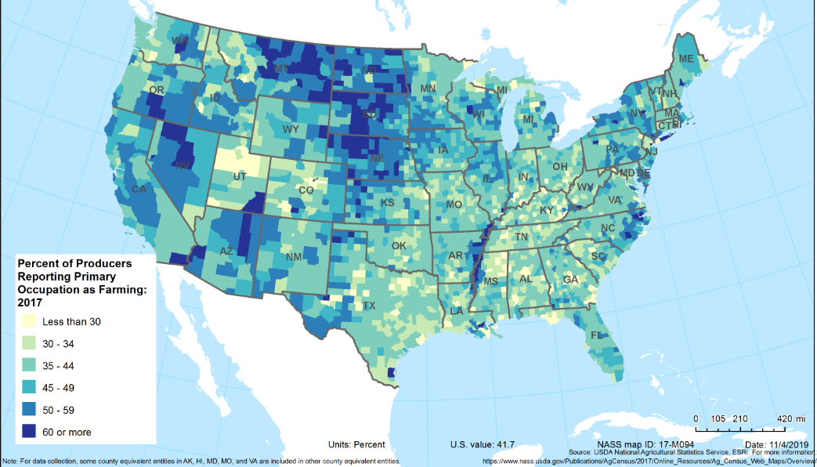
% Reporting Farming as Primary Occupation, 2017
Source: USDA National Agricultural Statistics Services, ESRI: nass.usda.gov/Publications/AgCensus/2017/Online_Resources/Ag_Census_Web_Maps/index.php

Slide 14
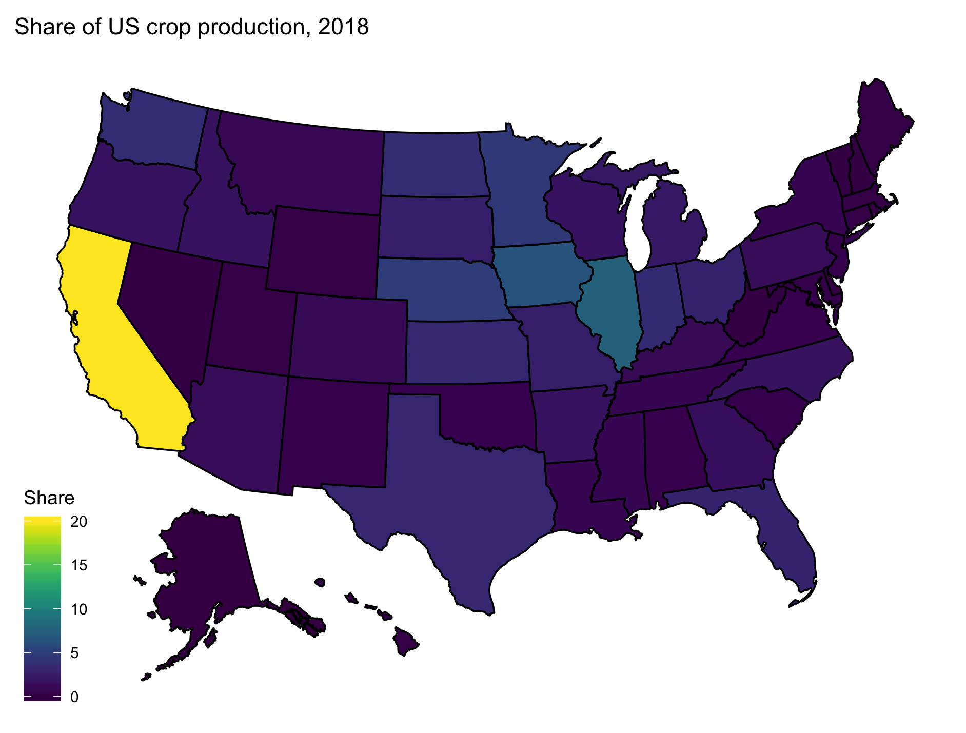
US Crop Production Share by State

Slide 15
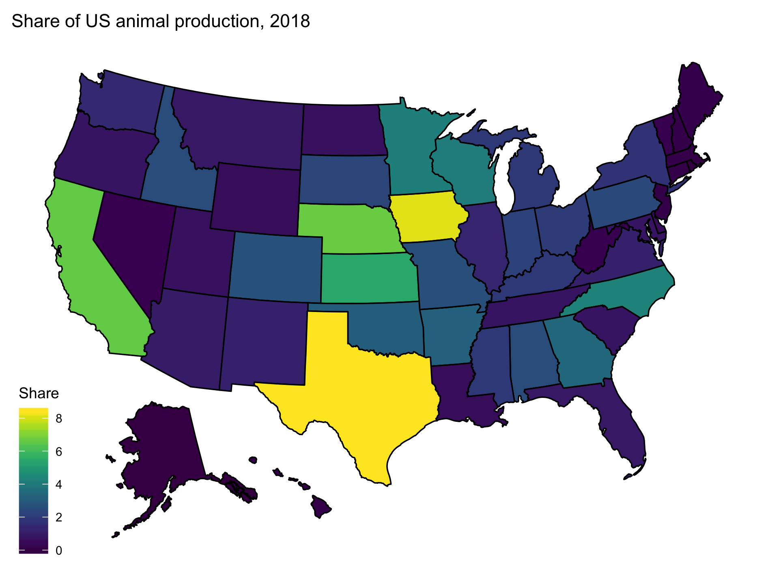
US Animal Production Share by State

Slide 16
Smaller but not less important

Slide 17
Agriculture impacts are high
Ag ranks fourth in overall impact after real estate, education services, and finance and insurance.
Ag forms a keystone to local economies which can add mental pressure to producers as they may feel responsible for local economic performance.

Slide 18
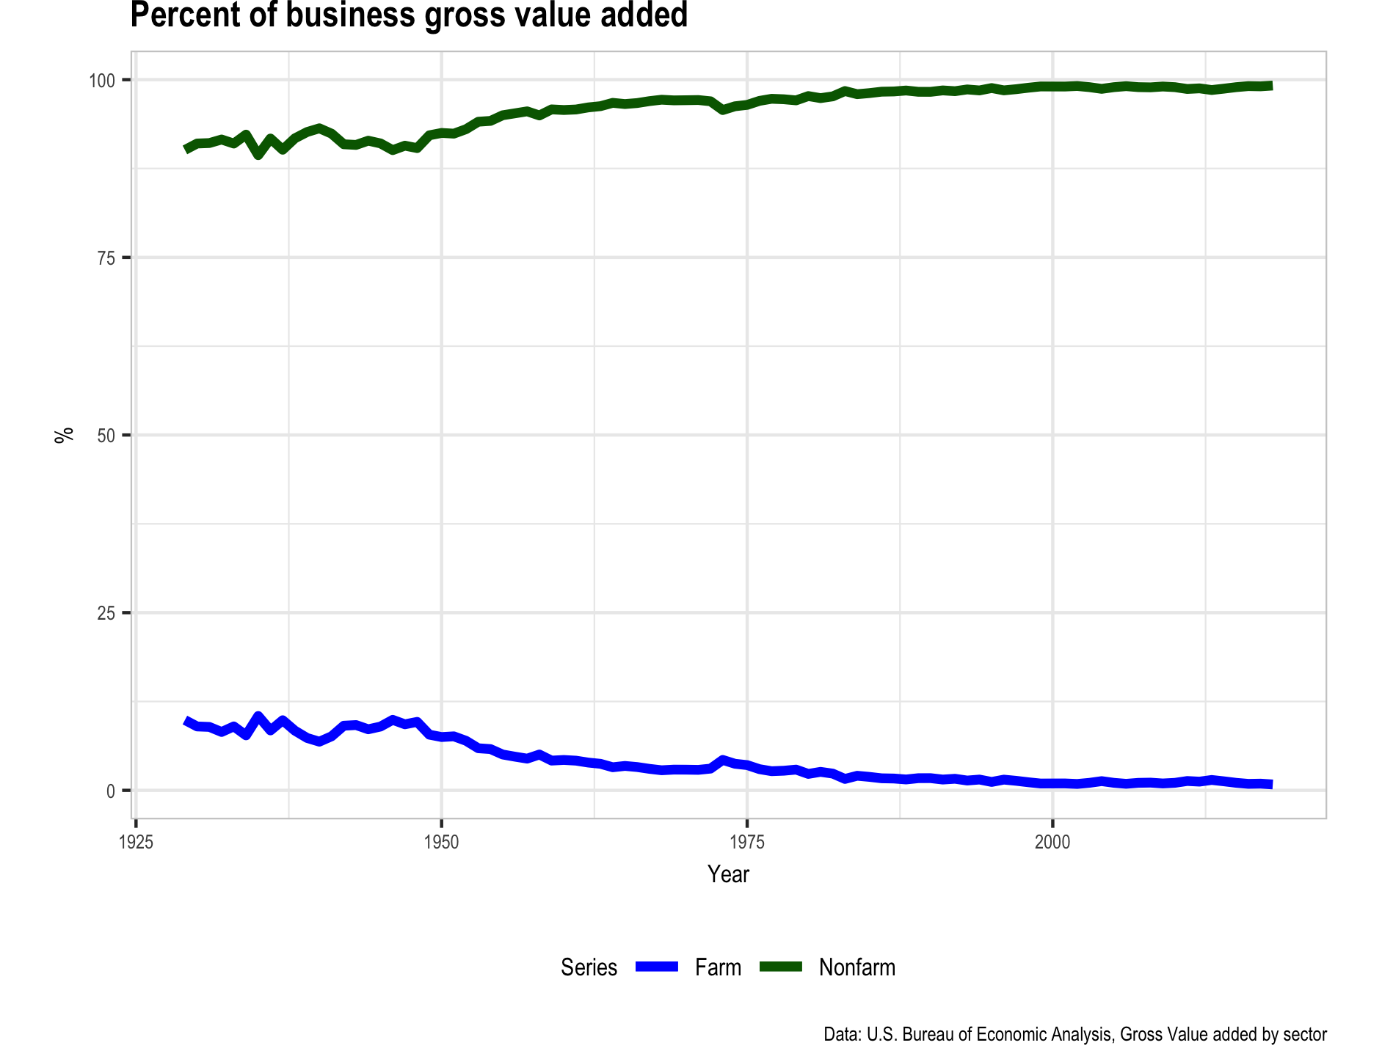
Percent of business value added from farm

Slide 19
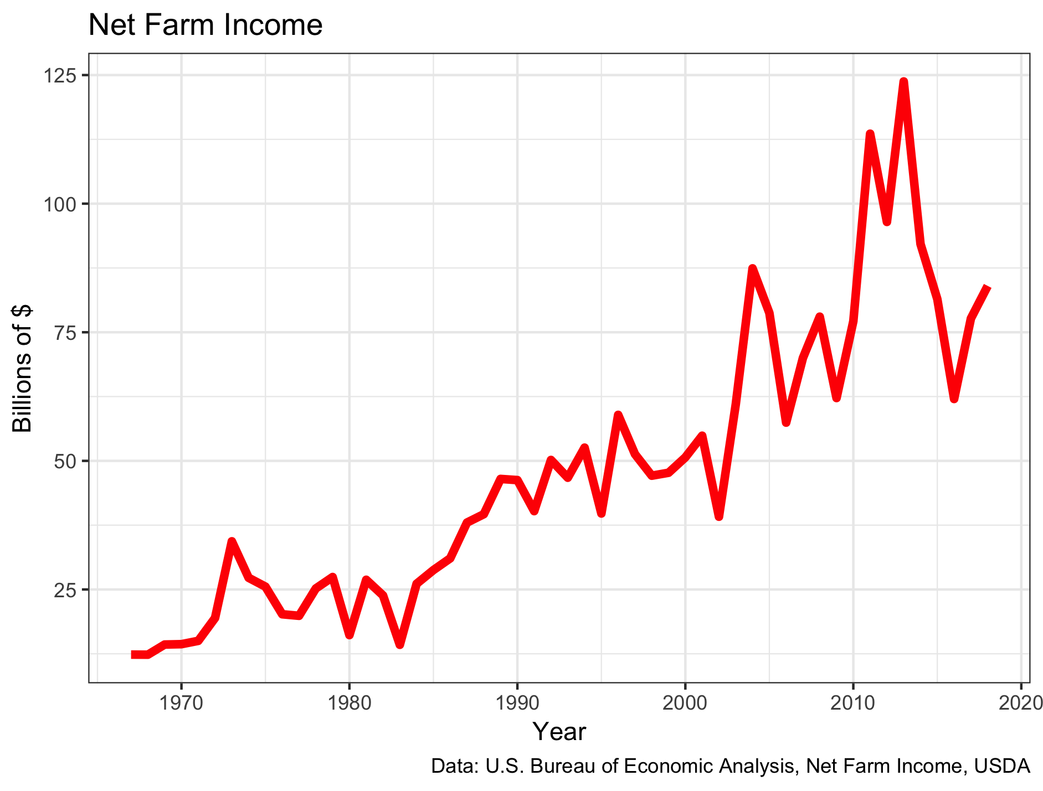
Net Farm Income

Slide 20
Focus beyond the numbers
The fact is that for almost all these graphs you observe ups and downs.
  While these are true of all industries the volatility in agriculture can be more problematic.
That volatility can be an enormous problem and a source of stress too.
  Especially if you are a marginal firm or in a product not doing as well.
The nature of farm economic management and issues require responses and reactions as these different activities unfold around them.

Slide 21
Farm management issues and Farm Stress
Debt levels
Input prices
Output prices
Market access
Consumer preferences
Labor supply
Contract issues related to all of the above.

Slide 22
Farm Debt Distribution

Slide 23
Farm Asset Distribution

Slide 24
Notable balance sheet items
Notice that real estate shows up in both debts and assets.
  Typically the biggest asset, but also often leveraged highly.
Few financial assets.
  Not a very liquid balance sheet.
  Retirement problems loom?

Slide 25
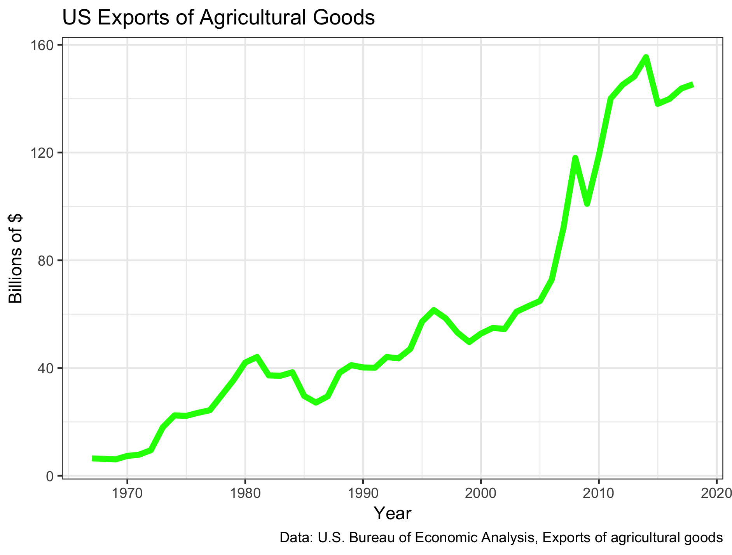
US Agricultural Exports, 1967-2018

Slide 26
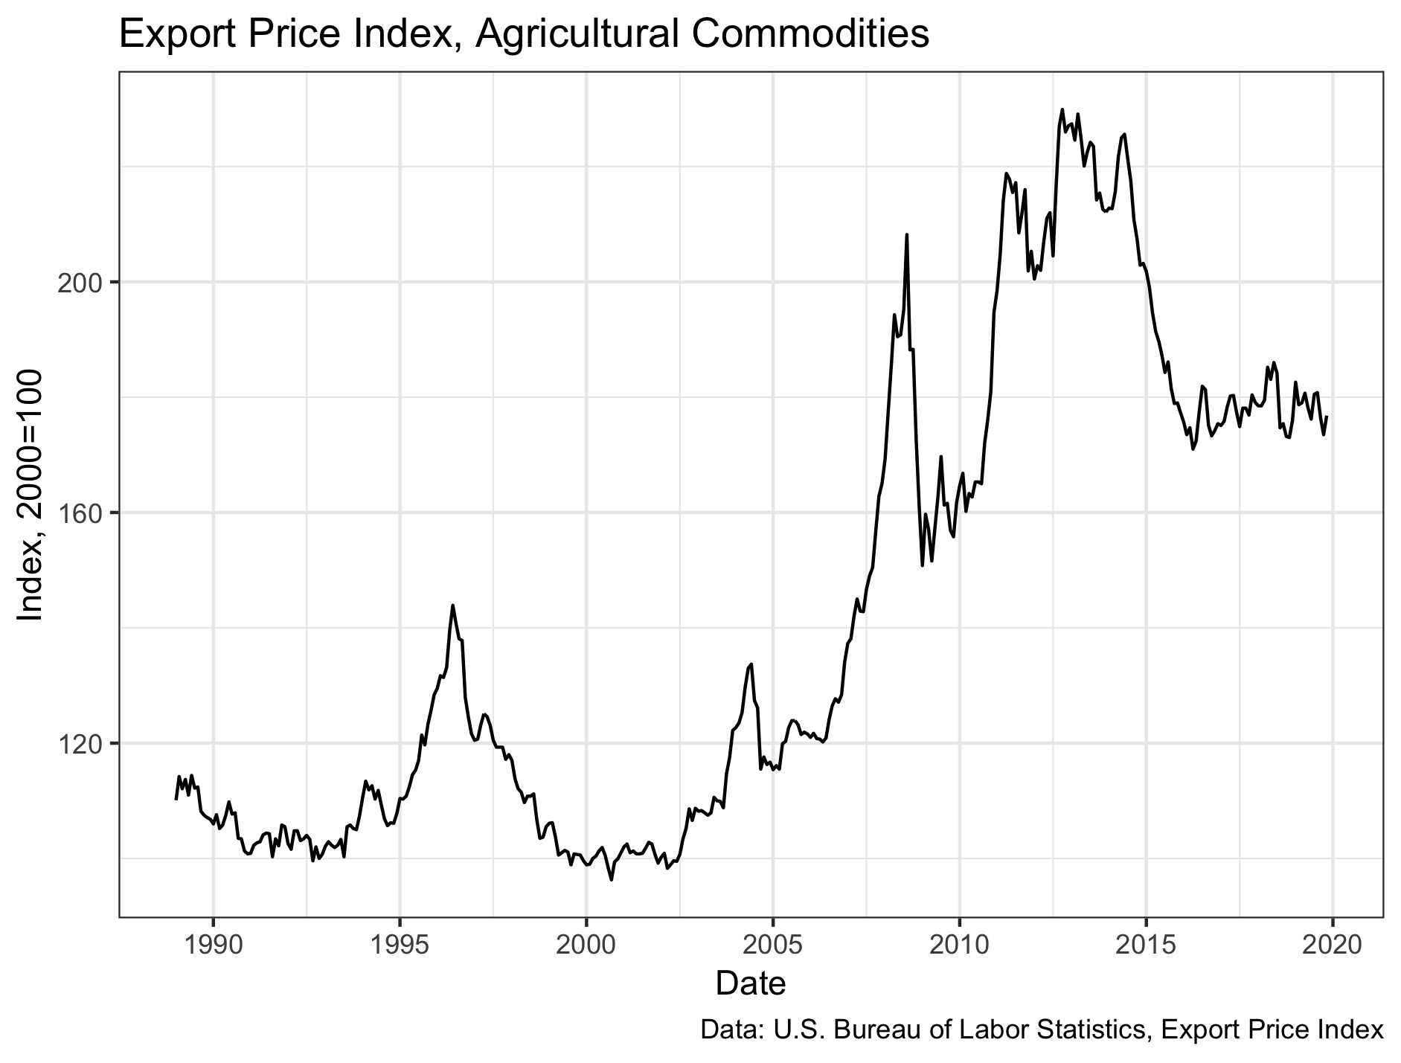
Export Prices

Slide 27
Export driven?
The value of export markets to agriculture is quite high.
  Somewhat dependent on products.
  Pork and soybeans focus overseas for example.
  Almonds are more domestic.
Exports impacted significantly by economic policy.
  Highly variable and depends on attitudes in multiple countries.

Slide 28
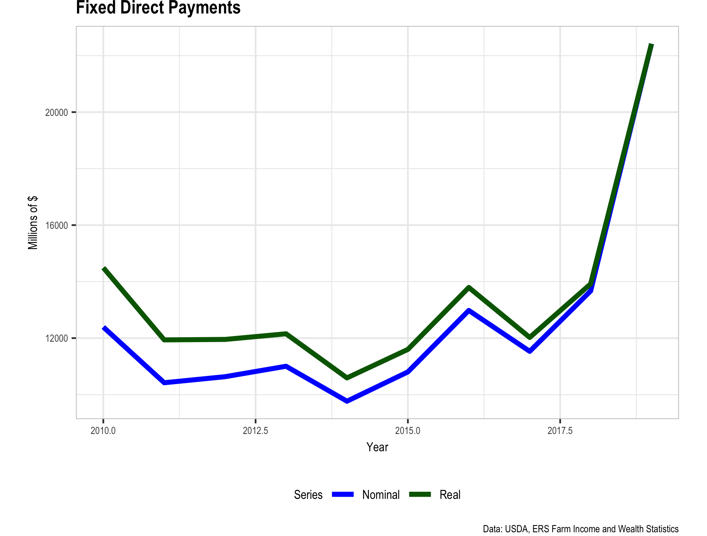
Government Supports

Slide 29
Mixed blessing
Direct supports are good and bad.
High support should offset losses.
The need for such drastic injections of support speaks to the level of the problem.
Many farm problems now sourced in the political and policy arena which is the next issue.

Slide 30
Economic Policy Changes

Slide 31
Policy changes are normal
As times and circumstances change policy should change too.
The last 20-25 years of US international trade policy targeted:
  Freer trade,
  Reduced trade barriers
  Expanded market access (both inputs and outputs)
To some extent this changed with President Trump, though agriculture was not his focus.

Slide 32
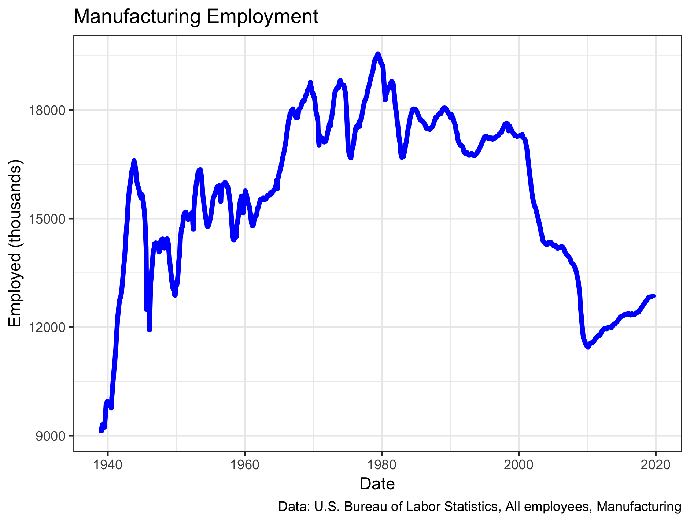
Manufacturing ”losses”

Slide 33
The policy landscape
There was a significant decline in manufacturing employment since 2000.
Rather than view this as a natural economic event or evolution towards services and information economy activities there was a thought to return to that with active trade intervention.
  Tariffs on friends and rivals alike.

Slide 34
Policy response
The reaction of trade partners was predictable
  Retaliation
Countries like China retaliated against agriculture, specifically soy beans and pork producers.
  These industries are

Slide 35
Economics & Farm Stress:
How to discuss the combination

Slide 36
Level, Change, and Volatility
While it is conventional to discuss prices received and prices paid as a source of financial problems there is another way to think about this.
Regardless of commodity or product, farm or ranch, there are three aspects that generate economic or financial pressures.
  The level of prices
  The change in prices
  The volatility of prices
There are common questions associated with each of these three factors.

Slide 37
Prices
Highly variable by the commodity.
There are two sets of prices about which farmers and ranchers are, or should be, concerned.
The first is the prices they receive for their products.
  What is the demand for the goods they produce?
The prices they pay on inputs, including interest, is equally of concern.
  The cost of doing business can change and is an important financial variable.

Slide 38
Q1: Can I keep going at these prices?
We can make generalizations about price but it really can be very idiosyncratic to a specific farm/ranch.
  Did they lock in favorable prices on either side of their production process?
  Is their product market growing?
  Are government policies helping or hurting?

Slide 39
Q2: Can I make it in such a volatile market?
Think of volatility as the nature and speed of changes, especially reversals, in the direction of prices.
Essentially we are asking how well the farmer/rancher anticipates the future.

Slide 40
Physical Symptoms of Farm Stress
Muscles are tighter or tense.
Aching head.
Upset stomach.
Shortness of breath.
Excessively low energy or fatigue.
High blood pressure.
Increased heart rate.
Poor sleep patterns.
Increase in illness.
Ulcers

Slide 41
Productivity issues
The physical toll of stress reduces farm productivity with knock on effects into the entirety of the local economy.
  Subpar performance creates financial problems for the farm enterprise.
  Subpar performance creates economic problems in the local economy too.
These factors contribute to further economic stress and likely farm stress too.

Slide 42
Conclusions
Economics on its own seldom leads to definitive conclusions.
Adding in the subjective elements of mental health and stress does not enhance the ability to be definitive.
There is more data we could examine but it will not enhance clarity.
However, it is clear that economic factors have a clear connection to farm stress and be a significant contributor.
Questions?

Slide 43
Economics of Farm Stress
David Flynn, PhD
Department Chair,
Professor, University of North Dakota Department of Economics and Finance
David.flynn@UND.edu

