Slide 1


Thank you for joining us today!
Please remember to:
Mute yourself
Ask questions in the chat box
Follow us on Twitter: @MPMHTTC
  And Facebook: @MountainPlainsMHTTC
If you would like more information on resources related to farm stress and mental health please visit:
https://mhttcnetwork.org/centers/mountain-plains-mhttc/farm-stress-and-mental-health

Slide 2
If you would like more information on resources related to farm stress and mental health please visit:
https://mhttcnetwork.org/centers/mountain-plains-mhttc/farm-stress-and-mental-health
Session 1 – Introduction to Farm Stress:
Download Slides
Session 2 – The Economics of Farm Stress:
Download Slides

Slide 3
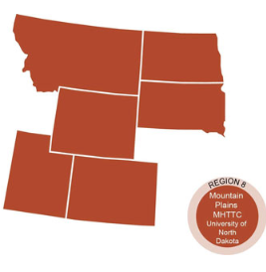
The Mountain Plains Mental Health Technology Transfer Center
Provides training and technical assistance on evidence based practices to the mental health providers of Region 8 (North Dakota, South Dakota, Montana, Wyoming, Colorado, and Utah). We are funded by the Substance Abuse and Mental Health Service Administration (SAMHSA)
Co-hosted by:
The University of North Dakota
and
The Western Interstate Commission for Higher Education (WICHE)

Slide 4
Disclaimer
This presentation was prepared for the Mountain Plains Mental Health Technology Transfer Center (TTC) Network under a cooperative agreement from the Substance Abuse and Mental Health Services Administration (SAMHSA). All material appearing in this presentation, except that taken directly from copyrighted sources, is in the public domain and may be reproduced or copied without permission from SAMHSA or the authors. Citation of the source is appreciated. Do not reproduce or distribute this presentation for a fee without specific, written authorization from the Mountain Plains Mental Health Technology Transfer Center. For more information on obtaining copies of this presentation, call 701-777-6367.
At the time of this presentation, Elinore F. McCance-Katz, served as SAMHSA Assistant Secretary. The opinions expressed herein are the views of Megan Moynihan and Monica McConkey and do not reflect the official position of the Department of Health and Human Services (DHHS), SAMHSA. No official support or endorsement of DHHS, SAMHSA, for the opinions described in this document is intended or should be inferred.

Slide 5
How we can continue to offer free training
A SURVEY!
https://ttc-gpra.org/P?s=409423

Slide 6
Hands-on Tools and Strategies to
Help Providers Work with
Farmers and Ranchers
Monica McConkey, Eyes on the Horizon Consulting
Meg Moynihan, Minnesota Department of Agriculture

Slide 7

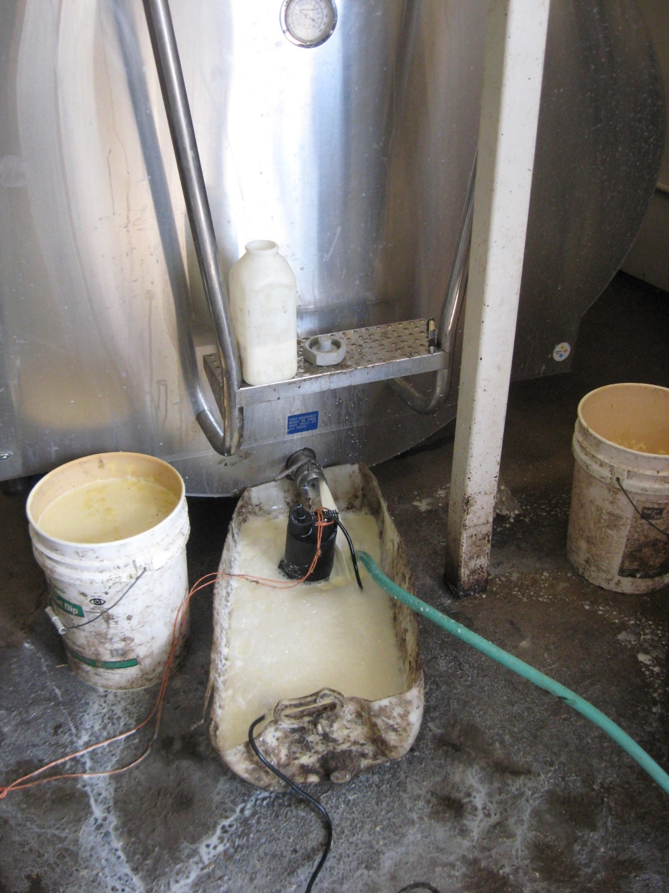
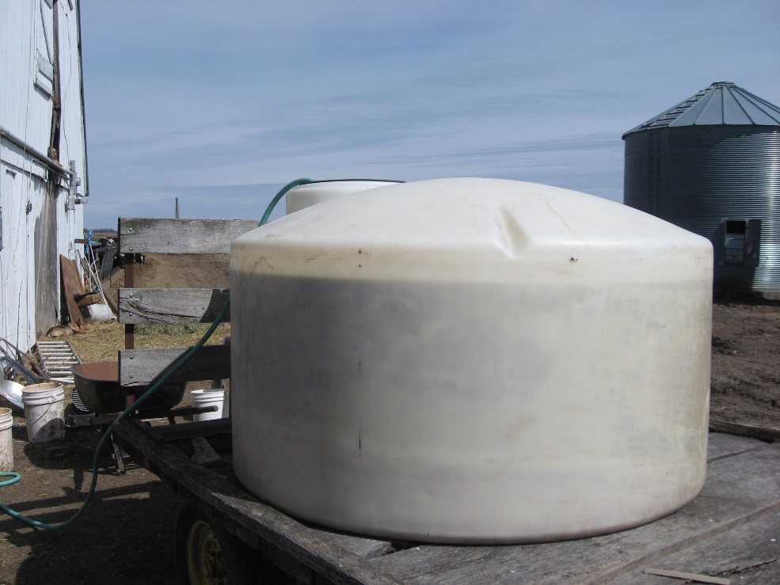

Slide 8
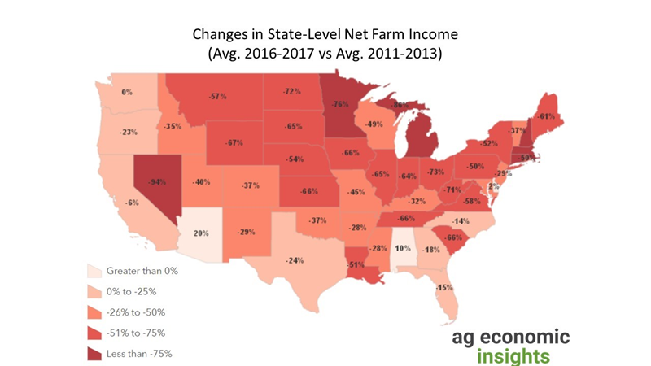

Slide 9
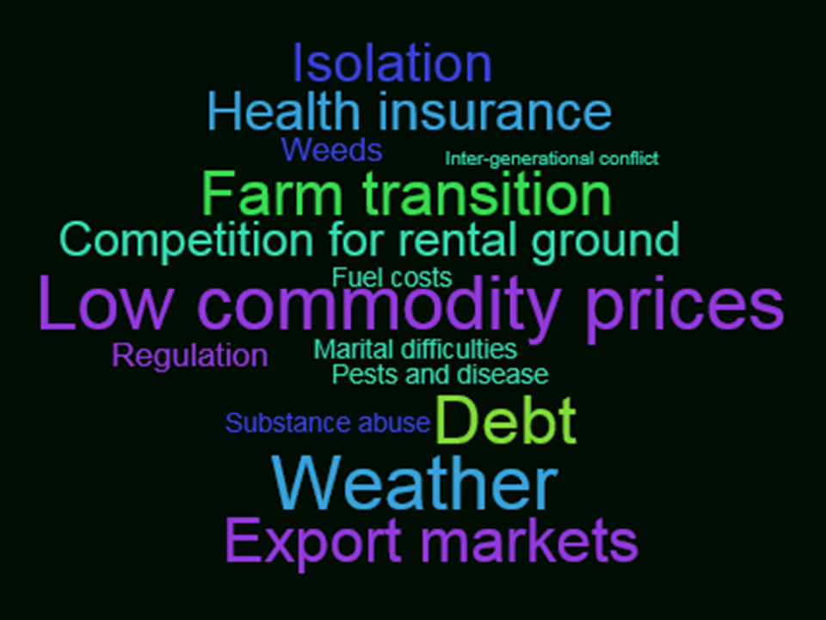
Farm Stressors
The 11th Commandment

Slide 10
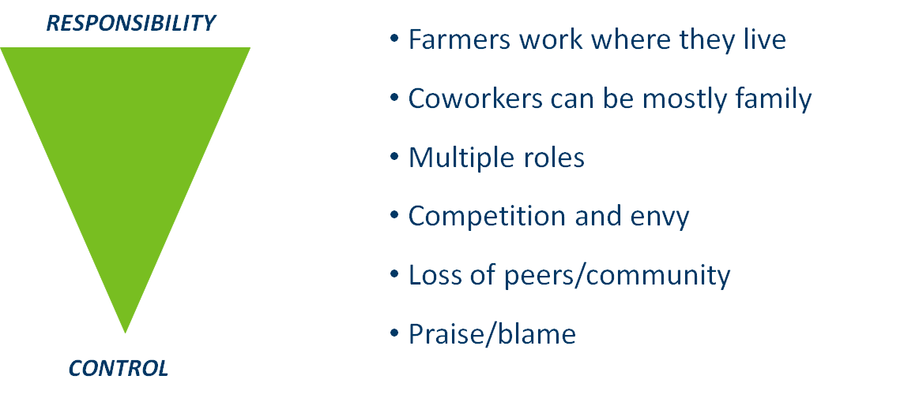
Complicating Characteristics

Slide 11
Why don’t more farmers and ranchers seek help?
I should be able to handle this myself.
Where would I go?
They wouldn’t understand.
Other people would find out.
Costs to much.
I don’t have time.
Nobody can fix what’s wrong.

Slide 12
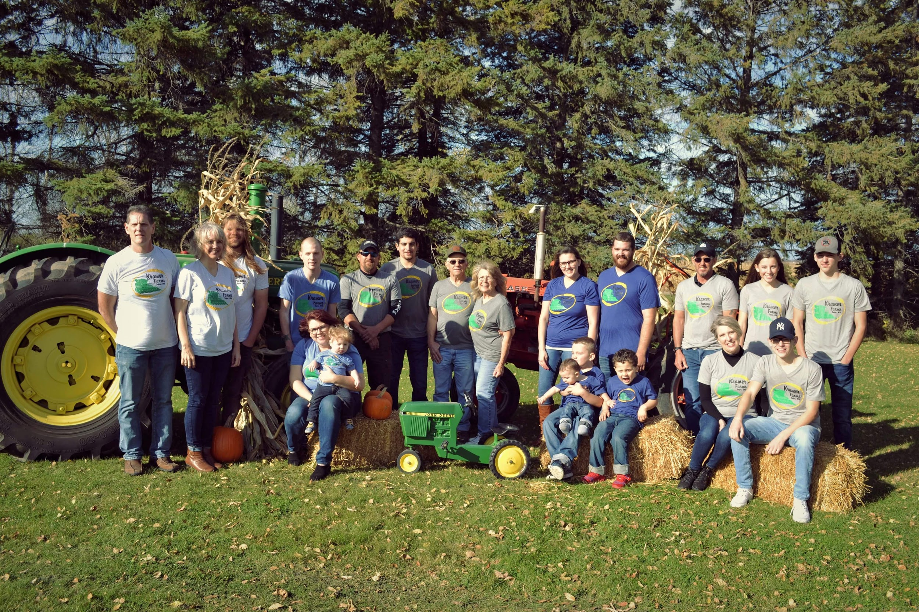
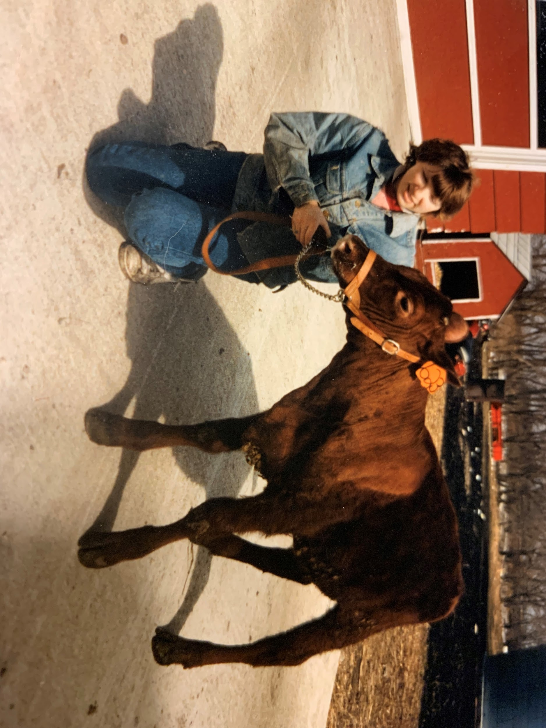


Slide 13
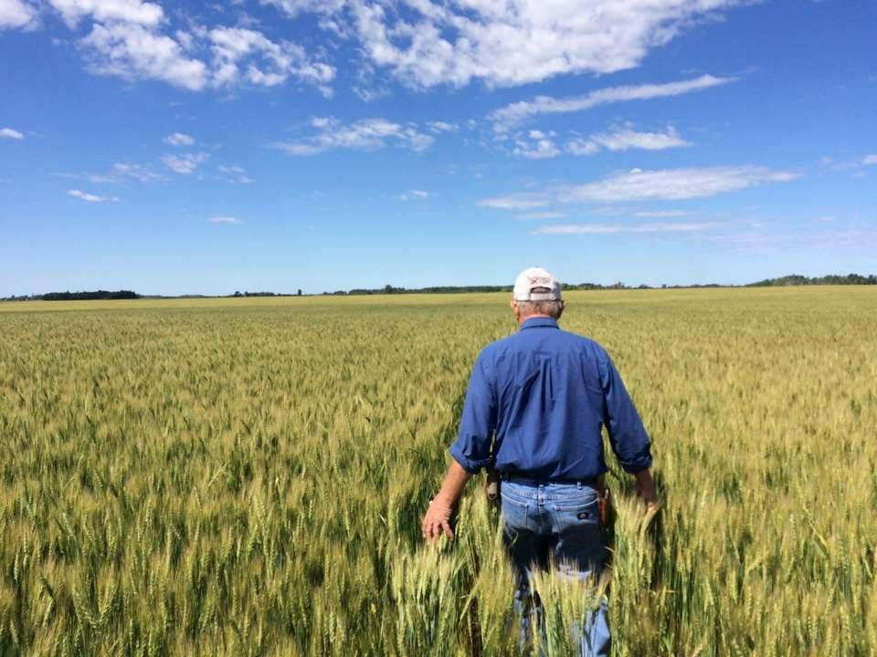
Helpful Strategies
“Tell me about the farm”
Basic Needs
Build Protective Factors
Practice Relaxation Strategies
Work on Helpful Thinking
Use Mindfulness Techniques

Slide 14

Therapy Approaches
Cognitive Behavioral Therapy (CBT)
Dialectical Behavior Therapy (DBT)
Acceptance and Commitment Therapy (ACT)

Slide 15

Cognitive Behavioral Therapy
Focus on thoughts
Helpful vs. Unhelpful
Link to feelings
Raising awareness

Slide 16
Dialectical Behavior Therapy
Skills to manage painful emotions and decrease conflict
Mindfulness
Distress Tolerance
Emotional Regulation
Interpersonal Effectiveness
“Both and” vs. “Either or”

Slide 17

Acceptance and Commitment Therapy
Accept and work with what you have. Don’t become stuck dwelling on the “why”.
Accept your reactions and be present
Choose a valued direction
Take action

Slide 18
Partner Up: Seek thought leaders, trusted entities
Farm/Commodity Organizations
  Farmers Union, Farm Bureau
  Commodity groups: corn, soybean, milk, beef, wheat, barley, fruit and veg, etc.
Family Doctor
Clergy
USDA & State Agencies (Farm Service Agency, state inspectors)
University Extension
Other farmers

Slide 19




Framers coping with adversity
RADIO: 60 seconds on all 20 RRFN stations
Heavy rotation – 1 week each
  Five :60 episodes available for rebroadcast larry.schumacher@state.mn.us
PODCASTS: 12-15 min at www.rrfn.com/transFARMation
  53,000+ “listens”

Slide 20
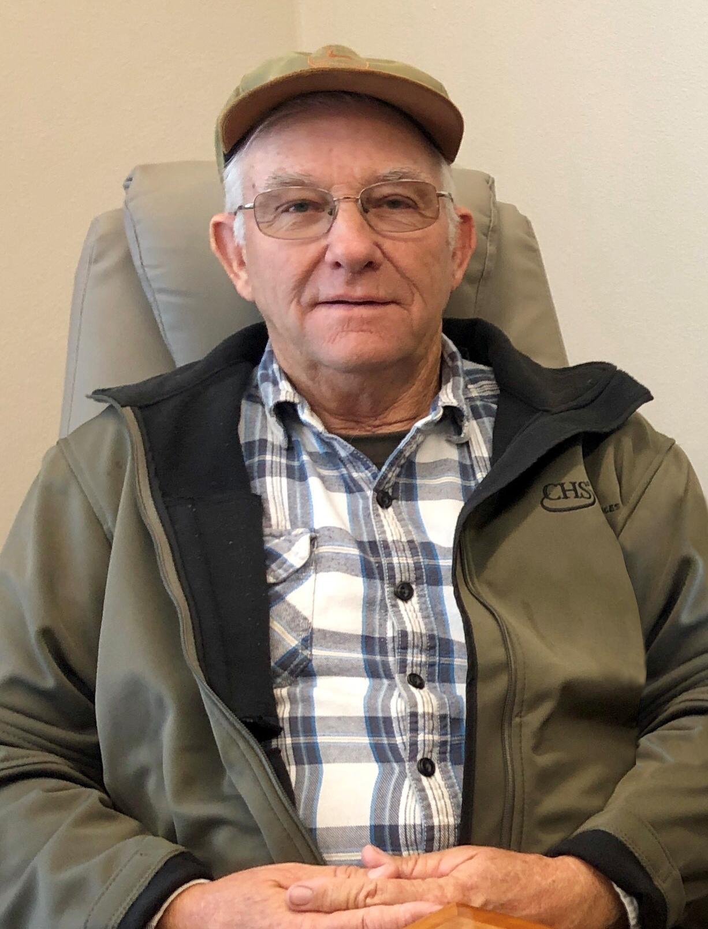
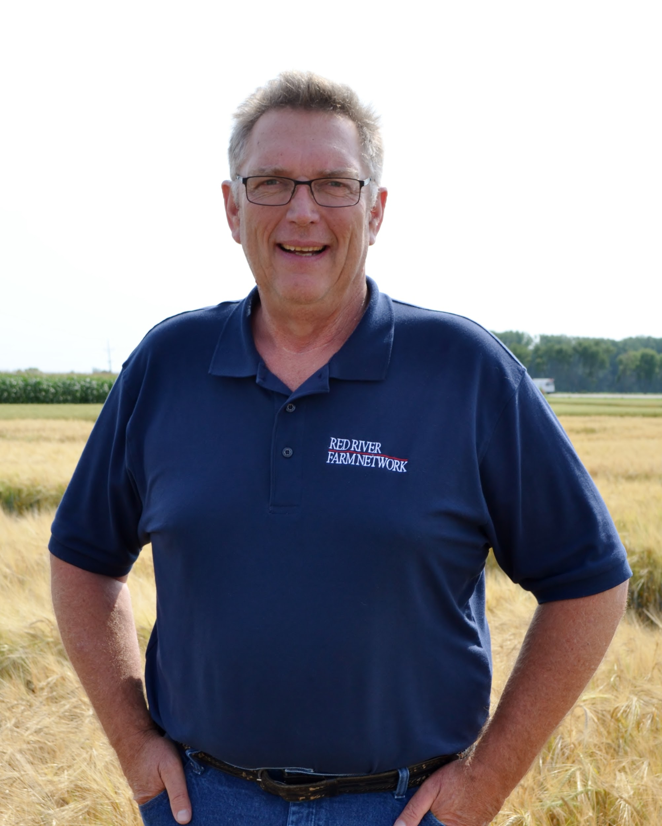



TransFARMation www.rrfn.com/transFARMation
Suicide:
  Losing a Husband and Partner
  Losing a Son
  Coming Close Myself
After a Farm Accident, Attitude is Everything
If Your Horse is Dead, it’s not Going to Get you to Town
How to Not let the Farm Wreck Your Marriage Plus 10 more and counting

Slide 21


Dedicated Farmer Counselors/Therapists
Meet 1:1 with farmers, farm families
No insurance; no paperwork
No charge
MN Legislative appropriation $238K/yr
Monica McConkey
Ted Matthews
218-280-7785
320-266-2390

Slide 22

24/7 Confidential Hotline
Contract: $21.5K/yr

Slide 23
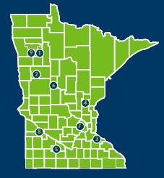
Farm Advocates
Since 1984
Peer farmers
Natural or financial disaster
In the farmer’s corner
Help navigate solutions to difficult and complex problems
  Lending/lender negotiation, mediation, farm programs, crisis counseling, disaster programs, legal and/or social services
2018: ~8,400 hours with clients
651-201-6311

Slide 24

Mobile Crisis Teams
Intensive, local, face-to-face short-term mental health services. During a crisis, can help people return to their baseline level of functioning.
Certified peer specialist
Mental health practitioner
Mental health professional
CELL: **27 47 47
https://mn.gov/dhs/crisis

Slide 25


Coping with Farm & Rural Stress
Brochure & Website

Slide 26
National Resources
    Suicide hotline: 1-800-273-TALK or 1-800-SUICIDE
      suicidepreventionlifeline.org
    Avera farm stress hotline: 1-800-691-4336
    FarmAid: 1-800-FARM-AID
    National Farmers Union: nfu.org
      National Farmers Union: Farm Crisis Center: farmcrisis.nfu.org
    Rural Advancement Foundation International: rafiusa.org
    AgriSafe Network: www.agrisafe.org
Notes:
These resources were highlighted in session 1 of our farm stress series. A recording of this session is available at: https://mhttcnetwork.org/centers/mountain-plains-mhttc/farm-stress-and-mental-health

Slide 27
Locally Focused Resource: Extension Offices
State and County Extension Offices add behavioral health resources and products on farm and family stress.
  Provide warning signs of stress or risk of suicide.
  Tips for managing stress.
  Financial planning tools.
  Tips for families and signs of family stress.
  Hotlines or chat resources.
  Videos of coping, managing, and warning signs.
Notes:
These resources were highlighted in session 1 of our farm stress series. A recording of this session is available at: https://mhttcnetwork.org/centers/mountain-plains-mhttc/farm-stress-and-mental-health

Slide 28
Farm and Ranch Stress Assistance Network (FRSAN)
Funded through the USDA, the purpose of FRSAN is to establish a network that connects individuals who are engaged in farming, ranching, and other agriculture-related occupations to stress assistance programs. The establishment of a network that assists farmers and ranchers in time of stress can offer a conduit to improving behavioral health awareness, literacy, and outcomes for agricultural producers, workers and their families.
    https://nifa.usda.gov/program/farm-and-ranch-stress-assistance-network-frsan
Notes:
These resources were highlighted in session 1 of our farm stress series. A recording of this session is available at: https://mhttcnetwork.org/centers/mountain-plains-mhttc/farm-stress-and-mental-health

Slide 29
Questions?
Please don’t forget to complete an evaluation survey for today’s training. https://ttc-gpra.org/P?s=409423
Thank you!!

