Slide 1


Thank you for joining us today!
Please remember to:
Mute yourself
Ask questions in the chat box
Follow us on Twitter: @MPMHTTC
  And Facebook: @MountainPlainsMHTTC
If you would like more information on resources related to farm stress and mental health please visit:
https://mhttcnetwork.org/centers/mountain-plains-mhttc/farm-stress-and-mental-health

Slide 2
If you would like more information on resources related to farm stress and mental health please visit:
https://mhttcnetwork.org/centers/mountain-plains-mhttc/farm-stress-and-mental-health
Session 1 – Introduction to Farm Stress:
Download Slides
Session 2 – The Economics of Farm Stress:
Download Slides

Slide 3
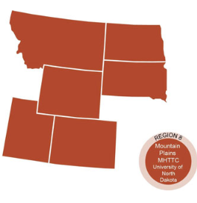
The Mountain Plains Mental Health Technology Transfer Center
Provides training and technical assistance on evidence based practices to the mental health providers of Region 8 (North Dakota, South Dakota, Montana, Wyoming, Colorado, and Utah). We are funded by the Substance Abuse and Mental Health Service Administration (SAMHSA)
Co-hosted by:
The University of North Dakota
and
The Western Interstate Commission for Higher Education (WICHE)

Slide 4
Disclaimer
This presentation was prepared for the Mountain Plains Mental Health Technology Transfer Center (TTC) Network under a cooperative agreement from the Substance Abuse and Mental Health Services Administration (SAMHSA). All material appearing in this presentation, except that taken directly from copyrighted sources, is in the public domain and may be reproduced or copied without permission from SAMHSA or the authors. Citation of the source is appreciated. Do not reproduce or distribute this presentation for a fee without specific, written authorization from the Mountain Plains Mental Health Technology Transfer Center. For more information on obtaining copies of this presentation, call 701-777-6367.
At the time of this presentation, Elinore F. McCance-Katz, served as SAMHSA Assistant Secretary. The opinions expressed herein are the views of Robin J. Landwehr and do not reflect the official position of the Department of Health and Human Services (DHHS), SAMHSA. No official support or endorsement of DHHS, SAMHSA, for the opinions described in this document is intended or should be inferred.

Slide 5
How we can continue to offer free training
A SURVEY!
https://ttc-gpra.org/P?s=404431

Slide 6

Compassion Fatigue: Farm Stress and the Mental Health Provider
Robin J. Landwehr, DBH, LPCC, NCC

Slide 7

Objectives
Dr. Charles Figley and Compassion Fatigue
What is Compassion Fatigue v. Compassion Satisfaction
CF and Clinical Supervision
Farm Stress and the Clinician
The Professional Quality of Life Scale (ProQOL)
Personal Values – Your Personal Compass
Art of Self-Compassion
Peer Consultation
Learn to Be Present, Open Up, Do What Matters
Tips!

Slide 8
Dr. Charles Figley
Marine during the Vietnam War
Created the term “Compassion Fatigue” through personal experience
  Credits CF for costing him his first marriage
  Noticed it in other professionals
“The demand to be compassionate with people that you try to help and understand by seeing the world from their perspective….in the process of doing that, you let yourself into their world.”

Slide 9
Vocabulary
Compassion Satisfaction
Positive aspects of working as a helper
Compassion Fatigue
Negative aspects of working as a helper
Burnout
Inefficacy and feeling overwhelmed
Work-related traumatic stress
Primary traumatic stress direct target of event
Secondary traumatic exposure to event due to a relationship with the primary person

Slide 10

Compassion Satisfaction
The positive aspects of helping
  Pleasure and satisfaction derived from working in helping, care giving systems
May be related to
  Providing care
  To the system
  Work with colleagues
  Beliefs about self
  Altruism
©Beth Hundall Stamm, 2009. www.ProQOL.org

Slide 11
Compassion Fatigue
The negative aspects of helping. Experienced by caregivers of people and animals. Can lead to preoccupation with suffering of others and can lead to apathy, anger, depression, grief, and even substance use have occurred.
The negative aspects of working in helping systems may be related to:
  Providing care
  To the system
  Work with colleagues
  Beliefs about self
Burnout
Work-related trauma
©Beth Hundall Stamm, 2009. www.ProQOL.org

Slide 12

Relationships are Complex
Multiple spheres
  Work environment
  Personal environment
  Previous situations
  Personality traits (Caregivers gonna care)
Positive (CS) & negative (CF)
Altruism CS can override CF
Compassion Fatigue two parts
  Worn out (BO) common
  Frightened, traumatized (STS) rarer but powerful
©Beth Hundall Stamm, 2009. www.ProQOL.org

Slide 13

Burnout and STS: Co-Travelers
Burnout
  Work-related hopelessness and feelings of inefficacy
STS
  Work-related secondary exposure to extremely or traumatically stressful events
Both share negative affect
  Burnout is about being worn out
  STS is about being afraid
©Beth Hundall Stamm, 2009. www.ProQOL.org

Slide 14
Compassion Fatigue and
Clinical Supervision
Who is Most at Risk?
New counselors
Understand Risks
Exposure to trauma through clients
Identifying It
Ethics and boundary violations, leaving profession early, clinical errors
How to help
Building protective factors and coping skills
©Beth Hundall Stamm, 2009. www.ProQOL.org

Slide 15
Farm Stress and the Clinician
Ted Matthews – MN Psychologist. Director of MN Rural Health. Practice is subsidized by the MN Dept. of Agriculture to provide counseling for farms.
#1 THEY HAVE FRIENDS!
You can’t change their situation.
“The demand to be compassionate with people that you try to help and understand by seeing the world from their perspective….in the process of doing that, you let yourself into their world.” – C. Figley.

Slide 16
Farm Stress and the Clinician
Its stressful to not be able to reach them. Figuratively and literally.
Long-term issues require a long-term plan
Feeling like we are not being effective in our jobs can lead to feelings of inadequacy. And this can be a slippery slope to compassion fatigue. So..
  Strive to become more competent if this is your client population. In 20 minutes with Ted I learned:
    The dynamics of age and stress on the farm
    The changing role of women and how this contributes to farm stress (Two heads are better than one.....not!)
    The changing of the marital dynamics of farm spouses
    When people think farm stress they think climate, tariffs, etc.
    Get to know you local farming culture and community resources

Slide 17
Measuring CS & CF
The Professional Quality of Life Scale (ProQOL)
The ProQOL is free
Compassion Fatigue has two subscales
  Burnout
  Secondary Trauma
The ProQOL measures Compassion Satisfaction and Compassion Fatigue
A 30 item self report measure of the positive and negative aspects of caring
©Beth Hundall Stamm, 2009. www.ProQOL.org

Slide 18
Flexibility Planning
Individual, personally
Organizational planning
Supportive Supervision
  The ProQOL can help you plan where to put your energy to increase our resilience
  Can help organizations find ways to maximize the positive aspects and reduce the negative aspects of helping
  The ProQOL can be used as information for discussions
©Beth Hundall Stamm, 2009. www.ProQOL.org

Slide 19
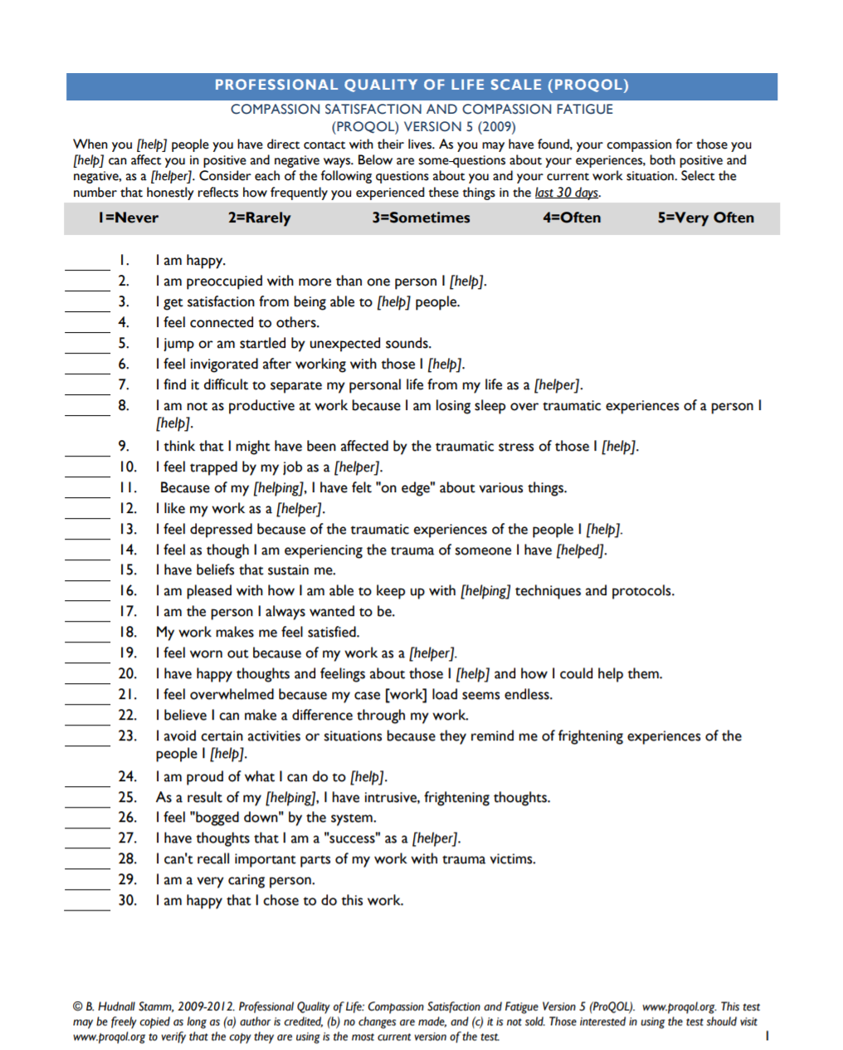
The ProQOL Scales
Compassion Satisfaction-average score is 50. Scoring below 40, you may have a problem with your job.
Burn-Out-average score is 50. Scoring above 57 you may be feeling you’re not effective in your position
Secondary Traumatic Stress (STS)-average score is 50. Scoring above 57 may mean something is frightening to you at work
©Beth Hundall Stamm, 2009. www.ProQOL.org

Slide 20
So, Why Do We Do It?
Personal Values – Your True North
  Who do I wanna be deep in my heart?
  When people describe me, I want them to say…
  When I am challenged and pushed to my limit, I want to be found doing what?
  Why is this important? Because if you don’t know YOU, you won’t know when you are in trouble.

Slide 21
The Art of Self-Compassion
Acknowledging your own suffering and responding kindly
Dr. Russ Harris’ Six Elements of Self-Compassion
  Acknowledging the Pain
  Defusing from Self-Judgement (unhooking)
  Acting with Kindness (Self-talk, Imagery, Self-touch, Deeds)
  Acceptance (Does not mean suck it up)
  Validation
  Connectedness (From thoughts of being alone, Engage with others)
Harris, R. (2015). How to develop self-compassion in just about anyone. Retrieved from Www.ImlearningAct.com.

Slide 22
Create a Peer Consultation Group
Dr. Irvin Yalom
Pulse Night Club and Chris.
  Look out for each other
  Build a healthy clinical setting
Combat clinician isolation through connection (isolation is rough on us, too).
Can help you with ethical decisions, boundary discussions
New ideas; New referral resources
Harris, R. (2015). How to develop self-compassion in just about anyone. Retrieved from Www.ImlearningAct.com.

Slide 23

Be Present, Open Up, Do What Matters
Learning STOP!
S (Slow Your Breathing)
T (Take Note)
O (Open Up)
P (Pursue Your Values)
Harris, R. (2015). How to develop self-compassion in just about anyone. Retrieved from Www.ImlearningAct.com.

Slide 24

More Tips
Love, Work, Play, Health
  Eat well
  Sleep!
  Exercise
  Do fun things
  Nurture your primary relationships
  Seek reassurance
  Develop a routine
  Values-guided work
  Set boundaries when necessary
SEE A PROFESSIONAL …
THE SOONER THE BETTER!

Slide 25
Let’s Rehash
Compassion Satisfaction good. Compassion Fatigue bad.
Values-guided Self-Compassion
The ProQOL is a tool that can help you determine if you may have CF

Slide 26
Questions?
Please don’t forget to complete an evaluation survey for today’s training. https://ttc-gpra.org/P?s=404431
Thank you!!

Slide 27
Resources
B. Hudnall Stamm, 2009-2012. Professional Quality of Life: Compassion Satisfaction and Fatigue Version 5 (ProQOL). www.proqol.org
Harris, R. (2015). How to develop self-compassion in just about anyone. Retrieved from Www.ImlearningAct.com.
Strosahl, K., Robinson, P, & Gustavsson, T. (2012). Brief interventions for radical behavior change: Principles and practice of focused acceptance and commitment therapy. Oakland, CA: New Harbinger Publications
Special Thanks to Ted Matthews at www.farmcounseling.org

