Slide 1


Psychosocial Impacts of Disaster: Assisting Community Leaders
(with annotations for pandemics)
Andrew J. McLean, MD, MPH

Slide 2
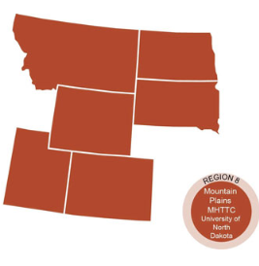
The Mountain Plains Mental Health Technology Transfer Center
Provides training and technical assistance on evidence based practices to the mental health providers of Region 8 (North Dakota, South Dakota, Montana, Wyoming, Colorado, and Utah). We are funded by the Substance Abuse and Mental Health Service Administration (SAMHSA)
Co-hosted by:
The University of North Dakota
and
The Western Interstate Commission for Higher Education (WICHE)

Slide 3
Disclaimer
This presentation was prepared for the Mountain Plains Mental Health Technology Transfer Center (TTC) Network under a cooperative agreement from the Substance Abuse and Mental Health Services Administration (SAMHSA). All material appearing in this presentation, except that taken directly from copyrighted sources, is in the public domain and may be reproduced or copied without permission from SAMHSA or the authors. Citation of the source is appreciated. Do not reproduce or distribute this presentation for a fee without specific, written authorization from the Mountain Plains Mental Health Technology Transfer Center. For more information on obtaining copies of this presentation, call 701-777-6367.
At the time of this presentation, Elinore F. McCance-Katz, served as SAMHSA Assistant Secretary. The opinions expressed herein are the views of Dr. Andrew J. McLean and do not reflect the official position of the Department of Health and Human Services (DHHS), SAMHSA. No official support or endorsement of DHHS, SAMHSA, for the opinions described in this Presentation is intended or should be inferred.

Slide 4
Objectives:
Review phases of disaster as pertains to mental health
Discuss the importance of risk communication in mitigating mental health problems during phases of disaster
Review protective and risk factors of both individuals and communities in the phases of disaster

Slide 5

Phases of Disaster Response
Mitigation
Preparedness
Response
Recovery

Slide 6
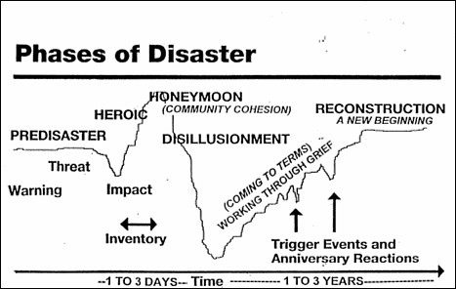
How communities experience disaster
Myers/Zunin
Notes:
Myers/Zunin

Slide 7
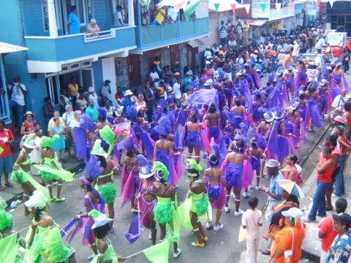
What is “Community”?
Rooted in Latin
Cum- “together”
Munus- “gift”

Slide 8
Resilience
Community resilience has been defined as “the ability of community members to take meaningful, deliberate, collective action to remedy the impact of a problem, including the ability to interpret the environment, intervene, and move on”.
Pfefferbaum and colleagues (2005)
Notes:
Pfefferbaum and colleagues (2005)

Slide 9
Successfully Resilient Communities
1. Strong civic (and other) leadership
2. Engagement of citizens
3. Coordination/Utilization of resources
4. Attention to Psychosocial Issues/Supports
Norris, et al
Notes:
Norris, et al

Slide 10
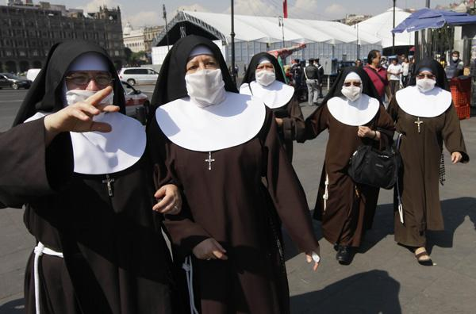

Communication
Public Health and Administrative officials need to be well versed in risk communication, and have cultural competency

Slide 11
Behavior and Public Health-
Risk Communication
Facts
Trust
Fear

Slide 12
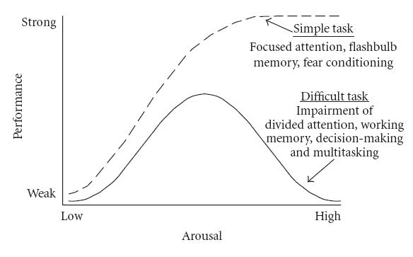
Why are messages so simple, short and repetitious?
Low stress may help memory/performance
High acute stress, or chronic stress impedes memory/performance, complex problem-solving ability
Think about digit span memory--many important numbers are no more than 5-7 digits. In high stress, memory ability often drops to 3 digits/pieces of info.
(think also about what you have personally remembered from the rest of the conversation after “the bad news” was delivered…)

Slide 13
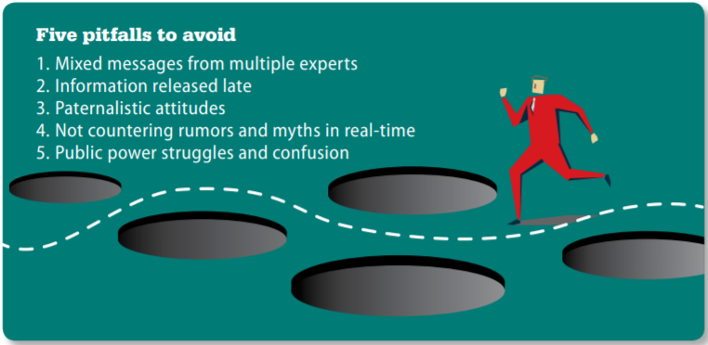
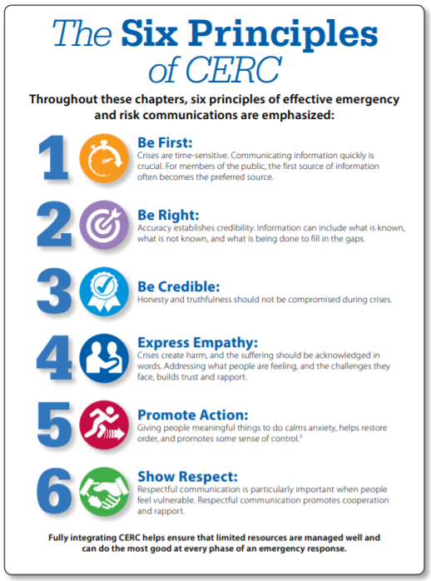
CDC-Crisis and Emergency Risk Communication (CERC)

Slide 14
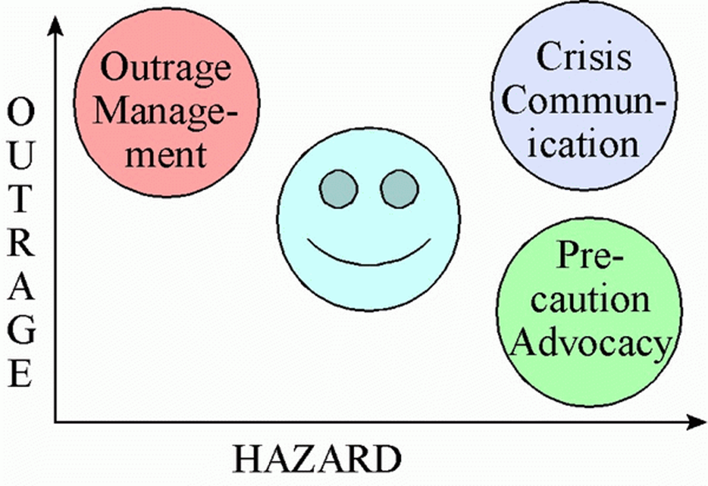
People’s Attention
Per Peter Sandman,
RISK = HAZARD + OUTRAGE
RISK = (“harm likelihood”) + (“upsetness”)

Slide 15
Response
Often:
People vicariously rehearse:
1) it’s not our problem
2) we could be next
3) AGGGGHHHH!
What helps:
Providing anticipatory guidance
Giving direction on what to do:
  Here’s what you:
  Must do
  Should do
  Could do

Slide 16

The Impact Pyramid
Individual victims
Family and social networks
Rescue workers, medical care providers, their families and social networks
Vulnerable populations and impacted businesses
Ordinary people and their communities
CDC

Slide 17
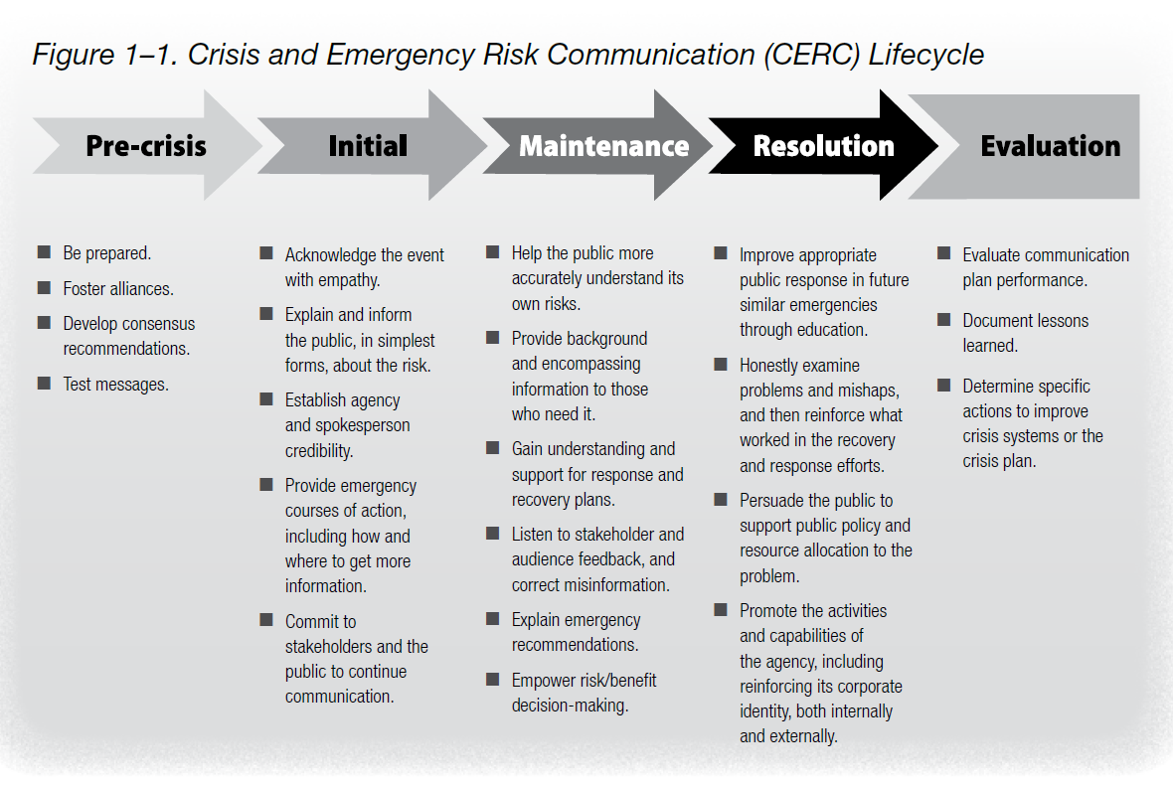
For Those In Leadership…
Crisis and Emergency Risk Communication
US. Department of Health and Human Services/CDC

Slide 18
Predictors
Man-made vs. natural (man-made disasters more challenging re: blame, etc…)
Developing vs. Developed (countries)
Severity of Exposure/History
Social Connectedness
Resources

Slide 19
“…one of the worst outcomes of a crisis is the collapse of fundamental assumptions about the world.”
Mitroff, 2004 (re: Hurricane Katrina)

Slide 20
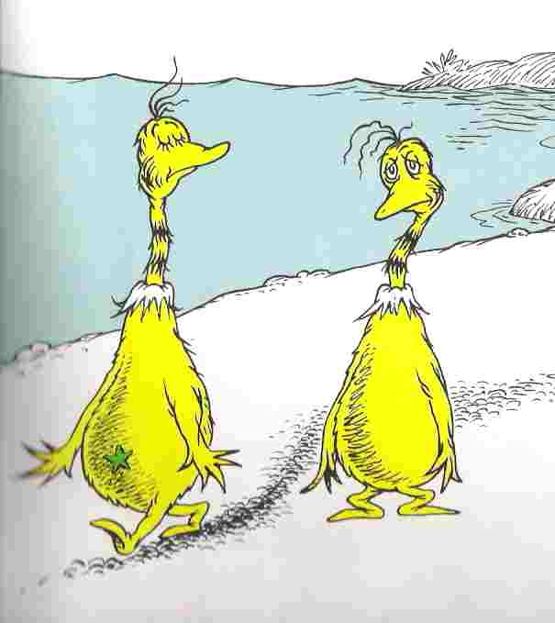
Fairness
Priorities need to be considered, given limited resources.
These are difficult decisions for all.
Dr. Seuss

Slide 21
Typical Signs of Stress
Irritable/moody
Tired/Sleep problems
Antsy/Anxious
More negative thinking
Trouble concentrating

Slide 22
What sorts of behavioral health issues do we often see?
Anxiety
PTSD
Depression
Increased interface with law enforcement, such as:
Substance use
Domestic violence

Slide 23
Why is taking care of physical and mental health during/after disasters so important?
Example:
In the year following Hurricane Katrina, the death rate in New Orleans rose 50%....
Likely a combination of limited health care access and stress impact on chronic disease

Slide 24
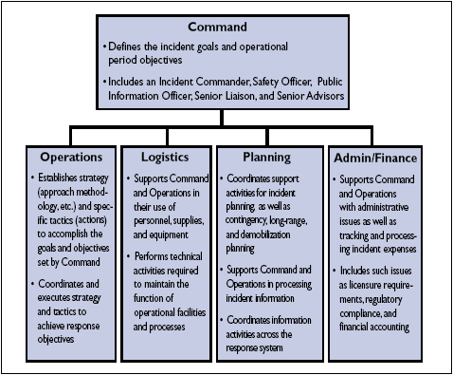
Assumptions
(how “deep” is your staff?)
Every government knows incident command paradigms.
However, do all essential agencies, (including healthcare) have in place a disaster plan with necessary resources, communication options, etc...?

Slide 25
Work Force-absenteeism
30-50 percent
(for both emergency and non-emergency providers….)
Pandemics, even longer…
Issues:
Moral
Professional
Personal

Slide 26
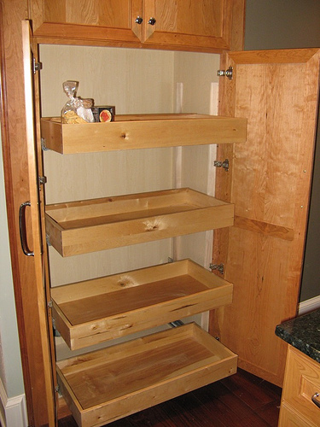
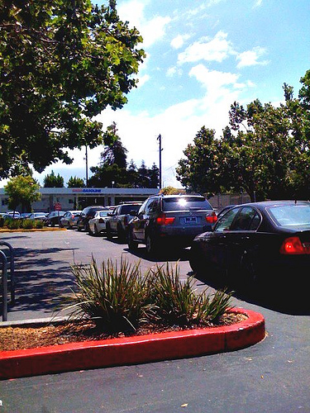
Assumptions-
How “deep” are your resources (work and home)
Do we have resources
for 72 hours? What about 1 week, 4 weeks, 12 weeks?
Problems with a “just-in-time economy”

Slide 27
Logistics
What can be done from home?
Will communication tools be available?
Who provides what service/function?
What is essential?

Slide 28



What can I do now?

Slide 29
What can communities do?

Slide 30
The 3 Ms of Pandemic Response
(3 Ms assume the primary “M”--Mitigation through vaccination is not yet available…)
Follow Public Health Expert recommendations re:
Movement-social distancing, etc…
Masks-PPEs (personal protective equipment)
Meds-are antivirals appropriate/available?
A. McLean, MD, MPH

Slide 31
Isolation, Quarantine and Social Distancing
Isolation-separation of a sick person from others
Quarantine-separation of an exposed person from others
Social Distancing-restriction of where people are allowed to gather
Potential impacts on mental health, particularly as social connectedness is a major factor in resilience
Again, leadership communication on
justification, needs, supports is paramount
https://www.thelancet.com/journals/lancet/article/PIIS0140-6736(20)30460-8/fulltext

Slide 32


Resilience
Individual
Community

Slide 33
Taking Care of the Caretakers
(The Risks of Empathic Engagement)
Burnout
Compassion Fatigue
Loss of Self
Vicarious Trauma
Change in cognitive schema
Secondary Traumatic Stress
Symptoms similar to post-traumatic stress disorder
Emotional Exhaustion
Bush, N.J. (2009). Compassion Fatigue: Are you at risk? Oncology Nursing Forum, 36(1), 24-28

Slide 34
Mitigating Burnout
Capture reminders of your purpose:
“Oh yeah, THIS is why I signed up…”

Slide 35
Specialized
Services
Focused, Non-Specialized Supports
Community and Family Supports
Basic Services and Security
Intervention pyramid for mental health and psychosocial support in emergencies
IASC Guidelines on Mental Health and Psychosocial Support in Emergency Settings

Slide 36
For “treating” the General Population:
No Critical Incident Debriefing
Consider Psychological First aid, or other supportive engagement
Normalize the process, screen for higher need.
“I don’t need a shrink, I need a contractor…”

Slide 37
Myths about disasters and resilience
Myth 1)
The majority of those affected will develop Post Traumatic Stress Disorder or Depression
Myth 2)
Resilience is an inherent trait and can’t be taught
Myth 3)
All Disasters result in long-term negative outcomes

Slide 38
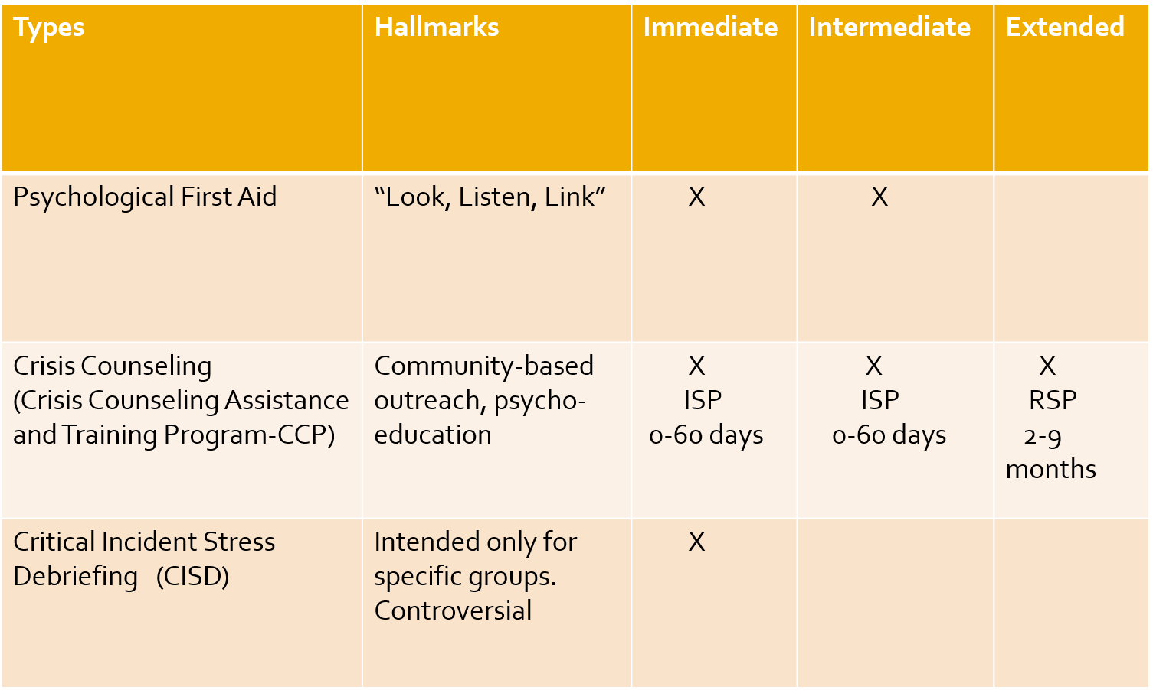
Types of Mental Health And Psychosocial Supports (MHPSS)

Slide 39
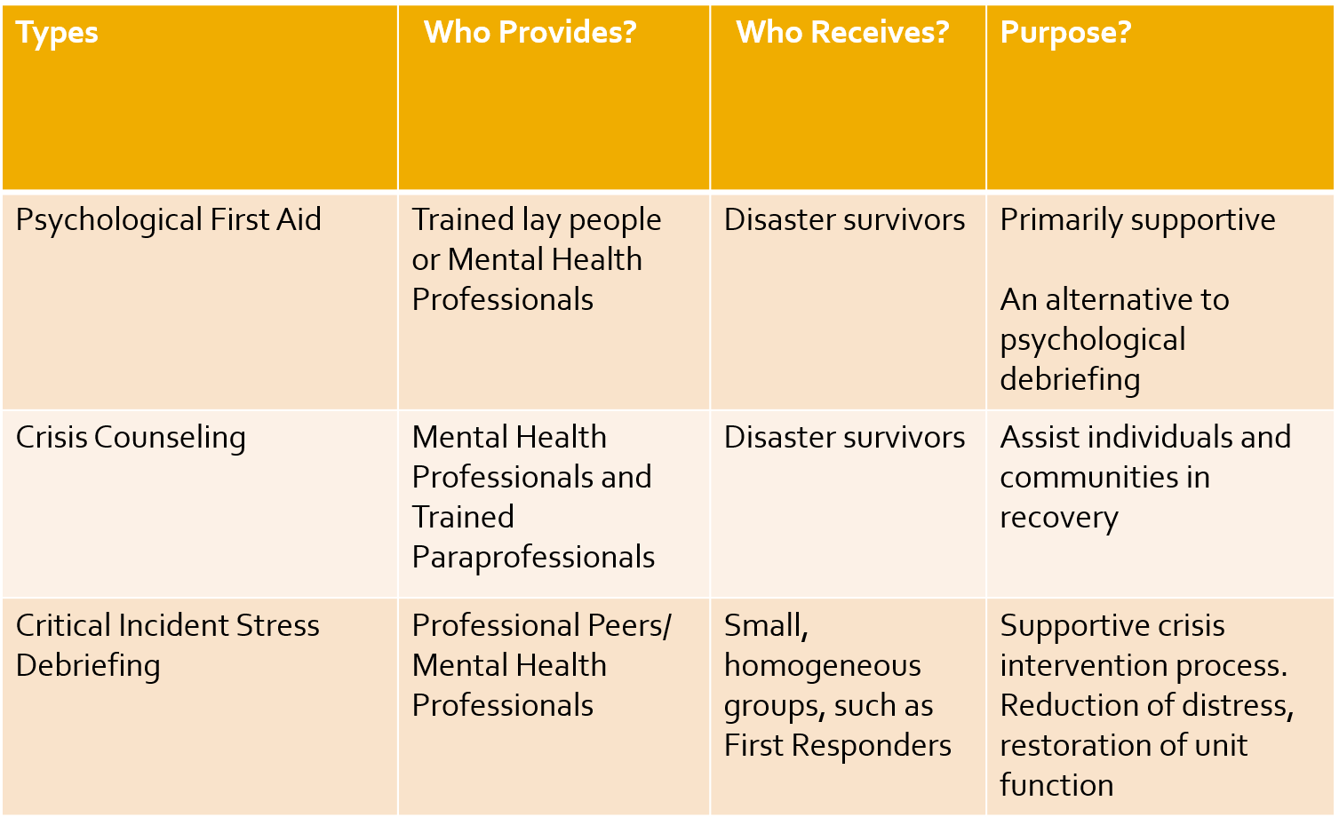
Types of MHPSS

Slide 40
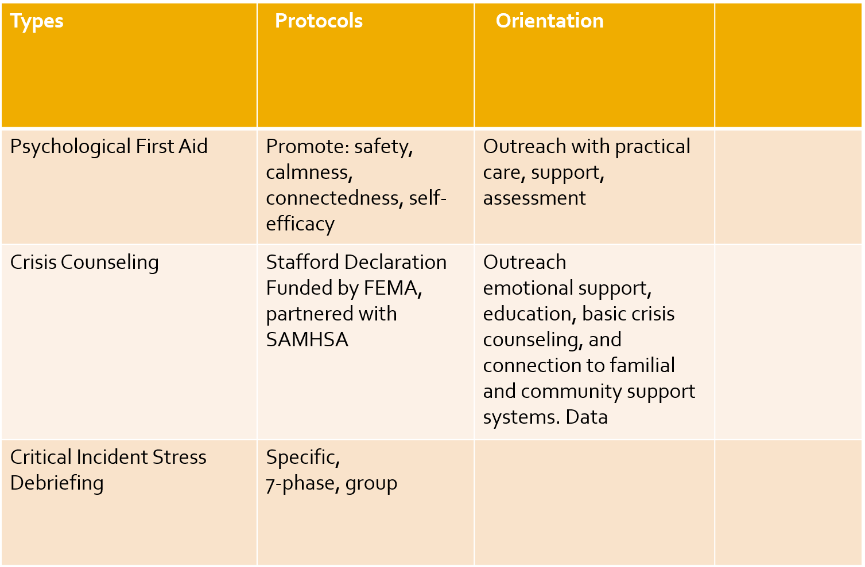
Types of MHPSS

Slide 41
Utilize Your Resiliency Toolkit
Vulnerability
Resiliency

Slide 42
Resilient Attitudes
View change as challenge or opportunity
Think realistically – keep things in perspective
Set goals and plan action steps
Dr. Kit O’Neill

Slide 43
Resilient Behaviors during crises
The 3 Rs
Rest
Routine (ritual…)
Relationships
(family, work, other)
R³
McLean

Slide 44

Resilience
Of all variables, two of the most impactful:
Resources (less controllable)
Social Connectedness (more controllable) Obviously an issue if there is required social distancing, particularly if technology is disrupted…

Slide 45

Get the FACTS:
Foster Hope (avoid negativity-keep perspective)
Act with Purpose (do something productive)
Connect with Others (don’t emotionally isolate)
Take Care of Self (basics)
Search for Meaning (how does this make sense…)

Slide 46
Awareness…
Be confident in your competence…
Know your strengths and weaknesses…
Supervisors-know staff and their situations….

Slide 47
For Providers
Network
Be Available
Lean in
Manage your own care needs

Slide 48
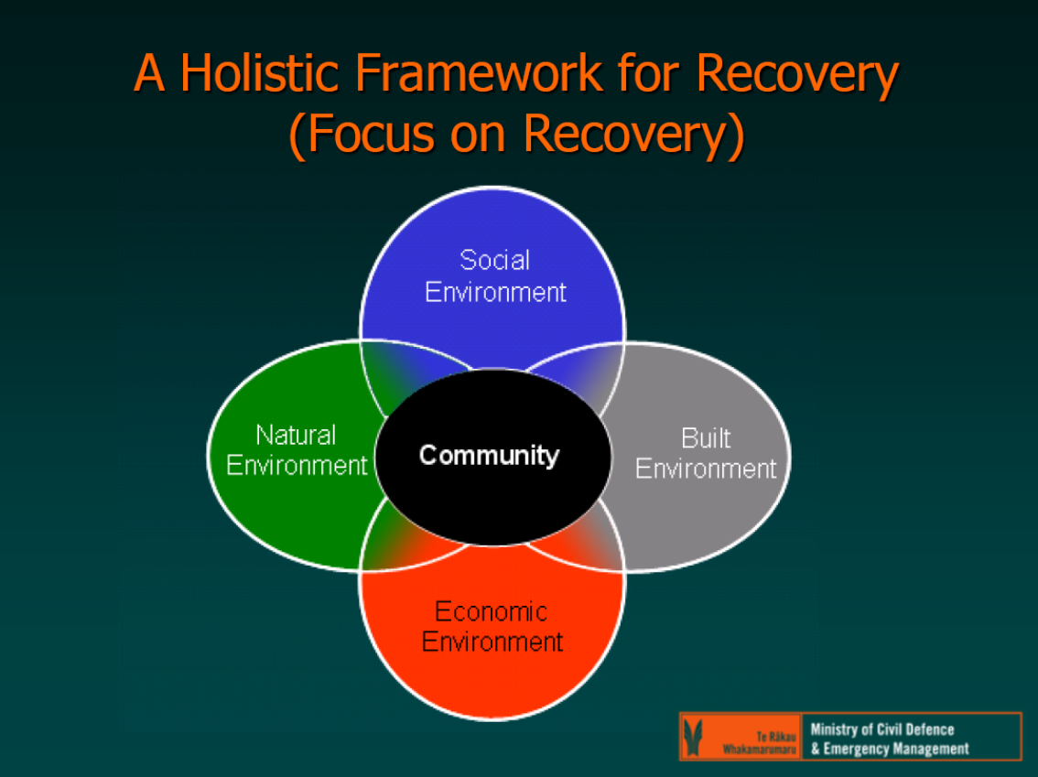
A Holistic Framework for Recovery (Focus on Recovery)
Appreciation to Dr. Alistair Humphrey

Slide 49
To Cap:
People need leaders who know how to communicate. Reducing stress in a population is protective both emotionally and physically (and fiscally…) Pay attention to the lead experts, as there will be a lot of “noise.”
Maintaining social connectedness and utilizing resources wisely are key factors during an event.
Individuals and communities/countries can experience positive outcomes despite disasters.

Slide 50

Thoughts/Experiences?

