Slide 1
Suicide Screening Remotely
Erin Briley, M.S., NCSP

Slide 2
This in-service is not intended to replace advanced training in suicide response and risk assessment. Please refer to resources at the end of this training for programs
The opinions expressed herein are the views of Erin Briley and do not reflect the official position of WICHE. The information presented in this document is not intended to replace the policies or guidance of your supervisor, agency or administrators.

Slide 3
Additional Components When Screening During the Pandemic ¹
Increase check-ins with students already presenting with emotional needs prior to the pandemic, especially if they’ve experienced suicidal ideation in the past
Have student’s contact information and address on hand in case you get disconnected or if emergency services need to be contacted
Know in advance whom to refer to if you require consult or if student requires increased supports or emergency response
Consider the emotional impact of this pandemic on suicide risk due to increased stressors (e.g., increased: isolation, familial conflict, financial concerns, anxiety and fear, disruption of routines; decreased social support, etc.) and inquire as appropriate
Consider increased access to lethal means (e.g., stockpiles of meds, etc.)
Increase check-ins and contacts until risk decreases
Identify people in student’s current environment that can help monitor suicidal ideation and behaviors in-person and remotely
Consider researching tele-health options available for insured and non-insured students

Slide 4
Screenings at School vs Remotely
At School: | Remotely:
Has your district created a crisis protocol for this? If so, follow it!
1. Screen if trained or refer to staff trained to recognize & screen (e.g., behavioral health staff). If unable to locate trained staff, alert admin (if at school) who will determine next steps or if crisis services needs to be called. If remote, locate trained staff/consultation or call crisis services if they can’t be located. Parents should be notified for both circumstances.
2. Screen. If positive, determine if crisis team needs to be contacted based on risk level. Err on the side of caution if unsure. Alert parents & admin. Do NOT leave alone until help arrives or initiates contact | 2. Screen. If positive, determine if crisis team/crisis services needs to be contacted based on risk level. Err on the side of caution if unsure. Alert parents. Do NOT leave alone until help arrives or initiates contact
3. In emergencies, call 9-1-1, inform admin, & notify parents | 3. In emergencies, call 9-1-1, notify parents, & later notify appropriate school officials
4. Develop safety plan (this may be done later if student is currently in crisis) and provide crisis/emergency/local resources. Determine follow-up monitoring plan and behavioral health supports. Document assessment results, whom contacted, and plan of action

Slide 5
When to Conduct a Screener
Suicide Screening: A standardized instrument or protocol to identify suicide risk. Can be done universally or selectively.
Conducted when:
1. Student inform of attempt, thoughts, or plans
2. Peer or staff learn of an attempt
3. Staff believes student is at risk
Suicide Assessment: A comprehensive evaluation done by a clinician to confirm risk, estimate immediate danger, and determine the course of treatment

Slide 6
Risk Factors (Characteristics associated with increased risk. Risk increases with multiple factors)
Individual Risk Factors¹³:
Previous suicide attempts and non-suicidal self-injury such as cutting
Mental illness, hopelessness, low self-esteem
Impulsive or risk-taking tendencies
Poor problem-solving or coping skills
Low stress and frustration tolerance
Social alienation or isolation, non-conforming
Environmental Factors:¹³
Exposure to suicidal behavior of others via media or other
Negative social and emotional environment at school
Expression and acts of hostility
Lack of respect and fair treatment
Limitations in school/home physical environment, including lack of safety and security
Access to lethal means
Exposure to stigma & discrimination

Slide 7
Risk Factors (Characteristics associated with increased risk. Risk increases with multiple factors)
Risky Behaviors¹³:
Alcohol or drug use
Delinquency
Aggressive/violent behavior
Risky sexual behavior
Family Characteristics:¹³
Family history of suicide
Parental mental health problems
Family stress and dysfunction
Stressful life event/loss or a situational crisis (breakups, abuse, divorce, death of a loved one, etc.)

Slide 8
Signs of Depression in Youth⁸
Young Children | Other Children/Teens
* Frequent tantrums, intense irritability Often talks about fears or worries Somatic complaints Very active except with TV or videogames Sleeps too much/little. Frequent nightmares or seems sleepy during the day Little interest playing with others or trouble making friends Struggles academically or recent decline in grades | Loss of interest in things previously enjoyed Fear of gaining weight; diet or exercise excessively Periods of highly elevated energy/activity; requires much less sleep Sleeps too much/little. Seems sleepy throughout the day. Low energy Increased isolation; avoids social activity Self-harm behaviors (e.g., cutting or burning their skin) Risky or destructive behaviors. Substance use

Slide 9
General Warning Signs^{15, 16} (Observable behaviors signaling suicidal thinking)
Warning Signs: Changes in behaviors, feelings, & beliefs about self. Most signs last 2+weeks, but can occur impulsively
Reckless or engaging in risky activities &/or increased alcohol/drug use
Feeling trapped, like there’s no way out
Anxiety, agitation, dramatic mood changes
Hopeless about the future; severe or overwhelming emotional pain or distress*
Rage, uncontrolled anger, seeking revenge or recent increased agitation or irritability*
Unable to sleep or sleeping all the time*
Withdrawal or changes in social connections*
Anger that seems out of character or context*
* Items marked with (*) also indicate warning signs for youth < 25 years of age

Slide 10
Acute Warning Signs¹⁵
Threatening to hurt or kill self or talking about wanting to die (sometimes this is seen as verbal clues)
Looking for ways to kill self by seeking access to lethal items
Talking, writing, or artwork about death, dying, or suicide
- Is there a detailed plan for attempt (how, where, when)?
The risk for Suicide increases if the warning sign is:
* New and/or
* Has increased, and
* Possibly related to an anticipated or actual painful event, loss, or change
Note: Be cautious of sudden improvement after a period of being very sad and withdrawn because a decision may have been made to escape problems by ending life

Slide 11
Protective Factors¹³
Protective factors don’t shield a child from risk if they are already actively suicidal, but they are very helpful in safety planning
Individual Characteristics
Emotional well-being and emotional intelligence
Adaptability, resilience, internal control of one’s environment
Strong problem-solving, coping, conflict resolution skills
Frequent, vigorous exercise or participation in sports
Spiritual faith. Cultural beliefs that affirm life
Frustration tolerance and emotional regulation
Body image, care, and protection

Slide 12
Protective Factors¹³
Social Supports
Connections. Close supportive bonds with family, caring adults, peers; positive therapeutic relationships; responsibility to others
Parental involvement, pro-social norms, and support for school
School Supports
Positive school experiences- safe and respectful climate
Adequate or better academic achievement
Connectedness to school. Part of a close school community

Slide 13
What to Explore in a Risk Assessment¹¹
Identify risk factors. Pay attention to those that can be reduced. Explore if they’ve made past attempts at suicide or if there is a family history.
2. Identify and mobilize protective factors
- Is there anything that could stop them? (E.g., younger siblings,
pets, religious beliefs, …)
- Also, helpful for safety planning

Slide 14
What to Explore in a Risk Assessment¹¹
3. Conduct suicide inquiry
a) Ideation. How long have they been thinking about suicide
(frequency, intensity, duration).
- Be direct, caring, and non-confrontational
- Be developmentally appropriate
- Prompt Questions:
“Are you thinking of suicide?”; “Have you thought about suicide in in the last two months?”; “Have you ever attempted to kill yourself?”
- Be specific. Avoid vague terminology like “hurt”

Slide 15
What to Explore in a Risk Assessment¹¹
Suicide Inquiry (cont.)
b) Plan. Is there a plan? How would they do it if they could? Get specifics.
c) Access. Are there means to carry through?
d) Intent. Have they made plans to follow through? If imminent (within next 24 hours, obtain immediate assistance or emergency response. Send to ER)
- Note: Asking about intent to kill oneself is not correlated with suicidality

Slide 16
What to Explore in a Risk Assessment¹¹
Determine risk level and if crisis team should be contacted.
* Always err on the side of caution! If you’re unsure, then seek
consult or contact the crisis team anyway!
5. Do not leave him/her alone.
6. Document assessment results, whom contacted, and plan of action

Slide 17
Or… Use a Developed Suicide Screener
Columbia-Suicide Severity Rating Scale (C-SSRS)
SAFE-T
Yes, you can screen remotely!

Slide 18
Columbia-Suicide Severity Rating Scale (C-SSRS)⁴
Brief screener (4-6 questions) for ideation severity within the last month and behaviors within the last 3 months
Combine results with clinical judgement to determine risk level and make clinical decisions about care
Population: All age ranges (6+) and special populations in different settings. Also available for very-young children/cognitively impaired
Administration Requirements: Any professional or self-report. MH background not required
Additional: Evidence-supported. Includes a follow-up screener. Endorsed by: SAMHSA, NIH, DOD, National Action Alliance for Suicide Prevention, Zero Suicide Initiative.
Cost: Free

Slide 19
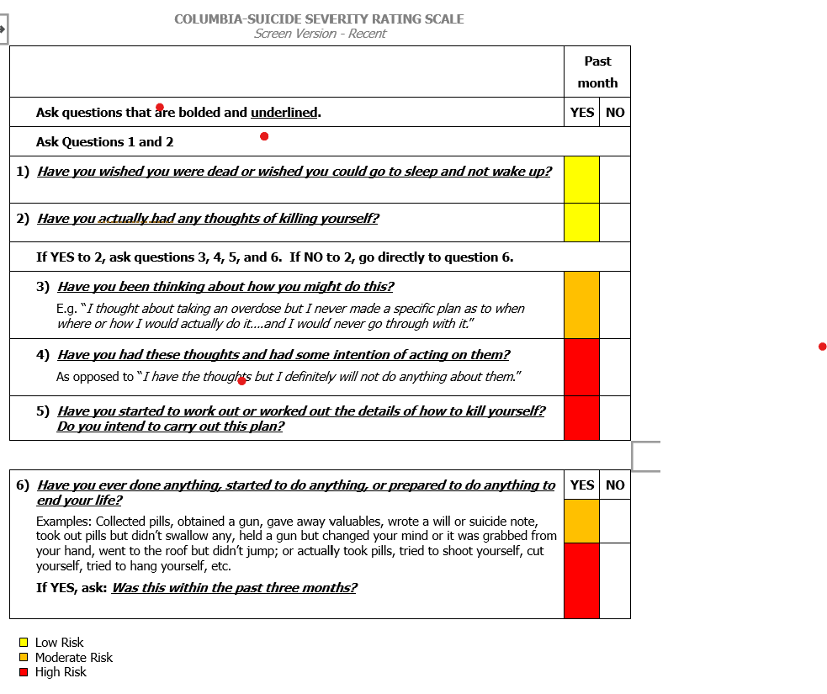
C-SSRS ⁴

Slide 20
SAFE-T¹⁴
Description: Interview-format to gather information related to suicide risk
Explores: 1) Ideation within last 48 hours, past month, and worst ever; 2) Plan (timing, location, lethality, availability, preparatory acts); 3) Behaviors (past and aborted attempts, rehearsals versus non-suicidal self-injurious actions); 4) Intent
Additional: Mobile App available. Endorsed by SAMHSA, SPRC

Slide 21
Levels of Risk¹⁰
Risk Level | Risk/Protective Factor | Suicidality | Possible Interventions
High | Psychiatric disorders with severe symptoms or acute precipitating event; protective factors not relevant | Potentially lethal suicide attempt or persistent ideation with strong intent or suicide rehearsal | * Contact crisis team* Suicide precautions. Remove dangerous objects from immediate area
Moderate | Multiple risk factors, few protective factors | Suicidal ideation with plan, but no intent | May need to contact crisis team dependent on risk factors. Develop safety plan. Provide resources.
Low | Modifiable risk factors, strong protective factors | Thoughts of death, no plan, intent, or behavior | Outpatient referral, symptom reduction, Provide resources.
**Obtain written consent to consult with outside providers** **Document screening/assessment results, whom contacted, and plan of action**

Slide 22
Problems with Levels of Risk
Suicidality is dynamic. Meaning, a variety of factors (personal events, availability of resources, etc.) can influence the level of severity at any point in time. ⁷ This is why using clinical judgement is so important.
Other factors that should be explored when determining severity of risk includes: a) the patient’s current available and accessible resources; b) foreseeable changes (events and stressors) which can influence risk; c) and, comparing the patient’s current risk state to their baseline or worst-point state¹¹

Slide 23
What’s Not Helpful?
Ignoring or dismissing the issue indicates you don’t hear their message, believe them, or care about their pain. ALL reports of suicide should be taken seriously
Acting shocked or embarrassed.
Panicking, preaching, or patronizing.
Challenging, debating, or bargaining. You can’t win a power struggle with someone thinking irrationally.
Giving harmful advice such as suggesting the use of drugs or alcohol to “feel better”.
Promising to keep a secret. The suicidal person is sharing his/her feelings hoping someone will help their pain, even though they may verbally contradict this.

Slide 24
RESOURCES

Slide 25
24/7 Crisis Lines
National Suicide Prevention Lifeline 1-800-273-TALK (8255) or 1-888-628-9454 (Spanish)
Crisis Text Line Text HOME to 741-741
Trevor Lifeline (For LGBTQ Youth) 1-866-488-7386
Trans Lifeline 1-877-565-8860 or translifeline.org

Slide 26
Advanced Training in Risk Assessment
Applied Suicide Intervention Skills Training (ASIST) A workshop designed for caregivers of individuals at risk of suicide. http://www.livingworks.net/programs/asist
Assessing and Managing Suicide Risk (AMSR) A one-day workshop focusing on core competencies to assessing and managing suicide risk. http://www.sprc.org/training-events/amsr or amsr@edc.org.
Recognizing and Managing Suicide Risk (RRSR)
QPRT Suicide Risk Assessment and Risk Management Training Program
Zero Suicide http://zerosuicide.sprc.org/resources/suicide-care-training-options

Slide 27
Safety Plans
Suicide Prevention Resource Center. Safety Planning Guide: A quick guide for clinicians. http://www.sprc.org/resources-programs/safety-planning-guide-quick-guide-clinicians
Suicide Prevention Resource Center. Patient safety plan template. http://www.sprc.org/resources-programs/patient-safety-plan-template
Safety Plan App iOS: https://apps.apple.com/us/app/stanley-brown-safety-plan/id695122998
Safety Plan App Android: https://play.google.com/store/apps/details?id=com.twopenguinsstudios.safetyplanningguide&hl=en_US

Slide 28
General Resources
National Center for the Prevention of Youth Suicide – preventyouthsuicide.org
National Institute of Mental Health – www.nimh.nih.gov
Substance Abuse and Mental Health Services Administration- www.samhsa.gov
Suicide Prevention Resource Center – http://www.sprc.org
Zero Suicide – zerosuicide.edc.org

Slide 29
References
Center for Practice Innovations of Columbia Psychiatry. New York State Psychiatric Institute (n.d.) Telehealth Tips: Managing Suicidal Clients During the COVID-19 Pandemic. Retrieved from: http://zerosuicide.edc.org/resources/telehealth-tips-managing-suicidal-clients-during-covid-19-pandemic
Centers for Disease Control and Prevention (n.d.). High School Youth Risk Behavior Survey. CDC. Retrieved from: https://www.cdc.gov/healthyyouth/data/yrbs/index.htm
Centers for Disease Control and Prevention (2015). Suicide: Facts at a glance. Retrieved from: https://www.cdc.gov/violenceprevention/pdf/suicide-datasheet-a.pdf
The Columbia Lighthouse Project (2016). Columbia-Suicide Severity Scale (C-SSRS). Retrieved from http://cssrs.Columbia.edu
Curtin, SC, Heron, M. (2019). Death rates due to suicide and homicide among persons aged 10–24: United States, 2000–2017. NCHS Data Brief, no 352. Hyattsville, MD: National Center for Health Statistics.
6. Heron, M. (2019). Deaths: Leading causes for 2017. National Vital Statistics Reports; vol 68 no 6. Hyattsville, MD: National Center for Health Statistics.
7. The Joint Commission (2016). Detecting and treating suicide ideation in all settings. Sentinel Event Alert, (56). Retrieved from http://www.jointcommission.org/assets/1/18/SEA_56_Suicide.pdf
8.Kochanek, KD, Murphy, SL, Xu, JQ, Arias, E. (2019). Deaths: Final data for 2017. National Vital Statistics Reports; vol 68 no 9. Hyattsville, MD: National Center for Health Statistics.
9. National Institute of Mental Health. (May 2019). Child and Adolescent Mental Health. Retrieved from https://www.nimh.nih.gov/health/topics/child-and-adolescent-mental-health/index.shtml

Slide 30
References
National Suicide Prevention Lifeline (2009). Suicide Assessment Five-Step Evaluation and Triage for Mental Health Professionals. Retrieved from https://www.integration.samhsa.gov/images/res/SAFE_T.pdf
Pisani, A.R., Murrie, D.C., & Silverman, M.M. (2016). Reformulating Suicide Risk Formula: From Prediction to Prevention. Acad Psychiatry 40, 623-629 (2016). https://doi.org/10.1107/s40596-015-0434-6
Sheftall, A.H., Asti, L., Horowitz, L.M., Felts, A., Fontanella, C.A., Campo, J.V., & Bridge, J.A. (2016). Suicide in Elementary School-Aged Children and Adolescents. Pediatrics, Volume 138, Issue 4, DOI: https://doi.org/10.1542/peds.2016-0436
Substance Abuse and Mental Health Services Administration (2012). Preventing Suicide: A Toolkit for High Schools . Retrieved from http://store.samhsa.gov/product/SMA12-466
Substance Abuse and Mental Health Services Administration (2009). SAFE-T: Suicide Assessment Five-Step Evaluation and Triage for Clinicians. Retrieved from https://store.samhsa.gov/product/SAFE-T-Pocket-Card-Suicide-Assessment-Five-Step-Evaluation-and-Triage-for-Clinicians/sma09-4432?referer=from_search_result
Western Interstate Commission for Higher Education Mental Health Program (WICHE MHP) & Suicide Prevention Resource Center (SPRC). (2017). Suicide prevention toolkit for primary care practices. A guide for primary care providers and medical practice managers (Rev. ed.). Boulder, Colorado: WICHE MHP & SPRC. Retrieved from http://www.sprc.org/resources-programs/suicide-prevention-toolkit-rural-primary-care and http://www.wiche.edu/pub/suicide-prevention-toolkit-for-primary-care-practices.
Youth Suicide Warning Signs(2013). Retrieved from https://www.youthsuicidewarningsigns.org

Slide 31
Thanks for coming!
Erin Briley, M.S., NCSP
Western Interstate Commission for Higher Education
Behavioral Health Program
WICHE BHP
ebriley@wiche.edu

