Slide 1
Trauma Informed Practices in the COVID-19 Pandemic: Supporting students at home
Sarah Younggren, LCSW
Manager of Child and Adolescent Initiatives
Mental Health Colorado

Slide 2
Collective and individual trauma
COVID-19 is causing increased uncertainty and stress
It can mean a lack of physical safety and a loss of power and control
Societal, collective stress and trauma
Increase in risk factors for exposure to family trauma
Financial, food, and housing insecurity
Strained access to caregiver coping skills
Reports to the Colorado child abuse and neglect hotline have reduced by 30%

Slide 3
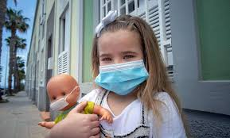
What does COVID-19 trauma or stress look like in children?
Regression academically and emotionally
Physical complaints
Sleep or appetite changes
Increase in disruptive behaviors
Withdrawal
Forgetfulness
Agitation or apathy or decreased energy
Strong feelings of fear or concerns about one’s own or family’s safety and health

Slide 4
Trauma informed approaches can promote resilience and healing for all

Slide 5
Establish a sense of safety
Create a structured and predictable routine
Maintain clear communication
Promote continuity of learning

Slide 6
Prioritize relationships and connection
Relationships before learning compliance
Student self-actualization
Be approachable
Perception of support

Slide 7
Continue and adapt social emotional learning
Continue SEL during summer and prepare to embed SEL in the fall transition
Promote self-awareness and self-regulation
Mindfulness and self-soothing exercises
Model and normalize emotions and experiences
Brain based education to families and students
Use data for continuous improvements
https://selproviders.casel.org/sel-resources/
https://casel.org/wp-content/uploads/2020/05/CASEL_Leveraging-SEL-as-You-Prepare-to-Reopen-and-Renew.pdf

Slide 8
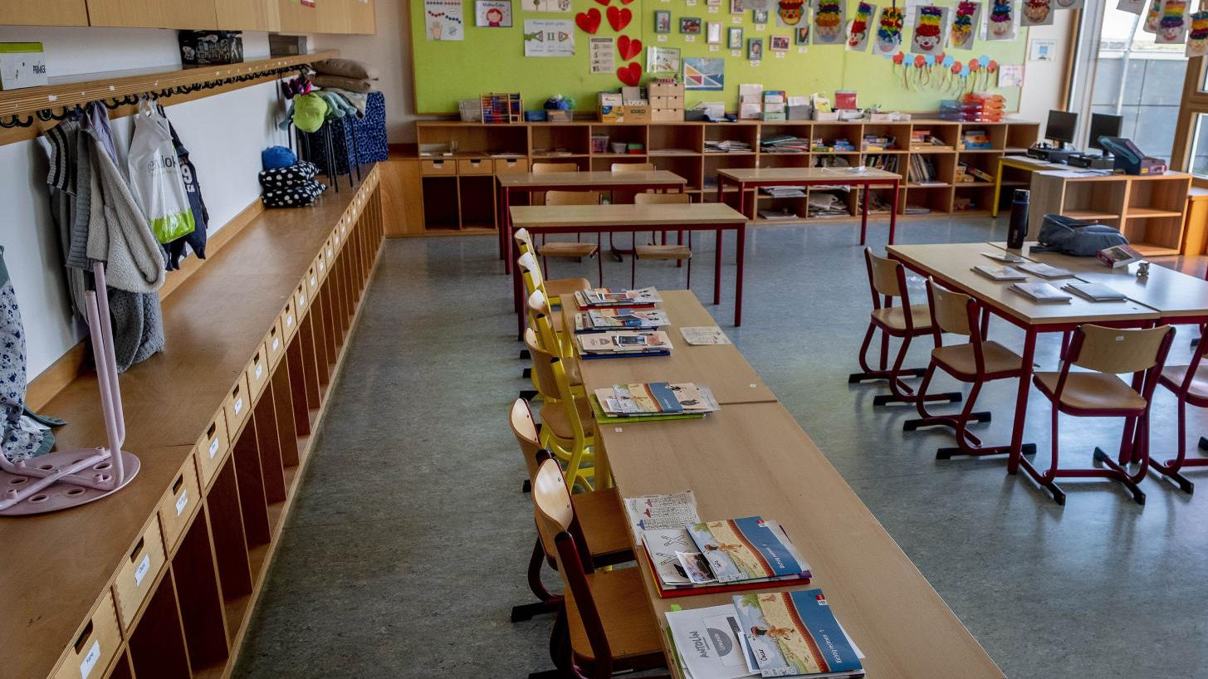
Staff social emotional learning and wellness
Allow space and create opportunities for connection and healing among school staff
Provide and enhance staff professional development with a focus on mental health and social emotional needs of students and themselves
Build infrastructures that make is easy for staff to connect to students and families
Ensure access to robust mental health supports for school staff now, and in the fall

Slide 9
Trauma Informed Parenting at Home
Regulate yourself
Mini-breaks, let go of control
Behavior is communication
Calm is contagious
Calmly assure children
Validate and normalize fears or anxieties about the pandemic
Develop a clear structure and routine
Visual schedules for every family member

Slide 10
Trauma Informed Parenting at Home
Play purposefully
Recess is essential
Focus on you
Find grace if you need a break, self-care, or have made a mistake
Stay connected to others
Physical distance, but do not socially isolate

Slide 11
Foster Hope

Slide 12
Questions and thoughts?
Sarah Younggren, LCSW
syounggren@mentalhealthcolorado.org

