Slide 1
Rural Primary Care Tools and Resources for Managing Suicidal Ideation During COVID-19
Shawnda Schroeder, Center for Rural Health
Thomasine Heitkamp, Mountain Plains MHTTC
Tammy Norville, National Organization of State Offices of Rural Health
Caitlin Peterson, Suicide Prevention Resource Center

Slide 2
Partners for Today’s Webinar
Mountain Plains Mental Health Technology Transfer Center
National Organization of State Offices of Rural Health
Suicide Prevention Resource Center
Center for Rural Health, University of North Dakota

Slide 3
Disclaimer
This presentation was prepared for the Mountain Plains Mental Health Technology Transfer Center under a cooperative agreement from the Substance Abuse and Mental Health Services Administration (SAMHSA). All material appearing in this presentation, except that taken directly from copyrighted sources, is in the public domain and may be reproduced or copied without permission from SAMHSA or the authors. Citation of the source is appreciated. Do not reproduce or distribute this presentation for a fee without specific, written authorization from the Mountain Plains Mental Health Technology Transfer Center. For more information on obtaining copies of this presentation please email
For more information on obtaining copies of this presentation, email Shawnda.Schroeder@UND.edu. At the time of this presentation, Elinore F. McCance-Katz, served as SAMHSA Assistant Secretary. The opinions expressed herein are the views of Thomasine Heitkamp, Shawnda Schroeder, Tammy Norville, and Caitlin Peterson and do not reflect the official position of the Department of Health and Human Services (DHHS), SAMHSA. No official support or endorsement of DHHS, SAMHSA, for the opinions described in this presentation is intended or should be inferred.

Slide 4
Presenters
Shawnda Schroeder
Research Associate Professor
Center for Rural Health
Thomasine Heitkamp
Chester Fritz Distinguished Professor
Director, Mountain Plains Mental Health Technology Transfer Center (MHTTC) and Addition Technology Transfer Center (ATTC)
Caitlin Peterson
Senior Project Associate for Health & Behavioral Healthcare Initiatives
Suicide Prevention Resources Center
Tammy Norville
Technical Assistance Director
National Organization of State Offices of Rural Health

Slide 5
Objectives
Explore mental health integration tools and resources for rural primary care providers during the COVID-19 pandemic.
Discuss the operational components of implementing suicide screening and referral to services for rural primary care providers, during the COVID-19 pandemic.
Identify local, state and national resources for rural primary care providers supporting patients with suicidal ideation.

Slide 6
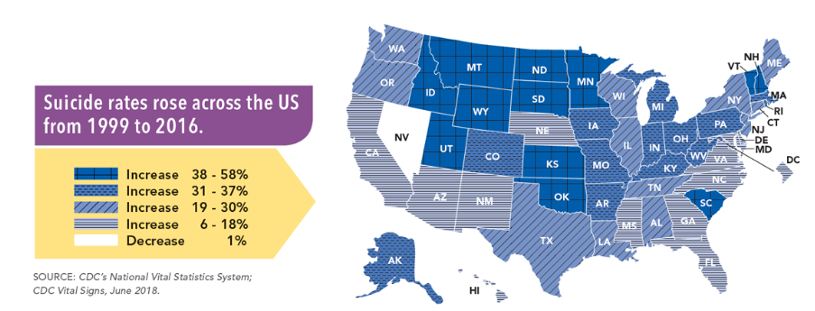
Rural Mental Health Inequities: Before COVID-19
2010-11, nonmetropolitan counties reported a higher percentage of residents with AMI (19.5%) than metropolitan counties (17.8%).
Nationally, 4% reported SMI, though rates rose with increasing rurality.
4.9%, or nearly 1.7 million, of residents of nonmetropolitan counties experienced serious thoughts of suicide during the year (2017).
Rural counties consistently had higher suicide rates than metropolitan counties from 2001-2015.

Slide 7
Rural Barriers to Mental Health Services
Accessibility
Rural residents may have limited access to mental healthcare due to cost of services, insurance coverage, lower behavioral health literacy which allows mental health concerns to go unrecognized and/or untreated, and the remote nature may require residents to travel long distances to receive services.

Slide 8
Rural Barriers to Mental Health Services
Accessibility: During a Global Pandemic (COVID-19)
At-risk patients concerned about visiting available providers or traveling to see providers limits accessibility.
Tele-mental health not an accessible option for all rural residents due to limited broadband access.
58% of rural residents believe access to high speed internet is a problem in their area – in contrast to 13% in urban areas and 9% in suburbs
Need to be mindful of the myriad of changes to tele-health practices and billing

Slide 9
Rural Barriers to Mental Health Services
Availability
County-Level Estimates of Mental Health Professional Shortage in the United States reports that higher levels of unmet need for mental health professionals exist in counties that were more rural and had lower income levels.

Slide 10
Rural Barriers to Mental Health Services
Availability: During a Global Pandemic (COVID-19)
Fewer providers working, or working fewer hours/home schooling children, adapting to work from home.
Increased need and demand which impacts availability.
CDC guidelines influencing how in-person visits need to occur and time spent with patient(s) which impacts availability.

Slide 11
Rural Barriers to Mental Health Services
Acceptability
Rural residents are likely to experience self-stigma, fear or embarrassment related to seeking out mental healthcare due to internal beliefs. When implementing rural mental health programs, community members and mental health care providers should consider how stigma may impact access and use of mental health services among rural residents. Lower health literacy and not recognizing the signs of various mental health issues can also serve as barriers to behavioral healthcare access in rural areas.

Slide 12
Rural Barriers to Mental Health Services
Acceptability: During a Global Pandemic (COVID-19)
Not recognize symptoms as mental health concern, but result of quarantine or physical distancing.
May downplay feelings and concerns.
Ongoing experience of self-stigma, fear or embarrassment related to seeking out mental healthcare due to internal beliefs.

Slide 13
Role of Primary Care in Rural Areas
Greater access to primary care than mental health care.
Less self-stigma to accessing primary care.
More likely to utilize primary care than mental health care.
Greater health literacy around primary care.
Established relationships in rural areas.

Slide 14
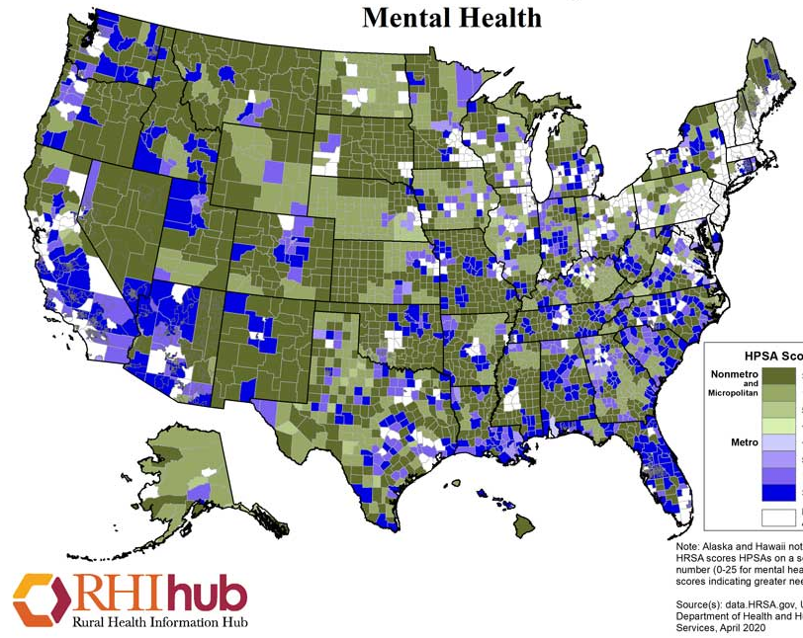
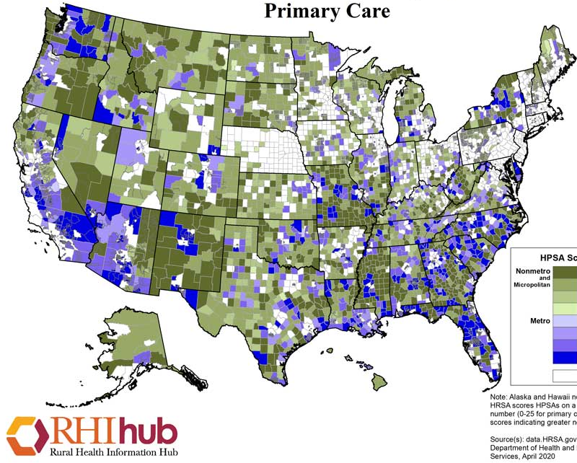
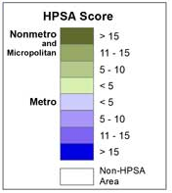
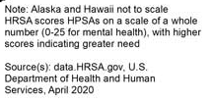

Slide 15
Rural Populations At-Risk for Mental Health Concerns
People who are older and have more chronic health conditions.
Tribal communities
(isolation, historical trauma from past pandemic of small pox, lack of understanding of tribal sovereignty, high suicide rates among youth).
Children
(lack of contact by teachers and other human service and health care providers creates greater risk of child abuse and neglect not being reported or an assessment conducted)
People in rural areas with behavioral health conditions including anxiety and depression
(often travel over 100 miles one-way to see a psychiatrist or psychologists).
Individuals in recovery from SUD
(including those on medically managed withdrawal, in residential treatment programs).
Individuals with mental health disorders including those who require access to psychotropic medications
(prescribers especially psychiatrists are great distance for their home).

Slide 16
Impact of COVID-19 on Mental Health: Unique Rural Considerations
Isolation and impact of economic downturn.
At-risk populations are at greater risk: Farm stress, unemployment, fears of things we can’t control i.e. weather when livelihood is dependent upon good weather
Increased drug and alcohol use.
Inactivity is exacerbated.
Great stigma (Schroeder et all study).
Tendency not to talk about problems; perceived as weak and COVID-19 enhanced isolation.

Slide 17
Pandemic Challenges and Opportunities for Rural Primary Care Providers
Public education.
Lack of access to resources in rural areas is exacerbated.
Spotlight on rural health care systems more generally.
A new focus on the impact of quarantine, isolation on mental health.
We’ve broken the pattern of brick and mortar mental health care.
(New guidelines daily on tele-health and tele-mental health)

Slide 18
New Opportunities: Tele-health
Telehealth Expanded Opportunity: Capitalize on the reduction in administrative barrier to treatment for primary care physician, advanced practice nurses and mental health care providers to offer telehealth. Use the new tele-health codes that are available and understand the new opportunities to conduct and bill for tele-behavioral health and health services.
https://mhttcnetwork.org/centers/mountain-plains-mhttc/telehealth-resources provides an extensive list of resource on tele-health that is updated with resources that are updated

Slide 19
Expanding Access to Treatment through Tele-health
It provides a forum to address stigma: You can secure services in your home/tractor/pick-up.
It is just as effective as in-person and with good efficacy (include in references).
Several HIPPA compliant platforms and new resources
https://cars-rp.org/_MHTTC/docs/Virtual-Learning-Guide.pdf

Slide 20
Mental Health Integration Tools and Resources for Rural Primary Care Providers: Underscores Need for Integration
Integration: to encompass care for patients around mental health, and substance abuse conditions, health behavior change, life stresses and crises, as well as stress-related physical symptoms.
Integrated care requires use of a consultative and team driven approach – effective (IPEC) as team work is cortical https://www.ipecollaborative.org/core-competencies.html

Slide 21
Resources for Rural Primary Care Providers Supporting Patients
Engage those that are most vulnerable:
Expand crisis intervention approaches (states are using SAMHSA disaster funding dollars to do this work. Check on what your state is doing through your State Behavioral Health Authority).
Educate regarding suicide prevention hotlines (National Suicide Prevention Lifeline, 1-800-273-TALK (8255), which also offers free materials, including posters and cards).
Expand access to compassion fatigue materials/trainings.
Use SAMHSA Treatment Locator https://findtreatment.samhsa.gov/
Provide education regarding how to manage stress
Use a variety of communication tools to educate people. In rural communities that may include talk radio, church bulletins, federal agencies like USDA example of a video that might be helpful for your patients https://www.youtube.com/watch?v=1KYC5SsJjx8.

Slide 22
Integrating Suicide Screens into Practice: Operational Considerations
https://mhttcnetwork.org/sites/default/files/2020-04/depression-alchohol-and-farm-stress_0.pdf MHTTC Provides a review of PHQ 2 and PHQ 9 page 22 and 23.
https://www.integration.samhsa.gov/clinical-practice/screening-tools SAMHSA Integrated Health Solutions (adolescent screening tools included) provides screenings in primary care to assist with earlier identification of mental health and substance use disorders which results in earlier care.
https://cssrs.columbia.edu/about-the-project/news-press/announcements/combating-social-isolation-columbia-protocol-community-resource-mitigate-covid-19-related-mental-health-sequelae/ The Columbia Index Lighthouse has a new tool entitled: COVID-19 UPDATE: Combating Social Isolation With the Columbia Protocol: A Community Resource to Mitigate COVID-19 Related Mental Health Sequelae (Andy really touts this as it is accessible and free)

Slide 23
Integrating Suicide Screens into Practice: Operational Considerations
https://www.integration.samhsa.gov/images/res/SAFE_T.pdf The SAFE-T provides a brief overview on conducting a suicide assessment using a five-step evaluation and triage plan. The plan involves identifying risk and protective factors, conducting a suicide inquiry, determining risk level and interventions, and documenting a treatment plan.
https://www.wiche.edu/files/files/Suicide_Prevention_Toolkit_US_April_2018.pdf WICHE’s Suicide Prevention Tool-Kit for Primary Care Providers
http://www.sprc.org/settings/primary-care/toolkit SPRC’s publication with WICHE

Slide 24
Rural Primary Care Tools and Resources for Managing Suicidal Ideation During COVID-19:
Local, State, and National Resources
June 2, 2020
Caitlin Peterson, M.S., MFT
Senior Project Associate, Health & Behavioral Healthcare
Suicide Prevention Resource Center
Education Development Center

Slide 25
Funding and Disclaimer
The Suicide Prevention Resource Center at EDC is supported by a grant from the U.S. Department of Health and Human Services (HHS), Substance Abuse and Mental Health Services Administration (SAMHSA), Center for Mental Health Services (CMHS), under Grant No. 5U79SM062297.
The views, opinions, and content expressed in this product do not necessarily reflect the views, opinions, or policies of CMHS, SAMHSA, or HHS.

Slide 26
Overview
A brief overview of the Suicide Prevention Resource Center
A quick review of what screening, assessment, & safety planning can look like in primary care settings, both in-person and via telehealth
Information on helpful resources detailing actionable steps to improving suicide prevention efforts in rural primary care settings

Slide 28
Suicide Prevention Resource Center
The SPRC and Zero Suicide websites include resources covering a broad spectrum of care, including community settings, primary care, acute care, inpatient, and outpatient care that include:
Screening and assessment
Care planning and management
Evidence-based treatment approaches for suicide prevention
Safety planning and risk management
Care transitions
Workforce training
State planning and infrastructure
Information on accessing these resources will be made available shortly after the webinar

Slide 29
SPRC COVID-19 Resources
http://www.sprc.org/covid19

Slide 30
Suicide Prevention in a Rural Context
Key risk factors in rural settings:
Health professional workforce shortages
Cultural barriers to help seeking and receiving treatment
Challenges accessing care
Social isolation/lack of connectedness
Access to lethal means, particularly firearms
Key populations:
American Indian/Alaska Native
Veterans
Middle-aged Men
Opportunities:
Screening in primary care
Telemedicine
Crisis Care/Crisis Services
Community Health Workers
Source: Understanding the Impact of Suicide in Rural America: Policy Brief and Recommendations, Department of Health and Human Services, 2017

Slide 31
Suicide Prevention in a Rural Context

Slide 32
Screening & Assessment
Based on the best available guidance on suicide prevention in health and behavioral health care, it is recommended that all patients age 12 and above are routinely screened for suicide risk using validated screening instrument
Screening should ask specifically and directly about suicide risk with questions such as:
An example from the PHQ-9: “During the past two weeks, have you been bothered by thoughts that you would be better off dead or of hurting yourself in some way?”
“Over the past two weeks, have you been bothered by:
Little interest or pleasure in doing things?
Feeling down, depressed, or hopeless?
Thoughts that you want to kill yourself or have you attempted suicide?”

Slide 33
Screening & Assessment
Once a patient has screened positively for suicide risk, a suicide risk assessment should be completed with the patient immediately
The assessment should include gathering further details regarding:
Thoughts of suicide and harming one’s self/others
Behaviors related to death or harm to self or others
A plan to attempt death by suicide or to harm others, including timeframe, location, and means
Access to lethal means/method
Intent to follow through on plans
One example of an assessment tool that includes the above is the Columbia Suicide Severity and Rating Scale (C-SSRS) (https://cssrs.columbia.edu/the-columbia-scale-c-ssrs/about-the-scale/)

Slide 34
Adaptations for Suicide Risk Assessment
In addition to standard risk assessment, assess for the emotional impact of the pandemic on suicide risk.
Possible COVID-related risk factors: social isolation; social conflict in sheltering together; financial concerns; worry about health or vulnerability in self, close others; decreased social support; increased anxiety and fear; disruption of routines and support.
Inquire about increased access to lethal means (particularly stockpiles of medications, especially acetaminophen (Tylenol) and psychotropic medications).
Stanley, B. 2020, April 14. Treating Suicidal Patients During COVID-19: Best Practices and
Telehealth. Retrieved from http://zerosuicide.edc.org/webinars-and-presentations/webinar-treating-suicidal-patients-during-covid-19-best-practices-and

Slide 35
Safety Planning
Every patient who screens positive for suicide risk and is assessed to be at any risk of suicide should not leave a provider’s office until a collaborative safety plan has been created
Safety plans should include the following:
Warning signs
Coping skills
Support people/services, along with contact information
Following up regarding the safety plan at subsequent visits
One example of a safety planning tool that can be utilized in a primary care setting is the Safety Plan Intervention (Stanley & Brown) (suicidesafetyplan.com)

Slide 36
Talking about Access to Lethal Means Matters
When talking with patients about suicide risk, it’s vital to assess their chosen method and discuss ways to help them safely and legally limit their access to lethal means, especially medications and firearms
This can be especially complicated when it comes to medication that is necessary for ongoing treatment, as well as for those who have attachment to their firearms and are wary of giving them up
Limiting access to lethal means doesn’t have to mean getting rid of an item completely or forever, but can instead mean limiting access for a specific period of time and enrolling the assistance of trusted individuals and coming up with a plan for when these items will be returned
Free resource: Counseling on Access to Lethal Means (CALM) training
https://www.sprc.org/resources-programs/calm-counseling-access-lethal-means

Slide 37
Building a Safety Net for Patients at Risk
After a patient leaves a provider’s office, it is vital that they connect to a safety net in the community – during the COVID-19 pandemic, this safety net may be virtual rather than in-person
Providers must know who in the community can be part of the safety net, this might include those who would normally respond, but should also include those individuals and resources specific to the patient
Resources should go beyond referrals to outpatient care, and should include:
Peer responders – many have warmlines (NAMI)
Crisis organizations
Support groups (virtual or in-person, depending on circumstances)
For pediatric populations, consider the school-based services that might be available – some may be able provide support virtually

Slide 38
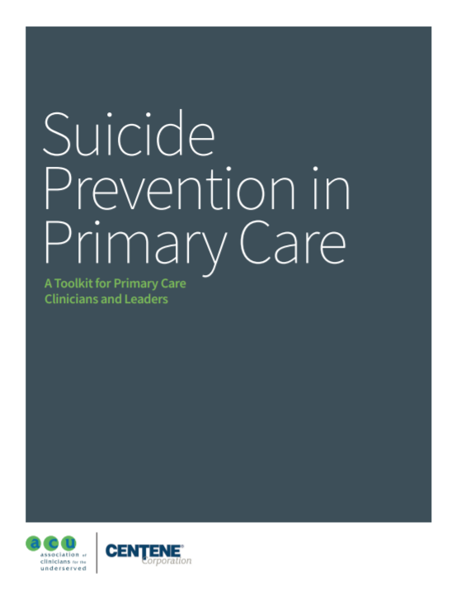
Suicide Prevention in Primary Care: A Toolkit for Primary Care Clinicians and Leaders
This toolkit provides tools and guidance such as:
Information summarized for providers speaking to patients about suicide risk, including some helpful provider communication tips
A list of recommended trainings and resources
Leadership actions organizations may wish to undertake to help providers reduce suicide in their organization’s patient population
Relevant tools, templates and case studies

Slide 39
Suicide Prevention Toolkit for Primary Care Practices
Among other helpful guidance, the toolkit contains the following:
A quick start guide that walks PCPs and office staff through the step-by-step development of a comprehensive yet streamlined strategy to help save patient lives.
Patient education and care management tools, including pocket-sized cards and templates to facilitate patient assessment and intervention.
A section on state resources, policy, and reimbursement

Slide 40
Recommended Standard Care for People with Suicide Risk: Making Health Care Suicide Safe
This guidance document contains:
The first-ever recommendations on suicide-related standard health care for primary care, behavioral health, and emergency department settings
Feasible, practical, and evidence-based actions that health care organizations can adopt immediately
Guidance developed with public and private sector experts, researchers, clinicians and consumers

Slide 41
COVID-19 Specific Resources
SPRC Resources to Support Mental Health and Coping with the Coronavirus (COVID-19): http://www.sprc.org/covid19
Access to mental health resources for a wide variety of audiences, including mental health professionals, medical professionals, first responders, teachers, community leaders, and more
Zero Suicide—Providing Suicide Care During COVID-19: http://zerosuicide.edc.org/covid-19
Access to recent webinars and guidance documents, including those related to suicide care via telehealth, information specifically for primary care providers, and updated guidance documents related to evolving regulations and billing

Slide 42
Screening & Assessment Resources
Screening Examples
Patient Health Questionnaire (PHQ): https://www.apa.org/pi/about/publications/caregivers/practice-settings/assessment/tools/patient-health
C-SSRS: https://cssrs.columbia.edu/documents/c-ssrs-screener-triage-primary-care/
Assessment Examples
SAFE-T: This resource gives a brief overview on conducting a suicide assessment using a five-step evaluation and triage plan; available via pocket card and app at https://store.samhsa.gov/product/SAFE-T-Pocket-Card-Suicide-Assessment-Five-Step-Evaluation-and-Triage-for-Clinicians/sma09-4432
C-SSRS: https://cssrs.columbia.edu/the-columbia-scale-c-ssrs/about-the-scale/

Slide 43
Resources – Safety Planning & Creating a Safety Net
Suicide Safety Plan (Stanley & Brown): suicidesafetyplan.com
Also available as an app for both Apple and Android devices
Dr. Stanley participated in a number of recent webinars related to safety planning in the time of the COVID-19 pandemic, which can be located by visiting the Zero Suicide COVID-19 resource page
Locating safety net resources:
211.org – this website can help you locate your local information and referral hotline that can give you information regarding organizations in your community that might offer peer resources, support groups, and other valuable safety net resources, as well as basic needs information
You can locate your local National Suicide Prevention Lifeline crisis hotline by visiting https://suicidepreventionlifeline.org/our-network/
Locate your local NAMI chapter: https://www.nami.org/home

Slide 44
Resources - Crisis
SAMHSA’s Disaster Distress Helpline
Call: 800-985-5990
Text/SMS: Text TalkWithUs or Hablanos (for Spanish) to 66746 Full details at: https://www.samhsa.gov/find-help/disaster-distress-helpline
National Suicide Prevention Lifeline
Call: 1-800-273-TALK (8255)
Chat available: https://suicidepreventionlifeline.org/chat/
Crisis Text Line – text “Home” to 741741 for 24/7 access to crisis counselors via text

Slide 45
Resources - Crisis
Trevor Project – available via hotline, chat, and text to support LGBTQ youth
Call: 1-866-488-7386
Website: https://www.thetrevorproject.org/
TransLifeline – A peer-led crisis hotline available to support people who are trans and/or questioning
Call: 877-565-8860
National Domestic Violence Hotline: Available by phone and chat
Call: 1-800-799-SAFE (7233)
Website: https://www.thehotline.org/help/

Slide 46
Resources - States
Locate your state’s Suicide Prevention Coordinator: https://www.sprc.org/states
Access information on state suicide prevention infrastructure: https://www.sprc.org/state-infrastructure
Find your state’s National Alliance on Mental Illness (NAMI) chapter at https://www.nami.org/Home

Slide 47
Operational Perspective - Is there reimbursement for these services?
Tammy Norville
Technical Assistance Director
June 2, 2020

Slide 48
A Little About Me
North Carolina native
Graduate of UNC-Chapel Hill
Worked at NC ORH for almost 15 years providing hands-on, in-depth TA to rural safety-net providers across the state
CPC-I, CPC, RMM, RMB, RMC

Slide 49
Disclaimer
The Center for Medicare/Medicaid Services (CMS) announces changes to documentation requirements and/or effective dates periodically. The following materials were created for the current environment.
CMS will continue to issue new guidance throughout the year; Medicare makes changes to its bundling edits each calendar quarter. Changes to Evaluation and Management Services and Telemedicine are inevitable.
The information provided here is general information only, and the user organization should consult with their Medicare Administrative Contractor (MAC) or other payer for specific reimbursement rules prior to implementing any billing processes or decision.

Slide 50
Disclaimer (continued)
Third-party payer interpretations of coding and billing rules and regulations can differ greatly. The following materials are intended to provide guidance and should not be relied on as a guarantee of payment.
The materials were prepared as a tool to assist healthcare service providers in enhancing a general understanding of documentation and coding principles. Although every effort has been made to ensure the accuracy of the information, the ultimate responsibility for the use of this information lies with the user. NOSORH does not assume nor accept responsibility or liability regarding errors, omissions, misuse or misinterpretation.

Slide 51
Specific Information
The following information is based on general Centers for Medicare and Medicaid Services guidelines due to the organizational variety of participants.
If your organization experiences challenges with specific scenarios or if you have specific questions, please do not hesitate to reach out to me (Tammy Norville – tammyn@nosorh.org). In collaboration with the appropriate State Office of Rural Health (SORH), will work to find resources that might assist in resolution of those specific scenarios.

Slide 52
Important Fact
I am not clinical.
Notes:
Any questions before we dig in?

Slide 53
Quick & Dirty Coding Class
CODING
DOCUMENTATION
BILLING
COMPONENTS

Slide 54
Documentation
The cornerstone of the business.
(aka, If it’s not documented, it didn’t happen and therefore cannot be coded nor billed for reimbursement.)

Slide 55
What is Coding?
“Medical coding is the transformation of healthcare diagnosis, procedures, medical services, and equipment into universal medical alphanumeric codes.”
Source: https://www.aapc.com/medical-coding/medical-coding.aspx

Slide 56
Why Do We Code?
“Accurate” reimbursement
Exchange health data with other organizations and government agencies
Provide evidence for healthcare policy advocacy work
• Evaluate utilization of resources
• Track potential public health threats (such as Lyme Disease, Flu, Ebola, etc.)
• Measure quality of care

Slide 58
Like Dominoes
Incomplete documentation, leads to incomplete coding, leads to incomplete billing, leads to incomplete reimbursement.

Slide 59
Denials

Slide 60
Reimbursement 101

Slide 61
Telling the Story
Use reports (aka, data) to tell the story of the services provided.
Every service has a purpose – or don’t do it, right? (aka, medical necessity)
Why, How & What of the service
Connect to value

Slide 62
Procedure Codes
Telehealth Services for Public Health Emergency for the COVID-19 Pandemic Effective March 1, 2020 (rev. 4/30/2020)

Slide 63
RHC Specific Information
New and Expanded Flexibilities for Rural Health Clinics (RHCs) and Federally Qualified Health Centers (FQHCs) During the COVID-19 Public Health Emergency (PHE)
MLN Matters SE20016 Revised
April 30, 2020

Slide 64
Other Considerations
“Distant site telehealth services can be furnished by any health care practitioner working for the RHC or the FQHC within their scope of practice. Practitioners can furnish distant site telehealth services from any location, including their home, during the time that they are working for the RHC or FQHC, and can furnish any telehealth service that is approved as a distant site telehealth service under the Physician Fee Schedule (PFS).”
SOURCE: MLN Matters SE20016 Revised April 30, 2020

Slide 65
Other Considerations
Question: Who are the Qualified Providers who are permitted to furnish telehealth services under the PHE waiver?
Answer: The same health care providers are still permitted to furnish Medicare telehealth services under the waiver authority during the Public Health Emergency, including physicians and certain non-physician practitioners such as nurse practitioners, physician assistants and certified nurse midwives. Other practitioners, such as certified nurse anesthetists, licensed clinical social workers, clinical psychologists, and registered dietitians or nutrition professionals may also furnish telehealth services within their scope of practice and consistent with Medicare benefit rules that apply to all services. New: 4/9/20
SOURCE: CMS COVID-19 Frequently Asked Questions (FAQs) on Medicare Fee-for-Service (FFS) Billing

Slide 66
No Time Today For…
MODIFIERS!!
A mention in passing…
25
51
59
CS
CG

Slide 67
Partner Resource
Rural Health Information Hub (RHI-Hub)
Primary Care Behavioral Health Model
Provides general framework information as well as best practices examples of Rural Programs that
integrate Behavioral Health into
Primary Care.

Slide 68
CMS Behavioral Health Integration Services

Slide 69
Resources
CMS – REVISED MLN Matters SE20016– RHC & FQHC Telehealth Distant Site Guidance 4/30/2020
CMS – Medicare Coverage and Payment of Virtual Services (YouTube) 4-3-2020
CMS – Rural Health Clinics (RHCs) and Federally Qualified Health Centers (FQHCs): CMS Flexibilities to Fight COVID-19 REVISED 4/29/2020
CDC – ICD-10-CM Official Coding and Reporting Guidelines April 1, 2020 through September 30, 2020
CMS – MLN Connects Special Edition Telehealth V
USDA – COVID-19 Telehealth Service Changes – Rural Telehealth Fact Sheet 5/1/2020ideo 4-7-2020
USDA – COVID-19 Federal Rural Resource Guide

Slide 70
Resources
ArchProCoding – Billing and Coding for COVID-19: Reporting Coronavirus Related Services Including Telemedicine
ArchProCoding – Facilitating HIPAA Compliance During the COVID 19 Pandemic

Slide 71
Questions or Comments? Thanks so much! Your participation is appreciated!
Tammy Norville NOSORH Technical Assistance Director Phone: 919.689.5110
Mobile: 919.215.0220 (including text) Email: tammyn@nosorh.org
Notes:
Again… my name is Tammy Norville and I’m the Technical Assistance Director for the National Organization of State Offices of Rural Health. It’s been a pleasure being with you today.
Please don’t hesitate to reach out with questions, for discussion or if I may be of assistance. That’s why I’m here.

Slide 72
Q&A With Presenters
Thank you so much for joining us today!

