Slide 1
Thank you for joining us today!
All attendees are muted, and all attendees' videos have been turned off.
Today’s session will be recorded and posted on our website.
Please Note:

Slide 2
Housekeeping Items
We have made every attempt to make today’s presentation secure. If we need to end today’s presentation unexpectedly, we will follow-up with you using your registration information.
All attendees are muted, and attendees cannot share video during this session.
Remember to ask questions using the Q&A feature.
Slides and resources for today’s session can be accessed on our program website.
Certificates of attendance are available for today’s session.
Instructions on how to obtain a Certificate of Attendance will be posted in the chat box and in a follow-up email.
Follow us on social media:
@MPMHTTC @MountainPlainsMHTTC

Slide 3
Evaluation Information
The MHTTC is funded through SAMHSA to provide this training. As part of receiving this funding we are required to submit data related to the quality of this event.
At the end of today’s training please take a moment to complete a brief survey about today’s training.
https://ttc-gpra.org/P?s=945555

Slide 4
Disclaimer
This presentation was prepared by the Mountain Plains Mental Health Technology Transfer under a cooperative agreement from the Substance Abuse and Mental Health Services Administration (SAMHSA). All material appearing in this presentation, except that taken directly from copyrighted sources, is in the public domain and may be reproduced or copied without permission from SAMHSA or the authors. Citation of the source is appreciated. Do not reproduce or distribute this presentation for a fee without specific, written authorization from the Mountain Plains MHTTC. For more information on obtaining copies of this presentation please email gberry@wiche.edu.
At the time of this presentation, Elinore F. McCance-Katz served as SAMHSA Assistant Secretary. The opinions expressed herein are the views of Shawnda Schroeder, Justine Ashokar, Liz Gerdeman, Kate Kerkmans, Rebecca Quinn, and Rebeccah Wolfkiel, and do not reflect the official position of the Department of Health and Human Services (DHHS), or SAMHSA. No official support or endorsement of DHHS, SAMHSA, for the opinions described in this presentation is intended or should be inferred.

Slide 5
Mountain Plains Mental Health Technology Transfer Center
The Mountain Plains Mental Health Technology Transfer Center (MHTTC) provides training and technical assistance to individuals who serve persons with mental health concerns throughout Region 8 (Colorado, Montana, North Dakota, South Dakota, and Utah). We belong to the Technology Transfer Center (TTC) Network, a national network of training and technical assistance centers serving the needs of mental health, substance use and prevention providers. The work of the TTC Network is under a cooperative agreement by the Substance Abuse and Mental Health Service Administration (SAMHSA).

Slide 6
How States are Addressing TBI and Mental Health
Shawnda Schroeder, PhD, Mountain Plains Mental Health Technology Transfer Center
Justine Ashokar, PhD, The Brain Injury Rehabilitation Center at Black Hills Works
Liz Gerdeman, MA, CBIST, MINDSOURCE Brain Injury Network
Kate Kerkmans, LCSW, CBIS, The Brain Injury Alliance of Colorado
Rebecca Quinn, MSW, LMSW, North Dakota Traumatic Brain Injury Network
Rebeccah Wolfkiel, MPP, National Association of State Health Injury Administrators
September 21, 2020
https://mhttcnetwork.org/centers/mountain-plains-mhttc/event/panel-discussion-how-states-are-addressing-tbi-and-mental

Slide 7
Justine Ashokar, PhD
Director of Clinical Services
The Brain Injury Rehabilitation Center

Slide 8
Liz Gerdeman, MA, CBIST
Director, MINDSOURCE – Brain Injury Network Colorado Department of Human Services

Slide 9
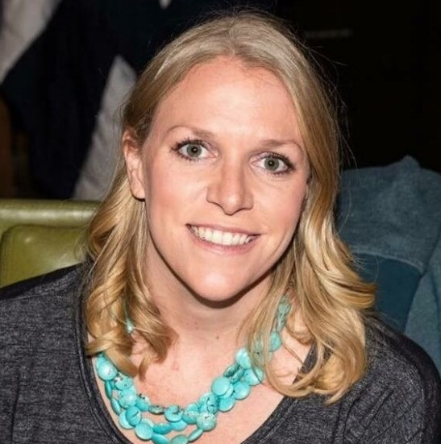
Kate Kerkmans, LCSW, CBIS
Director of Client Programs

Slide 10
Rebecca Quinn, LMSW, CBIST
Program Director
rebecca.quinn@und.edu
701-777-5200
Contact us today!
855.866.1884
www.ndbin.org

Slide 11
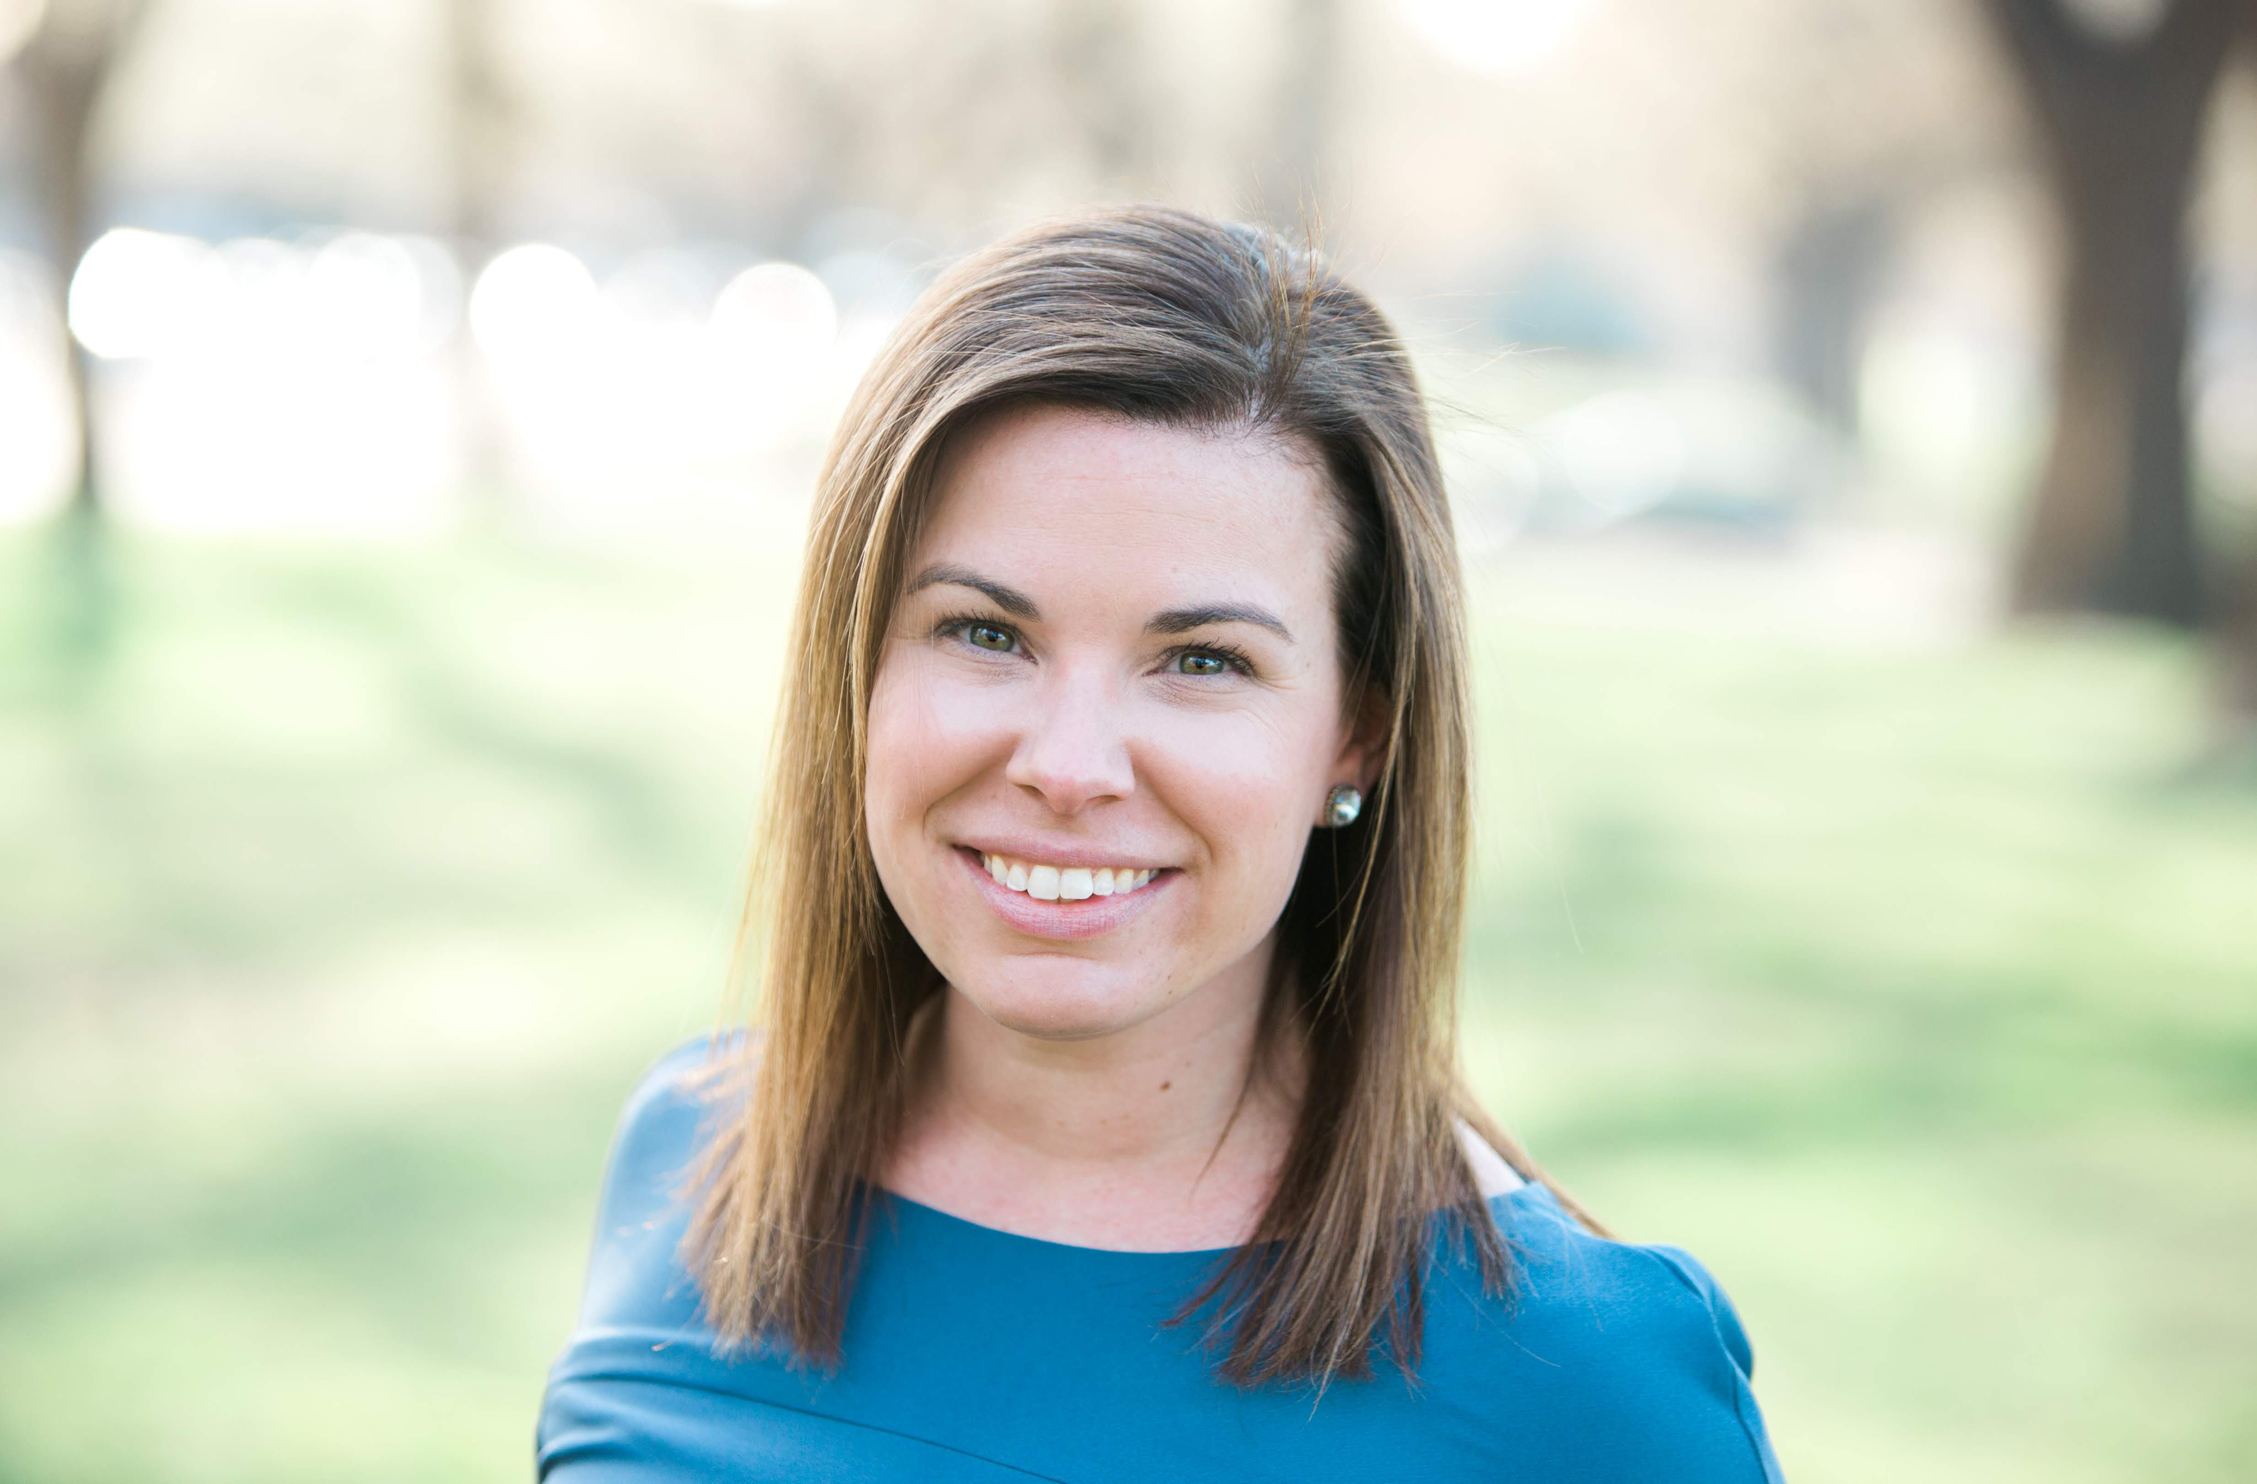
Rebeccah Wolfkiel, MPP
Executive Director
National Association of State Head Injury Administrators

Slide 12
Resources
Brandeis University resources about the interconnectivity between opioid misuse and brain injury.
VA Rocky Mountain MIRECC on Suicide Prevention toolkit on TBI and co-occurring conditions.
Factsheets on depression and emotional conditions after TBI: Model Systems Knowledge Translation Center.
In U.S. odds of committing suicide were 1.5-4x higher in veterans and civilians with TBI than in without.
Suicidal ideation can be 7x higher in people with TBI than in those without.
Attempts of suicide post TBI can be at rates close to 17%
Increased suicide risk persists up to 15 years post-injury
(Fazel, et al. 2014. JAMA Psychiatry, 71(3), 326-33.; Mackelprang et al., 2014. Am J Public Health, 104(7), e100; Simpson & Tate, 2007. Brain Inj., 21(13-14), 1335-51.)
CDC TBI-related Deaths
Association Between Traumatic Brain Injury and Risk of Suicide
Traumatic Brain Injury-Related Deaths From Firearm Suicide: United States, 2008-2017
Extensive listing of resources and informational handouts for TBI related conditions: https://www.ndbin.org/services/related

Slide 13
Evaluation Information
The MHTTC is funded through SAMHSA to provide this training. As part of receiving this funding we are required to submit data related to the quality of this event.
At the end of today’s training please take a moment to complete a brief survey about today’s training.
https://ttc-gpra.org/P?s=945555

Slide 14
Thank you for joining us today!

