Slide 1


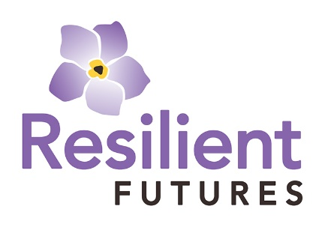
Trauma-Responsive Practices in Schools

Slide 2




Group Norms
Share what feels comfortable
Be mindful of the impact of our words or stories on others
Pay attention to yourself – color, use fidgets, stretch, stand up
Take a break if needed
Feel free to reach out in chat with reflections or questions
Remember that we enter this space with varying levels of knowledge and understanding
Personal experiences influence how we internalize information
What else?

Slide 3
Reflection
Share a reflection with the group of something that resonated with you from the training yesterday.

Slide 4
Key Learning Points
Introduction to Cultural Humility as a main tenet of trauma-informed practices
Challenge deficit mindset when implementing trauma-informed practices
Discuss strategies for deepening relationships that are compassionate and attuned to engage trauma-affected youth
Learn practices to foster a trauma-informed classroom (virtually or in-person) and school environment
Discuss trauma-informed strategies for supporting youth when schools re-open

Slide 5
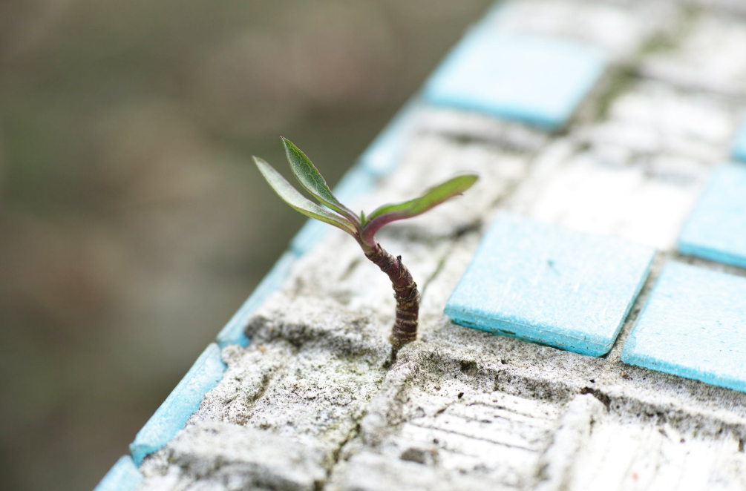
Experience is Not Destiny
“Trauma is not an excuse for behavior;
it is an explanation for it.”
-Dr. Bruce Perry

Slide 6

Core Guiding Principle:
Cultural Humility & Equity
We are from diverse social and cultural groups that may experience and react differently to stress and trauma.
When we are open to understanding these differences and respond with sensitivity, we increase understanding and equity is enhanced.

Slide 7

Cultural Humility
Video Credit: Vivian Chavez (2012), edited by W. B. Jordan (2015)

Slide 8

Cultural Humility Video Response
Reflect and journal about the following questions:
Head – What did I learn?
Heart – What am I feeling?
Feet – What am I taking away?
Hand – What would I do different?

Slide 9
Dyadic Listening Guidelines
The listener does not speak to interpret, paraphrase, analyze, give advice, or break in with a personal story.
Confidentiality is maintained.
The talker is not to criticize or complain about the listener or mutual acquaintances.
Honor silence.

Slide 10
Dyad Share
What resonated with you in this video?
Notes:
Break out – dyads – total of 5 minutes

Slide 11
Cultural Humility (2)
“More than a concept, Cultural Humility is a process of communal reflection to analyze the root causes of suffering and create a broader, more inclusive view of the world.”
-Tervalon & Murray-Garcia, 1998

Slide 12
Cultural Humility (3)
Lifelong learning and critical self-reflection
Recognizing and changing power imbalances
Developing institutional accountability

Slide 13
Core Guiding Principle:
Cultural Humility & Equity (2)
In response to the COVID-19 pandemic:
We come from diverse cultural groups that may react to the outbreak differently.
One cultural group may focus on the economics of the pandemic (e.g., buying lots of groceries). Another cultural group may focus on a religious perception of the pandemic (e.g., focusing on prayer during this time).
All responses should be honored equally.

Slide 14

The Power of Story

Slide 15
The Pair of ACEs
Source: Miliken Institute of Public Health, George Washington University

Slide 16

What is in your community’s soil that creates adversity?
Notes:
Break out small groups – total of 10 minutes (4 groups total)

Slide 17
What strengths are in your community’s soil that can be fertilized to build well-being and resilience?

Slide 18
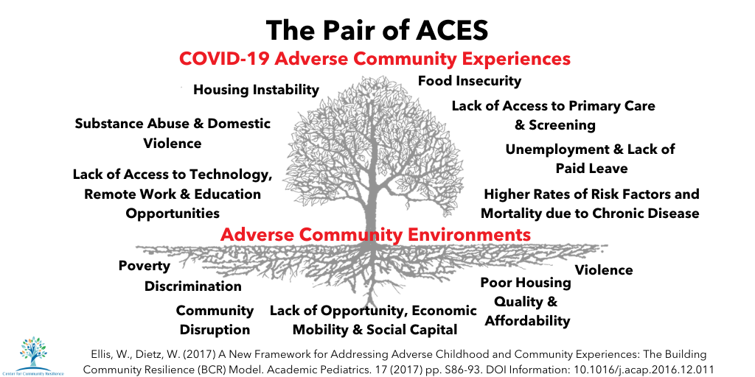
The Pair of ACEs.
Notes:
Break out – dyads – total of 5 minutes

Slide 19

Let’s Take a Break

Slide 20
Deficit Thinking Model
Belief that students fail in school because of their own deficiencies
Often attributed to parents/caregivers that do not value education
(Garcia & Guerra, 2004)

Slide 21

Deficit Thinking Model (2)
Belief doesn’t acknowledge unfair school policies or differential treatment
(Garcia & Guerra, 2004)

Slide 22

The Power of Language

Slide 23

The Power of Language:
Our Internal Dialogue

Slide 24
Classroom/School Application
Consistently engage in culturally responsive teaching practices
Know what pushes your buttons
Continually examine the role of bias
a. Self-reflection
b. Enlist an accountability partner

Slide 25
Critical Self-Reflection & Lifelong Learning
Ongoing reflection is a cornerstone of learning.
We know that when students, or any of us for that matter, are given time to reflect about what they’re doing or what they’re learning, they understand more fully why something is the way it is, not simply that it is.

Slide 26
Activity: Journal
What pushes your buttons in a physical classroom?
What pushes your buttons in a virtual classroom?

Slide 27
Let’s Take a Break.

Slide 28

Core Guiding Principle:
Compassion & Dependability
Trauma can leave us feeling isolated or betrayed, making it difficult to trust others.
When we experience compassionate and dependable relationships, we re-establish trusting connections with others.

Slide 29
Core Guiding Principle:
Compassion & Dependability (2)
In response to the COVID-19 pandemic:
The coronavirus outbreak can cause us to feel uncertainty and panic; social distancing can leave us feeling isolated and overwhelmed.
These factors may make it difficult for us to feel like we can trust or depend on others. But without a sense of trust, we cannot feel compassion, and compassion is a key component to building connection and addressing trauma.

Slide 30
What is Compassion?
In the classroom, it is the way you understand and interact with your students to build strong connections.
Fostering strong connections with students, between students, and in the school community builds resilience and readiness to learn!

Slide 31
What do we know about attachment?
Close personal bond between infant and caregiver that endures across time
Involved in modulating the stress-response system and emotional regulatory system
Fosters exploration and mastery, feelings of self-confidence, empathy, language development, reasoning processing, and the ability to manage and resolve conflict
Forms our foundations for relationships: it shapes the expectations (template) of what to expect of ourselves, and how to perceive the world

Slide 32
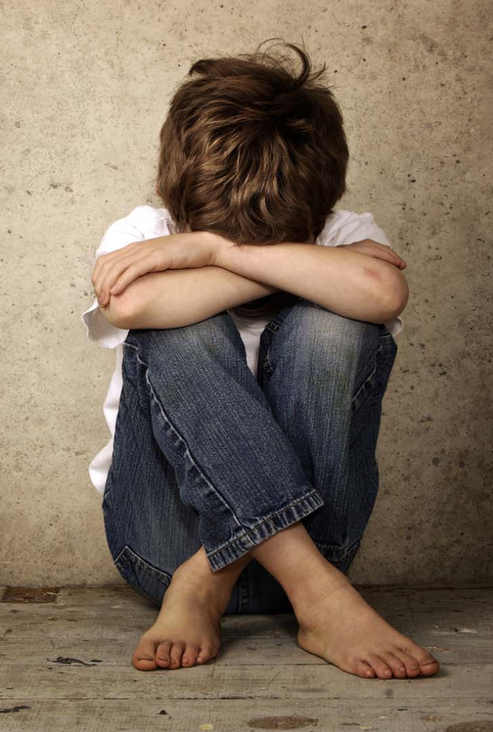
Attachment Difficulties
Related to Trauma
Uncertainty about reliability and predictability of relationships
Interpersonal difficulties
Healthy boundaries
Distrust
Suspicion
Social isolation
Asking for help
(NCTSN, 2003)

Slide 33
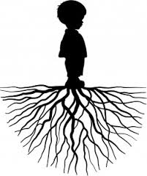
Complex Trauma Interferes with
Co-regulation
If a child’s caregiver is a source of trauma or unavailable to provide co-regulation, the child’s development of emotional regulation skills can be derailed: a hallmark symptom of complex trauma
This can affect relationships into adulthood
Relationships are also where healing takes place

Slide 34
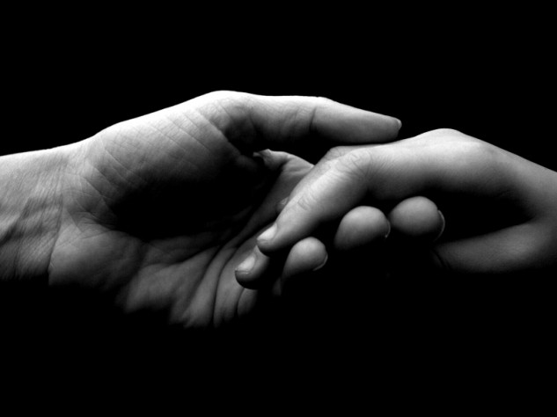
Connection & Attunement
Connection:
Nurtures relationships
Cultivates compassion
Fosters empathy and attunement
Attunement:
Attuned relationships prevent mismatch between “need and provision”
Attuned relationships help us to feel safe and calm down when we are stressed out

Slide 35
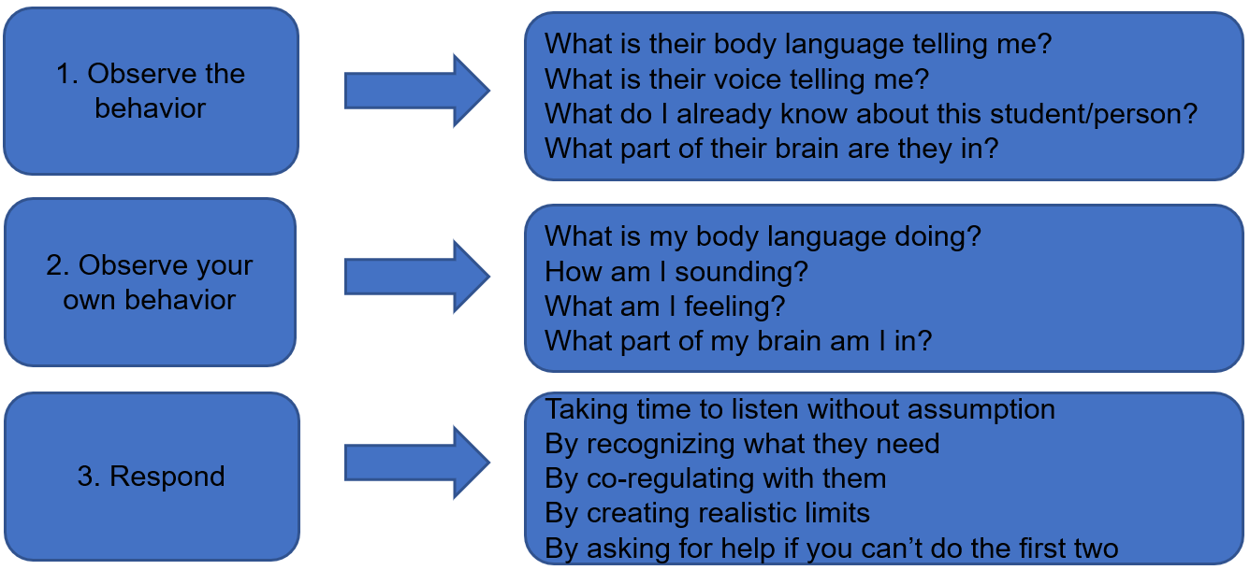
Connecting through Attunement
Adapted from UCSF HEARTS; Dorado, Martinez, McArthur, & Leibovitz (2016)
Notes:
Small groups – 10 minutes

Slide 36
Activity (2)
In small groups, read the vignette and answer the questions on the handout.

Slide 37
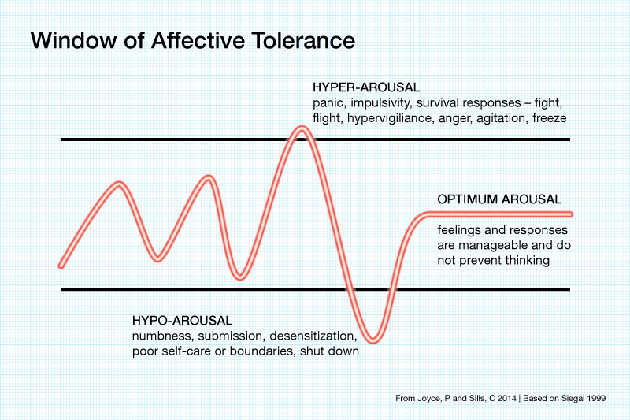
Affective Tolerance

Slide 38
Let’s Take a Break..

Slide 39
Fostering Resilience
Connection
Coping
Competence
ARC Model, Blaustein & Kinniburgh, 2010

Slide 40
“When children have positive early experiences, they strengthen their developing biological systems and are more likely to thrive and become healthy adults.”
-Center for the Developing Child at Harvard University

Slide 41
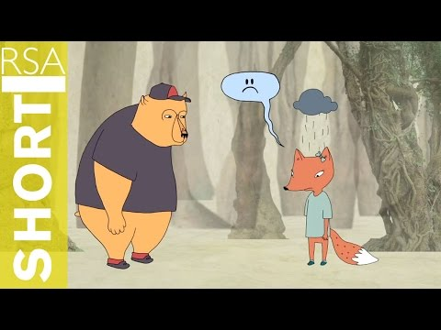
Identifying Feelings in Others
Video Credit: The RSA (2013)

Slide 42
Connection Circles
A relationship-building process to promote safety through predictability and sharing of experiences
Connection Circle Leader:
Introduce the circle
Uphold co-created group norms
Ask a question to the group
Actively listen and model group norms
Allow a pass – go back around
Close circle and thank everyone for their participation

Slide 43
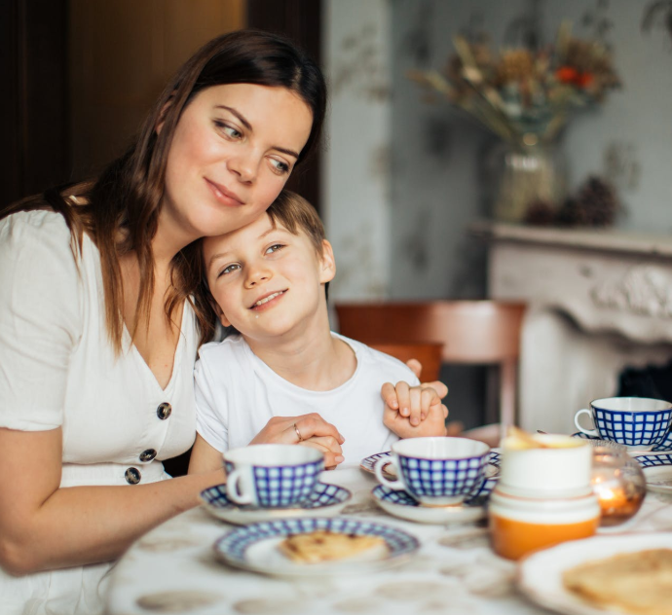
Fostering Resilience:
Connection
Consistent, responsive, nurturing relationships with caring adults is key.

Slide 44

Fostering Resilience:
Connection (2)
Relational Strategy:
Listening first (dyadic listening)

Slide 45
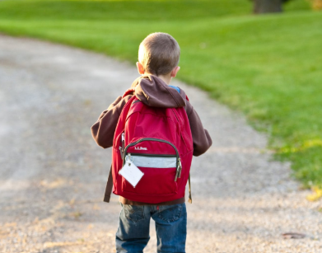
Fostering Resilience:
Connection (3)
Relational Strategy:
Don’t take it personally

Slide 46

Fostering Resilience:
Connection (4)
Relational Strategy:
Repair the relationship (apologize after a rupture, debrief)

Slide 47
Cultural Humility & Connection
Authentic connection requires a lens of cultural humility
Being curious

Slide 48
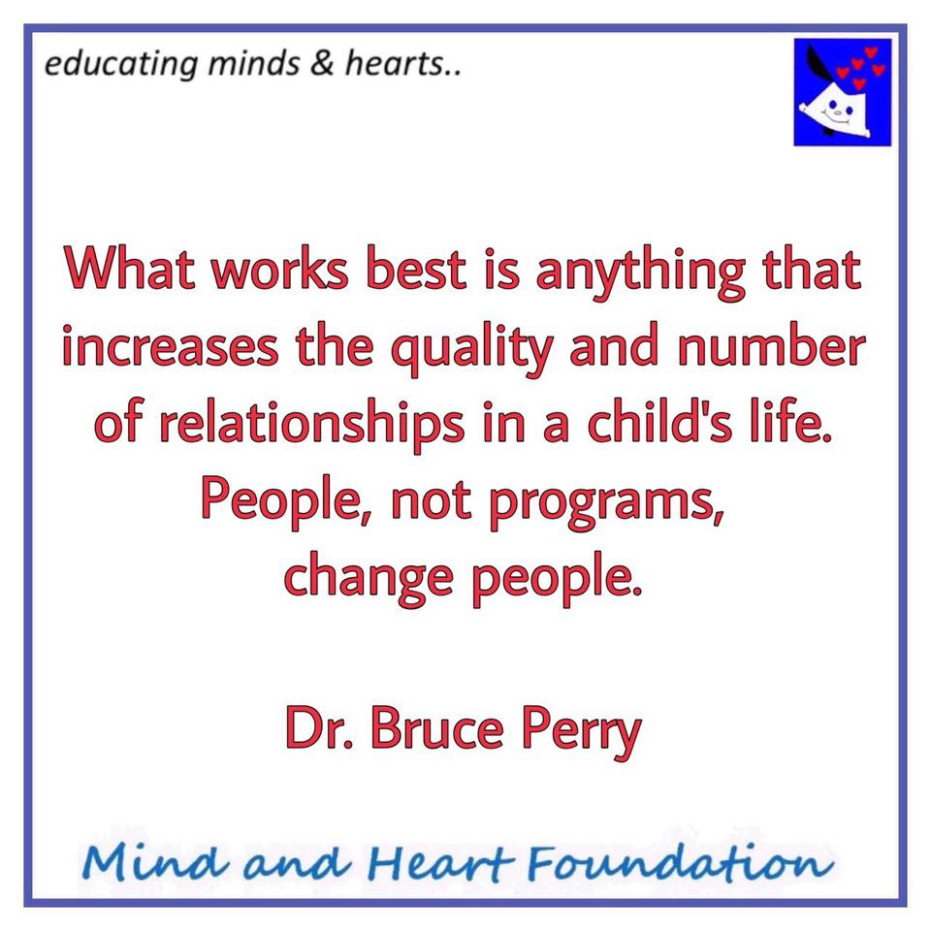
Quote from Dr. Bruce Perry

Slide 49
Let’s Take a Break…

Slide 50
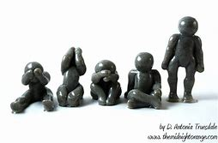
Understanding Grief and Increasing Wellness
Grief is normal.
Grief is healthy.
Grief can be hard.
Grief takes time.
Grief has no time frame.
Grief is unpredictable.
Grief requires adjustments.
Grief requires wellness.

Slide 51
What is Grief?
Grief is the psychological-emotional experience following a loss of any kind (death, relationship, status, job, house, game, income, future, etc.)
- Psychology Today (2012)

Slide 52
How might grief show up?
Physical: trouble sleeping, feeling shaky, becoming dizzy or lightheaded, lack of air, experiencing exhaustion, lack of appetite or increased appetite
Emotional: feelings of guilt, anger, anxiety, or resentment, feeling helpless, being afraid, experiencing numbness
Behavioral: sudden or continuous crying, being withdrawn, experiencing panic attacks, substance use
Cognitive: vivid or realistic dreams, feeling confused, lacking the ability to concentrate, lacking sustained attention

Slide 53
Activity: Journal
How is grief showing up for you?

Slide 54
The HEART of Trauma-Informed Teaching
“…children (and adults) absorb and learn through observation, mirroring, and modeling. Educators who embody a trauma-informed, equity focused lens embody the qualities they wish to cultivate in youth – through their curious listening, caring words, and un-reactive actions.
It’s not just what we teach, but how we teach it.”
And remember teaching and learning is FUN!!

Slide 55
Elements of a Trauma-Informed Classroom
Modeling
Focus on creating safety
Academic safety
Curriculum and assignments relevant to diverse cultures and communities
Schedules clearly displayed
Student work displayed
Classroom is not cluttered
Classroom décor is inclusive of student culture
Desks promote collaborative work
Exits unobstructed
Wellness/regulation space
Open space (if possible) for connection circles, brain breaks
Classroom norms created collaboratively with students
Tone of voice used intentionally
Classroom norms displayed and reviewed
Routines and rituals are used daily (clapping, morning connection circles, transition rituals, end of day)
SEL skills explicitly taught, practiced, and modeled
Awareness of space-induced triggers (windows, doors, etc.)
Avoid isolated desks as discipline

Slide 56
What are adaptations for a
Virtual Trauma-Informed Classroom?

Slide 57
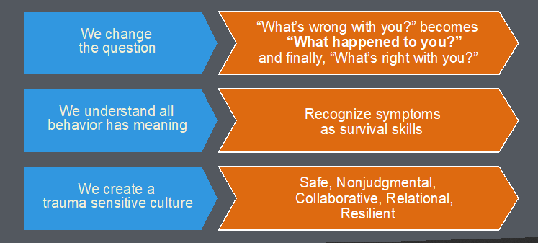
Thinking ahead:
Trauma-informed practices when school returns

Slide 58
Fostering Resilience.
Connection
Coping
Competence
ARC Model, Blaustein & Kinniburgh, 2010

Slide 59
Trauma-Informed Leadership
Leadership is taking responsibility for what matters to you.
- Passageworks Institute

Slide 60
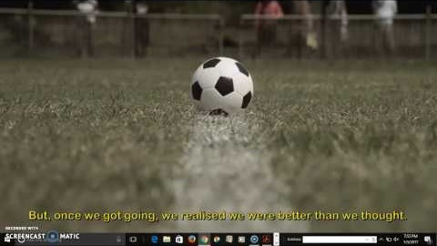
Panyee FC—Short Film
Video Credit: Produced by Revolver Film (2011) for TMB Bank Public Company Ltd., Thailand, Read Aloud by Lora Hodges

Slide 61
Megan Brennan, PsyD
megan.brennan@resilientfutures.us
Laura McArthur, PhD laura.mcarthur@resilientfutures.us
Visit us at resilientfutures.us

