Slide 1
Trauma-Responsive Practices in Schools

Slide 2
Virtual Logistics
Recording
Mute audio when not talking
Chat moderation—please post questions or comments in the chat box

Slide 3
Group Norms
Share what feels comfortable
Be mindful of the impact of our words or stories on others
Pay attention to yourself – color, use fidgets, stretch, stand up
Take a break if needed
Feel free to reach out in chat with reflections or questions
Remember that we enter this space with varying levels of knowledge and understanding
Personal experiences influence how we internalize information
Anything else?

Slide 4
The Power of Story

Slide 5
Dyadic Listening Guidelines
The listener does not speak to interpret, paraphrase, analyze, give advice, or break in with a personal story.
Confidentiality is maintained.
The talker is not to criticize or complain about the listener or mutual acquaintances.
Honor silence.

Slide 6
Dyadic Listening Prompt
Please share your reflection about why trauma-informed practices are important for your classroom, school, or community.
Notes:
Break out – dyads – total of 5 minutes

Slide 7
Resilient Futures
Our Mission:
To foster equitable, safe and resilient communities for all youth.
Notes:
Laura
If someone else is looking over your presentation, make sure they do not rearrange, add, or delete anything on your slide. This will mess up the template and reading order. Have them use the comment feature found under the Review tab.
You can locate the accessibility checker by selecting “File,” “Check for Issues,” “Check Accessibility.” On a Mac, you can find this under “Tools,” “Check Accessibility” or under “Review,” “Check Accessibility.”

Slide 8
Fostering Resilience: Emotional Expression through Storytelling
Sharing our stories allows us to be seen and heard
Sharing our stories allows us to identify and understand our emotions
Sharing our stories allows us to matter

Slide 9
Key Learning Points
Understand the types of trauma and a trauma response.
Be familiar with the effect of trauma on brain development and the central nervous system.
Identify how trauma can impact learning, self-regulation, and subsequent behavior.
Learn strategies to foster resilience.
Discuss the importance of safety and predictability as both an individualized and collective approach to healing trauma.
Explore and support the need for sustained individual wellness practices.

Slide 10
“Every child needs one person who is crazy about them.”
-Urie Bronfenbrenner, 1977
Video Source: 60 Minutes (https://www.cbsnews.com/60-minutes/)

Slide 11
Change the Paradigm
"What is wrong with you?"
to
"What has happened to you?"

Slide 12
HEARTS Healthy Environments & Response to Trauma in Schools
Core Guiding Principles:
Understanding Trauma and Stress
Compassion and Dependability
Cultural Humility and Responsiveness
Resilience and Social-Emotional Learning
Safety and Predictability
Empowerment and Collaboration
UCSF HEARTS; Dorado, J., Martinez, M., McArthur, L., & Leibovitz, T. (2016). Healthy Environments and Response to Trauma in Schools (HEARTS): A whole-school, multi-level, prevention and intervention program for creating trauma-informed, safe and supportive schools. School Mental Health, 8, 163-176.

Slide 13
A Trauma-Informed School System
REALIZES the widespread impact of trauma and understands potential paths for healing and resilience
RECOGNIZES how trauma and chronic stress show up in leadership, staff, students, families, and others in the school community
RESPONDS by fully integrating knowledge about trauma into policies, procedures, practices, and the overall school culture
RESISTS re-traumatization
Implementing trauma-informed principles represents a paradigm shift.
Adapted from SAMHSA’s Concept of Trauma and Guidance for a Trauma-Informed Approach, 2014.

Slide 14
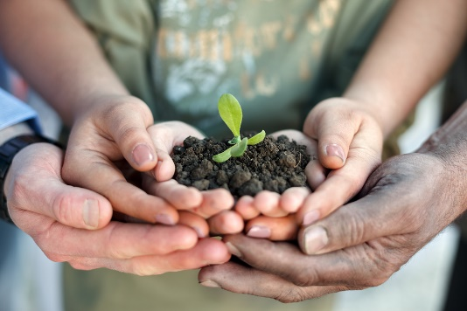
Core Guiding Principle: Understanding Trauma & Stress
Without understanding trauma we are more likely to misinterpret trauma-related behaviors.
When we understand trauma and stress, we increase our ability to act compassionately.

Slide 15
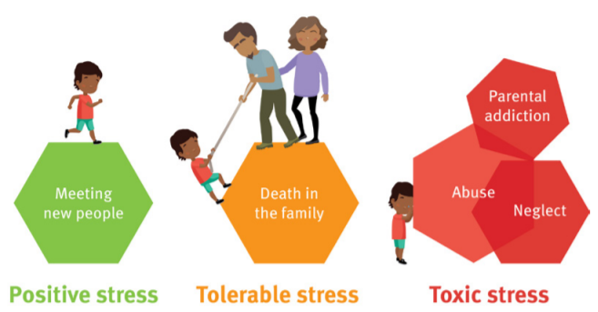
Stress and Toxic Stress
Image Source: https://www.childrens.health.qld.gov.au/wp-content/uploads/PDF/dream-big/Dream-Big-Act-Big-for-Kids-Issue-1-ACEs-Toxic-Stress.pdf

Slide 16
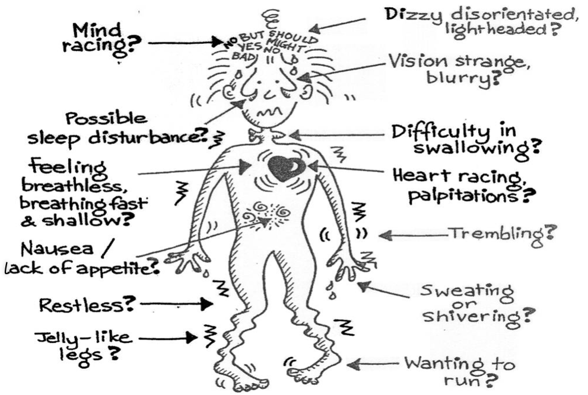
Stress Response

Slide 17
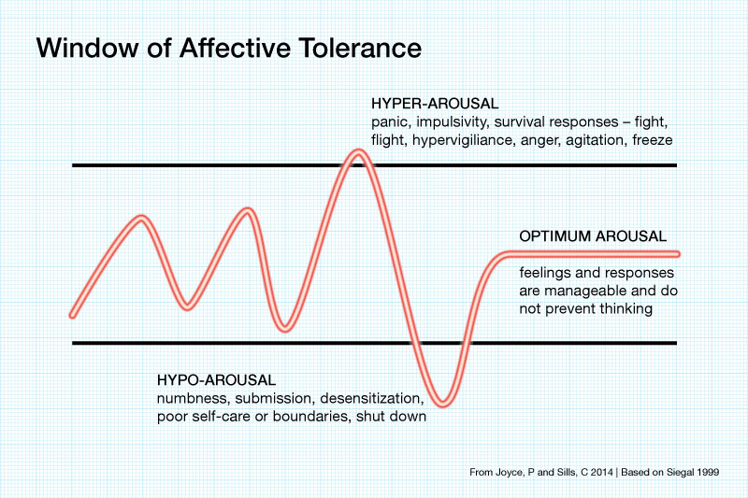
Affective Tolerance

Slide 18
Traumatization
“Traumatization occurs when both internal and external resources are inadequate to cope with an external threat, either real or perceived.”
-Bessel Van Der Kolk, 1989

Slide 19
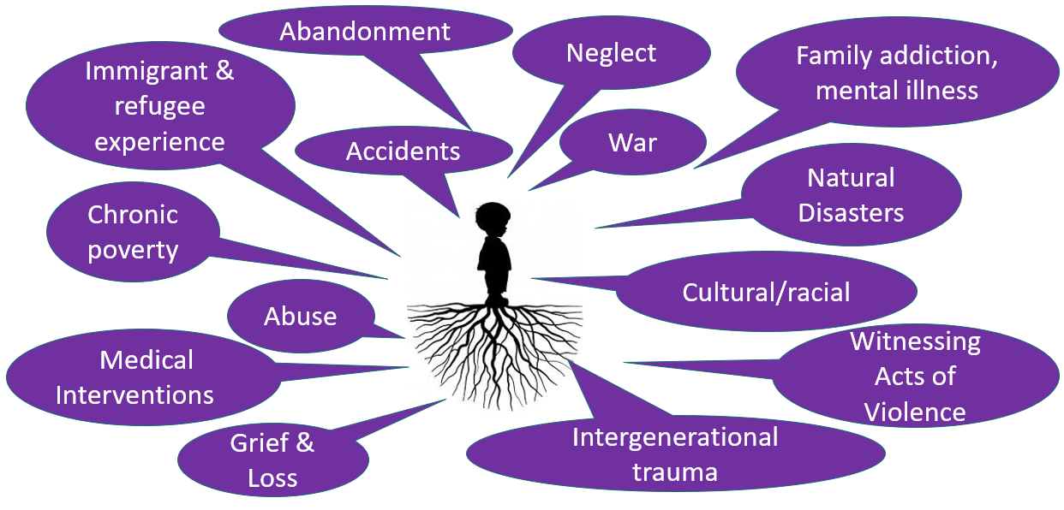
Where does trauma stem from?
Notes:
Ask participants to add other traumatic experiences in the chat that aren’t included on this slide

Slide 20
Types of Trauma
ACUTE
CHRONIC
COMPLEX

Slide 21
Complex Trauma
Children’s experiences of multiple traumatic events, often that occur within the caregiving system – the social environment that is supposed to be the source of safety and stability in a child’s life.
-National Child Traumatic Stress Network [NCTSN]

Slide 22
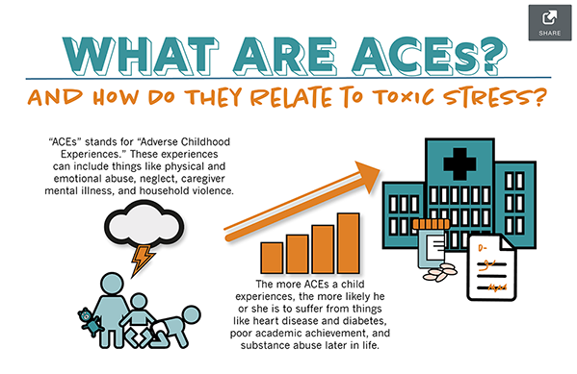
Notes:
JaShawn
The original ACE Study was conducted at Kaiser Permanente from 1995 to 1997 with two waves of data collection. Over 17,000 Health Maintenance Organization members
ACEs are common. About 61% of adults surveyed across 25 states reported that they had experienced at least one type of ACE, and nearly 1 in 6 reported they had experienced four or more types of ACEs.
Preventing ACEs could potentially reduce a large number of health conditions. For example, up to 1.9 million cases of heart disease and 21 million cases of depression could have been potentially avoided by preventing ACEs.
Some children are at greater risk than others. Women and several racial/ethnic minority groups were at greater risk for having experienced 4 or more types of ACEs.
ACEs are costly. The economic and social costs to families, communities, and society totals hundreds of billions of dollars each year.
This is a layout for text plus picture. You do not want text or pictures that belong inside the box to exceed the box size. That means you may have to adjust the size of the box or the font size (nothing lower than 12 points). Remember to add alt text to any icon or picture.
There are additional slide layouts available. Select “Layout” from the “Home” tab. (If “Layout” is grayed out, you will need to place your cursor in an open area outside the slide to activate it.)

Slide 23
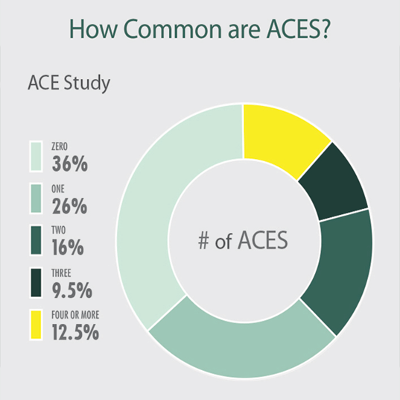
The ACES Study
Source: Center for Disease Control & Prevention

Slide 24
Trauma and Stress during COVID-19
The novel coronavirus (which causes COVID-19) can affect anyone in any country. People respond to this rapidly spreading pandemic in a variety of ways that includes reacting with no fear, having reasonable amounts of fear, and being extremely fearful. As with any trauma, fear results in a stress response that can include panic, sweating, diminished executive function, and difficulty following instructions. Times of great stress may also worsen effects of previous traumas.
- Resilient Futures 2020
Notes:
JaShawn
Not traumatic for everyone
What could be traumatic about it?
This is a layout for text plus picture. You do not want text or pictures that belong inside the box to exceed the box size. That means you may have to adjust the size of the box or the font size (nothing lower than 12 points). Remember to add alt text to any icon or picture.
There are additional slide layouts available. Select “Layout” from the “Home” tab. (If “Layout” is grayed out, you will need to place your cursor in an open area outside the slide to activate it.)

Slide 25
Let’s Take a Break

Slide 26
Trauma & the Developing Brain

Slide 27
“Experiences Build Brain Architecture”
Video Source: Center on the Developing Child at Harvard University (http://developingchild.harvard.edu)

Slide 28
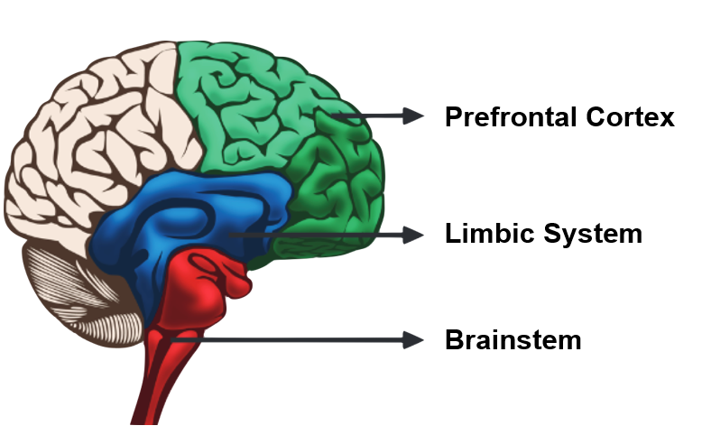
Survival Brain

Slide 29
What does this mean for our current context?

Slide 30
Often, student behaviors that are noted as “difficult” or ”disruptive” are a direct result of coping with adverse experiences. Look for the resilience in the behavior.

Slide 31
Notes:
JaShawn
The original ACE Study was conducted at Kaiser Permanente from 1995 to 1997 with two waves of data collection. Over 17,000 Health Maintenance Organization members
ACEs are common. About 61% of adults surveyed across 25 states reported that they had experienced at least one type of ACE, and nearly 1 in 6 reported they had experienced four or more types of ACEs.
Preventing ACEs could potentially reduce a large number of health conditions. For example, up to 1.9 million cases of heart disease and 21 million cases of depression could have been potentially avoided by preventing ACEs.
Some children are at greater risk than others. Women and several racial/ethnic minority groups were at greater risk for having experienced 4 or more types of ACEs.
ACEs are costly. The economic and social costs to families, communities, and society totals hundreds of billions of dollars each year.
This is a layout for text plus picture. You do not want text or pictures that belong inside the box to exceed the box size. That means you may have to adjust the size of the box or the font size (nothing lower than 12 points). Remember to add alt text to any icon or picture.
There are additional slide layouts available. Select “Layout” from the “Home” tab. (If “Layout” is grayed out, you will need to place your cursor in an open area outside the slide to activate it.)

Slide 32
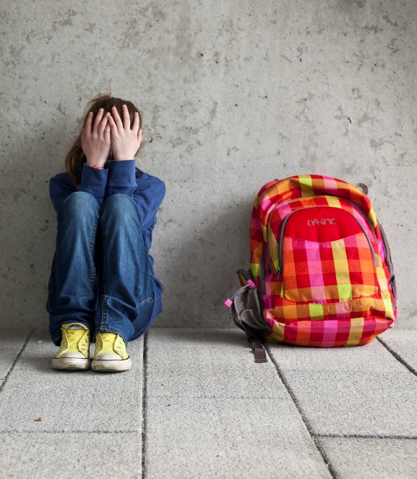
Unaddressed Trauma and School Performance
Problems with attention skills, abstract reasoning, long-term memory for verbal information, and reading ability (Perfect, Turley, Carlson, Yohanna, & St. Gilles, 2016)
Difficulties in self-regulation (Wolpow, Johnson, Hertel, & Kincaid, 2009)
More days of school absence (Perfect, Turley, Carlson, Yohanna, & St. Gilles, 2016)

Slide 33
Developmental Responses to Trauma
Elementary-Aged Children
Adolescents
Notes:
Give handouts

Slide 34
Developmental Responses to Trauma.
Divide into groups—discussion question:
Where are spaces, as an educator or in interactions with kids and families, in which you can support these different developmental needs?
Notes:
Divide into groups of elementary, secondary, other – 7 minutes total. We will ask the groups to have a note taker that they record their conversation in a google doc – we will ask each group to share out when we return to the larger group.

Slide 35
Let’s Take a Break.

Slide 36
Journal Activity
What makes you feel safe?
Notes:
Write in your journal for 3 minutes

Slide 37
Core Guiding Principle: Safety and Predictability
Trauma unpredictably violates physical, social, and emotional safety.
Increasing stability in the daily lives of our students can minimize stress reactions, increasing a focus on learning and emotional well-being.

Slide 38
Types of Safety
Physical Safety
Social Safety
Emotional Safety
Safety through Predictability
Academic Safety

Slide 39
Academic Safety
Connection before content
Clear expectations
Simple, clear communication
Instructions both verbally and written
Transparency
Model taking risks for learning
Multiple opportunities to ask questions
Equitable responses to students
Maintaining high expectations
Quality, not quantity
Voice/Choice
Giving multiple opportunities for demonstrating learning
Compassionate grading

Slide 40
Looking ahead:
Creating safety when school resumes

Slide 41
Creating Safety & Predictability
Safety is created through both the individual and the collective.
What are current systems/structures that can be used to increase the individual and collective safety of students, teachers, families, and the school community?
Considerations include physical, social, emotional, and academic safety.
How would you measure success?

Slide 42
What is Resilience?
“the capacity to grow and thrive with strength and tenacity in the face of trauma and oppression for individuals and communities”
-Resilient Futures, 2018

Slide 43
Fostering Resilience
Connection
Coping
Competence
ARC Model, Blaustein & Kinniburgh, 2010

Slide 44
The Power of Story: Transgenerational Resilience
Research from Emory University on trans-generational healing suggests that actively reflecting on your family stories and histories enhances emotional health and facilitates resilience in both adults and children.

Slide 45
Relationships are Central to Healing
Prioritize connection.
Every positive, attuned interaction with a trustworthy adult can help to rewire the brain.

Slide 46
Let’s Take a Break..

Slide 47
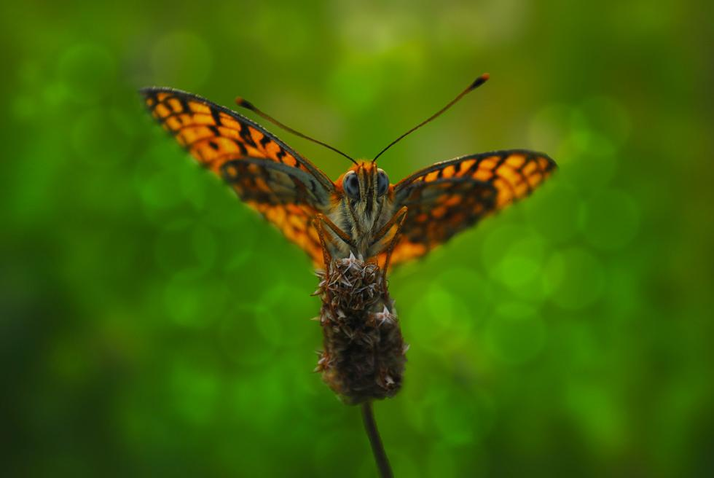
Increasing Our Capacity
Self-care refers to activities and practices that can help you to reduce your stress and enhance your overall well-being.

Slide 48
Sustained Individual Wellness
"a conscious, self-directed and evolving process of achieving full potential"
-The National Wellness Institute
A focus on your internal & external environment

Slide 49
In order to continue to give at our highest capacity,
we must actively engage in periods of recovery.

Slide 50
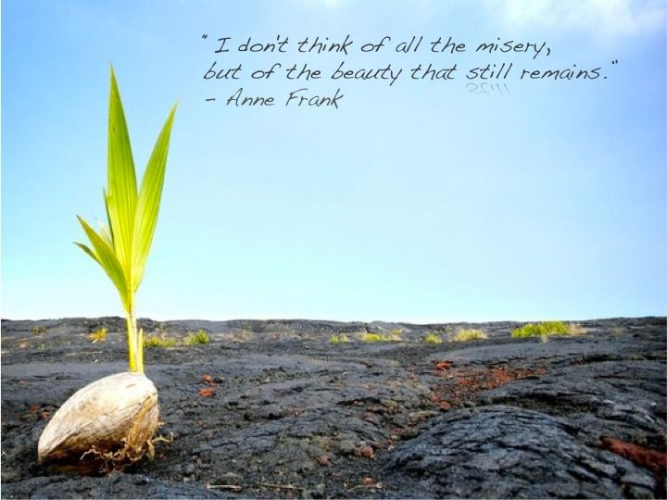
Vicarious Resilience
“Vicarious resilience is the positive effects on helping professionals who witness the healing, recovery, and resilience of persons who have survived severe trauma in their lives.”
-Hernandez, Gangsei, & Engstrom (2007)

Slide 51
Vicarious Resilience (continued)
Results in positive transformation and empowerment in ‘us’ through empathic engagement with the stories of others
Increased hopefulness and compassion
Balanced self-awareness and perspective
Increased racial and cultural consciousness
Increased awareness of relative privilege, marginalization, and oppression
Profound belief in the adaptability and strength of others

Slide 52
Research shows that by simply talking about the concept of vicarious resilience and letting people know that it exists will raise the likelihood of people having the experience.
Hernandez, Gangsei, & Engstrom (2007)

Slide 53
Pair Reflection
Through the lens of vicarious resilience, think about someone you know that has overcome significant challenges.
How has witnessing their growth changed your life?
Notes:
Break out in dyads – share for 2 minutes each. Total time 5 minutes

Slide 54
“…the aim is to increase teaching and learning time and reduce time spent on discipline. The ultimate goal is to help all traumatized students become successful members in their school communities.”
(Cole et al., 2005, p. 6)

Slide 55
Journaling Activity
Journal:
Identify 2-3 ways you will implement understanding trauma and stress within your role.
Identify 2-3 ways to implement the 4 r’s (realize, recognize, respond and resist)
Notes:
JaShawn
This is a layout for text plus picture. You do not want text or pictures that belong inside the box to exceed the box size. That means you may have to adjust the size of the box or the font size (nothing lower than 12 points). Remember to add alt text to any icon or picture.
There are additional slide layouts available. Select “Layout” from the “Home” tab. (If “Layout” is grayed out, you will need to place your cursor in an open area outside the slide to activate it.)

Slide 56
Megan Brennan, PsyD
megan.brennan@resilientfutures.us
Eleonora “Ellie” Cahill, PhD
eleonora.cahill@resilientfutures.us

