Slide 1
Strengthening Resilience: Promoting Positive School Mental Health Among Indigenous Youth
Professor LaVonne Fox, PhD, ORT/L
Professor Sarah Nielsen, PhD, OTR/L
Professor Thomasine Heitkamp, Project PI and LCSW

Slide 2
Disclaimer and Funding Statement
This Brown-Bag was prepared for the College of Nursing and Professional Disciplines under a cooperative agreement from the Substance Abuse and Mental Health Services Administration (SAMHSA). All materials appearing in the Strengthening Resilience: Promoting Positive Mental Health Among Indigenous Youth, except that taken directly from copyrighted sources, are in the public domain and may be reproduced or copied without permission from SAMHSA or the authors. Citation of the source is appreciated. Do not reproduce or distribute this content for a fee without specific, written authorization from the Mountain Plains Mental Health Technology Transfer Center. For more information on obtaining copies of Strengthening Resilience: Promotion Positive Mental Health Among Indigenous Youth please email David Terry at david.v.terry@und.edu
At the time of this presentation, Elinore F. McCance-Katz served as SAMHSA Assistant Secretary. The opinions expressed herein are the views of LaVonne Fox, Sarah Nielsen and Thomasine Heitkamp and do not reflect the official position of the Department of Health and Human Services (DHHS), or SAMHSA. No official support or endorsement of DHHS, SAMHSA, for the opinions described in this session is intended or should be inferred.
The work of the Mountain Plains MHTTC is supported by grant H79SM081792 from the Department of Health and Human Services, Substance Abuse and Mental Health Services Administration.
Notes:
David

Slide 3
Purpose of Document
Provide tools for K-12 educators, administrators, and mental health treatment providers to better address the learning and behavioral health needs of Indigenous youth in a holistic manner.
  Addresses the role of trauma in addressing the larger cultural context and limited access to resources.
  Use of a fictitious case scenario allows the authors to focus on resilience and culturally responsive practices.
  Discusses incorporation of the Seven Teaching and the Circle of Courage into traditional teaching in k-12 curriculum.

Slide 4
Language Matters
This document primarily uses the term Indigenous when addressing all Indigenous groups collectively.
Indigenous comes from the Latin word indigena, which means “sprung from the land; native.”
When possible, it is best to use the tribal nation's specific name and acknowledge the territory each nation currently resides on or was their ancestral lands.

Slide 5
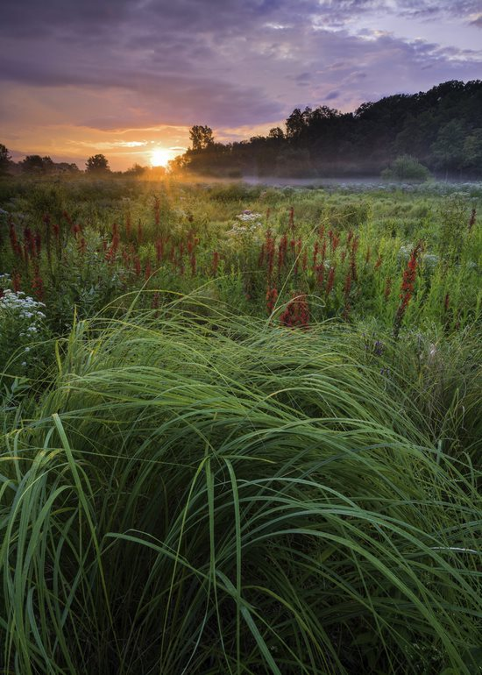
Territorial Acknowledgement Statement

Slide 6
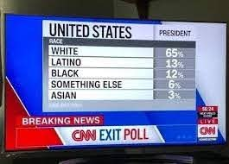
Historical Barriers to Addressing the Mental Health and Educational Needs of Indigenous Youth
Larger Historical Content – The Scar of Racial Hatred
Boarding Schools – Strategy for cultural genocide
Historical and Intergenerational Trauma
  Impacts Self-Identity (loss of land,
  family, self-respect, identity, and trust)
Use of Micro-aggressions –
  Harmful Communication that Is
  both Intended or Unintended

Slide 7
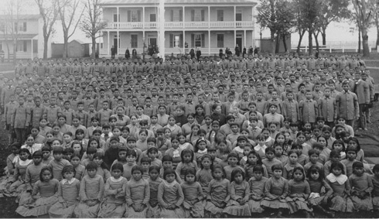
Carlisle Boarding School
Notes:
Do you see any child smiling or happy?

Slide 8
Barriers to Care – Untreated Trauma
Access – Limited Access of Behavioral Health Providers and greater limitations in access to care by Indigenous Members
Rationing Funding – Indian Health Services with Long-Standing History of Underfunding
Stigma – Lack of Awareness Among Providers of What is Culturally Appropriate Mental Health Care
Staffing – Lack of Access to Primary Care Providers with a 25% Providers Vacancy Rate in an Already Underfunded IHS System
Cultural Evidence Based Practices – Historically these Practices have Not Been Culturally Appropriate for Indigenous Persons.

Slide 9
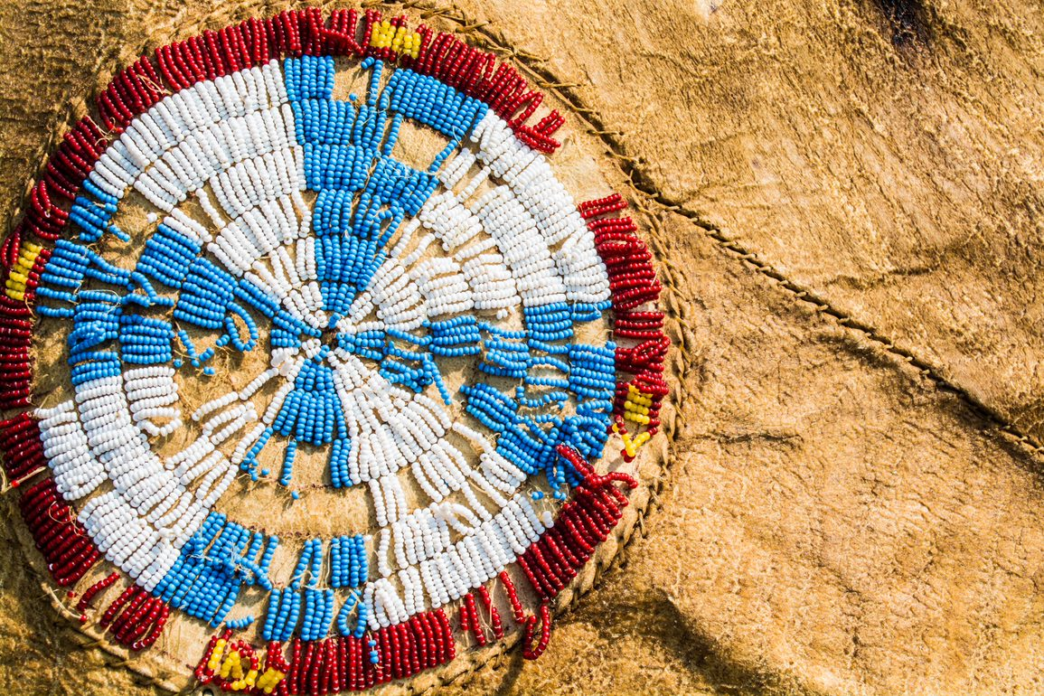
Untreated Trauma: A Slow Erosion of Beads on a Beautiful Art Piece

Slide 10
Social and Health Inequities Persist
In 2017, suicide was the second leading cause of death of Indigenous Americans between the ages of 10 and 34.
Violent deaths, unintentional injuries, homicide, and suicide account for 75% of all mortality in the second decade of life for American Indian/Alaska.
Adolescent Indigenous females, ages 15-19, have a death rate that is three times higher than non-Hispanic white females in the same age groups.
The overall death rate from suicide is about 20% higher for Indigenous Americans as compared to the non-Hispanic white population.
Indigenous youth are 2% of the population but 8% of the homeless.
70% of this population with suffer a mental health disorder in their lifetime.
More than 50% of indigenous youth live in poverty stricken neighborhoods and 62% living in low-income households today

Slide 11
Forced Changes in Traditional Ways of Child Rearing and Family Structure Contribute to:
Poor emotional and physical health
Suicidal ideation
Being fearful, overwhelmed, and helpless
Feeling anxious and isolated
Classroom behaviors that cause concerns:
  Being disrespectful
  Cheating to avoid failure
  Demonstrating arrogance
  Rebellious behaviors
  Manipulating others

Slide 12
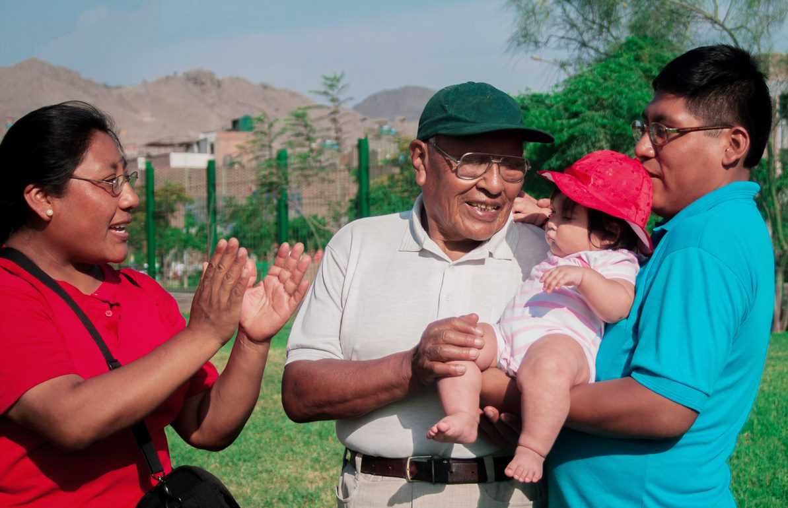

Slide 13
Fictionist Case Scenario
Carli is a 14 year old Indigenous female residing on a reservation with a total population of 300 people. During the course of the last two years, Carlie and her siblings have attended a Native American boarding school that is located more than 300 miles from their home. This is the same boarding school where her mother and father met.
Carli has experienced psychological and physical abuse, including bulling by classmates. Recently, peers passed a note that Carli tried to hook up with many boys. As a result, she has been in physical altercations with several girls.
Overwhelmed, embarrassed and frustrated, she recently attempted suicide by cutting her wrists in the dormitory of the boarding school. Following that incident, Carli and her siblings returned to their home community to reside with their parents. They will not be returning to the boarding school.

Slide 14
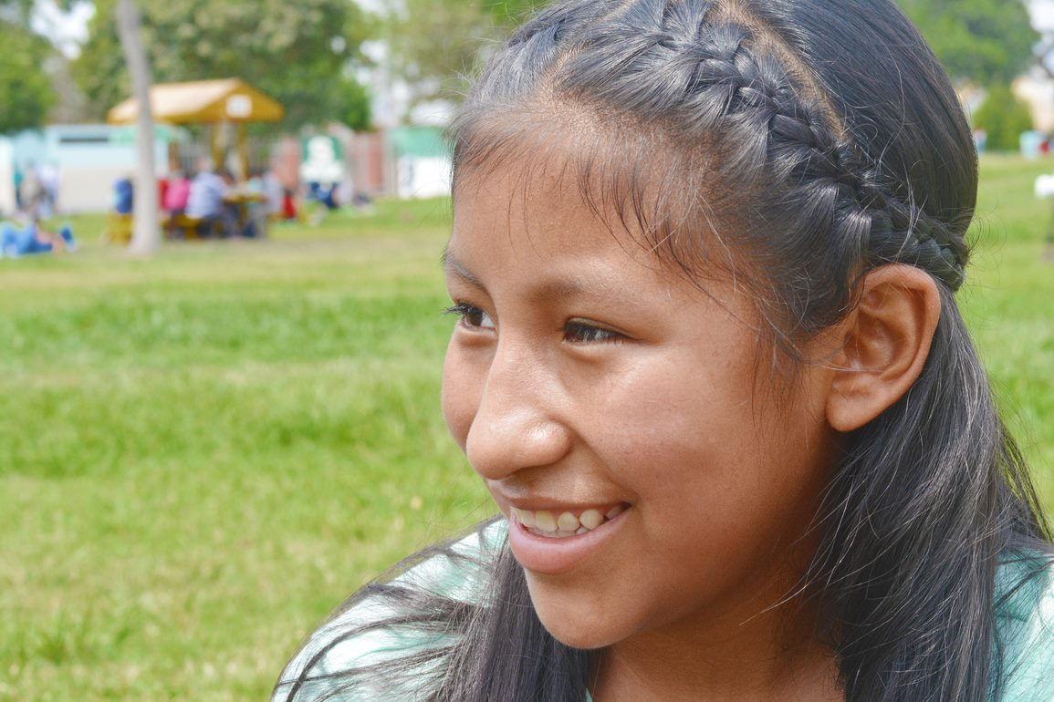
Carli

Slide 15
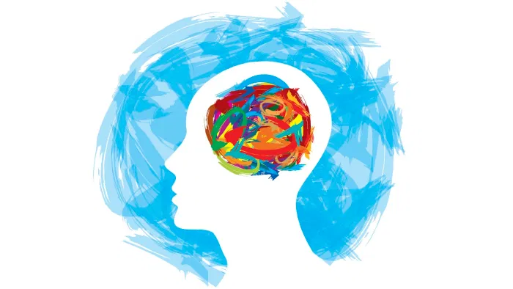
Non-linear because humans are not linear
No deficit approach – that always seems to identify us as absent of, lack of or failure Always less than or something else.
Strength based cultural approach – necessary to correct existing negative stereotypes. Most commonly used, accepted and successful.
Notes:
Deficits focus on and work to find ways to strengthen the stereotypes of the Indigenous person.

Slide 16
The Seven Teachings
A set of guiding values
Teaching on how to treat others and ourselves
Provides core values
Sacred teaching that can be modified for the needs of each tribe
Guides behavioral in the class
Build a curriculum that supports positive identity

Slide 17
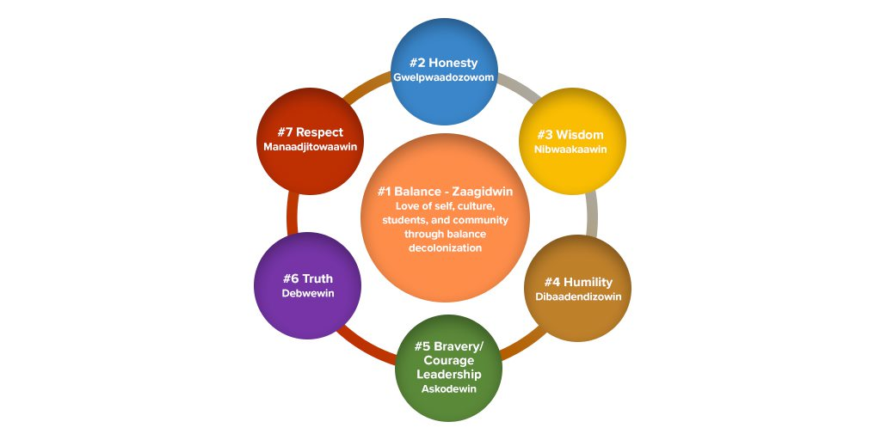
Strength Based: Seven Teachings

Slide 18
Using the Model Dos and Don’t
Don’t misinterpret; seek to understand
Keep promises and appointments
Help students create a system to keep them organized
Don’t embarrass the student
Keep your mood stable and consistent
Don’t require all students to read from the front or out loud to everyone
Get to know the community
Help them learn to set realistic goals
Do not display poor work as an example
Learn what the family’s ideas, experiences, and values are regarding education
Do not post grades publicly
Engage with the family/parents and share successes as well as concerns
Do not judge.

Slide 19
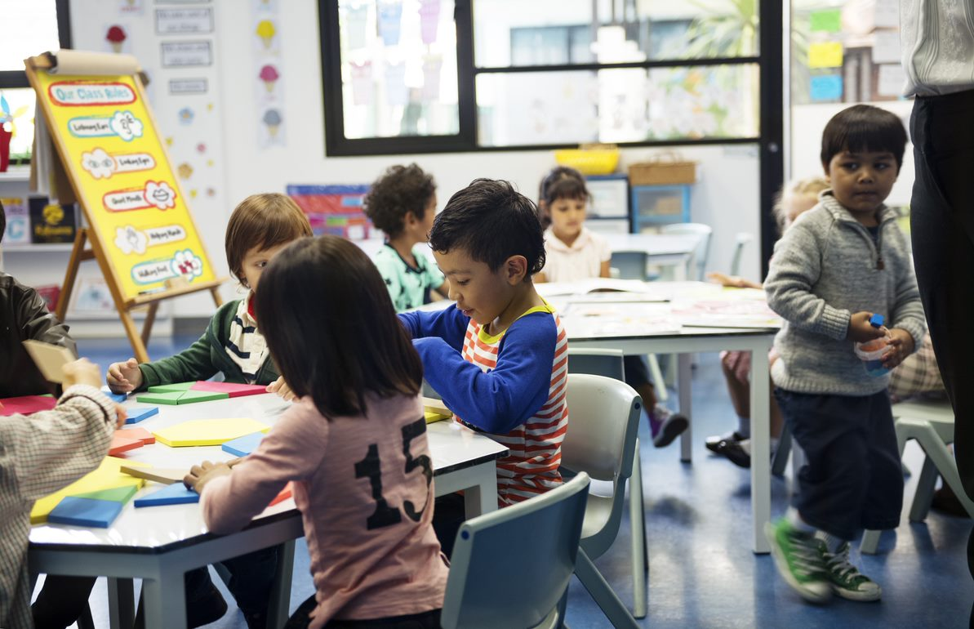

Slide 20
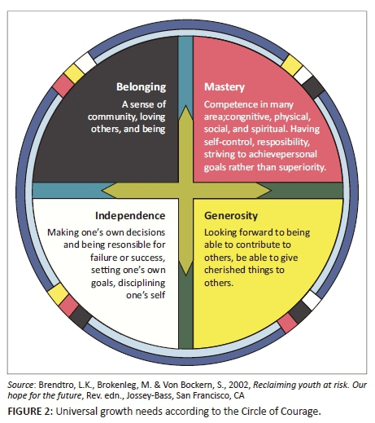
Strength Based: Circle of Courage Model

Slide 21
Building Protective Factors
Building positive social skills
Building positive self-image
Presence of positive adults
Schools that address social and emotional needs as well as academics
Safe environments
Parental resilience
Social connections
Conflict resolution skills
Concrete support in times of need
•Emotional regulation
•Community support
• Access to mental health services
•Connection to school
•Feeling of control over one’s life
•Trusting relationships
•Tolerance for delayed gratification
•Positive coping skills
•Strong cultural identity and pride
Notes:
Building positive social skills and self-image
Presence of positive adults
Schools that address social and emotional needs of students
Parental resilience
Conflict resolution
Community supports
Positive coping skills
Trusting relationships
Strong cultural identity and pride
Safe environments
Concrete support to address needs

Slide 22
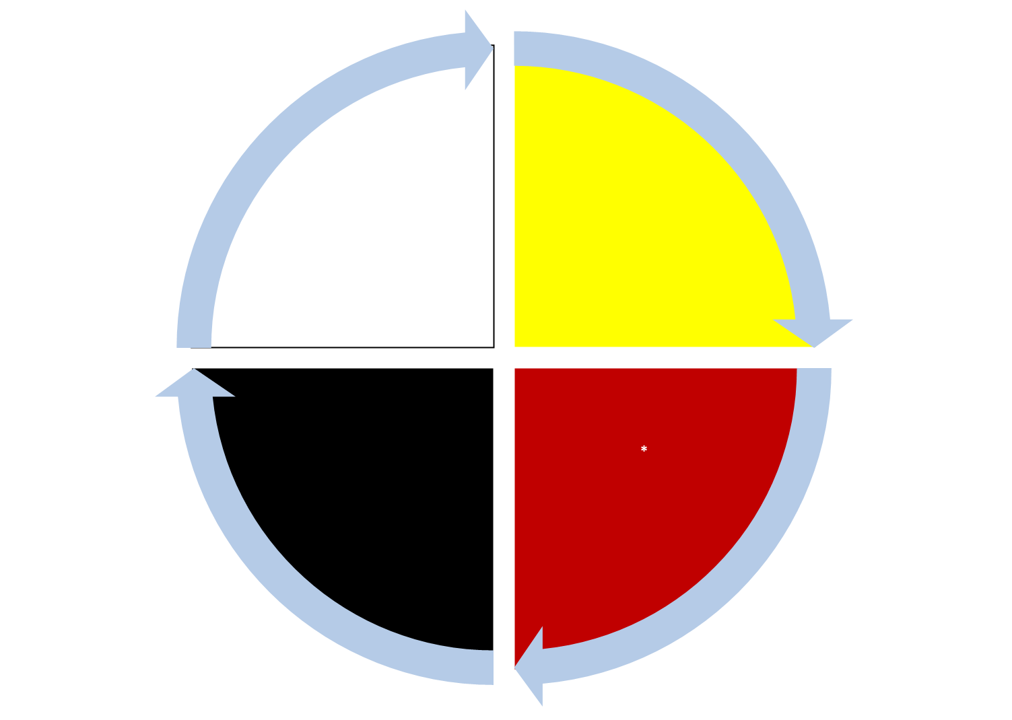
SPIRITUAL
Proud to be Indigenous. Respect all things Always, especially yourself. Try to do your best. Pray every day
PHYSICAL
Take care of your body, body image and body acceptance
Positive Indigenous Identity
EMOTIONAL
Be yourself, good attitude, control anger, share problems. Healthy relationships, set health personal boundaries
Mind/Cognitive
Don’t give into peer pressure. Good decision-making skills; Learn from mistakes. Think about your future: vision. Be creative. Learn
Notes:
This diagram provides various activities that can strengthen protective factors. These, in turn, contribute to developing a positive Indigenous identity and resilience. A growing body of research shows that a positive ethnic identity seems to provide minority adolescents with increased self-esteem contributing to healthier coping skills that make them more likely to use active strategies to confront hardship. A strong sense of cultural identity has also been correlated with higher levels of psychological health for Indigenous youth. Psychological well-being encourages individuals to more meaningfully engage with larger societal issues.

Slide 23
Outcome of Case of Carli and Circle of Courage
Carli worked with the school counselor and accessed telehealth through the IHS with a psychiatrist and counselor.
She and her counselor developed a plan, based on the 7 Teachings and the Circle of Courage.
She was placed on a 504 plan to decrease obstacles and risk factors affecting her learning.
After 3 months Carli was developing a more positive identity. She became more active in the community with her family, working to develop positive images of Indigenous people in the community and school.
Carli’s father also began therapy for additions related to PTSD since his discharge from the military.

Slide 24
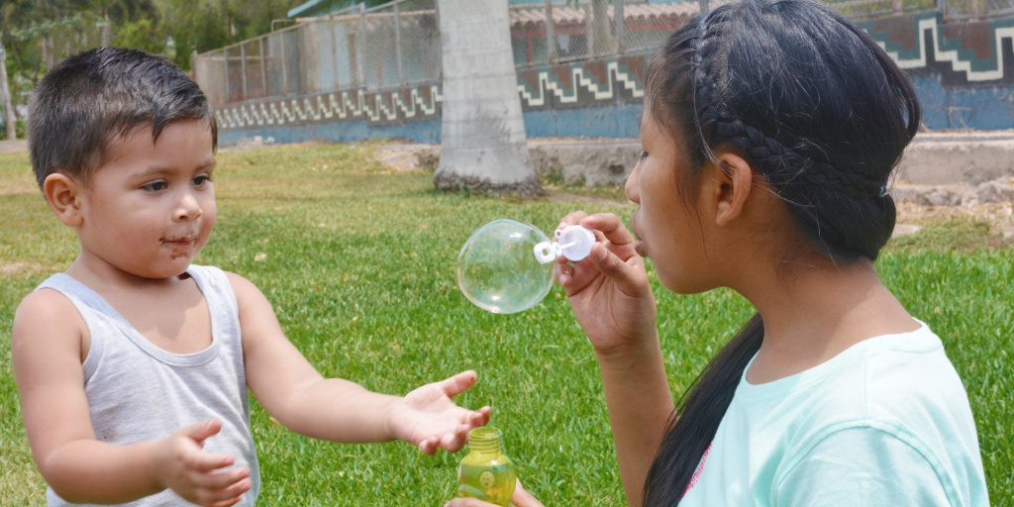

Slide 25
Rational and Access to this Document
building capacity to serve indigenous youth is on the MHTTC web page for all to use and you to share far and wide
All resources are in the public domain. Authors provides hyperlinks to the following:
  102 Current and Historical References
  Eight Additional Resources with Models to Serve Indigenous Youth in the Schools including an Explanation
  Four Promising Practices for Indigenous Youth and Additional Models Including an Explanation
  Eight SAMHSA Responses and Rational for Examination
  MHTTC Resources that Support this Content

Slide 26
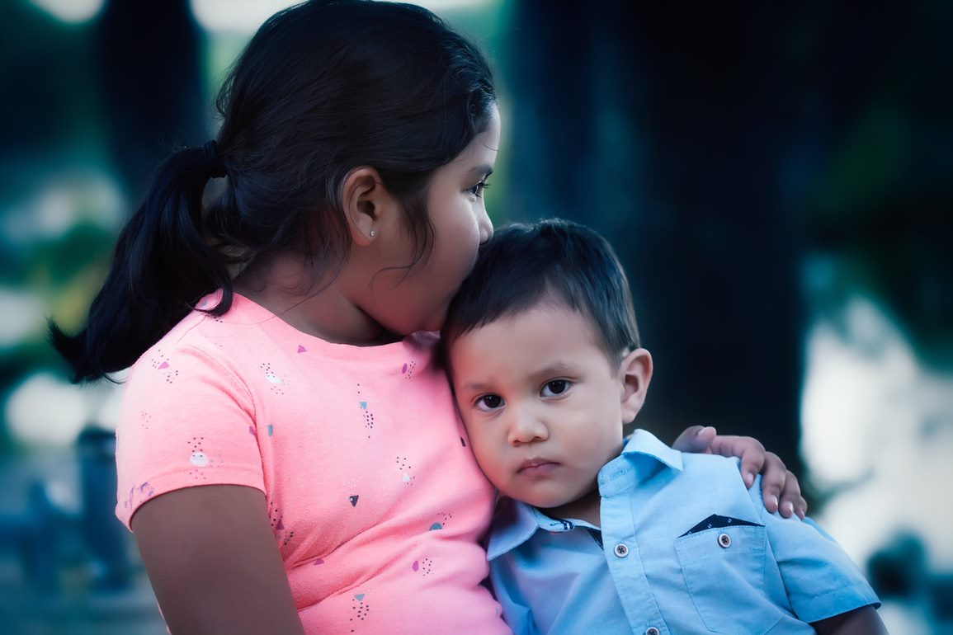
Notes:
Indigenous people are strong, and resilient people. We have faced considerable adversity yet our culture are resurging and becoming stronger. Our prime barrier is that many in the general public don’t like the visual reminder of what was done and how it was done to a generous people so often we are invisible. Again a prime example is the term ‘something else”

Slide 27
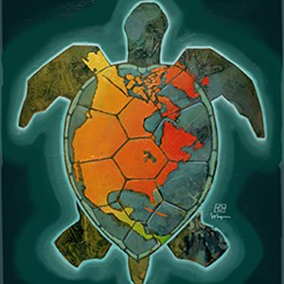
Notes:
We close again with the beautiful artwork by mark Wagner. Pay your respects to Indigenous people by educating yourself on their history and perseverance.

Slide 28
Thank you for joining!

