Slide 1


Please Note:
Thank you for joining us today!
Please Note:
All attendees are muted
Today’s session will be recorded

Slide 2
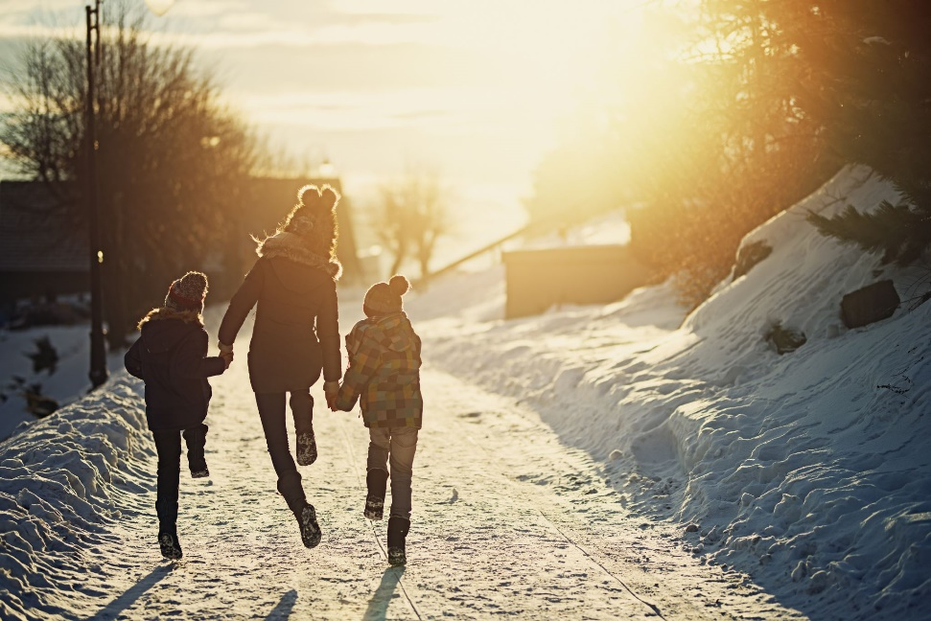
Supporting Families to Support Students
School Mental Health Professionals
Learning Series
10/26/2020
Liza Tupa, PhD
WICHE Behavioral Health Program
Mountain Plains MHTTC

Slide 3
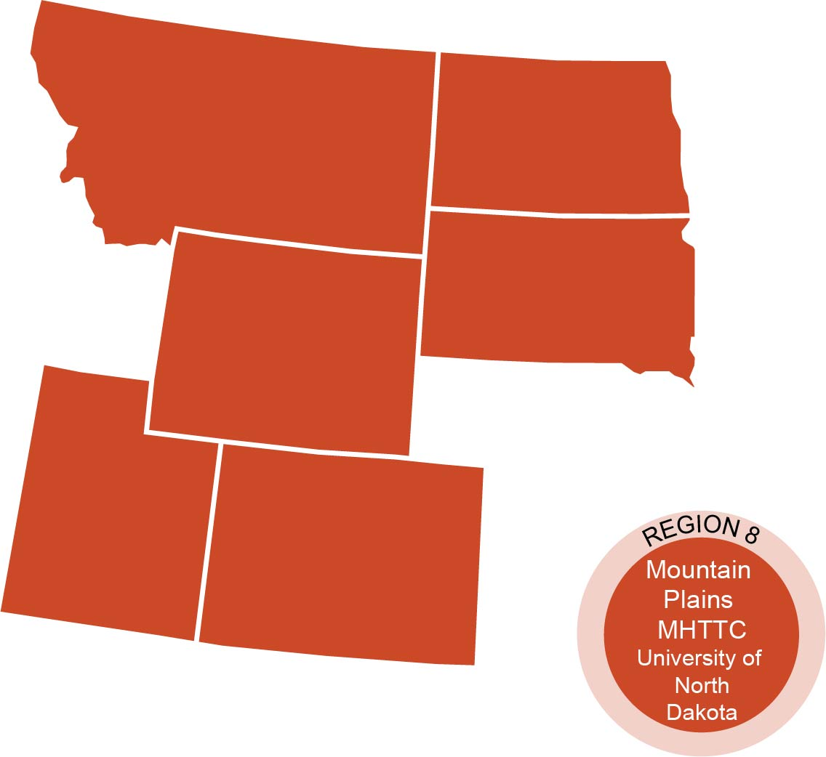
The Mountain Plains Mental Health
Technology Transfer Center
The Mountain Plains Mental Health Technology Transfer Center (Mountain Plains MHTTC) provides training and technical assistance to individuals who serve persons with mental health concerns throughout Region 8 (Colorado, Montana, North Dakota, South Dakota, Utah and Wyoming).
We belong to the Technology Transfer Center (TTC) Network, a national network of training and technical assistance centers serving the needs of mental health, substance use and prevention providers. The work of the TTC Network is under a cooperative agreement by the Substance Abuse and Mental Health Service Administration (SAMHSA).
Notes:
David will cover to here

Slide 5
Disclaimer and Funding Statement
This presentation was prepared for the Mountain Plains Mental Health Technology Transfer Center (Mountain Plains MHTTC) under a cooperative agreement from the Substance Abuse and Mental Health Services Administration (SAMHSA). All material appearing in this presentation, except that taken directly from copyrighted sources, is in the public domain and may be reproduced or copied without permission from SAMHSA or the authors. Citation of the source is appreciated. Do not reproduce or distribute this presentation for a fee without specific, written authorization from the Mountain Plains MHTTC. For more information on obtaining copies of this presentation please email swinfield@wiche.edu
At the time of this presentation, Elinore F. McCance-Katz served as SAMHSA Assistant Secretary. The opinions expressed herein are the views of Liza Tupa, PhD and do not reflect the official position of the Department of Health and Human Services (DHHS), or SAMHSA. No official support or endorsement of DHHS, SAMHSA, for the opinions described in this presentation is intended or should be inferred.
The work of the Mountain Plains MHTTC is supported by grant H79SM081792 from the Department of Health and Human Services, Substance Abuse and Mental Health Services Administration.
Notes:
David

Slide 6
Family Support = Powerful Medicine
Families and loved ones have the most power to help children heal
From the Indian Country Child Treatment Center http://www.icctc.org/

Slide 7
How Can Families Build Children’s Confidence?
Talking to your kids helps you learn about each other, makes kids feel important
Conversation Starters:
What was the best part of your day? What was the worst art of your day? What was the funniest part of your day?
How have you been feeling?
How is school going?
What is your favorite thing about our community?

Slide 8
The Importance of Safety
Safety & Stability: Increasing stability in the daily lives of our students can minimize stress reactions, increasing a focus on learning and emotional well-being.
Safety is created through both the individual and the collective (child > family > community)
Considerations include physical, social, and emotional safety
Predictability helps people of all ages feel safe
Brennan, M. & McArthur, L. (2020). Trauma Responsive practices in schools. Resilient Futures. [PowerPoint slides].

Slide 9
Safety and Predictability
Predictability helps people of all ages feel safe
When will my adults be home?
How can I get ahold of my adults if I need them?
Will there be food at home?
Who will be there to say good morning/goodnight to me?
Will my adults be happy to see me?
What will happen if I break a rule?
No family is perfect, but communicating often about these issues/questions help kids of all ages feel safe
Brennan, M. & McArthur, L. (2020). Trauma Responsive practices in schools. Resilient Futures. [PowerPoint slides].

Slide 10
The Importance of Rituals & Routines
Routines make home predictable. This is especially helpful for those experiencing trauma or stress!
Predictable routines & rules help children understand expectations & reduce behavior problems.
Rituals (or traditions) help people feel safe, special, and powerful.
Families can participate in community rituals and also create their own.
Ask children and families what rituals and routines they like.
Brennan, M. & McArthur, L. (2020). Trauma Responsive practices in schools. Resilient Futures. [PowerPoint slides].

Slide 11
Choice Making
Choice-making allows children of all ages to feel that they have some control over their environment.
Structured choices (e.g, “Would you rather finish this now or ____?”) to empower & eliminate power struggles. Virtual adaptations?
Maximize the choices that kids have- which chores to do, which hobbies to enjoy, when to finish a task, two choices for dinner, two choices for what to wear (for younger children).
Brennan, M. & McArthur, L. (2020). Trauma Responsive practices in schools. Resilient Futures. [PowerPoint slides].

Slide 12
Community Support
1. Find ways to connect families to the community
2. Community traditions, activities
3. Giving back- helping others
4. What are some ways that families can become more involved in the community?

Slide 13
How to Use this Info
Virtual back to school nights, parent teacher conferences
Create a handout
Newsletter or weekly email themes
Individually with parents, families

Slide 14
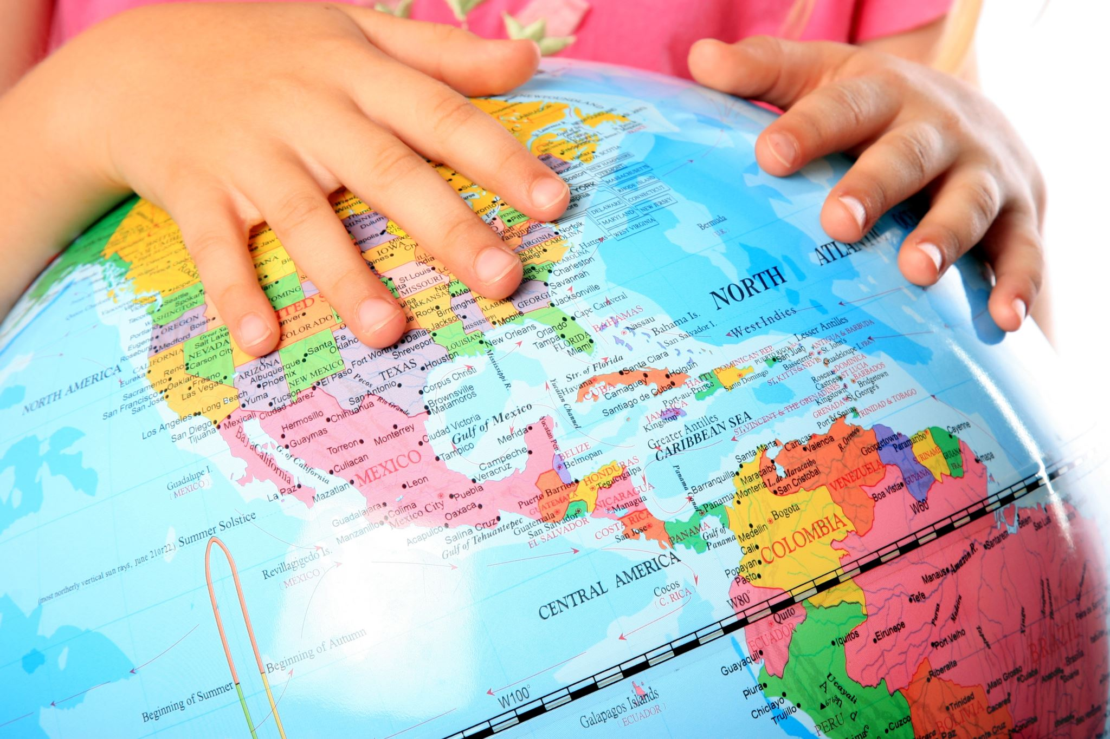
Thank you for joining us today!
Contact information:
Stefanie Winfield
            swinfield @wiche.edu
Liza Tupa
          ltupa@wiche.edu

