Slide 1


Strategies for Managing Behaviors in the Classroom Remotely
Erin Briley, M.S., NCSP
Technical Trainer
Mountain Plains Mental Health Technology Transfer Center (MHTTC)
December 7, 2020

Slide 2
Disclaimer and Funding Statement
This presentation was prepared for the Mountain Plains MHTTC under a cooperative agreement from the Substance Abuse and Mental Health Services Administration (SAMHSA). All material appearing in this presentation, except that taken directly from copyrighted sources, is in the public domain and may be reproduced or copied without permission from SAMHSA or the authors. Citation of the source is appreciated. Do not reproduce or distribute this presentation for a fee without specific, written authorization from the Mountain Plains MHTTC. For more information on obtaining copies of this presentation please email Swinfield@wiche.edu.
At the time of this presentation, Elinore F. McCance-Katz served as SAMHSA Assistant Secretary. The opinions expressed herein are the views of Erin Briley and do not reflect the official position of the Department of Health and Human Services (DHHS), or SAMHSA. No official support or endorsement of DHHS, SAMHSA, for the opinions described in this presentation is intended or should be inferred.
The work of the Mountain Plains MHTTC is supported by grant H79SM081792 from the Department of Health and Human Services, Substance Abuse and Mental Health Services Administration.

Slide 3
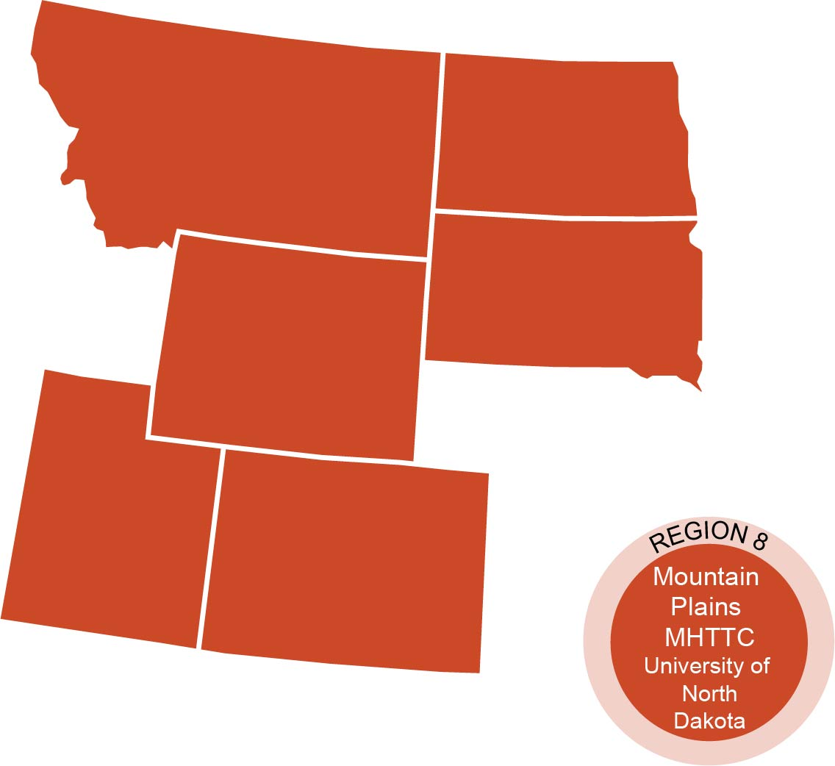
The Mountain Plains Mental Health Technology Transfer Center
The Mountain Plains Mental Health Technology Transfer Center (Mountain Plains MHTTC) provides training and technical assistance to individuals who serve persons with mental health concerns throughout Region 8 (Colorado, Montana, North Dakota, South Dakota, Utah and Wyoming).
We belong to the Technology Transfer Center (TTC) Network, a national network of training and technical assistance centers serving the needs of mental health, substance use and prevention providers. The work of the TTC Network is under a cooperative agreement by the Substance Abuse and Mental Health Service Administration (SAMHSA).

Slide 5
Prevention Methods

Slide 6
General Rules of Thumb
  Connect with each student weekly through video chats, phone calls, etc. Connect more frequently with those presenting with emotional needs prior to pandemic or currently.
  Establish set office hours for communication with families
  Keep a routine & have families create predictable routines for learning and play/breaks
  Set clear expectations for virtual classroom expectations and share with families. Consider sharing video clips of students engaged in appropriate virtual learning behavior.
  Identify and clearly define problematic behaviors with student & families
  Reinforce expectations. Use a token economy to do so if necessary
  Provide behavioral feedback to students not meeting expectations. If necessary, share concerns with parents and request support.
  Provide lots of movement breaks! Chunk tasks if necessary

Slide 7
Setting Virtual Classroom Expectations. Ideas..
On-time log in
Logging study times
Appropriate participation in virtual classroom (make sure they know what this looks like! E.g., appropriately dressed, music/TV off, sitting nicely at a desk/table, appropriate words in chat, etc.)
Appropriate home workspace
Checking in at designated times

Slide 8
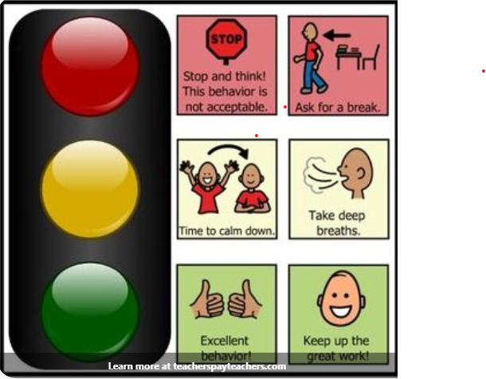
Check-In Ideas
Visual thermometers help to identify emotions, their intensity, self-regulate, & promote empathy for others.
Teacher or student can initiate check-ins.
Recommended check-in at beginning of each class & periodically throughout or when needed.
Traffic Light System
  Provide child 3 colored cards (red, yellow, green) & define what colors represent.
  E.g., (Green = I am doing good; Yellow = I am getting frustrated; Red = I am getting too angry).
  Goal: address before student is red (e.g., provide “time away” as a means to self-regulate, taking a brief walk, etc.).
  Can pair each color with pre-identified coping skills to implement.
Image retrieved from teacherspayteachers.com

Slide 9

Check-In Ideas
2. Emotions Thermometer
Numbers
Faces (mood emojis)
3. Peer check-ins
Peers check-in with 1 assigned classmate daily
4. (Virtual) Check-In/Check-Out
Check in and out with designated point person at beginning & end of each day
(fade frequency as appropriate)
Couple with specific behavioral feedback and daily behavioral report card/token economy
Note: Zones of Regulation is an excellent curriculum for emotional and behavioral regulation!
Image retrieved from:
gooddayswithkids.com/tags/zones-of-regulation

Slide 10
Behavioral Response

Slide 11
How to Use Rewards
  Use rewards and incentives more than punishments (punitive approaches can lead to negative behaviors so it’s best to avoid using)
  Use natural rewards/incentives before tangible ones
- Increase feedback & celebrations
- Provide more acknowledgments, choice, control, & novelty
  Reward good behavior and selectively ignore inappropriate behavior
  Consistently follow-through & reinforce immediately.
  AVOID: providing incentives prior to expectations

Slide 12
Token Systems
Points (stickers, tickets) earned for goals for specified time periods, accumulated, & exchanged for specified reward.
Best for no more than 3-4 behaviors. Pictures used for younger kids or those that with developmental disabilities.
Know the student’s baseline so you can create a challenging yet achievable goal. Consider their frustration level & allow room for error. No one is perfect. Do not expect 100% success unless related to physical aggression. I recommend aiming for 75-80% success to obtain incentives, but have made it as low as 50% for some students.
Consider how frequently reinforcer should be earned. At end of each assignment, class, day?
Give token (point) as soon as child shows appropriate behavior. Pair with specific feedback.
For virtual learning, consider involving parents to help with rewards or provide rewards within your control (e.g., homework passes).
Fines due to inappropriate behavior (response cost) should be avoided. But if you do, consult with specialist for this. Kids shouldn’t lose more points than they earn.

Slide 13
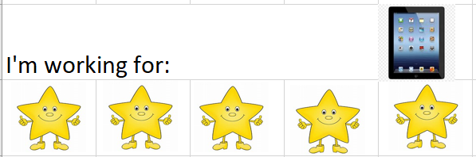
Token Boards
Or, have students color in 1 section of a picture each time they complete a task/problem. When the entire picture is colored in, they earn their incentive.
Virtual token boards: https://www.thetokenboard.com/
Downloadable boards: http://www.educateautism.com/free-materials-and-downloads.html/category/token-boards.html
Created by Erin Briley, M.S., NCSP

Slide 14
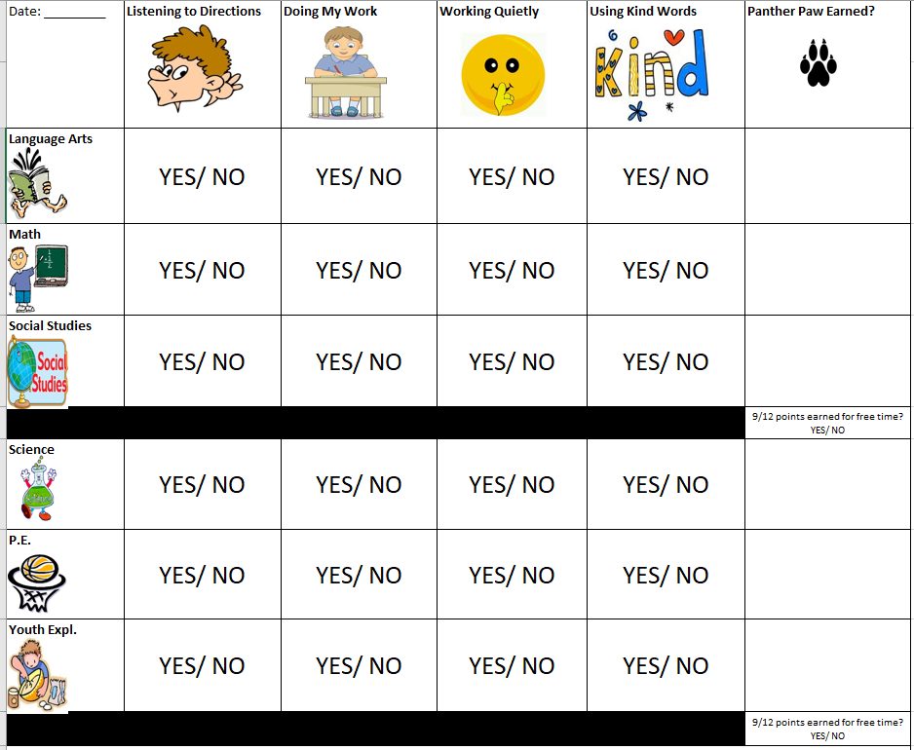
Token Economy Example #1
Created by Erin Briley, M.S., NCSP

Slide 15
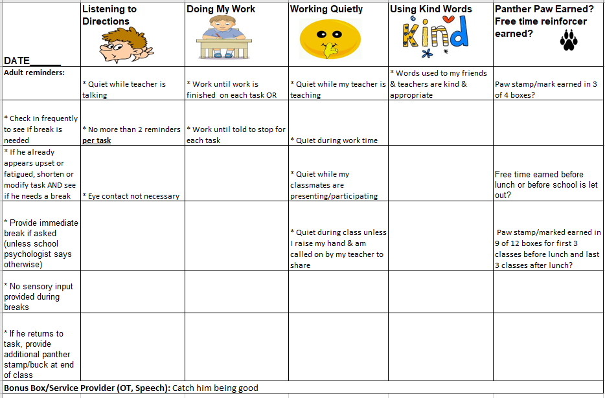
Token Economy #1 (Example of directions)
Created by Erin Briley, M.S., NCSP

Slide 16
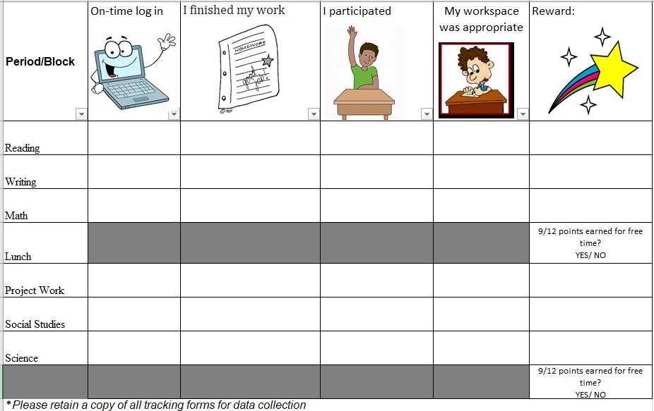
Token Economy Example #2
Created by Erin Briley, M.S., NCSP

Slide 17
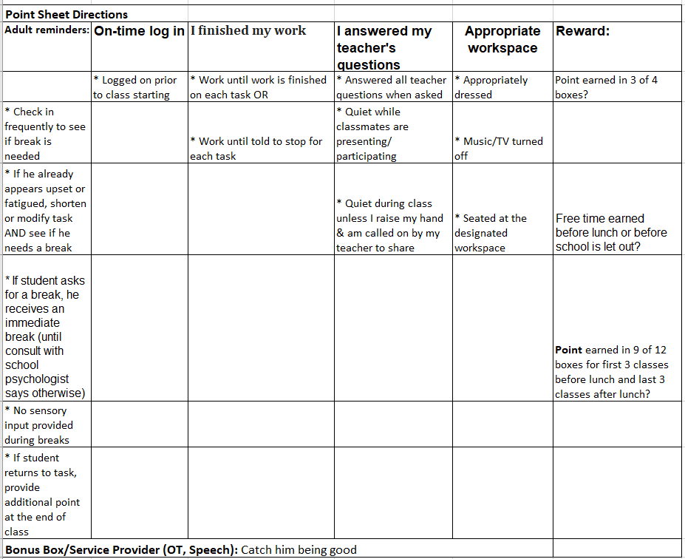
Token Economy #2 (Example of Directions)
Created by Erin Briley, M.S., NCSP

Slide 18
Reinforcer Menu Types #1 & #2
1. Choose from a list of preapproved incentives as long as student meets set points
2. Have student select several/or one item in advance to work towards
Class Reinforcement Menu
Miss X’s Third Grade Class
• 10 minutes extra recess
• 15 minutes free time in the computer lab
• Free assignment coupon
• Eat lunch with Miss X
• Treasure box
• Choose a friend to sit by for one day
• Read a book to the Kindergarten class
• Help the P.E. teacher for one class period
• Phone call home
• Help (principal) in the office for 1 hour
• Smelly sticker

Slide 19
Reinforcement Menu Type #3
Incentives are valued at different amounts, so the child can decide to save up for a high valued incentive (e.g., virtual lunch date with counselor) or turn in less points for a lower valued incentive (e.g., 5 minutes of free time to listen to music on iPod)
Sample Reinforcer Menu
5 Points 10 points 20 points
Free time for iPod Homework Pass Virtual lunch with counselor & friend

Slide 20
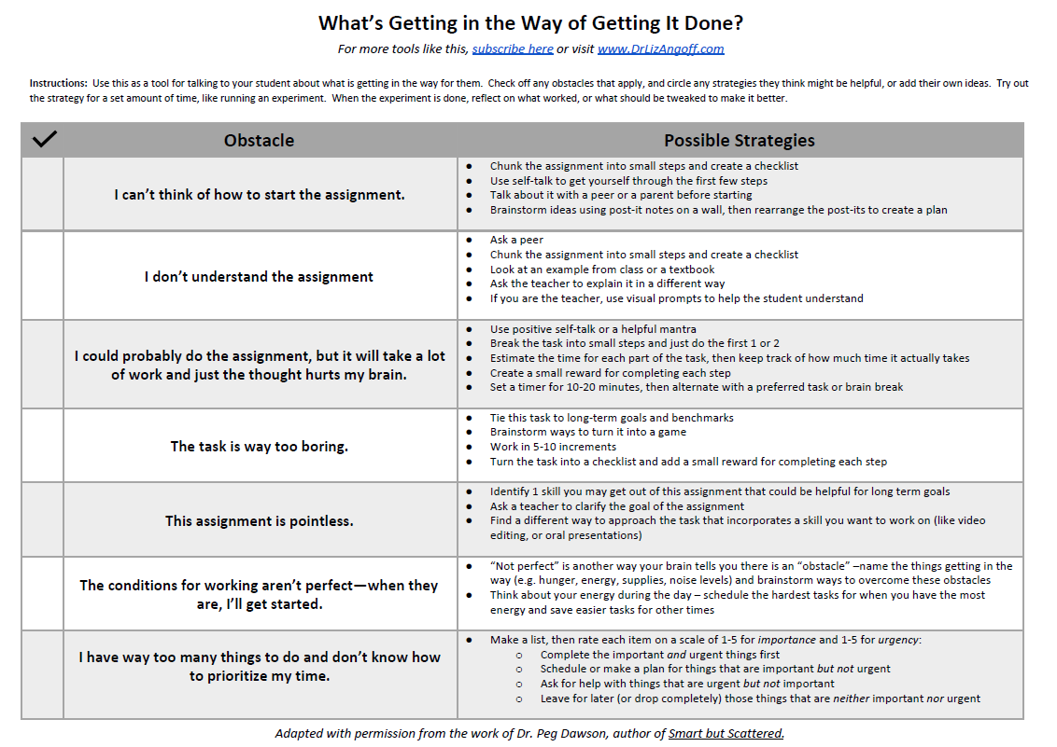

Slide 21
Other Incentives
Student/Teacher Game (a class wide incentive system)
Catch students demonstrating target behavior(s) to earn a point for the entire class. Class must earn set # of points to earn reward during designated time period.
Behavior Bucks
Provide students bucks for demonstrating target behavior(s) randomly that they can spend for incentives at class store/homework/virtual dance party.
Tip: PBIS World has a template that can be customized
https://www.pbisworld.com/tier-2/reward-system/

Slide 22
Reinforcers for Remote Learning
Privileges
Activities
iPad/iOS Sensory Apps that double as brain breaks
homework pass
extra points
do only odd problems for math
display of student’s ARTWORK/picture as teacher’s virtual class background
student selection of virtual class background
student monitor of chat box
selection of class virtual fieldtrip
selection of class theme
wearing special outfits
go noodle
bubble pop
pocket pond
fluidity HD
Super Slime simulator
calm down yoga (https://www.youtube.com/watch?v=rWP4Xl4IDYA&app=desktop)
free time
drawing, reading, board games, Games on tablet/Phone
listen to music on headphones
Lunch date with you & selected friend (zoom, etc.)
virtual talent shows
telling class favorite jokes
decorating things
Extra break time
Verbal
iPad/iOS Educational Game Apps
Tangibles
pbs kids games
candy crush
certificates
teacher avatar messages
badges/awards
Specific Praise (privately/in front of others)
peer-recognition
Personalized video messages from teacher/Avatar

Slide 23
Resources
Behavioradvisor.com
Interventioncentral.org
pent.ca.gov
pbis.org
Pbisworld.com
Boom learning (for virtual token economies)
Google Slides (for virtual token economies)

Slide 24
Thank you for joining!
ebriely@wiche.edu
swinfield@wiche.edu

