Slide 1
Distance Learning Strategies for Students with Disabilities
12/1/2020
Rachel Freedman, MA, MS, BCBA, LABA
Wyoming Institute for Disabilities (WIND)
College of Health Sciences
University of Wyoming
Mountain Plains MHTTC

Slide 2
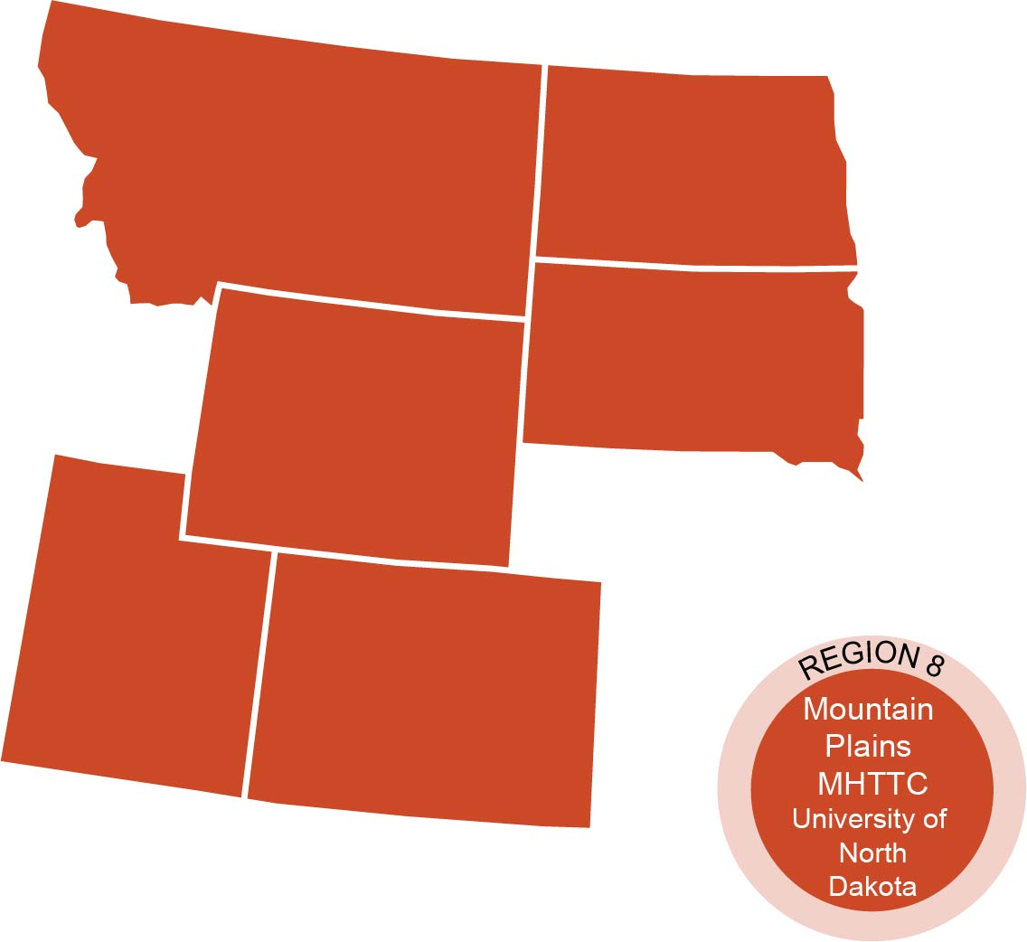
The Mountain Plains Mental Health
Technology Transfer Center
The Mountain Plains Mental Health Technology Transfer Center (Mountain Plains MHTTC) provides training and technical assistance to individuals who serve persons with mental health concerns throughout Region 8 (Colorado, Montana, North Dakota, South Dakota, Utah and Wyoming). We belong to the Technology Transfer Center (TTC) Network, a national network of training and technical assistance centers serving the needs of mental health, substance use and prevention providers. The work of the TTC Network is under a cooperative agreement by the Substance Abuse and Mental Health Service Administration (SAMHSA).
Notes:
David will cover to here

Slide 3
Disclaimer and Funding Statement
This presentation was prepared for the Mountain Plains Mental Health Technology Transfer Center (Mountain Plains MHTTC) under a cooperative agreement from the Substance Abuse and Mental Health Services Administration (SAMHSA). All material appearing in this presentation, except that taken directly from copyrighted sources, is in the public domain and may be reproduced or copied without permission from SAMHSA or the authors. Citation of the source is appreciated. Do not reproduce or distribute this presentation for a fee without specific, written authorization from the Mountain Plains MHTTC. For more information on obtaining copies of this presentation please email swinfield@wiche.edu
At the time of this presentation, Elinore F. McCance-Katz served as SAMHSA Assistant Secretary. The opinions expressed herein are the views of Rachel freedman and do not reflect the official position of the Department of Health and Human Services (DHHS), or SAMHSA. No official support or endorsement of DHHS, SAMHSA, for the opinions described in this presentation is intended or should be inferred.
The work of the Mountain Plains MHTTC is supported by grant H79SM081792 from the Department of Health and Human Services, Substance Abuse and Mental Health Services Administration.
Notes:
David

Slide 4
Distance Learning Strategies
for Students with Disabilities
Rachel Freedman, MA, MS, BCBA, LABA
Wyoming Institute for Disabilities (WIND)
College of Health Sciences
University of Wyoming
rfreedma@uwyo.edu
This Photo by Unknown Author is licensed under CC BY-NC-ND

Slide 5
Presenter Information:
Rachel Freedman, MA, MS, BCBA, LABA
Lifelong personal connections to individuals w/ autism & Down syndrome
Started professional Applied Behavior Analysis (ABA) training in 2007
Board-Certified Behavior Analyst (since 2011)
Licensed Special Education Administrator (Massachusetts)
Enrolled in PhD program in Special Education w/ emphasis in Autism Spectrum Disorder @ University of Idaho

Slide 6
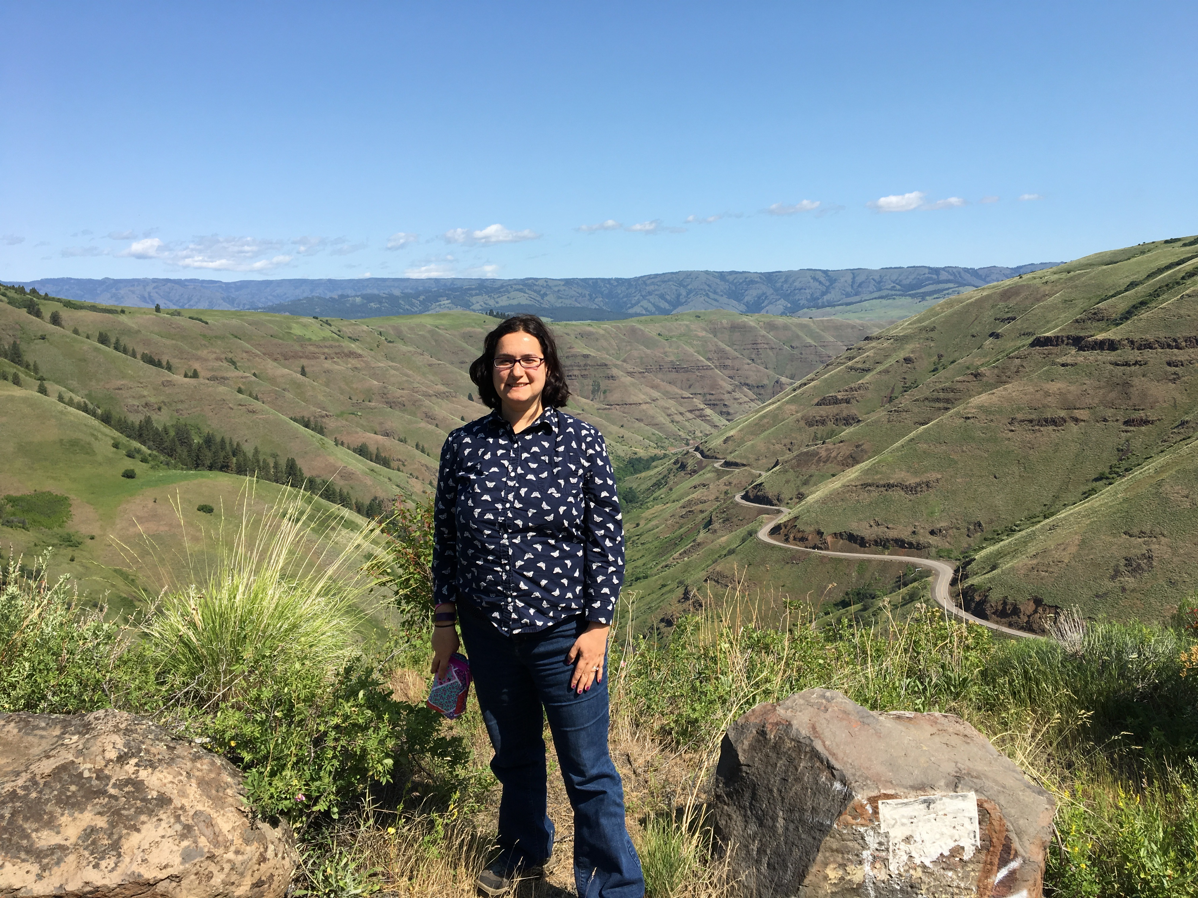
Rachel Freedman, MA, MS, BCBA, LABA
Experience across multiple states…
Wisconsin
Massachusetts
Virginia
Idaho
Wyoming
… and multiple systems of care!
Early Intervention
Preschool/Head Start/Early Childhood Centers
K-12 schools/districts
Medicaid/Health Insurance

Slide 7
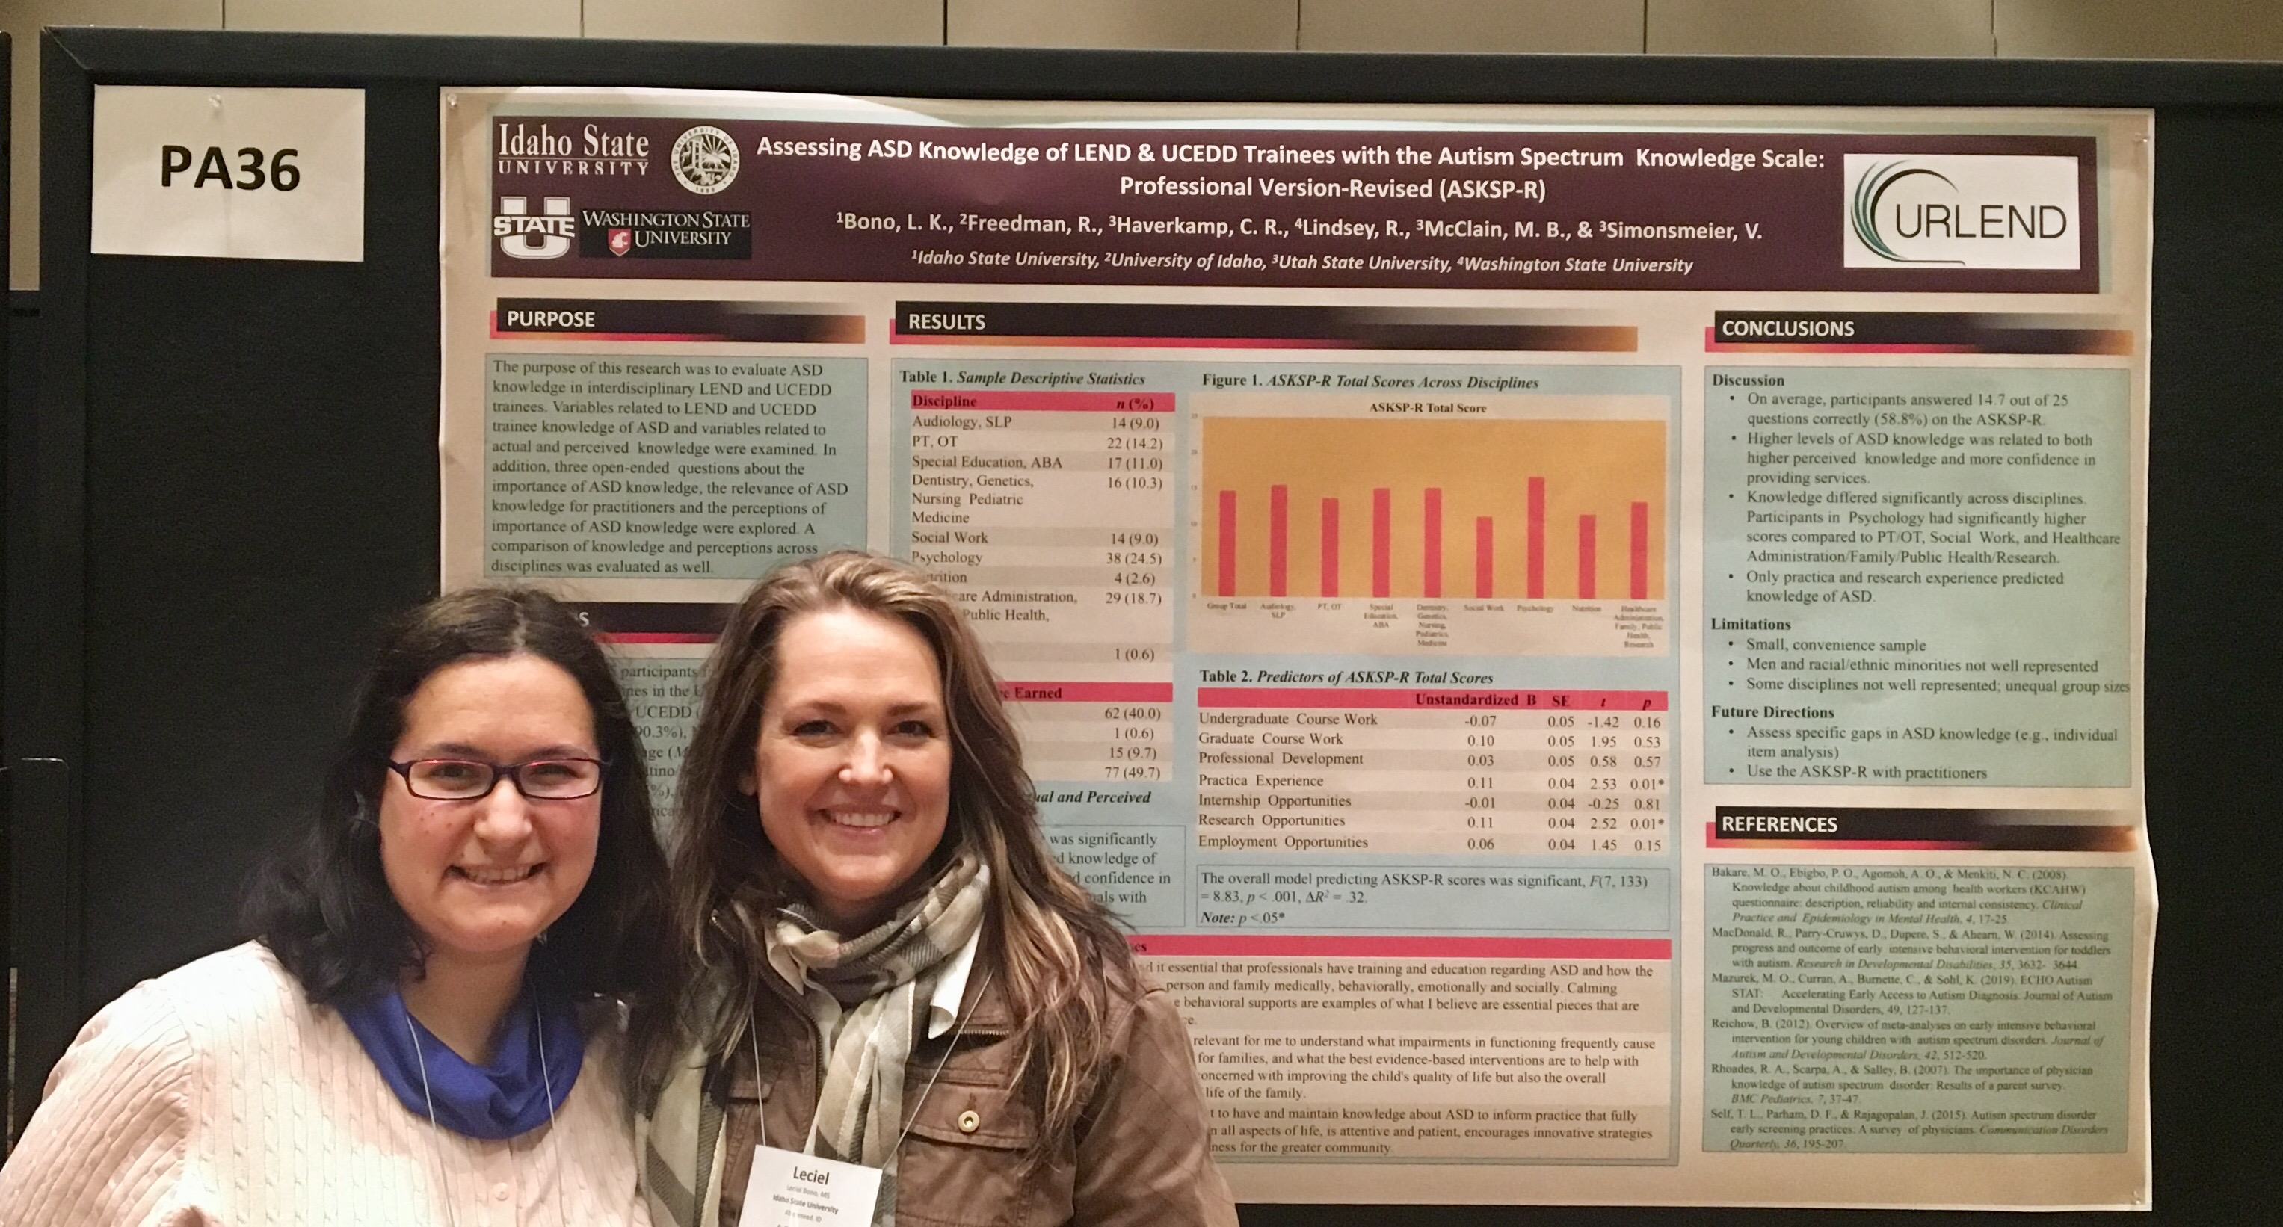
Rachel Freedman, MA, MS, BCBA, LABA
Interdisciplinary approach to supporting families
URLEND (Utah Regional Leadership Education in Neurodevelopmental Disabilities) training
Consultation to school districts & families to promote functional skills for learners with…
Autism Spectrum Disorder
Intellectual/Developmental Disabilities
Emotional Disabilities
Successor guardian for adult w/ autism & intellectual impairment

Slide 8
Disclosures
Picture symbols generated using
Board Maker Online.
No additional disclosures at this time.
Notes:
Presenter to populate

Slide 9
Learning Objectives
Be able to list the key components of successful distance learning sessions.
Be able to identify 3-5 different reinforcers for 2 different students with disabilities that could be delivered virtually.
Be able to identify online resources for providing Positive Behavioral Interventions and Supports during distance learning.

Slide 10
Session Agenda
Mini-Review of Individualized Education Programs (IEP) implementation during COVID-19
Key Components of Successful Distance Learning Sessions for Students with Disabilities
Online Resources
Questions/Discussion
***Food for thought…
Why do you think I included this Session Agenda
in the presentation?

Slide 11
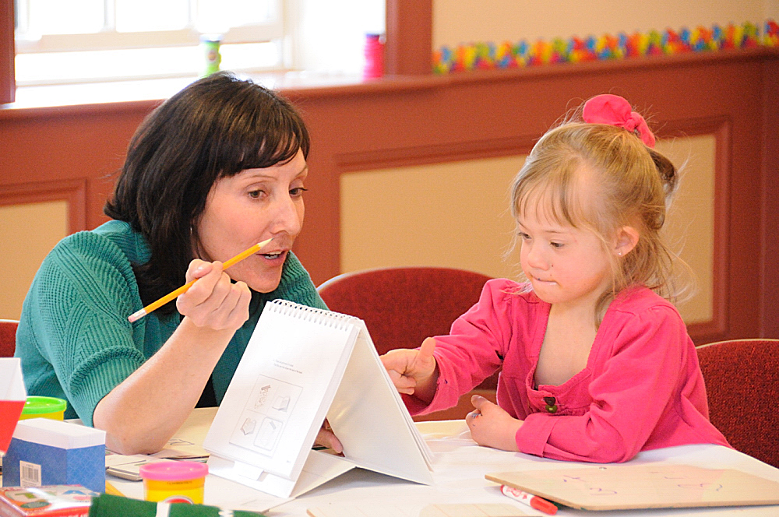
IEP Development
Each Local Education Agency/School District must develop an Individualized Education Program (IEP) for each student who requires specialized instruction to make effective progress in school due to 1 or more of the following disabilities:
Autism
Deaf-blindness
Hearing impairment
Intellectual disability
Multiple disabilities
Orthopedic impairment
Other health impairment (including ADHD)
Serious emotional disturbance
Specific learning disability
Speech or language impairment
Traumatic brain injury
Visual impairment

Slide 12
IEP Services + COVID-19
***Federal statute= IDEA (Individuals with Disabilities Education Act):
IDEA Part B applies to students ages 3-21
IDEA Part C applies to children from birth to age 3
IEPs are developed based on IDEA Part B & include:
Accommodations (accessible materials, assistive technology devices/equipment, visual supports, positive reinforcement systems)
Modifications
(extended curriculum standards; teaching a student to read a recipe instead of a Shakespeare play; teaching money skills in place of Algebra 1 Course)

Slide 13
IEP Services + COVID-19
Specialized Instruction (1:1 or small group teaching in content areas to achieve IEP Goals- reading, writing, math, daily living skills, vocational skills)
Related Services (Speech & Language Therapy, Occupational/Physical Therapy, Adaptive Physical Education, Vision/Orientation & Mobility, Behavioral Consultation, Counseling, Social Skills Groups)
***Food for thought…
How has COVID-19 impacted the related services that you are providing to support students’ mental health needs?
This Photo by Unknown Author is licensed under CC BY-SA

Slide 14
IEP Services + COVID-19
IDEA Part B has not changed due to COVID-19.
Accommodations, modifications, specialized instruction, & related services must be provided to students per their current IEPs (even during distance learning!)…
How has COVID-19 impacted your opportunities to support students with disabilities or students who are struggling with mental health challenges?
What are the impacts of COVID-19 on mental health… For students? For teachers? For mental health service providers?

Slide 15
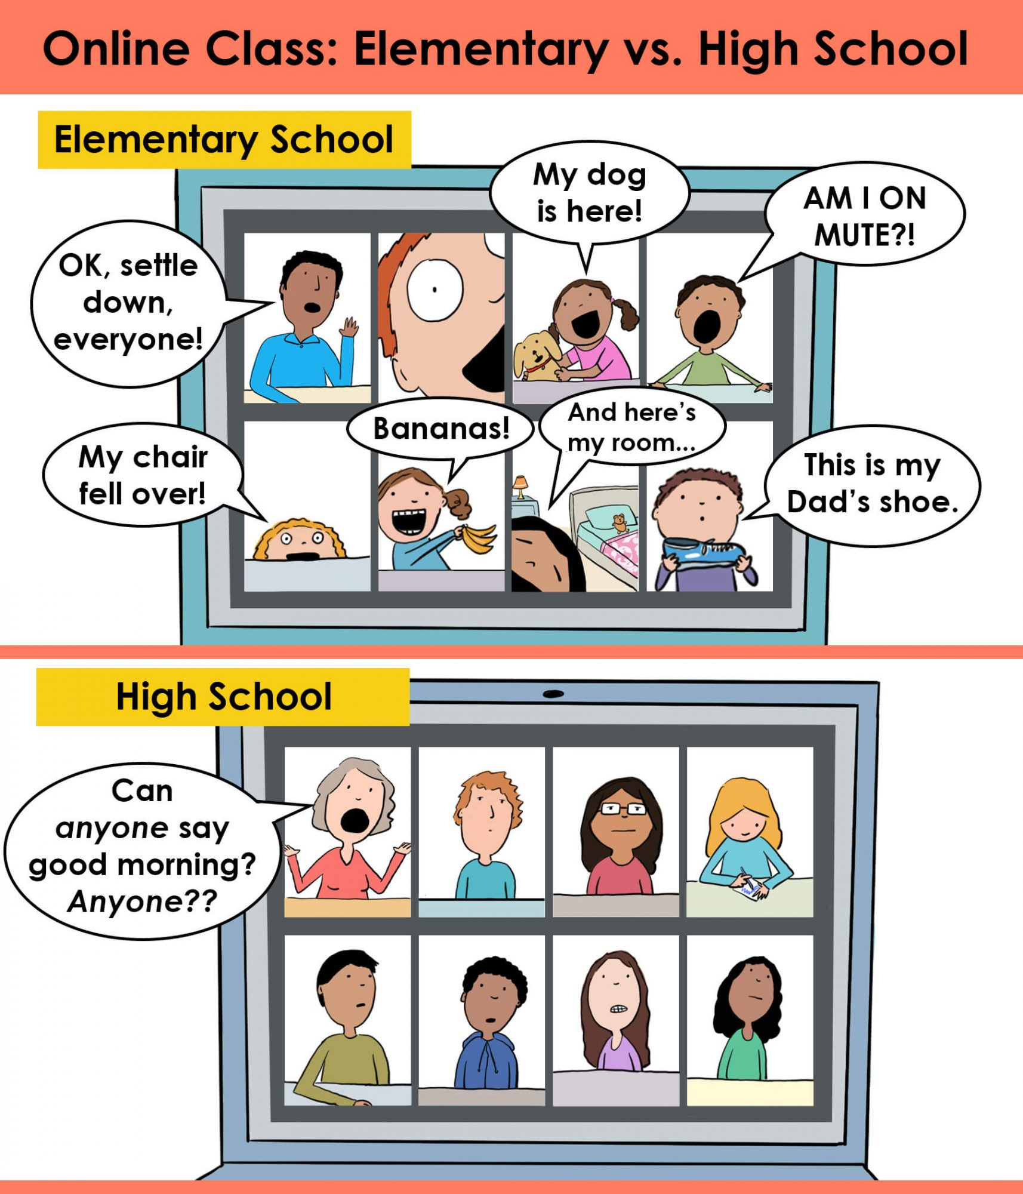
Remote Learning Sessions
Synchronous sessions (e.g., Zoom, Google Meet)
Morning Meeting; Academic Lessons
Teletherapy sessions (SLP; OT/PT; Counseling; Social Skills Group)
Asynchronous lessons
Uploaded or shared by teacher (materials + instructions)
Completed & submitted by students later
Must include accomodations + modifications + specialized Instruction + related Services
per student’s current IEP!
https://www.parents.com/kids/education/these-hilarious-cartoons-showcase-the-reality-of-distance-learning-at-home/

Slide 16
Key Components
Successful distance learning sessions are more likely to occur when educators/clinicians plan for each of the following session components:
Environment
Materials
Structure
Positive Reinforcement
Follow-Through

Slide 17
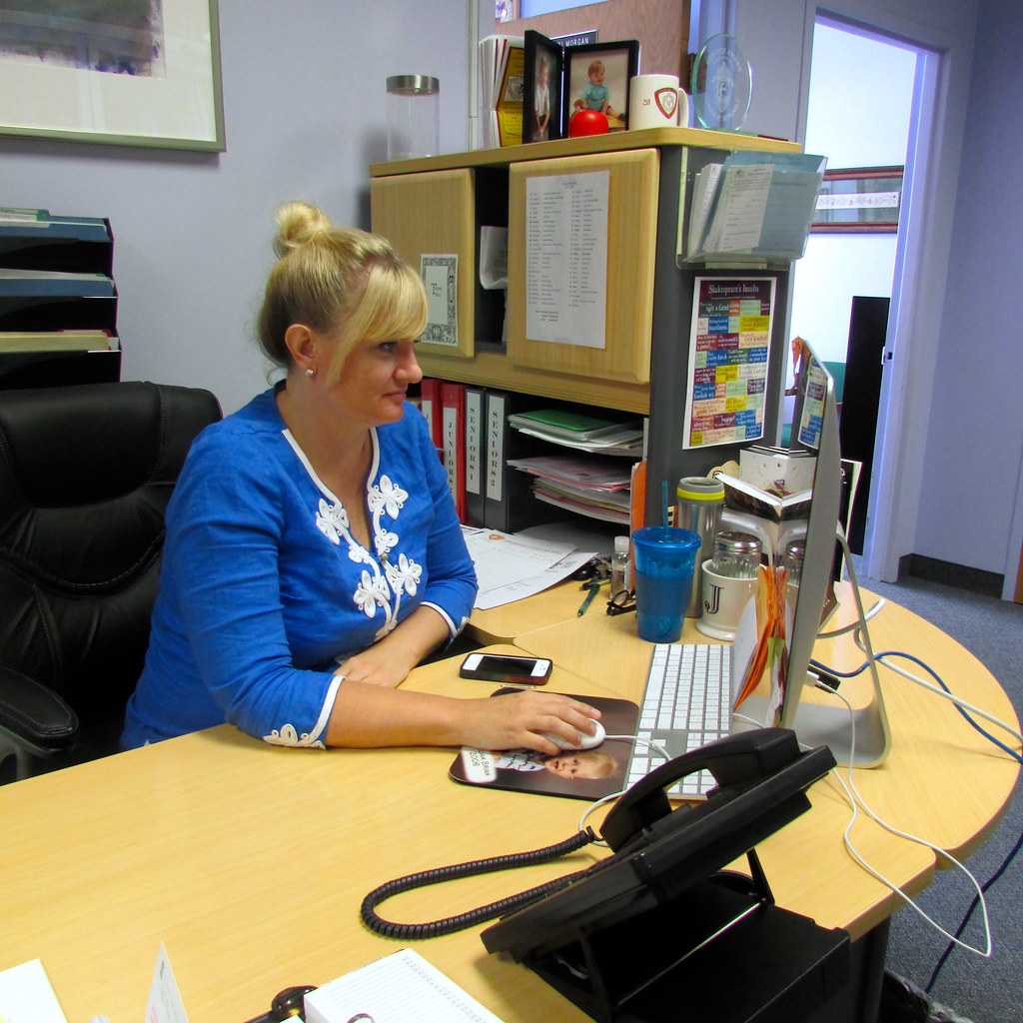
ENVIRONMENT
Educator’s/Clinician’s Setup
Internet connectivity
Device w/ audio/video, microphone
Software apps/platforms/websites
Minimal distractions (auditory, visual)
Access to curriculum resources & materials
Tools (visual, time management, progress monitoring)
Confidential location/area

Slide 18
ENVIRONMENT
Student’s Setup
Internet connectivity
Device w/ audio/video, microphone
Software apps/platforms/websites
Minimal distractions (auditory, visual)
Access to curriculum resources & materials
E-Helper (parent, caregiver, older sibling, etc. to help connect to software apps/platforms, login to websites, set up equipment, organize materials, etc.)
***Food for thought: What are some barriers to ensuring that students have the appropriate setup to access distance learning sessions?

Slide 19
MATERIALS
Visual supports (schedule, First/Then board, checklists, token boards, points sheets, etc.- on screen or hard copies)
Time management tools
(timer, watch, clock, etc.- can be high-tech or low-tech)
On-screen materials
(Jamboard, Padlet, Google Classroom site, discussion board,
digital textbooks, digital worksheets or graphic organizers)
Physical materials
(school supplies, textbooks, etc.)
Reinforcers (rewards students can earn)

Slide 20
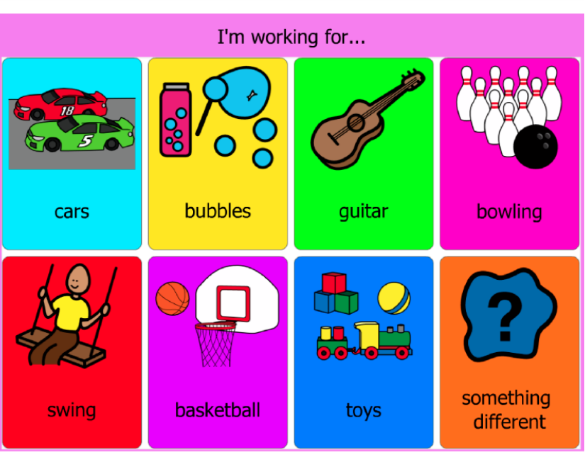
STRUCTURE
Make distance learning sessions PREDICTABLE!
Establish consistent routines.
Start with a check-in (make sure students have materials; ask how they are doing; build rapport).
Go over schedule/agenda for session.
Encourage students to choose their reinforcers (rewards) for participating in the session.
Provide instruction/start interactive activities.
End with a wrap-up to promote follow-through.

Slide 21
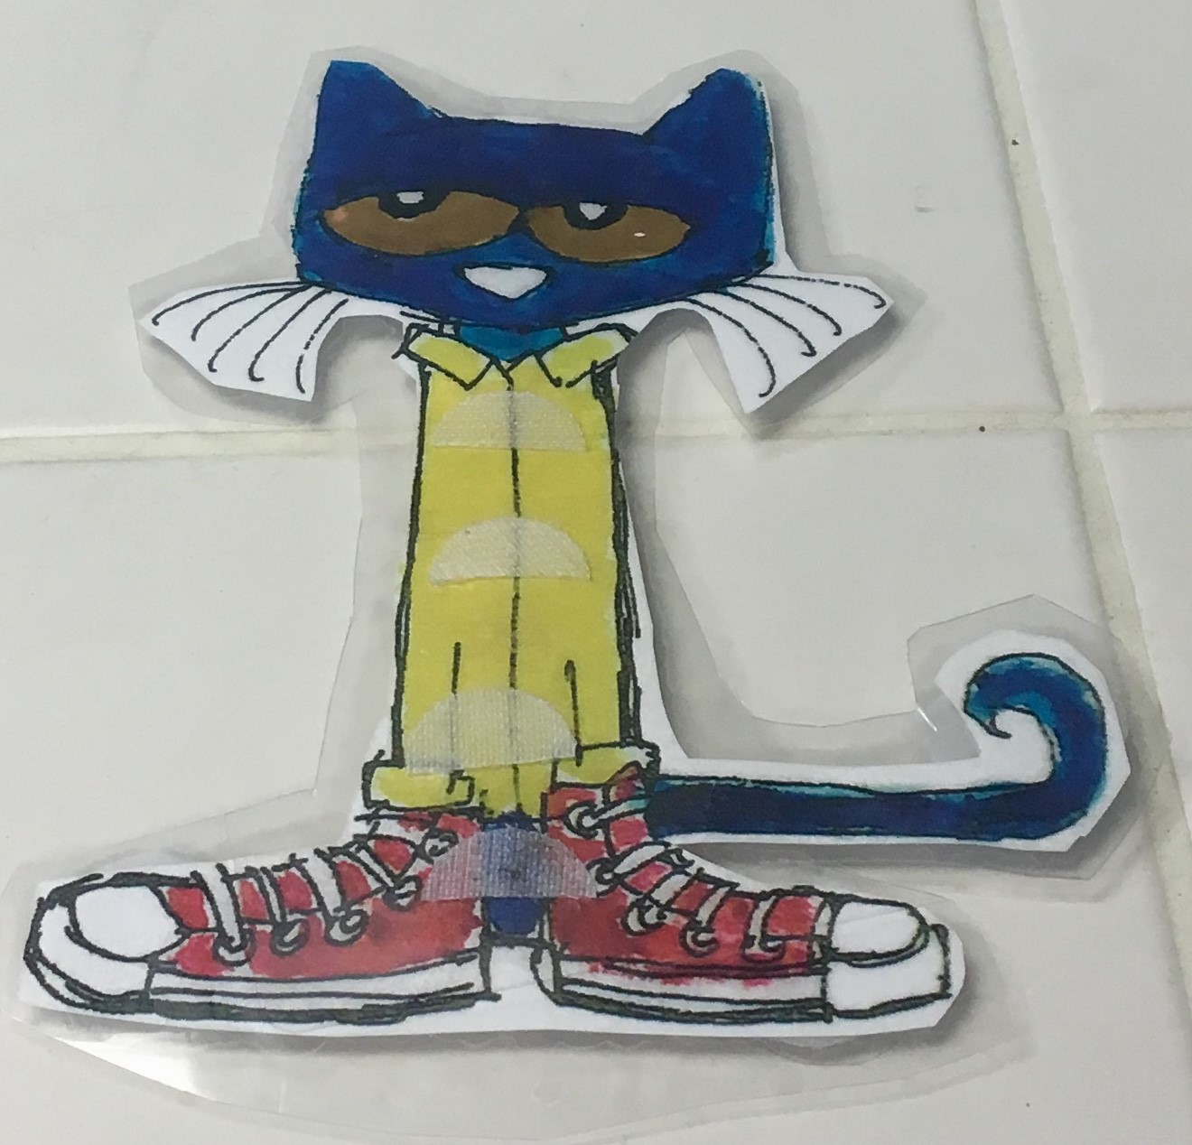
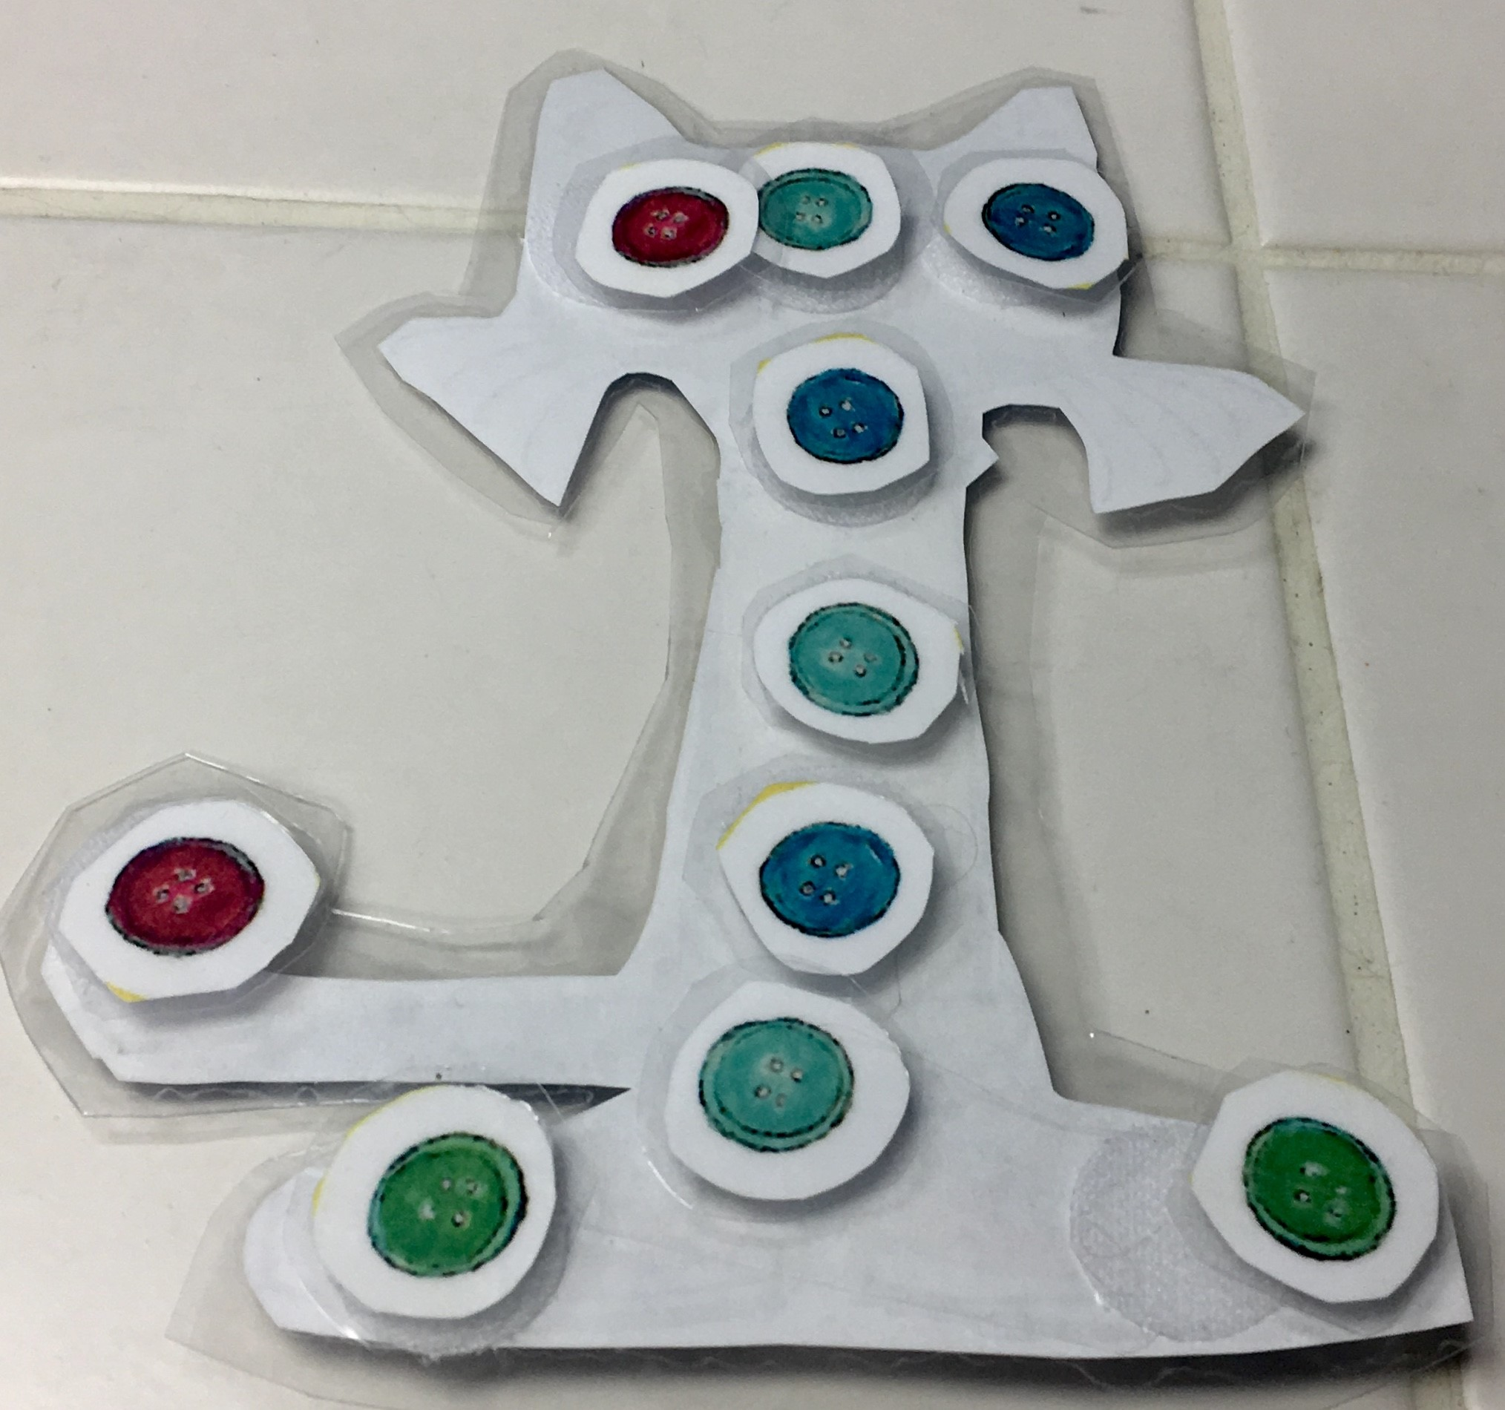
POSITIVE REINFORCEMENT
At the start of the session, each student should review the reinforcement plan:
What am I working for?
What do I need to do to earn it?
How & when will I receive the reward?
Types & schedules of reinforcement…
First/Then Boards
Token Boards
Points Sheets
Verbal Contract

Slide 22
FOLLOW-THROUGH
Lesson summary
What did we do?
How did we do it?
What did we learn?
What’s next?
When will the student(s) meet with you again?
What do students need to work on?
How can students get help? (virtual office hours, crisis hotlines, other resources)
How will you maintain rapport/connection?

Slide 23
Student-Specific Materials
Choiceworks App
(photo from
Rise 'N' Shine Paediatric Occupational Therapy Services)

Slide 24
Student-Specific Materials:
FIRST/THEN BOARD
Math Problems
Outside
Be specific! (How many math problems? How much time outside? Where?)
For students w/ advanced language, pictures can be faded out.

Slide 25
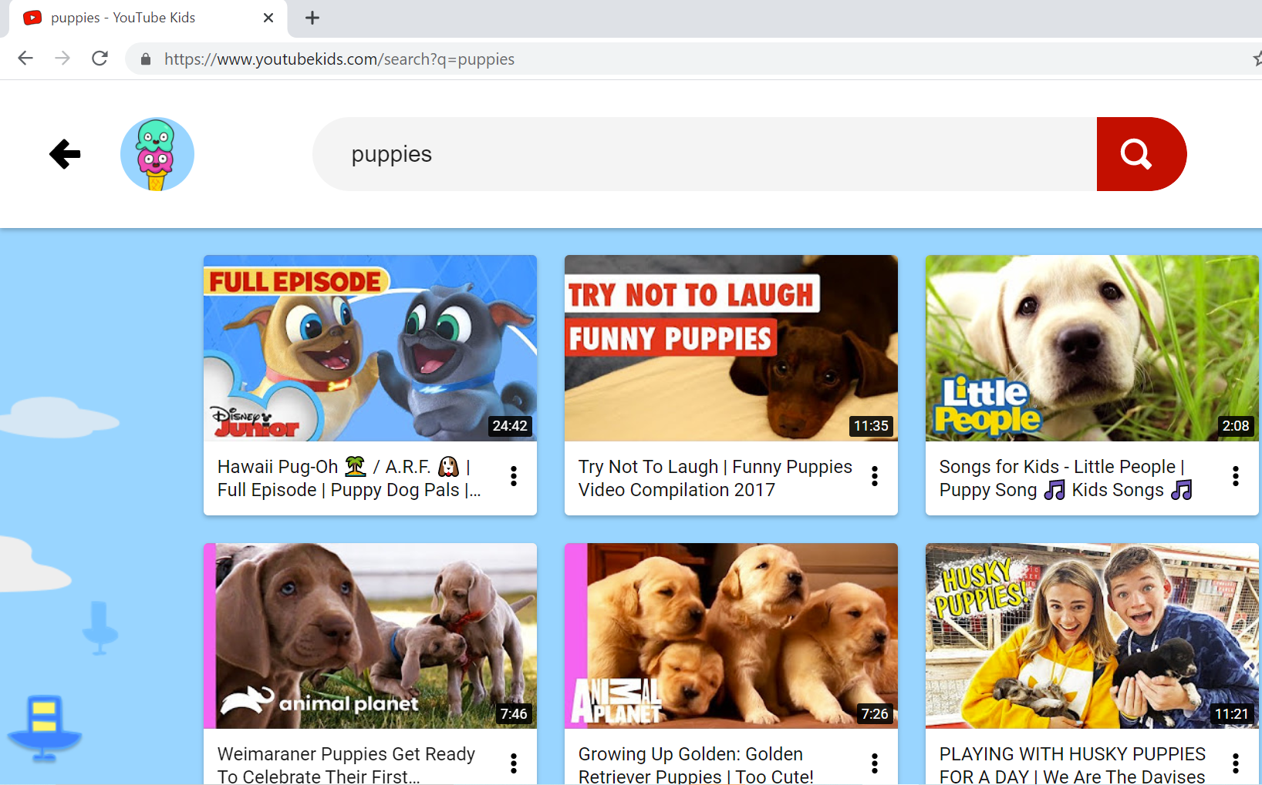
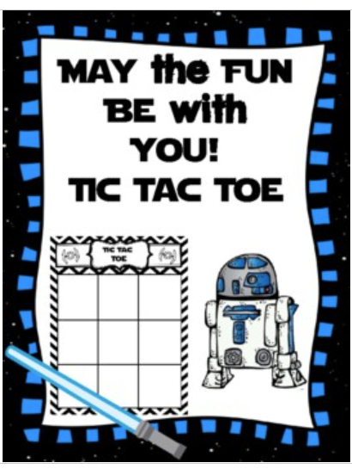
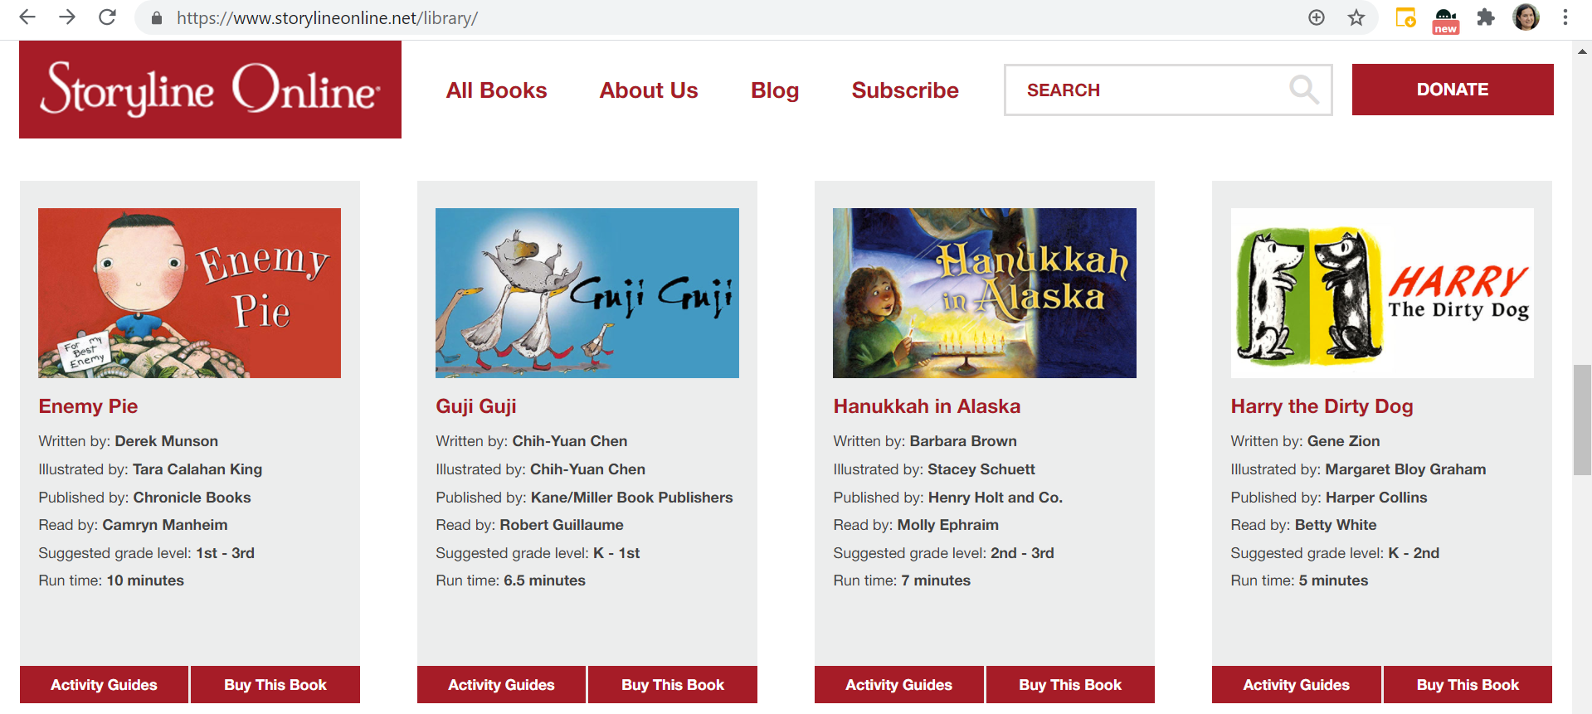
Student-Specific Materials: VIRTUAL REWARDS
Star Wars Tic Tac Toe from Teachers Pay Teachers: Teaching with a Louisiana Twist, https://www.teacherspayteachers.com/Product/May-the-Fun-Be-with-You-Star-Wars-Inspired-Tic-Tac-Toe-Board-Game-4566413 ($1.99 for digital download)
Video Clips
Games
Songs/Karaoke/Dance Party
→ Tell us about some Virtual Rewards that YOUR students would enjoy!
Online Books/Read-Alouds

Slide 26
PBIS Virtual Rewards
https://www.pbisrewards.com/blog/pbis-incentives-distance-learning/
*List of free or low-cost interactive rewards, such as…
Class DJ during Digital Dance Party
Choose virtual field trip
Introduce family pet to class
Read aloud to younger students
Virtual Scavenger Hunt

Slide 27
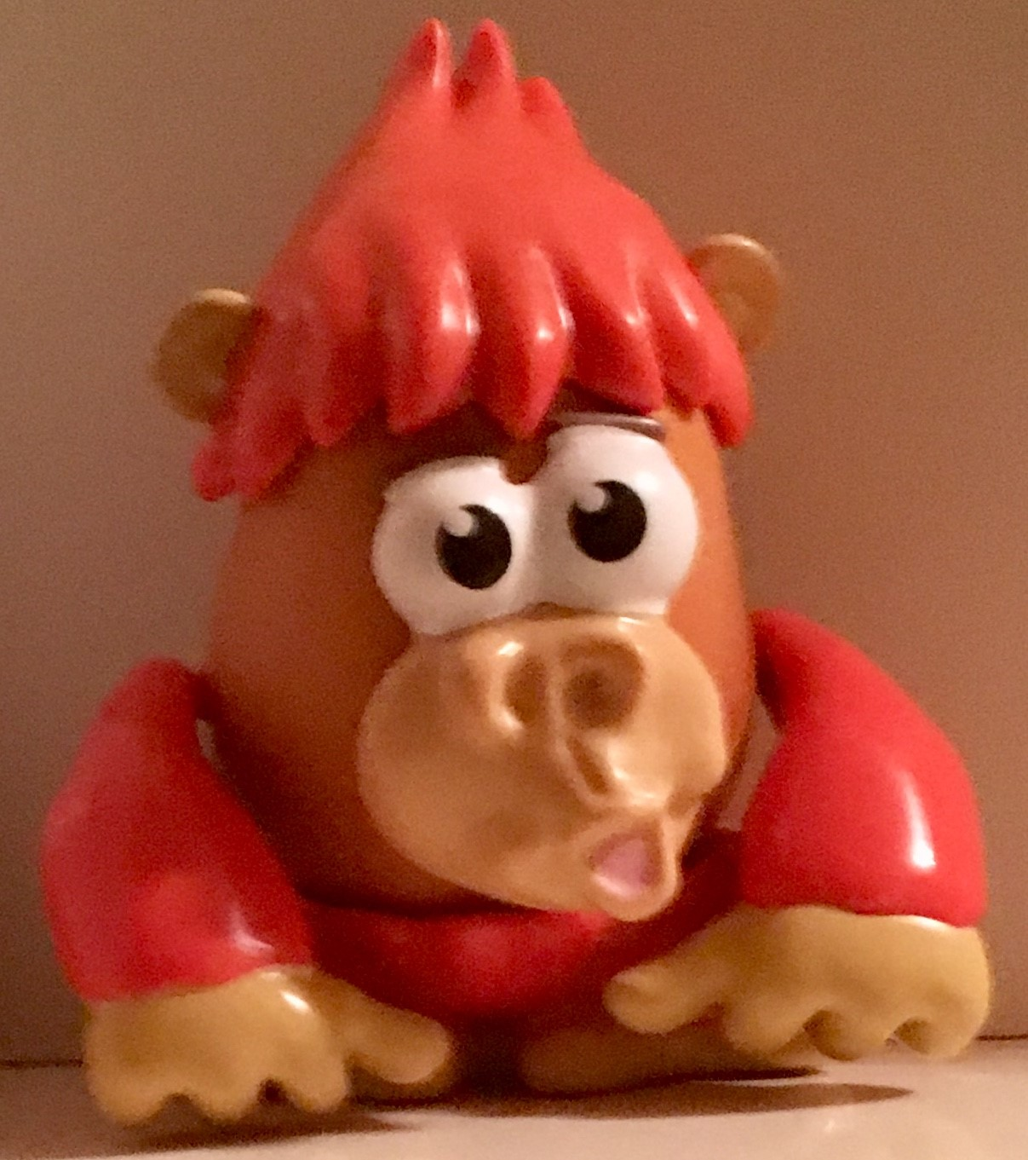
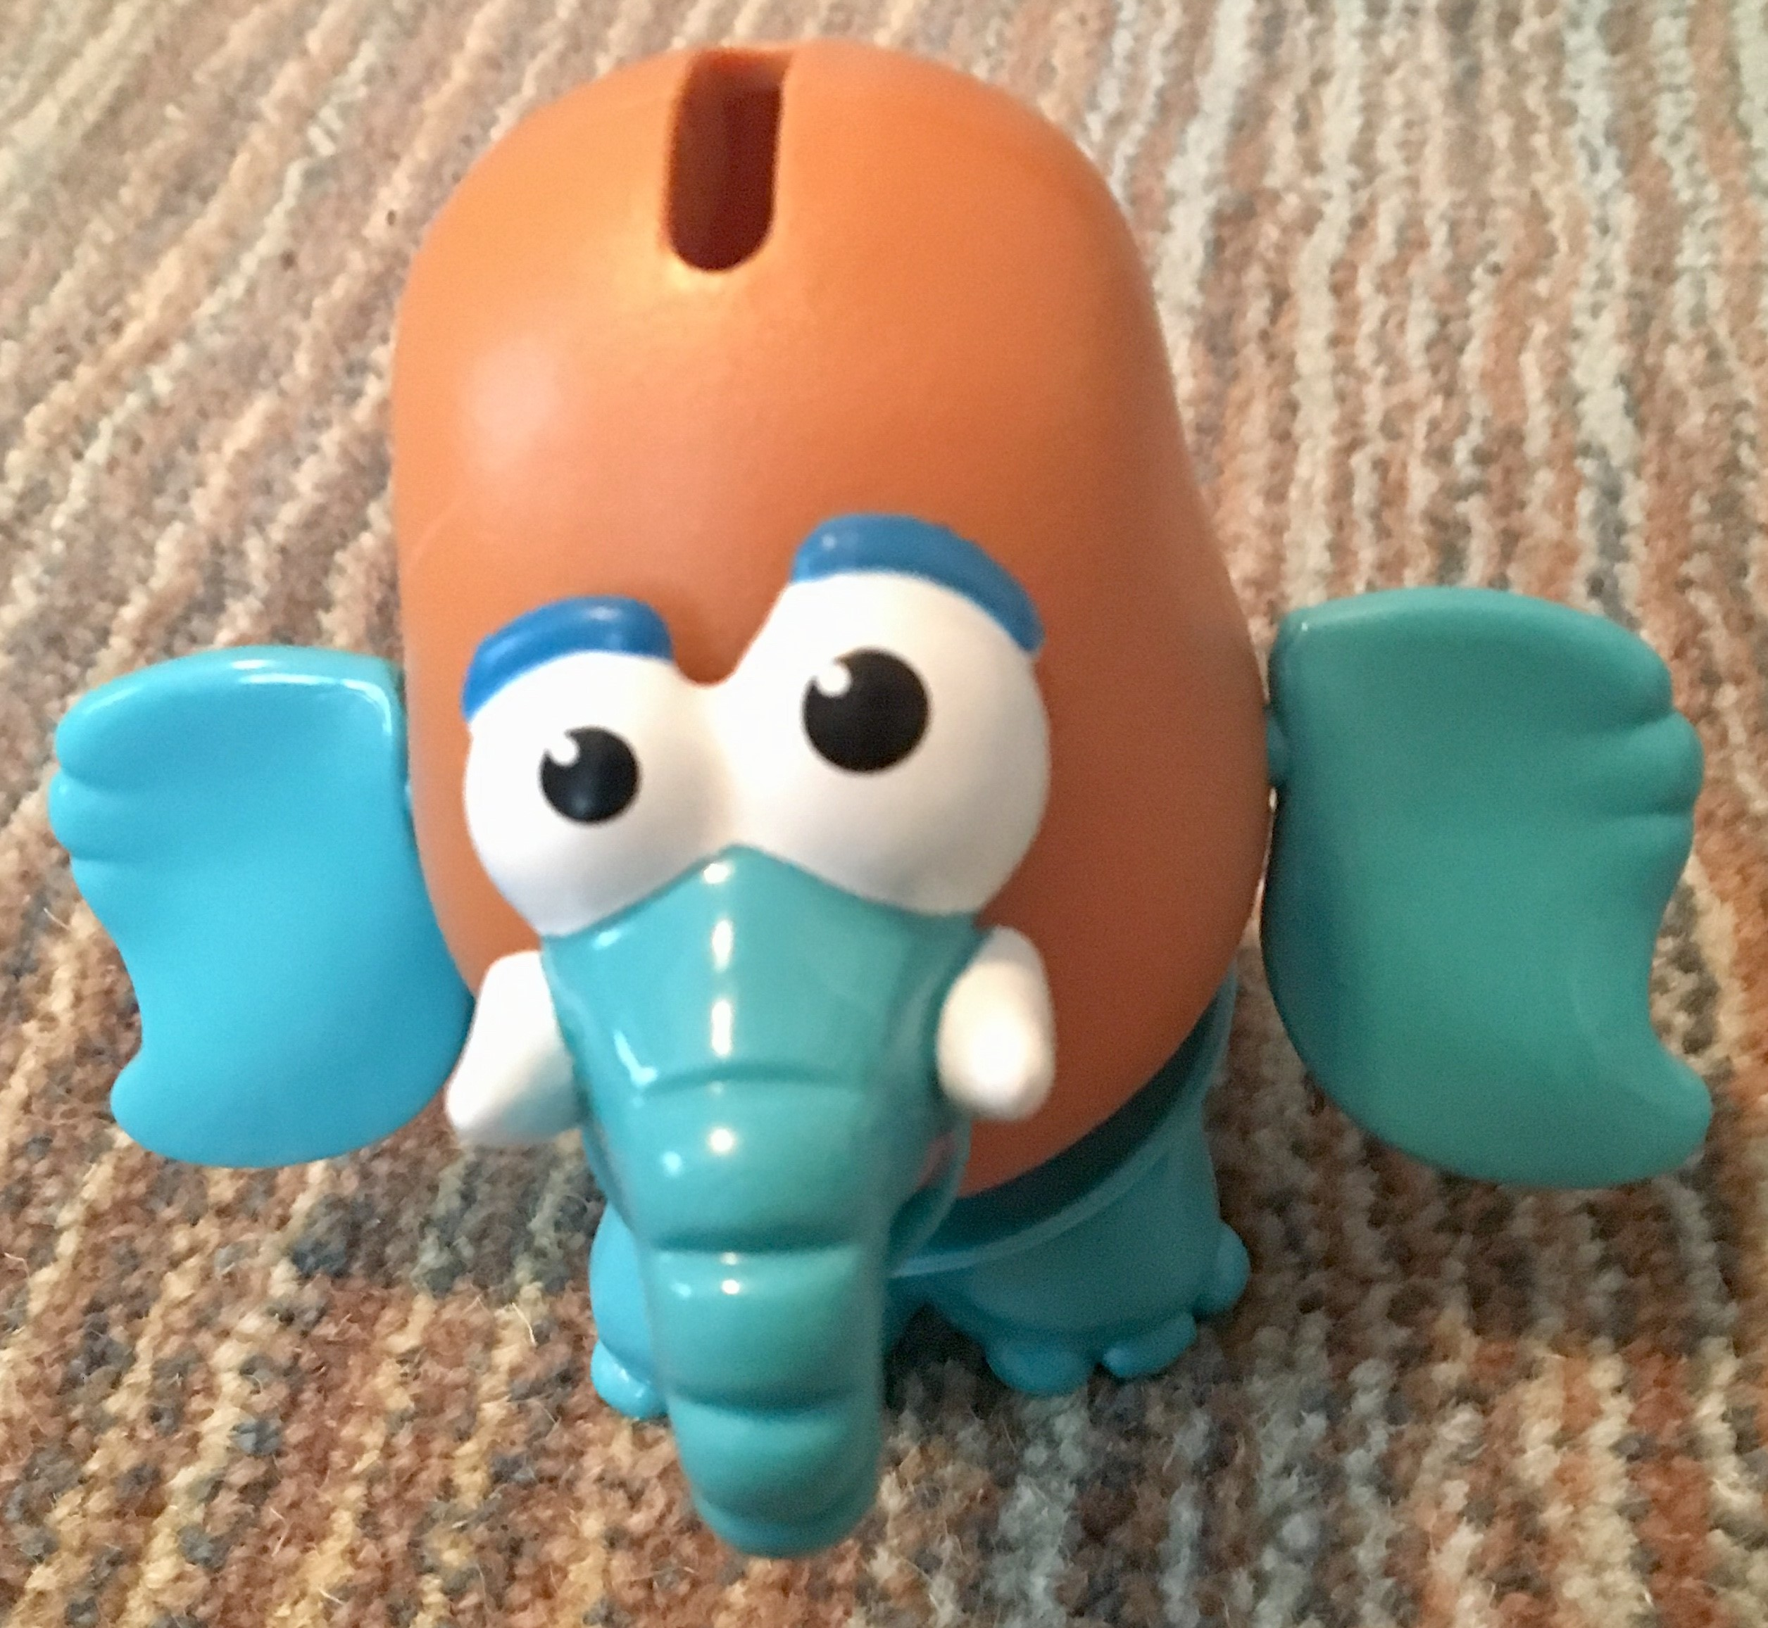
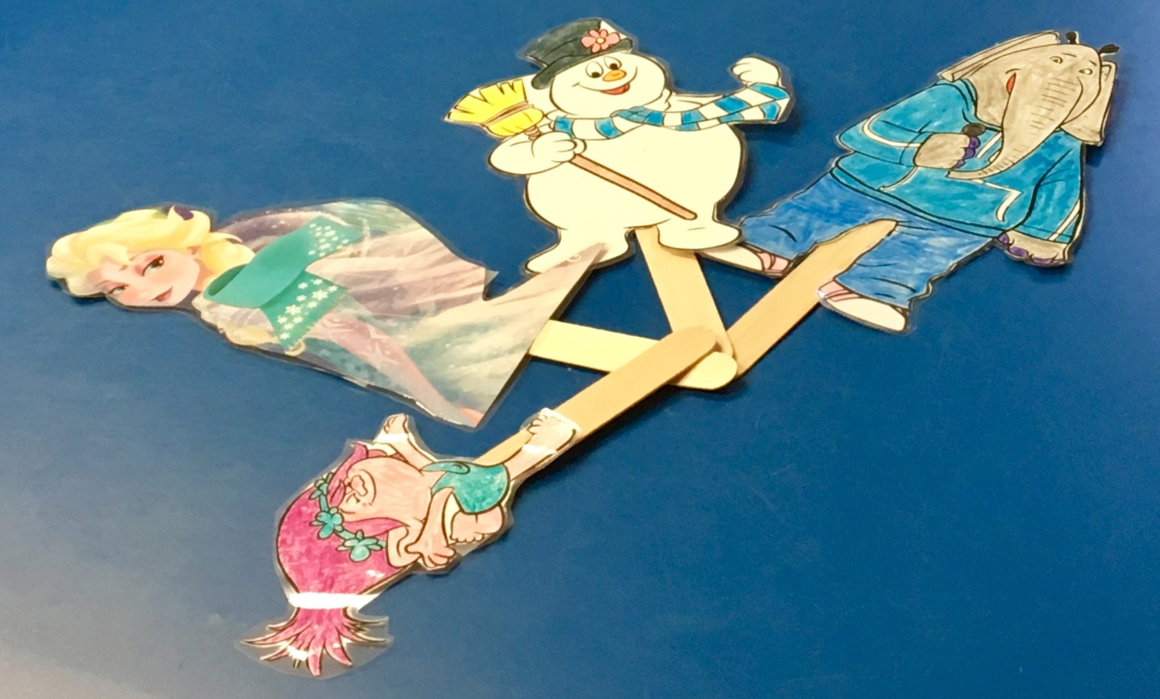
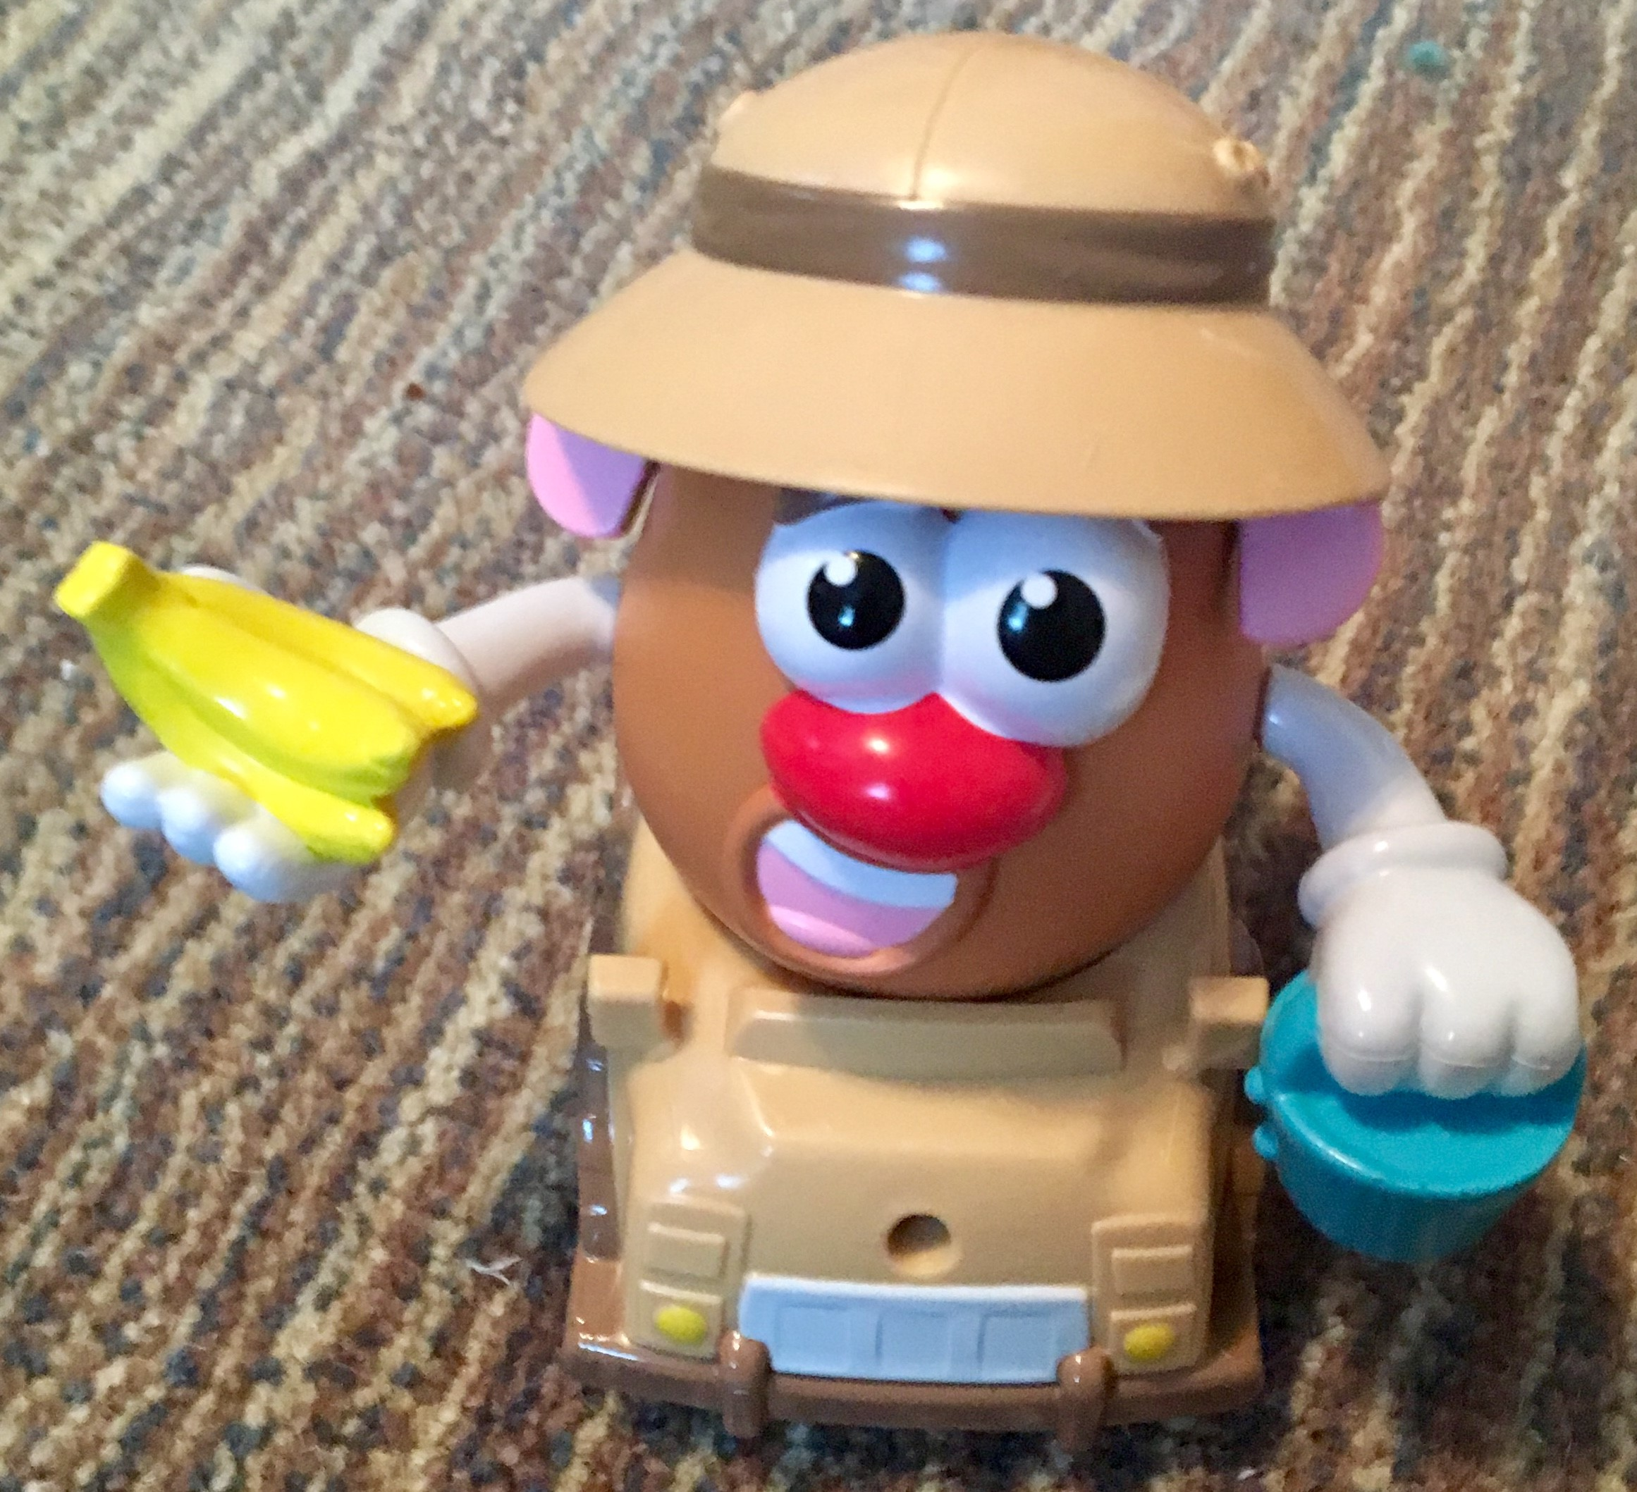
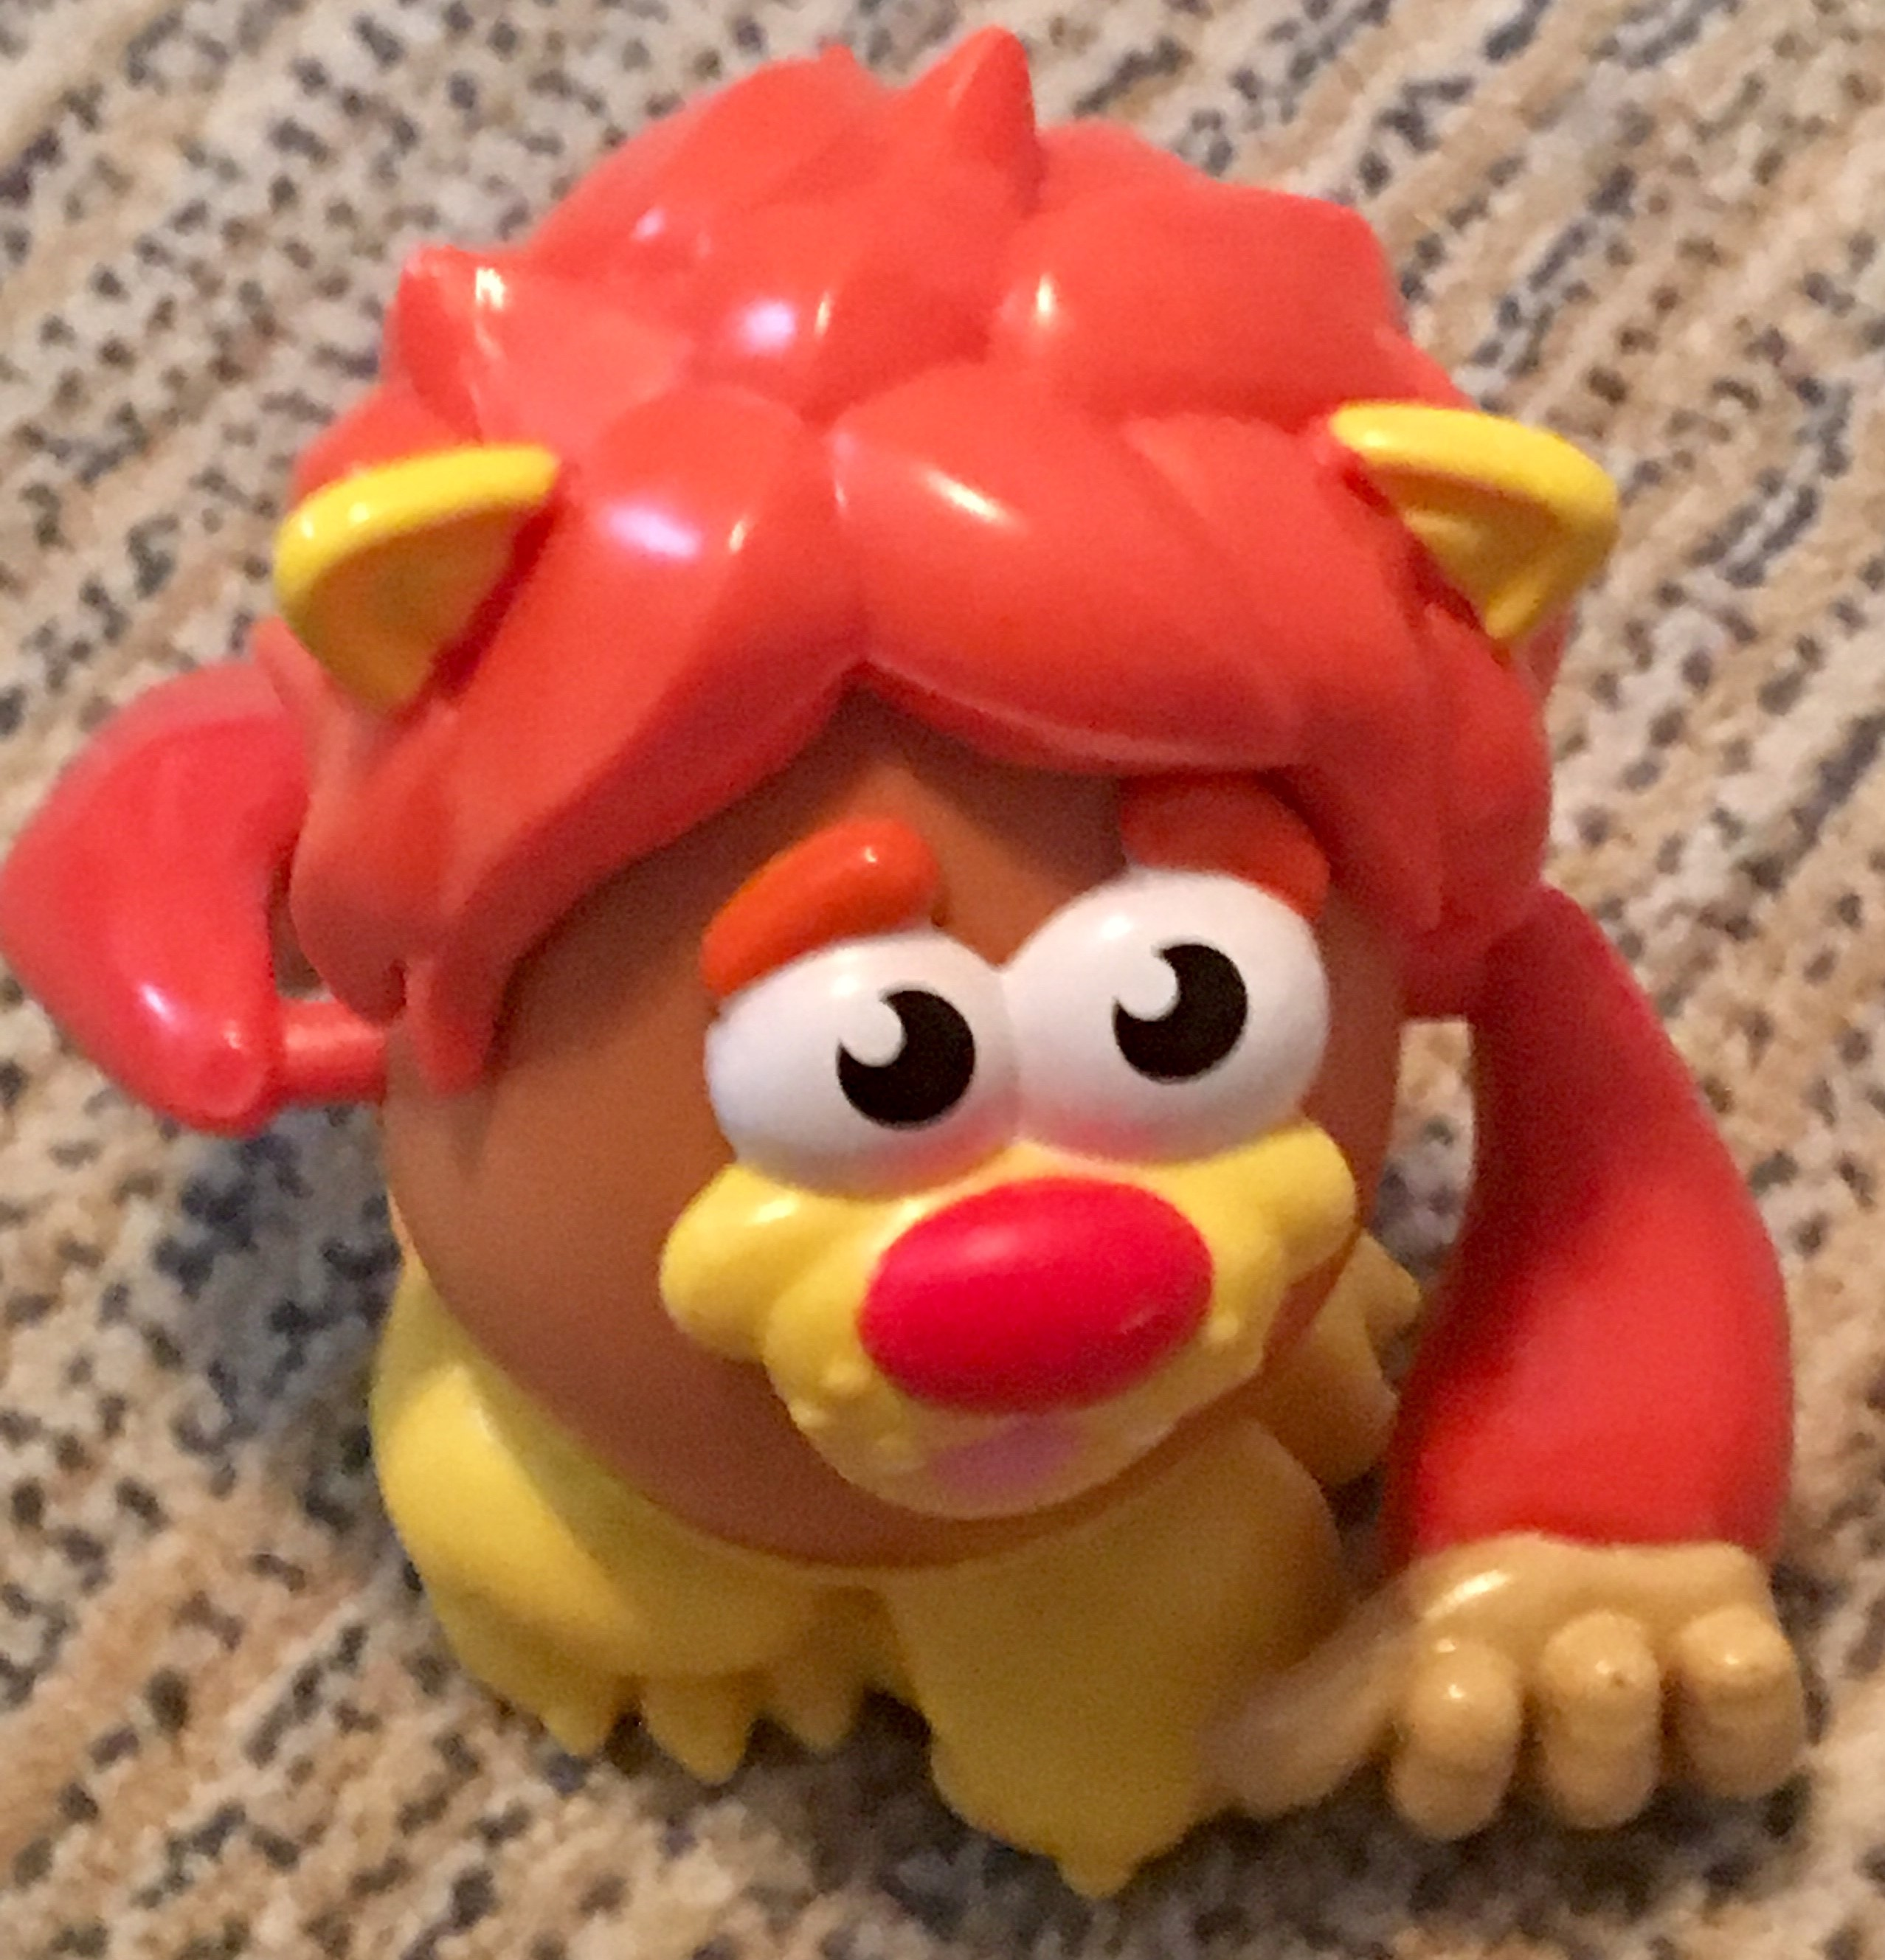
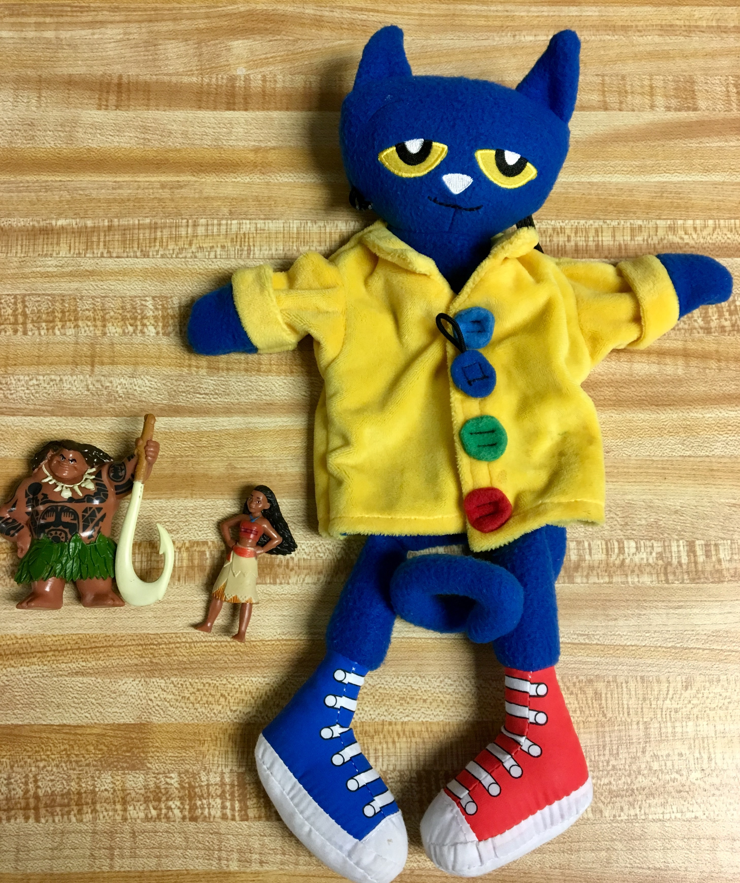
Student-Specific Materials: TANGIBLE REWARDS
*Make sure these specific items are ONLY available when the student earns a reward!

Slide 28
References/Resources
PBIS Incentives for Distance Learning: https://www.pbisrewards.com/blog/pbis-incentives-distance-learning/
Choiceworks Visual Schedule App: https://learningworksforkids.com/apps/choiceworks/
Easter Seals School Closure Tool Kit: https://l.ead.me/bbTE3n?fbclid=IwAR3LDl4YK2N0YLV2dW-aoHxgkEhNlaIrjF3FQ_6QDMPbcfY8JJrgXGBh-3g

Slide 29
Additional Online Resources
Office of Special Education Programs IEP Guidance September 2020: https://www2.ed.gov/policy/speced/guid/idea/memosdcltrs/qa-provision-of-services-idea-part-b-09-28-2020.pdf
Yale Child Study Center’s Guide to Coping During the COVID-19 Pandemic for Families of Children with Autism Spectrum Disorder: https://drive.google.com/file/d/1t51xS7Tf9M139U6_ovobIBNxnE28jpEB/view
Unique Learning System: https://www.n2y.com/unique-learning-system/

Slide 30
Please ask any questions or share any comments that you may have!
Contact Rachel Freedman at rfreedma@uwyo.edu for additional information or resources.

