Slide 1
This webinar is being recorded and will be posted to our website within a few weeks.
Participants are muted with video off.
Take note of the toolbox at the bottom of your screen.
Use Q&A feature to ask questions, which are answered at the end of the presentation.
Chat only goes to MHTTC staff. Please don’t ask questions here unless it you are having technical issues.
Certificates of attendance will be available for those who attend.
We are not able to offer CEUs for this webinar.
Welcome to
Supporting Staff Resilience & Recovery During Hard Times
Presented by
Ken Kraybill, MSW, Senior Trainer
We will begin soon!
Notes:
Welcome everyone, we'll be starting in just a few minutes, letting everyone get logged in. Please note the details on the slide in case those answer some of your questions.

Slide 2
Provider Well-Being with C4 Innovations
Supporting Staff Resilience & Recovery During Hard Times
PRESENTED BY
Ken Kraybill, MSW, Senior Trainer
Notes:
HOST: On behalf of the Northwest Mental Health Technology Center, welcome to today’s webinar TITLE/DESCRIPTION OF WEBINAR with PRESENTER NAME/AFFILIATION.
We’re grateful so many of you could join us to learn more about this important topic. We look forward to sharing information and tips and guidance, and to having an exchange of information with all of you.
My name is (HOST NAME), (HOST ROLE) the Northwest MHTTC {any other HOST ROLE}
First, a little introduction to the MHTTC:

Slide 3
Notes:
The MHTTC Network is a nation-wide that is supported by the Substance Abuse and Mental Health Services Administration.
Our purpose includes disseminating and implementing evidence-based practices for mental health issues into the workforce.
The goals of the network include:
Support mental health related evidence-based practices
Heighten the awareness, knowledge, and skills of the workforce
Foster regional and national alliances
Provide and connect you to free training and technical assistance
Now about our Northwest MHTTC

Slide 4
ABOUT THE NORTHWEST MHTTC
PROUDLY SERVING​ ALASKA, IDAHO, OREGON & WASHINGTON
mhttcnetwork.org/northwest
EVIDENCE-BASED PRACTICES
OUR WORKFORCE
TRAINING,
ONLINE COURSES & RESOURCES
Notes:
The Northwest MHTTC is based at the University of Washington in the Department of Psychiatry and Behavioral Sciences.
We provide training and technical assistance (TA) in evidence-based practices to Region 10 (Alaska, Idaho, Oregon, and Washington).
Our area of focus is evidence-based practices for serious mental health issues such as psychosis. However, we provide training on a variety of topics including integrated care, suicide prevention, diversity/equity issues, school mental health, peer support, trauma-informed approaches and others.
Our target workforce includes: ​
Behavioral health and primary care providers, school and social service staff, and others whose work has the potential to improve behavioral health outcomes for individuals with or at risk of developing serious mental illnesses.​
How do we fulfill our mission?
Live events like this webinar that we also record & post
Virtual learning communities
Free, self-paced online courses
Newsletters and our Resource Library on our website
Connection to other training centers & events
To find out more about our goals, training opportunities and resources, you can visit our website and sign up for our newsletter.
Next, we would like to talk about language.

Slide 5
INVITING TO INDIVIDUALS PARTICIPATING IN THEIR OWN JOURNEYS.
We use affirming, respectful and recovery-oriented language.
THAT LANGUAGE IS:
STRENGTHS-BASED
& HOPEFUL.
HEALING-CENTERED/ TRAUMA-RESPONSIVE.
RESPECTFUL, CLEAR & UNDERSTANDABLE.
INCLUSIVE & ACCEPTING OF DIVERSE CULTURES, GENDERS, PERSPECTIVES, & EXPERIENCES.
PERSON-FIRST &
FREE OF LABELS.
CONSISTENT WITH OUR ACTIONS, POLICIES, & PRODUCTS.
NON-JUDGMENTAL & AVOIDING ASSUMPTIONS.
Adapted from: https://mhcc.org.au/wp-content/upload/2019/08/Recovery-Oriented-Language-Guide_2019ed_v1_20190809-Web.pdf
Notes:
It is our intention to always be mindful of using language that promotes recovery and culturally-appropriate terminology.
We encourage all clinicians to use language that demonstrates respect for a person’s dignity and worth.
It is consistent with recovery-oriented practices and promotes treatment environments that foster respect, human dignity, and hope.​
We want to next review the logistics regarding communication during the session.

Slide 6
HOUSEKEEPING
SECURE
VIDEO OFF
MUTED
RECORDING
SLIDES
CERTIFICATE
Notes:
We have made every attempt to make today’s presentation secure. If we need to end the presentation unexpectedly, we will follow-up using your registration information.​
Due to the large audience, all attendees are muted and not appearing on video.​ Chat is only visible to our team.
The presentation is being recorded. The recording and the slides will be made available on our website in a few weeks, which you’ll be notified of by email.
We ask you to be mindful to avoid disclosing identifying details about persons receiving services if you share a question or scenario.
You will receive an email within 2 weeks on how to access a certificate of attendance​ if you desire that—but there are NOT formal CEUs available

Slide 7
EVALUATION
Notes:
Lastly, your feedback is crucial to our work, so we would appreciate your response to a very short survey that just takes a few minutes after the session.
Our team will share that link by the chat box today and by email reminder via Zoom tomorrow.
We are required by SAMHSA to conduct this survey, but we really appreciate your feedback about this session & to plan future sessions. And your participation helps to keep free training coming!
​

Slide 8
ASKING QUESTIONS
Q&A BOX
Notes:
We will be monitoring the Q&A box to facilitate answering as many questions as possible at the end of the presentation.
If you have any questions, please type them in the Q&A box at any point throughout the presentation. Please avoid putting content questions in the chat as we can't copy them into the Q&A.
Our team will moderate & share questions with the presenter. We might provide a short, written response during the webinar, or field live as time allows, but we will do our best to get an answer to you.

Slide 9
USING CHAT
Notes:
Things posted in the chat are only seen by our training team, not between attendees.
If you are experiencing any technical issues, please use the chat and our MHTTC staff will assist.

Slide 10
SUPPORT & DISCLAIMER
This work is supported by grant SM 081721 from the Department of Health and Human Services, Substance Abuse and Mental Health Services Administration.​
The opinions expressed herein are the view of our presenter(s) and do not reflect the official position of the Department of Health and Human Services (DHHS), SAMHSA.
Notes:
SAMHSA sponsors this work but does not reflect any official position on this content.
Now the important part:

Slide 11
TODAY’S PRESENTER
Ken Kraybill, MSW, Senior Trainer, has worked in healthcare, behavioral health, homelessness, and housing for more than 35 years. Ken has 18 years of experience working as a behavioral health practitioner in homeless services. For the past two decades, he has been developing curricula and facilitating in-person and online training nationally on topics including motivational interviewing, trauma-informed care, outreach and engagement, case management, critical time intervention, and supervision.
Notes:
I am very happy to introduce our presenter. REVIEW BIO/DESCRIPTION
Now I’ll turn it over to our presenter.

Slide 12
Supporting Staff Resilience and Recovery During Hard Times
Northwest MHTTC
February 10, 2021
ken kraybill
Notes:
Welcome. Thank you for making the effort to be here today. C

Slide 13
Welcome!
Notes:
Doctoral level psychology student & 2nd year medical students

Slide 14
Learning Objectives Participants will be able to: - Name two personal practices to stay grounded and focused - Describe three challenges/learning opportunities staff are currently experiencing - Name two guiding principles for best supporting staff - Identify three specific practices to employ to help staff adapt and thrive
Description
As agency leaders, directors, and supervisors, how do we stay grounded and focused during these hard times? How do we bring forth our humanity and strengths to support employees? What challenges/learning opportunities are staff experiencing? What do they need? How do we listen and respond well? Join us in identifying principles and practices to help staff adapt and thrive in this extraordinary period of our lives.

Slide 15
renews my hope and leaves me grasping for faith
exhilarating and exhausting
provides tremendous satisfaction and leaves me feeling profoundly helpless
puts me in touch with deep suffering and points me toward greater wholeness
brings me face to face with many poverties and enriches me encounter by encounter
This work...
enables me to envision a future but with no ability to control it
drives me up a wall and opens doors I never imagined
lays bare a wide range of emotions yet leaves me feeling numb beyond belief
breaks me apart emotionally and breaks me open spiritually
leaves me wounded and heals me
evokes genuine empathy and provokes a fearsome intolerance within me
Ken Kraybill

Slide 16
"Death on a Pale Horse," artist’s depiction of the Four Horsemen of the Apocalypse, Benjamin West, 1797
Apocalypse
“unveiling, uncovering, revealing”
Notes:
What’s being exposed, uncovered, becoming more apparent... “uncovering”

Slide 18
Overwhelming demands placed upon the physiological system that result in a profound felt sense of vulnerability and/or loss of control.
Robert D. Macy
Trauma
“Traumatic events overwhelm the ordinary systems of care that give people a sense of control, connection, and meaning.”
Judith Herman
Notes:
Lifetime exposure to potentially traumatic events is estimated to affect approximately 90 percent of the U.S. adult population (Kilpatrick et al., 2013).

Slide 19
“In short, trauma is about loss of connection — to ourselves, to our bodies, to our families, to others, and to the world around us… It is often hard to recognize, because it doesn’t happen all at once. It can happen slowly, over time…”
Peter Levine
Notes:
Results in sense of “otherness,” isolation, differentness, disembodiment, not belonging, bad/good, lacking worth…
Common in people experiencing complex traumatic stress
your own experience? see in others?

Slide 20
Human Stress Response
The physiologic stress response is due to massive amounts of cortisol and adrenaline being released.
Notes:
In what specific ways does the body respond to stress? ("body keeps the score")

Slide 21
How the brain tries to protects us

Slide 22
Notes:
thoughts?

Slide 23
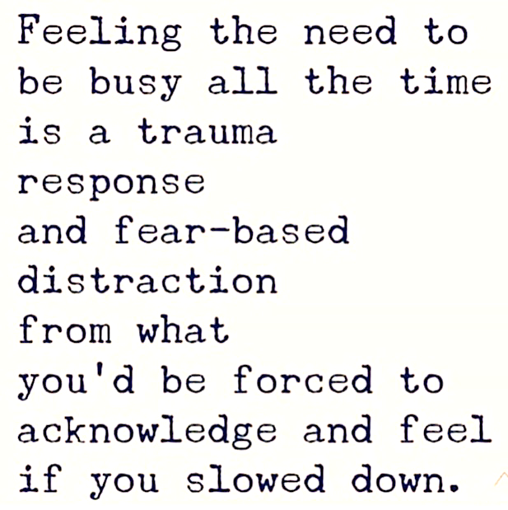
Naming what we’re experiencing
(individually and collectively)

Slide 24
What do you do in times of despair?” Archbishop Desmond Tutu was asked. “You show your humanity.”
Laura van Dernoot Lipsky, The Age of Overwhelm

Slide 26
Leadership in Hard Times
Leadership is the sum total of hundreds of thousands of small words and tiny actions.
- Charles S. Lauer
"Leaders are more powerful role models when they learn than when they teach.”
- Rosabeth Moss Kantor
"Above all, leadership is a position of servanthood.”
- Max De Pree

Slide 28
Your challenges in supporting staff in these extraordinary times?

Slide 29
Leading and supporting others...
It starts with loving-kindness for oneself.
Pema Chödrön.
Notes:
Read Pema Chodron piece

Slide 30
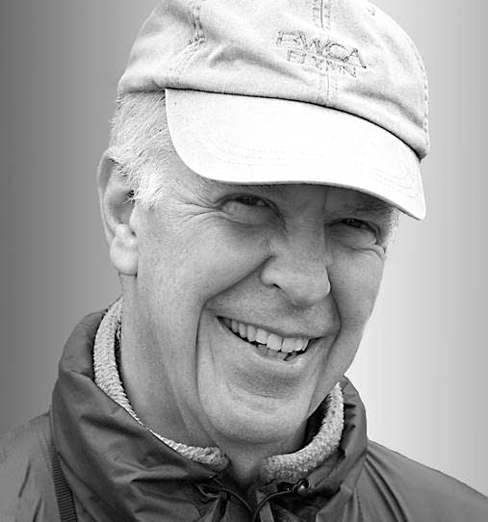
“Self-care is never a selfish act - it is simply good stewardship of the only gift I have, the gift I was put on earth to offer others. Anytime we can listen to true self and give the care it requires, we do it not only for ourselves, but for the many others whose lives we touch.”
Parker Palmer
Notes:
Read Pema Chodron piece

Slide 31
”Caring for myself is not self-indulgent, it is self-preservation, and that is an act of political warfare.”
Audre Lorde
Notes:
Selfish: lacking consideration for others; concerned chiefly with one's own personal profit or pleasure.
Audre Lorde - (1934-1992) American writer, feminist, womanist, librarian, and civil rights activist. She was a self-described “black, lesbian, mother, warrior, poet,” who dedicated both her life and her creative talent to confronting and addressing injustices of racism, sexism, classism, and homophobia.[
Self-care can be such a buzzword these days, but what’s often not discussed are the race, gender, and class dynamics behind the concept. When we’re expected to take care of others emotionally and physically, taking time, energy, and resources for ourselves can feel shameful. In the United States, women report higher rates of stress in their lives than men and people of color report higher rates of stress than white people—there are a lot of factors for why, including the stress of racism and discrimination.

Slide 32
What nobody tells you about self-care

Slide 33
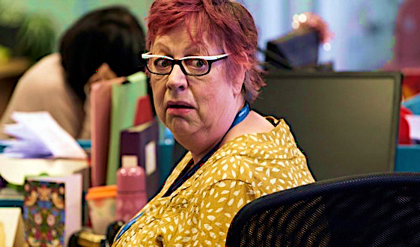
“What social workers and other people don’t often tell you is that self-care can be completely terrible. Self-care includes a lot of adult-ing, and activities you want to put off indefinitely.
Self-care sometimes means making tough decisions which you fear others will judge.
Self-care involves asking for help; it involves vulnerability; it involves being painfully honest with yourself and your loved ones about what you need.”
Mawiyah Patten

Slide 34
an intentional way of living by which our values, attitudes, and actions are integrated into our day-to-day routines

Slide 35
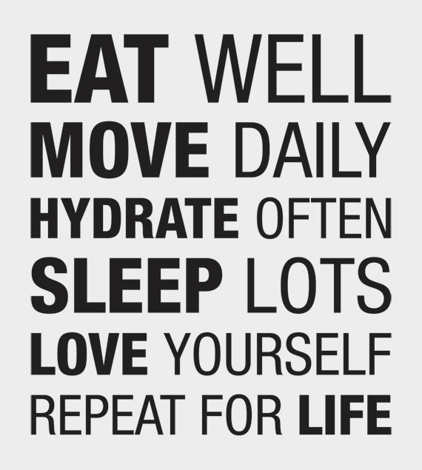

Slide 36
mindfulness
be here now
Ram Dass

Slide 37
“Mindfulness is not so much what you choose to focus on, but the quality of the awareness that you bring to each moment...”
“…it is about paying attention in a particular way: on purpose, in the present moment, and nonjudgmentally.”
Jon Kabat-Zinn

Slide 38
“Mindfulness shows us what is happening in our bodies, our emotions, our minds, and in the world. Through mindfulness, we avoid harming
ourselves and others.”
Thich Nhat Han
Notes:
What Mindfulness Is NOT
Having a blank mind; Changing the experience; Escaping pain; Becoming emotionless; Seeking bliss; Withdrawing from life; Relaxation

Slide 39
What mindfulness in NOT
Having a blank mind
Changing the experience
Escaping pain
Becoming emotionless
Seeking bliss
Withdrawing from life
Relaxation

Slide 40
grounding activity
“You can’t know what you want until you know what you’re doing.”
Moshe Feldenkrais, body therapist
Notes:
Activity adapted from DBT skills training by Marsha Linehan. About 1.5 minutes.
“Find a comfortable position. Staying in this position, I invite you to listen for your response after each statement. There will be about 5 seconds between each one."
Feel your hair touching your head. Feel your belly rising and falling as you breathe. Feel the space between your eyes. Feel the distance between your ears. Feel your breath touching the back of your eyes while you inhale. Notice your arms touching your body. Feel the bottoms of your feet. Imagine a beautiful day at the beach. Notice the position of your tongue in your mouth. Feel how one arm is more relaxed than the other. Notice any tightness in your left thigh. Imagine what it would feel like to float on a cloud. Imagine what it would feel to be stuck in molasses. Imagine floating in warm water. Feel your face getting soft. Imagine a beautiful flower.
As we close, I invite you to simply notice your breathing -- how your body does what it needs to do.... Now I invite you to come back [Chime]

Slide 41
Self-awareness
What brings you to this work?
What do you bring to this work?

Slide 42
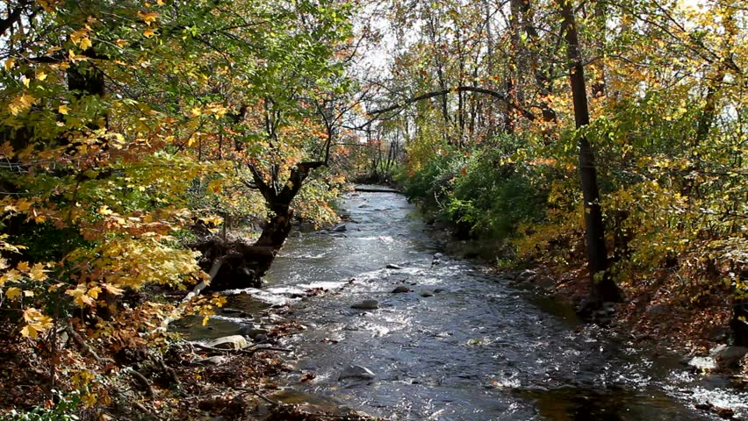
river of resilience

Slide 43
river of resilience
1. Please draw a river. In the river currents, identify the core values and strengths you bring to this work.
2. Add streams flowing into the river naming significant people in your life who have inspired you.
3. Place rocks or waterfalls in the river representing life events that have challenged and strengthened you.
4. Draw a signpost by the river with your personal mission statement related to your work.
Notes:
River of resilience = activity focused on work-related distress
1. In the currents of your river, identify the core values and strengths that sustain you in this work.
2. Add streams flowing into the river naming others who have inspired and supported you.
3. Include rapids representing life events that have both challenged and strengthened you.
4. Create a signpost briefly describing your personal mission or purpose related to your work.

Slide 44
Your core values?
Your strengths?
Significant people who have inspired you?
Challenges that have strengthened you?
Your purpose, calling, mission?
Notes:
What can you draw upon to continue to be a healing presence in your work – for self and others?

Slide 45
What staff need
Notes:
80,000 interviews - ongoing research

Slide 46
What staff need
Contemporary Women Artists from Aboriginal Australia
Key question: What do I get?
1. Do I know what is expected of me at work?
2. Do I have the materials and equipment I need to do my work right?
Notes:
1. What am I expected to do, produce, make happen? Process outcomes? Numerical outcomes?
2. Keys, laptop, cellphone, forms, resource lists, bus tickets, communications, safety, resources, keys, transportation, paper, access codes, sense of safety, escort to vehicle, privacy, lighting,

Slide 47
What staff need
Key question: What do I give?
3. At work, do I have the opportunity to do
what I do best every day?
4. In the last seven days, have I received
recognition or praise for doing good work?
5. Does my supervisor, or someone at work, seem to care about me as a person?
6. Is there someone at work who encourages my development?
Notes:
3. "right fit" - matching talent with role - everybody different
4. Recognition, praise, affirmation - see strengths - focused on effort more than outcomes
5. Know the person as a person (not just an employee) - what makes them tick, passions (superheroes), what inspires, what do for fun, what challenges/concerns
6. Ways to grow, develop, enhance skills, "change lanes," take more leadership

Slide 48
What staff need
Key question: Do I belong here?
7. At work, do my opinions count?
8. Does the mission/purpose of my company make me feel my job is important?
Notes:
Goals:

Slide 49
What staff need
Key question: How can we all grow?
9. Are my co-workers committed to doing quality work?
10. Do I have a best friend at work?
11. In the last six months, has someone at work talked about me about my progress?
12. This last year, have I had opportunities at work to learn and grow?
Notes:
Goals:

Slide 50
Principles for Leading and Supporting Teams
Acknowledge, affirm, create safe and supportive spaces
2. Share your own vulnerability
Promote flexibility and gentleness with ourselves and others
4. Hold the long view, while examining what
should change

Slide 51
1. Acknowledge, affirm, create safe and supportive spaces
Recognize the neurobiological effect of collective trauma, and its impact on concentration, productivity
Assume staff need support, whether or not they express it, or identify as being in recovery
Create space in an ongoing way to connect, support, share, and talk about mental health
Promote employee support resources and benefits
Set the tone and be a model – for openness, compassion, generosity, and self-care

Slide 52
1. Acknowledge, affirm, create safe and supportive spaces
Encourage people to make the most of weekends or other designated time off
Communicate regularly, frequently, balance reality and uncertainty with confidence, security, and hope
Be careful not to only acknowledge/lift up those staff who are going “above and beyond” right now; many are just trying to keep their heads above water and that is enough

Slide 53
1. Acknowledge, affirm, create safe and supportive spaces
Encourage people to make the most of weekends or other designated time off
Communicate regularly, frequently, balance reality and uncertainty with confidence, security, and hope
Be careful not to only acknowledge/lift up those staff who are going “above and beyond” right now; many are just trying to keep their heads above water and that is enough

Slide 54
Your thoughts?
How do we support staff as we all process this trauma?
How do we create space while maintaining a focus on productivity?
How do we support staff in participating in actions for racial justice?
With staff worries about lay-offs, how do we keep them focused on their work every day?

Slide 55
2. Share your own vulnerability
Demonstrate compassionate, authentic leadership
Share your own challenges and how you are managing
Be transparent and open, especially about unknowns
Provide updates and corrections to information as new info is available, acknowledge the rapidly changing landscape

Slide 56
2. Share your own vulnerability
Acknowledge that we are all affected
“We are all peers in this”
Yet…
It is important to acknowledge
the privilege that many of us have
even while affected

Slide 57
Your thoughts?
Why is showing vulnerability a strength?
What does it look like?

Slide 58
3. Promote flexibility and gentleness with ourselves and others
Support staff to work alternative schedules and manage family and household responsibilities
Encourage remote work when possible
Implement flexible sick leave policies and practices
Seek ways to equip staff to be productive at home (e.g., set up virtual phone/meeting systems, survey staff about home office needs, ship equipment)

Slide 59
3. Promote flexibility and gentleness with ourselves and others
Continuously evaluate priorities and reset expectations
Allow extra space and frequency for supervision and support
Encourage use of EAP, mental health counseling resources
Use a person-centered approach to support employees, in balance with adherence to current protocols

Slide 60
Your thoughts?
What are the benefits of being more flexible and gentle?
How do we balance flexibility with productivity, especially in these times?
How can we be intentional about continuing to be more flexible and gentle in the future?

Slide 61
4. Hold the long view, while examining what should change
Things will continue to change week to week, expect that and navigate around it
And...
This too shall pass.

Slide 62
4. Hold the long view, while examining what should change
Your organization might look different as a result of COVID-19 but chances are you will still exist and have important work to do over the long term
Yet…
It is important to examine whether going back to “normal” is good for everyone – use this time to examine policies, practices, programs for with a lens of equity, efficiency, innovation, renewal.

Slide 63
Your thoughts?
What steps can we be taking to plan for life beyond COVID-19?
What are some things our agencies can do right now to counteract dominant, white culture tendencies?
How can we use this time to examine and make changes to organizational structures and processes that reinforce inequities?

Slide 64
Promoting healthy teams
Notes:
Recovery happens.

Slide 65
Strategies to Support Teams
Develop expectation of secondary trauma
Address self-care and team-care in team meetings
Encourage team members to use vacation/comp days in a timely manner

Slide 66
Strategies to Support Teams
Hold virtual or social-distancing team retreats
Offer flexible work schedules
Develop practices/rituals to celebrate successes and accomplishments
Plan virtual or social-distancing lunches, picnics, parties, yoga practice, etc.

Slide 67
Strategies to Support Teams
Ensure ample opportunities for staff to provide input into practices and policies.
Staff members have formal channels for addressing problems/grievances.
Diversify caseloads
Provide opportunities for participating in social change activities

Slide 68
Strategies to Support Teams
Institute a staff recognition program
Encourage individuals to “go home” early if they’ve had an unusually tough day
Provide access to wellness programs as able
Have an “open door” policy and be as available as possible
Allow for an “administrative day” for staff to take work home or put up a “do not disturb” sign to catch up on paperwork

Slide 69
Strategies to Support Teams
Develop a buddy system to pair newer staff with senior staff
Equip supervisors to provide trauma-informed supervision
Ensure supervisors are providing supervision on a regularly scheduled 1:1 basis
Provide opportunities for staff development

Slide 70
Strategies to Support Teams
Develop a buddy system to pair newer staff with senior staff
Equip supervisors to provide trauma-informed supervision
Ensure supervisors are providing supervision on a regularly scheduled 1:1 basis
Provide opportunities for staff development

Slide 71
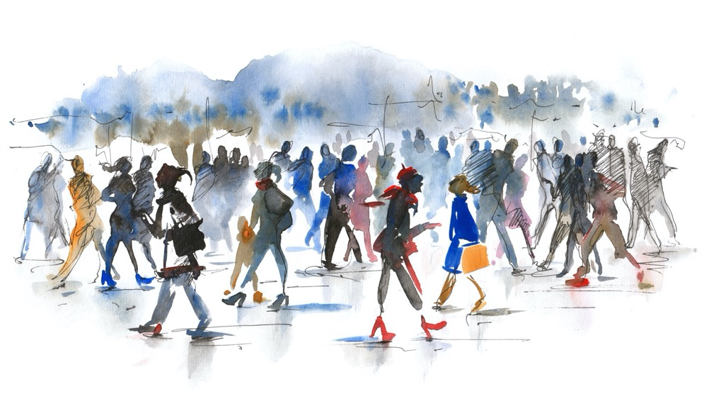
Next steps
One thing you might do differently...

Slide 72
What would be some benefits?
What might be at stake if you do nothing?
How might you go about it?
What are your three best reasons to do it?
Who could support you?
What next step(s) could you take?

Slide 73
Thank you!
Ken Kraybill
kkraybill@c4innovates.com

Slide 74
QUESTIONS & DISCUSSION

Slide 75
YOUR FEEDBACK IS IMPORTANT
Post-event surveys are critical to our work!​
Your feedback helps us to improve and develop future programming.
Notes:
Just a reminder, you’ll see the link to our evaluation survey in the chat which helps the presenters hear your input and us plan for future sessions.

Slide 76
LET’S CONNECT!
mhttcnetwork.org/northwest
https://bit.ly/NWMHTTCNewsletter
northwest@mhttcnetwork.org
@NorthwestMHTTC
Notes:
You can find out more about us and register for additional resources and training opportunities at our website at www.mhttcnetwork.org BACKSLASH northwest.
You can sign up to receive our newsletter, email us with any questions or find us on social media.

Slide 77
THANKS FOR JOINING US!
See you next time.
Notes:
I’d like to once again thank our presenter(s), [presenter name].
Thank you to everyone for taking the time to learn more about this important topic. We hope to see you again soon!

