Slide 1
Transgender Mental Health
Co-Conspiratorship
Ryan Kim Tieu
ryanktieu@gmail.com

Slide 2
Learning Objectives
Develop historical context and evolution of transgender care, diagnoses, and pathology.
Identify strategies for establishing trust, rapport, and mitigating medical mistrust.
Address the role of mental health clinicians as allies and co-conspirators in advocating for equity.
Develop awareness and knowledge of diversity of transgender experiences and identities.

Slide 3
Today’s Roadmap
Intros
Gender Basics & History
Transition-Related Care
DSM, Diagnoses, & Pathology
Tools, Resources, Q&A

Slide 4
Pre-Assessment Review

Slide 5
Approximately 60 responses:
Gender & Sexuality
88% understand difference between sex and gender, pronouns
54% are moderately to extremely familiar with the history of gender
81% are moderately to extremely familiar with the gender unicorn
Privilege & Power
White privilege
Cisgender privilege
Education, ability, heterosexual
Areas of Improvement
Supporting Black trans people
Disrupting systems of oppression

Slide 6
The Gender Binary & Gender VS “Biological Sex”

Slide 7
Notes:
MURAL

Slide 8
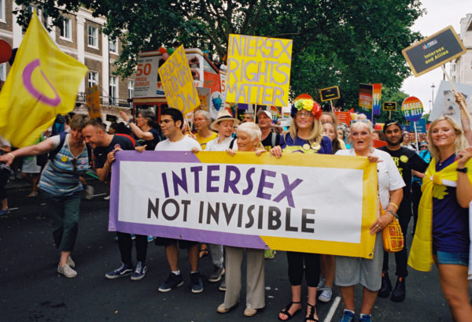

Slide 9
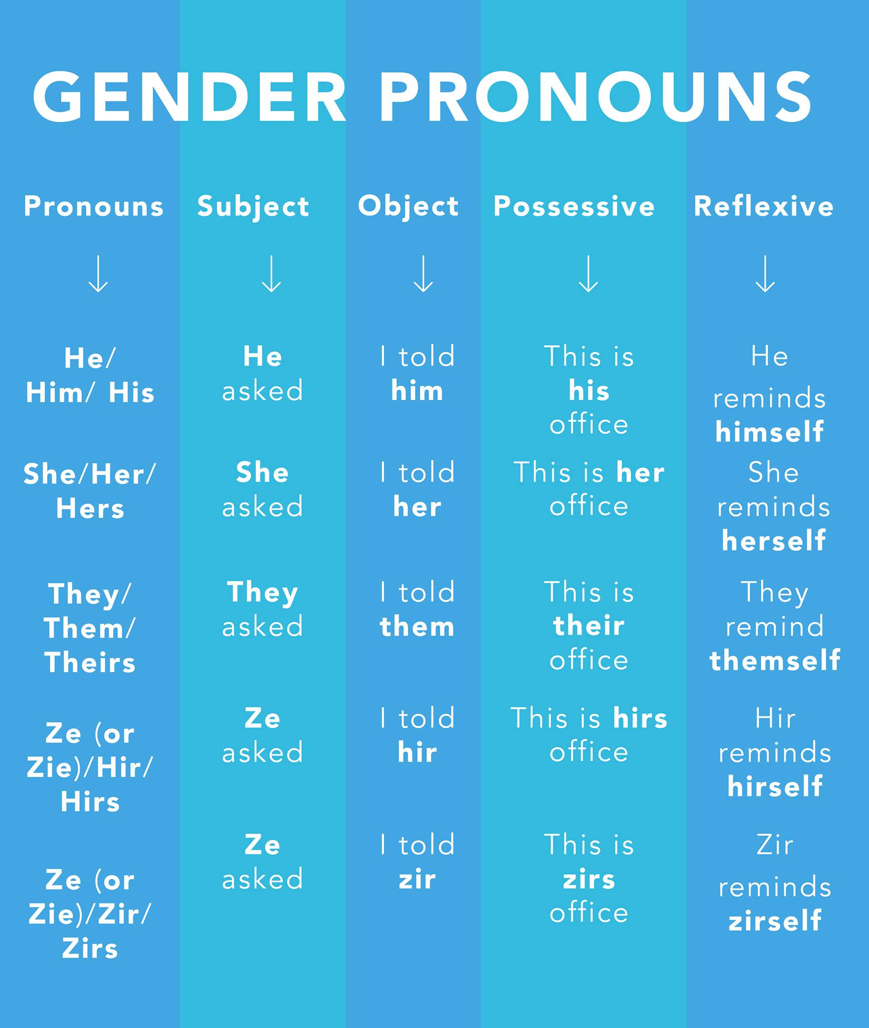
“What are your pronouns?”

Slide 10
What if I mess up?
DO BETTER
Credit: Stephen Wade Jr.

Slide 11
Gender is a racial construct; race is a gendered construct
“‘Gender’ and ‘race’ don’t exist in isolation from one another: they were co-developed as categories and remain co-evolving.”
Sex binary is a 19th century colonial invention
Visual difference between male and female seen as desirable
Credit: Alok Vaid-Menon

Slide 12
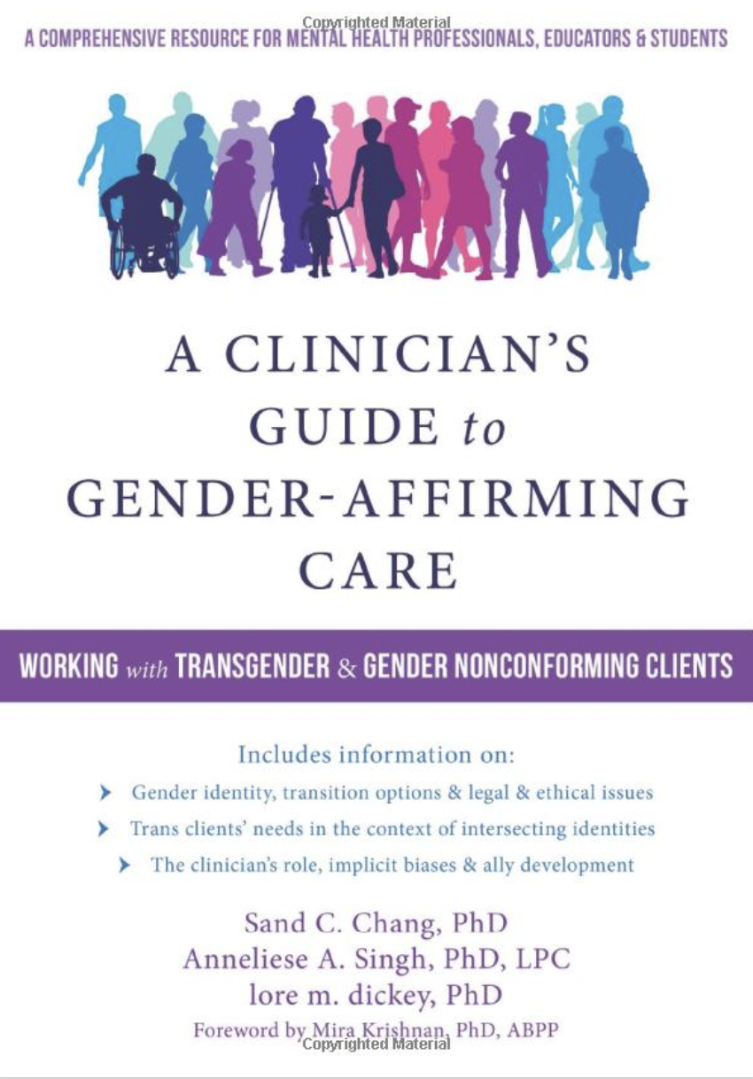
What is transition?

Slide 13
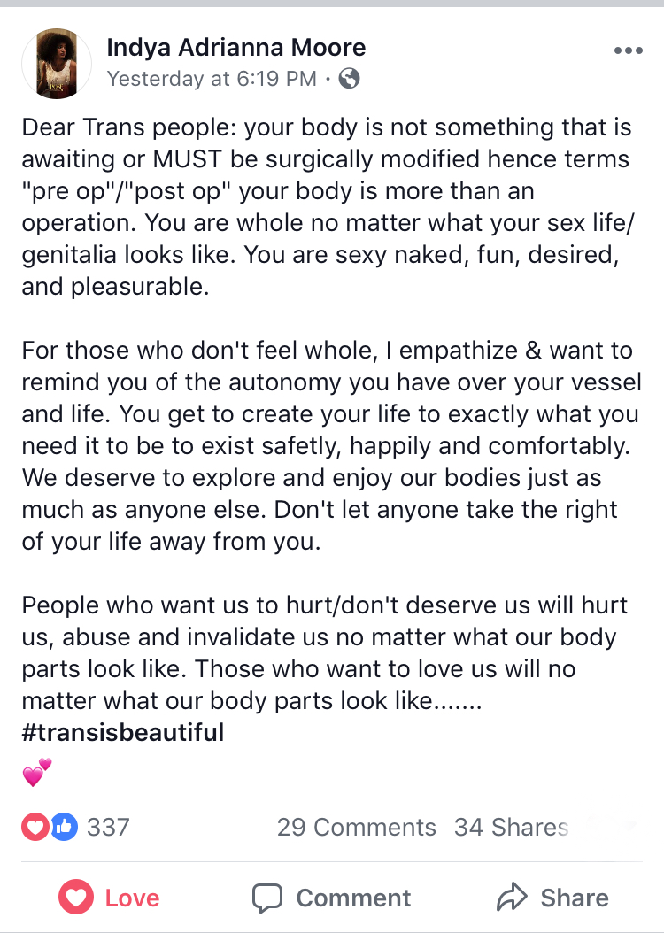
Notes:
MURAL

Slide 14
Medical Transition
Hormones (partially reversible)
Blockers (fully reversible)
Fertility options
Cryopreservation (not typically covered by insurance)
Surgery (irreversible)
Top
Bottom
-ectomy & -plasty (greek/latin)
Recovery
Benefits & risks

Slide 15
Social & Legal Transition
Names
Pronouns
Restrooms
Navigating public spaces
Familial roles
Community transition
Physical appearance
Gender expression
Employment
Notes:
Youtube video: Voice of transgender adolescents (1:47 - 3:01)
https://www.youtube.com/watch?v=CHN3YhMi-5A

Slide 16
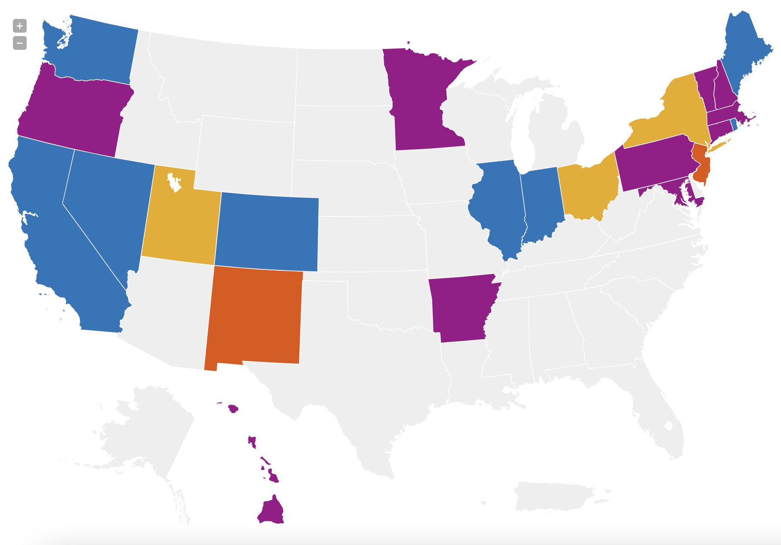
Notes:
https://www.lambdalegal.org/map/x-markers
Updated summer 2020

Slide 17
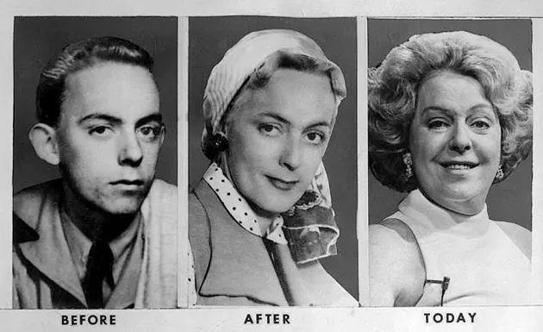
Pathology of Transness

Slide 18
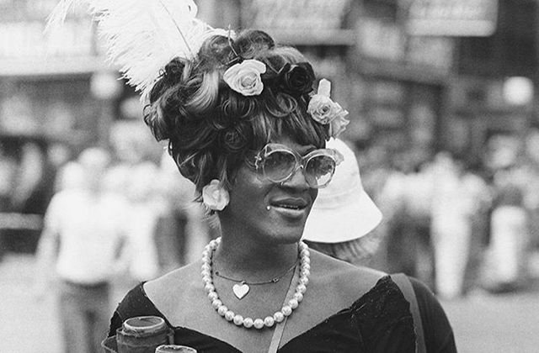
Trans Activism & Resistance

Slide 19
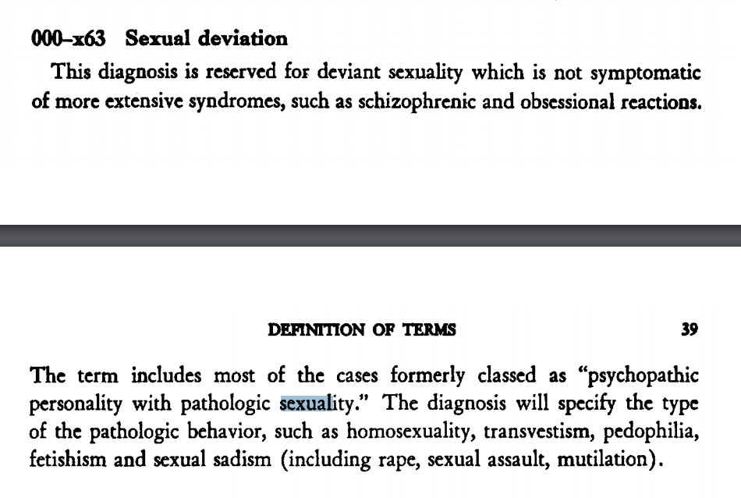
Iterations of
the DSM

Slide 20
A marked incongruence between one’s experienced gender and assigned gender, of at least 6 months duration, as manifested by two of the following

Slide 21
A strong desire to be rid of one’s primary and/or secondary sex characteristics
A strong desire to be of the other gender
A strong conviction that one has typical feelings and reactions of the other gender

Slide 23
2015 US Transgender Survey
50% of American Indian and Alaska Native respondents
34% of Black respondents
26% of Asian and Native Hawaiian/Pacific Islander respondents
Who saw a healthcare provider in the past year reported:
Having at least one negative experience related to being transgender;
Being verbally harassed;
Being physically or sexually assaulted;
Having to teach the provider about transgender people in order to get appropriate care.
Notes:
Youtube video: LGBTIQ people talk about their experiences accessing healthcare
https://www.youtube.com/watch?v=Q5-7t_qBw14&t=158s

Slide 24
Gender Minority Stress and Resilience

Slide 25
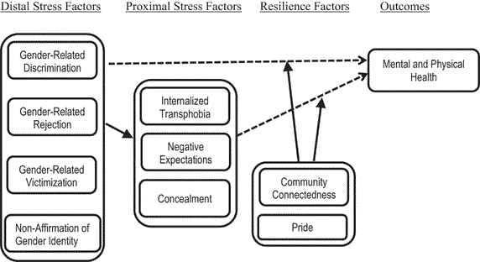
Testa, R. J., Habarth, J., Peta, J., Balsam, K., & Bockting, W. (2015). Development of the Gender Minority Stress and Resilience Measure. Psychology of Sexual Orientation and Gender Diversity, 2(1), 65–77. https://doi.org/10.1037/sgd0000081

Slide 26
GMSR Measure
Discrimination
Non-Affirmation
Rejection
4. Internalized Transphobia
5. Victimization
6. Pride
Notes:
https://www.paloaltou.edu/sites/default/files/Gender%20Minority%20Stress%20and%20Resilience%20Measure.pdf

Slide 27
Lessons Learned
Notes:
MURAL

Slide 28
Resource Guide

Slide 29
Q&A

