Slide 1
Safe,Sane and Stable
In Turbulent Times
times
S.Rebekah Demirel 2021
www.traumaprograms.com

Slide 2
“The longest journey you will ever make is the journey from your head to your heart”
Chief Phil Lane, Ihanktonwan Dakota and Chickasaw Nations,
“To heal a nation, we must first heal the individuals, the families and the communities.”
Art Solomon, Anishinaabe elder
S.Rebekah Demirel 2021
www.traumaprograms.com

Slide 3
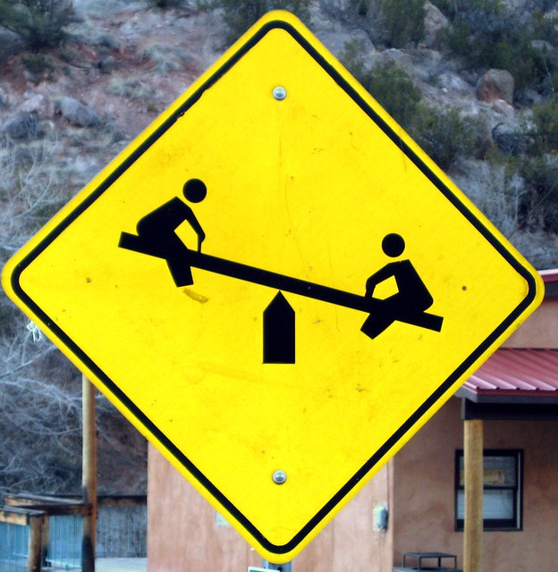
What The Bleep Is Going On?
Polarity
Rigidity
Politics
Rage
Cynicism
Violence
What now and what can we do?
S.Rebekah Demirel 2021
www.traumaprograms.com

Slide 4
Let’s Start By Breathing
Exhaling longer than inhaling allows our vagus nerve to up-regulate the parasympathetic (rest and digest) part of our nervous system
Sit or lie down if possible, close your eyes
Breathe slowly through the nose for six counts
Hold gently for one count
Exhale slowly through the nose for eight counts
Repeat three to five rounds
S.Rebekah Demirel 2021
www.traumaprograms.com

Slide 5
Dealing But Not Feeling
When we are constantly busy strong emotions can be suppressed
When we stop, slow down, without the usual distractions, feelings arise
Keeping busy may become a habit to avoid feelings
S.Rebekah Demirel 2021
www.traumaprograms.com

Slide 6
Fight, Flee, Collapse
When we are traumatized we try to run or fight and if neither of those things are possible, we freeze or collapse
We can also feel stree about something which happened in the past or we are projecting what we fear may happen in the future
S.Rebekah Demirel 2021
www.traumaprograms.com

Slide 7
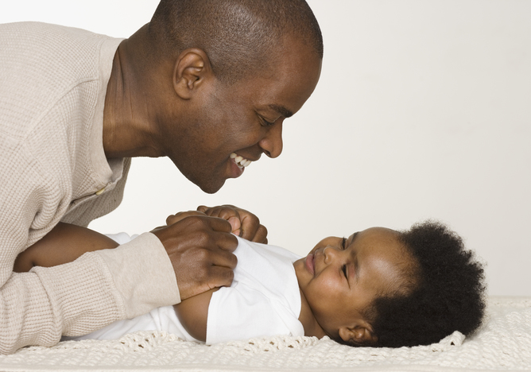
Defend Or Relax?
Brain chemistry is set in motion when we are very young and our brains are forming as we are nurtured and cared for
Chronic stress makes us hypervigilant and we may feel unable to relax, or feel numb and unable to experience pleasure
S.Rebekah Demirel 2021
www.traumaprograms.com

Slide 8
Observing Thoughts, Emotions, Body Sensations
Observation is the first step in healing
It takes courage and resolve to become aware of what we think, feel and sense in our bodies
Noticing and being conscious of what we think and feel is how we track what’s changing or what‘s not
S.Rebekah Demirel 2021
www.traumaprograms.com

Slide 9
Smoke Alarm/Watchtower
The amygdala is the smoke alarm of our brains, telling us when there is danger, along the hippocampus. It is an unconscious, limbic function, which happens automatically
The medial prefrontal cortex (mpfc) is the watchtower, located right above our eyes. It regulates decisions, emotions and our responses to stimuli
S.Rebekah Demirel 2021
www.traumaprograms.com

Slide 10
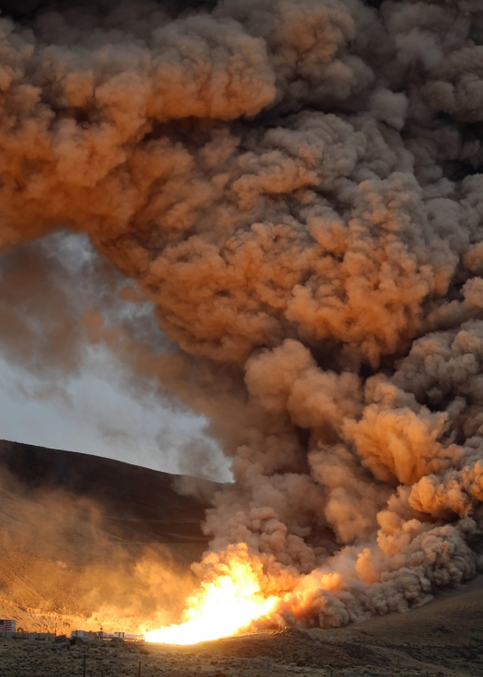
Amygdala – The Smoke Alarm
When a threat is detected it sends an instant message to engage stress hormones from the adrenals for a whole body response
The response in our bodies is instantaneous and we may not even be aware of it until our body is in motion to run or fight
S.Rebekah Demirel 2021
www.traumaprograms.com

Slide 11
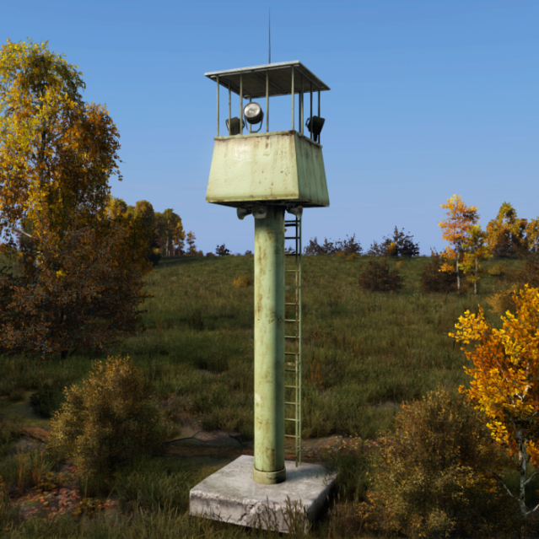
Medial Pre-Frontal Cortex (MPFC) The Watchtower
Controls the stress response, regulates emotions, rational choices and assesses emotional responses of others
Disrupted by chronic stress and substance use disorder so we may not assess danger accurately
S.Rebekah Demirel 2021
www.traumaprograms.com

Slide 12
Thalamus – The Gate Keeper
Collects and filters sensory information
Tells us which information can be ignored or which is important for our safety
In PTSD the “floodgates are wide open”, there is sensory overload and the thalamus cannot discern safe from not safe
S.Rebekah Demirel 2021
www.traumaprograms.com

Slide 13
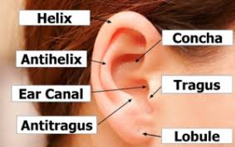
Sympathetic NS Auricular Soothing
Sit down or lay down and relax somewhere quiet
Find the concha spot on your ear, just above the ear canal
Gently massage tiny circles with your finger tip
Take your time, breath and let your nervous system unwind
Massaging and pulling on your ears feels good and can be done any time throughout the day
S.Rebekah Demirel 2021
www.traumaprograms.com

Slide 14
When Our Nervous System Gets Disrupted
A supple, well regulated nervous system, which can relax and return to normal after a stressful episode is able to accurately discern when something is a threat or not
A chronically stressed nervous system (mpfc) will demonstrate, to varying degrees, impulse control, lack of emotional regulation, memory loss and irrational behavior, which makes deep relationships difficult
S.Rebekah Demirel 2021
www.traumaprograms.com

Slide 15
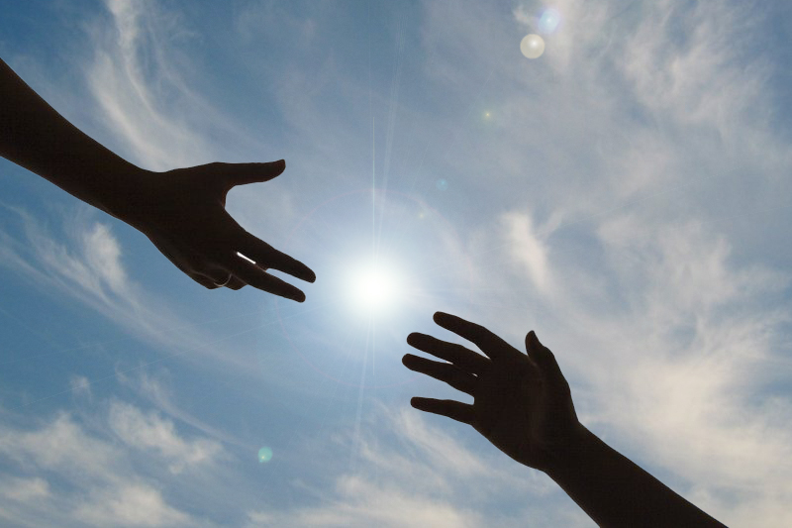
MPFC and Substance Use d/o
Disruption of the following functions are associated with long term substance use disorder:
Response inhibition
Emotional regulation
Motivation
Awareness
Memory
Decision making
S.Rebekah Demirel 2021
www.traumaprograms.com

Slide 16
Experience Shapes The Brain
The experience of trauma alters our perception of risk vs safety
Healing helps us recover the capacity to experience safety, relaxation and reciprocity
Experience shapes our brains and our entire nervous systems
As we heal, we learn new ways of responding and we can test them to see how they work
S.Rebekah Demirel 2021
www.traumaprograms.com

Slide 17
Vagus Baby…
Longest cranial nerve #10
Communication between the brain and the gut
Relaxation with deep breathing
Decreasing inflammation
Lowering heart rate and blood pressure
Fear management
Helps us recover from stressful and scary situations
S.Rebekah Demirel 2021
www.traumaprograms.com

Slide 18
The Healing Vagus Nerve Pathway

Slide 19
Healing From The “Bottom Up and Top Down”
Engaging the body in healing allows physiological manifestations of stress to reset from the “bottom up”
Examining thoughts, beliefs and behaviors allows mental and emotional patterns to shift, which also impacts physiological manifestations of stress response
S.Rebekah Demirel 2021
www.traumaprograms.com

Slide 20
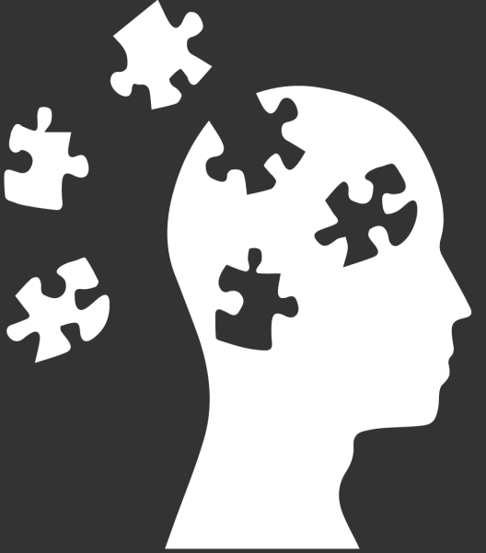
Top Down – Observing The Mind
Thoughts affect emotions and emotions affect our nervous system
Our pre frontal cortex is disrupted in stress and trauma
Taking time each day to examine what we think and feel brings a fresh perspective and helps our brains change old habits
S.Rebekah Demirel 2021
www.traumaprograms.com

Slide 21
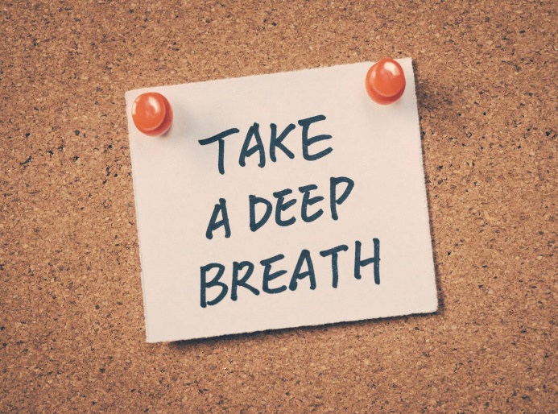
Bottom Up – Engaging The Body
Because our nervous systems tell our body how to respond, working directly with our bodies helps to change our disrupted nervous systems
The stress response affects physical things like breath, heart rate, circulation, smell, vision and taste, so any thing we do to enliven and calm these senses helps us heal
S.Rebekah Demirel 2021
www.traumaprograms.com

Slide 22
Tuning Our Voices Together
Settle in your seat, take a few deep breaths and close your eyes
Inhale through your nose, allowing the breath to move deep into your belly
Exhale with mouth closed while making a low, buzzing humming sound that vibrates your mouth (kind of like you are blowing in a bottle)
Repeat five times, feeling the vibration of the humming through your body
S.Rebekah Demirel 2021
www.traumaprograms.com

Slide 23
Meditation – Lightness
One of the most important ways we can heal is to simply sit and be still
Taking time each day just for you can be revelatory
If we can allow our practice to be the lightest, most gentle thing we do in a day it becomes a soothing refuge in the chaos
S.Rebekah Demirel 2021
www.traumaprograms.com

Slide 24
Toning the Vagus Nerve
Vagal tone improves the function of blood sugar regulation, reduced risk of stroke, cardiovascular disease, lowers blood pressure, improves digestion via better production of stomach basic and digestive enzymes, and reduces migraines
Higher vagal tone is also associated with better mood, less anxiety and more stress resilience
S.Rebekah Demirel 2021
www.traumaprograms.com

Slide 25
Breathe,Hum,Sing,Splash Sit and Eat Your Yogurt
Slow, rhythmic, diaphragmatic breathing
Humming
Singing
Washing your face with cold water
Meditation
Balancing the gut microbiome
All of these activities tone the vagus nerve and help the nervous system to heal
S.Rebekah Demirel 2021
www.traumaprograms.com

Slide 26
EMDR For Healing Trauma
Psychotherapuetic method developed by American psychologist, Francine Shapiro in mid 1980s for use with complex trauma and ptsd
S.Rebekah Demirel 2021
www.traumaprograms.com

Slide 27
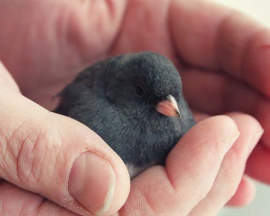
(Little Birds)Exercise
Sit quietly with spine straight and both hands palm up in your lap, eyes closed
Think of a negative belief you have about yourself and let that sit in the palm of your right hand. Think of the opposite of the negative belief and let it sit in your left hand
Gently close your fingers around each belief in your hands, like you are holding a tiny bird there
With eyes closed, begin rolling your eyes back and forth between each hand, feeling the belief and then letting it go
Keep breathing and take your time, doing as many cycles as you need to, then stop moving your eyes and open your right hand, let the bird fly away. Now open your left hand, let the bird fly away.
Take a few more deep breaths and let yourself settle before opening your eyes
It’s good to reflect afterwards and maybe write down your thoughts
S.Rebekah Demirel 2021
www.traumaprograms.com

Slide 28
Integrate (into great) You
Integration means bringing all the parts of us together in a unified whole – observing, trying new things, allowing change in ourselves and others
We integrate when we attend to ourselves by observing, inquiring, noticing, engaging, connecting and continuing to give ourselves time to heal
S.Rebekah Demirel 2021
www.traumaprograms.com

