Slide 1



Module 6: Early Intervention and Treatment (Tiers 2/3)
National School Mental Health Best Practices:
Implementation Guidance Modules
for States, Districts, and Schools
Notes:
Welcome to Module 6 of National School Mental Health Best Practices: Implementation Guidance Modules for States, Districts, and Schools – Early Intervention and Treatment (Tiers 2 and 3).
Module content was developed by the National Center for School Mental Health in partnership with the Mental Health Technology Transfer Center (MHTTC) Network.

Slide 2
Disclaimer
The opinions expressed herein are the views of the Mental Health Technology Transfer Center Network and the National Center for School Mental Health and do not reflect the official position of the Department of Health and Human Services (DHHS), SAMHSA. No official support or endorsement of DHHS, SAMHSA, for the opinions described in this document is intended or should be inferred.
National School Mental Health Implementation Guidance Modules
Notes:
Disclaimer

Slide 3
Disclaimer
Public Domain Notice
All material appearing in this publication except that taken directly from copyrighted sources is in the public domain and may be reproduced or copied without permission from SAMHSA.
Do not reproduce or distribute this publication for a fee without specific, written authorization from the MHTTC NCO.
All material appearing in this publication should be appropriately cited using the recommended citation below. If content is removed, added, or adapted from the original material in this publication, these modifications should be clearly noted.
Recommended Citation
National Center for School Mental Health and MHTTC Network Coordinating Office. (2019). Trainer manual, National School Mental Health Best Practices: Implementation Guidance Modules for States, Districts, and Schools. Palo Alto, CA: MHTTC Network Coordinating Office.
National School Mental Health Implementation Guidance Modules
Notes:
Disclaimer

Slide 4

Agenda
Definition
Value
Quality Indicators and Best Practices
Strategic Planning
National School Mental Health Implementation Guidance Modules
Notes:
In this module, we will review the definition and value of mental health early intervention and treatment services in schools. Next, we will discuss quality indicators and best practices to effectively implement these services and supports. Many of the implementation indicators are the same as those we discussed in Module 5 for mental health promotion (Tier 1) and so will be a review and will include consideration of how they are applied to Tiers 2 and 3. At the end of the module, we will spend some strategic planning time developing your own goals related to mental health early intervention and treatment.

Slide 5
What Is Mental Health Early Intervention?
Strategies designed to address mental health concerns for students who have been identified through a systematic, equitable process as experiencing mild distress or functional impairment, or being at risk for a given problem or concern.
What Is Mental Health Early Intervention?
National School Mental Health Implementation Guidance Modules
Notes:
Mental health early intervention or Tier 2 services and supports, sometimes referred to as mental health prevention or secondary prevention services, are strategies designed to address mental health concerns for students who have been identified through a systematic, equitable process as experiencing mild distress or functional impairment, or being at risk for a given problem or concern.
Examples include small group interventions for students identified with similar needs, brief individualized interventions (e.g., motivational interviewing, problem solving), mentoring, and/or low-intensity classroom-based supports such as a daily report card, daily teacher-in, and/or home/school note system.
NOTE: Tier 2 services and supports may also be appropriate for students experiencing more intensive needs, but they are often accompanied by more intensive services and supports.

Slide 6

Value of Mental Health Early Intervention
Value of Mental Health Early Intervention
Mental health problems often first emerge at school (Richardson, Morrissette, & Zucker, 2012)
Early identification of problems prevents worsening of symptoms
Early intervention promotes positive youth development
National School Mental Health Implementation Guidance Modules
Notes:
Early intervention is critical to any multitiered system of support in your district or school mental health system, for several reasons:
Mental health challenges often first emerge at school, making it a natural setting for identification and early intervention
When problems are identified early and supports put in place, the severity and chronicity of future mental health concerns can be prevented or reduced
Early identification promotes positive youth development

Slide 7
What Is Mental Health Treatment?
Strategies designed to address mental health concerns for students who are already experiencing significant distress and functional impairment.
What Is Mental Health Treatment?
National School Mental Health Implementation Guidance Modules
Notes:
Mental health treatment services and supports, or Tier 3, include strategies designed to address mental health concerns for students who are already experiencing significant distress and functional impairment. Sometimes these are referred to as indicated mental health intervention, tertiary, or intensive services and are individualized to specific student needs.
Tier 3 services include services provided by all school-based mental health professionals, including school-employed and community-employed.
Examples include individual, group, or family therapy for students receiving general or special education who have identified, and often diagnosed, social, emotional, and/or behavioral needs.

Slide 8

Value of Mental Health Treatment in Schools
Value of Mental Health Treatment in Schools
Schools are accessible.
Most children who receive mental health treatment do so in schools.
It effectively reduces symptoms.
Treatment is most effective when integrated into students’ academic instruction.
(Green et al., 2013; Rones & Hoagwood, 2000; Burns et al., 1995; Foster et al., 2005)
National School Mental Health Implementation Guidance Modules
Notes:
Providing mental health treatment in schools is valuable for students and families for many reasons.
First, schools are a natural, accessible environment where youth spend most of their day, five days a week. As such, the education sector is the primary system of care for children and adolescents. In fact, 70%-80% of children who receive mental health services do so in schools and 20% of students receive some form of school mental health services annually.
Also, mental health treatment in schools is effective in reducing mental health symptoms, with especially strong effects when treatment is integrated into students’ academic instruction.

Slide 9
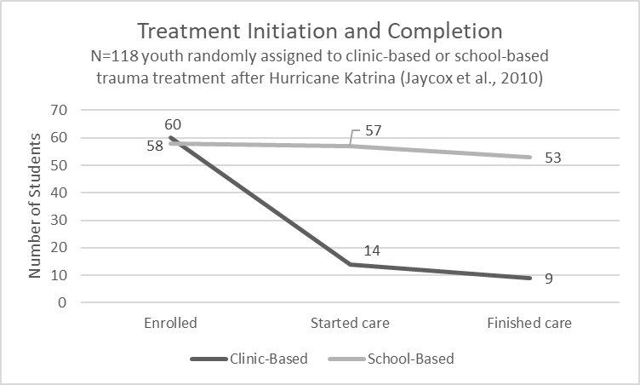
Why Mental Health Treatment in Schools?
Why Mental Health Treatment in Schools?
Youth are 6x more likely to complete mental health treatment in schools than in community settings (Jaycox et al., 2010).
Mental health treatment has large effects on decreasing mental health symptoms (Sanchez et al., 2018).
Mental health services are most effective when they are integrated into students’ academic instruction (Sanchez et al., 2018).
National School Mental Health Implementation Guidance Modules
Notes:
Mental health treatment completion rates are much higher than clinic-based treatment completion rates.
In one study of trauma treatment services, over 90% of youth served at school completed treatment as compared to about 15% of youth served in a community setting – that’s a six-fold increase in treatment completion.

Slide 10

Comprehensive School Mental Health System Planning and Implementation Module Series
Comprehensive School Mental Health System Planning and Implementation Module Series
Resources
https://healthysafechildren.org/learning-portal/learning-modules/
National School Mental Health Implementation Guidance Modules
Notes:
In this Module, we review best practices and strategies for selecting and implementing services and supports at Tiers 2 and 3. To understand some of the nuts and bolts of setting up and implementing services and supports, including effective partnerships with community mental health providers, we recommend the modules created by the National Center for Healthy Safe Children, in partnership with the National Center for School Mental Health.
The series is composed of three modules:
Introduction to Comprehensive School Mental Health
Preparing to Implement a Comprehensive School Mental Health Program
Implementing a Comprehensive School Mental Health Program
These are self-paced, free, online learning modules.

Slide 11
Quality Indicators
Quality Indicators
Provide access to needed services and supports.
Determine whether services are evidence-informed.
Ensure all services and supports are evidence-informed.
Ensure fit with strengths, needs, and cultural and linguistic considerations
Ensure adequate resources for implementation.
Provide interactive training and ongoing supports.
Monitor fidelity.
Ensure intervention goals are SMART.
Monitor student progress across tiers.
Implement a systematic protocol for emotional and behavioral crisis response.
National School Mental Health Implementation Guidance Modules
Notes:
This is a list of the quality indicators for the Mental Health Early Intervention and Treatment domain.
For each of these indicators we will discuss best practices, resources, and helpful tips.

Slide 12
Quality Indicators
Quality Indicators
Of the students who were identified as needing mental health early intervention (Tier 2) services and supports, how many received them?
Identification can include needs assessment, screening, referral, or teaming processes.
Tier 2 services and supports are for students experiencing mild distress or functional impairment, or at risk for a given problem or concern.
National School Mental Health Implementation Guidance Modules
Notes:
Consider: Of the students who were identified as needing mental health early intervention (Tier 2) services and supports, how many received them?
The first quality indicator addresses access to Tier 2 services and supports in your school or district. This indicator requires that you have a mechanism to systematically identify all students who would benefit from Tier 2 services and then count the number of students who actually received those services.

Slide 13
Quality Indicators
Quality Indicators
To what extent were mental health early intervention (Tier 2) services and supports evidence-informed?
Evidence-informed
  Based on research evidence, as recognized in national registries, and/or supported by practice-based evidence of success in local or similar schools
National School Mental Health Implementation Guidance Modules
Notes:
Consider: To what extent were your mental health early intervention (Tier 2) services and supports evidence-informed?
This quality indicator is intended to help your team assess how many of your Tier 2 services and supports were evidence informed. For instance, if you think of everything your school/district provides for Tier 2, are any evidence-informed? All? Or somewhere in between? Less than 25%? Less than half? More than half? More than 75%?

Slide 14
Early Intervention (Tier 2) Example
Early Intervention (Tier 2) Example
Brief Intervention for School Clinicians (BRISC)
4-session, flexible Tier 2 intervention for high school students
Provides a structured, systematic way to identify treatment targets
Based on skill building and problem solving
Uses standardized assessment tools to monitor progress
Designed to maximize efficiency for school mental health systems
Developed by Drs. Elizabeth McCauley and Eric Bruns at the University of Washington School Mental Health Assessment Research and Training (SMART) Center
National School Mental Health Implementation Guidance Modules
Notes:
There are many different types of Tier 2 services and supports. These should be selected based on the unique needs and strengths of students and their families, and implementation considerations such as school staffing and resources, as we will discuss shortly in this module
The Brief Intervention for School Clinicians (BRISC) is one example of a Tier 2 intervention. The BRISC was developed by Elizabeth McCauley and Eric Bruns at the University of Washington, School Mental Health Assessment Research and Training (SMART) Center to assess and address student concerns in an efficient, evidence-based manner. The BRISC is not a comprehensive treatment approach. Instead, it is designed to maximize the efficiency of school health and mental health professions by doing the following:
Engage with the student by asking about their immediate concerns.
Assess issues students want help with and the nature of the student’s needs.
Teach basic tools to empower students.
The BRISC is a 4-session, flexible, strengths-based, individualized intervention for high school students that provides a structured, systematic way to identify treatment targets based on skill building and problem solving. It also uses standardized assessment tools to monitor progress.
The BRISC is appropriate for students who meet any of the following criteria:
Have more need than your typical student
Have a repeated pattern of issue(s) such as referrals to the school nurse, disciplinary encounters, or attendance problems
Received Tier 1 supports, but not developing skills at the same rate as other peers
Are experiencing social, emotional, or behavioral concerns that are starting to develop or escalate

Slide 15
Quality Indicator
Quality Indicator
Of the students who were identified as needing Tier 3 services and supports, how many received them?
Identification processes can include screening and/or referral.
This refers to access to any service or support needed by students above or beyond what is provided universally (at Tier 1) to all students.
National School Mental Health Implementation Guidance Modules
Notes:
Consider: Of the students who were identified as needing Tier 3 services and supports, how many received them?
The next two indicators are similar to the previous two but with respect to Tier 3 services. This indicator requires that you have a mechanism to systematically identify all students who would benefit from Tier 3 services and then count the number of students who actually received those services. This indicator captures access to mental health treatment in your school or district.

Slide 16

District Example
One small, rural school district partnered with a community mental health provider to help meet the mental health needs of students by providing individual, group, and family counseling. The community partner examined referrals compared to enrollment in services at the mid-point and end of the school year to understand trends in access to care. They found that Hispanic/Latino students had disproportionately low service enrollment rates compared to rates overall, and Hispanic/Latino students were underrepresented among their enrolled cases as compared to the proportion of Hispanic/Latino students in school. The community provider organized a planning team with school and district staff, students, and family members to better understand these trends and plan for improvements to increase access to care for Hispanic/Latino students and their families. Communication messages and methods about the mental health services were re-developed based on leadership from Hispanic/Latino students and families, and a Hispanic/Latino clinician was recruited and hired based on one of the recommendations. Access to care rates are re-examined twice per year overall and for sub-populations served.
National School Mental Health Implementation Guidance Modules
Notes:
This district example illustrates how important it is to track how many students who need Tier 2 or 3 services or supports actually receive them. In this example, the district went a step further to disaggregate their data based on ethnicity of students referred to examine how they could improve the equity of access to care in their school for Hispanic/Latino students. This led to a series of conversations, planning, and changes with student and family input about how to improve access to care.

Slide 17
Quality Indicator
Quality Indicator
To what extent were mental health treatment (Tier 3) services and supports evidence-informed?
Evidence-informed
    Based on research evidence, as recognized in national registries, and/or supported by practice-based evidence of success in local or similar schools
National School Mental Health Implementation Guidance Modules
Notes:
Consider: To what extent were mental health treatment (Tier 3) services and supports evidence-informed?
This quality indicator is intended to help your district or school team assess the extent to which your Tier 3 services and supports were evidence-informed. For instance, if you think of everything your school/district provides for Tier 3, are any evidence-informed? All? Or somewhere in between? Less than 25%? Less than half? More than half?

Slide 18
Mental Health Treatment (Tier 3) Example
Mental Health Treatment (Tier 3) Example
Cognitive Behavioral Intervention for Trauma in Schools (CBITS)
School-based group and individual intervention to reduce symptoms related to post-traumatic stress disorder (PTSD), depression, and behavioral problems
10 group sessions, one to three individual sessions, two parent educational sessions, and one teacher education session
Has been used with students from 5th through 12th grade
Developed in the 1990s, and extensive research since 2000 has demonstrated its effectiveness and implementation feasibility
www.cbitsprogram.org
National School Mental Health Implementation Guidance Modules
Notes:
This is just one example of a Tier 3 intervention in order to illustrate its structure, format, and which students are appropriate.
The CBITS was developed in the 1990s and extensive research since 2000 has demonstrated its effectiveness and implementation feasibility. It is a school-based group with individual intervention components to reduce symptoms primarily intended to help children in schools cope with trauma. There are 10 group sessions, 1-3 individual sessions, 2 parent psychoeducational sessions and 1 teacher education session.
The CBITS has a strong and growing evidence base of high completion rates in hundreds of schools across the nation and positive impact on trauma symptoms, depression symptoms, and academic outcomes.
Students are appropriate for the CBITS if they have experienced trauma and have trauma-related symptoms. These students are likely experiencing some functional difficulties at home, at school, and/or in the community based on their trauma symptoms. A systematic screening and assessment process is needed to make sure students are correctly selected for this specialized treatment. Visit the CBITS website (www.cbitsprogram.org) to learn more about the program.

Slide 19
Quality Indicator
Quality Indicator
Best Practices
To what extent did your district/school determine whether early intervention and treatment (Tiers 2 and 3) mental health services and supports are evidence-informed?
Create an intervention selection committee.
Develop a selection process and policy.
Use national evidence-based practice registries.
Review national evidence-based practice registries.
Review evidence of success.
National School Mental Health Implementation Guidance Modules
Notes:
Trainer Note: Slides 17-31 were already presented in Module 5. You may review this material quickly with attention to application to Tiers 2 and 3. The next section in this module that is unique to Tiers 2 and 3 starts on slide 32 with monitoring student progress.
Consider: To what extent did your district/school use best practices to ensure early intervention and treatment (Tier 2 and 3) mental health services and supports are evidence-informed?
In addition to considering how many of your Tier 2 and 3 services and supports were evidence-informed, your team may wish to evaluate the degree to which you are using best practices to evaluate whether something is evidence-informed. You could do this before selecting an evidence-based practice or to critically evaluate practices you are currently implementing.
Best practices for this indicator include:
Create an intervention selection committee with diverse representation of stakeholders (e.g., school and community mental health providers, administrators, teachers, students, caregivers)
Develop an intervention selection process and policy to ensure evidence-informed services and support are implemented with fidelity
Use national evidence-based practice registries (e.g., IES What Works Clearinghouse, Blueprints for Healthy Youth Development, California Evidence-based Clearinghouse for Child Welfare (CEBC), OJJDP Model Programs Guide, Society of Clinical Child & Adolescent Psychology Effective Child Therapies), research literature,
Use resources that center and affirm the identities of individuals from groups that have been historically marginalized to inform selection of evidence-informed interventions.
In selecting an intervention consider whether:
Randomized controlled trials (RCTs) for the intervention demonstrate effectiveness and positive outcomes with the intended student population
The settings (e.g., urban/suburban/rural/frontier; school/outpatient/inpatient) are comparable to the intended setting
The outcomes are consistent with those valued and prioritized by members of the school community
The intervention is culturally responsive, in that it reflects cultural norms and values of the diverse cultural groups of students
The intervention is demonstrated to be effective with diverse cultural groups and identities
The intervention is effective at reducing disparities
Review of evidence of success (e.g., process or outcome data from program evaluation or quality improvement efforts, fidelity data) in schools with similar characteristics and student populations

Slide 20

Sources of Evidence
Sources of Evidence
Resources
Research literature
Intervention developers
Schools implementing the intervention or practice
Evidence-based practice (EBP) registries
IES What Works Clearinghouse
https://ies.ed.gov/ncee/wwc/
Blueprints for Healthy Youth Development
https://www.blueprintsprograms.org/about
Model Programs Guide
https://www.ojjdp.gov/mpg
Society of Clinical Child & Adolescent Psychology
https://effectivechildtherapy.org/therapies/
https://healthysafechildren.org/learning-module-series/evidence-based-module-series
National School Mental Health Implementation Guidance Modules
Notes:
There are many sources of intervention evidence to consider including:
Sources of evidence include:
Research literature: Published studies describe how the program has been tested and the outcomes that it has influenced.
EBP developers: Developers can describe available implementation supports, how to monitor fidelity of implementation, the feasibility of adaptation, and solutions to implementation challenges.
Schools implementing the EBP: Other schools and communities can describe their experience with implementation and, if relevant, adaptations to the EBP you will need to make for your population of focus. This is an often overlooked source of evidence that is very valuable.
EBP registries: Registries provide information about the EBP’s evidence base, features, training requirements, and cost.
These are described in more detail in the Evidence-Based Practice modules developed by the Mental Health Promotion and Youth Violence Prevention Center that supported the Safe Schools/Healthy Students grant program.

Slide 21
Evidence-Based Module Series
Resources
Evidence-Based Module Series
https://healthysafechildren.org/learning-module-series/evidence-based-module-series
National School Mental Health Implementation Guidance Modules
Notes:
And here is the evidence-based module series we referenced on the sources of evidence slide. These are self-paced, free, online learning modules that provide guidance specifically for EBP implementation in schools.

Slide 22
Quality Indicator
Quality Indicators
Best Practices
To what extent did your district/school ensure mental health early intervention and treatment (Tiers 2 and 3) services and supports are equitable and fit the unique strengths, needs, and cultural/linguistic considerations of your students and families?
Create an EBP selection committee with diverse representation.
Review your school’s student body.
Review your school’s mental health needs and strengths.
Review costs associated with implementation.
Evaluate training requirements.
Pilot test the new practice.
Adapt the practice.
National School Mental Health Implementation Guidance Modules
Notes:
Consider: To what extent did your district/school use best practices to ensure that mental health early intervention and treatment (Tiers 2 and 3) services and supports fit the unique strengths, needs, and cultural/linguistic considerations of your students and families? Any service or support you adopt or implement must, of course, fit the unique characteristics of the students and their families in your school or district.
Best practices for this indicator include:
Collect data on social and cultural demographics (i.e., age, disability, ethnicity, gender identity and expression, language, national origin, race, religion, sexual orientation, sex, socioeconomic status, etc.) of individuals to ensure equitable engagement in Tiers 2/3 services and supports.
Create an intervention selection committee with diverse representation (e.g., school and community mental health providers, school administrators, teachers, students, caregivers)
Consider intervention fit with unique school considerations through a review of:
School’s student body, inclusive of age, disability, ethnicity, gender identity and expression, language, national origin, race, religion, sexual orientation, sex, socioeconomic status
School’s and community’s mental health needs, and strengths
Evaluate fit of existing or prospective interventions with respect to the strengths, needs and cultural/linguistic consideration of students, families, and communities to inform adoption, adaptation, or abandonment of interventions
Pilot test new practices with school population to help inform fit
Collaborate with diverse stakeholders (including students and families) to evaluate fit of existing or prospective interventions with respect to the strengths, needs and cultural/linguistic considerations of students, families and communities to inform adoption, adaptation, or abandonment of interventions
Pilot test new practices with school population to help inform fit.
As appropriate, adapt the practice to fit school population unique considerations, and evaluate impact of adaptations

Slide 23
Resources
School Mental Health Quality Guide: Early Intervention and Treatment Services and Supports (Tiers 2 & 3)
Provides guidance to advance school mental health quality and sustainability
Includes:
  Background
  Best practices
  Action steps
  Examples from the field
  Resources
NCSMH, 2020
National School Mental Health Implementation Guidance Modules
Notes:
This resource, School Mental Health Intervention and Treatment Services and Supports (Tiers 2 & 3) Quality Guide, was developed by the National Center for School Mental Health and covers best practices and practical tips from the field in school mental health intervention and treatment services and supports. It also includes a number of customizable intervention and treatment resources, some of which are also featured as resources through out this module and included in your participant guide.

Slide 24
Selecting Evidence-Based Programs
Resources
Selecting Evidence-Based Programs
Includes worksheets and tools to assess:
Intended population of intervention
Intervention target
Tier of support (based on severity level)
Intervention delivery
Readiness to implement an EBP
Menu of options to measure impact
https://healthysafechildren.org//sites/default/files/Selecting_EBPs_Website_508.pdf
Notes:
The Selecting Evidence-Based Practices for Schools guide, developed by the National Center for Mental Health Promotion and Youth Violence Prevention in partnership with the National Center for School Mental Health, provides detailed, practical information about EBP selection in schools.
It includes worksheets and tools for your team to assess any prospective or current EBP in terms of its relevance to your student population, intervention target, tier of service, mode of delivery, readiness, and impact evaluation capacity.

Slide 25

Evidence-Based Programs in School Settings
Resources
Evidence-Based Programs in
School Settings
Three-part webinar series on evidence-based programs in schools
  Selecting
  Implementing
  Preparing
http://airhsdlearning.airws.org/EBPModule1/story_html5.html
National School Mental Health Implementation Guidance Modules
Notes:
This three-part series on evidence-programs in schools, developed by the National Center for Mental Health Promotion and Youth Violence Prevention in partnership with the National Center for School Mental Health, includes 3 parts:
Selecting Evidence-Based Programs for Schools
Implementing
Preparing
http://airhsdlearning.airws.org/EBPModule1/story_html5.html

Slide 26
Quality Indicator
Quality Indicators
Best Practices
To what extent did your district/school use best practices to ensure adequate resource capacity to implement mental health early intervention and treatment (Tiers 2 and 3) services and supports?
Evaluate staffing capacity.
Evaluate implementation supports.
Evaluate associated costs.
Determine whether staffing, supports, and costs are achievable.
National School Mental Health Implementation Guidance Modules
Notes:
Consider: To what extent did your district/school use best practices to ensure adequate resource capacity to implement mental health early intervention and treatment (Tiers 2 and 3) services and supports?
Of course at this point you might be wondering exactly how much it will cost in staff time to train, implement, and monitor mental health promotion activities being implemented. Consideration of these factors is absolutely essential to optimize the fit of any intervention with your local school or district.
Best practices for this indicator include:
Evaluate staffing capacity, including staff training requirement and qualifications and staff time needed to implement services and supports
Evaluate staffing capacity in terms of availability of staff with training and/or expertise in implementing Tier 2/3 interventions that are culturally responsive, anti-racist and promote equity
Evaluate implementation supports (ongoing training, coaching, peer support, supplies) needed to implement services and supports with fidelity and in a way that promotes cultural responsiveness, anti-racism and equity
Evaluate costs associated with training and implementation
Determine whether staffing, implementation supports, and costs of services and supports are achievable within current school mental health system

Slide 27
Intervention Planning Form
Resources
Intervention Planning Form
National School Mental Health Implementation Guidance Modules
Notes:
This is an intervention planning form developed by the NCSMH for teams to consider all the relevant details of the capacity needed for implementation prior to deciding to adopt a new practice or intervention.
This form is intended to support the mapping of current or prospective programs and guide conversations about realistic capacity needed and available, as well as to consider all interventions side by side to highlight any areas of duplication or overlap.

Slide 28
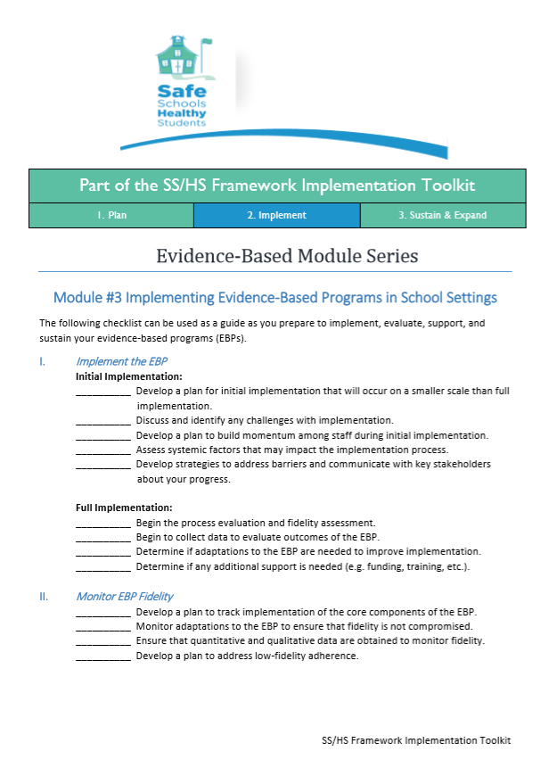
Implementing EBPs in School Settings Checklist
Resources
Implementing EBPs in School Settings Checklist
Develop a plan to track implementation of core components of the EBP.
Monitor adaptations to the EBP to check fidelity.
Ensure that quantitative and qualitative data are obtained to monitor fidelity.
Develop a plan to address low-fidelity adherence.
https://healthysafechildren.org/sites/default/files/EBP-ModulesChkltsMod-3-508.pdf
National School Mental Health Implementation Guidance Modules
Notes:
This is a checklist for Implementing EBPs in School Settings: https://healthysafechildren.org/sites/default/files/EBP-ModulesChkltsMod-3-508.pdf
It is brief and intended to support planning and teaming processes.

Slide 29

District Example
Seattle’s School Based Health Centers operate in every Seattle middle and high school, with funding provided by 2 property tax levies. In Seattle, 9,000 students make over 40,000 visits annually, for primary medical care, immunizations, reproductive health care, and mental and behavioral health care, which constitutes 44% of all visits. SBHCs operate within a Multi-Tiered Systems of Support (MTSS) framework and focus a majority of attention and resources within Tier 2 of this framework, with an emphasis on early intervention and developing students’ social, emotional, and behavioral skill sets.
National School Mental Health Implementation Guidance Modules
Notes:
This district example from Seattle’s School Based Health Centers offers an example of how one community delivers Tiers 2 and 3 services and supports in their schools.

Slide 30
Quality Indicators
Quality Indicators
Best Practices
To what extent did your district/school support training/professional development, including ongoing implementation supports such as coaching for early intervention and treatment (Tiers 2 and 3) services and supports?
Provide interactive training.
  Skills practice, role plays, and action planning.
Provide ongoing support for implementation.
  Regular coaching, consultation, or supervision that includes skills practice, role plays, and corrective feedback.
  Fidelity monitoring and feedback processes.
National School Mental Health Implementation Guidance Modules
Notes:
Consider: To what extent did your district/school use best practices to ensure adequate resource capacity to implement early intervention and treatment (Tiers 2 and 3) services and supports?
The research is clear that training and professional development is absolutely necessary to support implementation. However, it doesn’t stop there. Training should be interactive, and because one-time training rarely results in meaningful practice change, ongoing implementation supports such as coaching and consultation are equally important. Distribution of materials and one-time didactic training without follow-up support are not best practices to support training and implementation of practices and are generally necessary but insufficient to support implementation in schools.
Best practices for this indicator include:
Provide interactive trainings (with opportunity for skills practice, role plays, action planning.
Provide ongoing support for implementation (by regular coaching, consultation, or supervision that includes skills practice, role plays, and corrective feedback, as well as fidelity monitoring and feedback processes
Ensure trainings appropriately integrate principles of cultural responsiveness, anti-racism, and equity considerations relevant to the topic
NOTE: Distribution of materials and one-time didactic trainings without follow-up support are not best practices to support training and implementation of practices and are generally necessary but insufficient to support implementation in schools

Slide 31

What Does the Research Say About Training?
One-time training may improve knowledge or attitudes, but not practice.
Ongoing coaching and consultation predicts skill learning and application.
Train-the-trainer models require substantial oversight.
Projects achieve 80% success after 3 years of implementation with appropriate planning and ongoing support.
National School Mental Health Implementation Guidance Modules
Notes:
As mentioned on the previous slide, one-time training may improve knowledge or attitudes, but not actual practice. Coaching and consultation about the practices directly in the classroom or school setting where they are delivered is the best way to support implementers (such as clinicians, teachers, peer leaders, parent advocates) to learn and apply the skills to deliver the practice or program. The gold standard of training is an interactive workshop with materials and ongoing coaching or consultation.
Train-the-trainer models are increasingly popular for the cost-and-time-effectiveness of investing in the training and coaching of a smaller group of individuals to train others. However, the research literature supporting the effectiveness of this strategy is mixed at best; thus, we recommend if you use this model, you build in a substantial amount of oversight for the trainers and their trainees to ensure fidelity.
Finally, it is important to recognize that training is not an event, it is a process. This is the same with implementation overall. Even with the best planning and support, implementation projects take three years to achieve about 80% success. In order to maximize the return on your investment in training days and materials, ongoing supports should be included.

Slide 32
District Example
The BRISC strategy was developed by the UW SMART Center in the service delivery context of school-based health centers (SBHCs). The BRISC was developed to promote efficient, effective mental health that assures rapid triaging to the right intensity of care based on standardized assessment and progress monitoring. Evaluation data showed that mental health clinicians working in SBHCs who used the BRISC were able to complete treatment in 4 sessions over half the time, while achieving better mental health outcomes than treatment as usual.
National School Mental Health Implementation Guidance Modules
Notes:
This district strategy offers another example of delivering Tiers 2 and 3 services using a triaging system to the right intensity of care.

Slide 33
Quality Indicators
Best Practices
To what extent did your district/school monitor fidelity of the implementation of early intervention and treatment (Tiers 2 and 3) services and supports?
Identify fidelity monitoring tools.
Ensure your tool or system measures adherence to content, quality of delivery, and logistics.
Determine frequency of fidelity measurement.
Establish a benchmark.
Monitor and track adaptations.
Provide feedback to keep improving.
National School Mental Health Implementation Guidance Modules
Notes:
Consider - To what extent did your district/school use best practices to monitor fidelity of the implementation of early intervention and treatment (Tiers 2 and 3) services and supports?
Fidelity monitoring goes hand in hand with ongoing implementation supports. In fact, fidelity monitoring activities can be built into coaching and consultation models by adding a fidelity tool or measure to inform specific topics to discuss or skills to model.
Best practices for this indicator include:
Identify fidelity monitoring tools specific to the practice being implemented or develop a tool specific to the practice and the implementation context in schools (based on fidelity monitoring tools for similar evidence-based practices). Tools might involve reviewing student records or progress, directly observing school staff who are implementing the practice and/or talking with those implementing or receiving the practice
Ensure your fidelity monitoring tool or system measures the following:
Adherence to intervention content (what is being implemented)
Quality of program delivery (manner in which the facilitator delivers/implements program)
Disparities, inequities and disproportionalities related to the implementation of early interventions and treatment services and supports
Logistics (conducive implementation environment, number/length of sessions implemented)
Participant responsiveness to and staff engagement in services and supports by cultural group or identity (i.e., age, disability, ethnicity, gender identity and expression, language, national origin, race, religion, sexual orientation, sex, socioeconomic status) relevant to the program and school community
Determine frequency of fidelity measurement based on what is feasible and will yield actionable information
Establish a benchmark for acceptable levels of feasibility (e.g., not acceptable, adequate, excellent)
Monitor and track changes or adaptations to the practice
Provide feedback to implementers and use the results to continuously improve, adapt and sustain implementation

Slide 34
What Is Fidelity Monitoring?
Indicators of doing what is intended, which require you to:
  Know what is intended.
  Have some way of knowing the extent to which a person did what was intended.
  Understand why what you’re doing or how you’re doing it is leading to the outcomes you observe.
National School Mental Health Implementation Guidance Modules
Notes:
Fidelity monitoring measures the presence of a program, practice, or initiative as it is used in daily practice.
This involves knowing what is intended, in terms of skill development or competencies included. Next, you need a way to know the extent to which a person – the implementer – did what was intended.
When monitoring fidelity, you will want to pay attention to what degree the content of the program or practice is being implemented as intended. However, the implementer’s skill in effectively delivering the content, the context or environmental factors that implementation occurs in (e.g., the school or classroom setting), and any adaptations or changes to the content are also part of the fidelity monitoring process.
The most valuable part of fidelity monitoring is having a way to explain the progress or outcomes you observe. Even if the program is going very well, without fidelity data you might not know why exactly. Moreover, if the program is not going very well, fidelity data can indicate areas of implementation that need more support.

Slide 35
Fidelity Monitoring Checklist
Resources
Fidelity Monitoring Checklist
Identify fidelity monitoring tools.
Determine the frequency of fidelity measurement.
Establish a benchmark for acceptable levels of fidelity.
Monitor adaptations.
National School Mental Health Implementation Guidance Modules
Notes:
This is a basic fidelity monitoring checklist developed by the NCSMH in collaboration with the American Institutes for Research that can be used the next time you’re planning ahead to monitor fidelity to a specific practice or program. The intention of this checklist is to provide a quick reference for different considerations during the planning process, including the identification of fidelity monitoring tools, determining how often you need to collect fidelity data, what you would like to set as an “acceptable” benchmark, and how you will monitor and document changes or adaptations that are occurring in the school setting.

Slide 36
Fidelity Monitoring
Plan ahead for fidelity monitoring methods and tools before implementation.
Decide how to strike a balance between fidelity and adaptation.
  Fidelity – degree to which a program or practice is implemented as intended
  Adaptation – how much, an.d in what ways, a program or practice is changed to meet local circumstances.
Share fidelity data back with implementers and other key members of the team to make continuous improvements.
National School Mental Health Implementation Guidance Modules
Notes:
The intervention selection process is a great time to think about how you will monitor fidelity. Some evidence-based programs have a fidelity monitoring tool, and in other cases you might have to develop something yourself. This can be as informal as routine check-ins about implementation using the initial training materials as a guide. Or, fidelity monitoring methods can include a records review with a tool or checklist of items that might indicate the practice was implemented as intended (although of course not everything that is done is documented, so that can be a limitation of records review). The most common way to monitor fidelity is via a formal observation of implementation with ratings of specific aspects of the implementation.
Adaptation is a natural part of implementation. Document it and determine how much and what type of adaptations are appropriate as a team with input from implementers and program developers or trainers. Your team will need to decide how to balance fidelity benchmarks and adaptations for each program or practice you’re implementing. Implementer feedback and EBP developer input can be very helpful in this process. For example, if a teacher tells you she can only deliver the program in 30-minute sessions but the manual is written for 45-minute sessions, that is a necessary adaptation for the school context about which you may need to work with the developer and even obtain input from other schools/districts implementing the program to decide how to change.
Finally, you should always create feedback loops with the data, meaning that the findings are used constructively to learn from and support implementers over time. Make sure to provide feedback on strengths and areas for improvement. Fidelity data can also be used within your district or school mental health team to indicate how well the program or practice is fitting in the school context with your students. Some programs or practices will inevitably be a better fit than others, and fidelity data can be used to make decisions about whether or not to continue implementation and focus energy on sustainability.

Slide 37
Reflection
Considerations
What intervention is being used?
How is fidelity being assessed?
What feedback loops are in place to use the fidelity data?
How can fidelity monitoring be improved?
Reflection:
Select a Tier 2 or Tier 3 intervention that is currently being implemented. Discuss how, if at all, fidelity is being monitored and informing the implementation process.
National School Mental Health Implementation Guidance Modules
Notes:
Let’s take a few minutes to reflect.
Reflection:
Select a Tier 2 or Tier 3 intervention that is currently being implemented. Discuss how, if at all, fidelity is being monitored and informing the implementation process.
Reflection Considerations:
What intervention is being used?
How is fidelity being assessed?
What feedback loops are in place to use the fidelity data?
How can fidelity monitoring be improved?

Slide 38
Quality Indicator
Quality Indicator
Best Practices
To what extent did your district/school ensure intervention goals are specific, measurable, achievable, relevant, and time bound (SMART)?
Work with the student, parents, and teacher(s) to establish goals.
Ensure goals are specific.
Establish a measurement plan and set an achievable benchmark.
Ensure goals are time specific.
National School Mental Health Implementation Guidance Modules
Notes:
Trainer Note: The remainder of this module is specific to early intervention and treatment supports and services and includes content that did not appear in Module 5.
Consider: To what extent did your district/school ensure intervention goals are specific, measurable, achievable, relevant, and time bound (SMART)?
One basic yet critical way to ensure early intervention and treatment services and supports are of consistent quality and students begin with the best chance of success is to create interventions goals that are SMART. SMART goals are:
Specific
Measurable
Achievable
Relevant
Time bound
Goals may be documented in a treatment plan, individualized education program (IEP), or other charting or documentation system to track student response to intervention over time.
Best practices for this indicator include:
Work with the student, family, and school staff to establish specific goals for the student’s success. This typically involves standardized data collection, observation and/or discussion
Ensure goals are specific (concrete, detailed, and well-defined) and aligned with student and family’s cultural values, beliefs, strengths, and needs
Include strengths-based and person-first language (where appropriate)
Establish a measurement plan and set an achievable benchmark What is achievable will depend on the baseline. For example, if the student is not currently staying in school any days of the week, an achievable goal might be to stay in school 2 out of 5 days to start. Or, if the student is currently referred to the front office once per day, an achievable initial goal might be to decrease office referrals from 5 per week to 3 per week
Ensure goals are time specific, meaning there is a target date identified and interim steps are included to monitor progress during a specific timeline for goals to be achieved

Slide 39
SMART Goals Worksheet
Resources
SMART Goals Worksheet
Provides guidance for the development of SMART goals
Can be used with students, family members, and/or teachers for collaborative goal development
Guides assessment of potential obstacles and solutions, as well as benefits of the goal and action steps
National School Mental Health Implementation Guidance Modules
Notes:
Goals should always be developed collaboratively with the student, their parent or relevant family member(s), and school staff as appropriate depending on the type of intervention targets. This worksheet can be used to guide conversations about specific intervention targets to turn them into SMART goals and think ahead about working toward them in a systematic way.

Slide 40
Program Treatment Planning Guide
Resources
University of Maryland School Mental Health Program Treatment Planning Guide
Includes suggested SMART goals for a wide variety of specific student concerns
Reminders to include a baseline, make sure the goal is measurable, and indicate how the goal will be tracked or monitored over time
Sample formula
  “Patient will (increase/decrease) *behavior* from X times per (day/week/month) to X times per (day/week/month) as evidenced by teacher report, parent report, patient report, clinical observation, behavior chart, etc.”
National School Mental Health Implementation Guidance Modules
Notes:
This resource provides SMART goal examples for specific target problems that students might be working on in early intervention or treatment services. This was developed by clinicians and administrators at a university-based school mental health program that partners with over 25 public schools in Baltimore. It is regularly reviewed and updated based on clinician input. As the use of SMART goals are an expectation of the program and important component of its accreditation, chart reviews are completed on a biannual basis to ensure treatment plans include SMART goals and identify any training or implementation needs within the program to ensure treatment plans are of consistent quality. This document has been especially useful for clinical interns and newly hired clinicians who are learning the documentation and treatment planning process.

Slide 41
Quality Indicator
Quality Indicator
Best Practices
To what extent did your district/school monitor individual student progress across tiers?
Use multiple data sources and reporters.
Use validated assessment tool(s) or clearly measured targets for individual progress/goal attainment.
Ensure that progress monitoring data is aligned with the purpose of the service or support the student is receiving.
Provide feedback to the student, family, and teacher.
National School Mental Health Implementation Guidance Modules
Notes:
Consider: To what extent did your district/school monitor individual student progress across tiers?
At times, Tiers 2 and 3 services and supports may operate more like a continuum than two distinct categories. A student should be recommended for services and supports based on data and input from the student, their family, and school staff. Similarly, progress monitoring should inform when a student should continue, change, or discontinue services and supports.
Best practices for this indicator include:
Establish a clear process and logic for students moving from one Tier to a higher or lower Tier, considering student strengths and progress on target difficulties
Use multiple data sources and reporters
Use validated assessment tool(s) or clearly measured targets that are trauma-informed and healing-centered for individual progress/goal attainment
Use assessment tools that are validated for use with the cultural groups/identities of the student being served
Ensure the progress monitoring data is aligned with the purpose of the service or support the student is receiving
Provide culturally responsive, healing-centered feedback to the student, family, and school staff (when appropriate) about progress monitoring data to inform collaborative decision-making about changes services and supports

Slide 42
Student Progress Monitoring and Feedback
  Decide where to start (e.g., 1 student group, several identified clinicians, 1 school, 1 type of support or service delivered).
  Identify individual student goals.
  Identify a standardized or individualized measure to track progress.
  Identify data collection interval (e.g., weekly, monthly, quarterly).
  Collect data from students, parents, and school staff (teachers, coaches, after-school staff).
  Discuss progress data with the student, family, and teacher to decide when to continue or change services.
  Scale up to larger groups of students, clinicians, or school staff.
National School Mental Health Implementation Guidance Modules
Notes:
Progress monitoring and feedback is an evidence-based practice for improving student outcomes in early intervention and treatment services. Unfortunately, this practice is not used very routinely by clinicians due to implementation challenges such as not having access to the measures they like or need and having very limited time in their school day.
With focused effort, progress monitoring and feedback is definitely feasible in schools and can make a big difference in student outcomes.
Here are some tips about what is involved in progress monitoring and feedback, including reminders about making sure data are used to make collaborative decisions about services and supports with students, their family, and school staff when appropriate.

Slide 43
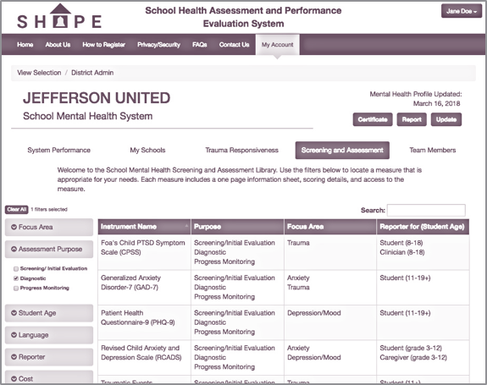
SHAPE Screening and Assessment Library
Resources
SHAPE Screening and Assessment Library
Searchable library of free or low-cost screening and assessment measures related to school mental health
Filter by academic, school climate, or social, emotional, and behavioral focus area, assessment purpose, student age, language, reporter, and cost
2-page summaries are available for every measure with links directly to the measure and scoring information
https://theshapesystem.com/assessmentlibrary/
National School Mental Health Implementation Guidance Modules
Notes:
This Screening and Assessment Library can be found on the SHAPE System once your school or district opens its SHAPE account. This resource is a searchable library of free or low-cost screening and assessment measures related to school mental health, including academic, school climate, and social, emotional, and behavioral focus areas. Search filters allow you to narrow your results by focus area, assessment purpose, student age, language, reporter, and cost.
The library was developed through a comprehensive review of publicly available or low-cost measures conducted by the Center for School Mental Health. Each measure was coded according to information available in the public domain using a standardized rubric developed through a team approach.

Slide 44
Student Information Systems Data Brief
Resources
Student Information Systems Data Brief
Describes the practice of data-driven decision-making in schools and reviews commonly used student information systems
Designed to help schools and districts better navigate how to identify the best student information system for them
National School Mental Health Implementation Guidance Modules
Notes:
This brief was developed by the National Center for School Mental Health in response to numerous technical assistance requests from schools and districts to provide guidance about available student information systems. The brief is a result of a review of the literature as well as input from schools and districts nationwide that reported on the information systems they use.

Slide 45
District Example
Education for Change, a charter management organization in Oakland, CA, partnered with Seneca Family of Agencies, a community-based mental health provider, to deliver mental health services and supports in their 7 charter schools. The Seneca Family of Agencies/Education for Change partnership team wanted to provide more guidance and accountability to school-based clinicians on progress monitoring practices to drive more data-driven decision making and effective services. They first focused on Tier 2 social skills groups. They partnered with 2 clinicians to better understand the supports needed to implement the new practice. Then, tools to identify and monitor intervention goals were developed and shared with clinicians to gather feedback over three months about the feasibility and clinical utility of the progress monitoring tool. The team also collected information in the pilot phase about how to make the practice part of routine workflows to improve data collection and inform decision making. Best practices and “tips” were developed based on clinician feedback to support continued implementation.
National School Mental Health Implementation Guidance Modules
Notes:
This district example shows how one school-community partnership team increased progress monitoring and feedback practices among their clinicians by:
1. focusing on a specific Tier 2 social skills group
2. starting with two clinicians to better understand the process
3. developing tools to support clinicians’ work
4. requesting clinician feedback and input about the new progress monitoring practices to determine how to support continued implementation.

Slide 46
Quality Indicator
Quality Indicator
Best Practices
To what extent did your district/school implement a systematic protocol for emotional and behavioral crisis response?
Develop a protocol for emotional and behavioral crisis response.
Circulate the protocol for feedback.
Disseminate protocol in a manner that is accessible.
Provide active training and ongoing support for protocol implementation.
Provide training and ongoing support for all school staff to use crisis prevention and de-escalation skills.
Revise protocol as needed.
National School Mental Health Implementation Guidance Modules
Notes:
Consider: To what extent did your district/school monitor individual student progress across tiers?
Having and implementing a systematic protocol for emotional and behavioral crisis response is particularly important for any comprehensive school mental health system, and often particularly relevant within the early intervention and treatment service array.
Best practices for this indicator include:
Develop a protocol for emotional and behavioral crisis response based on team (staff, families’, students’, community partners’) input that includes specific types of behaviors or crises, risk assessment of harm to self or others, who will respond in each instance, and how to connect students to the appropriate services and supports
Provide training to all school-based staff about the specific types of behaviors, traumatic events or crises that would warrant a referral for an emotional and behavioral crisis response
Include guidelines and procedures for contacting the caregiver/guardian, providing feedback to teachers and school staff, and supporting a student’s successful transition back to class.
Integrate restorative practices when addressing emotional and behavioral health crises.
Limit involvement of law enforcement (e.g., School Resource Officers, community police) in punitive discipline, and eliminate exclusionary disciplinary practices when possible
In evaluation of students, use best practices for assessing the impact of the student’s unique cultural norms and linguistic or communication styles on the student’s displayed behaviors to inform decisions about follow-up and/or referral
Include instructions that identify mental health coverage considerations if there is different coverage on different days of the week and offer tips for crisis prevention and de- escalation that are trauma-informed and healing-centered and/or considerations for responding to emotional and/or behavioral crises in the event of no or limited mental health provider coverage in the building
Get feedback from students, families, school staff involved in a crisis response incident to inform continuous quality improvement efforts related to the crisis response system
Disseminate crisis response protocol and have it readily available for all school-based staff
Provide training and ongoing support for protocol implementation
Provide training and ongoing coaching or support for all school

Slide 47
Creating Protocols for Student Crises
Specify
  Types of crises
  Point person to respond
  Process for how to connect student with point person
Include instructions for
  Contacting guardians
  Providing feedback to teachers/school staff after
  Responding when the point person is unavailable
Circulate
  To staff, parents, and community members
  In a desired format
Provide
  Training
  Ongoing support
  Time to evaluate and revise protocol
National School Mental Health Implementation Guidance Modules
Notes:
If you don’t have a protocol for: addressing student crises, or you need to improve what you have, these tips may be helpful for your team.

Slide 48
Example Crisis Response Protocol
Resources
Example Crisis Response Protocol
National School Mental Health Implementation Guidance Modules
Notes:
This is the most basic version of a crisis response protocol at the school building level. It was developed through a collaborative process led by school mental health providers (a school social worker, school psychologist, and community mental health clinician) with input from school administrators, teachers, and other staff to specifically address the need for a consistent crisis response process for days without mental health coverage. Despite having three school-based mental health providers at this elementary/middle school, none of them were full-time at the school and there were one to two days a week that the school was without coverage.
The protocol is part of a series of guidance documents that was developed by the mental health team to provide more information and support to school staff about how to respond to student mental health needs at varying levels of intensity and severity. The overall focus of this effort was to ensure students are connected to a mental health provider as soon as needs are identified, and to optimize communication and consistency among all school staff, including school-based mental health professionals (see resource mapping example in Module 3) . The team also developed a protocol outlining recommended graduated levels of response to specific student needs with an emphasis on supporting students’ coping and behavioral regulation in class whenever possible.

Slide 49
School Crisis Response Manual
School Crisis Response Manual
Resources
San Francisco Unified School District
This resource is an example of a school crisis response protocol developed for a specific school district. The manual provides strategies for addressing school crisis intervention using a “crisis response.”
Crisis response is defined here as “an intervention designed to restore a school and community to baseline functioning and to help prevent or minimize psychological results following a disaster or crisis situation.” (p. A-1, Healthier Kids San Francisco)
The purpose of crisis response is to:
  Help students and staff cope with painful emotions and feelings resulting from the crisis.
  Help schools return to their normal routine as quickly and calmly as possible after a major disruption of the educational process.
National School Mental Health Implementation Guidance Modules
Notes:
This resource is an example of a school crisis response protocol developed for a specific school district. The purpose of the manual is to provide strategies for addressing school crisis intervention using a “crisis response.”
Crisis response is defined here as “an intervention designed to restore a school and community to baseline functioning and to help prevent or minimize psychological results following a disaster or crisis situation.”
The purpose of crisis response is to:
Help students and staff cope with painful emotions and feelings resulting from the crisis.
Help schools return to their normal routine as quickly and calmly as possible after a major disruption of the educational process.

Slide 50
Virginia Department of Education
Resources
Virginia Department of Education
School Crisis Management Plan
Outlines district policy and district and school crisis management plans
Provides guidance for specific types of crises or emergencies from individual students to schoolwide emergencies and natural disasters
Includes many tools such as sample statements and communications, planning surveys and checklists, training and drills for preparedness, forms, and informational handouts
National School Mental Health Implementation Guidance Modules
Notes:
This is another example of a comprehensive crisis management plan for a district that features a model crisis management plan for a specific school as part of the guidance. Therefore, information about crisis management planning and activities at the school and district level is included.

Slide 51

National Education Association
Resources
National Education Association
School Crisis Guide
Guidance for schools to prevent, prepare for, respond, and recover from a school crisis
School crisis – any traumatic event that seriously disrupts coping and problem-solving abilities of students and school staff
National School Mental Health Implementation Guidance Modules
Notes:
A separate but related type of crisis response protocol is one that is focused primarily on traumatic events or crises that affect the entire school community. This resource from the National Education Association provides guidance for schools to prevent, prepare for, respond to, and recover from such large-scale school crises, such as severe violence, hostage situations, or natural disasters that require an emergency response from the community. School crises can also be more individualized, such as a car accident or the unexpected death of a student. This type of protocol may be particularly relevant for school safety planning.

Slide 52
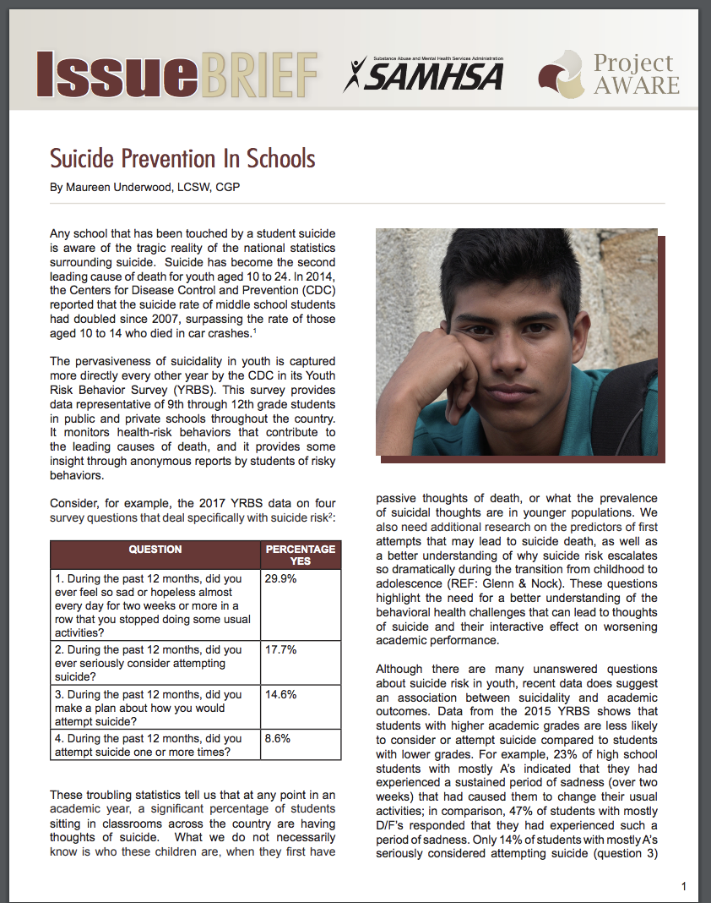
Suicide Prevention in Schools
Resources
Suicide Prevention in Schools
Background and prevalence
Suicide risk factors
Role of school in suicide prevention and postvention
Resources
National School Mental Health Implementation Guidance Modules
Notes:
There are many resources to support schools on the topic of suicide. This resource, developed by the Now Is the Time Technical Assistance Center, provides an overview of the prevalence of and risk factors for youth suicide and the role of schools in preventing and responding to student suicide. It also provides several resources helpful to schools.
https://www.dropbox.com/s/kmfop7pw4af7r74/Screenshot%202019-03-01%2018.15.33.png?dl=0

Slide 53
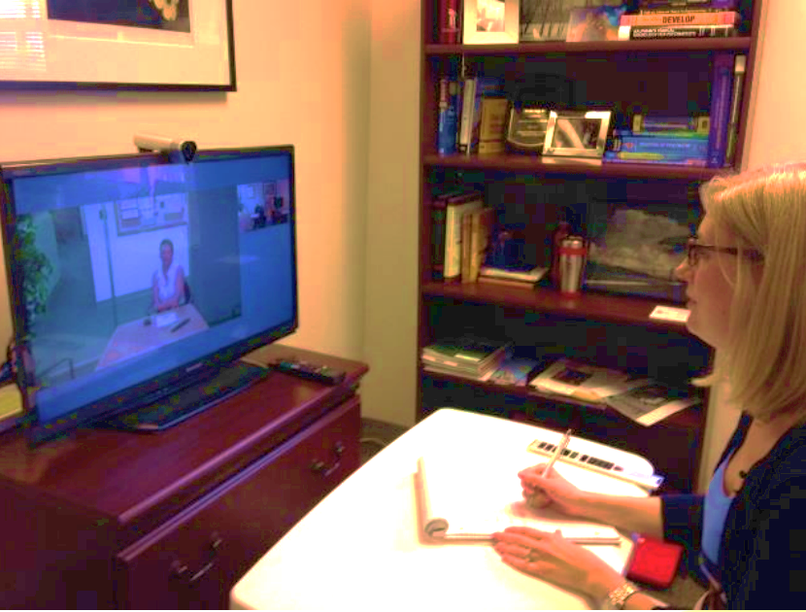
Telemental Health in Schools
Resources
Telemental Health in Schools
Access child mental health specialists, including child and adolescent psychiatrists
Support for intensive or complex mental health concerns
Variety of models:
  Direct care
  Multi-site consultation
  Didactic training
National School Mental Health Implementation Guidance Modules
Notes:
Technology solutions are increasingly being used by schools to support students with more intensive mental health needs.
Telemental health equipment allows schools to access specialty mental health providers in the community, including child and adolescent psychiatrists and other mental health providers that may be scarce or unavailable for direct care in schools.
Telemental health has been successfully used in both urban and rural settings as a way to increase access to care.
Telemental health encompasses a variety of models including direct care of students, multi-site consultation (where the provider is consulting to several school sites), and didactic training (where a provider uses video technology to offer educational information to school staff and others).

Slide 54
Wraparound Supports
Resources
Wraparound Supports
Several models to “wrap around” students with complex needs, including serious emotional and behavioral challenges
  Wraparound
    https://nwi.pdx.edu/
  Community Schools
    http://www.communityschools.org/
National School Mental Health Implementation Guidance Modules
Notes:
For students with complex needs, including serious emotional and behavioral challenges, it may be helpful for schools to partner with families and community providers to offer a holistic approach.
Two models that have been used by many schools and communities are Wraparound Services and Community Schools.
Wraparound provides a comprehensive, holistic, youth and family-driven way of responding when children or youth experience serious mental health or behavioral challenges. Wraparound puts the child or youth and family at the center. With support from a team of professionals and natural supports, the family’s ideas and perspectives about what they need and what will be helpful drive all of the work in Wraparound. https://nwi.pdx.edu/wraparound-basics/#whatisWraparound
Community Schools are both a place and a set of partnerships between the school and other community resources. Its integrated focus on academics, health and social services, youth and community development, and community engagement leads to improved student learning, stronger families, and healthier communities. Schools become centers of the community and are open to everyone – all day, every day, evenings, and weekends.
http://www.communityschools.org/

Slide 55

Discussion
Strategic Planning
State a specific goal for your district within this domain.
List three potential action steps to move this goal forward.
Discussion
How does this content fit with your district’s understanding and implementation of mental health early intervention and treatment services and supports?
National School Mental Health Implementation Guidance Modules
Notes:
We will now consider how this module and quality indicators fit with your understanding and implementation of mental health early intervention and treatment services and supports.
Please work together with your group to state a specific goal for your district and then consider 3 potential action steps that could reasonably be taken to move the goal forward.

Slide 56
Resources
Resources
Blueprints for Healthy Youth Development. (n.d.) https://www.blueprintsprograms.org/about
Coalition for Community Schools: http://www.communityschools.org/
Healthier Kids San Francisco. (2012). School crisis response manual. Retrieved from http://bit.ly/2TDgwd0
Institute of Education Sciences (IES). What Works Clearinghouse. (n.d.). https://ies.ed.gov/ncee/wwc/
National School Mental Health Implementation Guidance Modules

Slide 57
Resources
National Center for Healthy Safe Children. (2018). Safe schools FIT toolkit: Evidence-based module series. Retrieved from https://healthysafechildren.org/learning-module-series/evidence-based-module-series
National Center for Healthy Safe Children. (2018). Selecting evidence-based programs for school settings module. http://airhsdlearning.airws.org/EBPModule1/story_html5.html
National Center for Healthy Safe Children. (2018). Selecting evidence-based programs manual.
https://healthysafechildren.org//sites/default/files/Selecting_EBPs_Website_508.pdf
National Center for School Mental Health. (2019). Intervention planning form. Retrieved from http://bit.ly/2C64q2k
National Center for School Mental Health. (2019). Planning checklist for monitoring fidelity of evidence-based practices. Retrieved from http://bit.ly/2NKHtGy
National Center for School Mental Health. (2019). SMART goal worksheet. Retrieved from http://bit.ly/2Unv5if
National School Mental Health Implementation Guidance Modules

Slide 58
Resources
National Education Association. (2018). School crisis guide. Retrieved from
http://www.nea.org/assets/docs/NEA%20School%20Crisis%20Guide%202018.pdf
National Center for School Mental Health. (2016). Treatment planning guide. Retrieved from http://bit.ly/2EFk98S
National Center for School Mental Health. (2018). The SHAPE System screening
and assessment library. http://theshapesystem.com/
National Center for School Mental Health. (2019). Student data information systems brief.
Retrieved from http://bit.ly/SISbrief
National Center for School Mental Health (NCSMH, 2020). School Mental Health Quality Guide: Early Intervention and Treatment Services and Supports (Tiers 2 and 3). NCSMH, University of Maryland School of Medicine. Retrieved from http://www.schoolmentalhealth.org/media/SOM/Microsites/NCSMH/Documents/QualityGuides/Early-Intervention-and-Treatment-Services-Guide-(Tiers-2-and-3)-2.18.pdf
National School Mental Health Implementation Guidance Modules

Slide 59
Resources
National Wraparound Initiative. (n.d.). https://nwi.pdx.edu/
New Song Learning Center. (2017). Example crisis response protocol. Retrieved from: http://bit.ly/2XEZhHs
Now Is the Time Technical Assistance Center. (2015, September). Suicide prevention in schools (Issue Brief). Washington, DC: Substance Abuse and Mental Health Services Administration. Retrieved from http://bit.ly/2Ca44aK
Office of Juvenile Justice and Delinquency Prevention. (n.d.). Model Programs Guide. Retrieved from https://www.ojjdp.gov/mpg
Society of Clinical Child & Adolescent Psychology. (n.d.). Effective child therapy: Evidence-based mental health treatment for children and adolescents. Retrieved from https://effectivechildtherapy.org/therapies/
Virginia Department of Education. (2002). School crisis management plan. Retrieved from http://bit.ly/2VFLNJQ
National School Mental Health Implementation Guidance Modules

Slide 60
References
References
Burns, B. J., Costello, E. J., Angold, A., Tweed, D., Stangl, D., Farmer, E. M., & Erkanli, A. (1995). Children’s mental health service use across service sectors. Health Affairs, 14(3), 147–159.
Foster, S., Rollefson, M., Doksum, T., Noonan, D., Robinson, G., & Teich, J. (2005). School mental health services in the United States, 2002-2003. Substance Abuse and Mental Health Services Administration.
Green, J. G., McLaughlin, K. A., Alegría, M., Costello, E. J., Gruber, M. J., Hoagwood, K., ... & Kessler, R. C. (2013). School mental health resources and adolescent mental health service use. Journal of the American Academy of Child & Adolescent Psychiatry, 52(5), 501–510.
Healthier Kids San Francisco. (2012). School crisis response manual. Student, Family & Community Support Department San Francisco Unified School District. San Francisco, CA.
Hoover, S. A., Sapere, H., Lang, J. M., Nadeem, E., Dean, K. L., & Vona, P. (2018). Statewide implementation of an evidence-based trauma intervention in schools. School Psychology Quarterly, 33(1), 44–53.
National School Mental Health Implementation Guidance Modules

Slide 61
References
References
Jaycox, L. H., Cohen, J. A., Mannarino, A. P., Walker, D. W., Langley, A. K., Gegenheimer, K. L., ... & Schonlau, M. (2010). Children’s mental health care following Hurricane Katrina: A field trial of trauma‐focused psychotherapies. Journal of Traumatic Stress, 23(2), 223–231.
Richardson, T., Morrissette, M., & Zucker, L. (2012). School-based adolescent mental health programs. Social Work Today, 12(6), 24.
Rones, M., & Hoagwood, K. (2000). School-based mental health services: A research review. Clinical Child and Family Psychology Review, 3(4), 223–241.
Sanchez, A. L., Cornacchio, D., Poznanski, B., Golik, A. M., Chou, T., & Comer, J. S. (2018). The effectiveness of school-based mental health services for elementary-aged children: A meta-analysis. Journal of the American Academy of Child & Adolescent Psychiatry, 57(3), 153–165.
National School Mental Health Implementation Guidance Modules

Slide 62

This work is supported by grant SM081726 from the Department of Health and Human Services, Substance Abuse and Mental Health Services Administration.
Module content was developed by the National Center for School Mental Health in partnership with the MHTTC Network Coordinating Office.
Acknowledgments
National School Mental Health Implementation Guidance Modules

