Slide 1



Module 7: Funding and Sustainability
National School Mental Health Best Practices:
Implementation Guidance Modules
for States, Districts, and Schools
Notes:
Welcome to Module 7 of National School Mental Health Best Practices: Implementation Guidance Modules for States, Districts, and Schools – Funding and Sustainability.
Module content was developed by the National Center for School Mental Health in partnership with the Mental Health Technology Transfer Center (MHTTC) Network.

Slide 2
Disclaimer
The opinions expressed herein are the views of the Mental Health Technology Transfer Center Network and the National Center for School Mental Health and do not reflect the official position of the Department of Health and Human Services (DHHS), SAMHSA. No official support or endorsement of DHHS, SAMHSA, for the opinions described in this document is intended or should be inferred.
National School Mental Health Implementation Guidance Modules
Notes:
Disclaimer

Slide 3
Disclaimer
Public Domain Notice
All material appearing in this publication except that taken directly from copyrighted sources is in the public domain and may be reproduced or copied without permission from SAMHSA.
Do not reproduce or distribute this publication for a fee without specific, written authorization from the MHTTC NCO.
All material appearing in this publication should be appropriately cited using the recommended citation below. If content is removed, added, or adapted from the original material in this publication, these modifications should be clearly noted.
Recommended Citation
National Center for School Mental Health and MHTTC Network Coordinating Office. (2019). Trainer manual, National School Mental Health Best Practices: Implementation Guidance Modules for States, Districts, and Schools. Palo Alto, CA: MHTTC Network Coordinating Office.
National School Mental Health Implementation Guidance Modules
Notes:
Disclaimer

Slide 4

Agenda
Definition
Value
Quality Indicators and Best Practices
Strategic Planning
National School Mental Health Implementation Guidance Modules
Notes:
In this module, we will review the definition of school mental health funding and sustainability and opportunities to secure and leverage diverse funding sources and to sustain successful school mental health systems.
We will review quality indicators and best practices for the funding and sustainability domain, and then will engage in district strategic planning.

Slide 5
What Do We Mean by School Mental Health Funding and Sustainability?
What Do We Mean by School Mental Health Funding and Sustainability?
Strategies to optimize financial and nonfinancial assets needed to maintain and improve your school mental health system over time.
National School Mental Health Implementation Guidance Modules
Notes:
School mental health funding and sustainability refers to the strategies to optimize financial and nonfinancial assets needed to maintain and improve your school mental health system over time.
Sustainability is always evolving, but the goal is to ensure that your operational structures and capacity are sound and that your system can grow and adapt to match the changing needs of your students, families, schools, communities, and other systems.
Funding is intended to cover the costs of the school mental health system. It does not have to go directly to the school but could be a funding partnership with community or other partners to provide services to students and families in the school.

Slide 6
Funding and Sustainability
Quality Indicators
Used best practices to:
Use multiple and diverse funding and resources to support the full continuum of school mental health .
Leverage funding and resources to attract potential contributors.
Have strategies in place to retain staff.
Maximize expertise and resources of partners to support ongoing professional development.
Had funding and resources to support:
Tier 1 (mental health promotion) services
Tier 2 (early intervention) services
Tier 3 (treatment) services
Maximized reimbursement for eligible services
Funding and Sustainability
National School Mental Health Implementation Guidance Modules
Notes:
This is a list of the quality indicators for the Funding and Sustainability domain.
For each of these indicators we will discuss best practices, resources, and helpful tips.

Slide 7
Quality Indicator
Quality Indicator
Best Practices
To what extent did your district/school use multiple and diverse funding and resources to support a full continuum of school mental health services and supports?
Use diverse funding – different levels, types, and systems.
Ensure funding and resources align to support the full continuum of care.
Establish and use the process to:
  Develop, evaluate, and update financing plan.
  Regularly monitor new funding opportunities and policies.
National School Mental Health Implementation Guidance Modules
Notes:
Consider: To what extent did your district/school use multiple and diverse funding and resources to support a full continuum of school mental health services and supports?
Having multiple and diverse funding and resources to support a full continuum of school mental health services and supports is essential for building and sustaining high-quality school mental health systems.
Best practices for this indicator include:
Use multiple and diverse funding sources from different levels (e.g., school, local, district, state, and federal), types of funding (e.g., grants, third party reimbursement, cost sharing, private foundation funding, block grants) and different systems (e.g., education, physical, mental, and public health, substance use, juvenile justice)
Ensure your funding and resources align to support a full continuum of services and supports
Intentionally seek out funding for programming and/or services, including addressing trauma, well-being, cultural-responsive, anti-racism, and equity, etc., that meet the needs of a diverse school community
Establish and use a process to develop and regularly evaluate and update your financing plan
Establish and use a process to regularly monitor new funding opportunities and local, state and federal policies that may affect funding for comprehensive school mental health systems

Slide 8

Explore Diverse Funding Opportunities
School
Local/district/county
Tribal
Territory
State
Federal
Private foundations, donors
National School Mental Health Implementation Guidance Modules
Notes:
To maximize funding for your school mental health system, it is helpful to explore funding from diverse sources, all the way from school funding to federal funding, both public and private.
Some examples of funding include:
School (e.g., principal discretionary dollars, funding from PTA/PTO, private donations)
Local (e.g., general revenue, categorical revenue, taxes, community businesses)
State (e.g., block grant programs to develop school behavioral health infrastructure, Children’s Health Insurance Program- health coverage for families with incomes too high to qualify for Medicaid but who cannot afford private coverage, state health initiatives, taxes)
Federal funding (e.g., block grants, project grants, legislative earmarks, direct payments)
Private foundations/donors (e.g., pilot projects, behavioral health prevention and/or promotion activities)

Slide 9

Self-Assessment/Planning Guide
Resources
Self-Assessment/Planning Guide
Core areas to assist sites in developing financing plans:
Identification of current spending and utilization patterns across agencies
Realignment of funding streams and structures
Financing of appropriate services and supports
Financing to support family and youth partnerships
Financing to improve cultural/linguistic competence and reduce disproportionality in care
Financing to improve the workforce and provider network for behavioral health services for children and families
Financing for accountability
National School Mental Health Implementation Guidance Modules
(Armstrong et al., 2006)
Notes:
Developing a financing plan can guide the team’s funding and sustainability efforts.
This Self-Assessment and Planning Guide developed by the Research and Training Center for Children’s Mental Health offers practical strategies and tools to help a team to develop a comprehensive financing plan.
The Self-Assessment and Planning Guide: Developing a Comprehensive Financing Plan addresses seven important areas to assist systems/sites to develop comprehensive and strategic financing plans for building effective systems of care:
Identification of current spending and utilization patterns across agencies
Realignment of funding streams and structures
Financing of appropriate services and supports
Financing to support family and youth partnerships
Financing to improve cultural/linguistic competence and reduce disproportionality in care
Financing to improve the workforce and provider network for behavioral health services for children and families
Financing for accountability

Slide 10
School Mental Health Teaming Playbook
Resources
School Mental Health Quality Guide: Funding and Sustainability
Provides guidance to advance school mental health quality and sustainability
Includes:
  Background
  Best practices
  Action steps
  Examples from the field
  Resources
NCSMH, 2020
National School Mental Health Implementation Guidance Modules
Notes:
This resource, School Mental Health Funding and Sustainability Quality Guide, was developed by the National Center for School Mental Health and covers best practices and practical tips from the field in school mental health funding and sustainability. It also includes a number of customizable funding resources, some of which are also featured as resources through out this module and included in your participant guide.

Slide 11

District Example
District Example
An urban district in Maryland has successfully built a blended funding model that pools and leverages funding from multiple sources to support community-partnered school mental health providers in most schools.
  ~55% funding from fee-for-services (Medicaid, private insurance) reimbursement
  ~35% funding from city taxes, school district funds, and specific line items in the municipal budget
  ~10% funding from foundations and other grants
National School Mental Health Implementation Guidance Modules
Notes:
This example illustrates how one large urban district was able to leverage funding from education, mental health, private foundations, and fee-for-services to collectively support community-partnered school mental health.
As part of this system, 55% of funds are secured through fee-for-services reimbursement, 35% through mental health and education funds at the district level, and 10% from foundations and other grants.

Slide 12
State Example
State Example
Pennsylvania
  Medicaid (including Behavioral Health Managed Care Organizations), CHIP, or private insurance for behavioral health treatment services
  Mental health and drug and alcohol allocations to counties to provide liaison services to Student Assistance Program (SAP) teams in all 500 school districts
  Education system for the training of SAP or Positive Behavior Support (PA PBS) team members or Youth Mental Health First Aid training
  Drug and alcohol funding to counties to provide evidence-based prevention services to schools
National School Mental Health Implementation Guidance Modules
Notes:
This Pennsylvania state example illustrates how one state with a long history of success in advancing comprehensive school mental health at the state and district levels has used braided funding to help support its school mental health services and supports.
Funding to support their system has come from fee-for-service revenue, mental health and substance use allocations, education training funding, and drug and alcohol funding to counties to support prevention efforts.

Slide 13
Reflection
Federal Funding Sources
  Public insurance
  Entitlements
  Formula/block grants
  Categorical funding
  Discretionary grants
  Demonstration grants
  Research
Non-Federal Public Funds
  State
  Tribal
  Territory
  County
  Local
Private Funds
  Private insurance
  Fees
  Civic, charity, philanthropic
  Business investments
Reflection:
In your district, which funding sources are currently being accessed to support school mental health, and which remain to be explored?
National School Mental Health Implementation Guidance Modules
Notes:
Let’s take a few minutes to reflect.
Reflection:
In your district, which funding sources are currently being accessed to support school mental health and which remain to be explored?
Funding Sources to Consider
Federal Funding Sources:
Public Insurance
Entitlements
Formula/block grants
Categorical funding
Discretionary grants
Demonstration grants
Research
Non-Federal Public Funds:
State
Tribal
Territory
County
Local
Private Funds:
Insurance coverage
Fees
Civic, Charity, Philanthropic
Business investments

Slide 14

Funding and Sustainability
Resources
A Guide to Federal Education Programs That Can Fund K-12 Universal Prevention and Social and Emotional Learning Activities
The Guide aims to help districts be aware of and increase their use of federal education funds to implement prevention efforts in elementary and secondary schools.
National School Mental Health Implementation Guidance Modules
(Center for Health and Healthcare in Schools, 2014)
Notes:
Federal education funding has often been overlooked by school districts in search of sources of support for prevention. This guide developed by the Center for Health and Health Care in Schools at the George Washington University Milken School of Public Health is intended to help districts take advantage of those funds by identifying K-12 grant programs in the U.S. Department of Education (ED) that could be used to implement prevention efforts in elementary and secondary schools.
http://healthinschools.org/issue-areas/school-based-mental-health/federal-education-funding-guide-for-sel-programs/#sthash.qKVopO4Q.dpbs

Slide 15

Accessing Medicaid Funds for School-Based Mental Health Services
Accessing Medicaid Funds for School-Based Mental Health Services
Resources
This Issue Brief provides strategies to access and utilize Medicaid funds for school mental health.
National School Mental Health Implementation Guidance Modules
(NITT-TA, n.d.)
Notes:
This Issue Brief, designed by the Now Is the Time Technical Assistance Center, provides schools, districts, and education agencies with strategies to access and utilize these funds to support mental health services in schools.
http://www.fredla.org/wp-content/uploads/2015/09/Medicaid-for-School-Based-MH-Services.pdf

Slide 16
Quality Indicator
Quality Indicator
Best Practices
To what extent did your district/school leverage funding and resources to attract potential contributors?
Establish and use an agreement that specifies funding and resources.
Regularly seek partners with funding or nonfinancial resources to contribute.
Establish and foster relationships with diverse agencies and organizations.
National School Mental Health Implementation Guidance Modules
Notes:
Consider: To what extent did your district/school leverage funding and resources to attract potential contributors?
To adequately support a comprehensive school mental health system, it is beneficial to leverage resources to attract potential contributors.
Best practices for this indicator include:
Establish and use a formal agreement that specifies contingent funding and/or non-financial resources
Regularly seek potential diverse partners who may have funding or non-financial resources that can be contributed to support the larger school mental health system
Foster relationships with diverse agencies and organizations in the community, that value cultural responsiveness, anti-racism, and equity, with a goal to create mutually beneficial opportunities that will support students and families

Slide 17

Leveraging Funding Resources
Conduct a comprehensive scan of existing funding opportunities.
Establish partnerships with community mental health programs and other agencies and organizations to expand available services, resources, and infrastructure.
Develop an MOU that documents agreed-upon services.
Think beyond dollars and consider exchanging services, training, or resources.
National School Mental Health Implementation Guidance Modules
Notes:
Some helpful tips for leveraging funding resources include:
Conduct a comprehensive scan of existing funding opportunities available at the school, local, state, and federal levels.
Establish partnerships with outpatient hospital and community behavioral health programs and other agencies and organizations to expand available services to students and leverage existing funding resources and infrastructure.
Develop a Memorandum of Understanding (MOU) that clearly documents agreed-upon services (e.g., the local department of education agrees to commit funds to support x FTE in schools by a particular program in return for the local department of health providing professional development related to x school-based staff).
Think beyond dollars and consider exchanging services, such as professional development and training. For example, if one group is very skilled at providing training on a given evidence-based program or practice, instead of the school or the community partner having to purchase that, they can exchange that service as a way of sharing funding expenses.

Slide 18
Reflection
Considerations
Identify 3 potential allies in your state or community who are likely to share some of the same aims as your CSMHS initiative.
Think of at least 2 potential “investors” in the expansion and sustainability of your initiative who have not been engaged before.
Reflection:
What ideas does your district have to expand potential funding partners?
National School Mental Health Implementation Guidance Modules
Notes:
Let’s take a few minutes to reflect.
Reflection:
What ideas does your district have to expand potential funding partners?
Reflection Considerations:
Identify three potential allies in your state or community who are likely to share some of the same aims as your CSMHS initiative.
Think of at least two potential “investors” in the expansion and sustainability of your initiative who have not been engaged before.

Slide 19
Quality Indicator
Quality Indicator
Best Practices
Provide ongoing professional development.
Regularly recognize accomplishments and personal milestones.
Practice open communication and provide opportunities for anonymous input.
Offer flexible work schedules.
Provide and evaluate staff wellness activities.
Engage staff to provide input on how to optimize staff retention.
Provide supervision and peer support.
Provide opportunities for career advancement.
Provide incentive-based pay.
Ensure salary is fair and there are opportunities for growth.
To what extent did your district/school have strategies in place to retain staff?
National School Mental Health Implementation Guidance Modules
Notes:
Consider: To what extent did your district/school have strategies in place to retain staff?
Retention of staff is important for student, family, and school staff relationships and trust and is cost-effective. Hiring and training new staff is time-consuming and costly.
Best practices for this indicator include:
Provide in-person and virtual ongoing professional development activities such as lectures, didactic presentations, and peer consultation
Regularly recognize and celebrate accomplishments (e.g., monthly awards, recognition, sharing success stories with others) and personal milestones (e.g., birth of a child, birthdays)
Practice open, bidirectional communication and provide opportunities for staff to provide anonymous input if desired
Offer flexible work schedules
Recognize and address the impact on staff of secondary traumatic stress
Collaborate with staff to provide, monitor and evaluate staff wellness activities
Engage diverse staff to provide input on how to optimize staff retention across diverse groups and identities
Provide supervision and opportunities for peer support (e.g., new hire mentor and support group, supervision, buddy program)
Outline pathways and provide clear opportunities for career advancement
Provide incentive-based pay
Work to ensure salary is fair and equitable and that there are growth opportunities
Ensure all staff are aware of the district’s Employee Assistance Program and behavioral health coverage in insurance benefits
Ensure that all policies, procedures, and practices related to staff are culturally responsive, anti-racist and equitable

Slide 20

District Example
A community-partnered school mental health program in an urban district in Maryland has successfully retained staff for an average of over 6 years by:
Integrating federal loan forgiveness programs for staff
Offering ongoing high-quality professional development training opportunities
Providing opportunities for professional growth and leadership
Including staff recognition and wellness as part of biweekly staff meetings
Being flexible with schedules and ability to work part-time
National School Mental Health Implementation Guidance Modules
Notes:
This example illustrates how one community-partnered school mental health program in an urban district in Maryland has been able to successfully retain staff for an average of over 6 years through:
Integrating federal loan forgiveness programs for providers in underserved settings
Offering ongoing high-quality professional development training opportunities through conference attendance, training in evidence-based practices and programs, case conferences
Opportunities for professional growth and leadership
Staff recognition as part of biweekly meetings (e.g., shout-outs)
Being flexible with schedules and ability to work part-time
Integrating staff wellness into meetings

Slide 21
Moving Beyond Self-Care: Organizational Factors
Resources
Sample Items Include:
The organization provides all employees with staff management trainings.
The work environment is well-lit.
The organization offers an employee assistance program (EAP).
The organization provides opportunities for staff to provide input into practices and policies.
Staff members have regularly scheduled team meetings.
The Organizational Self-Care Checklist
Training and Education
Support and Supervision
Employee Control and Input
Communication
Work Environment
(Guarino et al., 2007)
National School Mental Health Implementation Guidance Modules
Notes:
Beyond just individual staff self-care, it is important to consider broader organizational factors that contribute to staff well-being and reduce burnout. Using this assessment or one like it can inform action steps or quality improvement goals intended to improve staff retention.
The Organizational Self-Care Checklist considers five categories:
Training and Education
Support and Supervision
Employee Control and Input
Communication
Work Environment
Sample items included on the checklist are included on the slide.

Slide 22
Quality Indicator
Quality Indicator
Best Practices
To what extent did your district/school maximize the expertise and resources of all stakeholder groups to support ongoing professional development activities?
Poll school staff members, community providers, students, and caregivers about expertise.
Offer professional development activities that use the diverse knowledge and skills of stakeholder groups.
Train school and community employed mental health providers together.
Engage youth and family leaders and advocates in professional development as trainers and learners.
Use diverse professional development mechanisms.
National School Mental Health Implementation Guidance Modules
Notes:
Consider: To what extent did your district/school maximize the expertise and resources of all stakeholder groups to support ongoing professional development activities?
Ongoing professional development is critical for staff to be able to perform at the highest levels of functioning.
The expertise and resources of all stakeholder groups should be used to maximize professional development activities.
Best practices for this indicator include:
Poll school staff members (e.g., teachers, nurses, school social worker/psychologist, guidance counselors, behavioral specialists, administrators), community providers and students, family members and caregivers about expertise in relevant mental health-related content, including expertise in cultural responsiveness, anti-racism and equity and trauma-informed and healing-centered approaches
Offer professional development activities that use the diverse knowledge and skills of family-school-community partners engaged in school mental health.
Have school mental health providers partner with community mental health providers to train school staff on the signs and symptoms of exposure to trauma, identifying and supporting students in the classroom and making referrals for mental health and trauma-related concerns
Have school psychologists, social workers and/or counselors to train community mental health providers on inclusive school language and policy
Have professionals with relevant expertise train educators and school-based clinicians on cultural responsiveness, anti-racism and equity practices for promoting positive mental health and well-being
Train school- and community-employed mental health providers on the same topics, at the same time (such as evidence-informed services or supports, policies or procedures related to Individualized Education Programs, etc.) to foster mutuality and collaboration
Engage youth and family leaders and advocates in professional development as learners and trainers, offering opportunities for school staff to hear youth and family perspectives and experiences
Use diverse professional development mechanisms (in-person and virtual lectures, presentations, consultation, coaching, mentoring and written resources)

Slide 23
Examples of Maximizing Expertise
Community mental health providers training teachers on identification of mental health problems
School psychologists training community mental health providers on school language and policy
Youth and family members training school-based mental health providers on effective ways to engage and support student mental health
Training school staff as trainers of an evidence-based mental health practice to train the larger community mental health workforce
National School Mental Health Implementation Guidance Modules
Notes:
Examples of how training expertise of all partners may be maximized include:
Community mental health providers training teachers on identification of mental health problems
School psychologists training community mental health providers on school language and policies
Youth and family members training school-based mental health providers on effective ways to engage and support student mental health
Training school staff as trainers of an evidence-based mental health practice to train the larger community mental health workforce

Slide 24
Quality Indicators
Quality Indicators
To what extent did your district/school have funding and resources to support:
Tier 1 (mental health promotion) services?
Tier 2 (early intervention) services?
Tier 3 (treatment) services?
To what extent did your school maximize reimbursement opportunities for eligible services?
Funding and Resources for a Multitiered System of Support
National School Mental Health Implementation Guidance Modules
Notes:
Consider: To what extent did your district/school have funding and resources to support:
Tier 1 (mental health promotion) services?
Tier 2 (early intervention) services?
Tier 3 (treatment) services?
It is important to have funding for services and supports within each tier of a multitiered system of support.
Consider: To what extent did your school maximize reimbursement opportunities for eligible services?
Maximizing opportunities to be reimbursed for services is a necessary component in building a sustainable school mental health system.

Slide 25
Reflection
Questions to Consider
Who can bill for school-based services in your state?
What services are billable?
Are there services that are billable and are not being billed?
Are there services that your state would like to consider adding to billable services?
What other obstacles to reimbursement exist?
Reflection:
Is your state optimizing Medicaid and private insurance to support school mental health?
National School Mental Health Implementation Guidance Modules
Notes:
Let’s take a few minutes to reflect.
Reflection:
Is your state optimizing Medicaid and private insurance to support school mental health?
Questions to Consider:
Who can bill for school-based services in your state?
What services are billable?
Are there services that are billable and are not being billed?
Are there services that your state would like to consider adding to billable services?
What other obstacles to reimbursement exist?

Slide 26
5 Medicaid Dimensions to Support
School Mental Health
Maximize enrollment of eligible children.
Expand services and supports.
Expand provider types.
Use cross-system strategies to optimize funding.
  Braided funding, case rate approaches
Improve reimbursement methods.
  Fee for service, prepaid capitation, case rate
National School Mental Health Implementation Guidance Modules
Notes:
Five dimensions can be explored within Medicaid to better support school mental health:
Maximize enrollment of eligible children by assisting with enrollment in Medicaid and the Children’s Health Insurance Program.
Expand covered services and supports to include, for example, teacher consultation, parent support, case management, and prevention approaches.
Create new provider types to include, for example, parent support partners and graduate trainees.
Use cross-system strategies to optimize funding. For example, school mental health can be supported with braided or blended funding or a case rate model using funds from multiple child-serving systems including education, mental health, child welfare, juvenile justice, and developmental disabilities.
Improve reimbursement methods to include:
Fee-for-Service
Prepaid Capitation (“managed care”)
Case Rate (“managed care”)
In a fee-for-service system, the state should review fee schedule for home- and community-based services on a regular basis to ensure adequacy of rates. School-based services should be allowed and should be at reimbursement rates similar to home and community-based services.

Slide 27
Medicaid Strategies at the Local Level
Access Early and Periodic Screening, Diagnostic and Treatment (EPSDT) for universal screening/early identification of mental health risk
Take steps for your school/district to become a direct Medicaid provider
Make a plan to identify and regularly monitor:
  State Medicaid plan and waivers
  What other states are requesting/receiving CMS approval for
  Federal guidance about Medicaid coverage
  Public education/policy and related resources
National School Mental Health Implementation Guidance Modules
Notes:
Early and Periodic Screening, Diagnostic, and Treatment (EPSDT) is the child health component of Medicaid. Children under age 21 enrolled in Medicaid are entitled to prevention and treatment services. Find out how well EPSDT is accessed in your state for universal screening/early identification of mental health risk.
Take steps for your school/district to become a direct Medicaid provider.
Make a plan to identify and continuously monitor:
Your own state Medicaid plan and waivers
What other states are requesting/receiving Center for Medicare and Medicaid Services (CMS) approval for
Federal guidance to states about effective ways to use Medicaid coverage
Public education/policy initiatives and useful websites/groups/resources including Kaiser Family Foundation and Center for Health Care Strategies Inc.

Slide 28
State Examples
Alabama – Departments of Education and Mental Health developed cross system funding to support school mental health programming.
Arkansas – Department of Social Services revised social work job description to provide care coordination services in the schools; state cross agency partnership to blend-braid funding for school mental health treatment.
California – Mental Health Services Act (MHSA) school mental health program funded through additional tax, and local ownership of school mental health program development to fit local needs.
Michigan – IDEA Medicaid revised to include Tier 2 & 3 counseling sessions by school professionals.
South Carolina – Department of Education developed a Psychosocial Behavioral Health Rehab Medicaid Standard for Tiers 2 & 3 counseling; Department of Mental Health provides state legislative reoccurring funds for rural school mental health.
Tennessee – School mental health funding for case managers in schools for Tier 2 & 3 services.
National School Mental Health Implementation Guidance Modules
Notes:
There are numerous innovations in states to fund school mental health services. Examples from six states are highlighted below:
Alabama – Departments of Education and Mental Health developed cross-system funding to support school mental health programming.
Arkansas – Department of Social Services changed the social work (SW) job description to provide care coordination services in the schools for all students with a Response to Intervention for Behavioral Health (RTI-BH) plan; and state-level partnership among the Departments of Education, Mental Health, and Juvenile Justice to provide shared funding for Tiers 2 and 3 services in the schools.
California – “Mental Health Services Act” (MHSA) school mental health program funded through additional tax, and local ownership of school mental health program development to fit local needs.
Michigan – IDEA Medicaid revised to include Tiers 2 & 3 mental health counseling sessions by school professionals.
South Carolina – Department of Education developed a Psychosocial Behavioral Health Rehab (PBHR) Medicaid Standard for School Social Workers, Psychologists, and Licensed Counselors for Tiers 2 and 3 treatment. The state developed a recurring line item in the state budget to ensure funding for rural communities to develop school mental health programs.
Tennessee – School mental health funding provided for case managers in schools for Tiers 2 and 3 services.

Slide 29
Reflection
Questions to Consider
What policies are currently helping to support school mental health efforts?
What policies need to be in place?
Who are your advocates and policy champions?
Reflection:
What policies are in place or should be in place to sustain school mental health in your state or district?
National School Mental Health Implementation Guidance Modules
Notes:
Let’s take a few minutes to reflect.
Reflection:
What policies are in place or should be in place to sustain school mental health in your state or district?
Questions to Consider:
What policies are currently helping to support school mental health efforts?
What policies need to be in place?
Who are your advocates and policy champions?

Slide 30
State Example
Nevada – Governor’s Social Workers in Schools state-funded block grant provides a full-time social worker to address behavioral health issues based on school climate survey data. The 2015 Legislature passed SB 515, Section 23, which funded social workers and other licensed mental health workers.
National School Mental Health Implementation Guidance Modules
Notes:
Influencing policy related to supporting school mental health can be a heavy lift but can yield significant results. Working with key knowledge leaders and advocates can help inform the most effective policy to influence school mental health in your state. One exemplar for state policy to advance school mental health services and supports is the State of Nevada.
Nevada – Governor’s Social Workers in Schools state-funded block grant provides a full-time social worker to address behavioral health issues based on school climate survey data. The 2015 Legislature passed SB 515, Section 23, which funded social workers and other licensed mental health workers.

Slide 31

5-Step Process for Strategic
School Mental Health Financing and Sustainability
Clarify what you will need, by when.
Map current funding and resources.
Determine gaps in needs versus existing resources.
Select financing strategies and funding sources.
Make and execute a financing action plan.
National School Mental Health Implementation Guidance Modules
Notes:
As part of the National Center for School Mental Health National Quality Initiative, virtual training sessions and resources were developed in collaboration with the American Institutes for Research to help districts to develop a strategic financing and sustainability plan. The 5-step process can help districts better understand and plan for sustainability of school mental health. The process is intended to be circular as part of a continuous improvement process.
1. Clarify what you will need, by when.
2. Map current funding and resources.
3. Determine gaps in needs versus existing resources.
4. Select financing strategies and funding sources.
5. Make and execute a financing action plan.
Tools to support this strategic financing and sustainability plan are found on the next few slides and in the Resources section.

Slide 32
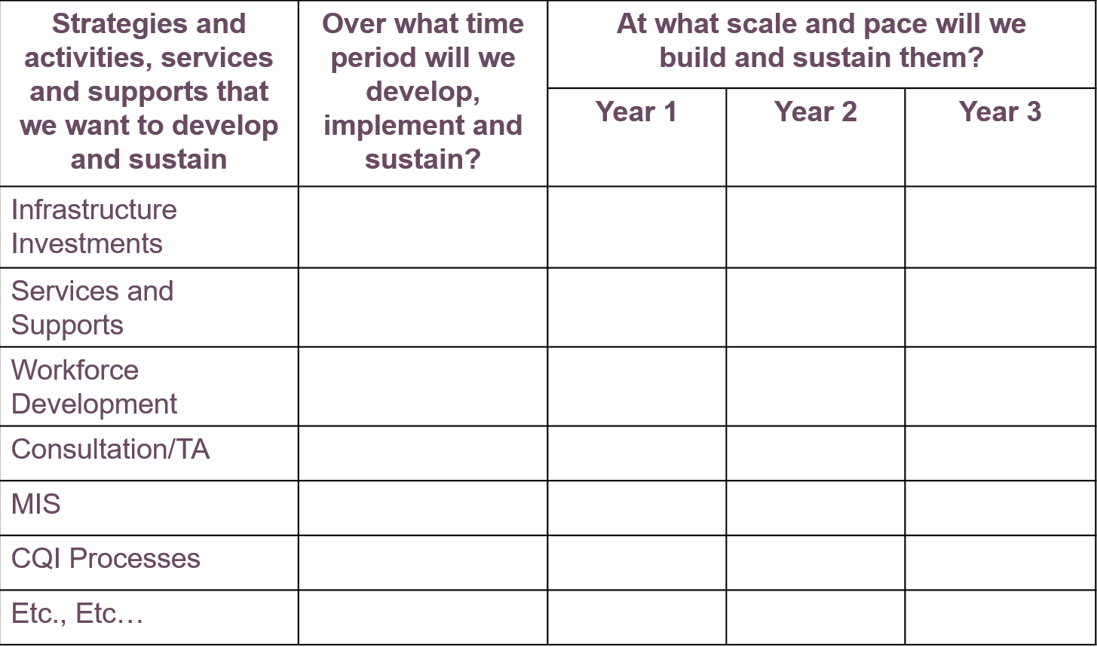
Financing for What? Worksheet
Resources
(NCSMH, 2018)
Notes:
First – you need to clarify what you will need and by when.
What will you need to pay for?
Services and supports:
Types?
How many students/families?
For how long?
Infrastructure needs
Supportive operations (e.g., continuous quality improvement [CQI], contracting)
Unique costs of ramping up
Other costs?
This resource offers a guide for planning future costs in categories and over time.

Slide 33
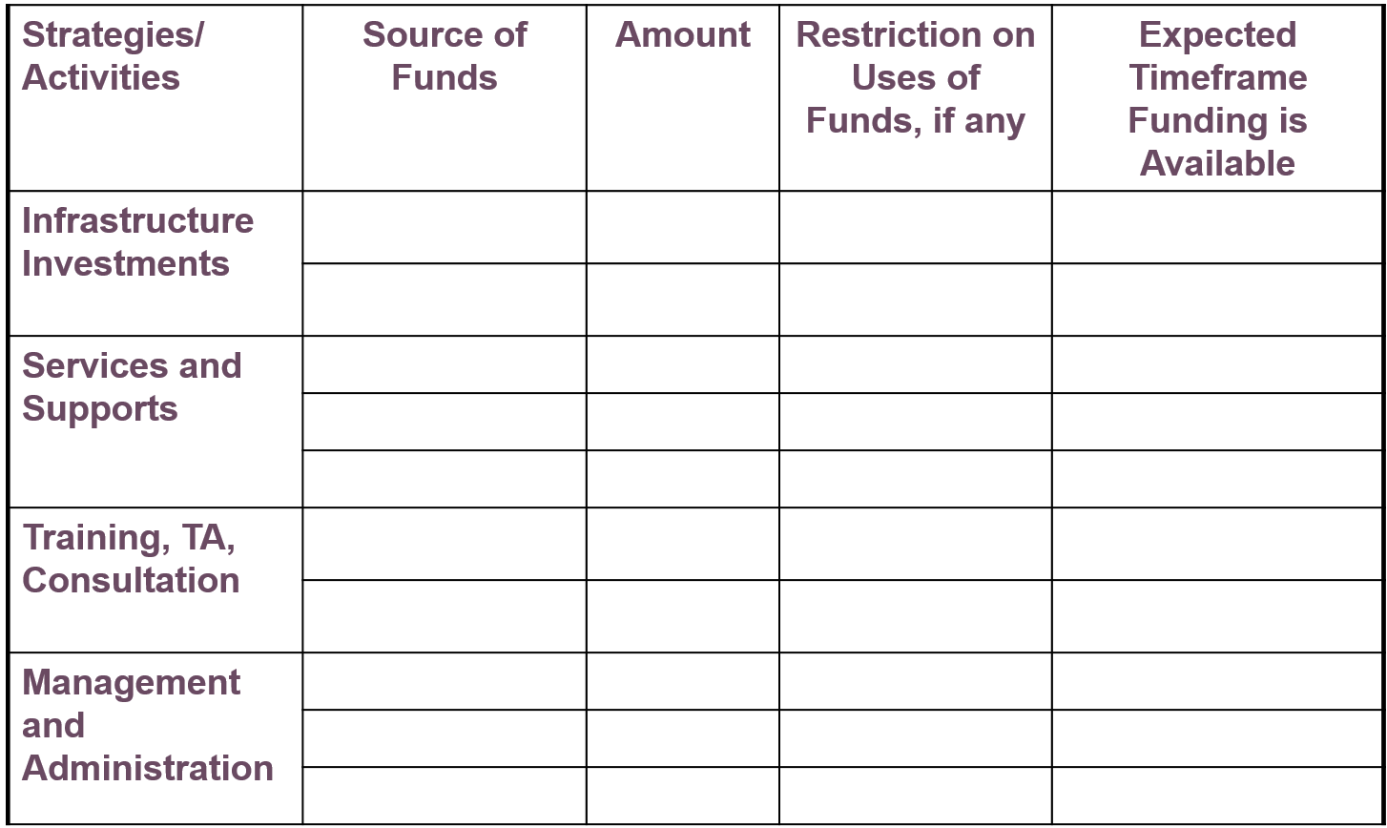
Funding Resource Mapping Worksheet
Resources
(NCSMH, 2018)
Notes:
Next, we map current resources.
What resources do we already have to work with?
Grant funds
Ongoing funding streams, amounts
Matching resources that will remain available
In-kind contributions
Complementary spending by other systems
Existing infrastructure components that will persist
Existing operational spending that will persist
What else?
This resource helps to map current funding including source and amount of funds, funding restrictions, and time frame of funding availability.

Slide 34
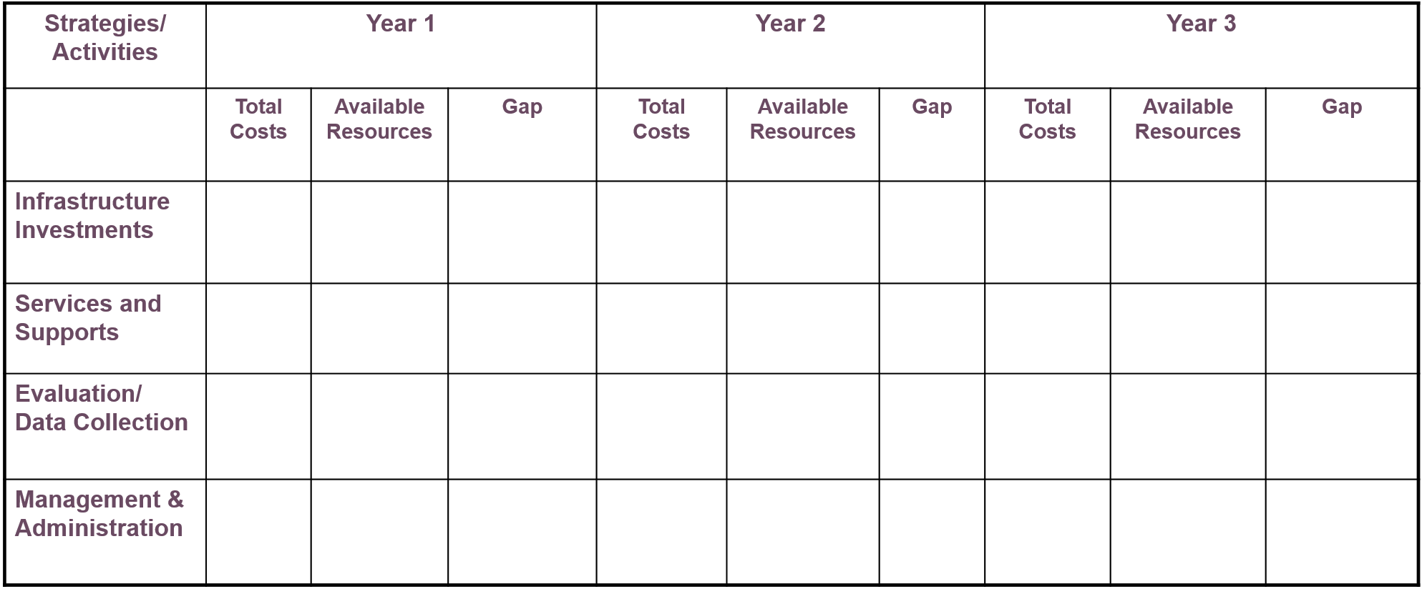
Funding Gap Analysis Worksheet
Resources
(NCSMH, 2018)
Notes:
Next, we determine gaps between needs versus existing resources.
What is the gap between current spending and projected fiscal needs?
By services and supports
By subpopulations
By strategy or activity
By fiscal year
The Funding Gap Analysis Worksheet can be used to help teams assess the current costs of their school mental health system, available resources, and gaps in funding over multiple years.

Slide 35

Developing a Business Plan for Sustaining School Mental Health Services
Developing a Business Plan for Sustaining School Mental Health Services
Resources
This document describes how 3 communities and their lead mental health agencies have worked with schools and other local and state agencies to develop sustainable programs.
(Behrens, Lear, & Price, 2012)
National School Mental Health Implementation Guidance Modules
Notes:
This document, Developing a Business Plan for Sustaining School Mental Health Services, was developed by the Center for Health and Health Care in Schools at the George Washington University Milken School of Public Health to describe different models of financing school mental health services.
Specifically, the document describes how three communities and their lead mental health agencies have worked with schools and other local and state agencies to develop sustainable programs.

Slide 36

Strategic Planning
Strategic Planning
State a specific goal for your district within this domain.
List 3 potential action steps to move this goal forward.
Discussion
How does this content fit with your district understanding and policy/practice related to school mental health funding and sustainability?
National School Mental Health Implementation Guidance Modules
Notes:
We will now consider how this module and quality indicators fit with your understanding and implementation of school mental health funding and sustainability.
Please work together with your group to state a specific goal for your district and then consider 3 potential action steps that could reasonably be taken to move the goal forward.

Slide 37
Resources
Resources
Armstrong, M. I., Pires, S. A., McCarthy, J., Stroul, B. A., Wood, G. M., & Pizzigati, K., (2006). RTC Study 3: Financing structures and strategies to support effective systems of care—A self-assessment and planning guide: developing a comprehensive financing plan. Tampa, FL: University of South Florida, Louis de la Parte Florida Mental Health Institute (FMHI), Research and Training Center for Children’s Mental Health. Retrieved from https://gucchd.georgetown.edu/products/FinancingAssessmentandPlanningGuide.pdf
Behrens, D., Lear, J. G., Price, O. A. (2012). Developing a business plan for sustaining school mental health services: Three success stories. Center for Health and Health Care in Schools, The George Washington University. Retrieved from https://hsrc.himmelfarb.gwu.edu/cgi/viewcontent.cgi?referer=https://www.google.com/&httpsredir=1&article=1065&context=sphhs_prev_facpubs
The Center for Health and Health Care in Schools. (2014, May). Federal education funding guide for SEL programs. Retrieved from http://healthinschools.org/issue-areas/school-based-mental-health/federal-education-funding-guide-for-sel-programs/#sthash.qKVopO4Q.pkuEOuXj.dpbs
Guarino, K., Soares, P., Konnath, K., Clervil, R., & Bassuk, E. (2007). Trauma-informed organizational self- assessment for programs serving families experiencing homelessness. Rockville, MD: Center for Mental Health Services, Substance Abuse and Mental Health Services Administration, and the Daniels Fund, the National Child Traumatic Stress Network, and the WK Kellogg Foundation. Retrieved from http://www.unified-solutions.org/wp-content/uploads/2017/08/HANDOUT_Resiliency-Organizational-Self-Care-Checklist.pdf
National School Mental Health Implementation Guidance Modules

Slide 38
Resources
Resources
National Center for School Mental Health. (2018). Financing for what? worksheet. Retrieved from http://bit.ly/2GYB4a0
National Center for School Mental Health. (2018). Sample funding gap analysis worksheet. Retrieved from http://bit.ly/2TlZh0t
National Center for School Mental Health. (2018). Sample resource mapping worksheet. Retrieved from http://bit.ly/2H0KphM
National Center for School Mental Health (NCSMH, 2020). School Mental Health Quality Guide: Funding and Sustainability. NCSMH, University of Maryland School of Medicine. Retrieved from http://www.schoolmentalhealth.org/media/SOM/Microsites/NCSMH/Documents/QualityGuides/Funding-and-Sustainability-1.27.20.pdf
Now Is the Time Technical Assistance Center (NITT-TA). (n.d.). Issue Brief: Accessing Medicaid funds for school-based mental health services. Retrieved from http://www.fredla.org/wp-content/uploads/2015/09/Medicaid-for-School-Based-MH-Services.pdf
National School Mental Health Implementation Guidance Modules

Slide 39
References
References
Armstrong, M. I., Pires, S. A., McCarthy, J., Stroul, B. A., Wood, G. M., & Pizzigati, K., (2006). RTC Study 3: Financing structures and strategies to support effective systems of care—A self-assessment and planning guide: developing a comprehensive financing plan. Tampa, FL: University of South Florida, Louis de la Parte Florida Mental Health Institute (FMHI), Research and Training Center for Children’s Mental Health.
Guarino, K., Soares, P., Konnath, K., Clervil, R., & Bassuk, E. (2007). Trauma-informed organizational self- assessment for programs serving families experiencing homelessness. Rockville, MD: Center for Mental Health Services, Substance Abuse and Mental Health Services Administration, and the Daniels Fund, the National Child Traumatic Stress Network, and the WK Kellogg Foundation. Retrieved from http://www.unified-solutions.org/wp-content/uploads/2017/08/HANDOUT_Resiliency-Organizational-Self-Care-Checklist.pdf
National School Mental Health Implementation Guidance Modules

Slide 40

Acknowledgments
Acknowledgments
This work is supported by grant SM081726 from the Department of Health and Human Services, Substance Abuse and Mental Health Services Administration.
Module content was developed by the National Center for School Mental Health in partnership with the MHTTC Network Coordinating Office.
National School Mental Health Implementation Guidance Modules

