Slide 1
Note to Presenter
These materials were developed by the Mountain Plains MHTTC, Mid-America MHTTC, and the Mid-America ATTC for use by extension offices and other rural organizations to support community mental health efforts. Inserting local contact information and resources is encouraged; however, any co-branding efforts, such as adding organization logos, must adhere to TTC Network branding and style guidelines. For more information, please contact mountainplains@mhttcnetwork.org.
#TogetherWeFarm
Notes:
Speaker’s Notes:
Co-branding information.

Slide 2





Co-Occurring Disorders: A Community Conversation
Farm Stress and Mental Health
#TogetherWeFarm
Mental Health Supports for Farmers and their Communities

Slide 3
Disclaimer and Funding Statement
These materials were prepared by the Mountain Plains Mental Health Technology Transfer Center, the Mid-America Mental Health Technology Center, and the Mid-America Addiction Technology Treatment Center under a cooperative agreement from the Substance Abuse and Mental Health Services Administration (SAMHSA). All material appearing in this presentation, except that taken directly from copyrighted sources, is in the public domain and may be reproduced or copied without permission from Mountain Plains MHTTC or the authors. Citation of the sources is appreciated. Do not reproduce or distribute this presentation for a fee. For more information on obtaining copies of this presentation please email gberry@wiche.edu.
At the time of this presentation, Miriam E. Delphin-Rittmon, Ph.D., serves as SAMHSA Assistant Secretary. The opinions expressed herein are the views of Mountain Plains MHTTC, Mid-America MHTTC, and Mid-America ATTC and do not reflect the official position of the Department of Health and Human Services (DHHS), or SAMHSA. No official support or endorsement of DHHS, or SAMHSA, for the opinions described in this presentation is intended or should be inferred. ​
​
The work of the Mountain Plains MHTTC, Mid-America MHTTC, and Mid-America ATTC is supported by grant H79SM081792 from the Department of Health and Human Services, Substance Abuse and Mental Health Services Administration.​

Slide 4
About the TTC Network
The Technology Transfer Center (TTC) Network is a national network of training and technical assistance centers serving the needs of mental health, substance use, and prevention providers. The work of the TTC Network is under a cooperative agreement by the Substance Abuse and Mental Health Services Administration (SAMHSA). For more information about the Technology Transfer Centers, please visit the TTC Information Center
In response to mental health and substance use issues in farming communities in HHS Region 7 and 8 states, the Mountain Plains Mental Health Technology Transfer Center (MHTTC), the Mid-America MHTTC, and the Mid-America Addiction Technology Transfer Center (ATTC) collaborated to produce these materials. For technical assistance and training, please contact your regional TTC office at the email addresses below.
mhttcnetwork.org/mountainplains | mountainplains@mhttcnetwork.org
mhttcnetwork.org/midamerica | midamerica@mhttcnetwork.org
attcnetwork.org/midamerica | midamerica@attcnetwork.org

Slide 5
Language Matters
Notes:
Speaker’s Notes:
The words we use matter. This is especially true when talking about Mental Health and Mental Illness issues. Studies show that many people do not seek treatment due to the stigma attached to mental illness. Experts agree that the “single most important barrier to overcome in the community is the stigma and associated discrimination towards persons suffering from mental and behavioral disorders.”

Slide 6
Presentation Objectives
Increase awareness and understanding about
co-occurring disorders
Create a common language about mental health
Identify unique community assets and resources
#TogetherWeFarm
Notes:
Speaker’s Notes:
These presentations were designed to assist rural communities increase their awareness and understanding of the relationship between mental health and farm stress.
Thru the creation of a common language about mental health, communities can identify their unique resources and implement next steps in determining community-wide solutions.

Slide 7

Co-Occurring Disorder Definition
Co-Occurring Disorder (COD): The co-existence of both a mental illness and a substance use disorder (SUD)* (SAMHSA 2020)
Sometimes referred to as a “Dual Diagnosis”
Mental illness may develop before the SUD or the addiction may appear first.
In most cases, a combination of issues contributes to the diagnoses, including:
  Biology
  Genetics
  Trauma
  Environment
  Life experiences
#TogetherWeFarm
Notes:
Speaker Notes:
Substance use disorders include misuse of alcohol, methamphetamines, prescription drugs and other illicit drugs
Mental illness includes diagnoses like depression, anxiety, bipolar disorder
Only 7.4% of people with COD currently receive treatment for both disorders
Resources:
SAMHSA. https://www.samhsa.gov/medication-assisted-treatment/medications-counseling-related-conditions/co-occurring-disorders
Shogren, M., Landwehr, R., Terry, D., Roach-Moore, A., & McLean, A. (2020, April). Depression, alcohol and farm stress: Addressing co-occurring disorders in rural America. SAMHSA, Mountain Plains ATTC, Mountain Plains MHTTC.
*This toolkit can be distributed during the Community discussion and offers additional information about CODs and farm stress

Slide 8
Protective Factors for CODs
Positive self-image
Self-control
Social competence
Strong social support
#TogetherWeFarm
Notes:
Speaker’s Notes:
Understanding the difference between risk factors and protective factors can help to educate a community about AUD and devise a more effective plan to address the problem.
Many factors influence a person’s chance of developing a mental and/or substance use disorder. Effective prevention focuses on reducing those risk factors, and strengthening protective factors, that are most closely related to the problem being addressed.
SAMHSA’s National Survey on Drug Use and Health publishes information every year. The annual report focuses on substance use and mental health in the United States and examines trends over time to study changes in society and emerging issues. Information is collected through a comprehensive household interview survey. Approximately 67,500 persons in the United States are interviewed annually.
Resource:
https://www.samhsa.gov/data/release/2019-national-survey-drug-use-and-health-nsduh-releases
Slide ID: Nat19-4
Source: 2019 DT 5.1, 8.1, 8.4, and 8.47
Resources:
https://www.samhsa.gov/sites/default/files/20190718-samhsa-risk-protective-factors.pdf
https://vertavahealthohio.com/alcohol/7-risk-factors/
A Public Health-Based Approach to Addressing Substance Use Disorders
https://www.ruralhealthinfo.org/toolkits/substance-abuse/1/public-health-based-approach
https://www.ruralhealthinfo.org/rural-monitor/alcohol-elixir-poison/

Slide 9
Alcohol Use Disorder (AUD) and Depression:
A Frequently Co-Occurring Combination
AUD
DEPRESSION
AUD is a medical condition.
It is a chronic relapsing brain disorder characterized by an impaired ability to stop or control alcohol use despite adverse
social, occupational, or health consequences.
AUD can be mild, moderate,
or severe.
Depression is one of the most common mental health disorders
in the U.S.
It can happen at any age.
Depression is diagnosed when
a depressed mood or a loss of interest or pleasure in daily activities occurs for mor than two weeks. The mood represents a change from the person’s baseline.
Notes:
Speaker’s Notes: This slide provides basic definitions of each disorder
Resources:
Shogren, M., Landwehr, R., Terry, D., Roach-Moore, A., & McLean, A. (2020, April). Depression, alcohol and farm stress: Addressing co-occurring disorders in rural America. SAMHSA,
Mountain Plains ATTC, Mountain Plains MHTTC.
*This toolkit can be distributed during the Community discussion and offers additional information about CODs and farm stress
National Institute on Mental Health. https://www.nimh.nih.gov/health/topics/depression/index.shtml

Slide 10
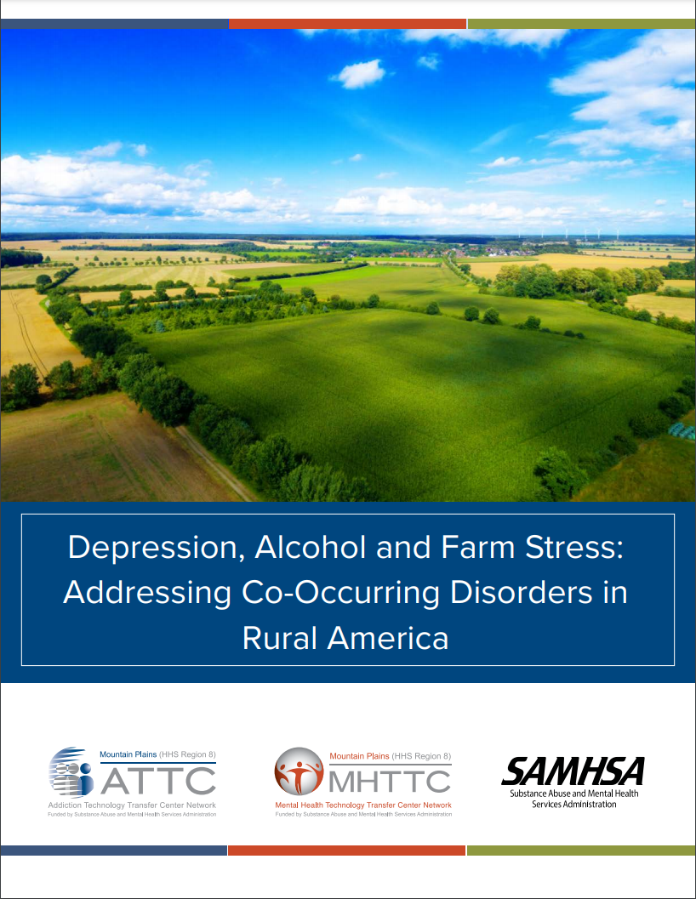
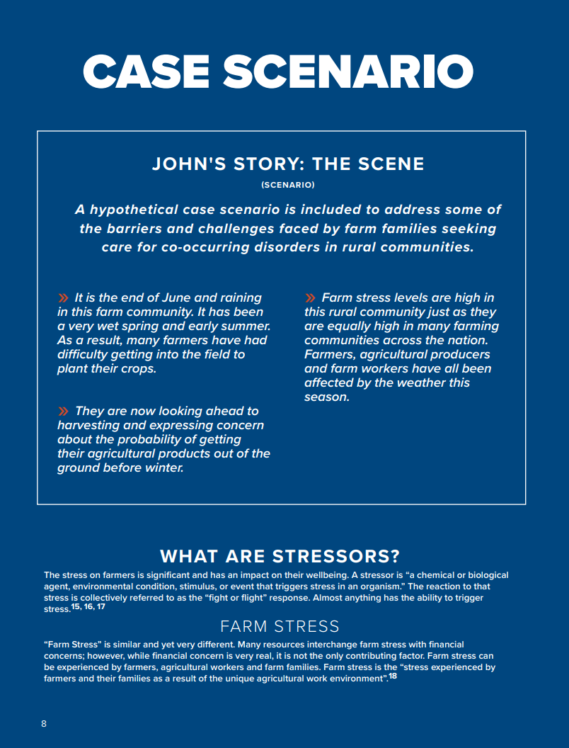
https://mhttcnetwork.org/centers/mountain-plains-mhttc/product/depression-alcohol-and-farm-stress-addressing-co-occurring
Notes:
Speaker’s Notes:
This is the toolkit referenced in resources for slide 8.

Slide 11
Symptoms of AUD
Drinking more or longer than you intended.
A desire to cut down or stop drinking but cannot.
Spending a lot of time drinking.
Drinking often interferes with taking care of your home or family or causes
problems with your job.
Giving up on activities that were once important or interesting to you.
Gotten into situations while, or after, drinking that increased your chances
of getting hurt.
Needing to drink much more than you once did to get the effect you want.
Withdrawal symptoms like shakiness, restlessness, nausea, sweating, racing heart that occur when the effects of alcohol are wearing off.
#TogetherWeFarm
Notes:
Speaker’s Notes:
Resources:
National Institute on Alcohol Abuse and Alcoholism. https://www.niaaa.nih.gov/alcohol-health/overview-alcohol-consumption/alcohol-use-disorders

Slide 12
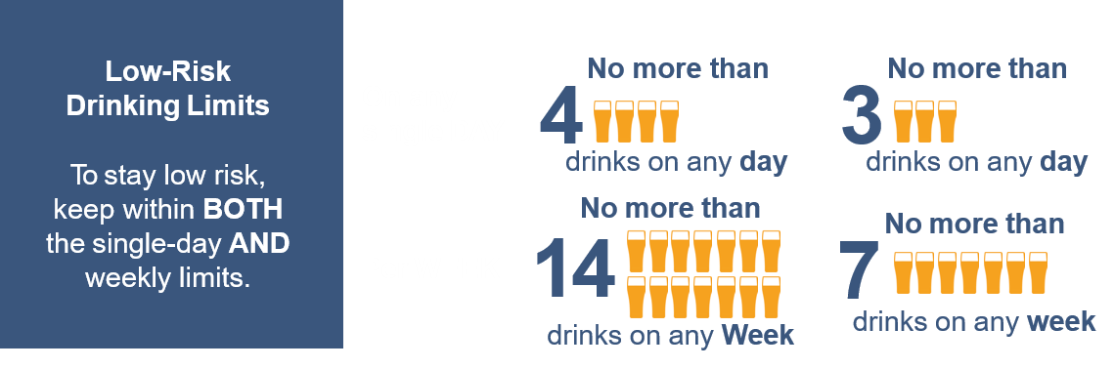

Low-Risk Drinking
For people over 65: low-risk limits are 3 drinks a day or 7 drinks
a week.
Women who are pregnant or may become pregnant should not drink.
For healthy adults ages 65 and under:
MEN
WOMEN
sbirt.care/education.aspx
#TogetherWeFarm
Notes:
Speaker’s Notes: People often do not realize how much they are drinking in one sitting.
This is a good place to discuss low-risk drinking parameters and helps bring awareness to standard drink sizes and use.
At-Risk Drinking (Heavy Drinking) in Adults:
Drinking more than the recommended daily, weekly, or episodic amount of alcohol
Females: >3 standard drinks in one sitting or more than 7 drinks per week
Males: >4 standard drinks in one sitting or more than 14 drinks per week
Resources:
University of Missouri Kansas City: SBIRT. Alcohol Patient Education. https://sbirt.care/education.aspx
*This infographic can be printed and distributed for education

Slide 13
How Much Alcohol Is Too Much?
What’s risky or harmful drinking?
Risky alcohol use is drinking more than single-day or weekly amounts shown above
Harmful alcohol use is drinking more than single-day or weekly amounts shown above, and having negative effects from drinking such as accidents, not being able to stop drinking, or not doing what you normally do (work, school, family) because of drinking.
#TogetherWeFarm
Notes:
Speaker’s Notes:
People often do not realize how much they are drinking in one sitting. This is a good place to discuss low-risk drinking parameters and helps bring awareness to standard drink sizes and use.
At-Risk Drinking (Heavy Drinking) in Adults:
Drinking more than the recommended daily, weekly, or episodic amount of alcohol
Females: >3 standard drinks in one sitting or more than 7 drinks per week
Males: >4 standard drinks in one sitting or more than 14 drinks per week
Resources:
University of Missouri Kansas City: SBIRT. Alcohol Patient Education. https://sbirt.care/education.aspx
*This infographic can be printed and distributed for education

Slide 14

Depression
Symptoms
  Depressed mood or irritable most of the day, nearly every day,
  as indicated by either subjective report (e.g., feels sad or empty)
  or observation made by others (e.g., appears tearful)
  Decreased interest or pleasure in most activities, most of each day
  Significant weight change or change in appetite
  Change in sleep: Insomnia or hypersomnia
  Change in activity: Psychomotor agitation or retardation
  Fatigue or loss of energy
  Guilt/worthlessness: Feelings of worthlessness or excessive
  or inappropriate guilt
  Concentration: Diminished ability to think or concentrate, or more indecisiveness
  Suicidality: Thoughts of death or suicide or has suicide plan
Notes:
Speaker’s Notes: This slide provides information on common symptoms of depression.
Resources:
“Depression.” National Institute on Mental Health, 2018, www.nimh.nih.gov/health/topics/depression/index.shtml.
55. “Diagnostic and Statistical Manual of Mental Disorders: Depressive Disorders.” American Psychiatric Association, ed. 5, 2013, doi.org/10.1176/appi.books.9780890425596.dsm04.

Slide 15
Farm Stress Definition
“Farm Stress”
  The stress experienced by farmers, agricultural workers and their families as a result of the unique agricultural work environment
Typical Stressors
  Constant responsibilities
  Location
  Multi-generations
  Stigma
  Access to relevant care
Extraordinary Stressors
  Weather
  Market prices and tariffs
  Debt and cash flow
  Health-care costs
Farm Stress and the Family
Women are more likely than men to experience stress
Children are not immune to farm stressors and the impact may be noted physically, emotionally, socially
#TogetherWeFarm
Notes:
Speaker’s Notes:
A stressor is “a chemical or biological agent, environmental condition, stimulus, or event that triggers stress” . Many resources interchange farm stress with financial concerns; however, while financial concern is very real, it is not the only contributing factor
Farm stress impacts the entire family. Farm women typically play a supportive role in helping husbands deal with their stress and frustration; often do not get same support in return. Farm children often work on the farm and identify closely with rural values.
Resource:
Shogren, M., Landwehr, R., Terry, D., Roach-Moore, A., & McLean, A. (2020, April). Depression, alcohol and farm stress: Addressing co-occurring disorders in rural America. SAMHSA, Mountain Plains ATTC, Mountain Plains MHTTC.
*This toolkit can be distributed during the Community discussion and offers additional information about CODs and farm stress

Slide 16
How Does Farm Stress Impact CODs?
  Increased stressors experienced by farm families may lead to use of alcohol
  to self-medicate with substance use.
  Increased stressors may lead to increased depression symptoms.
  Increased rates of suicidality have been seen in the past 15 years and
  is a major public health concern.
#TogetherWeFarm
Notes:
Speaker’s Notes:
Referring to slide 16 and the stressors that are listed below, this slide give some examples about how the unique farm stress stressors impact CODs.
Typical Stressors: Constant responsibilities, Location, Multi-generations, Stigma, Access to relevant care.
Extraordinary Stressors: Weather, market prices and tariffs, Debt and cash flow, Health-care costs.
Farm Stress and the Family: Women are more likely than men to experience stress. Children are not immune to farm stressors and the impact may be noted physically, emotionally, socially.
A stressor is “a chemical or biological agent, environmental condition, stimulus, or event that triggers stress” . Many resources interchange farm stress with financial concerns; however, while financial concern is very real, it is not the only contributing factor
Farm stress impacts the entire family. Farm women typically play a supportive role in helping husbands deal with their stress and frustration; often do not get same support in return. Farm children often work on the farm and identify closely with rural values.
Resource:
Shogren, M., Landwehr, R., Terry, D., Roach-Moore, A., & McLean, A. (2020, April). Depression, alcohol and farm stress: Addressing co-occurring disorders in rural America. SAMHSA, Mountain Plains ATTC, Mountain Plains MHTTC.
*This toolkit can be distributed during the Community discussion and offers additional information about CODs and farm stress

Slide 17
Co-Occurring Disorders in Our Rural Communities
CODs are often thought of as “inner city problems” but rural communities are impacted everyday.
Rural communities
  Often have less availability of screening, treatment and recovery services for both AUDs, Depression, and other CODs.
  Often experience healthcare professional workforce shortages.
  Have transportation obstacles to get to services.
  May experience limited acceptability of these disorders:
    People may have self-stigma and be embarrassed to seek care.
    “Goldfish Effect”: People are very aware of each other’s lives, illnesses, health events; community-wide gossip. Our friends know our vehicles, we are often friends with clinic staff, we serve on committees/boards with our healthcare providers.
Notes:
Speaker’s Notes: Use this slide to start or frame the conversation about the community’s availability of healthcare services
Resources:
Rural communities are diverse, and their culture is shaped by many factors including weather, primary options for employment, heritage, access to health and behavior healthcare,
and proximity to urban areas to access goods and services.
“If you’ve seen one rural town you’ve seen one rural town.” This adage reminds us that not all rural communities are the same and not all rural people are the same.
Schwartz, Brett. “The Good Ol’ Days Are Back: The Revival of the Potosi Brewery.” National Association of Development Organizations, 30 Nov. 2012,
www.nado.org/the-good-ol-days-are-back-the-revival-of-the-potosi-brewery/.
Shogren, M., Landwehr, R., Terry, D., Roach-Moore, A., & McLean, A. (2020, April). Depression, alcohol and farm stress: Addressing co-occurring disorders in rural America. SAMHSA, Mountain
Plains ATTC, Mountain Plains MHTTC.
*This toolkit can be distributed during the Community discussion and offers additional information about CODs and farm stress

Slide 18

Starting the Community Conversation
What are our community strengths?
What resources and assets do we have to help support one another?
What is the “Cultural Norm” in your community?
  Is alcohol use readily accepted?
  Is illicit drug use a concern?
  Does your community openly address mental illness?
  Does your community openly address depression?
Notes:
Speaker’s Notes:
We recommend that you start this portion of the presentation by listing your community strengths, resources, and assets.
To develop a community response to co-occurring disorders such as alcohol use disorder or substance abuse (i.e., meth, heroin, opioid addiction) , we can begin by looking at our own community statistics and contributing environmental factors.
This slide allows you to customize with local statistics and concerns
Your Community’s “Cultural Norm” allows you to help community members consider the cultural norm or what is considered acceptable behavior especially in regards to alcohol, illicit drug use and mental illness in your local community.
Applying one definition to “rural” is complicated by changing community demographics, urban sprawl, and diverse geographies. Regardless of the definition, rural areas are commonly characterized by a combination of low population density (sparseness), isolation (distance from an urban center), and small size (total population).
“It’s Complicated…Why What’s Rural Matters.” The Rural School and Community Trust, 21 Nov. 2013, www.ruraledu.org/articles.php?id=3127
Resources:
Rural Prevention and Treatment of Substance Use Disorders Toolkit. https://www.ruralhealthinfo.org/toolkits/substance-abuse

Slide 19
The Community Conversation
Local Statistics and Concerns
  Prevalence of SUDs and CODs in our community
  What are we most concerned about?
Additional Questions
Next Steps
#TogetherWeFarm
Notes:
Speaker’s Notes:
Additional questions – next steps.
Applying one definition to “rural” is complicated by changing community demographics, urban sprawl, and diverse geographies. Regardless of the definition, rural areas are commonly characterized by a combination of low population density (sparseness), isolation (distance from an urban center), and small size (total population).
“It’s Complicated…Why What’s Rural Matters.” The Rural School and Community Trust, 21 Nov. 2013, www.ruraledu.org/articles.php?id=3127
Resources:
Rural Prevention and Treatment of Substance Use Disorders Toolkit. https://www.ruralhealthinfo.org/toolkits/substance-abuse

Slide 20
Starting the Community Conversation
Responding to the issues
  Define the problem in our community
  Identify risk and protective factors
    Harm Reduction Strategies
  How can we work across the public and private sectors to develop effective prevention and treatment interventions
    What do WE need?
    Who are our community providers?
    What resources are available?
    Where are providers referring for
    specialty services?
    Does our community have access to telehealth services?
  How will we know if we are making
  a difference?
Notes:
Speaker’s Notes:
This slide can be used to start a community conversation about alcohol concerns if you chose not to present on Co-Occurring Disorders and Alcohol Use
Disorder at the same time. The resources below direct you to a toolkit to start this process
Resources:
A Public Health-Based Approach to Addressing Substance Use Disorders
https://www.ruralhealthinfo.org/toolkits/substance-abuse/1/public-health-based-approach
https://www.ruralhealthinfo.org/rural-monitor/alcohol-elixir-poison/

Slide 21
Local Resources
Use this slide for local resources
#TogetherWeFarm
Notes:
Speaker’s Notes:
This slide is optional and provides the presenter with the opportunity to list local behavioral healthcare providers and other resources.

Slide 22
National Resources
Understanding Alcohol Use Disorder, a brief overview of AUD. National Institute on Alcohol Abuse and Alcoholism. https://www.niaaa.nih.gov/alcohol-health/overview-alcohol-consumption/alcohol-use-disorders
A Practitioner’s Guide: Alcohol Screening and Brief Intervention for youth: National Institute on Alcohol Abuse and Alcoholism (NIAA). https://www.niaaa.nih.gov/sites/default/files/publications/YouthGuide.pdf
A Public Health-Based Approach / Toolkit for Addressing Substance Use Disorders in Rural Communities. Rural Health Info. https://www.ruralhealthinfo.org/toolkits/substance-abuse/1/public-health-based-approach
The Alcoholic Beverage: An Elixir, and Yet a Poison? Rural Monitors news article. https://www.ruralhealthinfo.org/rural-monitor/alcohol-elixir-poison/
Alcohol Use Disorder: Addressing Stigma and Treatment Access in Rural America. Rural Monitor news article. https://www.ruralhealthinfo.org/rural-monitor/alcohol-use-disorder/
NCHS Data Brief. Rates of Alcohol-induced Deaths Among Adults Aged 25 and Over in Urban and Rural Areas: United States, 2000-2018. Centers for Disease Control and Prevention. https://www.cdc.gov/nchs/data/databriefs/db383-H.pdf
#TogetherWeFarm
Notes:
Speaker’s Notes:
This slide provides the presenter with national resources related to Co-Occurring disorders.

Slide 23
TTC Resources
SAMHSA National HELPLINE is a free, confidential, 24/7, 365-day-a-year treatment referral and information service
for individuals and families facing mental and/or substance use disorders.
https://www.samhsa.gov/find-help/national-helpline
  1-800-662-HELP (4357)
  SAMHSA. 2019 National Survey of Drug Use and Health (NSDUH) Releases. https://www.samhsa.gov/data/release/2019-national-survey-drug-use-and-health-nsduh-releases
  SAMHSA. Co-Occurring Disorders and Other Health Conditions. https://www.samhsa.gov/medication-assisted-treatment/medications-counseling-related-conditions/co-occurring-disorders
  Depression, alcohol and farm stress: Addressing co-occurring disorders in rural America: https://mhttcnetwork.org/centers/mountain-plains-mhttc/rural-mental-health-farm-stress
University of Missouri Kansas City: SBIRT. Alcohol Patient Education. https://sbirt.care/education.aspx
*This infographic can be printed and distributed for education
#TogetherWeFarm
Notes:
Speaker’s Notes:
The Technology Transfer Centers (TTC) offer free technical assistance and training on a variety of mental health and addiction topics. These are just a few of the resources that are free and available to the public.

Slide 24
Get in Touch
mhttcnetwork.org/mountainplains | mountainplains@mhttcnetwork.org
mhttcnetwork.org/midamerica | midamerica@mhttcnetwork.org
attcnetwork.org/midamerica | midamerica@attcnetwork.org
Notes:
Speaker’s Notes:
The Technology Transfer Centers offer free technical assistance and training on the topic presented here. Please visit:______________(insert url for farm stress grab-n-go–page)

