Slide 1


Intersectionality of the Transitioning Veteran
Presented by
Ahmad H. Bennett MA, LMFTA, MHP
Crossroads Family Therapy Services PLLC.
Notes:
Express gratitude to UW for opportunity and thank Gabrielle Orsi, Christina Clayton, Kristen Hiatt
Introduce self (Credentials, Current Role, & Veteran background, Social Services Background)

Slide 2

To establish social connectedness and successful transition and integration into a dominant society, some veterans may need first to reconnect, discover, and navigate their cultural identity from multiple perspectives.

Slide 3
Topics of Discussion
What are we talking about today?
  What is a Veteran
  What is the meaning of transition?
  How many identities do veterans have?
  Where do veteran identities Intersect
  Cognitive Expectations
  Building Rapport
  What is in your veteran support toolbox
Notes:
Tell audience that sometimes you will insert your perspective and experiences as a Black man

Slide 4
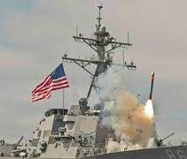
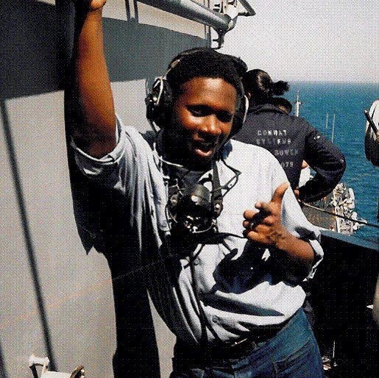
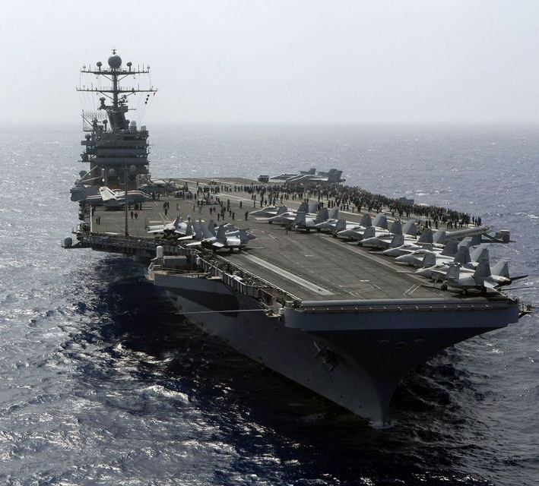
Former Life: Operations Specialist (Surface Warfare) 2nd Class Petty Officer
Joined at 17 years old
Radar Operations, Command & Control Specialist, Tactical Data Coordinator
Operation Vigilant Sentinel
Operation Southern Watch
Counter Terrorist & Drug Trafficking Operations
Multiple (TS-SCI) Weapon Testing Events
Medically retired at 27 years old
Notes:
Going to use my personal experience to narrate why the need for understanding our own identities were so important

Slide 5
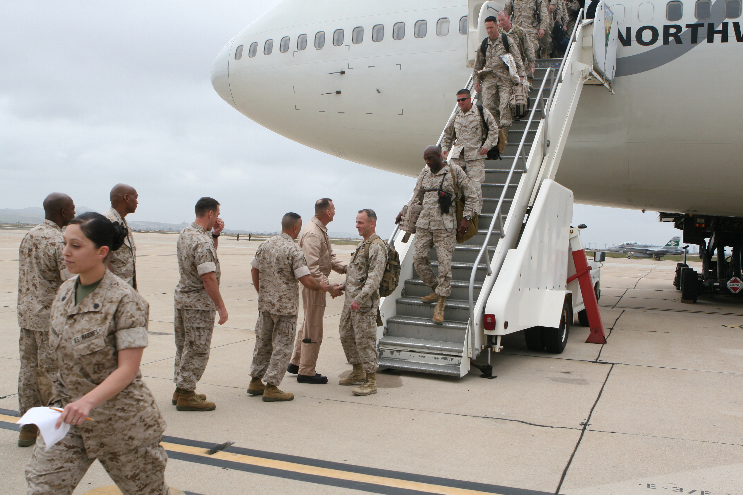
What is a Veteran
A minimum service requirement exists. Service members must have served a minimum of 24 months of active duty to be considered a veteran. If the service member becomes disabled because of their time in the service, there is no minimum length of service to qualify for VA benefits
(www.va.gov/health-care, 2022)

Slide 6
Veteran Norms
In the civilian sector, people’s jobs are what they do. In the military one’s job is a profound characterization of identity among their peers/unit/etc.
For both military members and their families, military life provides a great sense of community as well as distinctly structured expectations, rules and, guidelines.
A common saying or mindset in the military is “never assume. If you don’t know, then ask.” Particularly in a combat situation, if a service member assumes something and they are wrong, someone very well could be killed.
The belief that any psychological issues within themselves or others is a sign of weakness.
Fear that expressing an emotional reaction may be confronted with, "suck it up" or "get over it".
A command climate that discourages getting help.
Fear that emotional reactions and/or seeking help will negatively impact their careers.
Source: (Army Behavioral Health, 2013)

Slide 7
Notes:
Clinicians should be aware that the determination process for which category a veteran is rated, placed, or approved for can be a stressful process. Veteran statuses determine VA benefit accessibility.

Slide 8
U.S. Department of Veterans Affairs
Office of Transition and Economic Development (TED)
Services
Mission
• Pre-separation counseling
• Educational assistance benefits
• Disability compensation
• Vocational benefits
• Job placement assistance for Servicemembers, Veterans, and spouses
• Relocation services
• Medical benefits
• Education and career counseling
Each year, approximately 200,000 Servicemembers transition from military to civilian life in the United States.2 While each transition is different, some of the most common issues facing newly separated Servicemembers include:
• Reconnecting with family
• Entering the workforce
• Enrolling in benefits and service programs
(Dept. of VA Affairs, 2020)
Notes:
2019 Cross-Sectional Survey Report
These are standard services provided by the VA. However, discovery and attunement to service member attunement is not a standard practice.

Slide 9
Transition Cohort Stats

Slide 10
What is the meaning of transition (interpersonal themes)?
Nine themes were identified
Individual character
Relational character
Systemic character
Betrayals
No conflict
Transgressions
Personal struggles
Personal growth or continuity of military culture
Limited help sources
(McCormick et al., 2019)
Notes:
2019 edition of the Journal of Veteran Studies, Wesley H. McCormick et al. -Qualitative Analysis study
Individual character - “Honor. Pride. A team, a unit, working together, having pride in your work. Always working hard.” Participants also discussed the themes of Courage/Confront Mortality (E = 10; e.g., acceptance of potential death in the line of duty and/or willingness to face exceptionally difficult, often life-threatening situations) and Mission First/Overcome Adversity (E = 6; e.g., persevering in the midst of suffering; prioritizing the mission over self)
Relational character - A single theme, Camaraderie, captured the essence of relational character within the military. “I was taught there is no race; everybody is related. Everybody’s your brother, because at that time, you don’t know who’s gonna save your life, so we are all the same.”
Systemic character - themes described organizational facets within military culture. Order, Structure, and Training was a common theme within this category. “Just the military way of doing things, from the uniform to the core values that each service has, their own traditions, the language, the heritage, and ways of doing things. ****Be mindful of Generational Differences*****
Betrayals - Three themes were identified that described how veterans might feel betrayed by their government, military leadership, and society during their military service.
No conflict - Three themes were identified that captured how veterans might not perceive any betrayals or transgressions from their military service.
Transgressions - The two themes of Internal Conflict of Killing and Incongruent Behavior with Values captured how veterans might perceive violations of values or beliefs while in the military.
Personal struggles - Nine themes captured how veterans can experience struggles as they reintegrate into society. The most prolific theme, Disparate from Civilian Culture, captured how civilian society possesses different values, character, and ways of living from the military
Personal growth or continuity of military culture - “I’ll always be a veteran. I’ll always live by their standards as much as I possibly can. It will never change.”
Limited help sources - “I don't have anyone, outside of people I knew over there, that I can speak with because they won't understand what I just went through or they'll worry too much. So, you don’t want that burden to be put on them, as well.”

Slide 11
Notes:
Discuss the Bias of the qualitative study, but if does provide insight to what current orgs are looking at when serving Veterans.

Slide 12
Cognitive Expectations
(18-19)
MSU, 2014

Slide 13
Cognitive Expectations
(18-19)
MSU, 2014

Slide 14
Emotional Development-
Generativity versus stagnation - Erikson’s seventh stage, in which individuals leave a legacy of themselves to the next generation (generativity)
▪ Active involvement in teaching/guiding the next generation
▪ Stagnation involves not seeking outlets for involvement / being self-centered.
▪ Guiding the next generation, or improving society in general or may be self- centered, isolated and unable to participate meaningfully in the world
MIDDLE ADULTHOOD
§ Period from 40 years of age to about 60
§ Middle adulthood is time of:
– expanding personal and social involvement and
responsibility
– assisting next generation in becoming competent, mature individuals
– reaching and maintaining satisfaction in a career
– A decline of physical skills
– Balancing work and relationships
– A reassessment of life’s priorities
Cognitive Development-
Some intellectual abilities decline in middle age, but others increase
▪ Crystallized intelligence [acquired store of information, skills, strategies] increases in middle adulthood
▪ Fluid intelligence [ability to deal with new situations])) begins to decline in middle adulthood
(Shaban, 2011)
Notes:
We now have more emphasis on psychosocial development & Milestones in Middle Adulthood

Slide 15
How many identities do veterans have?
Discussion Topic:
How do we intersect with a veteran’s identity and build rapport in therapy?
Notes:
This slide is designed for communication with audience. Examples of Identities. Veterans encompass every ID found in society.
Unit/Branch of Service ID
Gender
Sexuality (LBTQIA+)
Spirituality
Family member (Parent, Child, Sibling)
Cultural/Racial
Political
Nerd/Geek (pop-culture/social media ID
THERE IS NO WRONG ANSWER, VETERANS OCCUPY ALL IDENTITIES

Slide 16
  Building Rapport - Discussion
1. Be prepared
2. Listen without judgement
3. Use disclosure with caution
4. Be aware of your limitations in knowledge and experience
5. Use EMPATHY
(Open Colleges. Edu, 2022)
Notes:
Discuss with audience if they agree with the five suggestions of Therapeutic Rapport and what would they add for veterans?
1. Be prepared
Read your client notes before each session. This might sound obvious, however, if you are seeing back to back clients, it can be easy to skip this very important step. Nothing destroys rapport than “forgetting” critical details.
2. Listen without judgement
We all have morals and values. While these should always inform our practice, they should not interfere or intrude on the counselling process.
3. Use disclosure with caution
This is a terrific way to develop rapport, particularly with difficult-to-engage clients. However, be careful. Maintaining professional boundaries is important, so keep it to the small stuff.
4. Be aware of your limitations in knowledge and experience
This is important for new counsellors and therapists. It’s ok to be unsure, and when you are – be honest. Your client will respect this much more than if you try and practice skills you have not yet developed.
5. Use EMPATHY
Active listening not only creates a sense of trust during counselling but it leads to the development of empathy. This is by far the most powerful tool when it comes to developing rapport. Building a meaningful connection with your client will mean that you feel what they feel.
This may mean that you cry when they cry, or you feel anger when they feel anger. This gives powerful insight into what your client is feeling, which can be used to help them understand and process their emotions.

Slide 17
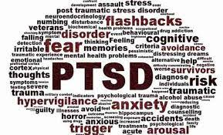
Common Diagnoses
Post Traumatic Stress Disorder (PTSD)
Military Sexual Trauma (MST)
Traumatic Brain Injury
Substance Use Disorder (SUD)
(SAMSHA, 2016)
Notes:
Substance Abuse and Mental Health Services Administration (US); Office of the Surgeon General (US). Facing Addiction in America: The Surgeon General's Report on Alcohol, Drugs, and Health [Internet]. Washington (DC): US Department of Health and Human Services; 2016 Nov. CHAPTER 4, EARLY INTERVENTION, TREATMENT, AND MANAGEMENT OF SUBSTANCE USE DISORDERS. Available from: https://www.ncbi.nlm.nih.gov/books/NBK424859/

Slide 18

Discussion
  What is in your veteran support toolbox?
Notes:
Engage Audience in conversations about what tools do the use, or wish the could use in Therapy (Intake Process, Modality of Choice, Views on Cultural iconography (Video Games, Pop-Culture, Social Media)

Slide 19
REFERENCES
Army Behavioral Health, U.S. Army Medical Department. (2013, January). Provider information: combat and operational stress general information. Retrieved from http://www.behavioralhealth.army.mil/provider/general.html
Hall, L. (2021, August 25). How to build rapport with new counselling clients. https://www.opencolleges.edu.au/careers/blog/how-to-build-rapport-with-new-counselling-clients
Janelle Stewart, Michigan State University Extension. (2022, January 21). 18- to 19-year-olds: Ages and stages of youth development. MSU Extension. https://www.canr.msu.edu/news/18_to_19_year_olds_ages_and_stages_of_youth_development
McCormick, W. H., Currier, J. M., Isaak, S. L., Sims, B. M., Slagel, B. A., Carroll, T. D., ... & Albright, D. L. (2019). Military culture and post-military transitioning among veterans: A qualitative analysis. Journal of Veterans Studies, 4(2), 287-298.
Shaban, DR. (2011, August 11). Adulthood Age Group Growth & Development. Tps://web2.aabu.edu.jo. https://web2.aabu.edu.jo/tool/course_file/lec_notes/1001242_Adulthood%20Age%20Group%20GD.pdf

