Slide 1
COPE, CALM & CARE ©
Skills Models for Resilience Building
COPE MODEL
Northwest MHTTC Learning Community
November 2nd, 2023
Kira Mauseth, Ph.D.
© 2020 Astrum Health, LLC.

Slide 2
“It doesn’t get easier, we just get better at dealing with hard things.”
-teacher in Uvalde, TX

Slide 3
COPE, CALM & CARE
COPE, CALM and CARE are skills models and resources designed to help people of all ages recover from trauma, build personal resilience, and engage in healthy living.
The COPE model focuses on Thinking Skills associated with cognitive therapy and critical evaluation our patterns, choices, and behaviors.
The CALM model teaches Feeling Skills associated with biofeedback, behavioral activation, and other physiological strategies for maintaining a healthy limbic system balance.
The CARE model teaches Being Skills associated with active resilience building, social interest, connection with others, and being part of something greater than ourselves.
© 2020 Kira Mauseth, Ph.D.

Slide 4
QUESTIONS FOR DISCUSSION
Reminder to be respectful of individual differences of opinion.
What are things that frustrate you, scare you or bother you most (just generalities)?
What are the indicators that you notice when your stress levels are too high? (physical, behavioral, emotional, etc)
What does stress ‘feel’ like to you?

Slide 5
PLEASE CHOOSE A PERSONAL STRESSOR
THAT CAME UP IN DISCUSSION
FOLLOW ALONG WITH THE COPE MODEL TO ADDRESS YOUR STRESSOR

Slide 6
COPE model starting points
The basics: broadly accessible CBT skills with some specific tactics related to coping plans and ideas.
Just like gears in any system, thoughts, feelings and behaviors within people are all connected.
By changing one, you can change the other two.
Feelings are the easiest to notice, but harder to change than thoughts or behaviors.
By changing unhealthy thoughts, behaviors and reactions intentionally, we can develop positive feelings and take ownership over our wellbeing.
© 2020 Astrum Health, LLC
Kira Mauseth, Ph.D.

Slide 7
THINKING SKILLS:
C.O.P.E. by:
CHECKING, OBSERVING, PLANNING, EXECUTING
Check for your automatic reactions and responses to other people and situations. Check yourself for your thought patterns to develop insight and awareness.
Observe the emotion and behavior connected to the reaction. Pay attention to the circumstances when it is harder
Plan an alternative thought, reaction or response
Execute positive change though practice and repetition
© 2020 Kira Mauseth, Ph.D.

Slide 8
COPE: C = CHECKING
Check for your automatic reaction (first thought) to people and situations.
Notice how you are responding, and question why you are responding in that way.
Is there a different, or healthier way for you to respond? What are your options?
© 2020 Kira Mauseth, Ph.D.

Slide 9
COPE:
O = OBSERVING
Observe both the emotion and the behavior that comes from the automatic thought reaction you have.
Identify the chain reaction between thoughts, feelings and behaviors.
By observing how things are connected, you can then plan for change.
© 2020 Kira Mauseth, Ph.D.

Slide 10
COPE: P = PLANNING
Plan an alternative response.
Come up with several reasonable options and alternatives for your original reaction.
Prepare to choose and practice the new response, so that it becomes automatic.
© 2020 Kira Mauseth, Ph.D.

Slide 11
COPE: E = EXECUTING
Execute your plan to create the change you need in your life.
Practice new or alternative thoughts, feelings and behaviors that will lead to a positive and healthy change in your outlook and way of doing things.
You have the power to be intentional about how you are coping!
© 2020 Kira Mauseth, Ph.D.

Slide 12
Practice COPE by identifying a scenario where your automatic reaction might be causing a problem for you. Start by describing the issue.
Scenario:
Then, practice The COPE thinking skills:
C: Check for automatic reaction (thought) that you have regularly and that causes trouble for you because of the way the thought makes you feel or act:
O: Observe the emotion and the behavior that are connected to the thought:
P: Plan for a new, reasonable response or thought to try in the same scenario:
E: Execute your new plan by practicing the new thought response, which will then lead to a new feeling and behavior:

Slide 13
COPE (c) for Kids and Teens
For older kids (10+): Sometimes, imagining a special place where you feel safe and calm can help you feel that way when your worry thoughts take over. (Help kids to imagine and then describe a physical place- maybe their room, the beach, a special fort, or any other place where they usually feel calm and safe.
Have them practice taking their mind to that place for a few minutes when they feel angry or overwhelmed). If you want to try this, please tell me about a place that you feel safe and calm- maybe your room, or a special fort, or place you have visited? (ask them to describe what they see, hear, and even what it smells like to get them to connect to that place).
When your worry thoughts start to take over, you can take a break from them by going to this place in your mind. Just imagine all the things about it that you just told me, take some deep breaths, and give yourself a few minutes. Then, after you feel better, go back to what you were doing. Learning how to control what you are thinking about will help you feel much better!

Slide 14
QUESTIONS FOR DISCUSSION:
How much of your “down” or “off” time do you spend doing things that are oriented around “escape / avoidance” vs “restoration” of your self and your energy?
What are some of your “go-to” activities in your down time?
Are you able to identify what it is that you get OUT of those activities? Eg: confidence, connection, joy, energy?

Slide 16
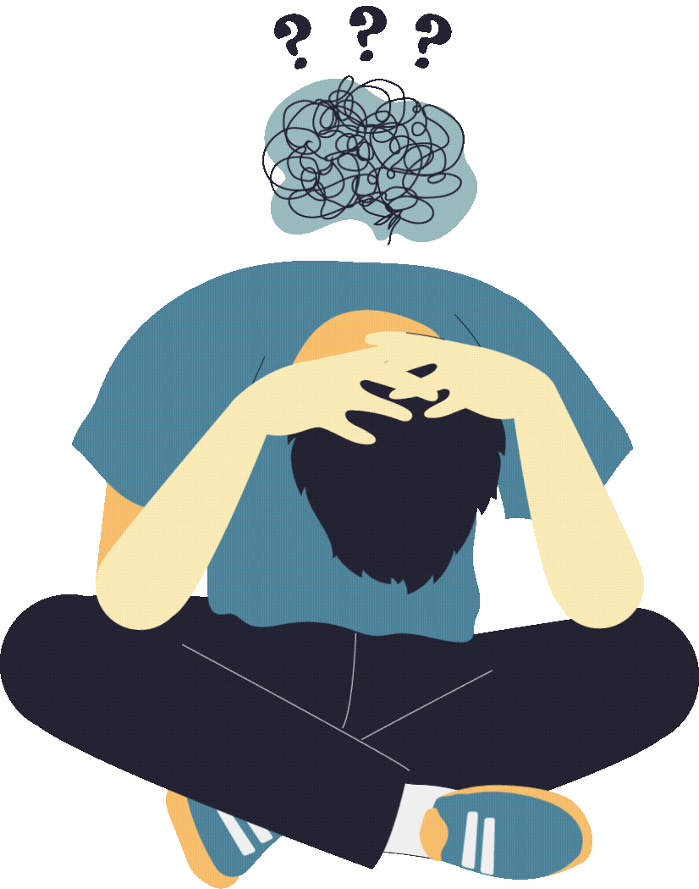
Active Coping
ANXIETY
EXHAUSTION
DEPRESSION
Sensory interventions:
Frozen orange, ice
Music
Shower
Fuzzy slippers
Apps
Breathing = calming
Sleep hygiene
Same bed and wake times
Alcohol and sugar considerations
Notepad (not phone or laptop)
Apps
Boundaries
Behavioral activation: Small steps
Get a “this makes me feel better” list made on a good day
5 minutes to 5 hours
Movement of any kind
Connection and support from others

Slide 17
Using an active coping plan is one of the most effective ways to divert symptoms of distress away from pathological conditions

Slide 18
CREATING A (good) COPING PLAN:
General Considerations
Anticipation of our ‘exposures’ to stressful events, as well as creating and working a deterrent plan is one of the most effective ways of reducing symptoms and new incidents of disorder.
Let’s take a note from not making “new years resolutions” and set the right kinds of goals (hint: they have to be achievable).

Slide 19
Plan ideas /examples
Concern | Indicators | People resources | Coping Option(s) | Length of time or resource needed | Other info or resources needed
Exhaustion | Tension headache, snappiness | (names)
 |  |  | Walking the dog | 10-30 minutes | After work / at home
 |  |  | 3 days sleep hygiene | 3 days to re-set | None
Anxiety | Mental confusion, High heart rate, Stomach upset | (names)
 |  |  | Hot shower | 30 minutes | Home / none
 |  |  | Brief Mindfulness exercise | 5-10 minutes | No interruptions at work
 |  |  | Text memes | 2-5 minutes | (Names of friends)

Slide 20
COPING WORKSHEET
A few minutes to make some notes or add things to the coping plan

