Slide 1
AWE
Piper Sangston
Abby Asplund-Smith

Slide 2
Purpose and Objective
Purpose
To increase understanding of AWE and how to integrate AWE into our direct practice with students, staff and families.
Objective
Define AWE
Understand science behind AWE
Create an AWE board

Slide 4
WOULD YOU LIKE TO…
better your health?
help yourself think more critically?
decrease materialism?
feel smaller and feel humble?
feel like you have more time?
become more generous and cooperative?
feel more connected to others and to humanity?
improve your mood and make you more satisfied with your life?

Slide 5
What is AWE
Awe is the feeling of being in the presence of something vast that transcends your understanding of the world.

Slide 6
The Science of Awe
Studies have found that feelings of awe can be accompanied by heart rate changes, goosebumps, and the sensation of chills, and there is some evidence that awe may even decrease markers of chronic inflammation.

Slide 7
So, what is it biologically?
Awe wasn’t one of the six basic emotions — anger, surprise, disgust, enjoyment, fear and sadness — identified back in 1972, Dr. Keltner said. ‌But new research shows that awe “is its own thing,” he said‌. Our bodies respond differently when we are experiencing awe than when we are feeling joy, contentment or fear. We make a different sound, show a different facial expression. Dr. Keltner found that awe activates the vagal nerves, clusters of neurons in the spinal cord that regulate various bodily functions, and slows our heart rate, relieves digestion‌ and deepens breathing.

Slide 8
The facial expression associated with awe is very different from the expressions of most other positive emotions; instead of a smile it includes widened eyes, raised inner eyebrows, and a relaxed, open mouth.

Slide 10
What AWE does for us:
Helps us Live Healthier
Lowers Stress
Lowers inflammatory cytokines
Provides Sense of Meaning

Slide 11
For Example:
Calms Nervous System
Activates the vagal nerves
de-activates negative self talk

Slide 12
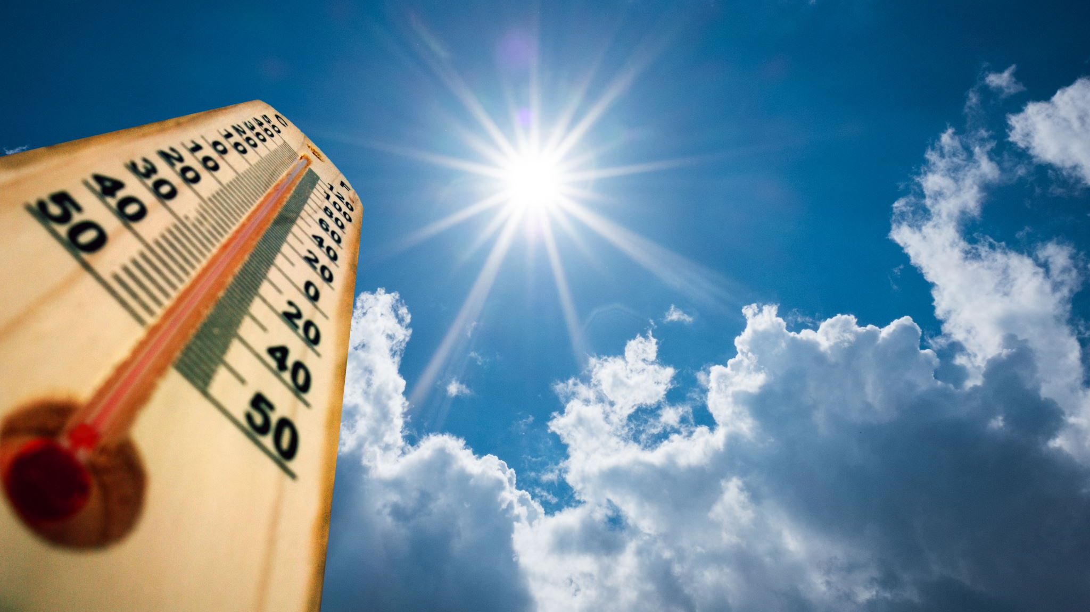
Perceived Vastness AND Need for Accommodation
By Keltner and Haidt

Slide 13
Perceived Vastness
“Perceived vastness” can come from observing something literally physically large — the Grand Canyon, for example — or through an encounter with something or someone that is vast or profound, such as being in the presence of someone with immense prestige or being presented with a complex idea like the theory of relativity.

Slide 15
Need for Accommodation
An experience evokes a “need for accommodation” when it violates our normal understanding of the world. When a stimulus violates expectations in this way, it can provoke a modification of the mental constructs that we use to understand the world. This need for cognitive realignment is an essential part of the awe experience.

Slide 16
Suggestions for provoking AWE:
Viewing something giant such as a mountain range or ocean
Discovering something tiny such as the world seen through a microscope
Contemplating a piece of music or art
Taking “awe walks” in nature or neighborhood
Choose an unfamiliar experience
Practice Mindfulness
Learn about inspiring people
Watch videos about inspirational figures
Witness acts of goodness

Slide 18
Why AWE is vital:
Awe's ability to elicit cognitive accommodation may also explain why humans evolved to experience this unique emotion. Experiencing awe may be adaptive because it encourages us to take in new information and adjust our mental structures around it, helping us navigate our world and increasing our odds of survival.

Slide 19
Depression and AWE
https://www.frontiersin.org/articles/10.3389/fpsyg.2021.617715/full
To show the potential therapeutic role of awe for depression, we showed potential connections between this emotion and Major Depression Disorder (MDD), relying on the four previously presented levels of awe's functioning: (i) the electrical level; (ii) the immediate basic psychological level, (iii) the more sophisticated psychological level, which also includes hormonal chemical changes; and (iv) the existential level. We then further clustered the four levels according to their time occurrence. First, the neurological and physiological changes associated with awe were reported in the very short term. We then deepened the medium-term changes involving a basic and more sophisticated psychological level as well as hormonal effects. Finally, we introduced and discussed the most complex changes expected in the long run at the existential level.

Slide 20
Awe Inspiring Facts
Number of atoms it takes to make you: 7,000,000,000,000,000,000,000,000,000. If you wish to boast about it to a friend out-loud, that is seven billion billion billion, or seven octillion
The length of all your blood vessels, if they were lined after each other: enough to go around the Earth 2.5 times

Slide 21
Gruesome Fact
Number of bacteria you are swapping from mouth to mouth during a passionate kiss: 1 billion. In addition to protein (0.7 mg), salt (0.45 mg), fat (0.7 mcg) and bits of food (0.2 mcg)

Slide 22
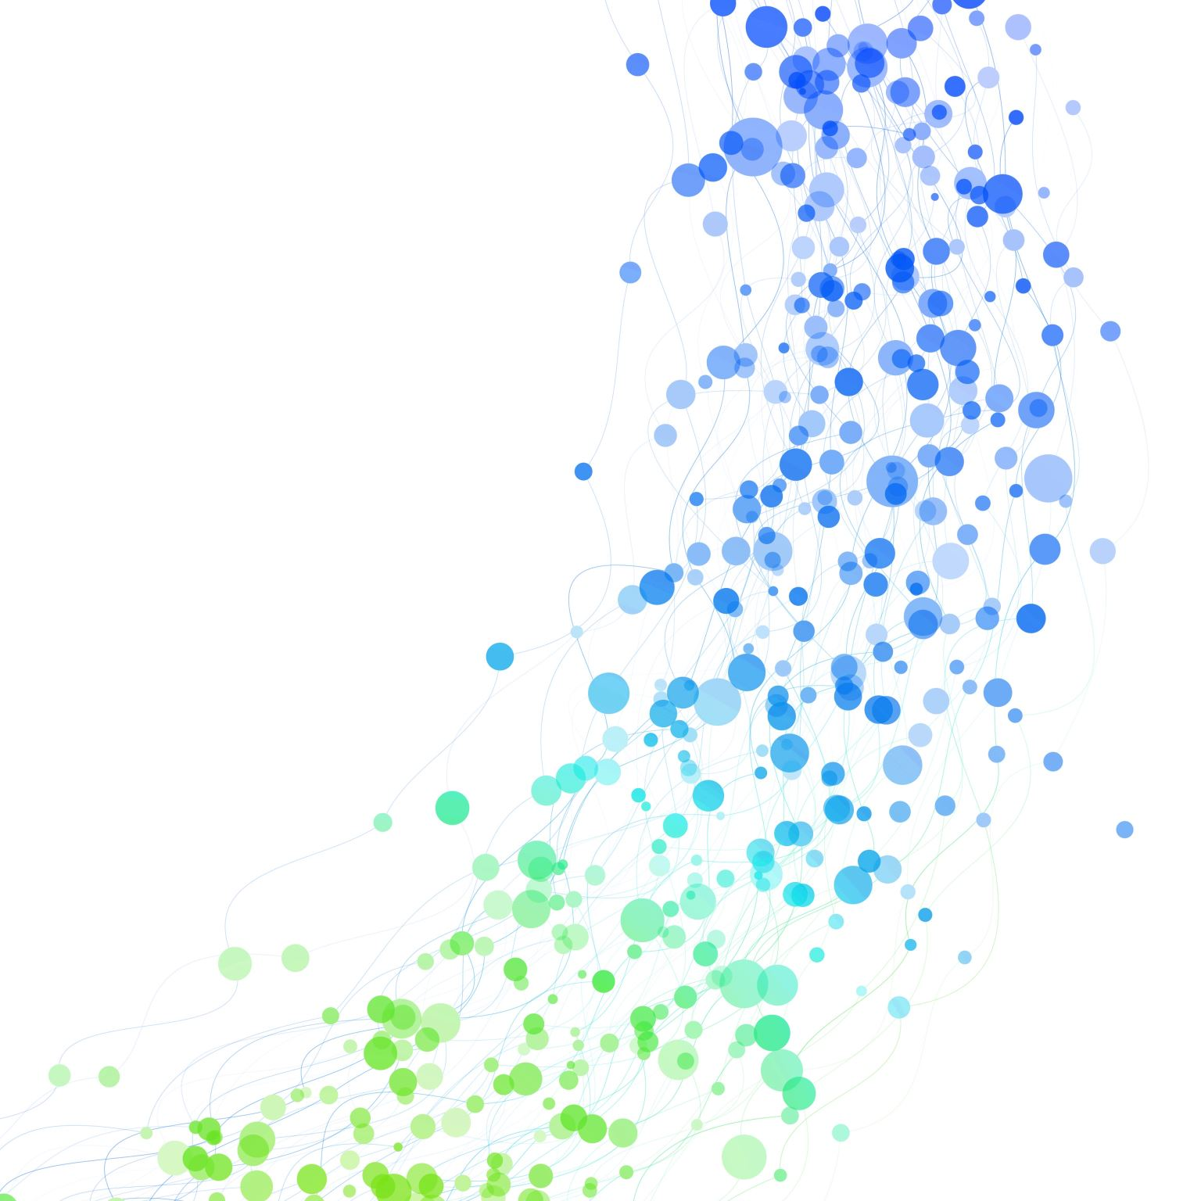
Awe Inspiring Fact
The blue whale is the largest animal to have ever lived
And yes, that includes the dinosaurs. The largest blue whale ever recorded weighed around 200 tons and was 100 feet long (33 meters). That’s as long as three school buses from end to end. As you would expect, their organs are also enormous – their arteries are large enough for a child to crawl through, and the blue whale’s heart is the size of a small car (but weighs much less, at around 400 pounds). Their tongue alone can weigh as much as an elephant. However, the blue whale's brain is much smaller, at around 12 pounds – although that still makes it one of the largest animal brains.

Slide 24
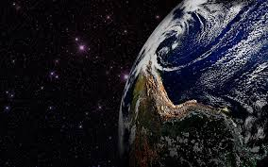
https://www.youtube.com/watch?v=YUSkVO3ixfo

Slide 25
Create Personal Awe Board

Slide 26
AWE Inspiring Resources:
https://greatergood.berkeley.edu/article/item/eight_reasons_why_awe_makes_your_life_better
https://www.templeton.org/wp-content/uploads/2018/08/White-Paper_Awe_FINAL.pdf
https://ggsc.berkeley.edu/images/uploads/GGSC-JTF_White_Paper-Awe_FINAL.pdf
https://www.nytimes.com/2023/01/03/well/live/awe-wonder-dacher-keltner.html
https://www.cnn.com/style/article/awe-wonder-art/index.html
Movies/Documentaries:
How to Change the World (2015)
This Much I Know to be True (2022)
Mr. Bachmann and His Class (2021)
Fifi Howls from Happiness (2014)
https://elleneastwood.medium.com/ive-watched-hundreds-of-documentaries-here-are-the-6-most-inspirational-fbccafac0582
Google “awe inspiring images”

Slide 27
AWEsome presenters:
Piper Sangston, M.S.W.
Abby Asplund, M.S.W.
Mental Health Assistance Team Counselors
Bellevue School District

Slide 28
