Slide 1

COPE, CALM & CARE ©
Skills Models for Resilience Building
CALM MODEL
Northwest MHTTC Learning Community
November 9th, 2023
Kira Mauseth, Ph.D.
© 2020 Astrum Health, LLC.

Slide 2
COPE, CALM & CARE
  COPE, CALM and CARE are skills models and resources designed to help people of all ages recover from trauma, build personal resilience, and engage in healthy living.
  The COPE model focuses on Thinking Skills associated with cognitive therapy, active coping plans, and critical evaluation our patterns, choices, and behaviors.
  The CALM model teaches Feeling Skills associated with biofeedback, behavioral activation, and physiological strategies for maintaining a healthy limbic system balance.
  The CARE model teaches Being Skills associated with active resilience building, social interest, connection with others, and being part of something greater than ourselves.
© 2020 Kira Mauseth, Ph.D.

Slide 3

CALM model starting points
  The CALM model is all about helping you remind yourself that you are in control (or can be in control) of your body and its reactions to stress, panic and anxiety.
  The COPE model taught thinking skills, and the CALM model teaches feeling skills; active behaviors that can be used with children and adults to increase resilience, and strengthen physiological responses to stressors.
© 2020 Kira Mauseth, Ph.D.

Slide 4
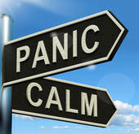
DOING SKILLS
CALM yourself by:
CONTROLLING, ATTENDING, LISTENING, MANAGING
  Control breathing and heart rate
  Attend to the present moment
  Listen to your thoughts & feelings
  Manage stressors with active techniques
© 2020 Kira Mauseth, Ph.D.

Slide 5

Transitioning to and from
“Emergency Mode”
  The brain and body need an opportunity to let down on the ‘threat scanning’ and be more accurately tuned in to day-to-day ups and downs.
  ADDICTION TO THE EMERGENCY IS A REAL THING.
  Key physiology: Dopamine, Adrenaline / Epinephrine / Norepinephrine / Cortisol
  IDEAS: Slow down and evaluate the criticality of a task or a job before you start to do it. Does it need to be done “RIGHT NOW” or can it realistically wait or be prioritized behind other things? Establish a practice of this evaluation for any new task / ask.

Slide 6
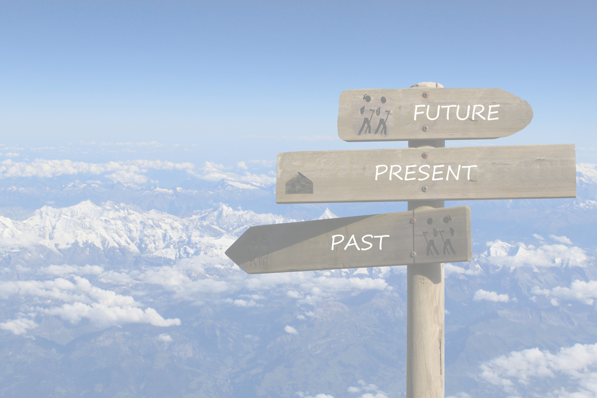
The benefits of orienting to ”right now” increase a sense of safety
  Taking part of your day to ‘tune in’ to the present moment (mindfulness, deep breathing, meditation) is related to decreases in anxiety and depression.
  Being oriented about right now reminds us that we are not currently under ‘threat’.
  Mindfulness can improve cognitive functioning and emotion regulation for people who are experiencing grief and bereavement.
  *** Mindfulness and meditation as practices are not “one size fits all”, and they can be triggering for some people.
  https://news.harvard.edu/gazette/story/2018/04/harvard-researchers-study-how-mindfulness-may-change-the-brain-in-depressed-patients/
  https://askthescientists.com/brain-meditation/
  https://www.frontiersin.org/articles/10.3389/fnhum.2018.00541/full

Slide 7
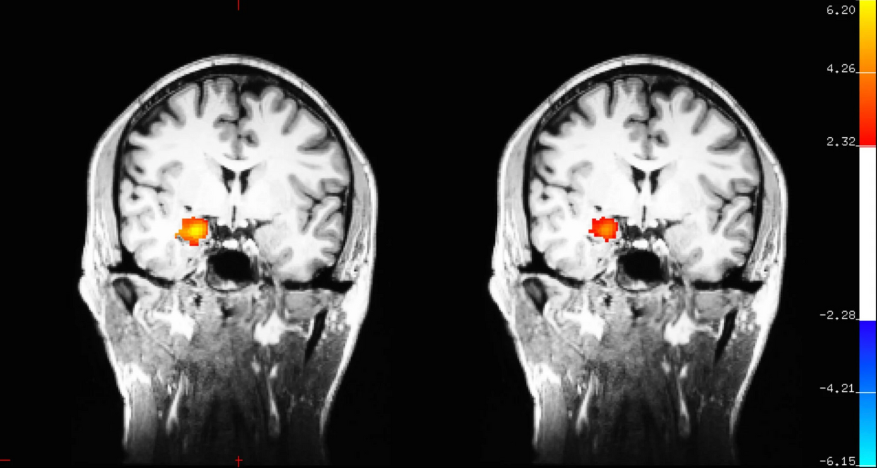

Slide 8
Please share in breakouts
What are some things you already do to regulate your physiological responses to stress?

Slide 9
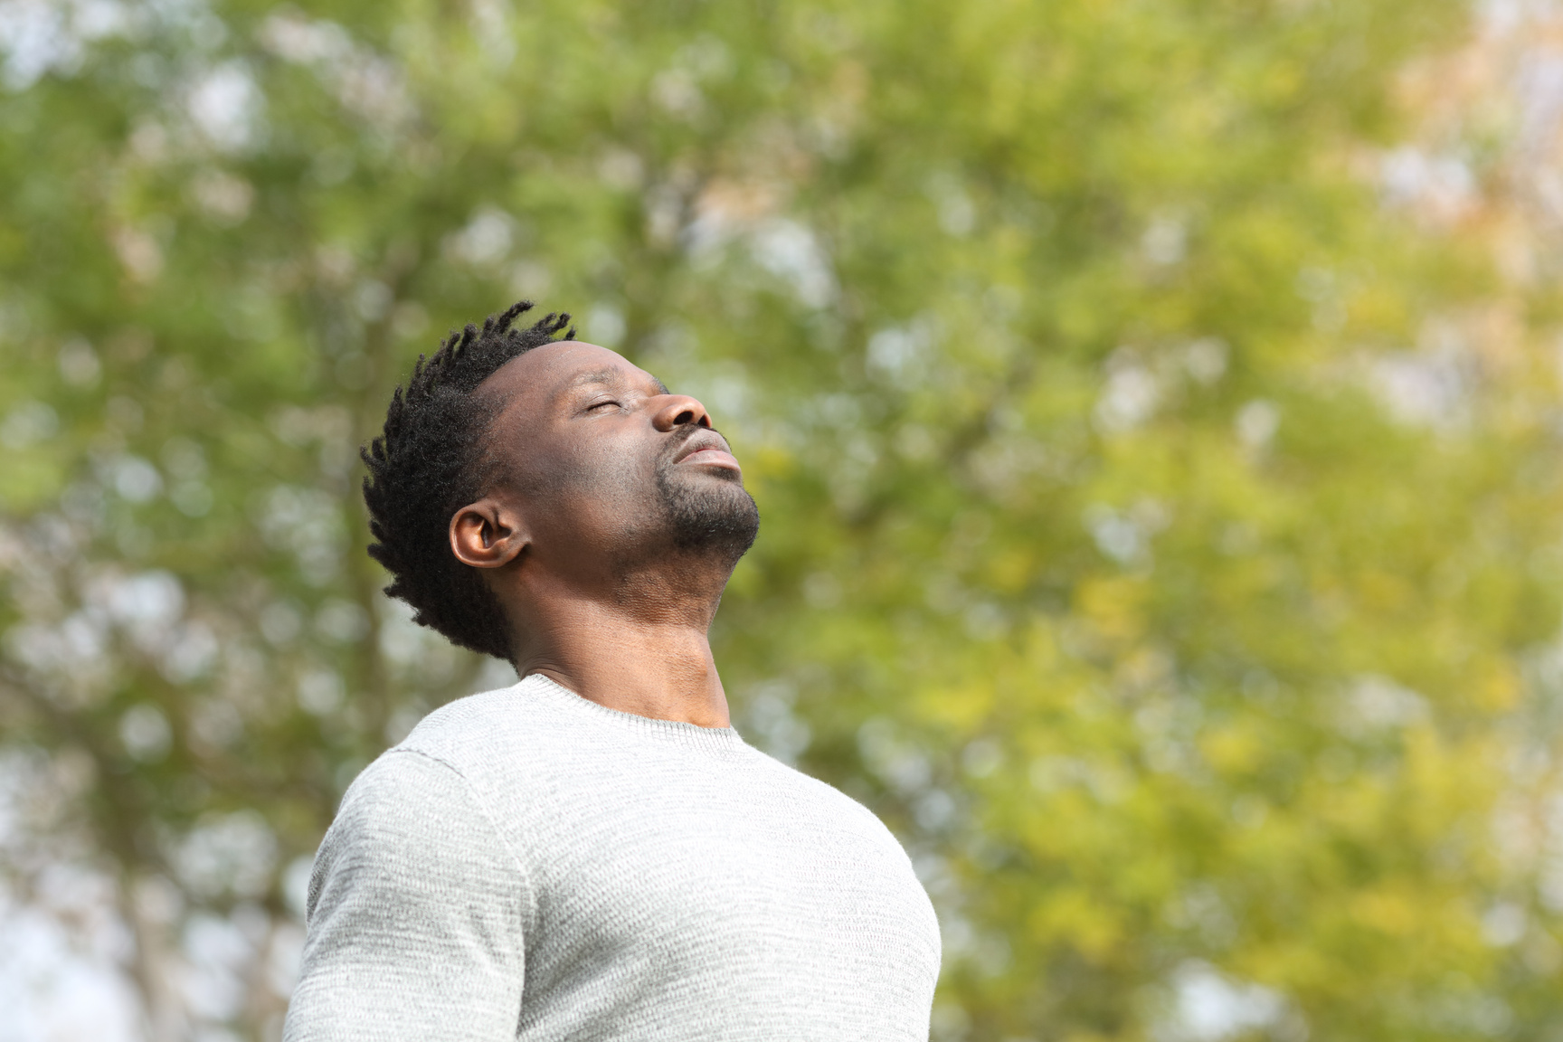
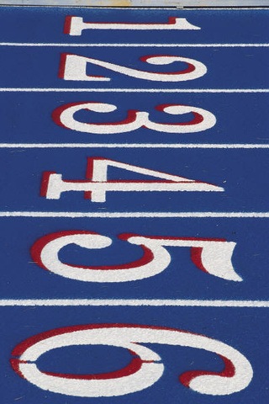
CALM: C = CONTROLLING
  Control your breathing and heart rate. You can’t panic if your body isn’t in panic mode.
  Slow your breathing by counting slowly to three for every breath in and out.
  Use square breathing, ‘tactical’ breathing, or bubble breathing with children.
  Remind yourself that you are in charge of your body, and not the other way around.
© 2020 Kira Mauseth, Ph.D.

Slide 10
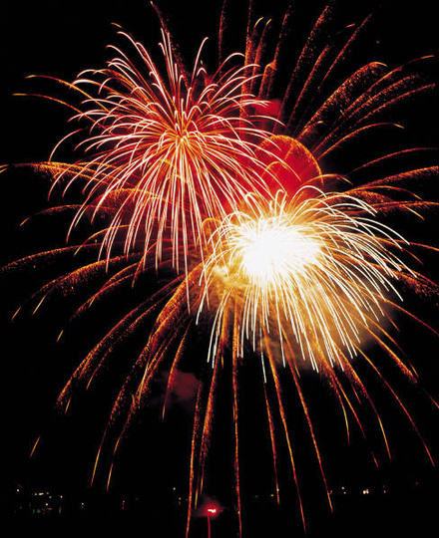
CALM: A = ATTENDING
  Attend to the present moment (not getting caught up in the past or future), but tuning in to what it happening within you and around you RIGHT NOW.
  Use all your senses to help you attend to the present.
© 2020 Kira Mauseth, Ph.D.

Slide 11
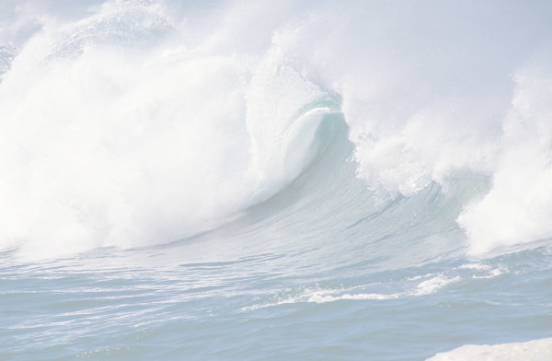
CALM: L = LISTENING
  Listen to your thoughts, feelings and sensations.
  Pay attention to your thoughts, feelings and sensations, acknowledge each, and let them pass over you like a wave rather than getting stuck.
  Listening and attending allows you to control what you do next in response to what you notice.
© 2020 Kira Mauseth, Ph.D.

Slide 12
CALM: M = MANAGING
  Manage your anxiety. Remind yourself that you are in charge, and that anxiety is not.
  Use muscle relaxation and body scanning to put yourself into a relaxed state. Scan your body and your five senses (while attending to the present and listening to your thoughts and feelings). Starting at your toes, check in on each area of your body; tighten and then relax it.
  Try progressive muscle relaxation for adults and children, or other evidence-based interventions that have known efficacy for symptom reduction.
© 2020 Kira Mauseth, Ph.D.

Slide 13
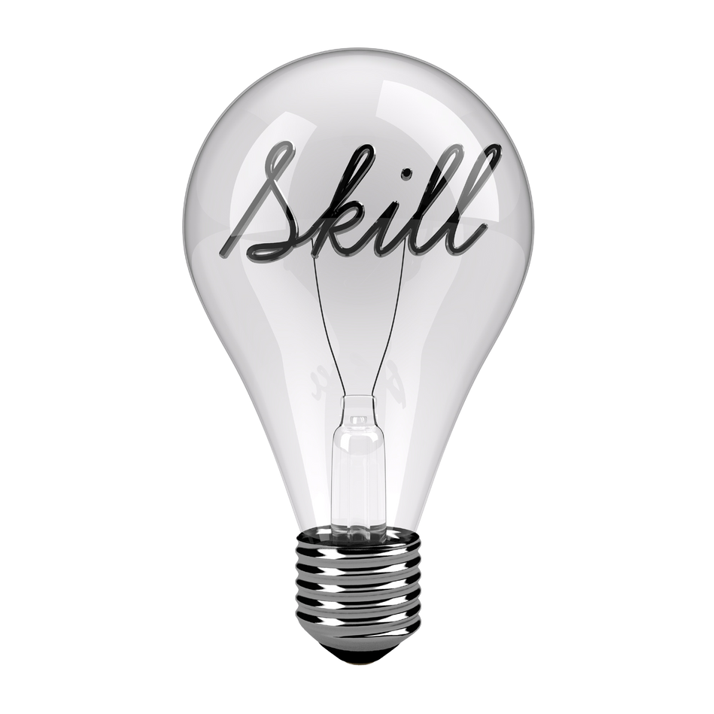
CALM skills menu
  Basic deep breathing
  Progressive Muscle Relaxation
  Mindfull/ Sensory Awareness
  Biofeedback / Heart rate Pulse checking
  Tapping / EFT

Slide 14
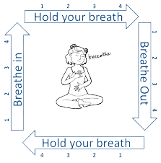
Basic Deep Breathing (also square breathing or ‘tactical breathing’:
  Assume a comfortable position
  Close your eyes if you are comfortable doing so.
  Breathe slowly in through your nose, feeling the air in your lungs expand down towards the stomach; pushing the diaphragm out as your lungs fill up with air.
  Slowly count to three and release the breath during another three count.
  Repeat.

Slide 15
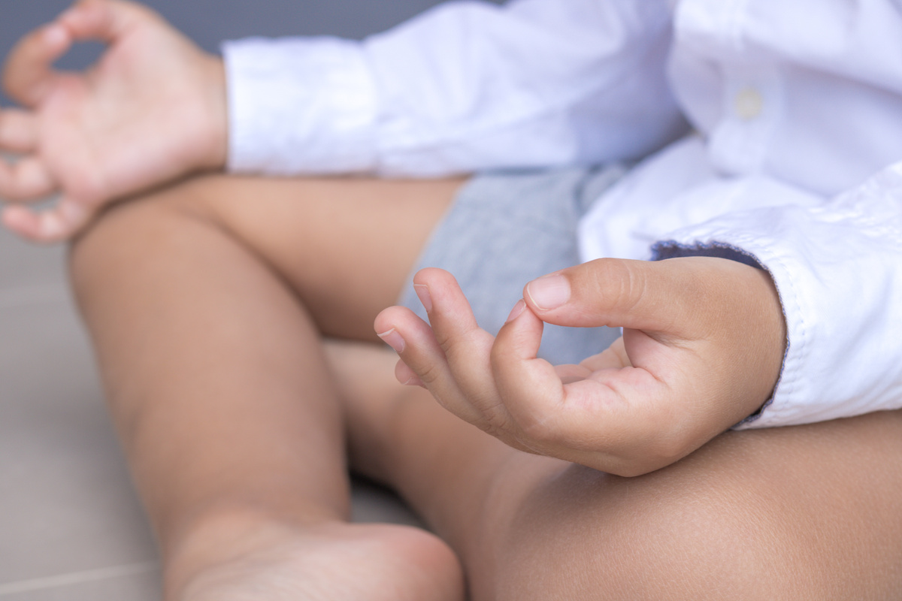
CALM Activities for Kids from 5-12:
  Bubble Breathing
  Grow and Scrunch
What are some others that you use and can share with the group?

Slide 16
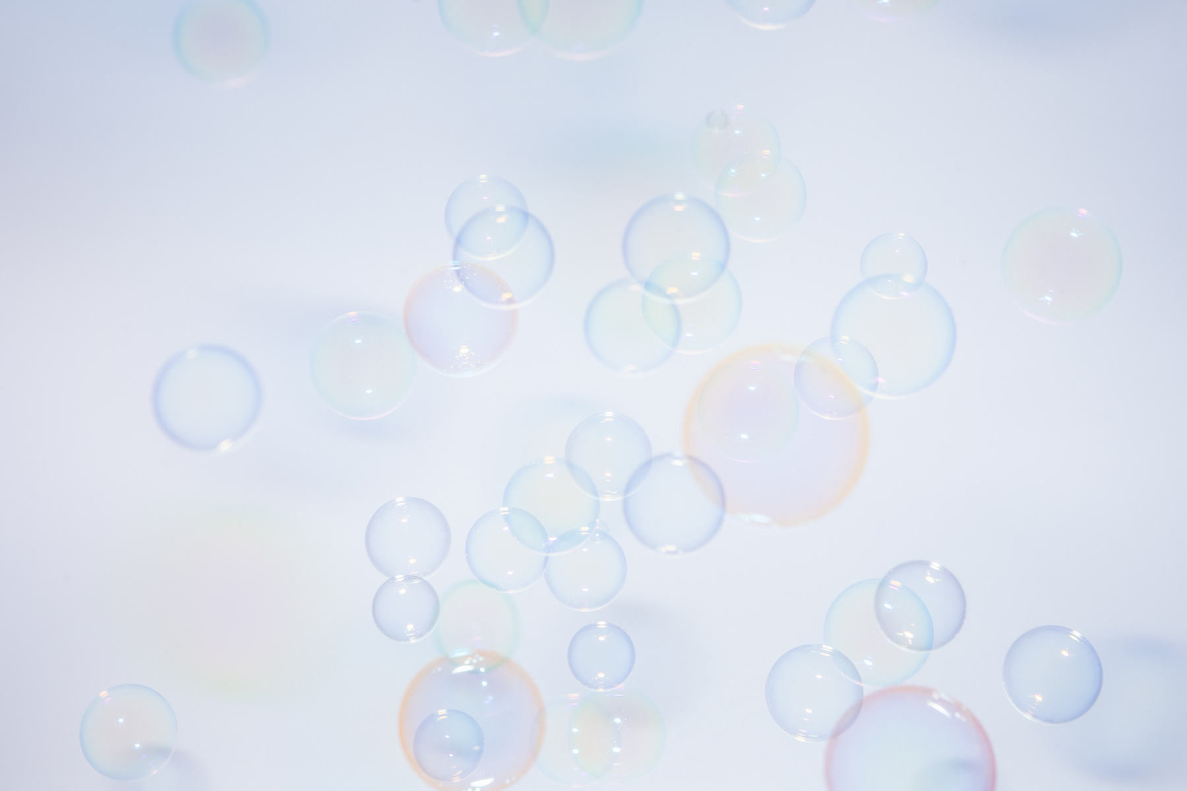
Bubble Breathing:
A fun way to get children to learn to master their response to anxiety is to use bubble breathing. Using a bubble wand and bubble soap, follow the deep breathing instructions: [Breathe slowly in through your nose, feeling the air in your lungs expand down towards the tummy; pushing the tummy out as your lungs fill up with air.
Slowly count to three and release the breath during another three count]. Ask the child to try to blow the biggest bubble that they can. It is impossible to blow a big bubble without slowing down the breathing process and breathing deeply.Be sure to have them pause for a few seconds between bubble breaths.

Slide 17

Grow and Scrunch
(Progressive Muscle Relaxation for kids):
A fun way to teach kids the elements of muscle relaxation is to have kids mimic the movements of a bug by tensing their body into a tight ball, and then releasing it and relaxing completely into a floppy body. Called a rolly-poly, pill bug or potato bug, by copying this movement, and holding the ‘rolled up’ position for a few seconds before releasing, kids can have fun learning how to control their bodies and practice relaxing techniques!

Slide 18
Breakouts:
  What are some challenges to practicing the CALM skills?
  Please take a moment to reflect and share other interventions that you use professionally or that you use for yourself in order to manage and increase a sense of CALM.

Slide 19


