Slide 1

COPE, CALM & CARE ©
Skills Models for Resilience Building
CARE MODEL
Northwest MHTTC Learning Community
November 16th, 2023
Kira Mauseth, Ph.D.
© 2020 Astrum Health, LLC.

Slide 2
COPE, CALM & CARE
  COPE, CALM and CARE are skills models and resources designed to help people of all ages recover from trauma, build personal resilience, and engage in healthy living.
  The COPE model focuses on Thinking Skills associated with cognitive therapy and critical evaluation our patterns, choices, and behaviors.
  The CALM model teaches Feeling Skills associated with biofeedback, behavioral activation, and other physiological strategies for maintaining a healthy limbic system balance.
  The CARE model teaches Being Skills associated with active resilience building, social interest, connection with others, and being part of sometihng greater than ourselves.
© 2020 Kira Mauseth, Ph.D.

Slide 3
CARE model starting points
  The COPE and CALM models are about thinking and doing.
  The CARE model includes reminders for being and growing.
  The CARE model is more personal, in that the activities and ways that the skills are practiced are very unique to each individual.
  The CARE model is based on the idea of each person identifying and working towards their happiest, healthiest self.
© 2020 Kira Mauseth, Ph.D.

Slide 4
BEING SKILLS
CARE by being:
CONNECTED, ACCEPTING, REASONED, ENGAGED
  Connected to other people or ideas
  Adaptive to change
  Reasoned with choices or purpose for growth
  Engaged in mindful living
© 2020 Kira Mauseth, Ph.D.

Slide 5

CARE: C = CONNECTED
  Connect with other people, ideas, activities, groups or causes that stimulate your personal growth and support you.
  Connections are essential and very meaningful, even if small.
© 2020 Astrum Health LLC

Slide 6

CARE: A = ADAPTIVE
  Adaptive to change and growth.
  Adapting to change, particularly when it is unexpected and / or negative is very difficult.
  Mental and physical health and happiness are associated with the ability to be flexible and adapt to change by adjusting yourself to new situations and circumstances.
© 2020 Astrum Health LLC

Slide 7



CARE: R = REASONED
  Use critical thinking to carefully evaluate choices and behaviors.
  Plan to devote your personal energy towards being the best person you can be, based on the characteristics you would like to develop. Spending energy on behaviors that are inconsistent with who you want to be results in discomfort and unhappiness.
  Spending time identifying your core values can help with this.
© 2020 Astrum Health LLC

Slide 8

CARE: E = ENGAGED
  Engage actively in mindful living.
  Developing a commitment to a person, idea, group or activity that is bigger than yourself, and using that commitment to find purpose and motivation in your life is an important part of caring for yourself and enjoying mental health.
© 2020 Astrum Health LLC

Slide 9
BEING SKILLS
CARE by being:
CONNECTED, ACCEPTING, REASONED, ENGAGED
  Connected to other people or ideas
  Adaptive to change
  Reasoned with choices or purpose for growth
  Engaged in mindful living
© 2020 Kira Mauseth, Ph.D.

Slide 10
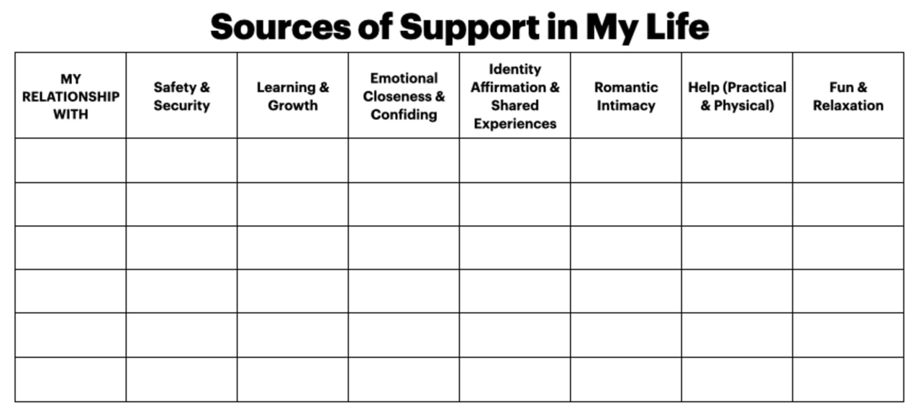
    Robert Waldinger, MD, is a professor of psychiatry at Harvard Medical School, director of the Harvard Study of Adult Development, and director of Psychodynamic Therapy at Massachusetts General Hospital. He is a practicing psychiatrist and also a Zen master and author of "The Good Life." Follow Robert on Twitter @robertwaldinger.
    Marc Shulz, PhD, is the associate director of the Harvard Study of Adult Development, and a practicing therapist with postdoctoral training in health and clinical psychology at Harvard Medical School. He is also the author of "The Good Life."

Slide 11
Consider sharing in your group:
  What aspect of the CARE model is most challenging for you and why?
  What are some examples of things you already do that are consistent with actively working on Connection, Adapting, Reasoning and Engagement?

Slide 12
CORE VALUES ACTIVITY

Slide 13
General Guidelines for Core Values Pyramid
    The “Core Values Pyramid”© represents characteristics of the best YOU that you can become.
    Not others’ expectations or desires for who you are, but your own.
    Start with ONLY the first five blocks on the bottom and leave the rest blank.

Slide 14


Your Pyramid

Slide 15
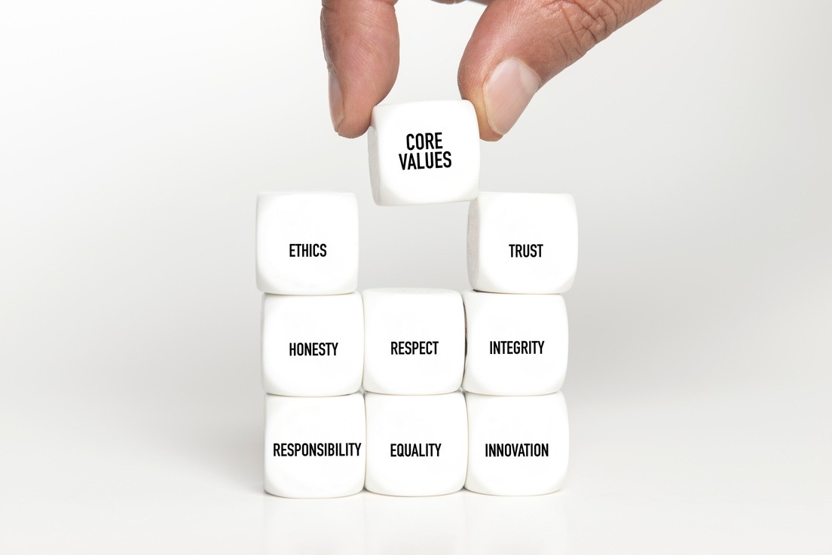
Step 1
Identify a characteristic or descriptor (one in each of the bottom five blocks on the next slide) that describes you as the person that you would like to more fully develop or that you aspire to become.

Slide 16
Start with JUST the bottom 5

Slide 17

    Evaluate the percentage to which you feel as if you are completely embodying each value, as of today’s date, in the small blue circle next to that value.
    Remember: to be at 100% you need to embody this value in ALL aspects of your life and in all the various roles you play. (Friend, leader, parent, sibling, etc)
    Hint: most of us don't reach 100% in all our roles....
Step 2

Slide 18


NEXT
STEP 3
STEP 4
    Pick one or two that you would like to focus on for development
    On another piece of paper or on the worksheet, Define how embodiment of those value would look in your daily life.
      In what role?
      Towards self or others?

Slide 19
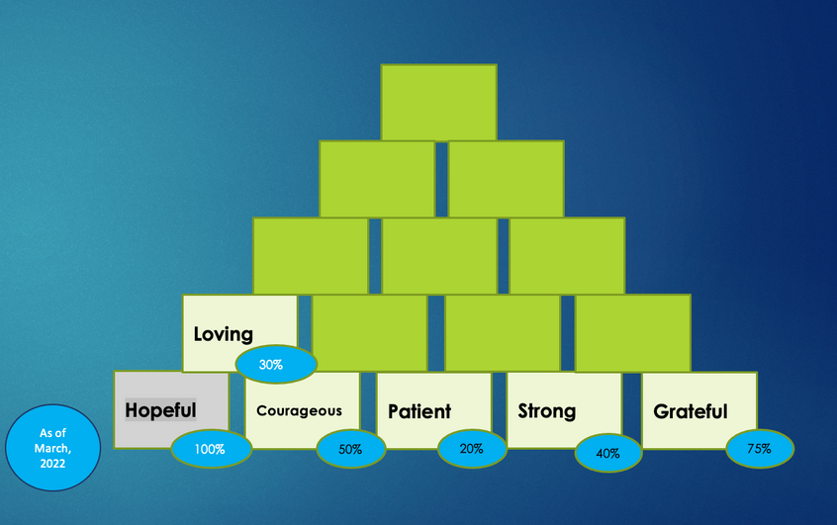

EXAMPLE

Slide 20
Ideas /examples
CORE VALUE | ROLE | CHALLENGE / OBSTACLE | OPPORTUNITY
Patient
 | Parent | Tiredness | Slow down when disciplining
 | Clinician | Boredom | Look for connections in their story
Strong
 | Self - Physical | Time to exercise during day | Walks in evening with kids
 | Self- Mental | Too much work | Boundaries for time on computer at night

Slide 21

Consider sharing
ONE of your core values, and an example of how you are considering developing it this next year.

Slide 22
Other Concepts that Relate to CARE: Being Skills
  AWE
  FLOW
  PEAK EXPERIENCES

Slide 23




What is AWE
Thank you to Piper Sangston &
Abby Asplund-Smith, Bellevue SD for sharing!
Awe is the feeling of being in the presence of something vast that transcends your understanding of the world.

Slide 24



Studies have found that feelings of awe can be accompanied by heart rate changes, goosebumps, and the sensation of chills, and there is some evidence that awe may even decrease markers of chronic inflammation.
  https://www.frontiersin.org/articles/10.3389/fpsyg.2021.617715/full
  https://greatergood.berkeley.edu/article/item/eight_reasons_why_awe_makes_your_life_better
  https://www.templeton.org/wp-content/uploads/2018/08/White-Paper_Awe_FINAL.pdf
  https://ggsc.berkeley.edu/images/uploads/GGSC-JTF_White_Paper-Awe_FINAL.pdf https://www.nytimes.com/2023/01/03/well/live/awe-wonder-dacher-keltner.html
  https://www.cnn.com/style/article/awe-wonder-art/index.html
The Science of Awe

Slide 25



Suggestions for provoking AWE:
  Viewing something giant such as a mountain range or ocean
  Discovering something tiny such as the world seen through a microscope
  Contemplating a piece of music or art
  Taking “awe walks” in nature or neighborhood
  Choose an unfamiliar experience
  Practice Mindfulness
  Learn about inspiring people
  Watch videos about inspirational figures
  Witness acts of goodness

Slide 26

FLOW
“ is the mental state in which a person performing some activity is fully immersed in a feeling of energized focus, full involvement, and enjoyment in the process of the activity. In essence, flow is characterized by the complete absorption in what one does, and a resulting transformation in one's sense of time.”
  https://www.ted.com/talks/mihaly_csikszentmihalyi_flow_the_secret_to_happiness?language=en
  Ellis, Gary D.; Voelkl, Judith E.; Morris, Catherine (September 1994). "Measurement and Analysis Issues with Explanation of Variance in Daily Experience Using the Flow Model". Journal of Leisure Research. 26 (4): 337–356. doi:10.1080/00222216.1994.11969966. ISSN 0022-2216.

Slide 27
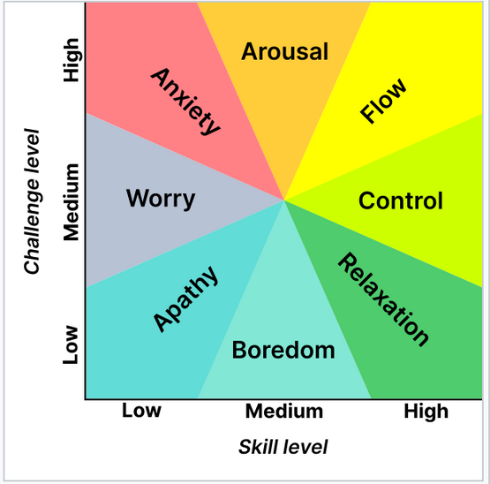
Jeanne Nakamura and Csíkszentmihályi identify the following six factors as encompassing an experience of flow:
  Intense and focused concentration on the present moment
  Merging of action and awareness
  A loss of reflective self-consciousness
  A sense of personal control or agency over the situation or activity
  A distortion of temporal experience, as one's subjective experience of time is altered
  Experience of the activity as intrinsically rewarding, also referred to as autotelic experience
Nakamura J, Csikszentmihályi M (20 December 2001). "Flow Theory and Research". In Snyder CR, Lopez SJ (eds.). Handbook of Positive Psychology. Oxford University Press. pp. 195–206. ISBN 978-0-19-803094-2. Retrieved 20 November 2013.

Slide 28
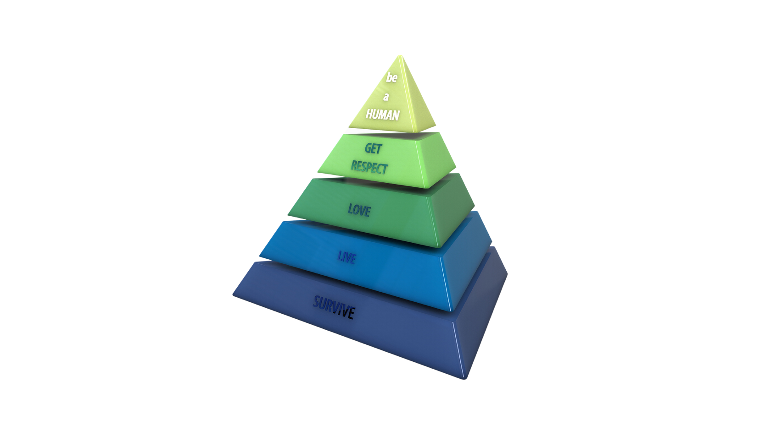
Remember Maslow and the concept of Self-Actualization:
Self Actualizers are / have:
  Perceptions are reality based
  Acceptance of self, others, nature
  Spontaneous, simplicity, naturalness
  Dedication to a cause (problem focused)
  Need for privacy / alone and “down time”
  Freshness of appreciation of life
  Periodic peak experiences
  Social interest
  Deep friendships with a few; profound relationships
  Tolerance and acceptance of others; Strong ethical sense
  Autonomous / Independent
  Creative

Slide 29
Peak Experiences
“an altered state of consciousness characterized by euphoria, often achieved by self-actualizing individuals.The concept was originally developed by Abraham Maslow in 1964, who described peak experiences as "rare, exciting, oceanic, deeply moving, exhilarating, elevating experiences that generate an advanced form of perceiving reality, and are even mystic and magical in their effect upon the experimenter."
Corsini, Raymond J. (1998). Encyclopedia of Psychology. United States: John Wiley & Sons. ISBN 9780471192824.

Slide 30

Final Share
  What are some examples of Flow, Awe, or Peak Experiences that you have cultivated or experienced recently?
  How can we cultivate and draw our attention to these aspects of living?

Slide 31
THANK YOU ALL FOR YOUR PARTICIPATION IN THIS LEARNING COMMUNITY

