Slide 1

Amigas Latinas Motivando el Alma (ALMA):
An Intervention to Reduce Mental Health Disparities in Latina Immigrants
India J. Ornelas, PhD, MPH
Interim Chair and Professor
Health Systems and Population Health
iornelas@uw.edu | @profe_ornelas
Notes:
logo

Slide 2
Background
Latina immigrants experience immigration related stressors that increase their risk for depression and anxiety.
COVID-19 has added further stress.
Latina immigrants face many barriers to mental health care.
Social networks and social support can serve as important resources for Latina immigrants.
Need for culturally-grounded community-based interventions to promote mental health of Latina immigrants.

Slide 3
Immigration Related Stressors
Fear for safety during migration
Political environment at the time contributed to a lack of a sense of safety
Immigration disrupts supportive social ties
Legal status limits access to employment, health and social services
“Currently many of us immigrants are scared of being detained by immigration… I think the majority of us immigrants are frightened. We have to figure out where we find the strength to be tough mentally.”
“And I said goodbye to my family with great sadness, at the same time I had …like mixed emotions. I was excited, but at the same time I left part of me.”
Rios-Casas, et al. Journal of Racial and Ethnic Health Disparities, 2020
Notes:
“And I said goodbye tomy family with great sadness, at
the same time I had …like mixed emotions. I was
excited, but at the same time I left part ofme.”

Slide 4
Strategies for Coping with Stressors
Transnational family ties provide support
Women use social ties to access resources
Children are a source of encouragement and support
“It was very difficult to say goodbye to my mother and siblings, I did not know when I would return. It was something very difficult, but I do not regret it because I am providing something for my children. I am here for them.”
“You meet good people that teach you a lot, there are so many things that you do not know [when you first arrive] and others will show you.”

Slide 5

Amigas Latinas Motivando el Alma (ALMA)
Conceptual Model
Social Ties
Social Cohesion
Depression
Anxiety
Coping Strategies
Notes:
ALMA aims to reduce depression and anxiety in 2 ways, 1. through increasing social ties and social cohesion. 2 by helping participants to recognize and share coping strategies they are already using and introducing new ones.

Slide 6
ALMA Program Overview
Goal is to prevent and reduce anxiety and depression symptoms
8 week group program, 2 hour sessions
Encourages women to continue using existing coping strategies and teaches women new strategies they may not have been exposed to
All sessions and communications in Spanish
Child care, transportation and food provided
Delivered by mental health and mindfulness professionals at community-based organizations.
ou're mindful, you carefully observe your thoughts and feelings without judging them good or bad. Instead of letting your life pass you by, mindfulness means living in the moment and awakening to your current experience, rather than dwelling on the past or anticipating the future.
When you're mindful, you carefully observe your thoughts and feelings without judging them good or bad. Instead of letting your life pass you by, mindfulness means living in the moment and awakening to your current experience, rather than dwelling on the past or anticipating the future. When you're mindful, you carefully observe your thoughts and feelings without judging them good or bad. Instead of letting your life pass you by, mindfulness means living in the moment and awakening to your current experience, rather than dwelling on the past or anticipating the future. Instead of letting your life pass you by, mindfulness means living in the moment and awakening to your current experience, rather than dwelling on the past or anticipating the future. When you're mindful, you carefully observe your thoughts and feelings without judging them good or bad. Instead of letting your life pass you by, mindfulness means living in the moment and awakening to your current experience, rather than dwelling on the past or anticipating the future.
ou're mindful, you carefully observe your thoughts and feelings without judging them good or bad. Instead of letting your life pass you by, mindfulness means living in the moment and awakening to your current experience, rather than dwelling on the past or anticipating the future.
When you're mindful, you carefully observe your thoughts and feelings without judging them good or bad. Instead of letting your life pass you by, mindfulness means living in the moment and awakening to your current experience, rather than dwelling on the past or anticipating the future. When you're mindful, you carefully observe your thoughts and feelings without judging them good or bad. Instead of letting your life pass you by, mindfulness means living in the moment and awakening to your current experience, rather than dwelling on the past or anticipating the future. Instead of letting your life pass you by, mindfulness means living in the moment and awakening to your current experience, rather than dwelling on the past or anticipating the future. When you're mindful, you carefully observe your thoughts and feelings without judging them good or bad. Instead of letting your life pass you by, mindfulness means living in the moment and awakening to your current experience, rather than dwelling on the past or anticipating the future.
Notes:
Add fidelity and community engagement

Slide 7
ALMA In-Person Curriculum
Session 1: Arriving, Connecting, Introduction to Program
  Intros to each other, the program, mental health & coping, guided body relaxation
Session 2: Telling Our Stories of Migration
  Migration story-telling, singing, mindfulness of the breath meditation, movement
Session 3: Stress and Life here in Seattle/Washington
  Tree of stressors, sponge activity, mindful and compassion movement
Session 4: Interconnectedness and Support
  Centering practice, mindful eating, web of interconnectedness
Session 5: Homecoming—to Mindfulness, to Ourselves, to Each Other
  Emotion identification, emotion embodiment practice, mental health resources
Session 6: Working with Challenging Emotions
  Mindfulness of challenging emotions, self-compassion letters, affirmations
Session 7: ALMA in our Daily Lives
  Review of practices, loved ones’ dichos, ALMA soul collage
Session 8: Celebration, Graduation, Staying Connected to Self & Others
  Gratitude circle, potluck, mindful movement

Slide 8
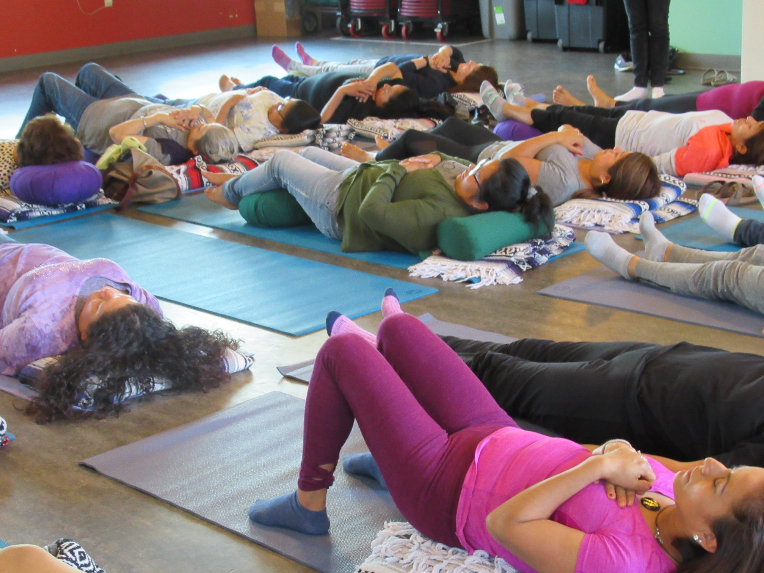
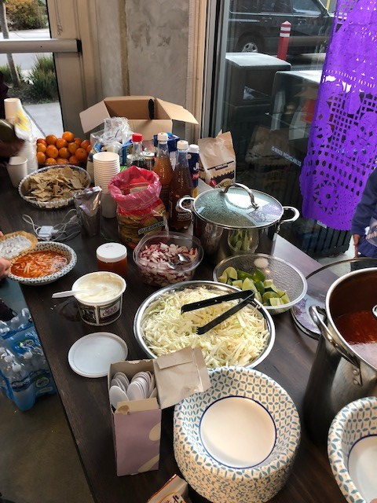
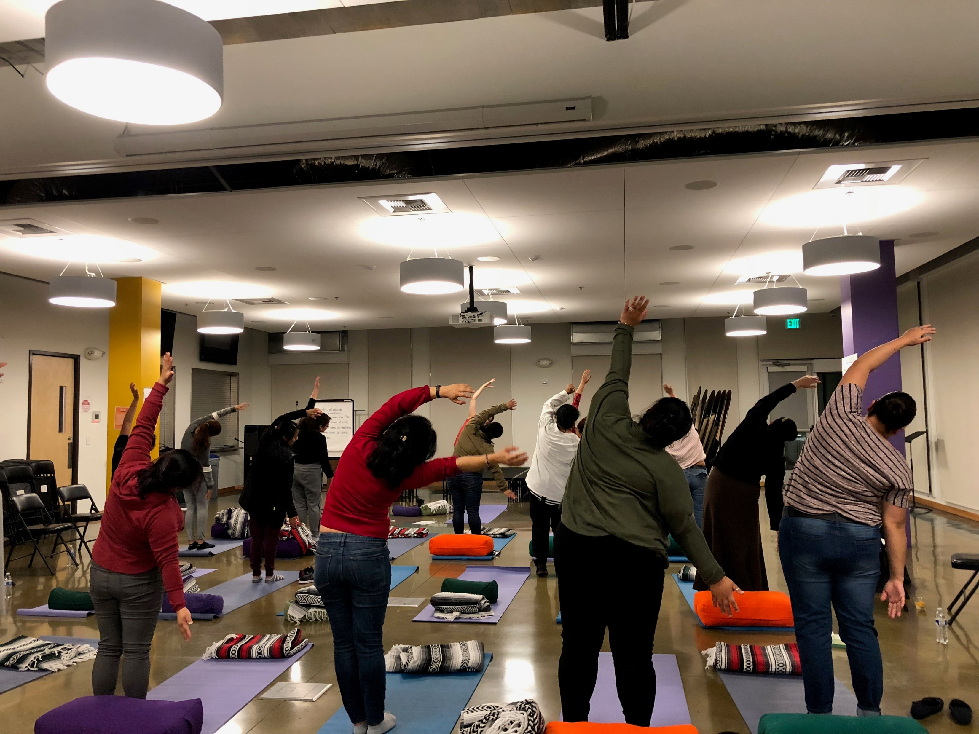
Notes:
Average attendance at Casa Latina = 20
Average attendance at El Centro = 15
Average attendance for Intervention group = 18

Slide 9
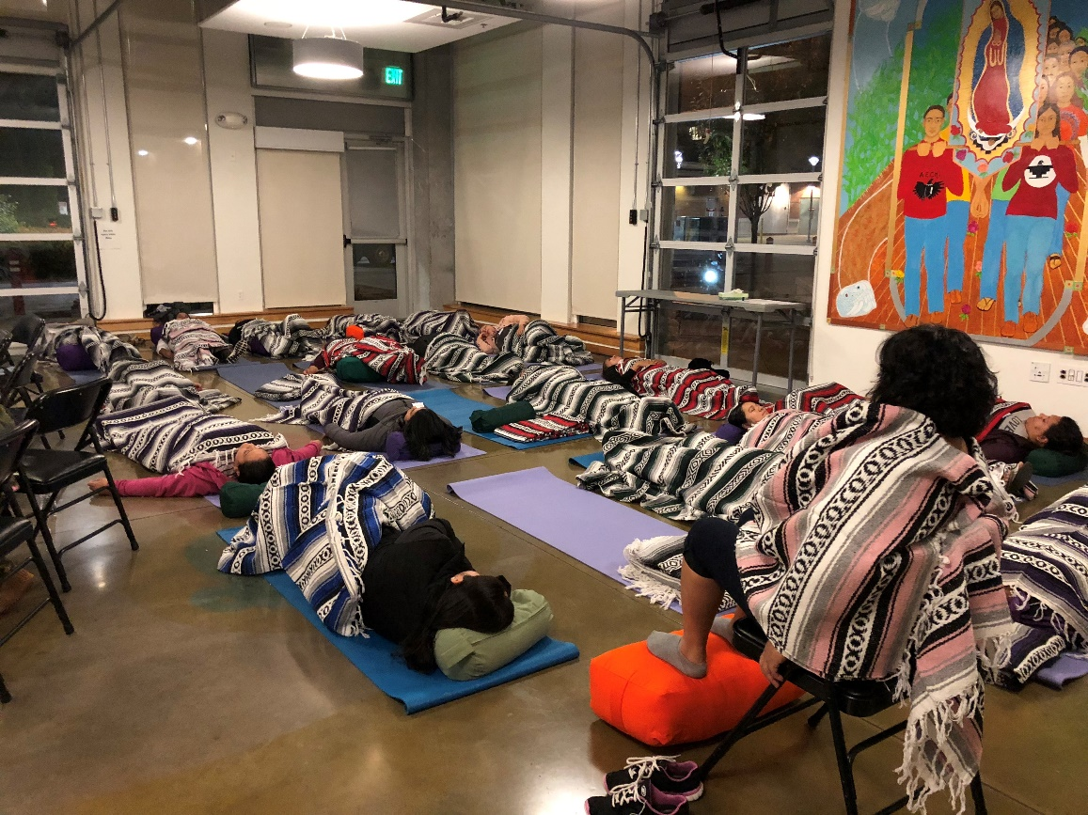

Slide 10
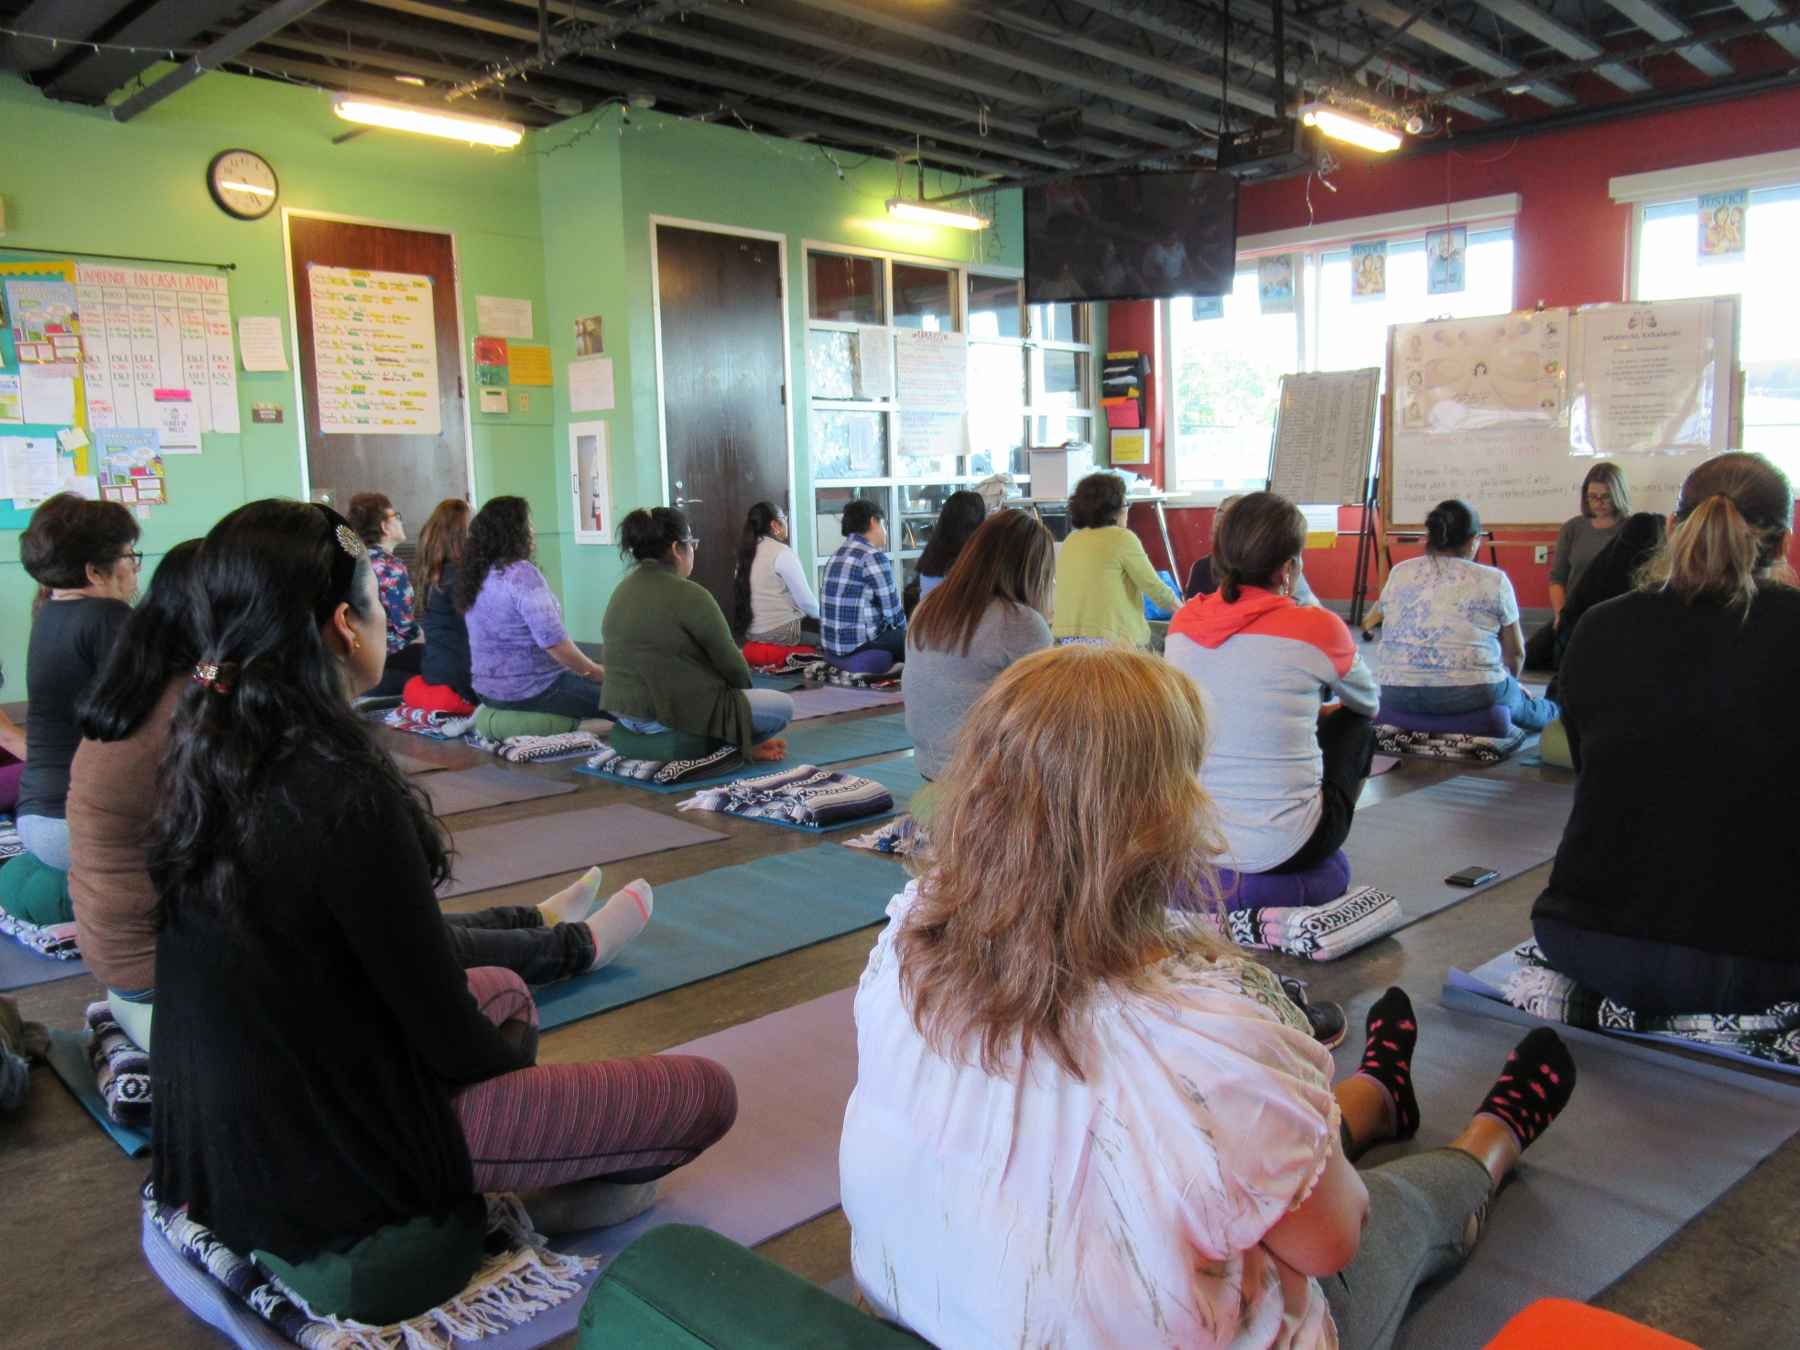
Notes:
Seated guided MF of the breath meditation on mats/cushions

Slide 11


Body Awareness
Mindfulness of the Breath Meditation
Notes:
Booklet, Ivonne
7 ‘home practices’
1/week, starting in week 2
Home practices developed from a range of mindfulness and compassion practices and curricula
Intention: mindfulness (we define as friendly, open, non-judgmental awareness of what’s happening as it’s happening) and self-compassion/self-care/self-love (‘amor’, cariño, cuidarse de si misma)
We adapted, over time, during the first 3 ALMA groups, noticing how they responded….
Starting with mindfulness:
Body awareness (mindfulness of the body): cultivating friendly awareness of (emotional and physical) sensations in the body
Mindfulness of the Breath Meditation: cultivating friendly awareness of the breath as it moves in and out of the body

Slide 12


Mindful Eating
Loving self-talk
Notes:
Mindful eating: mindfulness of the food we eat, where it comes from, what’s in it (rain, clouds, sun, the love and labor of those who grew it)
(moving more into the self-care/love/kindness): Loving self-talk: (1) mindfulness of how we talk to ourselves (2) practicing talking to ourselves with care, love, kindness

Slide 13
Offering ALMA Online
Provided participants materials prior to the session (ALMA Tote Bag)
Provided reimbursements for childcare and food
Adjusted orientation to offer different levels of Zoom training
Encouraged those that are familiar with the Zoom chat to share their feelings, thoughts and ideas
Asked everyone to turn on their cameras to help build connection and community
Used breakout rooms (for the migration story circles)
Notes:
Gigi to draft

Slide 14
ALMA – Wave 1 Example Timeline
T1: Baseline Survey
T2 – T4: Follow-Up Surveys
T1
T2
T3
T4
Intervention Site
Receives 8-week
Intervention
Control Site
Receives 8-week
Intervention
Jul Aug Sep Oct Nov Dec Jan Feb Mar Apr May
2018
2019

Slide 15
Recruitment and Data Collection
Latina immigrants recruited from two community organizations in King County, WA
Data collected in-person or by phone
Survey measures listed below
  Primary Outcomes:
  Depression (PHQ-9)
  Anxiety (GAD-7)
  Secondary Outcomes:
  PTSD
  Mental Health Care Utilization
  Stress Measures:
  Perceived Stress
  Immigration Stressors
  Discrimination
  Trauma
  Social Support:
  Social Support
  Social Isolation
  Social Ties
  Coping Measures:
  Coping Strategies
  Coping Activities
  Resilience
  Mindfulness Measures:
  Multidimensional Assessment of Interoceptive Awareness (MAIA)
  Freiburg Mindfulness Inventory
  Self-Compassion

Slide 16
Flow diagram of participant enrollment, participation, and retention
Enrollment
Groups
Intervention (n=111)
Baseline survey (T0) completed (n=111)
Comparison (n=115)
Baseline survey (T0) completed (n=115)
Time 1:
Post-intervention
Lost to follow-up (n=12, 10.8%)
Reasons: Could not contact (n=11), Declined survey (n=1)
Lost to follow-up (n=15, 13.2%)
Reasons: Could not contact (n=12), Declined survey (n=2), Lost data (n=1)
Time 2: Follow-up
Lost to follow-up (n=17, 15.3%)
Reasons: Could not contact (n=15), Declined survey (n=2)
Lost to follow-up (n=12, 10.5%)
Reasons: Could not contact (n=10), Declined survey (n=2)
Analysis
Analyzed: Baseline=111, Post-intervention=99, two-month follow-up=94
Excluded from analysis n=0
Intent to treat analysis principle
Analyzed: Baseline=115, Post-intervention=100, two-month follow-up=103
Excluded from analysis n=0
Intent to treat analysis principle
Notes:
Updated 1.25.22 for Aim 2 paper and reporting- this slide only update
Add Title

Slide 17
Demographic Characteristics of ALMA Participants (n=226)
Demographic | N or mean | % or SD
Age | 40 | 0.7
Years in the US | 15 | 0.5
Country of birth
Mexico | 168 | 74%
Other | 58 | 26%
Language
Monolingual Spanish | 133 | 59%
More Spanish than English | 58 | 26%
Bilingual Spanish/English | 28 | 12%
Mostly English | 7 | 3%
Education
Less than high school | 76 | 34%
High school diploma | 95 | 42%
More than high school diploma | 55 | 24%
Immigration status
Citizen or current visa/permission | 61 | 27%
Entry and/or stay without permission | 132 | 58%
Prefer not to or did not answer | 33 | 15%
Mean monthly income in US dollars (SD) | $2417 | 98.4
 | Total
Mental Health Outcome | N | (%)
Depression Symptom Severity
None (0-4) | 89 | 39%
Mild (5-9) | 80 | 35%
Moderate (10-14) | 35 | 16%
Moderate to Severe (15-27) | 22 | 10%
Anxiety Symptom Severity
None (0-4) | 76 | 34%
Mild (5-9) | 92 | 41%
Moderate (10-14) | 40 | 18%
Severe (15-21) | 18 | 8%
ou're mindful, you carefully observe your thoughts and feelings without judging them good or bad. Instead of letting your life pass you by, mindfulness means living in the moment and awakening to your current experience, rather than dwelling on the past or anticipating the future.
When you're mindful, you carefully observe your thoughts and feelings without judging them good or bad. Instead of letting your life pass you by, mindfulness means living in the moment and awakening to your current experience, rather than dwelling on the past or anticipating the future. When you're mindful, you carefully observe your thoughts and feelings without judging them good or bad. Instead of letting your life pass you by, mindfulness means living in the moment and awakening to your current experience, rather than dwelling on the past or anticipating the future. Instead of letting your life pass you by, mindfulness means living in the moment and awakening to your current experience, rather than dwelling on the past or anticipating the future. When you're mindful, you carefully observe your thoughts and feelings without judging them good or bad. Instead of letting your life pass you by, mindfulness means living in the moment and awakening to your current experience, rather than dwelling on the past or anticipating the future.
ou're mindful, you carefully observe your thoughts and feelings without judging them good or bad. Instead of letting your life pass you by, mindfulness means living in the moment and awakening to your current experience, rather than dwelling on the past or anticipating the future.
When you're mindful, you carefully observe your thoughts and feelings without judging them good or bad. Instead of letting your life pass you by, mindfulness means living in the moment and awakening to your current experience, rather than dwelling on the past or anticipating the future. When you're mindful, you carefully observe your thoughts and feelings without judging them good or bad. Instead of letting your life pass you by, mindfulness means living in the moment and awakening to your current experience, rather than dwelling on the past or anticipating the future. Instead of letting your life pass you by, mindfulness means living in the moment and awakening to your current experience, rather than dwelling on the past or anticipating the future. When you're mindful, you carefully observe your thoughts and feelings without judging them good or bad. Instead of letting your life pass you by, mindfulness means living in the moment and awakening to your current experience, rather than dwelling on the past or anticipating the future.

Slide 18
Participant Satisfaction
 | In-person | Online
I would recommend this program to my friends, family, or other women. | 5.0 | 4.8
I enjoyed the ALMA program. | 4.9 | 4.8
ALMA helped me find new strategies to reduce the stress in my life. | 4.7 | 4.7
ALMA helped me reduce my stress. | 4.7 | 4.8
ALMA helped me recognize difficult emotions. | 4.8 | 4.7
ALMA helped me in having self-compassion. | 4.8 | 4.7
ALMA helped me feel less alone. | 4.7 | 4.7
ALMA helped me relax. | 4.8 | 4.7
ALMA helped me by teaching me how to relax. | 4.8 | 4.8
I thought the information shared was relevant for women like me. | 4.8 | 4.8
The information I received in the program helped me improve my mental health. | 4.7 | 4.7
I am interacting with people I met in ALMA outside of the program. | 3.4 | 2.8
The connections I have with other people improved due to ALMA. | 4.1 | 3.9

Slide 19
Model Estimates for Depression and Anxiety for Full Sample*
Repeated measures model effects | Depression |  | Anxiety
 | Coefficient | p value | Coefficient | p value
Intervention main effect | 0.40 | p=0.54 | -0.31 | p=0.63
Time main effect (T1 post-intervention) | -0.23 | p=0.65 | -1.45 | p=0.003
Time main effect (T2 follow- up) | -0.30 | p=0.48 | -1.66 | p=<.0001
Intervention by Time interaction (T1) | -1.82 | p=0.01 | -1.17 | p=0.07
Intervention by Time interaction (T2) | -1.52 | p=0.01 | -0.74 | p=0.22
Model-based least squared means | Depression |  | Anxiety
 | Intervention | Comparison | Intervention | Comparison
Baseline (T0)
Mean | 7.01 | 6.61 | 6.71 | 7.02
95% CI | 6.10, 7.92 | 5.76, 7.47 | 5.83, 7.60 | 6.17, 7.86
Post Intervention (T1)
Mean | 4.96 | 6.39 | 4.09 | 5.56
95% CI | 4.06, 5.87 | 5.32, 7.45 | 3.34, 4.84 | 4.67, 6.46
Follow-up (T2)
Mean | 5.19 | 6.31 | 4.30 | 5.35
95% CI | 4.20, 6.18 | 5.27, 7.36 | 3.48, 5.12 | 4.43, 6.27
*Adjusted for age, education, and language spoken

Slide 20
Mean depression scores for intervention and comparison groups
at all three timepoints, n=226

Slide 21
Mean anxiety scores for intervention and comparison groups
at all three time points, n=226

Slide 22
Mean depression scores for in-person and online intervention and comparison groups at all three time points
In-person (n=107)
Online (n=119)

Slide 23
Mean anxiety scores for in-person and online intervention and comparison groups at all three time points
In-person (n=107)
Online (n=119)

Slide 24
Mediation Models
Social Support
Social isolation
Emotional social support
Depression
Anxiety
Mindfulness
Attention regulation
Emotional awareness
Self-regulation
Body listening
Trusting
Mindfulness skills
Self-compassion
Notes:
ALMA aims to reduce depression and anxiety in 2 ways, 1. through increasing social ties and social cohesion. 2 by helping participants to recognize and share coping strategies they are already using and introducing new ones.

Slide 25
Qualitative Interviews with Participants
Random sample of 32 participants that had attended at least 75% of the sessions
Half online, half in-person
Half intervention, half comparison group
30 minute interviews via Zoom

Slide 26
Interviews: Themes & Quotes
ALMA helped participants understand how they experience stress physically and how to prioritize self-care
Participants were able to apply the ALMA practices in their daily lives
What impacted me the most after taking the program is being aware of my body. If I feel something in my body, I am able to identify it and use relaxation, breathing and self-compassion.
I am more aware of what my body feels. Before, I didn't pay as much attention to it, if I felt tired or felt ill, I went on and on. Now, I pay more attention to the things that happen to my body
I start breathing when I feel very tense. Before I did not know the importance of taking your time to breathe and how this can reduce stress.
I will continue to feel frustration, sadness, and depression. There are situations that stress you out, but I can remember to stop and breathe, and if I feel sad, I can sing a song, remembering those moments when we were in ALMA.

Slide 27
Participants found empathy and understanding in hearing other participants’ stories
They felt supported by the ALMA facilitators
I felt comfortable because I think we all were going through something that was stressing us out and by sharing our experiences, we helped each other and felt we were united and understood.
I did feel a connection because we were women, we spoke Spanish, we were moms, and we have all experienced difficult things putting ourselves last since we have work, have to be a wife, and take care of our children. ALMA felt like a safe space, where each of us could share (talk) if we wanted to.
We were part of a group where all the women had a chance to participate. The facilitators gave each one of us a chance to share, one by one, verbally or using the chat. They never forgot that we were all there. They always took us all into account.
They made us feel like they were our sister or a friend, allowing us to open up our hearts. I loved the way they treated us during the group. I participated in other programs, but none like this, and I enjoyed it very much

Slide 28
In-person vs. Online Participation
Even though we could still see each other online, I feel that being in person would have been better because it would allow for more communication, and it would be easier to get to know each other.
It was challenging because children talk to you, look for you. They do not understand why you're online. They do not allow you to fully relax as one would in-person.
Engagement and satisfaction was high for both versions
Online participants appreciated the convenience, but also noted challenges of distraction and limited opportunities to connect with other participants
Other ways to support engagement in online programs?

Slide 29
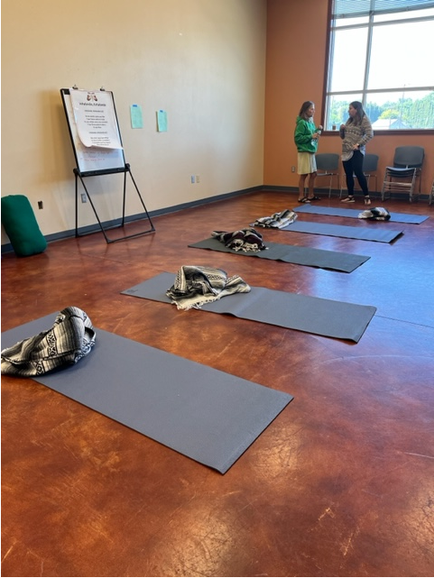
Next steps: Dissemination
Developed an ALMA leader training for community health workers within community-based organizations.
Teams in two community organizations are currently offering ALMA to their staff and/or clients.
Assessing mental health outcomes and fidelity.

Slide 30
ALMA Team
Staff:
Gigi Perez
Serena Maurer
Veronica Poveda
Adriana Perez Solorio
Perla Bravo
Katrina Nelson
Students:
Monserrat Miranda Morales
Juan Gudino
Francisco Rios Casas
Co-Investigators:
Deepa Rao, UW
Cynthia Price, UW
Gary Chan, UW
Gino Aisenberg, UW
Anh Tran, Duke
Funding:
NIMHD R01MD012230
UW Population Health Initiative
Community Partners:
El Centro de la Raza
Casa Latina
Puentes
SeaMar Community Health Centers

Slide 31
Publications
“Se vale llorar y se vale reir”: Latina Immigrants’ Coping Strategies for Maintaining Mental Health in the Face of Immigration-Related Stressors
Rios Casas, F. et al. Journal of Racial and Ethnic Health Disparities.
Stress, Social Support and their Relationship to Depression and Anxiety among Latina Immigrant Women
Ryan, D. et al. Journal of Psychosomatic Research.
Understanding the Relationship between Social Stressors, Trauma and Somatic Symptoms among Latina Immigrant Women
Abarca, G. et al. Journal of Racial and Ethnic Health Disparities.
Coping with COVID-19: The Impact of the Pandemic on Latina Immigrant Women’s Mental Health and Wellbeing
Ornelas, IJ, et al. Health Education and Behavior, 2021
Amigas Latinas Motivando el ALMA (ALMA): In-person and online delivery of an intervention to promote mental health among Latina immigrant women
Ornelas, IJ, et al. Journal of Integrative and Complementary Health, 2022
Promoting mental health in Latina immigrant women: Results from the Amigas Latinas Motivando el Alma intervention trial
Ornelas, IJ et al. Social Science and Medicine, 2023

