Slide 1
New England Mental Health Technology Transfer Center of New England (NE-MHTTC) SAMHSA #1H79SM081775-01
Yale Program for Recovery and Community Health
in partnership with
Center for Social Innovation and Harvard University Department of Psychiatry
Notes:
Place your title on this first slide and include any subtitle.
DO NOT CHANGE THE FORMAT OF THIS TEMPLATE. If you are creating MHTTC-branded slides, you must use this template. If you move around boxes, make sure to check the reading order. If you widen any boxes they must not overlap any other box.
IF YOU ADD ANY GRAPHICS, you will need to add ALT TEXT and check READING ORDER.

Slide 2
NEW ENGLAND MHTTC: An Overview
MISSION
GOALS AND OBJECTIVES
SCHOOL MENTAL HEALTH
ACCESSING TRAINING AND TECHNICAL ASSITANCE
LEARNING COLLABORATIVES
Photo credit: Unknown Author, licensed under CC BY-SA
Notes:
This Photo by Unknown Author is licensed under CC BY-SA

Slide 3
OUR MISSION
To use evidence-based means to disseminate evidence-based practices across the New England States.
Notes:
This is a layout for text plus picture. You do not want text or pictures that belong inside the box to exceed the box size. That means you may have to adjust the size of the box or the font size (nothing lower than 12 points). Remember to add alt text to any icon or picture.
There are additional slide layouts available. Select “Layout” from the “Home” tab. (If “Layout” is grayed out, you will need to place your cursor in an open area outside the slide to activate it.)

Slide 4
Ensuring Inclusion
To ensure the responsiveness of our work, we will actively develop and maintain a network of government officials, policy makers, system leaders, administrators, and community stakeholders, providers, researchers, youth and adults, and family members from each of the six states to guide The New England MHTTC activities.
This Photo by Unknown Author is licensed under CC BY-SA-NC

Slide 5
Areas of Focus
Recovery-Oriented Practices, including Recovery Support Services, within the Context of Recovery-Oriented Systems of Care
This Photo by Unknown Author is licensed under CC BY-ND
This Photo by Unknown Author is licensed under CC BY-ND
Notes:
This is a layout for text plus picture. You do not want text or pictures that belong inside the box to exceed the box size. That means you may have to adjust the size of the box or the font size (nothing lower than 12 points). Remember to add alt text to any icon or picture.
There are additional slide layouts available. Select “Layout” from the “Home” tab. (If “Layout” is grayed out, you will need to place your cursor in an open area outside the slide to activate it.)

Slide 6
Foster Alliances
Establish the NEAT
Complete Needs Assessment and Resource Inventory
Provide Targeted Training and Technical Assistance
Identify local and regional experts on priority topic areas
Finalize Strategic Plan
Respond to TA requests, create T/TA plans of action, link to TLCs and experts
Increase broad awareness, knowledge, and skills
Create Best Practices Repository
Identify annual priority topic areas and establish TLCs
Accelerate adoption and implementation of EBPs
Launch website
Year 1: Establish TLCs with focus on: 1) Suicide Prevention & 2)
Establish guiding principles for recovery-oriented, person-centered, trauma-informed, and culturally-competent care
Work with TLCs to ensure broad reach
Develop Communications and Marketing Plan
Goals and Objectives
Notes:
Foster Alliances across region, experts, and other MHTTCS nationally
Provide Training and Technical Assistance- Free, publicly available
Heighten awareness knowledge and skills to implement evidence-based prevention, treatment, and recovery practices
Accelerate adoption and implementation of mental health evidence-based practices

Slide 7
Key Activities
Assess Regional T/TA Needs
Identify T/TA Priorities
Develop and Disseminate Core Topic Learning Products
Market, Receive, and Respond to T/TA
Monitor and Evaluate T/TA
NE-MHTTC

Slide 8
Measuring Our Success
The New England MHTTC outcomes are as follows:
Increase the number of people in the mental health or related workforce trained in mental health-related practices/activities.
Increase the number of individuals who have received training in prevention or mental health promotion.
Increase the number of individuals contacted through program outreach efforts.
Increase the number of programs, organizations, and communities that implemented evidence-based mental health- related practices and activities.

Slide 9
School Mental Health
This Photo by Unknown Author is licensed under CC BY-SA

Slide 10
Children and Trauma
1 in 4 children experience trauma before the age of 4, and 6 in 10 before the age of 18.
When children live in poverty, neighborhoods of high crime, or experience racism and discrimination, the frequency and severity of their trauma will be even greater.
Significant trauma exposure can undermine normal development and lead to cognitive, emotional, behavioral, and educational challenges.
As children move into middle and high school, trauma exposure increases the risk of behavioral health disorders, risk taking behaviors, educational failure, and violence.
Without intervention, the consequences of trauma persist into adulthood.

Slide 11
Trauma-Informed School Based Mental Health
Trauma-informed, child-centered interventions improve resilience, learning and achievement for children who have experienced trauma.
Schools are ideal settings to provide support to ameliorate the effects of trauma and amplify protective factors.
Availability of educated and nurturing adults and teachers within schools can meet the mental health needs of children.

Slide 12
School Supplement Goals
Aim: To enhance school culture and prepare school personnel to improve the mental health of school-aged children the Northeast region
Goal 1. Foster alliances to address the needs of children and youth who have experienced or are at risk of experiencing significant trauma.
01
Goal 2. Provide publicly available, free training and technical assistance to early childhood, elementary, and secondary teachers, principals, school psychologists, and other school staff.
02
Goal 3. Accelerate adoption and implementation of mental health evidenced-based practices through establishing the Childhood Trauma Learning Collaborative (C-TLC) for New England.
03

Slide 13
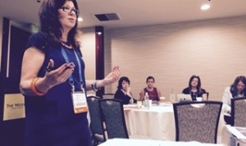
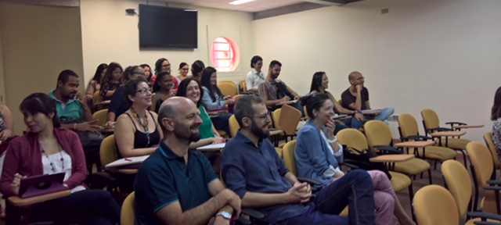
School Supplement C-TLC Activities
One year of funding under the MHTTC-NE to:
Recruit 4 educators from each NE state to participate in C-TLC to become local champions
Develop a repository of monthly webinars and resources on school-based mental health
Invite 20 schools per state to take the School Compassionate Culture Analytic Tool for Educators (S-CCATE)
Participate in broader MHTTC-NE initiatives

Slide 14
Accessing Training and Technical Assistance
This Photo by Unknown Author is licensed under CC BY-NC-ND

Slide 16
Outcomes

Slide 17
Outcomes

Slide 18
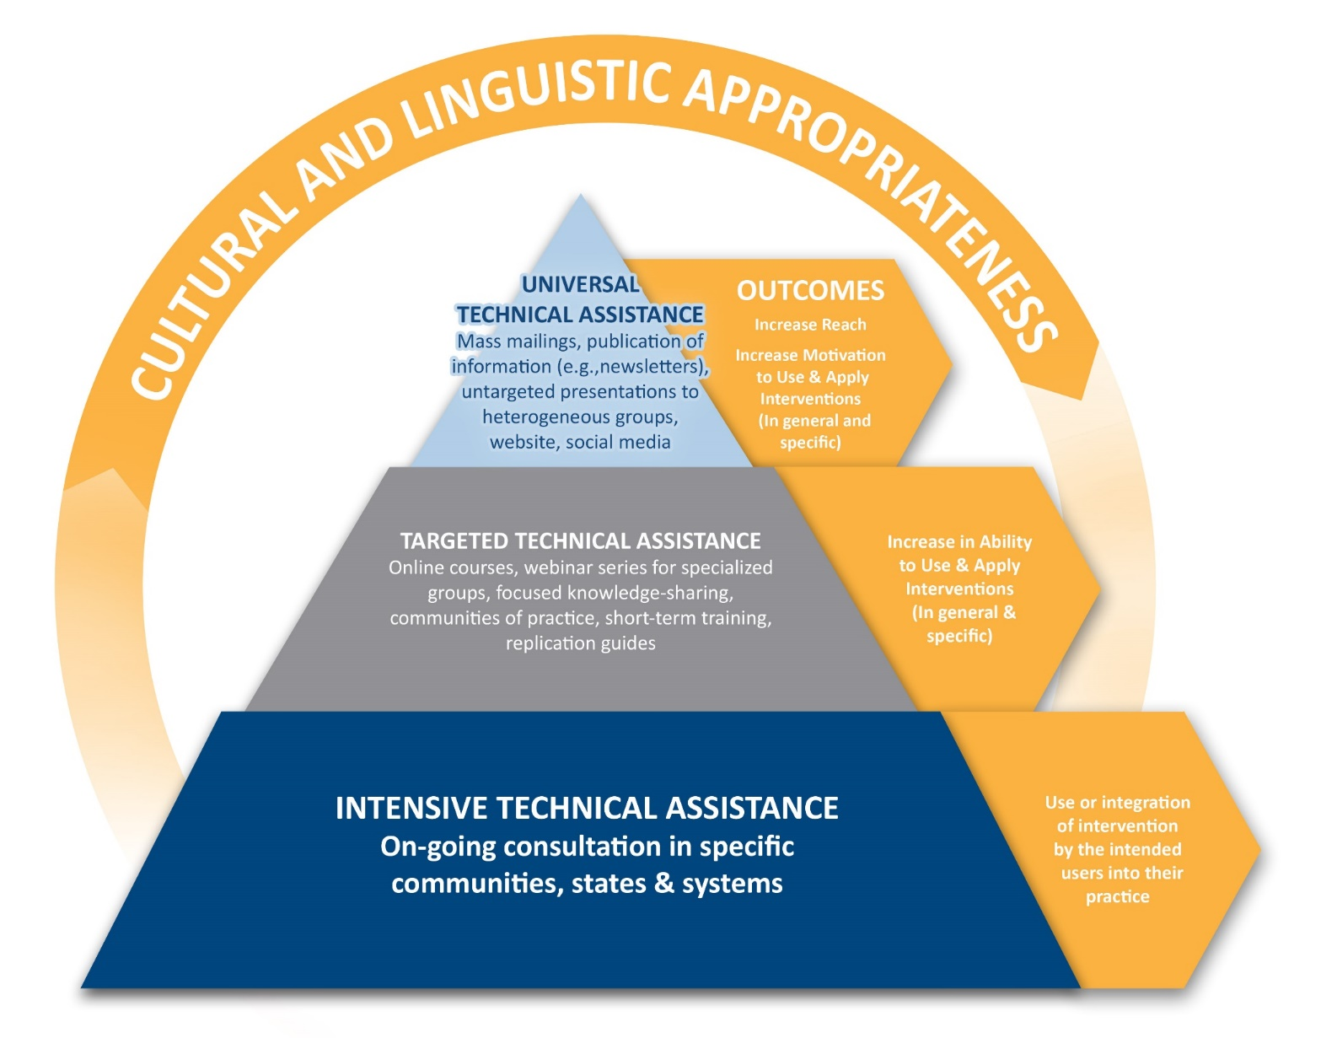
Notes:
LAURIE

Slide 19
Learning Communities
The Early Psychosis Learning Collaborative (EPLC): Emily Kline & Raquelle Mesholam-Gately
Suicide Prevention Learning Collaborative (SPLC):Sherrie Winton
Let(s)lead: Lived Experience Transformational Leadership Academy: Maria E. Restrepo-Toro
School Mental Health - Childhood - Trauma Learning Collaborative (C-TLC): Martha Staeheli and Christine Mason
Notes:
This is a layout for text plus picture. You do not want text or pictures that belong inside the box to exceed the box size. That means you may have to adjust the size of the box or the font size (nothing lower than 12 points). Remember to add alt text to any icon or picture.
There are additional slide layouts available. Select “Layout” from the “Home” tab. (If “Layout” is grayed out, you will need to place your cursor in an open area outside the slide to activate it.)

Slide 20
The Early Psychosis Learning Collaborative (EPLC)
Access to CEDAR Clinical Briefs and MAPNET Webinars
Webinar and clinical brief on Acceptance and Commitment Therapy for early psychosis
Webinar and clinical brief on engagement in early psychosis
Training in the MATRICS Consensus Cognitive Battery
Psychopharmacology consult line once/month to respond to early psychosis psychopharmacology issues/questions

Slide 21
Suicide Prevention Learning Collaborative (SPLC)
This Learning Collaborative is based on:
A partnership with Zero Suicide and the Suicide Prevention Resource Center (SPRC)
An interdisciplinary, community-based model
A hybrid format; a blended teaching and learning approach
Shared learning and coaching; continuous quality improvement

Slide 22
New England Let(s)Lead: Lived Experience Transformational Leadership Academy
1. Assist emerging leaders in gaining an understanding of the critical and emerging issues in mental health and other systems of care.
2. Learn and put into practice the key elements of transformational leadership.
3. Develop a project focused on systems or social change or develop a change initiative specific to their own personal and shared vision of The New England MHTTC.
Notes:
Here is an example of content layout. You can put text, images, videos, graphs, etc. in either box. Do not use SmartArt (it is not and cannot be made to be 508 compliant).
Check out the other slide layouts available by selecting “Layout” from the “Home” tab. (If “Layout” is grayed out, you will need to place your cursor in an open area outside the slide to activate it.)

Slide 23
Davidson, Larry larry.davidson@yale.edu
Maria E. Restrepo-Toro maria.restrepo-toro@yale.edu
O'Connell, Maria maria.oconnell@yale.edu
Staeheli, Martha martha.staeheli@yale.edu
Christine Mason cmason@edimprovement.org
Keshavan,Matcheri mkeshava@bidmc.harvard.edu
Mesholam-Gately,Raquelle rmeshola@bidmc.harvard.edu
Kline,Emily R.ekline@bidmc.harvard.edu
Friedman-Yakoobian,Michelle mfriedm3@bidmc.harvard.edu
Livia Davis ldavis@center4si.com
Katie Volk kvolk@center4si.com
Sherrie Winton swinton@center4si.com
Faculty and staff from the Yale University Program for Recovery and Community Health (PRCH), Harvard University Department of Psychiatry and The Center for Social Innovation
This Photo by Unknown Author is licensed under CC BY-SA

Slide 24
Need to contact us? networkoffice@mhttcnetwork.org
https://mhttcnetwork.org/centers/new-england-mhttc/home
Notes:
Place your title on this first slide and include any subtitle.
DO NOT CHANGE THE FORMAT OF THIS TEMPLATE. If you are creating MHTTC-branded slides, you must use this template. If you move around boxes, make sure to check the reading order. If you widen any boxes they must not overlap any other box.
IF YOU ADD ANY GRAPHICS, you will need to add ALT TEXT and check READING ORDER.

