Slide 1


First Episode Psychosis
Andrew J. McLean, MD, MPH

Slide 2
Notification
This presentation was prepared for the Mountain Plains Mental Health Technology Transfer Center (TTC) Network under a cooperative agreement from the Substance Abuse and Mental Health Services Administration (SAMHSA). All material appearing in this presentation, except that taken directly from copyrighted sources, is in the public domain and may be reproduced or copied without permission from SAMHSA or the authors. Citation of the source is appreciated. Do not reproduce or distribute this presentation for a fee without specific, written authorization from the Mountain Plains Mental Health Technology Transfer Center. For more information on obtaining copies of this publication, call 701-777-6367.
At the time of this publication, Elinore F. McCance-Katz, served as SAMHSA Assistant Secretary.
The opinions expressed herein are the views of Dr. Andrew J. McLean, MD, MPH, and do not reflect the official position of the Department of Health and Human Services (DHHS), SAMHSA. No official support or endorsement of DHHS, SAMHSA, for the opinions described in this document is intended or should be inferred.

Slide 3
Objectives for the Series
Understand the concept of psychosis
Identify the phases of psychosis, as relates to particular illnesses
Recognize best practices of care for first episode psychosis

Slide 4
Psychosis
Psychosis is a symptom, not a diagnosis…
It is essentially a “break with reality,” typically with changes in:
  Perception (hallucinations/delusions). Hallucinations are things that an individual sees/hears which others don’t. Delusions are fixed false beliefs
  Emotion (feelings)
  Cognition (thought; both form and content)
  Behaviors

Slide 5
Psychosis
Up to 3 % of the population will experience psychosis.
For many, it is a one-time event
For some, it is part of an ongoing illness
Be cautious in misinterpreting cultural beliefs for psychopathology…

Slide 6
What Causes Psychosis?
Medical Illnesses
Substances
Severe stressors
Part of specific mental illness

Slide 7
Causes of severe mental illness, such as schizophrenia
Unknown:
  ? Multi-hit hypothesis
Theories:
  Genetic predisposition
  Early environmental insults, with some brain changes
  Later insults with further brain changes
  Neurodegeneration and subsequent illness/disorder

Slide 8

Paradigms
Cultural aspects to mental illness…
Nomenclature:
Outcomes…

Slide 9
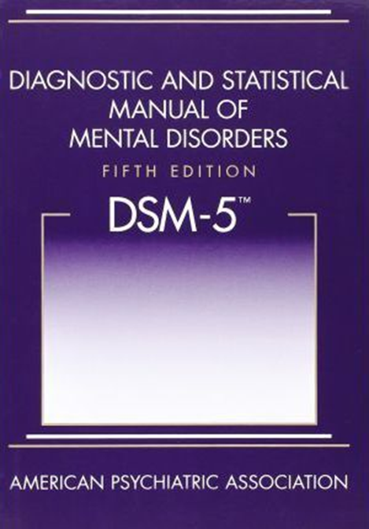
Formal Diagnosis of any mental illness …
Symptoms (number and type)
Time (duration)
Impact (severity)
Differential (what else might this be?)

Slide 10
Example
Delusions: strange beliefs and ideas which are resistant to rational/logical dispute or contradiction from others.
Hallucinations: auditory, or visual.
Disorganized Speech: incoherence, or irrational content.
Disorganized or Catatonic behavior: repetitive, senseless movements, or adopting a pose which may be maintained for hours.

Slide 11
Example Continued …
Brief Psychotic Disorder
  Symptoms: one or more
  Time (at least a day, but less than a month)
Schizophrenia
  Symptoms: 1 symptom for at least 6 months (prodrome), and 2 for at least a month.
  Additional, “negative symptoms” i.e., diminished emotional expression…

Slide 12
Mental Illnesses with psychosis as an ongoing symptom (usually intermittent)
Schizophrenia
Schizoaffective Disorder
Bipolar Affective Disorder
Severe Depression
Delusional Disorder (may be more fixed)
Episodes within trauma disorders and certain personality disorders (borderline personality disorder) can occasionally manifest in brief psychosis as part of brief psychotic disorder. “Cluster A” Personality Disorders (Paranoid, Schizotypal, Schizoid) may share traits with certain thought disorders.

Slide 13
Scope
The age onset of most major psychiatric illnesses occurs in adolescence or early adulthood
Roughly 1% of the population will develop schizophrenia.
In the U.S., in 2013, the fiscal impact of schizophrenia was estimated at over $150 billion. (Cloutier et al., 2016)
Individuals with such illnesses tend to have shorter life expectancy*

Slide 14
Scope: Potentially impacted by schizophrenia and other serious mental illnesses
Individual goals and aspirations
Relationships
Employment
Education
Other behavioral health issues:
  depression, anxiety, substance use, suicide
Physical Health
Societal:
  Lost productivity
  Criminal Justice issues
  Emergency Room Care
  Long-term care

Slide 15
Concepts
Episode
Remission
Recovery

Slide 16
Outcomes…
You will hear different data, but the numbers roughly fall into the “law of thirds” or “law of fourths.”
In other words, of individuals with schizophrenia; over time, 1/3 will do very well, 1/3 will be improved, and 1/3 will require significant assistance
Some use 1/4 will fully recover, 1/4 will be improved and relatively independent, 1/4 will require robust support, and 1/4 will be unimproved or have died early.
The goal is obviously to move towards recovery… HOPE IS HUGE!

Slide 17
Considerations
While some consider schizophrenia to be a progressive brain disease, it is important to recognize that there is not “one schizophrenia.”
Brain changes do not necessarily correlate with changes in function.
There is work being done via neuroimaging, biological markers, etc… on predicting onset of symptoms, predicting outcome of illness.
Literally hundreds of genes have been tested looking for causes of schizophrenia
An individual with an identical twin with schizophrenia has roughly a 50% chance of also developing schizophrenia. A fraternal twin, 15%

Slide 18
First Episode Psychosis Programs
Many countries around the world have developed “First Episode Psychosis Programs.”
The reason: “Treatment as usual” (medication with limited other resources) did not have the outcome that coordinated specialty care had regarding symptom management and functionality.
In the U.S., the “Consolidated Appropriations Act, 2014,” provided funds to the Substance Abuse and Mental Health Services Administration (SAMHSA) to support such programs.
A 5% set-aside to the Mental Health Block grant program was provided.

Slide 19
First Episode Psychosis
Essentially, the first time someone experiences a psychotic episode.
However, designating “first” implies that there are more to follow (not always the case)

Slide 20
Why Early Identification and Intervention? In doing so,
The Following Goes Up
  Prognosis
  Treatment adherence
  School/work attendance
  Social Supports
The Following Goes Down
  Family disruption
  Hospitalization need
  Suicide risk
  Symptom relapse

Slide 21
First Episode Psychosis
Positive Predictive Factors include:
  Good pre-illness functioning
  More abrupt (vs. insidious) onset
  Older age (most first episodes occur between 15-25 years of age)
  Positive vs. negative symptoms (will discuss)
  Presence of mood symptoms

Slide 22
Duration of Untreated Psychosis (DUP)
Positive Predictive Factors, continued…
Early identification and treatment (reduction in duration of untreated psychosis-DUP) improves outcomes

Slide 23
Phases
In episodes where symptoms are likely to continue to some extent, we see the following phases:
  Prodromal
  Acute
  Recovery
(If abrupt onset, and brief occurrence, there will only be an acute and recovery phase)

Slide 24
Again,
The research looks at large numbers of individuals. There can be significant variability in outcomes between individuals.
There is ongoing research regarding what particular symptoms are impacted by longer or shorter durations of untreated psychosis, as well as what interventions are most useful.

Slide 25
Terms
Positive Symptoms
  Symptoms that are present that you don’t want-primarily the ones we always think of with schizophrenia:
  Hallucinations, Delusions, Disorganized Speech…
Negative Symptoms
  Something is missing…
  Volition, emotional expression, etc…

Slide 26
Prodromal Phase (reminder)
Often subtle, often identified in hindsight after acute episode
Can last months to years, and might include:
  Social withdrawal
  Difficulty with concentration
  Sleep disturbance
  Odd beliefs/behavior
  Mood changes
  Anxiety
  Deterioration in functioning

Slide 27
Acute Phase (reminder)
Essentially, onset of overt symptoms, (most commonly the “positive symptoms.”)

Slide 28
Symptoms and Cognitive Difficulties
Positive Symptoms
  Hallucinations, Delusions, Disorganized Speech, Catatonia
Affective Symptoms
  Mood, Aggression
Negative Symptoms
  Blunting, Amotivation, Social Isolation, Poverty of Speech
Cognitive Difficulties
  Executive Functions, Attention, Memory

Slide 29
Another way of looking at symptoms
Experiencing
Thinking
Behaving

Slide 30
Illusion vs. Hallucination vs. Thought …
Illusion: an external stimulus wrongly interpreted by the senses
Hallucination: a perception in the absence of an external stimulus
Thought:

Slide 31
Examples of Experiencing-Hallucinations:
Auditory (hearing things)
  The most common type
  Commentary (one or more “voices” talking to the individual or between themselves.)
  Command (a “voice” telling the person to do something.)
  Can be benign, nuisance, or harmful

Slide 32
Examples of Experiencing-Hallucinations, continued …
Visual (seeing things)
  Sometimes people, sometimes objects
Tactile (feeling things)
  Like bugs crawling, etc…
Olfactory (smelling things)
Gustatory (tasting things)
While we always want to consider medical causes when evaluating the onset of hallucinations, we particularly are interested when the symptoms are one of these…

Slide 33
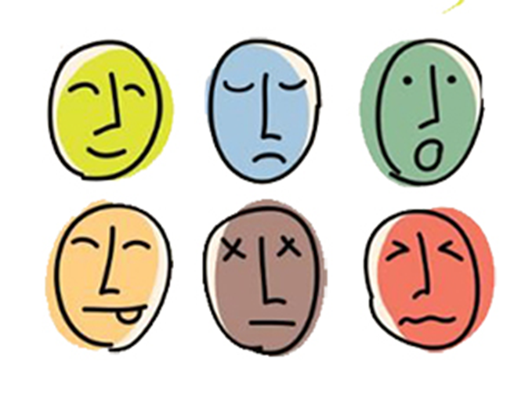
Example of Experiencing
Feeling
Mood
Anxiety

Slide 34

Co-Morbidity is the Rule
A person can have more than one mental illness.
Individuals with mental illness can also be at higher risk for substance use issues, and vice versa.

Slide 35
Examples of Issues with Thinking
Thought Form
  Organized?
  Disorganized?
  Fast Pace?
  Slow Pace?
Thought Content
  Bizarre?
  Plausible?
  Congruent with Mood?

Slide 36

Examples of Issues with Thinking
Loose Associations

Slide 37
Examples of Issues with Thinking: Delusions (Fixed False Beliefs)
Persecution/Paranoia-someone wants to intentionally harm them
Ideas of Reference-special meaning
Delusions of Grandeur (I am the Savior, I can fly, I am telepathic)
Delusions of Control:
  Thought broadcasting - others can read/hear thoughts
  Thought insertion - thoughts have been placed

Slide 38
Examples of Thinking-Trouble with Executive Functioning
Attentional difficulties*
Memory Difficulties*
Organizing
Planning
Self-Monitoring
Regulation of goal-directed behavior

Slide 39
Examples of Behaving (movement, speech, etc…)
Agitation
Other-directed behavior
Catatonia
Slowing
Stereotypic movements

Slide 40
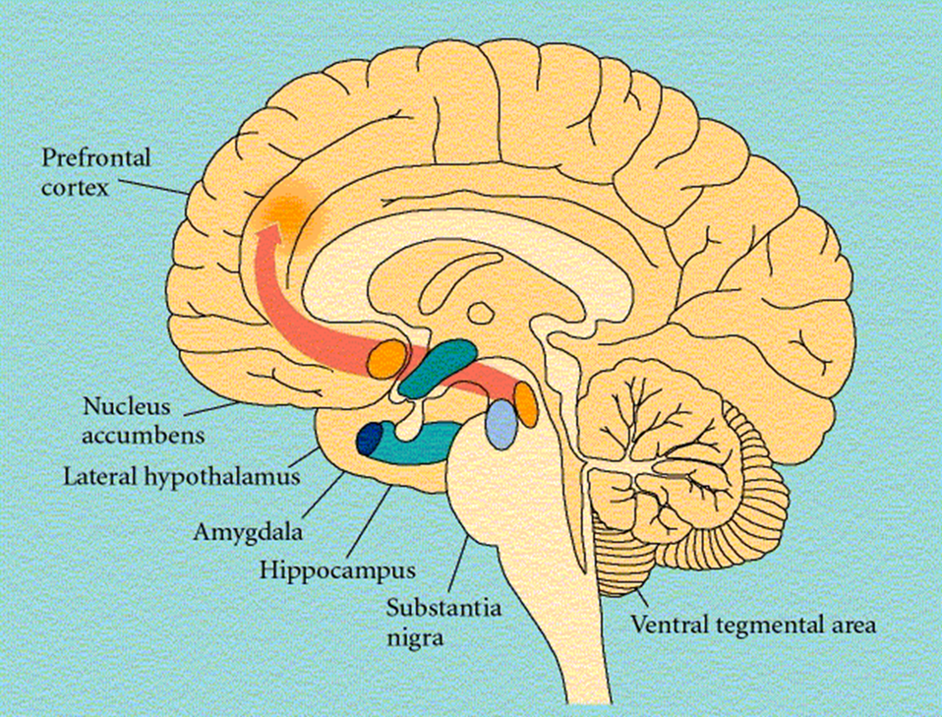
Positive, Negative, Affective, Cognitive Symptoms

Slide 41
Schizophrenia and Violence
Violence is not a common attribute, though a small subset of individuals do have a higher incidence, particularly those who are:
  Angry
  Experiencing Persecutory Delusions
  Inadequately/Untreated
Most likely victim: family member
Perspective: In society, being male and a user of substances brings a much higher risk of violence than having a mental illness
Individuals are much more likely to be victims of violence rather than perpetrators

Slide 42
Recovery Phase (reminder)
Sometimes abrupt improvement (symptoms completely gone)
Sometimes gradual dissipation of symptoms

Slide 43
Effective Treatment of First Episode Psychosis
Components:
  Coordinated Specialty Care
  Shared Decision-Making
  Recovery Oriented
Team Based:
  Strong Leadership
  Care Management
  Supported Employment and Education
  Psychosocial therapies
  Family Education and Support
  Pharmacotherapy and Primary Care Engagement

Slide 44
Disease Centered Model
Professional Role
  Hierarchical
  Paternalistic
  In-Charge
  Holds the knowledge
  Responsible for treatment
  Disease is focus
From Patricia Deegan’s work
Patient Role
  Subservient
  Obedient
  Passive
  Recipient of knowledge
  Responsible for following treatment
  Host of disease

Slide 45
Recovery Model
Person’s Role
  Personal power
  Personal knowledge
  Personal responsibility
  Person in context of life is focus
  Person is self-determining
From Patricia Deegan’s work
Professional’s Role
  Power sharing
  Exchange information
  Shared decision-making
  Co-investigator
  Professional is expert consultant on journey

Slide 46

Recovery
SAMHSA’s working definition of recovery
  Hope
  Person-Driven
  Many Pathways
  Holistic
  Peer Support
  Relational
  Culture
  Addresses Trauma
  Strengths / Responsibility
  Respect

Slide 47
Coordinated Specialty Care
Medication/Primary Care
Psychosocial Therapies
Family Education and Support
Supported Employment and Education
Case/Care Management
Notes:
National Council

Slide 48
Example of what a First Episode Psychosis Coordinated Specialty Care program looks like:
4-6 team members or more (often with “caseloads” of many clients)
Meeting frequently (daily-weekly)
Multiple interdisciplinary-contributors
Understanding the philosophy and skill sets required for FEP treatment

Slide 49
Primary Care
As we had discussed in a previous seminar, it is important to connect an individual with a primary care provider ongoing, in order to:
  Have a good assessment, including review of differential diagnoses
  As part of the assessment, baseline labs and vital signs that could change with treatment.
  Address physical and sexual health issues for young people treated for psychosis …
  Provide ongoing care, in order to reduce burden of physical issues.

Slide 50
Medication
Low dose* anti-psychotic medication
Minimize “polypharmacy,” i.e., keep it simple when possible
Medications with less troublesome side-effects
LAI (Long-Acting Injectables) may be of benefit

Slide 51
Antipsychotic (“Neuroleptic”) Medications
They can have useful benefits
They can have troublesome side effects

Slide 52
The History of Antipsychotics
Typical Antipsychotics
  1950s: chlorpromazine, trifluoperazine, prochlorperazine, mesoridazine
  1960s: haloperidol, fluphenazine, thioridazine, perphenazine, thiothixene
  1970s: molindone, loxapine
  Decanoates: fluphenazine, haloperidol
Atypical Antipsychotics
  1990s: clozapine, risperidone, olanzapine, quetiapine
  2000s: ziprasidone, aripiprazole
  2006+: paliperidone, asenapine, iloperidone, lurasidone, cariprazine
  Long Lasting IM: risperidone, paliperidone, olanzapine, aripiprazole

Slide 53
Course
“Positive symptoms” often respond sooner to antipsychotic treatment than “negative symptoms.”
And, anti-psychotic medications are usually more effective for the former.
Hence, the importance of non-medication treatments previously mentioned:
  Care management
  Supported Employment/Education
  Psychosocial therapies
  Family Education and Support

Slide 54
Psychosocial Therapies:
Group or Individual
  CBT (Cognitive Behavioral Therapy), with focus on helpful thinking patterns and goal-oriented behaviors
  Cognitive Remediation (working on domains of attention/memory/language/executive function)
  Social Skills therapy
  Interpersonal and Social Rhythm Therapy (IPSRT)?-most work has been done re: bipolar affective disorder. Focus on treatment adherence, management of life events, reduction in disruption of social rhythms.

Slide 55
Care/Case Management
Assists with coordination of services
Works on problem-solving skills, social skills, etc…

Slide 56
Peer Supports
Regional (State or County)
  State-Wide Policy Planning Initiatives, Independent Mental Health Commissions, State-Wide Services Evaluations Projects, Legislative Advocacy, State-Wide Clinical Trainings or Continuing Education
Organizational or Program-Level
  Program Planning & Development, Direct Service Delivery, Quality Improvement & Evaluation, Public Outreach Engagement & Stigma Reduction, Internal Staff Training, Consumer Involvement Coordination
Social or Interpersonal
  Challenging Stigma, Engagement with Family and Peers, Active Treatment Engagement (including groups), Advocacy on Behalf of Others
Individual
  Shared Decision Making, Self Advocacy, Personal Goal Setting & Self-Management
Jones N. SAMHSA/CMHS
Notes:
Jones N. SAMHSA/CMHS

Slide 57
Supportive Employment/Education
Reintroduction/placement, as soon as feasible, to work or school setting in concert with personal goals.
Coaching, support

Slide 58
Family Support and Education
Both local supports and education. Family Intervention Therapy…
Connection with regional and national advocacy resources:
  National Alliance on Mental Illness (NAMI)
  Mental Health America (MHA)
  Treatment Advocacy Center (TAC)
  Bazelon Center for Mental Health Law
  Many others…
  See Resource Slide specific to First Episode Psychosis

Slide 59

Additional somatic and other therapies…

Slide 60
Shared Decision-Making
A process by which clinical decisions are:
  Shared by providers and consumers/patients
  Based on the best evidence available about treatments
  Weighted according to the specific needs, preferences and values of the person
  Thus, Culturally Competent care

Slide 61
“How long do I have to stay in treatment?”
Lots of discussion still!
Many variables contribute to the decision.

Slide 62
The individual’s experience:
What do you call “following the program?”
“Adherence” - implies following a plan
“Compliance” - implies following a command

Slide 63
Cognitive Predictors of Treatment Adherence
Strongest related predictor of ability to manage one’s own treatment?: cognitive function*
Schizophrenia-specific difficulties:
  Ability to recall need to perform an action
  Ability to distinguish between intention to perform action (thinking about taking medicine or practicing therapy tools) versus performance (taking the medicine, practicing therapy tools)
*Habitual Prospective Memory

Slide 64

For the Clinician/Agency: Terminology
Stigma and labels
  (fostered by public and profession)
Language matters
(I want to know WHO you are, not WHAT you are…)

Slide 65
Stages of Accessing Care/Opportunities for Reducing Delay
Recognition
  Family/Support Network Engagement
  Symptom Level of Intrusion
Help Seeking
  Family/Support Network Engagement
Agency Response
From WICHE and Wyoming Department of Health
Notes:
From WICHE and Wyoming Department of Health

Slide 66
Administrators and Clinicians
What type of a resource are you?
Does your agency have the ability to assist?
Do you have a program in place, or do you know where to refer?
How flexible is your agency?
From WICHE and Wyoming Department of Health
Help Seeking
  Knowing where to turn
  Referent knowing how to connect
  Trust of provider agency
  Overcoming stigma/belief in positive outcome
  Opportunities to impact:
    Positive community relationships
    Visibility
    Rapid access
    Positive language and examples
Notes:
From WICHE and Wyoming Department of Health

Slide 67
First Episode Psychosis Coordinated Specialty Care Programs and other information
NAVIGATE (RAISE-ETP) U.S. and Canada
Orygen, The National Centre of Excellence in Youth Mental Health-treatment guidelines
One can actually obtain a Master in Science Degree in Early Intervention Psychosis at King’s College in UK.

Slide 68
Resources Specific to First Episode Psychosis
NIMH- RAISE: Recovery After an Initial Schizophrenia Episode
National Council: Early Intervention Treatments for Psychosis
NASMHPD: Treatment Programs
SAMHSA:
  For young adults: Understanding First Episode Psychosis for Young Adults
  For Caregivers: Understanding First Episode Psychosis for Caregivers

Slide 69
So….
In our series, we reviewed and discussed:
  What First Episode Psychosis is and why early identification is important
  The Symptoms of First Episode Psychosis
  Treatment and Resources for First Episode Psychosis

Slide 70

Questions/Comments?

