Slide 1
Understanding & Managing Our Reactions to COVID-19
Rutgers, School of Health Professions
Department of Psychiatric Rehabilitation and Counseling Professions

Slide 2
Northeast and Caribbean MHTTC
Provides 5 years (2018 – 2023) of funding to:
Enhance capacity of behavioral health workforce to deliver evidence-based and promising practices to individuals with mental illnesses
Address full continuum of services spanning mental illness prevention, treatment, and recovery supports
Train related workforces (police/first responders, primary care providers, vocational services, etc.) to provide effective services to people with mental illnesses

Slide 3
Grow Your Knowledge and Skills
Keep up with the latest effective practices, resources, and technologies!
Subscribe to receive our mailings. All activities are free!
https://bit.ly/2mpmpMb

Slide 4
Feedback
Our funding comes from the Substance Abuse and Mental Health Services Administration (SAMHSA), which requires us to evaluate our services. We appreciate your honest, ANONYMOUS feedback about this event, which will provide information to SAMHSA, AND assist us in planning future meetings and programs. Feedback about this training will assist us in developing trainings that are relevant to your current professional needs. Therefore, your feedback counts!

Slide 5
Video Recording Information
Please note that we will be recording this webinar and posting it to our website. Any information and input you provide during today’s call will be recorded and posted on our website.
THANKS!

Slide 6
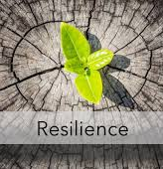
Today’s Agenda
Define the Covid-19 Crisis
Review how the body reacts to traumatic stress
Identify ways to mitigate cognitive disruptions
Practice techniques to reduce physical and emotional stress

Slide 7
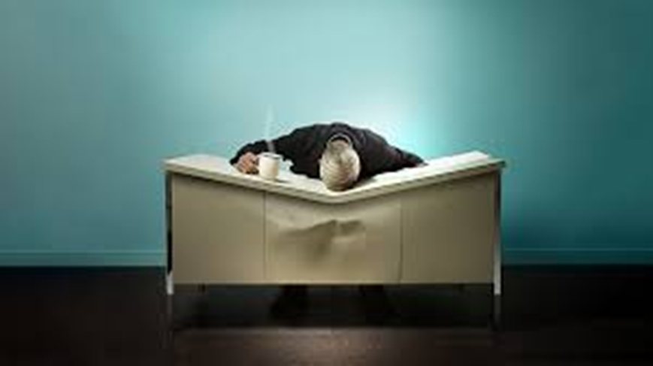
This is hard...
Notes:
Unprecedented health crisis – novel virus that is impacting people in wide spectrum of sx and severity
An abundance of uncertainty – how long will Covid 19 impact our community, how long will social distancing last?
Safety- Seemingly benign tasks, going to get groceries, obtaining the mail, hugging a friend, visiting a loved one
Juggling of roles- reduced boundaries and overlap of work/ school/ personal life
Disruption to life/ to routine/ to how we SHP learn/ practice and congregate
Living in a “new normal”
Navigating a different landscape
Adjusting to the changes
We have all these euphemisms that inadvertently minimize our experiences & down plays what this new reality is…

Slide 8
Covid-19 is a Natural Disaster
“Disasters are a serious disruption of the functioning of society, causing widespread human, material or environmental losses which exceed the ability of the affected society to cope using the available resources.”
United Nations International Strategy for Disaster Reduction, 2009
Notes:
A pandemic is a form of a natural disaster
A disaster follows a crisis or emergency when people have a disruption in meeting their basic survival needs, or there is serious and immediate threat to human life and well being
Normal procedures are suspended and extraordinary measures are taken in order to divert additional crisis or loss of life
Disasters cause trauma and increase in distress, they are a time when people are overwhelmed and struggle to function while utilizing their normal coping skills
Disasters are phasic( 5 phases) with the first phase the impact phase ( when the disaster strikes)
Impact phase on average lasts from 0 -48 hours
We are on day 37 of NJ’s lock down, with no current end in sight
we are all experiencing disaster trauma – the adverse impact on psychological functioning and wellness related to the event/ crisis.
The reality is the no one who experiences a disaster is untouched by it
Your reaction is normal, you are doing all you can to survive and manage this crisis, and we are going to supply you with additional tools to reduce your distress and draw support from our SHP community

Slide 9
Normal Responses to an ABNORMAL Event: Emotional Reactions
Shock
Fear
Grief
Guilt
Shame
Feeling Helpless
Sadness
Feeling Numb
Weber & Mascari, 2018

Slide 10
Normal Responses to an ABNORMAL Event: Physical Reactions
Tension
Fatigue
Insomnia
Body aches/ pains
Fast Pulse
Easily Startled
Weber & Mascari, 2018

Slide 11
Normal Responses to an ABNORMAL Event: Cognitive Reactions
Confusion
Indecisiveness
Worry
Shortened attention span
Trouble concentrating
Weber & Mascari, 2018
Notes:
“You need a lot of physical energy for your cognitive work,”. “We’re doing so much worrying and rumination…there’s a lot that’s going on that’s kind of sucking up our energy.”
Less productive
Things take longer

Slide 12
Normal Responses to an ABNORMAL Event: Interpersonal Reactions
Distrust
Conflict
Withdrawal
Work/ School Issues
Irritable
Loss of intimacy
Feeling rejected / abandoned
Weber & Mascari, 2018

Slide 13
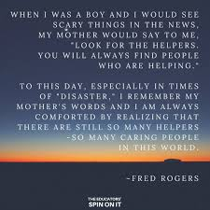
At Rutgers-SHP, we are the Helpers
Notes:
. G is going to provide you with some educational information on how our bodies react to traumatic stress related to Covid 19 and then we will explore ways to mitigate this reaction, to empower you and gove you proactive tools to support your own health and wellness.

Slide 14
How Our Brains
Process Trauma

Slide 15
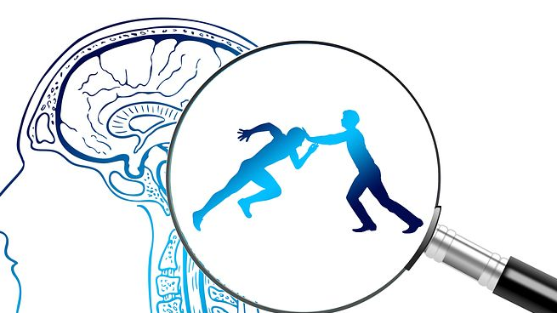
COVID-19
and its connection to
SURVIVAL MODE

Slide 16
How does our brain responds to threat?
Sight
Sound
Smell
Taste
Touch

Slide 17
How does our body responds to threat?
Amygdala- the alarm system in our brain
Our brain is designed to protect us from danger
Once the alarm is set off hormones rush into our body
This sends our nervous system into fight, flight or freeze/faint
This is not done by our choice, this is something that our brain/body does automatically.
Physiological responses: your heart beats fast, increase in breathing, sweating, butterflies in your stomach, blood pressure increases, muscles tense, tunnel vision, and hearing may become more selective

Slide 18
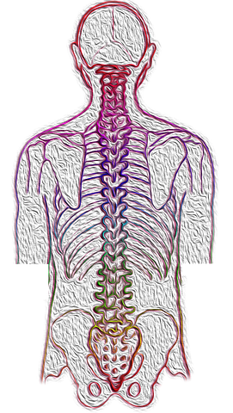
How Trauma Impacts Our Autonomic Nervous System
Sympathetic
Nervous System
Parasympathetic Nervous System
Revs us up
Responsible for Fight and Flight
Increase heart rate
Tenses muscles
Stress, anxiety and fear turn it on
Once it turns on it makes it difficult to think, make decisions and concentrate
Helps to calm down the body
Slows our heart rate
Relaxes muscles
Helps with digestion
We can turn it on with relaxation exercise like breathing exercise, yoga
We can think more clearly when it is turned on
Being social helps turn it on

Slide 19
Triune Brain
Brain Stem (reptilian brain) Fight and Flight: It’s instinctive and reacts automatically and sends messages between the brain and the rest of our body. It also helps to control our bodily functions like breathing, heart rate, swallowing, blood pressure.
Neocotex Cortex (human brain): This is the rational part of our brain. Responsible for language, imagination, consciousness, abstract thinking, organizing, rationalizing and reasoning. Socializing activates this part of the brain.
Limbic System (mammalian brain): Responsible for emotions, memories, arousal and habits. Our Amygdala is located in this system.

Slide 20
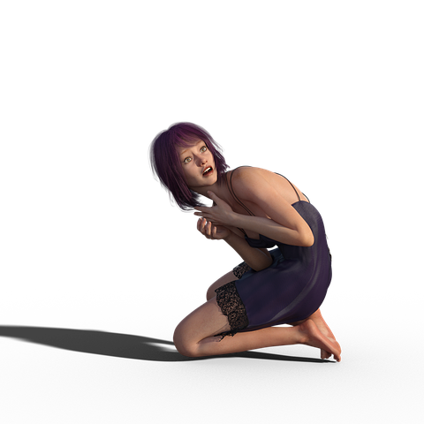
COVID-19 has put us into Survival Mode
We do not choose these states/responses, they are made quickly by our nervous system:
Active Bodily Responses
Fight- to attack or confront aggressively
Flight- to run or flee
Or
Passive Bodily Responses
Freeze- unable to move
Fawn- to hide or comply with who is attacking you
Faint- you lose consciousness

Slide 21
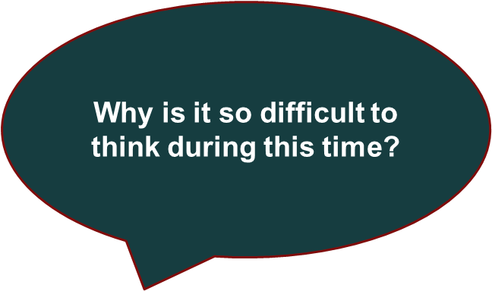

Slide 22
Executive Function | Functional Implication- Trouble with… | Support Strategies | Personal Strategies
Planning: plotting a sequence of steps to achieve a goal | Punctuality Remembering appointments & due dates Estimating how long it takes to complete tasks | Encourage habits/routines Multiple due dates for sections of large projects Early availability of course materials/syllabus | Calendaring with weekly review Use To-Do lists (daily/weekly) Chunking for large tasks Transfer due dates/appointments immediately Task management over time management
Reasoning: thinking through information in a logical way | Identifying solutions to problems Completing assignments Creative expression Test-taking | Opportunity for draft feedback Administrative accommodations (assistance with course selection, registration, financial aid) Requesting model of assignment | Brainstorming (pros/con list) Utilize office hours to clarify Partner with a classmate/colleague Talk through problems out loud Seek out feedback (natural supports)
Attention Control: choosing how one directs their attention | Note-taking Listening to lectures or meetings Reading comprehension Studying | Learning Management Accessibility Exam reader/scribe Record lectures Use of SmartPen Extra time to complete exams | Paraphrasing Active/pre-arranged breaks Shorter more frequent study sessions Schedule based on energy Choosing shorter sections
Inhibiting Automatic Responses: resisting urges that lead to undesired outcomes | Classroom norms Eliminating &/or ignoring internal/external distractions Managing strong emotions | Distraction-free testing area Private feedback on academic performance | Remove phone temptation Turn off Wi-Fi Disable notifications Separate browser for fun/school/work Website blocking software Skill development accepting/responding to criticism
Working Memory: the ability to hold and process information | Committing what is read or seen to memory Keeping track of appointments & due dates Studying for and taking exams Writing papers | Discourage multi-tasking Increased frequency of tests Change of test format Textbooks in alternate format (audiobooks) Use of assistive computer software | Summarizing Overlearning Note-taking: listen for restated points Flash cards Visualization & self-talk
Notes:
As Amy said earlier, “You need a lot of physical energy for your cognitive work,”. “We’re doing so much worrying and rumination…there’s a lot that’s going on that’s kind of sucking up our energy.” We might be less productive (or that could be bc we’re also trying to work with family members and roommates in and out), difficulty with memory, things taking us longer perhaps due to scrolling or Netflix or reorganizing a closet that’s been a mess since you moved in 7 years ago. This very full slide shows some of the common executive functions. Which is really just a fancy umbrella term for the cognitive processes that help thought and action. It also provides examples of what it might look like if we’re having trouble with that area. FOR EXAMPLE… Moving into the 3rd & 4th columns, we have compensatory strategies that can mitigate some of these disruptions you may be experiencing. Some of these things you can implement, while others may require additional, external supports. Perhaps accommodations for work or school. In the resource section of this presentation you’ll find a link for JAN. Also in the resource section you can find some youtube videos and additional resources demonstrating compensatory strategies. We will also be posting a handout along with the slides, recording, and a transcript of this presentation. The handout has some additional information on Executive Functioning and mental health. And if you would like more information on any of this information please let us know in the chat box.
Before we shift focus, are there questions from the chat that we should address?

Slide 23
Eliciting the Relaxation Response
Strategies for switching off your body’s stress response
Notes:
So now that we have an understanding of what might be happening in our body and our brain from traumatic stress let’s begin to review techniques to switch off our body’s stress response.

Slide 24
Assess Your Distress: Subjective Units of Distress (SUDS)
10: Unbearably upset to the point that you cannot function
9: Extremely anxious and desperate, helpless/unable to handle it
8: Worried and panicky; losing focus and feeling anxious in the body
7: Discomfort dominates your thoughts and you struggle to function normally
6: Strong levels of discomfort
5: Upset and uncomfortable; still functional
4: Moderate anxiety and worry
3: Worried or upset; still able to function
2: A little bit sad or distressed
1: No distress; alert and focused
•0: Peace and complete calm
Notes:
People are experiencing unprecedented mental health concerns, some people are experiencing an increase in symptoms/distress while other people w/o previous history of a MHC are experiencing symptoms for the first time
Increase in sx of anxiety
Increases in sx of depression
Compounded by disruption to accessing supports/ family/ friends
Compounded by very legitimate safety concerns
Compounded by utilization of negative coping skills
The SUDs Rating Scale, or Subjective Units of Distress Scale (SUDs) as it is officially known, is used to measure the intensity of distress or nervousness in people with emotional distress. The SUDs is a self-assessment tool rated on a scale from 0 to 10.﻿ The SUDs can be a subjective tool used by your therapist or healthcare provider to evaluate your progress and the success of your current treatment plan or you can use it on your self to get a measure of what’s working and what isn’t. Using a scale to assess your distress provides a way to track and guage your progress when working on your wellness. Try to implement some of the wellness strategies discussed today or ones that you know work for you and rate your distress using the SUDS periodically---see what’s working and what may need to be adjusted.
Rating Your Distress

Slide 25
Social Engagement
How do we maintain our social connection while social distancing?
Notes:
The role of social connection is well documented in mental health and recovery research. In fact it is included as one of the 8 Dimensions of Wellness, a holistic model of recovery endorsed by the Substance Abuse and Mental Health Service Administration. In the context of trauma/PTSD, most of us might not immediately consider the importance of social support. Both research and clinical narratives show that it really is crucial for people who have survived trauma and it also serves as a protective factor for PTSD. Given the importance of social support and the role it plays in our wellness, an important question arises: how do we maintain social engagement while social distancing? How to we engage with our community when we can’t be physically in our community?
For many of this this is going to look pretty different. We can’t go out for coffee with a colleague, attend an AA mtg, spend the whole day in a Broadway theater seeing Harry Potter and the Cursed Child, or if you’re like my husband go to the gym. So how do we prevent isolation, loneliness, and a whole host of other unhealthy coping strategies while we’re under stay at home orders? I would love to hear what you’re doing, enter it in the chat box.
There are 2 resources included at the
This might also look like making masks, donating food to responders and hospital workers, picking up or ordering groceries for a neighbor, buying school supplies for local families, it could be attending a virtual church service, or taking a yoga class via Zoom. Doing virtual support group meetings, join a virtual bookclub, send cards or flowers, NetFlix Party, Disney Sing a-longs, Broadway musicals, visit a museum or aquarium, doodle with artists…
And for some of us who may feel too exhausted at the end of the day to pick up the phone, schedule it in. Make a commitment.

Slide 26
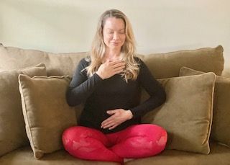
A Breathing Exercise to Calm Our Brain and Nervous System
Place one hand on your heart and one hand on your belly
Take a normal breath in for 4 seconds
Take a long exhale out for 5 seconds

Slide 27
Focus on Your Breath Out
Breathe in for 4 seconds...
Breathe out for
5 seconds…

Slide 28
Grounding Technique
Notes:
Crisis intervention tech. utilized in addressing disaster trauma for those who are feeling overwhelmed, disconnected, and having difficulty calming their thoughts.

Slide 29
Assess Your Distress: Subjective Units of Distress (SUDS)
10: Unbearably upset to the point that you cannot function
9: Extremely anxious and desperate, helpless/unable to handle it
8: Worried and panicky; losing focus and feeling anxious in the body
7: Discomfort dominates your thoughts and you struggle to function normally
6: Strong levels of discomfort
5: Upset and uncomfortable; still functional
4: Moderate anxiety and worry
3: Worried or upset; still able to function
2: A little bit sad or distressed
1: No distress; alert and focused
•0: Peace and complete calm
Crisis Text Line:
Text HOME to 741741
National Suicide Prevention Lifeline:
1-800-273-8255
Notes:
Thank you Amy and Giovanna. Now that we’ve completed these exercises, I want you to take another look at the SUDs. Do you notice a change? How does your body feel? What’s your frame of mind? If you don’t notice anything now, I would encourage you to try these again. Incorporate them into your day when you’re not in a Zoom room filled with colleagues or professors. We will also be hosting another version of this webinar next week, May 7th where we will highlight additional strategies to bring about the relaxation response.
But no matter what strategies you use, remember to take inventory. It can be helpful for you personally but also in conversations with loved ones or providers, it may help to have a record. Now, if you continue to feel like your distress level is climbing, especially when you start to get in that 6 and above range. Consider reaching out to a provider or expert. The Crisis text line is listed on this slide is a wonderful resource that allows you to connect instantly with a professional crisis counselor. There’s also the suicide lifeline which provides free and confidential support. In the slides below, we have curated a variety of resources as well as linked Rutgers specific resources.

Slide 30
Resources

Slide 31
Resources & Strategies for Students
The Hope Center: https://hope4college.com/hope-center-response-to-covid19-for-realcollege-students/
https://hope4college.com/surviving-covid-19-a-realcollege-guide-for-students/
Student Loans During COVID-19: https://www.apa.org/members/content/student-loan-interest-waiver
For graduate students or early career professionals: https://pages.apa.org/staying-on-track/
https://www.apa.org/education/covid-questions
Notetaking: https://www.youtube.com/watch?v=3rFNnhYMlQY&feature=youtu.be
Study and Memory Aids: https://www.youtube.com/watch?v=I9Gv3IHXxNs&feature=youtu.be
WISE Choice Model of Decision Making: https://www.youtube.com/watch?v=I9Gv3IHXxNs&feature=youtu.be
Mental Health America: https://mhanational.org/blog/college-students-7-tips-transitioning-online-classes

Slide 32
Wellness Resources
Apps:
Stop Breathe Think: https://www.stopbreathethink.com/
Headspace: https://www.headspace.com/
Calm: https://www.calm.com/
Breathe2Relax: https://www.psyberguide.org/apps/breathe2relax/
Smiling Mind: https://www.smilingmind.com.au/
Strategies:
Care for Your Corona Virus Anxiety: https://www.virusanxiety.com/
Take a Break: https://www.virusanxiety.com/take-a-break
COVID Anxiety: https://ideas.ted.com/dear-guy-im-incredibly-anxious-about-coronavirus-what-can-i-do/
How to Prevent Loneliness in a Time of Social Distance https://www.scientificamerican.com/article/how-to-prevent-loneliness-in-a-time-of-social-distancing/
Keeping Connected While Staying Apart: http://www.tucollaborative.org/keeping-connected-while-staying-apart/

Slide 33
Resources
HERE4U: https://facultyaffairs.rbhs.rutgers.edu/diversity-inclusion/here4u/
Rutgers COVID-19 Resources: https://coronavirus.rutgers.edu/
Rutgers RBHS COVID Resources: https://academichealth.rutgers.edu/hcp-resource-center
The Job Accommodation Network: https://askjan.org/
The Hope Center: https://hope4college.com/supporting-students-during-covid19/
PsychHub: https://psychhub.com/covid-19/
Self Compassion and COVID19: https://centerformsc.org/self-compassion-and-covid-19/
Zero To Thrive: https://zerotothrive.org/

Slide 34
Additional Covid 19 Support Resources
NJ 211
NJCOVID Hub
NJ Childcare Assistance for Essential Workers
NJ Medical Benefits Assistance
NJ Food Assistance
NJ Employment Safeguards
NJ Unemployment Claims
Covid 19 Grief & Loss Telehealth Group
NJ's Technology Lending Center | Advancing Opportunities
NJWINS
NJ Disability Benefits Calculator
NJ Department of Labor & Workforce Development
US Department of Labor
NJ Covid19 Jobs Portal

Slide 35
What do you want more of?
How can we help?
Notes:
This is a lot of information packed in a very short period of time. The three of us could easily spend hours on any number of these topics. So if there’s something you want more of or something we missed, let us know in the chat so if can inform upcoming webinars.

Slide 36
Thank
you
for
coming!
Notes:
Before we close, we would love to answer questions you may have.
Thank you so much for joining us this morning. Stay well.

Slide 37
Contact us!
By phone: (908) 889-2552
Email:
northeastcaribbean@mhttcnetwork.org
Website:
https://mhttcnetwork.org/centers/northeast-caribbean-mhttc/home
Subscribe to Receive Emails:
https://bit.ly/2mpmpMb
All Event are FREE!
Like and follow us on Social Media!
Northeast & Caribbean MHTTC
@necmhttc

