Slide 1


New Guidelines on Best Practices for Videoconferencing-based Telemental Health
Jay H. Shore, M.D., M.P.H.
Mental Health Technology Transfer Center (MHTTC) Webinar
August 28, 2019
Notes:
Place your title on this first slide and include any subtitle.
DO NOT CHANGE THE FORMAT OF THIS TEMPLATE. If you are creating MHTTC-branded slides, you must use this template. If you move around boxes, make sure to check the reading order. If you widen any boxes they must not overlap any other box.
IF YOU ADD ANY GRAPHICS, you will need to add ALT TEXT and check READING ORDER.

Slide 2

This presentation was prepared for the Mountain Plains Mental Health Technology Transfer Center (TTC) Network under a cooperative agreement from the Substance Abuse and Mental Health Services Administration (SAMHSA). All material appearing in this presentation, except that taken directly from copyrighted sources, is in the public domain and may be reproduced or copied without permission from SAMHSA or the authors. Citation of the source is appreciated. Do not reproduce or distribute this presentation for a fee without specific, written authorization from the Mountain Plains Mental Health Technology Transfer Center. For more information on obtaining copies of this presentation, call 701-777-6367.
At the time of this presentation, Elinore F. McCance-Katz, served as SAMHSA Assistant Secretary. The opinions expressed herein are the views of Dr. Jay Shore and do not reflect the official position of the Department of Health and Human Services (DHHS), SAMHSA. No official support or endorsement of DHHS, SAMHSA, for the opinions described in this presentation is intended or should be inferred.
Notes:
Place your title on this first slide and include any subtitle.
DO NOT CHANGE THE FORMAT OF THIS TEMPLATE. If you are creating MHTTC-branded slides, you must use this template. If you move around boxes, make sure to check the reading order. If you widen any boxes they must not overlap any other box.
IF YOU ADD ANY GRAPHICS, you will need to add ALT TEXT and check READING ORDER.

Slide 3

Disclosures
I am solely responsible for the content of this presentation. It does not represent an official position, policy, endorsement, or opinion of any of the organizations with which I am involved.
Dr. Shore is Chief Medical Officer of AccessCare Services which provides telehealth services and technologies and receives royalties from American Psychiatric Press.

Slide 4
Learning objectives
Participants will become familiar with the recent APA-ATA Best Practices in Videoconferencing-Based Telemental Health.
Participants will learn how to incorporate these best practices as they work with individual patients as well as administer and implement telemental health services.

Slide 5
Outline
History and evolution of technology and medicine and the shaping of telemental health
History of Guideline Development
APA-ATA Guidelines: Overview and pearls

Slide 6

Terminology
Telemental Health
Telepsychiatry, Telepsychology, Teletherapy, Telecounseling
Telebehavioral health
E-mental Health
Guidelines focus on live interactive videoconferencing

Slide 7

Notes:
Epidaurus (EpA der us)
ask-LEE-pee-uhs

Slide 8
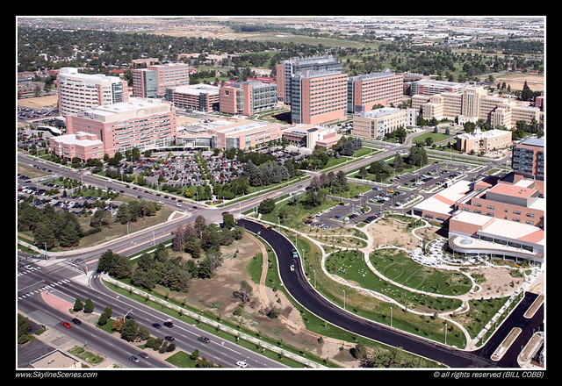
Notes:
Epidaurus (EpA der us)
ask-LEE-pee-uhs

Slide 9





Slide 10


Slide 11


Slide 12


Slide 13



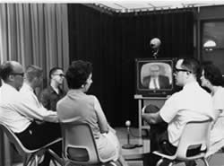

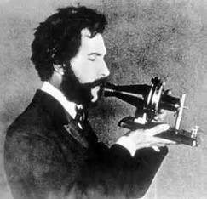
*Telepsych photos from UNMC Archives, Special Collections Department, McGoogan Library of Medicine, University of Nebraska Medical Center, Omaha, Nebraska

Slide 14
Psychiatric Practice
videoconferencing
web-based videoconferencing
email
EHR
telephone
web
mobile
1990
2000
2010
2020
In-person
Telephone
Videoconferencing
Email
Mobile (text and phone)
EHR (patient portals)
Web
Social Networking
AI
Robotic
Metrics/data mining
APPS
Virtual Reality
Models attempt to replicate current in-person care at a distance
Improved care through enhanced models across different modalities-24/7, mobile, asynchronous and coordinated.

Slide 15


Evidence base for Telemental health

Slide 16
Empirical evidence supporting telemental health
2-3 decades of studies
Began with case reports, feasibility, satisfaction and progressed to controlled trials.
An explosion of review articles.
  Hubley, S., Lynch, S. B., Schneck, C., Thomas, M., & Shore, J. (2016). Review of key telepsychiatry outcomes. World journal of psychiatry, 6(2), 269.
  Hilty, D. M., Ferrer, D. C., Parish, M. B., Johnston, B., Callahan, E. J., & Yellowlees, P. M. (2013). The effectiveness of telemental health: a 2013 review. Telemedicine and e-Health, 19(6), 444-454.
  Benavides-Vaello, S., Strode, A., & Sheeran, B. C. (2013). Using technology in the delivery of mental health and substance abuse treatment in rural communities: a review. The Journal of Behavioral Health Services & Research, 40(1), 111-120.
  Hilty, Donald M., Nadiya Sunderji, Shannon Suo, Steven Chan, and Robert M. McCarron. "Telepsychiatry and other technologies for integrated care: evidence base, best practice models and competencies." International Review of Psychiatry30, no. 6 (2018): 292-309.

Slide 17
The Empirical Evidence for Telemedicine Interventions in Mental Disorders
Systematic review of
  Feasibility and acceptance of telemental health
  Randomized controlled trials with sample greater than or equal to 150- both child and adult.
  Included telephone-based therapy.
  Time frame is the decade from 2005-2015
Bashshur, R. L., Shannon, G. W., Bashshur, N., & Yellowlees, P. M. (2016). The empirical evidence for telemedicine interventions in mental disorders. Telemedicine and e-Health, 22(2), 87-113.

Slide 18
The Empirical Evidence for Telemedicine Interventions in Mental Disorders
Countries | Sample Size | Population | Intervention | Effectiveness
US, Australia, Netherlands, UK, Spain, Italy, Sweden | 100 - 3070 | Depression, panic disorder, PTSD, ADHD, Anxiety | Psychotherapy, Collaborative Care, Psychiatric Consultation, coaching, CBT, CPT | Effective, sometimes no difference between treatment arms of two active treatments.
  Telemental health research far exceeds comparable telemedicine research for other conditions in methodologic rigor and sample size.
  Telephone-based telemental health appears to be the technology of choice, followed by Internet-based therapy.
  Focus was primarily on mood and anxiety disorders.
  Research addresses both direct care and consultation / educational models that address workforce issues.

Slide 19
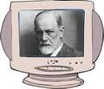
Is Telemental Health as good as Same-Room Care?
Even Freud Agrees!
Yes

Slide 20

Is therapeutic rapport possible?
PATIENTS: No difference in ratings of therapeutic alliance between TMH and same-room care.
PROVIDERS: Perceive high levels of rapport but somewhat lower levels than same room care.
This mirrors satisfaction research where providers are less satisfied with TMH than patients.

Slide 21
American Psychiatric Association
AND
American Telemedicine Association
Best Practices In Videoconferencing-based Telemental Health

Slide 22


Background
Collaboration between the American Psychiatric Association (APA) and the American Telemedicine Association (ATA).
  The ATA is the principal organization bringing together telemedicine practitioners, healthcare institutions, government agencies, vendors and others involved in providing remote healthcare using telecommunications.
  The American Psychiatric Association is an organization of psychiatrists working together to ensure humane care and effective treatment for all persons with mental illness, including substance use disorders. It is the voice and conscience of modern psychiatry. Its vision is a society that has available, accessible quality psychiatric diagnosis and treatment.

Slide 23
OFFICIAL APA AND ATA GUIDELINES, RESOURCES AND TELEMENTAL HEALTH TRAININGS
ATA
APA
Practice Guidelines for Telemental Health with Children and Adolescents (2017)
Online Training for Video-Based Online Mental Health Service (2014)
A Lexicon of Assessment and Outcome Measures for Telemental health (2013)
Practice Guidelines for Video-Based Online Mental Health Service (2013)
Practice Guidelines for Videoconferencing-Based Telemental Health (2009)
Evidence-Based Practice for Telemental Health (2009
APA Web-based Telepsychiatry Toolkit (2016)
Resource Document on Telepsychiatry and Related Technologies in Clinical Psychiatry, Council on Law and Psychiatry (2014)
American Psychiatric Association. Telepsychiatry via Videoconferencing. (1998)

Slide 24
Focus
These guidelines focus on interactive videoconferencing based mental health services (a.k.a., telemental health). The use of other technologies such as virtual reality, electronic mail, electronic health records, telephony, remote monitoring devices, chat rooms, or social networks are not a focus of this document except where these technologies interface with videoconferencing services.
  Administration
  Technical
  Clinical

Slide 25
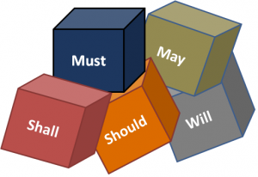
Recommendation Strength
[I] Recommended with substantial clinical confidence
[II] Recommended with moderate clinical confidence
[III] May be recommended on the basis of individual circumstances
Language in document generally parallels strength
  Shall: indicates required action or adherence whenever feasible and/or practical
  Shall Not: indicates a proscription or action that is strongly advised against
  Should: indicates a recommended action without excluding others
  May: indicates pertinent actions that may be considered to optimize the telemedicine encounter

Slide 26
CAVEATS
“It should be recognized that compliance with these recommendations will not guarantee accurate diagnoses or successful outcomes. The purpose of this guide is to assist providers in providing effective and safe medical care founded on expert consensus, research evidence, available resources, and patient needs. “
“This document is not meant to establish a legal standard of care. “

Slide 27

Administrative: Program development
Needs Assessment
  Content: statement, services to be delivered, proposed patient population, provider resources, technology needs, staffing needs, quality and safety protocols, business and regulatory processes, space requirements, training needs, evaluation plan, and sustainability.

Slide 28

Administrative: Legal and regulatory
Licensure and Malpractice
Scope of Practice
Prescribing (Ryan Haight)
Informed Consent
Billing and Re-imbursement

Slide 29

Administrative: sop
How are you going to do it?
What are the common ground rules ?
What is the workflow?
SOP is organic not rigid

Slide 30

Administrative: Emergencies
Standard Operating Procedures/Protocols for emergencies
Shall have technical & clinical competence managing emergencies
Management of emergencies shall be included in procedures
Shall be familiar with local civil commitment regulations and should have arrangements with local staff to initiate/assist with civil commitments or other emergencies

Slide 31
Administrative: emergencies
Patient locations where other medical or support staff are not available in real-time
Should discuss the importance of consistency of location and knowing a patient’s location at the time of care
Shall be aware of the impact of location on emergency management protocols, if patient location changes
  Emergency regulations, resources (e.g., police, emergency rooms, crisis teams), and contacts should be documented
Should consider PSP (Patient Support Person) as clinically indicated and may contact to evaluate nature of emergency or make local 9-1-1 call

Slide 32
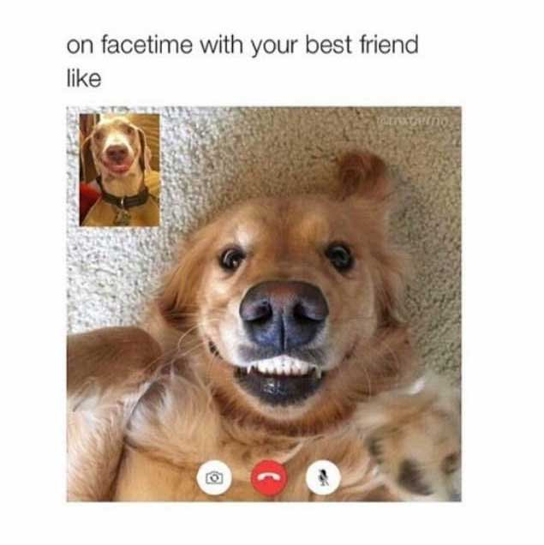
Technology considerations
Appropriate security and encryption
Bandwidth capabilities
Technology support and back-up
  Clinical vs. non-clinical settings
Integration with other technologies
Privacy, security and room requirements

Slide 33
Key Features in Thinking about Technical Aspects of Telemedicine
The videoconferencing application
Device characteristics
    Mobility
Network or connectivity features
How privacy and security are maintained
Notes:
Though there many different types of technologies one can use for real-time videoconferencing, we believe there are four key features that you can use to help you decide which is the best technology for your practice.
First there is the videoconferencing application. For online telemental health, this refers to the software you will be using to conduct the videoconferencing. It is important to learn about all of the features of
the software, such as its optimal bandwidth for transmission, the level of encryption it entails, and whether or not it uses social networking features in conjunction with its videoconferencing features. Each of these features has implications for how you go about setting up the videoconferencing platform for your practice.
Second, there are the device characteristics. Generally, this refers to what type of computer will you be using to host your videoconferencing software. Will it be a desktop computer? A laptop? A smartphone? The decision is yours based on the demands of your clinical practice and whether or not you intend to use the device for other purposes. When making this decision, one will have to consider questions such as how mobile they want the device to be? What other storage demands will be made of the device? What is the mobility of your device? Will this device be working within a larger network that has other specifications that may favor using one type of device over another.
Third, what network or connectivity features will be used in practice. Will all videoconferencing be done through a larger healthcare system network? A private connection to an individual data plan? Will
videoconferencing be occurring through wireless connections? Hot spot connections in the community?
Finally, and very importantly, how are privacy and security maintained on the technology you choose? Again, security issues are of the utmost importance and standards of maintaining technological security change over time. Therefore, it is important to engage a consultant who specializes in this type of security. However, we will try to give you some general guidelines for thinking about how to maintain the privacy of your consultations with patients or with other providers.

Slide 34

Technology: Privacy Concerns
Social Networking Features
  Automatic notification when
  contact list members have
  logged onto the internet
  Availability of chat “room” features that allows others to enter at will.
  Recommendation: Turn these off by changing your default selections
Notes:
Videoconferencing applications.
Many clinicians are using video conferencing applications that they can download for free from the Internet. It is important to note that these applications have multiple uses, some which may not be desirable when providing private consultations to patients or to other providers.
These technologies have many features to promote social networking. For example, they openly display a contacts list which could reveal patient identifying information. In addition, the user of the software could be notified anytime someone in the contacts lists logs onto the computer which many patients may feel intrudes upon their privacy. If you decide these features are not desirable, it is important to turn them off in the default settings prior to treatment.
In addition, when using these technologies turn off any of the default settings that allows one party to interrupt you during a connection with another party.

Slide 35
Technology: Privacy
Technical Aspects of Privacy and Security: Device and network configurations needed to protect identity and health information of the patient.
Behavioral Aspects of Privacy and Security: Behaviors of both patient and provider need to protect identity and health information of the patient.
Notes:
One of the biggest concerns clinicians have when using videoconferencing software to conduct tele-mental health is how to protect patients' privacy and security.
Most often, clinicians focus on the technical aspects that are required for protecting privacy. While technical specifications are important, there are also many behaviors and steps that must be taken by both the clinicians and their patients to ensure privacy.
These essential behavioral steps tend to receive less attention, but they may be more likely to lead to a breach and confidentiality if not attended to in advance.
We will refer to this as behavioral privacy. They are the behaviors both the patient and provider need to engage in to protect the health information of the patient.

Slide 36
Behaviors that Protect Privacy
Behaviors to ensure privacy over and above configuration of the device
  Making sure others cannot hear the session from adjacent rooms
  Educating patients about the importance of storing any session related information securely
  Emphasizing the importance of the patient being in a private space during the session
  Developing protocols for providing care to reduce variability and thereby increase risk of unauthorized disclosure of patient health information
Notes:
We've already discussed many of the behaviors providers need to engage in to maintain the privacy of care provided through online mental health services. However there are additional steps that clinicians need to take about aspects of care that are often taken for granted in same-room treatment.
For example, it's important to talk with patients receiving care in non-clinical settings about whether or not others can inadvertently hear what the patient or the provider are saying. Many patients receiving care in their home, will state that they don't have any secrets from their loved ones. Nonetheless, most people find it much easier to speak freely when they are sure that no one else, even loved ones, can hear what they're saying.
Conducting tele-mental health online also allows for a lot of variability in how you provide your mental health services. With each new way that you provide these services, careful consideration needs to be made for each of the aspects of service that are often taken for granted in same room care. How is privacy protected? How is the patient safety insured? How are patients properly informed about the structure and expectations of the treatment? Every time you see a patient in a new setting all of these important aspects need to be considered and made explicit both to the patient and made explicit in your documentation and medical records.

Slide 37

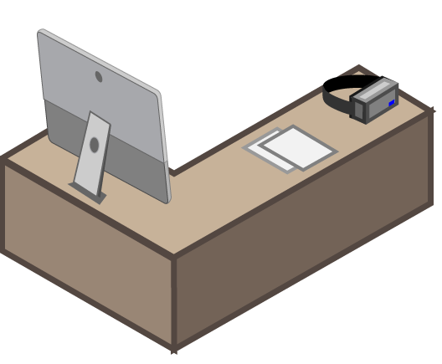

Hybrid care
VIRTUAL SPACE
PHYSICAL SPACE
Advantage for those with avoidant behavior, PTSD, and anxiety
Convenient & immediate
Provider can observe patient in their environment
Indirect & off-hours care opportunities
Modalities include videoconferencing, e-mail, text messaging & telephony
Traditional in-person gold standard
Immediacy & trust in interpersonal interaction
Physical boundaries can be set for therapeutic frame
Ample research and practice guidelines available for healthcare in the physical space
Diagram and illustrations by @StevenChanMD. Content based on Peter Yellowlees & Jay Shore.

Slide 38
Advantages of virtual space
FOR THE PATIENT
FOR THE PROVIDER
Can see providers outside of the patient’s community
Can have highly intense, intimate and empathic relationships
Can discuss embarrassing, stigmatizing, or awkward topics
Can give more direct feedback to patients
Can safely patients who are placed in dangerous settings — e.g. correctional institutions
Can be an objective observer
PHYSICAL
DISTANCE
Diagram and illustrations by @StevenChanMD. Content based on Peter Yellowlees & Jay Shore.

Slide 39
Clinical: ethical considerations
Ethical considerations parallel standards of in person care
Additional considerations include
  consent processes
  patient autonomy, and privacy
  Patient and provider boundaries

Slide 40

Clinical: Space/Time continuum issues, Culture and Environment
Space-time continuum issues
Environmental contexts
Culture and experience of patients in using technology
Rural-Urban considerations

Slide 41
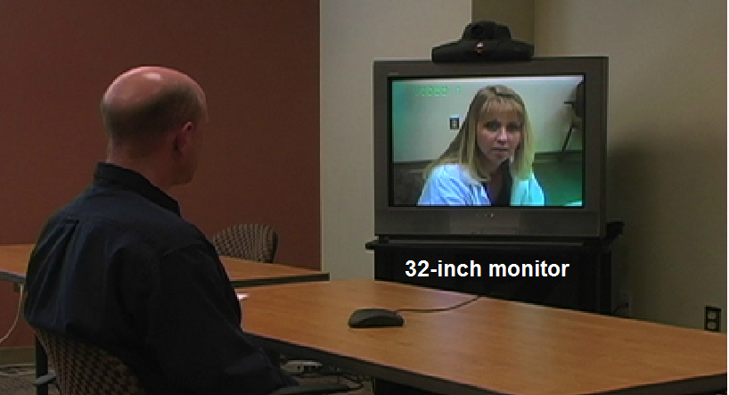
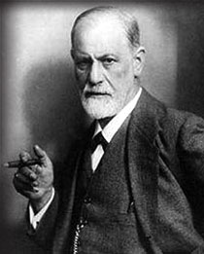
Adapting Personal Style to Video Conferencing
110%, increase in animation
Awareness of how one maybe coming across on the other end (body language space and perception).
  Slight increase in use of body language
  Gaze
Increase small talk
  Asking about local setting (activities, current events, weather, home environment)
  Slight increase in appropriate self-disclosure (bridge virtual gap)
Increased inquiry on patient status and active listening

Slide 42

Clinical: specific populations and settings
Child/adolescent
Forensic and correctional
Geriatric
Military, veteran, and other federal populations
Substance use disorder treatment
Inpatient and residential settings
Primary Care Settings
Rural

Slide 43
Key resources
APA Telepsychiatry Toolkit: https://www.psychiatry.org/psychiatrists/practice/telepsychiatry
Hubley S, Lynch SB, Schneck C, Thomas M, Shore J. Review of Key Telepsychiatry Outcomes. World Journal of Psychiatry. 2016 Jun 22. 6(2); 269-282.
https://www.ncbi.nlm.nih.gov/pmc/articles/PMC4919267/
Yellowlees, Shore Telepsychiatry and Health Technologies: A Guide for Mental Health Professionals, APPI Press, Forthcoming 2017.

Slide 44

Contact information
Jay H. Shore, MD, MPH | Professor
Department of Psychiatry and Family Medicine, School of Medicine
Centers for American Indian and Alaska Native Health, Colorado School of Public Health
University of Colorado Anschutz Medical Campus
Mail Stop F800 | 13055 East 17th Avenue, | Aurora, Colorado 80045
303.724.1465 | fax 303.724.1474| jay.shore@cuanschutz.edu

