Slide 1
Supporting Each Other and Ourselves: Mental Health Awareness and Promotion in the Wake of COVID-19
Ann Murphy, Ph.D., CPRP
PJ Wenger, LPC
Rutgers, School of Health Professions
Department of Psychiatric Rehabilitation and Counseling Professions

Slide 2
Northeast and Caribbean MHTTC
Provides 5 years (2018 – 2023) of funding to:
Enhance capacity of behavioral health workforce to deliver evidence-based and promising practices to individuals with mental illnesses
Address full continuum of services spanning mental illness prevention, treatment, and recovery supports
Train related workforces (police/first responders, primary care providers, vocational services, etc.) to provide effective services to people with mental illnesses

Slide 3
Grow Your Knowledge and Skills
Keep up with the latest effective practices, resources, and technologies!
Subscribe to receive our mailings. All activities are free!
https://bit.ly/2mpmpMb

Slide 4
Disclaimer
This presentation was prepared for the MHTTC Network under a cooperative agreement from the Substance Abuse and Mental Health Services Administration (SAMHSA). All material appearing in this presentation, except that taken directly from copyrighted sources, is in the public domain and may be reproduced or copied without permission from SAMHSA or the authors. Citation of the source is appreciated. Do not reproduce or distribute this presentation for a fee without specific, written authorization from the Northeast and Caribbean MHTTC.
At the time of this presentation, Elinore F. McCance-Katz served as SAMHSA Assistant Secretary. The opinions expressed herein are the views of the presenters, and do not reflect the official position of the Department of Health and Human Services (DHHS), or SAMHSA. No official support or endorsement of DHHS, SAMHSA, for the opinions described in this presentation is intended or should be inferred.

Slide 5
Feedback
Our funding comes from the Substance Abuse and Mental Health Services Administration (SAMHSA), which requires us to evaluate our services. We appreciate your honest, ANONYMOUS feedback about this event, which will provide information to SAMHSA, AND assist us in planning future meetings and programs. Feedback about this training will assist us in developing trainings that are relevant to your current professional needs. Your feedback counts!

Slide 6
Objectives
Understand how COVID-19 has changed our world both personally, professionally and globally.
Identify populations more susceptible to stress during pandemic.
Recognize stress reactions and other mental health concerns in response to pandemic.
Strategies for supporting children and available resources.
Support tools for ourselves and others.

Slide 7
How COVID-19 Has Changed Our World
Parents Becoming Teachers
Social Distancing
Working From Home
Quarantine Reactions
Remote Learning
Decreased Access to Medical Care
Unemployment
Underemployment
Fear of COVID-19
Financial Losses
Conflicting Information
Changes in Death/Dying Rituals

Slide 8
What we are Seeing - Mental Health
20%
Rise
Since Pre-COVID
Top 3 Topics
Anxiety
Depression
Relationships
Add. Topics
Job loss
Grief
Racism
35 and older
Increase in Anxiety
Frontline Workers
LatinX Specific Concerns
African American Loss 2x’s Higher
Asian
Americans Experiences
Notes:
Crisis Text Line(2013) has seen a 20% rise since Pre-COVID
Top 3 topic on the rise via the Crisis line are anxiety, depression and relationships.
More conversations mentioning domestic and substance abuse
Additional increases in conversations about job loss, grief and racism
Shift towards people over 35 having anxiety because they’re not sure how they’re going to support their families.
More people on the front lines. There’s an overall feeling of “What’s next?” The fear, the hopelessness. It’s such a stressful time for everybody.
LatinX community texters are mentioning significantly higher rates of recent discrimination or racism, financial issues, recent loss of a loved one, or difficulty caring for a loved one versus the other texters we’re seeing. And they’re significantly more likely to have a parent that is an essential worker.
Asian-Americans are experiencing three times higher rates of racism and discrimination compared to other texters.
African-Americans are experiencing loss of a loved one two times the rate of other texters.
(Inteview with Jen James, Crisis Text Line Founding

Slide 9
What we are Seeing - Substance Use
Off-premise alcohol sales up 55%
Sales up
Spirits - 75%
Beer - 66%
Wine – 42%
Home delivery of alcohol has increased dramatically – up 300%
Notes:
Off-premise alcohol sales were up 55% in the third week of March this year compared to last year, according to data reported by Nielsen, an international measurement and data analytics company.
Sprits sales increased by 75 percent compared to the same dates in 2019.
Beer purchases up by 66 percent
wine, up 42 percent year-on-year.
Home delivery of alcohol has increased dramatically
and one report notes a 300% increase in alcohol sales
in March compared to January.

Slide 10
Risks Associated with Substance Use
Shelter in Place
Social Isolation
Decreased access to treatment
Decreased opportunity for distraction
Decreased support systems
Increase in relapse
Higher risk of overdose
Higher risk for COVID related death
(Drugabuse.com)
Notes:
COVID19 shelter in place has forced people in struggling with sobriety into isolation
Higher related death due to suppressed respiratory function.

Slide 11
Stress and COVID-19
Health Fears
Financial Concerns
Unemployment
Sleep/appetite
Concentration
Chronic Health Problems
Mental Health Concerns
Increase Substance Use
Regression in kids
Teenage Concerns
Adult Models
Loss of Supports
Notes:
Stress during an infectious disease outbreak can sometimes cause the following:
Fear and worry about your own health and the health of your loved ones, your financial situation or job, or loss of support services you rely on.
Changes in sleep or eating patterns.
Difficulty sleeping or concentrating.
Worsening of chronic health problems.
Increase use of tobacco, and/or alcohol and other substances
Young children may be regressing and are in need of age appropriate explanations about COVID-19
Teenagers may be experiencing more depression as the result of physical distancing or missing events.
Children of all ages are vamping off of the adults who are around them and their reactions.

Slide 12
Populations More Susceptible to Stress
Older adults
Underlying health conditions
Children and teens
Care givers
Frontline & essential workers (e.g., health care providers, first responders, retail clerks, food industry)
Existing mental health conditions
Substance use

Slide 13
Populations More Susceptible to Stress
Job loss, reduced of work hours, other changes to employment
Individuals with disabilities
Socially isolated, living alone, or reside in rural areas
Some racial and ethnic groups
Language barrier (e.g., ESOL, hearing/visual impairment)
Homelessness
Congregate living
Notes:
ESOL – English for Speakers of Other Languages

Slide 14
Experiences of Children
Uncertainty
Frustration
Fear
Anxiety
Depression
Hopelessness
Helplessness
Grief/Loss

Slide 15
Experiences of Older Adults
Fear
Isolation vs. loneliness
Disconnection from support systems
Limited access to remote platforms
Virtual socialization
Decreased availability of virtual resources
Minimization of the value of older adults
Limited financial resources
Elder abuse
This Photo by Unknown Author is licensed under CC BY-NC-ND

Slide 16
Experiences of People with Disabilities
Isolation vs. loneliness
Need for care making social distancing difficult
Exposure by caregivers
Challenges practicing precautionary measures

Slide 17
How to Help
Develop care plans
Emergency notebooks
2 plans for communication
Ample supply of medications
Supplies for 2 week period
Ask - what might work for you?
Notes:
I’m not sure if this slide is needed. Seems like the time for this has passed somewhat.

Slide 18
What Affects How You Respond to COVID-19?
Background
Social support system
Personal health
Emotional background
Community
Trauma load
Coping strategies
This Photo by Unknown Author is licensed under CC BY-SA

Slide 19
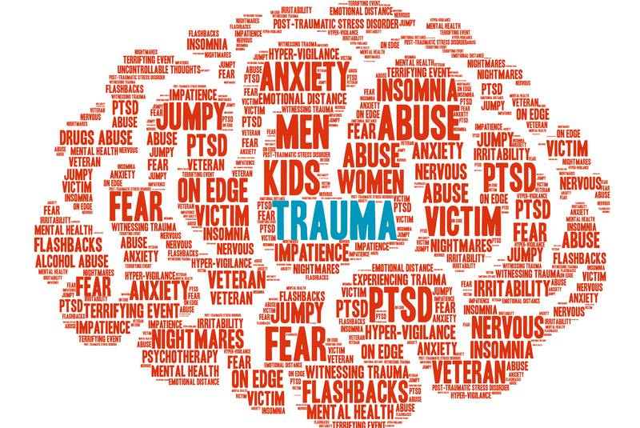
Trauma and COVID-19
Isolation
Financial
Fear of contagion
Reduced access to medical care
Anticipatory grief
Affects all aspect of life
Increased contact with family +/-

Slide 20
Signs of COVID Stress
What people are saying…
Fear has immobilized me
I feel trapped
I’m frozen
I can’t/don’t want to move
I feel like a hostage
I just can’t…
I’m freaking out
I’m losing it
I’m barely keeping it together
The day goes by and I don’t do anything but lie on the couch and watch TV
Notes:
During this slide I will also identify how these statements can be indicative of a mental health issue as well.

Slide 21
Mental Health Concerns
Anxiety Existing or Newly Experienced
Depression Existing or Newly Experienced
Substance Use
Relapse, Increased, Newly Experienced
Grief
Grief and Loss
Anticipatory Grief

Slide 22
Notes:
Transition slide to begin talking about taking care of yourself.

Slide 23
Assess your Wellness
Notes:
How are you feeling in each of the dimensions of wellness? What are you doing to support your wellness right now? Which areas need more attention?

Slide 24
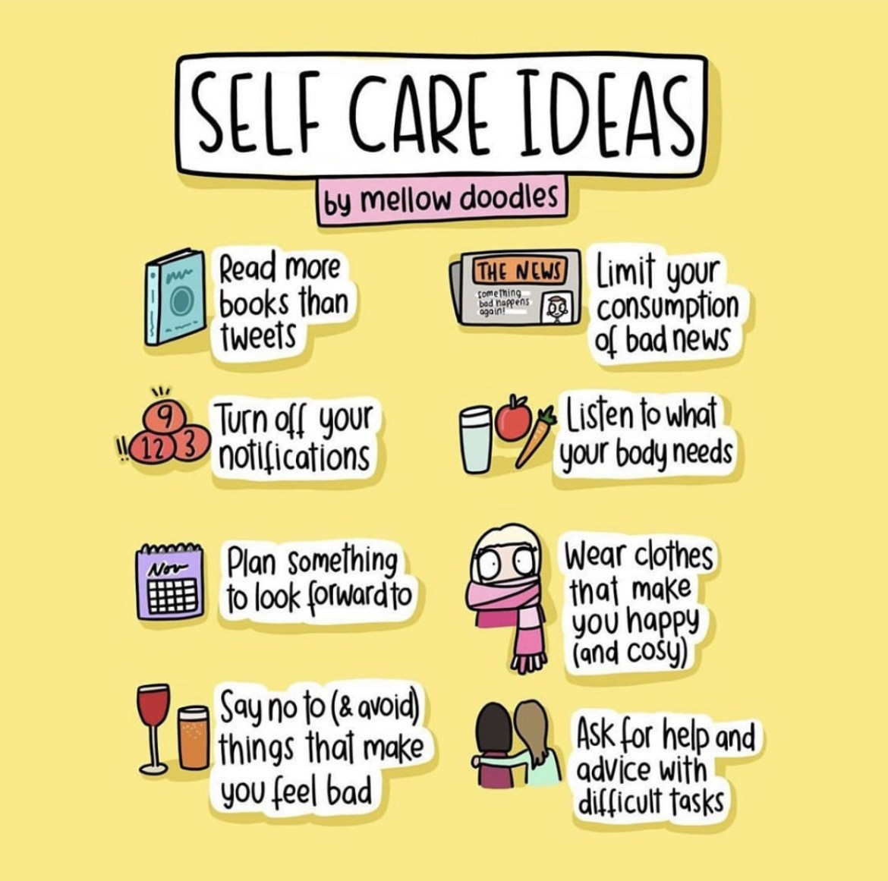
Self-Care Plan
https://store.samhsa.gov/product/Creating-a-Healthier-Life-/SMA16-4958
Notes:
Consider creating a self-care plan. There are many out there. One has been created by SAMSHA and helps you explore each of the 8 dimensions of wellness and provides ideas regarding strategies to include in your plan. It breaks down each dimension (for example physical is broken down into nutrition, physical activity, sleep, alcohol, tobacco, other drugs, medication safety, and preventative medicine). and provides things to consider in each dimension as well as providing related resources. Then it prompts you to identify what you will do to improve in that area and what you need to do those things.
But you can also create your own more creative plans.

Slide 25
Make a Schedule
Notes:
Make a schedule
balance time for self, others, work, family
This lack of structure and routine can actually exacerbate your feelings of distress and make you pay more attention to the source of your problems.
Research has consistently shown that routines can play an important role in mental health.¹﻿ One study, for example, found that routines could help people better manage stress and anxiety.²
﻿
Having a regular routine can help you:
Lower stress levels
Form good daily habits
Take better care of your health
Help you feel more productive
Help you feel more focused
Focus on things you can control (when you wake up and go to sleep)
Can look like a full schedule or just a to do list.

Slide 26
Social Engagement
How do we maintain our social connection while social distancing?
Notes:
The role of social connection is well documented in mental health and recovery research. In fact it is included as one of the 8 Dimensions of Wellness, a holistic model of recovery endorsed by the Substance Abuse and Mental Health Service Administration. In the context of trauma/PTSD, most of us might not immediately consider the importance of social support. Both research and clinical narratives show that it really is crucial for people who have survived trauma and it also serves as a protective factor for PTSD. Given the importance of social support and the role it plays in our wellness, an important question arises: how do we maintain social engagement while social distancing? How to we engage with our community when we can’t be physically in our community?
For many of this this is going to look pretty different. We can’t go out for coffee with a colleague, attend an AA mtg, spend the whole day in a Broadway theater seeing Harry Potter and the Cursed Child, or if you’re like my husband go to the gym. So how do we prevent isolation, loneliness, and a whole host of other unhealthy coping strategies while we’re under stay at home orders? I would love to hear what you’re doing, enter it in the chat box.
There are 2 resources included at the
This might also look like making masks, donating food to responders and hospital workers, picking up or ordering groceries for a neighbor, buying school supplies for local families, it could be attending a virtual church service, or taking a yoga class via Zoom. Doing virtual support group meetings, join a virtual bookclub, send cards or flowers, NetFlix Party, Disney Sing a-longs, Broadway musicals, visit a museum or aquarium, doodle with artists…
And for some of us who may feel too exhausted at the end of the day to pick up the phone, schedule it in. Make a commitment.

Slide 27
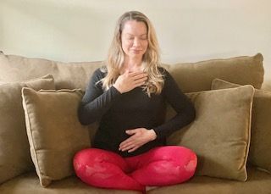
Breathing and Calming Exercises
Place one hand on your heart and one hand on your belly
Take a normal breath in for 4 seconds
Take a long exhale out for 5 seconds

Slide 28
Grounding Techniques

Slide 29
Additional Strategies
Limit the amount of exposure to negative news
Acknowledgement of feelings about the virus
Do something out of the ordinary
Exercise, eat well, sleep
Use aromatherapy
Reduce caffeine
Journal
Gratitude practice
Develop a body practice (e.g., Yoga, Tai Chi, Pilates)
Develop a meditative skill (e.g., knitting, crocheting, painting)
Develop a tool box
Notes:
Plan is the same for students and staff

Slide 30
Helping Others

Slide 31
Ages 4-7
Provide an age appropriate explanation
Provide REAL play time
Engage in new and interesting activities
Lower expectations of kids understanding
Utilize online resources
Practice relaxation exercises
Notes:
Provide an age appropriate explanation of why things are going to be different for a while
Provide time to really play with kids
Have a plethora of new and interesting age appropriate activities
Do not expect kids this age to understand social distancing.
Utilize on line resource to go on virtual tours of zoos.
If possible get some unique and engaging toys
Do relaxation exercises.

Slide 32
Ages 7-10
Provide age appropriate information
Dispel rumors or misinformation
Review healthy practices
Maintain a schedule
Teach relaxation techniques
Consider yoga https://www.karmakidsyoga.com
Bee You Kids Yoga and Mindfulness on Facebook https://www.thelittlegym.com
Notes:
Age appropriate Information
Engage in conversations. What do they know.
Healthy practices i.e. hand washing, masks. Etc.
Schedule- play rest alone time family time.

Slide 33
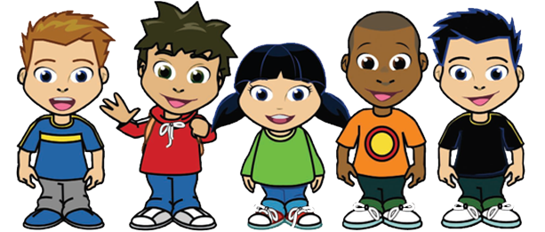
Ages 10-13
Develop a schedule - VERY IMPORTANT
Encourage good sleep/hygiene
Have realistic expectations about schoolwork
Acknowledge time spent on school
Validate how hard this is for them
Share how hard it is for you
Suggest doing things together to manage stress
Notes:
Acknowledge time whether they finish one or all of their assignments.

Slide 34
Ages 13-17
Connections with peers
Acknowledge their losses
Avoid minimizing feelings
Listen with non-reactivity
Allow time alone
Intervene if isolating
Monitor for changes in behavior and mood
Provide options for connection with peers (e.g., play social video games, eating on zoom, going for a walk or a bike ride)
Consider online therapy if needed
This Photo by Unknown Author is licensed under CC BY-NC

Slide 35
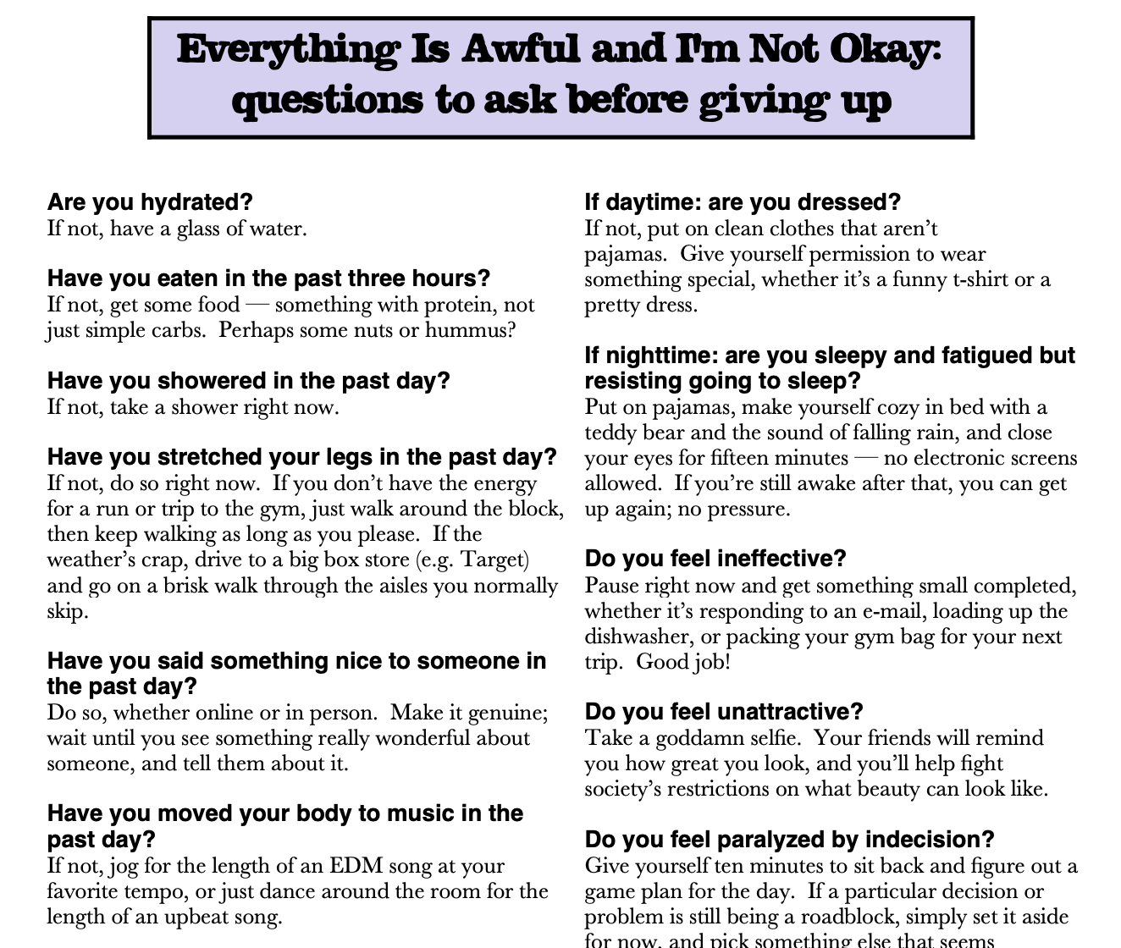

Slide 36
Making the Transition
Uncertainty
2 steps forward 1 step back
Empathy
Evidenced-based decision making
Transparency
Visibility vs. Planning & Strategizing
Collaboration
Compassion
Increased Anxiety
Notes:
Will not be “like it used to be”
Not a light bulb but a dimmer switch that goes back and forth as we adjust
Empathy for our co-workers, staff, etc. We don’t know who has been affected by the COVID via relatives, friends, co-workers or facing death from COIVD (a teacher who maybe is a volunteer fireman or EMT on weekends)
Evidence Based Decisions- Not politically motivated or driven by misinformation or conspiracy theories.
Transparencies- Let people know what is going on and how decisions are being made.

Slide 37
Helplines
Suicide Prevention Lifeline
1-800-273-8255
Veterans Crisis Line
1-800-273-8255
Substance Abuse & Mental Health Services Administration (SAMHSA) National Helpline
1-800-662-HELP (4357)
OK2Talk Helpline Teen Helpline
1 (800) 273-TALK
Crisis Text Line
Text SIGNS to 741741 for 24/7, anonymous, free crisis counseling
Disaster Distress Helpline
Call 1-800-985-5990, or Text TalkWithUs to 66746
National Domestic Violence Hotline
1-800-799-7233 and TTY 1-800-787-3224.

Slide 38
Help Finding Treatment
SAMSHA’s Behavioral Health Treatment Services Locator
American Psychiatric Association Foundation
American Academy of Child and Adolescent Psychiatry
American Psychological Association

Slide 39
Resources for Opioid and Substance Use
Local Health Centers for Substance Abuse Services
Buprenorphine Treatment Practitioner Locator
Opioid Treatment Program Directory by State Providing Medication-Assisted Treatment
Behavioral Health Treatment Services Locator (SAMHSA)-https://findtreatment.samhsa.govz

Slide 40
Resources For Children Ages 4-7
Moovlee
Moovlee is great for toddlers who need to move around while parents work from home. These friendly monkeys guide your kids through several different workouts including yoga, meditation, stretching, and even Kung Fu! Browse through their video library on Youtube whenever you need some indoor exercise for kids.
Karma Kids Yoga https://www.karmakidsyoga.com (Free)
The Little Gym https://www.thelittlegym.com/classes (Free)
Obe Fitness https://obefitness.com/schedule (Free Trial)
Books for PreK-Teenagers https://www.newyorkfamily.com/books-pre-k-to-teenagers-during-coronavirus-new-york/
PBS Kids- Free Daily Activities for kids to play and learn at home. https://pbskids.org

Slide 41
Resources for Children Ages 4-7
DuckDuck Moose- Offers free, interactive iPad apps for the younger set. http://www.duckduckmoose.com
ABCmouse.com Offers almost 1,000 lessons across 10 levels, covering reading, math, science, social studies, and art. With animated lessons and games, curriculum is supported with music, puzzles, printable worksheets, and art projects. https://www.abcmouse.com/abt/homepage?8a08850bc2=T2932261623.1592587825.2627
National Geographic Kids https://kids.nationalgeographic.com
Sesame Street https://www.sesamestreet.org
Fun Brain https://www.funbrain.com
Disney Jr http://disneyjunior.disney.com.au/games

Slide 42
Resources for Children Ages 7-10
Alo Yoga https://www.aloyoga.com/pages/alo-gives
Books for PreK-thru Teenagers https://www.newyorkfamily.com/books-pre-k-to-teenagers-during-coronavirus-new-york/
Kidsbridge-Free Resource calendar for activities for children https://www.kidsbridgecenter.org/kidsbridge-at-home/
Go Noodle- On line dance, exercise https://www.gonoodle.com
Kids Learn to Cook https://kidscookrealfood.com
Fun Brain https://www.funbrain.com
Highlights For Kids https://www.highlightskids.com
Disney Jr. http://disneyjunior.disney.com.au/games

Slide 43
Resources for Children Ages 10-13
Fun Brain https://www.funbrain.com
Books for PreK-thru Teenagers https://www.newyorkfamily.com/books-pre-k-to-teenagers-during-coronavirus-new-york/
Kids Learn to Cook https://kidscookrealfood.com
****Resources can be pulled from the 7-10 list or the 13-17 list depending on the maturity level of the child.

Slide 44
Resources for Children Ages 13-17
Youth Service America YSH Youth helping community https://ysa.org/covid/
EntertainmentCalendar.com Has multiple activities for teens to participate in every day. https://rochester.kidsoutandabout.com/content/1000-things-do-during-covid-19-online-activities-kids-teens-families-and-adults
The Times is working with Verizon to provide high schools with three free months of digital access from April 6 to July 6 — helping students stay connected to the world, even as they learn remotely. https://www.nytimes.com/initiative/highschoolaccess

Slide 45
Resources for Children Ages 13-17
Atlas is a wellness journaling app dedicated to helping you live the good life. Atlas guides you through day-to-day stress of relationship drama, dealing with fake friends, family problems, school work, and getting enough sleep. Helps you with the big picture too: pursuing purpose, finding connectedness, knowing your authentic self, and navigating an uncertain future. https://www.atlasmh.com
Google Arts & Culture https://artsandculture.google.com
Audible-provides entertainment and stories https://stories.audible.com/start-listen
Duolingo-Learning a new language https://www.duolingo.com

Slide 46
Additional Resources
Downloadable care plan from the CDC https://www.cdc.gov/aging/caregiving/pdf/Complete-Care-Plan-Form-508.pdf
Calm App Daily Calendar https://static1.squarespace.com/static/57b5ef68c534a5cc06edc769/t/5eab6adcdb2c571335f4c005/1588292502618/2020+Daily+Calm+Calendar.pdf
Creating a Healthier Life: A step by step guide to wellness: https://store.samhsa.gov/product/Creating-a-Healthier-Life-/SMA16-4958
https://www.healthline.com/health/9-resources-for-coping-with-coronavirus-anxiety#8.-Breathe-deeply-with-guided-GIFs
https://youfeellikeshit.com/index.html
https://i0.wp.com/everydayshouldbefun.com/wp-content/uploads/2015/07/5ab1b4d87915aa3d85770ceab611292e.jpg
https://quarantinechat.com
Everything is awful and I’m not okay : https://depts.washington.edu/fammed/wp-content/uploads/2019/03/Katers-selfcare_printable.pdf

Slide 47
Contact us!
By phone: (908) 889-2552
Email: northeastcaribbean@mhttcnetwork.org
Website: https://mhttcnetwork.org/centers/northeast-caribbean-mhttc/home
Like and follow us on Facebook and Twitter!
Find us at
Northeast & Caribbean MHTTC
@necmhttc
@Northeast and Caribbean MHTTC

