Slide 1
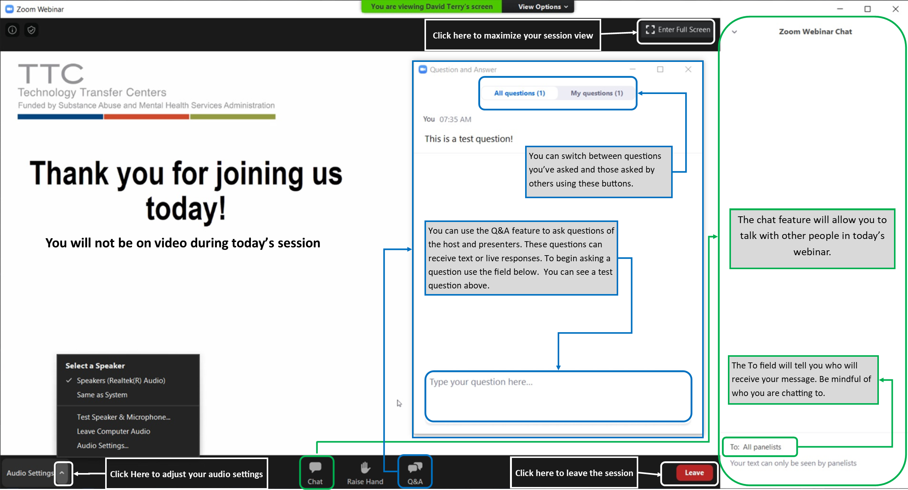
Please Note:
All attendees are muted
Today’s session will be recorded
Get to know the Zoom Webinar interface
Notes:
This slide is intended to be displayed via screen share as people are first joining your meeting or webinar room.
TTC Logo – Consider replacing this logo with your center logo if this is a regional training. Refer to the TTC style guide regarding what logos to display when hosting a cross-region or cross-TTC training.
If this training relates to telehealth please use the TTC Telehealth logo
Please Note -The Please Note section can include whatever information you feel like people should see when they are first joining the webinar/meeting.
Consider reminding people to mute themselves (if this is an option) or that they are already muted.
Consider letting people know if the session will be recorded. Give people a reminder that they will be receiving a prompt that the session is being recorded when the host hits the record button. Also mention that they will be able to access the recording at a later date.
Zoom Webinar Screen Image – This screen grab summarizes many of the features unique to webinars on Zoom. Region 9 MHTTC has developed a similar graphic for Zoom Meetings.
Regardless of what platform you are using, consider developing similar images to assist your audience in feeling comfortable with the technology you are asking them to use.

Slide 2
Rural but Reachable:
How to Build Grief Support by Creating Community

Slide 3
Housekeeping Items
We have made every attempt to make today’s presentation secure. If we need to end today’s presentation unexpectedly we will follow-up with you using your registration information.
All attendees are muted and attendees cannot share video during this session.
Remember to ask questions using the Q&A feature
Follow us on social media: @MPMHTTC
Notes:
Housekeeping Items – This slide (or series of slides) should contain all of the important information that people need to know regarding the training session. Sample messages have been added, but should be edited for your training/audience as needed.
Consider pre-writing prompts for many of these items so you can easily copy and paste things into the tele-video chat feature (examples follow each section as appropriate). Remember to use attendees names when sending chat messages.
Safety – Given the increasing reliance on tele-video conferencing safety has become a major concern. Address with your audience how you will handle an unplanned interruption in your session. Consider mentioning that if a session is “Zoom-bombed”, or otherwise interrupted by inappropriate behavior that you will end the session for everyone and follow-up with people using the registration information they provided. Use this item to give yourself, your presenters, and your attendees permission to end or leave the session should things become unsafe.
Sample message – you should not use typed responses if you are closing a session due to unsafe behavior. If possible: open your microphone and state that you are ending the session. Then end the session. Be decisive in ending a session and then immediately follow-up with your attendees.
Audio/Visual information – Let your attendees know your expectations around use of audio and video. If attendees are automatically muted or prevented from using their cameras, tell them. If you expect attendees to mute themselves and remain muted when not speaking, ask them to do so. Let attendees know if you will be muting people as necessary. Let people know if you expect them to be visible on camera during the presentation or meeting (hopefully this expectation is made clear in advertising for the meeting).
Sample message – Thank you for joining us today! Please note that all participants have been muted.
How to Access Training Resources – Let your attendees know how to access training materials from today’s session. If possible, send presentation slides ahead of time, or have them uploaded to a webpage that is easily accessible at the time of training. Share download links and web addresses for materials using your chat feature. If the meeting in being recorded, and the recording will be posted later, let people know this. Tell people where they can view the recording when it is available.
Sample message – Thank you for your question! You can access today’s presentation slides here: [HYPERLINK]
Communications with hosts and others – Let people know how to communicate with hosts and one another using in meeting messaging. If you are using a Zoom webinar with the Q&A feature (or something similar) remind people to use this feature. Let people know if you have also enabled the chat feature to allow communication with other attendees. If you are allowing people to use the chat feature remind them that their messages may be visible to others depending on how the message is sent.
A sample statement developed by Region 8 MHTTC and Region 8 PTTC is:
The Q&A feature has been enabled for this webinar. Please use the Q&A feature to send relevant questions to the presenters. (Our program staff will actively monitor the qustions submitted using the Q&A feature and the presenter will attempt to answer these questions during our Q&A session at the end of today’s training.) The chat feature is also enabled for this webinar. Please use this feature appropriately. (Depending on how you are using the chat feature, information you submit can be viewed by all attendees. Please keep this in mind when using the chat box. This feature can be disabled for everyone if not used appropriately). [bolded text is intended to be added to the slides and parenthetical text is intended to be read]
Sample message – Thanks for your question! Please remember to ask questions of our presenter using the Q&A feature.
Sample message – Thank you for your question! We will address this during the Q&A session today.
Certificates of attendance or CEUs – Let attendees know what is required to obtain certificates of attendance or continuing education from the training session.
Tell people if they :
Need to view the entire live session of the presentation
Are required to complete a follow-up test
CANNOT receive credit for watching a recording of the session
Need to put information in the chat box to confirm attendance
Sample Message – Thanks for your question! If you need assistance related to certificates of attendance following today’s session please email: [EMAIL ADDRESS]
Social media engagement – Let people know how to continue to engage with you. If you use Twitter, or are live tweeting during your training or meeting tell people how to find you.
Sample message – Thanks so much for joining us! Please visit our website for more information about our program: [HYPERLINK]

Slide 4
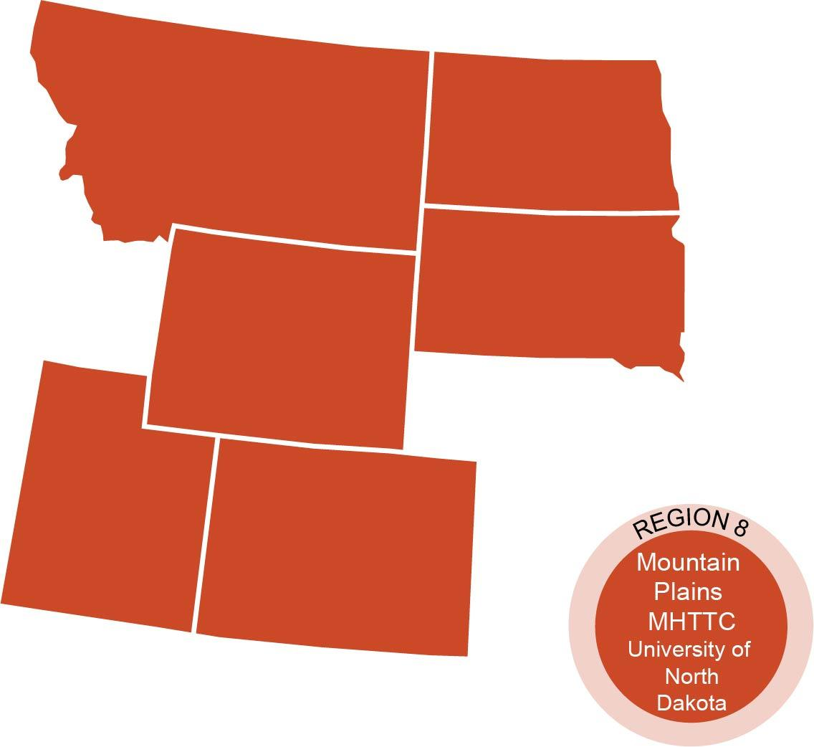
Who We Are
The Technology Transfer Center (TTC) Network is a national network of training and technical assistance centers serving the needs of mental health, substance use and prevention providers. Today’s training is hosted by the Mountain Plains Mental Health Technology Transfer Center (Mountain Plains MHTTC) from Health and Human Services (HHS) Region 8. The work of the TTC Network is funded under a cooperative agreement by the Substance Abuse and Mental Health Services Administration (SAMHSA).

Slide 5
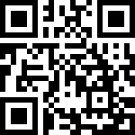
Evaluation Information
The Mountain Plains MHTTC is funded through SAMHSA to provide this training. As part of receiving this funding we are required to submit data related to the quality of this event.
At the end of today’s training please take a moment to complete a brief survey about today’s training.
Notes:
GPRA information – At the beginning of your presentation give people a notice that you will be asking them to complete a GPRA survey at the end of the session.
Picture field – Consider adding your GPRA QR code into your slide so participants can scan the code using their phone. Additionally, consider pre-setting text to add to the chat-box. Example text could be: Thank you so much for participating in our training! Please take a moment to complete a brief survey about today’s training here: [GPRA link]
When using Zoom Webinar – Zoom webinar provides you with the ability to set a “Post attendee URL”. Participants are directed to this link when they leave your Zoom session. You can access information about setting Post attendee URLs in Zoom here: https://support.zoom.us/hc/en-us/articles/360000518526-Post-Attendee-URL
Anecdotally - we have observed a 70% rate of GPRA completion when using the post attendee URL versus a 25-30% return rate when just using QR codes, links in chat box, and follow-up emails with GPRA links when hosting online trainings.

Slide 6
Disclaimer
This presentation was prepared for the Mountain Plains Mental Health Technology Transfer Center (Mountain Plains MHTTC) under a cooperative agreement from the Substance Abuse and Mental Health Services Administration (SAMHSA). All material appearing in this presentation, except that taken directly from copyrighted sources, is in the public domain and may be reproduced or copied without permission from SAMHSA or the authors. Citation of the source is appreciated. Do not reproduce or distribute this presentation for a fee without specific, written authorization from the Mountain Plains MHTTC. For more information on obtaining copies of this presentation please email david.v.terry@und.edu.
At the time of this presentation, Elinore F. McCance-Katz served as SAMHSA Assistant Secretary. The opinions expressed herein are the views of Cynthia Drake and do not reflect the official position of the Department of Health and Human Services (DHHS), or SAMHSA. No official support or endorsement of DHHS, SAMHSA, for the opinions described in this presentation is intended or should be inferred.
Notes:
Disclaimer – This slide was developed using the language contained on page 12 of the TTC style guide manual.
Items in red will need to be adjusted based on the type of information this disclaimer relates to (presentation, publication, recording, etc.)
Items in blue will need to be adjusted based on your center information and contact information.
Items in green will need to be adjusted based on your presenter’s information.

Slide 7
Rural but Reachable:
How to Build Grief Support by Creating Community

Slide 8
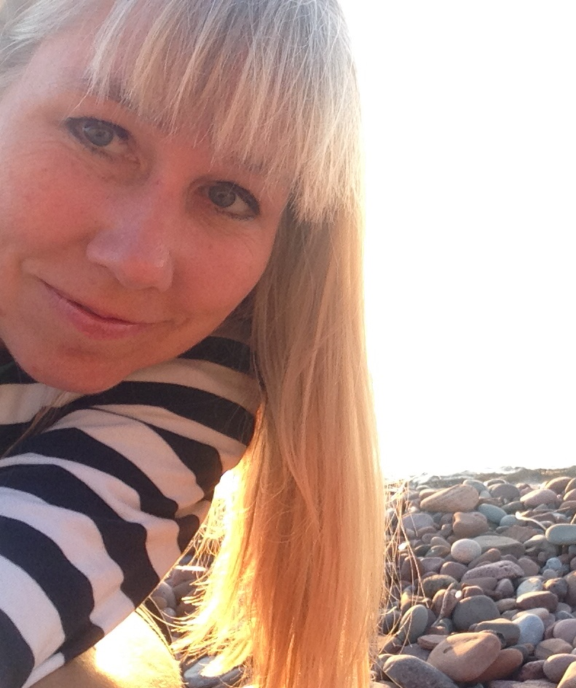
Today’s Presenter
A native of Colorado, Cynthia Drake attended the College of Wooster in rural Ohio and earned a BA degree in Sociology with a Concentration in Anthropology. Post-graduation, she relocated to the Upper Peninsula of Michigan to work at a non-profit, Little Brothers - Friends of the Elderly, serving lonely and isolated elderly people with socialization programs.
During Cynthia’s 31-year career working and serving rural people, she has worked serving elderly people; a local helpline; with sexual assault victims; as a volunteer with domestic violence victims; helped to found and create a land trust; and with the local hospice program where she teamed in developing its first community grief support program. She is currently the Grief Counselor at Omega House, guiding a monthly support group and offering individual counseling. In addition she manages her business, Openings Life Coaching, working with people individually and in group retreats to reach their highest potential.
Living in the UP, Cynthia is familiar with the challenges of rural living. She understands the importance of community building, one relationship at a time.

Slide 9
Rural But Reachable
How to Build Grief Support by Creating Community
Notes:
Rural But Reachable: How to Build Grief Support by Creating Community
What are the unique qualities of our rural environments which lend to us creating community surrounding our common denominator of grief? Come explore in this engaging and interactive webinar where we will discuss how you can start the thread of connection in your own community to support those in grief. How has COVID-19 changed this and where are we now as we create new avenues of support for each other and grief becomes even more of our common experience and language?

Slide 10
Holding Space
In order for humans to open up and feel that they are able to be heard, establish a sense of trust, relax and absorb a situation and or even information, they need to feel: safe, comfortable, and well nourished.
Notes:
Please find your comfort place today. Get a cup of something to drink. Find paper and pen to do a participatory exercise in a bit. Sit back, relax and enjoy this time we have to share today.

Slide 11
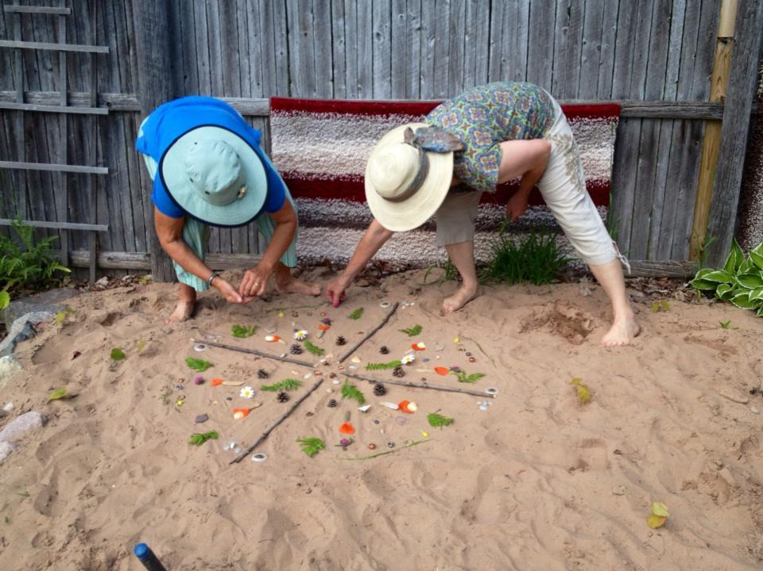
Flow for Rural But Reachable...
Holding Space~ Let’s get comfortable
Who I am and my journey to rural, grief and community
Mind Mapping
Digging Deeper into Intersections between: Rural; Grief; Community and Covid 19
Story Sharing: Omega House creating a rural community response to grief.
Courageous Conversations and Voices in Grief
Covid 19 and Grief Intersections
Covid 19 and the Many Ways to Reach In.
Wrap up and Question/Answers

Slide 12
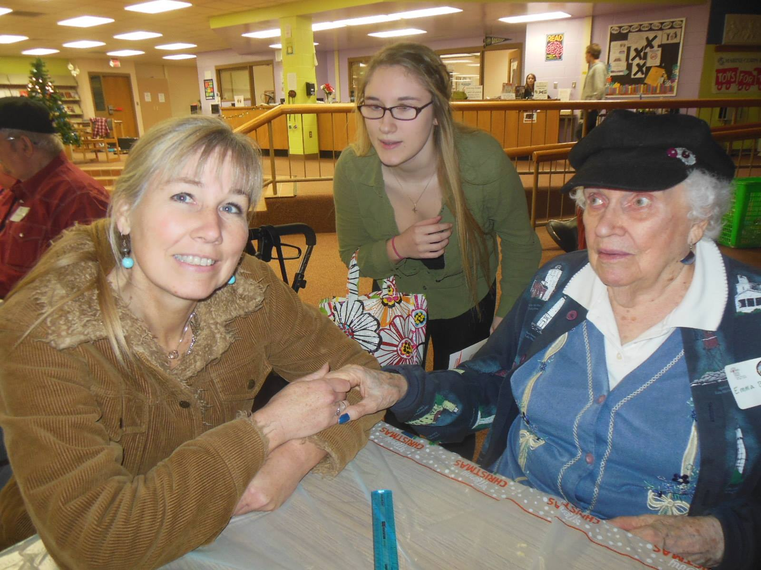
Rural By Choice...
Notes:
I moved to the UP of Michigan as a young person to work with a non-profit working and serving isolated and lonely elderly people. I chose rural because I knew that these are the places where community matters and where people know their neighbors and truly care. I have raised my three girls here and we all have volunteered and served our community in many ways. By participating in our community we are a part of its strong and resilient fabric.
A native of Colorado, Cynthia Drake attended the College of Wooster in rural Ohio and earned a BA degree in Sociology with a Concentration in Anthropology. Post-graduation, she relocated to the Upper Peninsula of Michigan to work at a non-profit, Little Brothers - Friends of the Elderly, serving lonely and isolated elderly people with socialization programs.
During Cynthia’s 31-year career working and serving rural people, she has worked serving elderly people; a local helpline; with sexual assault victims; as a volunteer with domestic violence victims; helped to found and create a land trust; and with the local hospice program where she teamed in developing its first community grief support program. She is currently the Grief Counselor at Omega House, guiding a monthly support group and offering individual counseling. In addition she manages her business, Openings Life Coaching, working with people individually and in group retreats to reach their highest potential.
Living in the UP, Cynthia is familiar with the challenges of rural living. She understands the importance of community building, one relationship at a time.

Slide 13
Grief takes many forms...
Notes:
Father’s Day of 2018 the community I live in experienced a weather event which was unprecedented. The unincorporated town of Ripley, near Houghton in the Upper Peninsula, was battered in the Father's Day flood, as up to 7 inches of rain fell in a matter of hours, causing massive damage. Heavy rains fell and a mudslide (a failed ski hill) in the waterway above my home came down and through my home and neighborhood. The ensuing months were some of the most excruciating of my life. Grief does indeed take on many forms.

Slide 14
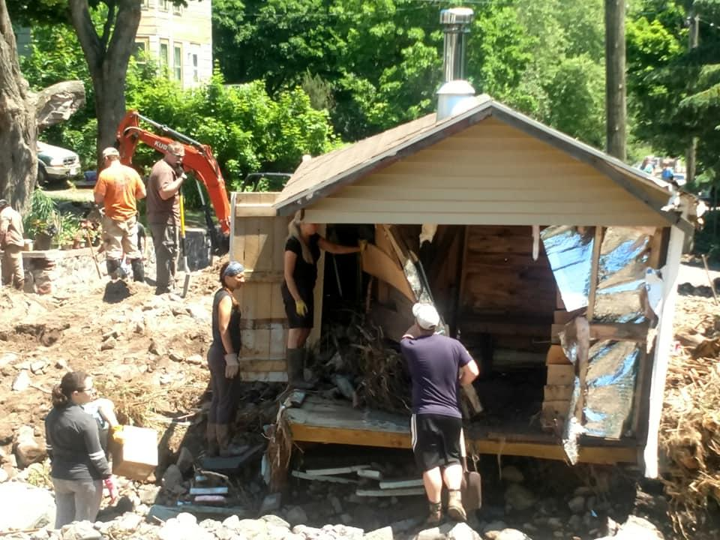
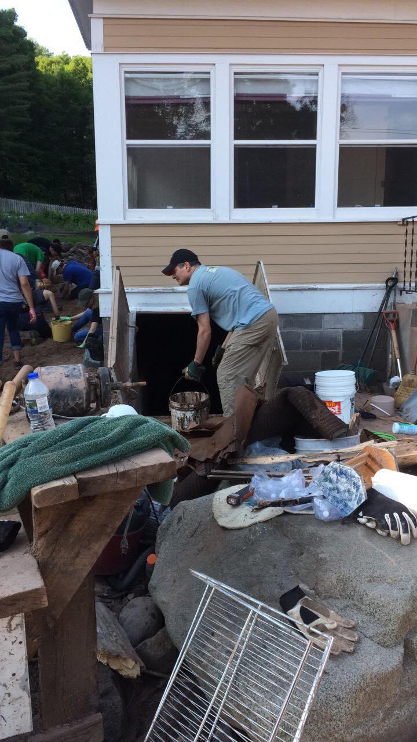
Community forms in response to a call to our humanity...
Notes:
The community pulled together during this tragedy and so many pitched in so readily and quickly that by the time national help organizations appeared, the community was well on it’s way to rebuilding. Outside, national groups noted that they had never experienced such a strong and full response anywhere, they were emotional when they shared what they witnessed. I personally viscerally experienced agape love for the first time. Politics fell away and people as individuals and families appeared out of nowhere with muck boots, buckets, shovels and gloves, ready to muck out the basement.

Slide 15
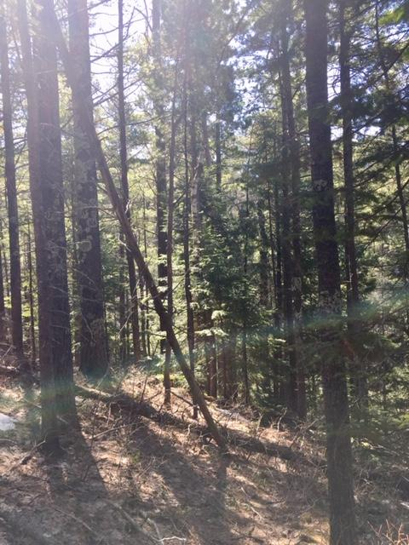
Value of Community...
“Every tree, therefore, is valuable to the community and worth keeping around for as long as possible. And that is why even sick individuals are supported and nourished until they recover. Next time, perhaps it will be the other way round, and the supporting tree might be the one in need of assistance. [...]
A tree can be only as strong as the forest that surrounds it.”
from: The Hidden Life of Trees by Peter Wohlleben
Notes:
Humans and trees have this in common, they build and sustain community quite naturally. They internally realize that we are stronger as we rise up together and the sum of our parts is what makes us resilient and able to withstand the storms of life.

Slide 16
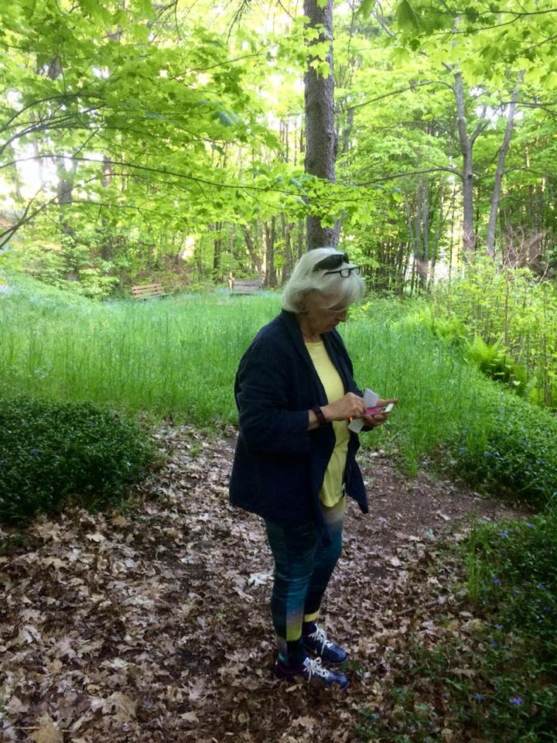
Mind Mapping:
Rural
Notes:
Mind Mapping is an awesome tool to process things stream of consciousness. Often what we really believe, think or know is just below the surface and if we free it up, it flows. So just a prompt and then writing with anything that comes to you brings out a lot of insight. One way to do this is to put a word in the middle of a blank page, draw a circle around it and put words or ideas out from that like rays of sunshine. It is interesting what you find arrives when you open yourself up and flow with this exercise.

Slide 17
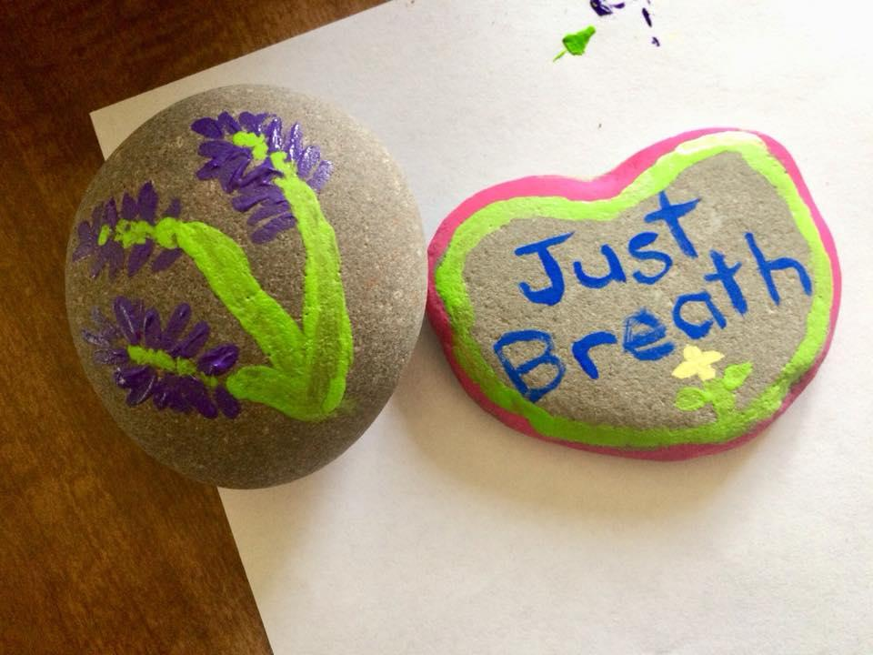
Mind Mapping:
Grief

Slide 18
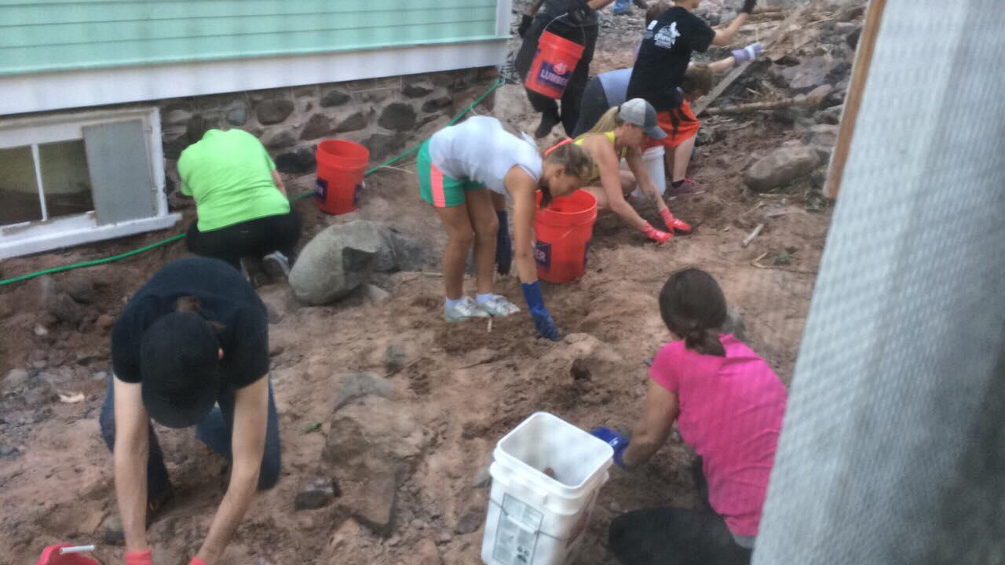
Mind Mapping:
Community

Slide 19
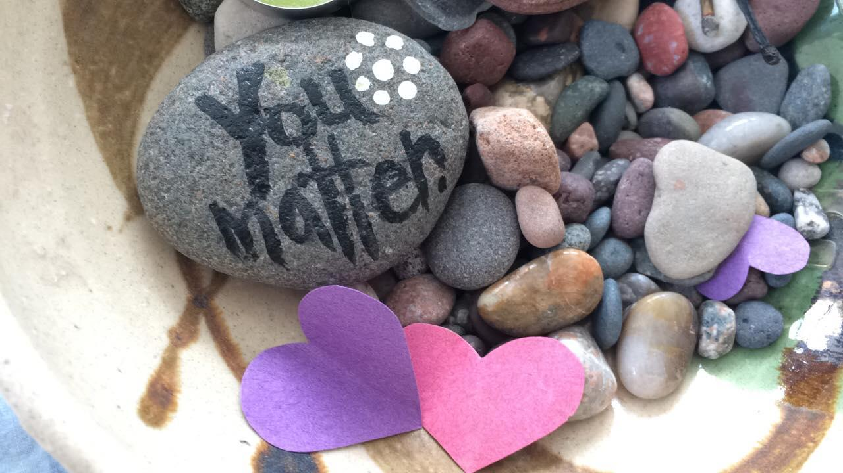
Mind Mapping:
Covid 19

Slide 20
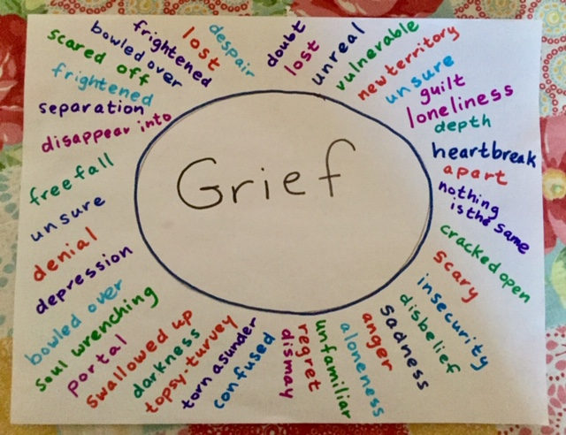
Mind Mapping
You can do it low-tech
Or high-tech
https://www.mindmup.com
https://www.mindmeister.com/
https://www.canva.com/graphs/mind-maps/

Slide 21
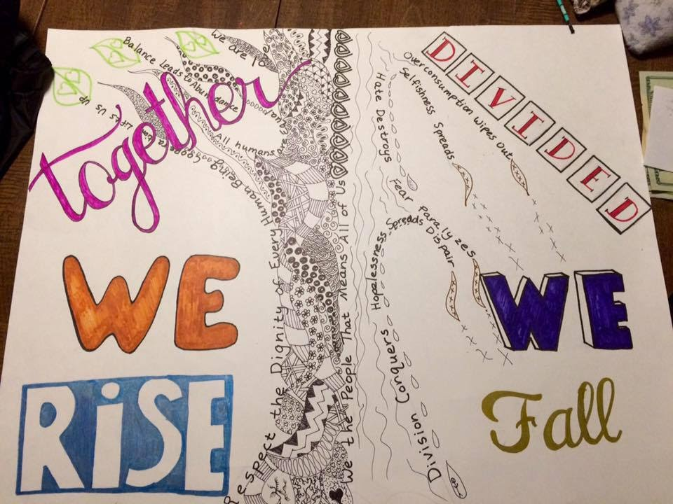
Digging Deeper
How do these concepts intersect? When you were mind-mapping each concept, what was coming out? Do you see anything which intersects these or flows from one concept to the other? Threads of connection?
Let’s talk about this...

Slide 22
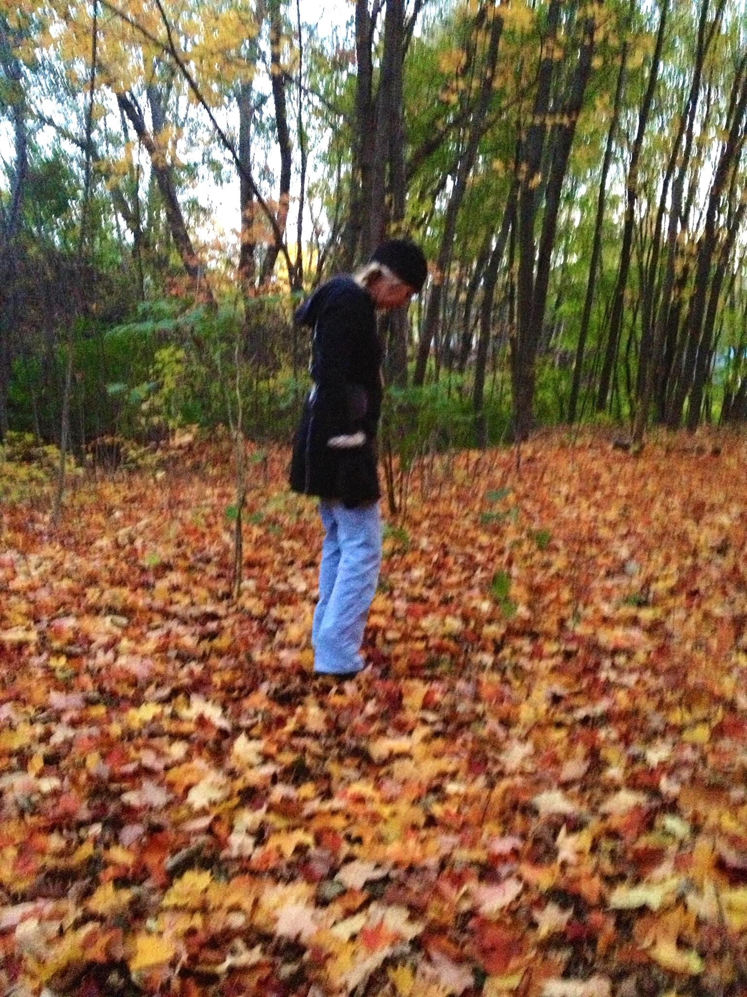
One Story: A Rural Community Builds Support Around Grief
The non profit Omega House (founded in 1999), offers a peaceful, homelike environment for terminally ill people and provides end-of-life care that emphasizes compassion, independence, respect and dignity. Over 630 Upper Peninsula of Michigan residents have been served to date.
About three years ago Omega House decided to form a committee to look into serving those grieving in our community more deeply.
Notes:
We created a grief support program in our community with these components: education; outreach; and support. We have a lending library of grief materials. We offer up workshops/lunch and learn sessions for any local business or organization to hold Courageous Conversations about grief. We offer group grief support on every Third Thursday of the month and individual grief support sessions are offered as needed. In the future we hope to have outdoor walking paths, grief gardens, possibly a labyrinth and sit spots for those on their grief journeys to traverse. We continue to help those in grief navigate this via rituals, memorials and being witnessed and supported.

Slide 23
MONTHLY GRIEF SUPPORT
Courageous Conversations...
You are welcome to come to the Third Thursday Community Grief monthly support group at Omega House from 5:00-6:00 PM. This support group is open to anyone who wants to come and process grief together. Come as you are and settle into a relaxed, safe environment of support and communication with each other. We grieve because we love and we do not have to be alone in our grief.
Notes:
In 2019 Omega House served 30 different individuals via this program and 66 in total came to the monthly Third Thursday Group Grief Support Meetings. The demographics of those attending ranged in age from the early 20’s to the 80’s and the ratio was even between male and female.

Slide 24
Some Voices from those in Grief...
The group just before Christmas sent a powerful message to me. I came away from that group with a different outlook on life itself. The woman that talked about her cancer and not knowing how much time she has left really hit me hard. Her tears were felt deep in my heart. The courage for her to come there and speak was amazing to me. What it did was send a message to me that life is truly a gift. I have so much to be thankful for. So for me I saw so much pain in that room yet there was courage all around me. That courage lifted me with some new energy for life. GM Grief Client 1-22-2020
From the moment I entered the Omega House, I felt welcomed, like I was coming home... I felt comfortable -a safe space of belonging. From what I had just come out of, this was so important to my healing. I can honestly say that Cynthia saved my life, and my life will never be the same since now knowing her. I had all these emotions of sadness, anger, depression -all mixed together to make a pretty nasty life of pain. What I did not realize was it was grief I was going through. I was experiencing some extreme grief. Grief from a lifetime of losses and now facing my own, with a terminal cancer diagnosis, I was grieving so deeply, I could not stop crying, and the pain was deep. This work with her continues on weekly and there is a wonderful grief group that has also changed my life. She holds a space for me to go through it all -she has a gift to listen with no judgement, and guide me through this journey, together. She is my guiding light and star...MR Grief Client 1-27-2020

Slide 25
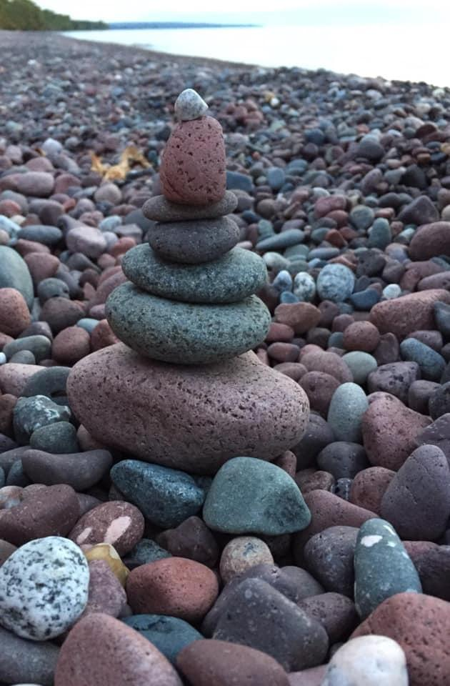
Covid 19 and Grief ~ Intersections
Covid 19 is acting as a universal grief portal. Life will never be the same again. The unexpected will keep happening and reality will be altered at a moment’s notice.
Grief is already a painful journey. Covid 19 furthers the potential for isolation, further stress and added grief layers which seems too daunting to imagine.
Those for whom grief has been a hidden conversation for only the most courageous to enter will find kinship in the masses now as they, willingly or not, enter into unchartered territory full of angst, uncertainty and shifting sands.
Notes:
Covid 19 and Grief intersect in many places. For those for whom grief is already a painful journey, the entry of Covid 19 and furthering the potential for isolation, more added grief layers and stress seems too daunting to imagine. However there are many intersections where Covid 19 is acting as a universal grief portal. No one is escaping it’s grasp. Everyone can feel the touch of it on their lives. Life will never be the same again The unexpected will keep happening and reality will be altered at a moment’s notice. Those for whom grief has been a hidden conversation for only the most courageous to enter will find kinship in the masses now as they,willingly or not, enter into unchartered territory full of angst, uncertainty and shifting sands. This is the life, those in the grief journey know intimately already. Now we shall as a world, experience this together.

Slide 26
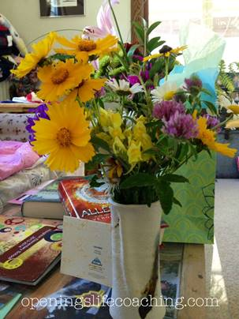
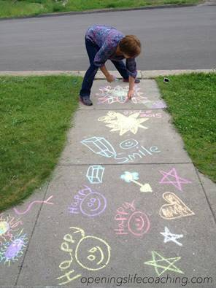
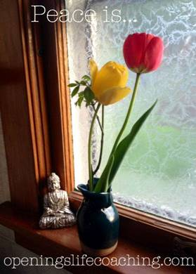
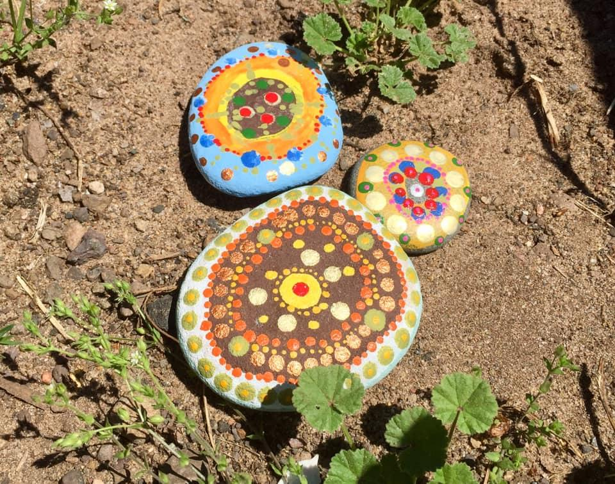
Covid 19 and Many Ways to Reach In...
Notes:
Our capacity to reach in is limited only by our imagination. We, as rural people, are resourceful and used to finding our way through tough times. We have a way of reaching toward each other and building community as this is the way we have always had to make it through tough times, be it a winter of snow, a summer of flooding or a draught. We are tough for a reason. This toughness is also a way toward love, as it softens when we open up to each other and realize that we need one another for survival.
Covid 19 has brought us back in closer to the basics of life and knowing what is essential and what is not. We are able to discern what we really require to feel human and to build our humanity with one another. Sometimes the simplist act of kindness and attention is all that is needed as an inroad toward someone.

Slide 27
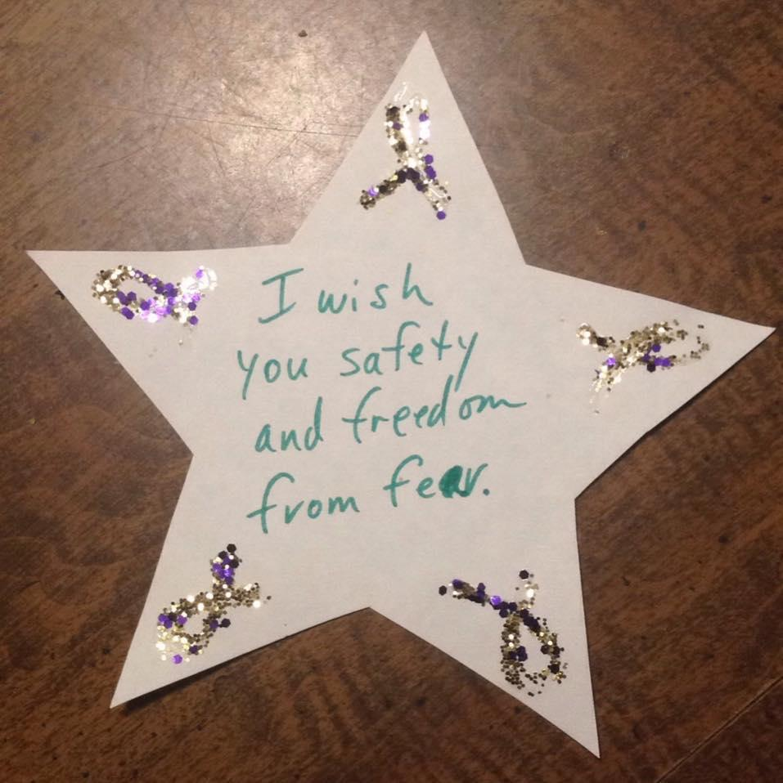
Remembering what really matters and utilizing tools we have now.
New Technologies in Rich Ways
Zoom; FaceTime
We have re-discovered old truths and ways of being in community with one another.
Phone Calls
Sidewalk Chalk
Pen Pals… reaching in.
Notes:
Covid 19 has become our new way of living. It has forced us to wake up to what really matters in our lives. To simplify and come home to ourselves and others we are close to. It has us re-assessing what we “must have” to survive and what is extra. It has put a fine point on discerning what is essential and what we were just “doing”.
In this step back and reflection, we have re-discovered old truths, ways of being in community with one another from phone calls, to sidewalk chalk, to parades outside our window, to pen-pals. It has also allowed us to utilize the new technologies in more rich ways. Diving deeper into social media to find connections that matter with group zoom calls, facetime with loved ones, and world wide connections as a pandemic spread throughout the world. We have never before in the history of humans been more widely connected to others so far away and yet, we found out the truth that, those who live in our actual community are those whom we lean in on in times of trouble the most and who sustain our literal existence.

Slide 28
Wrap Up and Questions/Answers
“Covid is linking us, this specific grief is linking us with how to identify and name things. We are not the only ones, there is relief in that, in not feeling alone. This is huge, then you do not feel you are crazy...
What connects us is when people feel really heard.” -Carol Olsen, LCSW Hospice Social Worker

Slide 29
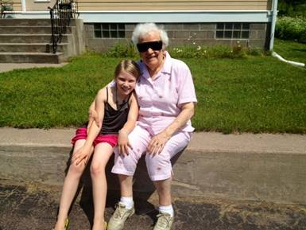
“People who are hurting don’t need Avoiders, Protectors, or Fixers. What we need are patient, loving witness. People to sit quietly and hold space for us. People to stand in helpful vigil to our pain.” Glennon Doyle

Slide 30
Resources
Omega House:
Our Mission - to provide a home-like environment where people at the end of life may live fully, receiving compassionate and competent care from professional, volunteer and family caregivers.
History of Omega House
Prior to 1995, residential hospice care did not exist in the Copper Country. One day, Magdalena Belej, who became a founding member, read a story in the Daily Mining Gazette “about a group of people who wanted to address the needs of terminally ill people.” Close to 40 individuals met at Gloria Dei church, and the journey began – it led to the naming of Omega House, a capital campaign to build the house and the eventual opening in 2005. Omega House relies on the generosity of donors. Website: https://www.omega-house.org/
Grief Support
Our monthly grief support via the Third Thursday Community Grief Support Group meets at Omega House. This program has become a touchstone for people in their individual grief journeys to come together in a sacred, safe space to share where they are in their grief and receive the peer support of others who are also on the path of grief. The synergy of the group allows for people to feel witnessed, heard, and understood. While the grief does not leave, it becomes somewhat lighter in the sharing and laying it down at each other’s feet. We hold this space together for the hour once a month and it is powerful and healing. We learn how to have language around our experiences and know that we have an intentional time for being able to share them.
Click here for more information: https://www.omega-house.org/grief-bereavement-program/
Reading from: “The Cure for Sorrow A Book of Blessings for Times of Grief” by Ann Richardson c2016 the reading: “The Blessing You Should Not Tell Me”

Slide 31
Resources
Death Cafe: A Death Cafe is a group directed discussion of death with no agenda, objectives or themes. It is a discussion group rather than a grief support or counselling session. Community Coalition on Grief and Bereavement:
https://www.grief-ccgb.org/
Mind Mapping Resources online:
https://answergarden.ch/
https://www.mindmup.com
https://www.mindmeister.com/
https://www.canva.com/graphs/mind-maps/

Slide 32
Evaluation Information
The Mountain Plains MHTTC is funded through SAMHSA to provide this training. As part of receiving this funding we are required to submit data related to the quality of this event.
At the end of today’s training please take a moment to complete a brief survey about today’s training.

