Slide 1
Suicide Prevention in Primary Care
August 2020
Liza Tupa, Ph.D.
WICHE Behavioral Health Program
Mountain Plains MHTTC Technical Trainer

Slide 2


Housekeeping Items
We have made every attempt to make today’s presentation secure. If we need to end today’s presentation unexpectedly, we will follow-up with you using your registration information.
All attendees are muted, and attendees cannot share video during this session.
Remember to ask questions using the Q&A feature. Only the answers
will be seen by all attendees.
The chat feature is public, and comments can be seen by all attendees.
Follow us on social media:
@MPMHTTC @MountainPlainsMHTTC

Slide 3
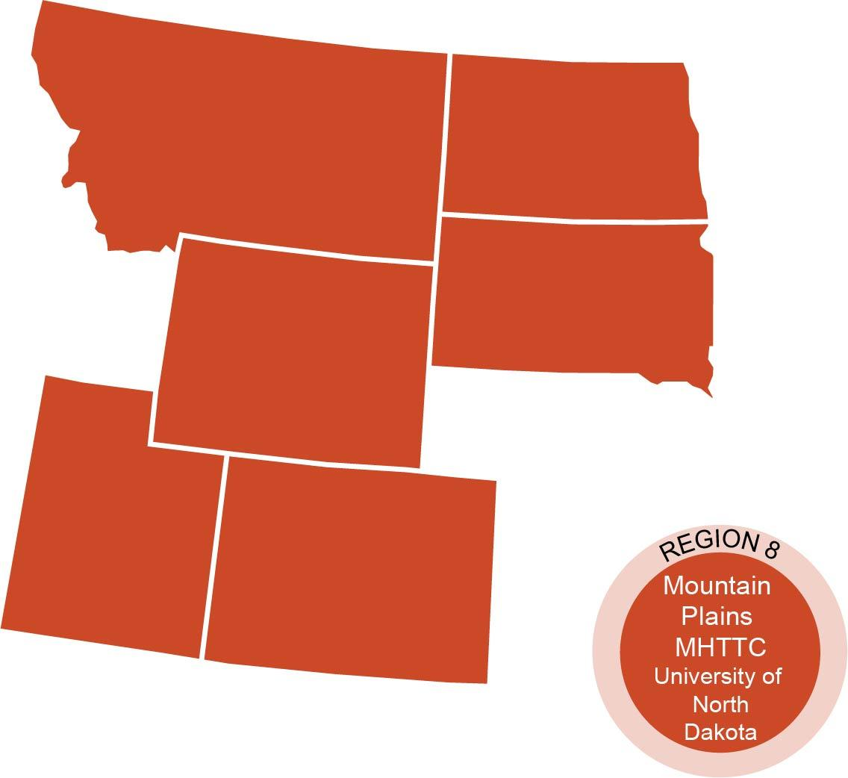
Who We Are
The Mountain Plains Mental Health Technology Transfer Center (MHTTC_ provides training and technical assistance on evidence-based practices to the mental health providers of
Region 8 (Colorado, Montana, North Dakota, South Dakota, and Utah).
We belong to the Technology Transfer Center (TTC) Network, a national network of training and technical assistance centers serving the needs of mental health, substance use and prevention providers. The work of the TTC Network is under a cooperative agreement by the Substance Abuse and Mental Health Service Administration (SAMHSA).
Co-hosted by:
The University of North Dakota
and
The Western Interstate Commission for Higher Education (WICHE)

Slide 4
Evaluation Information
The Mountain Plains MHTTC is funded through SAMHSA to provide this training. As part of receiving this funding we are required to submit data related to the quality of this event.
At the end of today’s training please take a moment to complete a brief survey about today’s training.
https://ttc-gpra.org/P?s=104900

Slide 5
Disclaimer
This presentation was prepared for the Mountain Plains Mental Health Technology Transfer Center (Mountain Plains MHTTC) under a cooperative agreement from the Substance Abuse and Mental Health Services Administration (SAMHSA). All material appearing in this presentation, except that taken directly from copyrighted sources, is in the public domain and may be reproduced or copied without permission from SAMHSA
or the authors. Citation of the source is appreciated. Do not reproduce or distribute this presentation for a fee without specific, written authorization from the Mountain Plains MHTTC. For more information on obtaining copies of this presentation please email gberry@wiche.edu
At the time of this presentation, Elinore F. McCance-Katz served as SAMHSA Assistant Secretary. The opinions expressed herein are the views of Liza Tupa, Ph.D., and do not reflect the official position of the Department of Health and Human Services (DHHS),
or SAMHSA. No official support or endorsement of DHHS, SAMHSA, for the opinions described in this presentation is intended or should be inferred.

Slide 6
Suicide Prevention in Primary Care
August 2020
Liza Tupa, Ph.D.
WICHE Behavioral Health Program
Mountain Plains MHTTC Technical Trainer

Slide 7
Who am I and why am I here?
Mountain Plains Mental Health Technology Transfer Center- MP MHTTC
WICHE BHP
Primary care system primed for prevention
Community and whole-practice approach
Toolkit funding from Health Resources and Services Administration (HRSA) and Colorado Department of Public Health and Environment

Slide 8
Getting to know your setting
Disciplines?
Behavioral health on site?
Level of integration?
Electronic health record?
Behavioral health screening?
How do referrals generally occur?
Other resources in the community?

Slide 9
Why primary care?
Preventive care focus
Early intervention (e.g., diabetes/amputation)
PCs frequent source of psychotropic medications
  Most psychotropic scrips written by GPs
Chronic conditions
PCPs often reluctant to discuss suicide

Slide 10
Why Primary Care?
People who die by suicide are more likely to have seen a PCP in the previous month before their death than any other health care provider.
For a patient at risk for suicide, a visit with the PCP may be the only chance to access needed care – especially in rural settings
70% of those who die by suicide in Colorado are not engaged in mental health care at the time of their death

Slide 11
Risk Factor Conditions Observed in Primary Care Settings
Major depression
Substance use disorders
PTSD/anxiety disorders
Insomnia
Chronic pain – farm injuries
Physical illnesses, especially CNS disorders (TBI)

Slide 12
Rural Primary Care
  Fewer behavioral health resources.
    More than 65% of rural Americans get their mental health care from their primary care provider
  Elderly
  Veterans returning to rural areas (especially National Guard)
    44% of recruits are from rural areas
    Many aren’t service connected

Slide 13
Stigma ! ! !

Slide 14
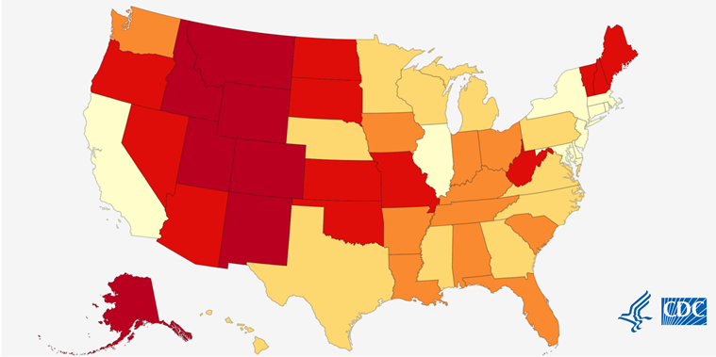
Suicide Across The Nation 2018
https://www.cdc.gov/nchs/pressroom/sosmap/suicide-mortality/suicide.htm
http://www.cdc.gov/ncipc/maps/default.htm

Slide 15
Toolkit Organization:
  Getting Started
  Toolkit Primer
  Developing Mental Health Partnerships
  Patient Management Tools
  State Resources, Policy, and Reimbursement
  Physician Self-care
  Patient Education Tools/Other Resources

Slide 16
Section 1:
Getting Started

Slide 17
Quick Start Guide

Slide 18
Implementation Checklist

Slide 19
Cont’d: Implementation Checklist for the Suicide Prevention in Primary Care Toolkit
□ Follow-up/Outreach. Identify who will follow-up with patients who have expressed suicidal ideation and how follow-up will occur (e.g., office visit, phone call).
In case of the need for hospitalization:
□ Hospitalization is always the last resort, if efforts at illness management, safety planning, and referral fail to mitigate risk.
□ Identify and label where all necessary forms, such as legal Mental Health Hold and Evaluation forms, for hospitalizing suicidal patients will be kept (it is assumed that the patient’s physician will fill out all necessary paperwork for hospitalization).
□ Identify who will sit with the patient while waiting for transport to the emergency department if necessary.
□ Identify how soon a patient should be seen back in your clinic after being evaluated by the emergency department and/or being hospitalized. How frequently should they be seen and for what duration should more intensive contact with the PCP occur?

Slide 20
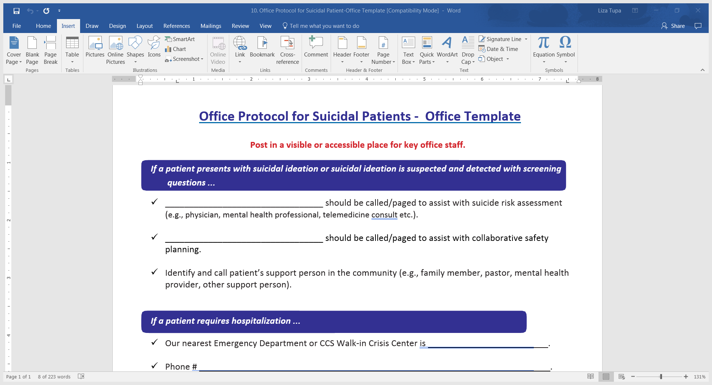

Slide 21
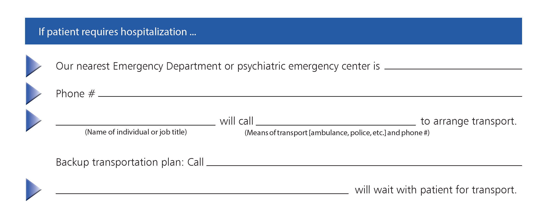
Cont’d: Office Protocol for Suicidal Patients- Office Template

Slide 22
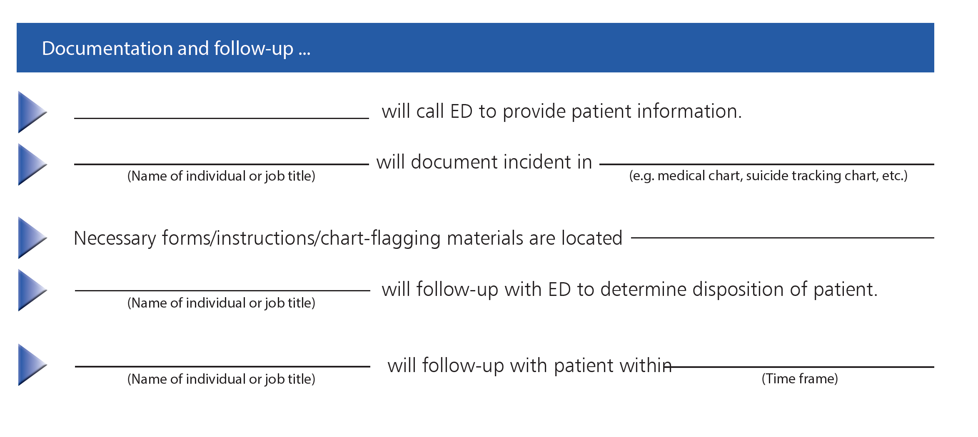
Cont’d: Office Protocol for Suicidal Patients- Office Template

Slide 23
Section 2:
Educating Clinicians and Staff

Slide 24
Toolkit Primer Module 1: Prevalence and Comorbidity
Tenth leading cause of death in the U.S.
Mental illness is neither a necessary nor sufficient condition for suicide but…
  Approximately 66% of adults who consider suicide and nearly 80% of those who attempt suicide had a prior mental health disorder.

Slide 25
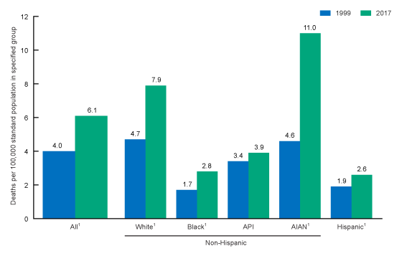
Primer Module 1: Prevalence and Comorbidity
Age-adjusted suicide rates for females, by race and ethnicity: United States, 1999 and 2017
By Sally C. Curtin, M.A., Division of Vital Statistics, and Holly Hedegaard, M.D., M.S.P.H., Division of Analysis and Epidemiology
https://www.cdc.gov/nchs/data/hestat/suicide/rates_1999_2017.htm

Slide 26
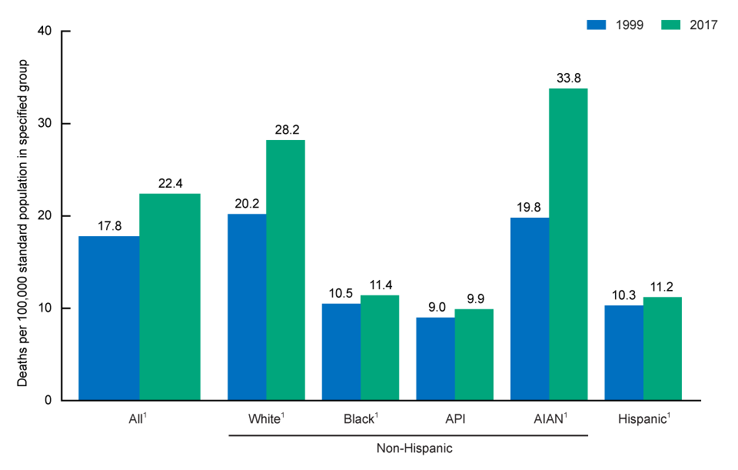
Primer Module 1: Prevalence and Comorbidity
Age-adjusted suicide rates for males, by race and ethnicity: United States, 1999 and 2017
By Sally C. Curtin, M.A., Division of Vital Statistics, and Holly Hedegaard, M.D., M.S.P.H., Division of Analysis and Epidemiology
https://www.cdc.gov/nchs/data/hestat/suicide/rates_1999_2017.htm

Slide 27
Primer Module 2: Epidemiology
Gender
Age
Race/Ethnicity
Special Populations

Slide 28
Primer Module 3:
Effective Prevention Strategies
Suicide Prevention Strategies in Primary Care
Train staff to recognize and respond to warning signs of suicide
Screen for and treat depression
Screen all patients for suicide risk
Educate patients about warning signs for suicide
Safety Plan/Temporarily restrict means for lethal self-harm

Slide 29
Warning Signs
Anxiety (also worry)
Agitation, aggression
Acting reckless
Insomnia or sleep disturbance
Increased alcohol or drug use
Withdrawing or feeling isolated
Talking about being a burden to others
Rage or seeking revenge
Dramatic mood swings
Feeling trapped – like there’s no way out
Talking about being in unbearable pain

Slide 30
Screen for & Manage Depression
Increases prescription rates for antidepressants
Decreases suicidal ideation and completed suicides in their patients
Tools for screening and managing depression in a primary care setting: The MacArthur Initiative on Depression and Primary Care
PHQ-9
PHQ9-A
http://otgateway.com/articles/13macarthurtoolkit.pdf
Best approach to treating major depressive disorder uses a combination of medication and psychotherapy whenever possible

Slide 31
Screen for Suicide Risk
Zero Suicide says Universal Screening!
Screening Tools:
PHQ-9
PHQ-9 A
C-SSRS
SPRC’s Decision Support Tool

Slide 32
PHQ-9
Over the last 2 weeks, how often have you been bothered by any of the following problems?
Not at all Several days More than half the days Nearly every day
Little interest or pleasure in doing things
Feeling down, depressed, or hopeless
Trouble falling or staying asleep, or sleeping too much
Feeling tired or having little energy
Poor appetite or overeating
Feeling bad about yourself—or that you are a failure or have let yourself or your family down
Trouble concentrating on things, such as reading the newspaper or watching television
Moving or speaking so slowly that other people could have noticed? Or the opposite—being so fidgety or restless that you have been moving around a lot more than usual
Thoughts that you would be better off dead or of hurting yourself in some way
If you checked off any problems, how difficult have these problems made it for you to do your work, take care of things at home, or get along with other people?
Not difficult at all Somewhat difficult Very difficult Extremely difficult

Slide 33
COVID: New Telehealth Opportunities
State and federal changes/relaxation of telehealth rules
  Zoom, Facetime, audio-only
Many potential consumers may be more comfortable with increased anonymity
internet providers increased coverage in many areas
Provider need to get comfortable!

Slide 34
Module 4: Suicide Risk Assessment
Key Components
  Assess for risk factors
  Suicide Inquiry: The Big Four
    Thoughts
    Plan
    Intent
    Means
  Assess for protective factors
  Use your clinical judgment
  Document, document, document

Slide 35
Individual Risk Factors
  Previous suicide attempt, especially within the past year
  Major physical illnesses, especially with chronic pain
  Central nervous system disorders, incl TBI
  Mental illnesses, particularly:
    Mood disorders
    Schizophrenia
    Anxiety disorders (including, PTSD)
  Some alcohol and other substance use disorders
  Personality disorders (such as Borderline PD, Antisocial PD, and Obsessive-Compulsive PD)

Slide 36
Individual Risk Factors
  In youths: ADHD and conduct disorders (antisocial behavior, aggression, impulsivity)
  Psychiatric symptoms/states of mind: anhedonia, severe anxiety/panic, insomnia, command hallucinations, intoxication, self-hate
  Impulsive and/or aggressive behavior
  History of trauma or abuse
  Family history of suicide
  Precipitants/triggering events leading to humiliation, shame, or despair

Slide 37
Social/ Environmental Risk Factors
  Chaotic family history
  Lack of social support and increasing sense of isolation
  Easy access to/familiarity with lethal means (e.g., guns, illicit drugs, medications)
  Local clusters of suicide that can have a contagious influence
  Legal difficulties/contact with law enforcement/incarceration
  Barriers to accessing health care, especially mental health and substance abuse treatment

Slide 38
Societal Risk Factors
  Certain cultural and religious beliefs
  Exposure to, including through the media, and influence of others who have died by suicide

Slide 39
Module 4:
Suicide Risk Assessment
Key components of a suicide risk assessment
Assess warning signs and risk factors
Assess protective factors
Suicide Inquiry: thoughts/plan/intent/access to means
Clinical judgment

Slide 40
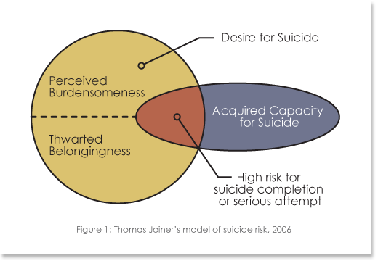
Joiner’s Model

Slide 41
Protective Factors
  Sense of responsibility to family
  Life satisfaction
  Social support; belongingness
  Coping skills
  Problem-solving skills
  Strong therapeutic relationship with a trusted provider
  Reality testing ability
  Religious faith

Slide 42
Asking the tough questions
Suicide Inquiry: You can’t find the fever if you don’t take the temperature
  Ask directly
  Ask calmly
  Ask without dread
  Be prepared to follow up if the answer is “yes”
  Many people feel relieved to be asked

Slide 43
Screening & Assessing via Telehealth
Reach out to at-risk clients.
Request the person’s location (address, apartment number) at the start of the session Request or make sure you have emergency contact information.
Secure the client’s privacy during the telehealth session as much as possible.
Prior to contact, develop a plan for how to stay on the phone with the client while arranging emergency rescue, if needed.
https://practiceinnovations.org/I-want-to-learn-about/Suicide-Prevention

Slide 44
Screening & Assessing via Telehealth
Express concern and ask directly about recent suicidal ideation and behavior using a tool like the Columbia Suicide Severity Scale (C-SSRS).
In addition to standard risk assessment, assess for the emotional impact of the pandemic on suicide risk. Examples that can escalate risk: increased social isolation; social conflict for those sheltering together; increased financial concerns or worry about health or vulnerability in self, friends, and family; decreased social support; increased anxiety and fear; disruption of routines and support.
Identify protective factors that can be emphasized: Reasons for living (family, hope for the future, children); deterrents (fear of injury, religious beliefs). Attend to protective factors that may have diminished recently.
Inquire about increased access to lethal means (particularly stockpiles of Tylenol or medications).
https://practiceinnovations.org/I-want-to-learn-about/Suicide-Prevention

Slide 45
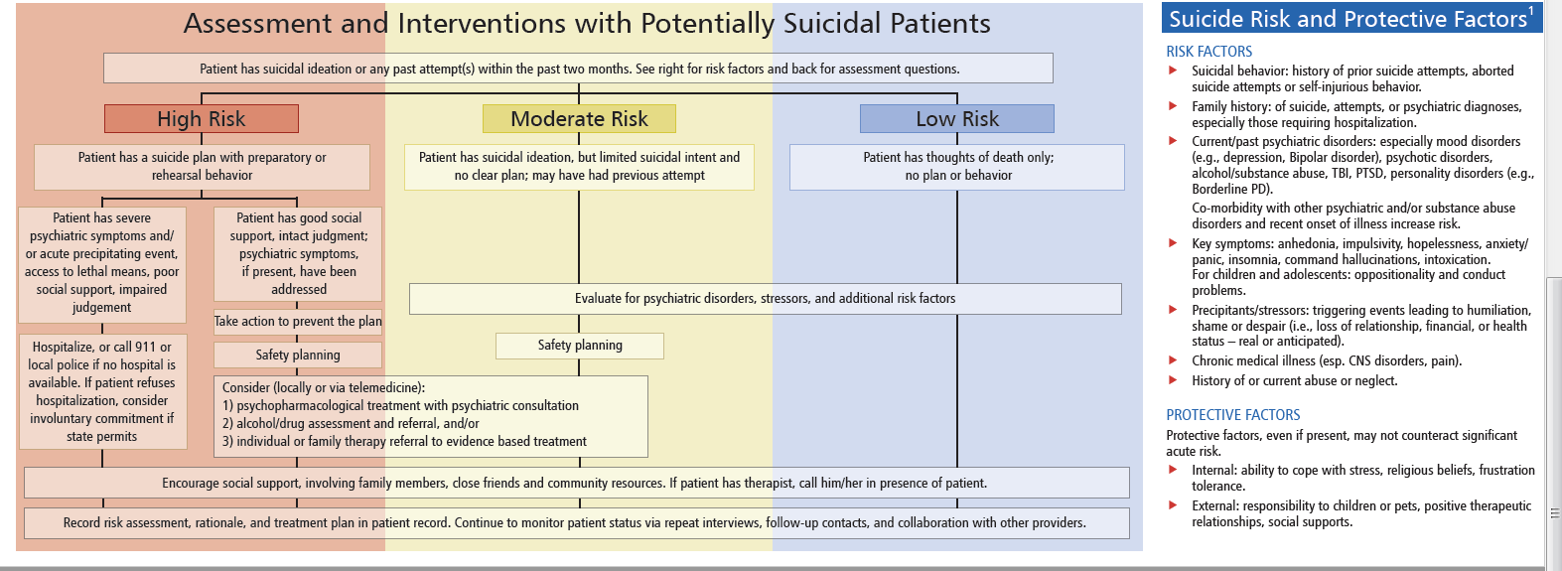
Pocket Guide Tool
Pocket Card Tool

Slide 46
Messaging and Stigma
We talk about this stuff here.
Display public awareness materials- many are free!
Communicate comfort with the topic.
Providers are not alone:
  Rally all staff levels in your clinic.
  Identify natural helpers/resources in the community.

Slide 47
Developing a Workflow and Office Protocol
Adapt for your Practice and Community.
  Review/Complete an Office Protocol.
  Walk through a patient entering your office (Table Top).
  Staff best positioned to aid in this effort?
  Level of integration.
  Where are the blanks?

Slide 48
Please join us for Part Two
Suicide Prevention in Rural Primary Care: Intervention, Follow-up, and Telehealth Tips
Click Here to register or use: https://bit.ly/34zqVeR

Slide 49
Thank you
For working to help impact this health crisis
Liza Tupa, PhD
Mountain Plains MHTTC Technical Trainer
Western Interstate Commission for Higher education, Behavioral Health Program WICHE BHP
ltupa@wiche.edu
mentalhealthemail@wiche.edu
https://wiche.edu/mentalHealth/suicide-prevention-toolkits

