Slide 1

Pine Ridge Girls’ School
Building Resilience for Students and Staff During Troubled Times
Stefanie Winfield, MSW
Liza Tupa, PhD
WICHE Behavioral Health Program
September 2020

Slide 2
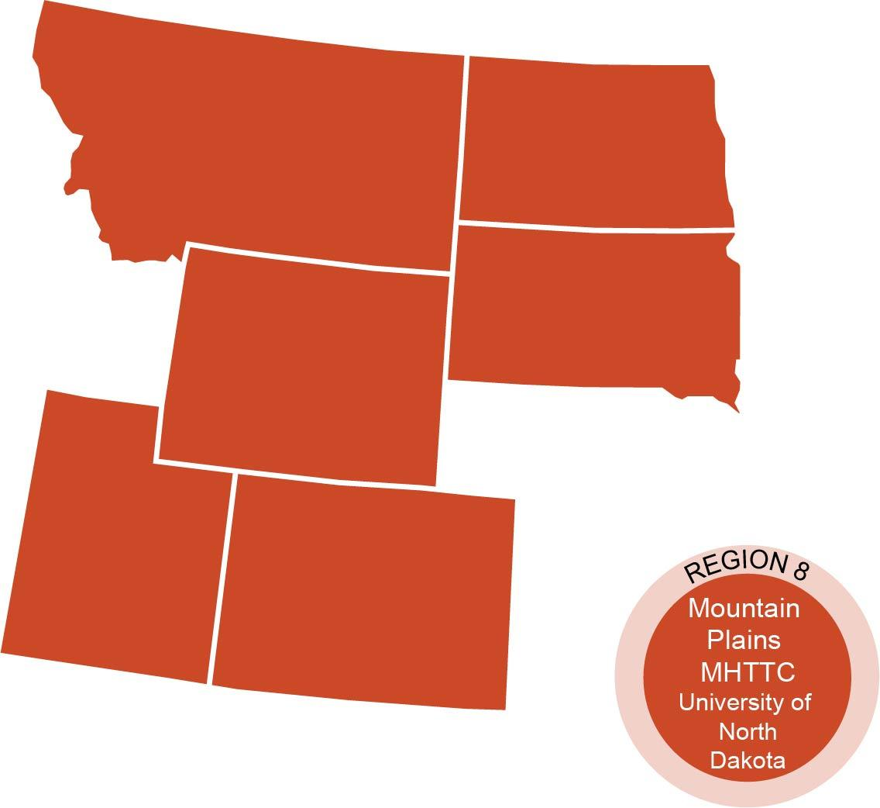



Who We Are
  The Mountain Plains Mental Health Technology Transfer Center (MHTTC_ provides training and technical assistance on evidence-based practices to the mental health providers of
  Region 8 (Colorado, Montana, North Dakota, South Dakota, and Utah).
  We belong to the Technology Transfer Center (TTC) Network, a national network of training and technical assistance centers serving the needs of mental health, substance use and prevention providers. The work of the TTC Network is under a cooperative agreement by the Substance Abuse and Mental Health Service Administration (SAMHSA).
Co-hosted by:
The University of North Dakota
and
The Western Interstate Commission for Higher Education (WICHE)

Slide 3
Disclaimer
This presentation was prepared for the Mountain Plains Mental Health Technology Transfer Center (Mountain Plains MHTTC) under a cooperative agreement from the Substance Abuse and Mental Health Services Administration (SAMHSA). All material appearing in this presentation, except that taken directly from copyrighted sources, is in the public domain and may be reproduced or copied without permission from SAMHSA
or the authors. Citation of the source is appreciated. Do not reproduce or distribute this presentation for a fee without specific, written authorization from the Mountain Plains MHTTC. For more information on obtaining copies of this presentation please email swinfield@gmail.com
At the time of this presentation, Elinore F. McCance-Katz served as SAMHSA Assistant Secretary. The opinions expressed herein are the views of Liza Tupa, Ph.D. and Stefanie Winfield, MSW, and do not reflect the official position of the Department of Health and Human Services (DHHS), or SAMHSA. No official support or endorsement of DHHS, SAMHSA, for the opinions described in this presentation is intended or should be inferred.

Slide 4
Agenda for Today
Opening
Introductions
Effects of trauma on the brain and body
Trauma Informed Teaching
  Resilience and healing
  Safety and Predictability
  Relationships
Taking care of yourself!

Slide 5

Trauma Changes Behavior:
Change the Paradigm
from
"What is wrong with you?"
to
"What has happened to you?"

Slide 6
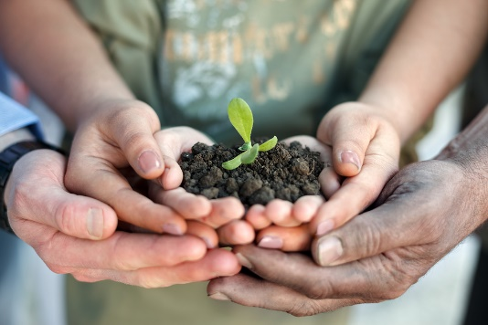
Understanding Trauma & Stress
Without understanding trauma we are more likely to misinterpret trauma-related behaviors.
When we understand trauma and stress, we increase our ability to act compassionately.

Slide 7
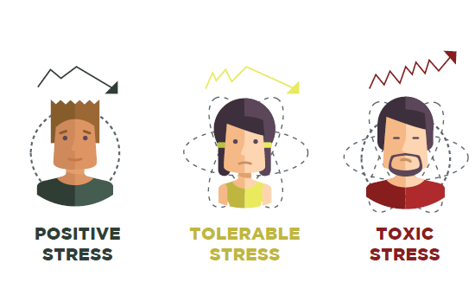
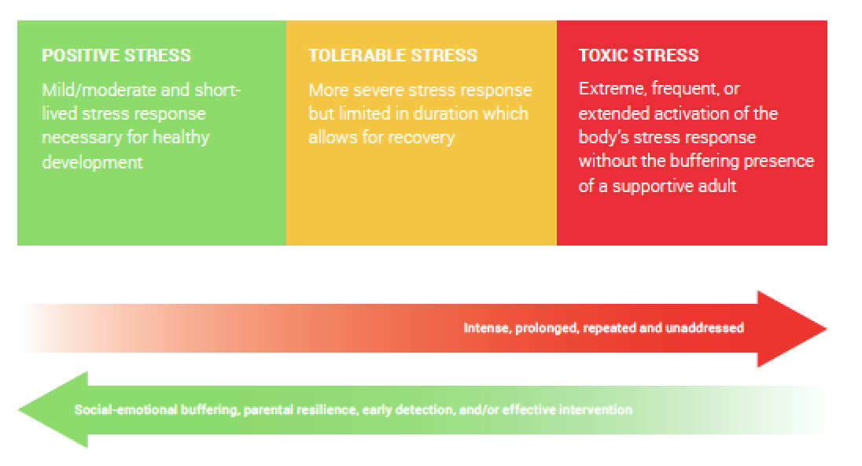

Slide 8
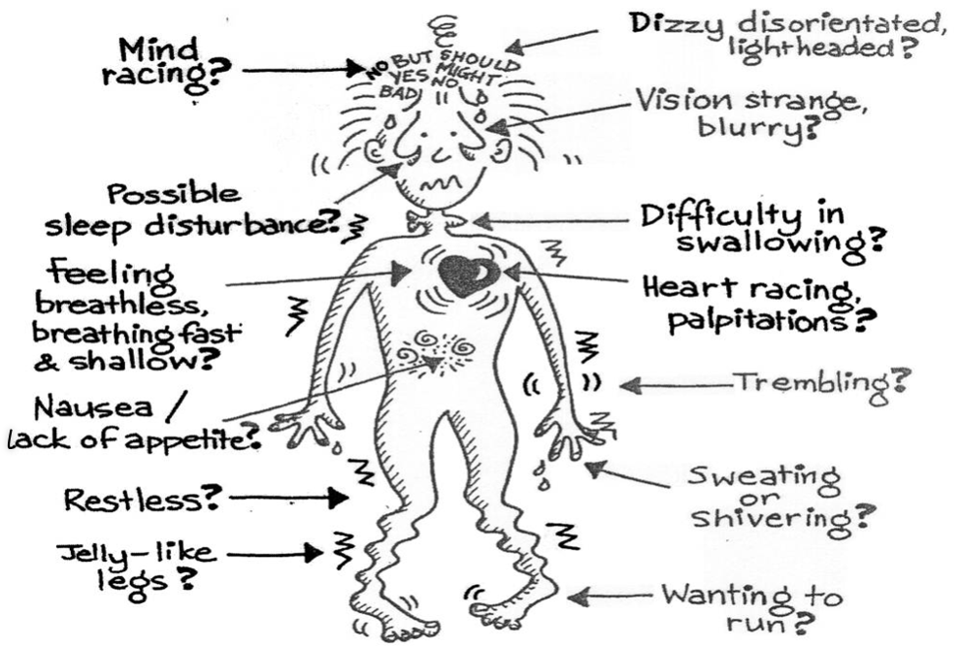
Stress Response

Slide 9
A Trauma-Informed School System
REALIZES the widespread impact of trauma and understands potential paths for healing and resilience
RECOGNIZES how trauma and chronic stress show up in leadership, staff, students, families, and others in the school community
RESPONDS by fully integrating knowledge about trauma into policies, procedures, practices, and the overall school culture
RESISTS re-traumatization
Implementing trauma-informed principles represents a paradigm shift.
Adapted from SAMHSA’s Concept of Trauma and Guidance for a Trauma-Informed Approach, 2014.

Slide 10
What is Resilience?
“the capacity to grow and thrive with strength and tenacity in the face of trauma and oppression for individuals and communities”
-Resilient Futures, 2018

Slide 11
The Power of Story:
Transgenerational Resilience
Research from Emory University on trans-generational healing suggests that actively reflecting on your family stories and histories enhances emotional health and facilitates resilience in both adults and children.

Slide 12
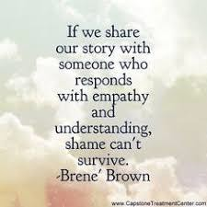
Fostering Resilience:
Emotional Expression through Storytelling
Sharing our stories allows us to be seen and heard
Sharing our stories allows us to identify and understand our emotions
Sharing our stories allows us to matter
Talk Circles, Journaling

Slide 13

What strengths are in your community’s soil that can be fertilized to build well-being and resilience?

Slide 14

Relationships are Central to Healing
Prioritize connection
Every positive, attuned interaction with a trustworthy adult can help to rewire the brain.
Aim for Attunement
Attuned relationships help us to feel safe and calm down when we are stressed out.

Slide 15

Fostering Resilience:
Connection
Consistent, responsive, nurturing relationships with caring adults is key.

Slide 16
Fostering Resilience:
Connection (3)
Relational Strategy:
Don’t take it personally

Slide 17

Fostering Resilience:
Connection (4)
Relational Strategy:
Repair the relationship
(apologize after a rupture, debrief)

Slide 18

Core Guiding Principle:
Safety and Predictability
Trauma unpredictably violates physical, social, and emotional safety.
Increasing stability in the daily lives of our students can minimize stress reactions, increasing a focus on learning and emotional well-being.

Slide 19
Creating Safety & Predictability
Safety is created through both the individual and the collective.
What are current systems/structures that can be used to increase the individual and collective safety of students, teachers, families, and the school community?
Considerations include physical, social, emotional, and academic safety.
How would you measure success?

Slide 20
Academic Safety
Connection before content
Clear expectations
Simple, clear communication
Instructions both verbally and written
Transparency
Model taking risks for learning
Multiple opportunities to ask questions
Equitable responses to students
Maintaining high expectations
Quality, not quantity
Voice/Choice
Giving multiple opportunities for demonstrating learning
Compassionate grading

Slide 21
The Importance of Routines & Rituals
Routines/rituals make settings predictable. This is especially helpful for those experiencing trauma or stress!
Predictable routines & rules help children understand expectations & reduce behavior problems.
Warn in advance of changes so there’s time to mentally prepare & so changes aren’t disruptive or stressful
Use picture cues or a picture schedule for younger children or for those that are developmentally disabled
Routines can be implemented with online learning as well!

Slide 22
Choice Making
Choice-making allows control over one’s environment.
Beneficial most to those who display problem behavior to escape participation.
Structured choices (e.g, “Would you rather finish this now or ____?”) to empower & eliminate power struggles.

Slide 23

Helpful Modifications
Eliminate excessive noises & distractions
Chunk work (“challenging yet achievable”)
Provide extended time or modify/shorten work
Allow freedom of movement and movement
breaks
Provide “alert” cues
Use a peer as a child’s “support buddy”
Use color to highlight important words or phrases
Simplify directions, write instructions out & repeat important information to assist with memory
Provide written schedules to help with organization

Slide 24

Preventing Burnout:
Remember All Parts of Yourself
Have 2 strategies for each aspect:
Physical
Emotional
Spiritual
Mental

Slide 25
What Else Can I do?
Throw Out Unrealistic and Unproductive Beliefs:
Beliefs that lead to internal stress:
Giving 100% every day is what every teacher is expected to do.
The success or failure of my students depends entirely on me.
I will never be bored as a teacher.
If I don’t help and heal all of my students, I have failed.
I should always deny my own needs for rest and recreation in order to help my students.

Slide 26
What Else Can I do?
Sometimes, because teachers and providers are in such stressful positions, they need extra help from counseling or talking with people who’ve shared similar experiences- but focus on finding solutions, not just comparing complaints.
Daily Gratitude – each morning before you get out of bed, take a moment to think of 5 things that you are grateful for.
Daily Priorities – evening or morning, prioritize your day and visualize a good day, don’t leave out self- care!

Slide 27
Thank you !!
Contact information
Stefanie Winfield swinfield@wiche.edu
Liza Tupa ltupa@wiche.edu
Part 2 Monday September 21th 3-4:15

