Slide 1
Pine Ridge Girls’ School
Healing: Supporting Families to Support Students
Stefanie Winfield, MSW
Liza Tupa, PhD
WICHE Behavioral Health Program
September 2020

Slide 2
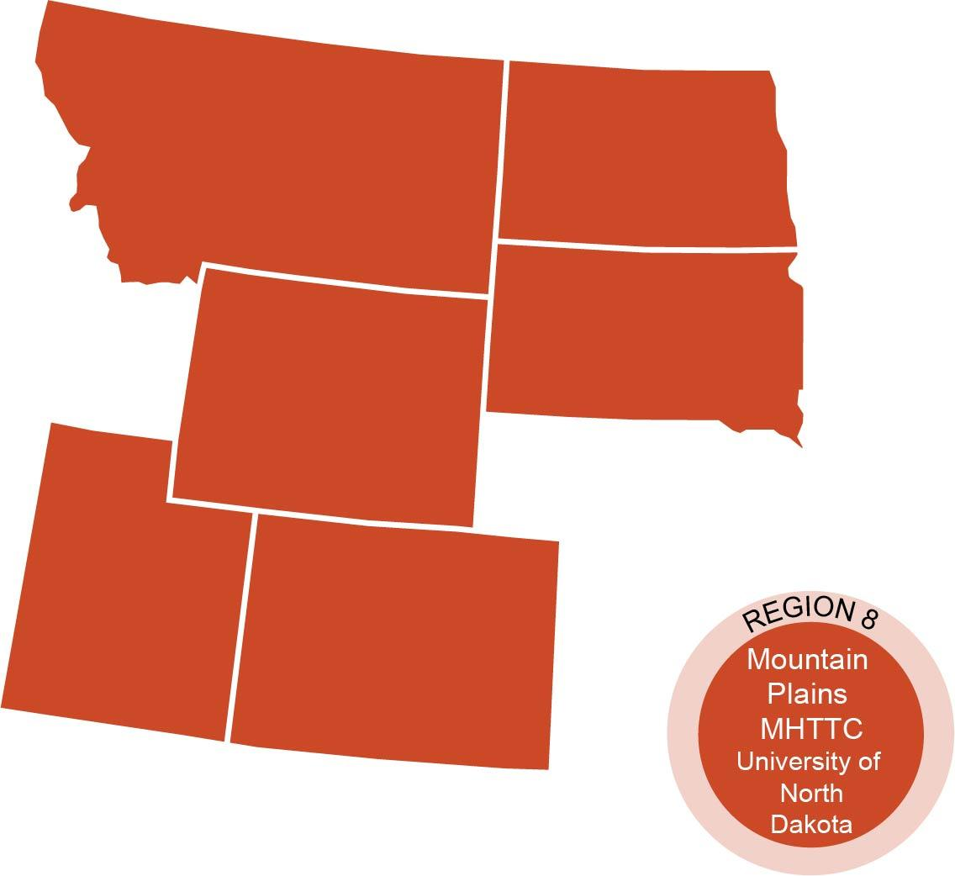
Who We Are
The Mountain Plains Mental Health Technology Transfer Center (MHTTC_ provides training and technical assistance on evidence-based practices to the mental health providers of Region 8 (Colorado, Montana, North Dakota, South Dakota, and Utah). We belong to the Technology Transfer Center (TTC) Network, a national network of training and technical assistance centers serving the needs of mental health, substance use and prevention providers. The work of the TTC Network is under a cooperative agreement by the Substance Abuse and Mental Health Service Administration (SAMHSA).
Co-hosted by:
The University of North Dakota
and
The Western Interstate Commission for Higher Education (WICHE)

Slide 3
Disclaimer
This presentation was prepared for the Mountain Plains Mental Health Technology Transfer Center (Mountain Plains MHTTC) under a cooperative agreement from the Substance Abuse and Mental Health Services Administration (SAMHSA). All material appearing in this presentation, except that taken directly from copyrighted sources, is in the public domain and may be reproduced or copied without permission from SAMHSA or the authors. Citation of the source is appreciated. Do not reproduce or distribute this presentation for a fee without specific, written authorization from the Mountain Plains MHTTC. For more information on obtaining copies of this presentation please email swinfield@wiche.edu
At the time of this presentation, Elinore F. McCance-Katz served as SAMHSA Assistant Secretary. The opinions expressed herein are the views of Liza Tupa, Ph.D. and Stefanie Winfield, MSW, and do not reflect the official position of the Department of Health and Human Services (DHHS), or SAMHSA. No official support or endorsement of DHHS, SAMHSA, for the opinions described in this presentation is intended or should be inferred.

Slide 4
Agenda for Today
Welcome
Introductions
Trauma Review
Ways to Support Students
Stigma
Talking Heals
Predictability
Rituals
Parent Handout

Slide 5
Trauma Review
Cultural trauma: An attack on the “fabric of society,” affects the “essence” of the community. Discrimination and racism, possible limitations of reservation life, associated stress.
Historical trauma: The cumulative effect of traumatic historical events on an individual or community that affects subsequent generations. Historical trauma often leads to intergenerational trauma.
Intergenerational trauma: When trauma is transferred from the first generation or survivors to subsequent generations.
Present trauma: Current traumatic events being experienced by community members in present or recent time (this includes abuse or neglect, witnessing violence, or other negatively overwhelming events).
Dolores Subia BigFoot, PhD. (Caddo Nation of Oklahoma/Affiliation with Northern Cheyenne Tribe of Montana in which her children are enrolled), Director of the Indian Country Child Trauma Center at the University of Oklahoma Health Sciences Center

Slide 6
Trauma Review
Types of experiences that are traumatic for children:
Physical Abuse
Emotional Abuse
Sexual Abuse
Extreme Neglect
Serious Accidents
Bullying, Harassment
Serious Injury, Death or Loss of a Loved One

Slide 7
Family Support = Powerful Medicine
Families and loved ones have the most power to help children heal
From the Indian Country Child Treatment Center http://www.icctc.org/

Slide 8
Shame, Stigma
Anyone can suffer from a damaged spirit or mental health problems
Asking for help is a sign of strength
Words can hurt- “Not all there”
Encouraging a child to get help can help prevent suicide

Slide 9
Family Support = Powerful Medicine
1. Let your child or children hear you pray for them every day.
2. Read to your child or children every night
3. Have one sit-down meal a day with all your family together.
4. Greet each child each day by name and welcome them into the day.
From the Indian Country Child Trauma Center http://www.icctc.org/

Slide 10
More Ways to Cherish Your Child’s Spirit
Talking to your kids helps you learn about each other, makes kids feel important
Conversation Starters:
What was the best part of your day? What was the worst art of your day? What was the funniest part of your day?
How have you been feeling?
How is school going?
What helps you feel connected to me (your family)? What helps you feel connected to our community?

Slide 11
The Importance of Safety
Increasing stability in the daily lives of our students can minimize stress reactions, increasing a focus on learning and emotional well-being.
Safety is created through both the individual and the collective.
What are ways to increase the safety of children in families, families?
Considerations include physical, social, and emotional safety.
Predictability helps people of all ages feel safe

Slide 12
Safety and Predictability
Predictability helps people of all ages feel safe
When will my adults be home?
How can I get ahold of my adults if I need them?
Will there be food at home?
Who will be there to say good morning/goodnight to me?
Will my adults be happy to see me?
What will happen if I break a rule?
What chores are expected of me?
No family is perfect but communicating often about these issues/questions helps kids of all ages feel safe.

Slide 13
The Importance of Rituals & Routines
Routines make home predictable. This is especially helpful for those experiencing trauma or stress!
Predictable routines & rules help children understand expectations & reduce behavior problems.
Rituals help people feel safe, special, and powerful.
Families can participate in tribal ritual and also create their own.
What rituals and routines do your children like?

Slide 14
Choice Making
Choice-making allows children of all ages to feel that they have some control over their environment.
Structured choices (e.g, “Would you rather finish this now or ____?”) to empower & eliminate power struggles.
Maximize the choices that kids have- which chores to do, which hobbies to enjoy, when to finish a task, two choices for dinner, two choices for what to wear (for younger children).

Slide 15
Family Support = Powerful Medicine
If a child discloses abuse, caregivers can lessen the impact of the abuse by communicating:
I love you.
What happened is not your fault.
I will do everything I can to keep you safe.
Communicate through words and actions.
From RAINN, https://www.rainn.org/

Slide 16
Emotional Expression through Storytelling
Sharing our stories allows us to be seen and heard
Sharing our stories allows us to identify and understand our emotions
Sharing our stories allows us to matter
Share how you overcame challenges

Slide 17
Family Support = Taking Care of Yourself
Taking care of yourself helps you take care of the children in your life
Model that you matter (believe in yourself, don’t tolerate mistreatment)
Take breaks, especially when frustrated
Calm is contagious
Nurture your own social connections
From RAINN, https://www.rainn.org/

Slide 18
Community Support = Powerful Medicine
1. Find ways to connect families to the community
2. Community traditions, activities
3. Giving back- helping others heals the spirit
4. What are some ways that families can become more involved in the community?

Slide 19
Parenting Tips Handout
Discussion of Handout
Feedback, changes?
How, where, can the handout be distributed?
How can it be used?

Slide 20
Thank you for inviting us!
Contact information:
Stefanie Winfield swinfield@wiche.edu
Liza Tupa ltupa@wiche.edu

