Slide 1
Mountain Plains - Mental Health Technology Transfer Center
This Training is Provided By:
A collaborative effort between:
Funded by:

Slide 2
MHTTC Background
Substance Abuse and Mental Health Services Administration Grant Project
Serves: CO, MT, ND, SD, UT, & WY
5-year funding plus year-to-year school supplemental funding
PI: Thomasine Heitkamp, LCSW
Collaborators: University of North Dakota and the Western Interstate Commission for Higher Education (WICHE)

Slide 3
Aim of School Supplement
Assist rural schools to implement best-practice approaches to address mental health needs of students
Training and technical assistance
Promoting Positive Mental Health in Rural Schools
Self-paced courses
Communities of Practice
National school curriculum
Advancing Trauma Sensitive Schools
https://mhttcnetwork.org/centers/mountain-plains-mhttc/home

Slide 4
Trauma 101
https://quotesgram.com

Slide 5
Objectives
Understand what is childhood trauma
Recognize the impact of trauma
Understand the impact of trauma and/or social emotional difficulties on school performance
Understand the role of self-awareness and self-care in building relationships
Explore several school level strategies

Slide 6
What is Child Trauma
Witnessing or experiencing an event that poses a real or perceived thread to the life or well-being of the children or someone close to the child.
The event overwhelms the child's ability to cope and causes feelings of fear, helplessness, or horror, which may be expressed by disorganized or agitated behavior.

Slide 7
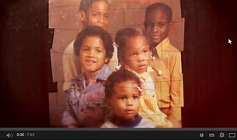
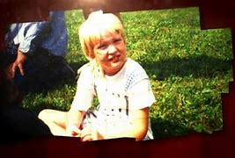
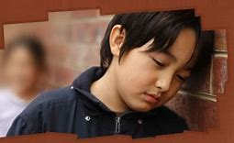
Narratives
Through Our Eyes: Children, Violence, and Trauma

Slide 9
Child’s Perception

Slide 10
Trauma & Overwhelming Emotion
Trauma can trigger intense fear, anger, shame and helplessness when the child is overwhelmed. This can interfere with the development of age-appropriate self-regulation.
It can be seen as:
over-controlled behavior and
under controlled behavior.

Slide 11
Triggers
Examples
Loud noises
Physical touch
Chaos
Changes in routine
Times of the year
Emergency vehicles
Response
Flight
Fight
Freeze

Slide 12
Know Signs and Symptoms ~ Do not diagnose
Emotions/Affect
Depressed mood
Excessive anxiety
Excessive irritability
Helplessness/hopelessness
Thinking
Poor concentration
Pessimism
Difficulty making decisions
Rigid thinking
Functional/behavioral
Appetite changes
Sleep changes
Social withdrawal
Academic challenges
Change in hygiene
Physical
Headaches
Pounding heart, tremors
Nausea

Slide 13
Maladaptive Coping Strategies
Can be observed as:
Sleeping, eating or toiling problems
High activity levels, irritable or acting out
Emotional detachment, unresponsive, distant or state they feel ‘numb’
Hypervigilance
Reckless or self-destructive behaviors
Mental health issues such as depression or anxiety
Exaggerated response when told no or boundaries are set

Slide 14
Understand the impact of trauma and/or social emotional difficulties on school performance

Slide 15
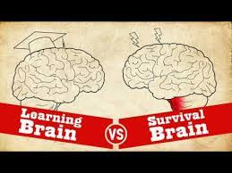

Slide 16
What We do Know About Learning
The brain never stops growing, changing, responding to interaction and environments
Effective learning happens
in caring relationships
when physically and emotionally safe
when sense of belonging, connection, engagement
when opportunities for challenge, failure, and success are plentiful
Individuals learn skills and concepts in different ways at different times
Positive, stable relationships can buffer the potentially negative effects of even serious adversity
Adversity affects learning so policies, philosophy and interventions schools use do make a difference
Learning is increased when you use hands-on learning, skill practice, goal setting and a sense of mastery.
(Linda Darling-Hammond and Channa M. Cook-Harvey, Educating the Whole Child: Improving School Climate to Support Student Success, Learning Policy Institute, 2018 https://learningpolicyinstitute.org/sites/default/files/product-files/Educating_Whole_Child_REPORT.pdf)

Slide 17
What We do Know About Learning (cont.
6. Emotions and social relationships affect learning
Interest and excitement increase learning
Fear, anxiety, self doubt reduce learning
Positive social and emotional skills that build on a foundation of empathy and self awareness contribute to relationships, safe environments and learning

Slide 18
Impact on Educational Outcomes
Attendance
Behaviors
Coursework
Health
(Souers & Hall, 2016; NCTSN, 2019)

Slide 19
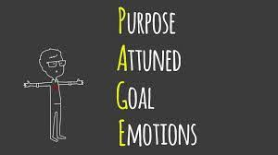
Creating Trauma-Sensitive
Learning Environments
Because it is not about you!

Slide 20
Stay True to You
Personal Mission Statement
What drives you?
Why did you choose teaching?
What inspired you to teach?
What do you want to get out of your career?
What do you believe about students?
Name your three most important core values.

Slide 21
Trigger Exercise
Common states that increase being triggered
Tired
Our own past experiences
Belief system challenges and ideas
Fear

Slide 22
Preparing for My Own Emotional Intensity
Push Pause- don’t say anything and deep breath
Quick Calm Breathing Exercise
Know your baseline and triggers--self-awareness is key in managing your own intensity

Slide 23
Attune & Goal
Prevention
Have a plan
Avoid power struggles
Know your students
Visual grounding

Slide 24
Balancing Empathy and Accountability
Empathy-
Asking yourself what the student is needing right now
Respecting it is ok not to be ok at the moment
Accountability-
Repairing what was done
Making a plan for next time

Slide 25
Self-Care
Revisit your mission statement often
Know our triggers and plan responses
Take the self-care challenge (Souers & Hall, 2016)
For your health--exercise 40 minutes, 3 times a week
Once a week do something just for you
Try something new each week to get you out of your comfort zone
Identify one thing you are grateful for each day

Slide 26
School Level Strategies

Slide 27
General Strategies
Provide structure
Teach with enthusiasm and passion
Have a positive attitude
Incorporate humor into lessons
Make learning fun
Incorporate storying telling into lessons
Show an interest in their lives outside of school
Treat them with respect
Go the extra mile (Meador, 2019)

Slide 28
Traditional vs Trauma-informed Responses
Traditional Reactions | Trauma-Informed Responses
Go to the principal’s office | I’m here. You’re not in trouble
Stop acting like a baby | That really set you back, didn’t it
It’s not that difficult | I need to understand how hard this is for you
Act your age | This is too big to keep to yourself
Nobody is going to like you if you don’t behave | I know you want to be liked, so let’s make that happen
Sporleder & Forbes, 2019

Slide 29
Triggers Through a Trauma Lens (NCSSLE, 2019)
Manipulative--Getting needs met in a way that has worked
Lazy--Lacking skills, feeling overwhelmed
Resistant--Mistrustful or scared
Unmotivated--Depressed, fearful
Disrespectful--Feeling threatened, unsafe
Attention-seeking--feeling disconnected, alone

Slide 30
Applying an Equity Lens
Five barriers contribute to inequitable access to a high-quality SEL education
poverty
exclusionary discipline practices and policies
lack of trauma-informed practices
implicit bias in school staff
educator stress and burnout
(Simmons DN, Brackett MA, and Adler N, Applying an Equity Lens to Social, Emotional, and Academic Development, Robert Wood Johnson Foundation, 2018 - https://www.rwjf.org/en/library/research/2018/06/applying-an-equity-lens-to-social-emotional-and-academic-development.html)

Slide 31
Applying an Equity Lens :
Five opportunities identified for overcoming those barriers
school racial and socioeconomic integration initiatives
restorative justice practices for school discipline
trauma-informed system interventions
culturally competent and equity-literate educators
SEL and mindfulness programming to support students and teachers
(Simmons DN, Brackett MA, and Adler N, Applying an Equity Lens to Social, Emotional, and Academic Development, Robert Wood Johnson Foundation, 2018 - https://www.rwjf.org/en/library/research/2018/06/applying-an-equity-lens-to-social-emotional-and-academic-development.html)

Slide 32
Trauma Sensitive Schools and Multi-tiered Systems of Support

Slide 33
Tier 1 –Universal
Implemented by all school personnel who are capable of taking over when the student can’t regulate
Implementation of Positive Behavioral Supports, Social Emotional Learning Curriculums, universal programs such as Every Moment Counts

Slide 34
Tier 1--Universal Social Emotional Learning Example
Direct instruction in the following areas:
Self-awareness
Self-management
Social awareness
Relationship skills
Responsible problem solving
(See CASEL for more information)

Slide 35
Tier 1--Universal General Principles
Establish a sense of community
Set clear expectations
Respect cultural differences
Use consistent classroom routines and procedures
Offer alternatives
Establish backup support systems
Regular monitoring of students to identify concerns
(Jennings, 2019)

Slide 36
Tier 2 – Targeted
Typically occur in a small group setting facilitated by interdisciplinary teams
For kids with trauma--interventions focus on self-soothing, self-regulation and relationship building to develop trust
504 or additional individual plans
Teacher may implement accommodations determined by the team
(Craig, 2017)

Slide 37
Tier 3--Targeted
Involves one-to-one intervention
Examples:
Counseling provided by the counselor or psychologist
IEP
Teachers and other staff implement accommodations determined by the team
(Craig, 2017)

Slide 38
Social Emotional Learning and Trauma Sensitive Schools Improve Function in Areas That are Affected by Trauma
Concentration
Problem-solving
Abstract thinking
Working collaboratively in groups
Ability to recall facts
Working memory
Comprehension
Classroom and teacher transitions
Forming relationships
Regulating emotions
Organizing material sequentially
Application of knowledge

Slide 39
Building a Positive Environment
Strengths-based - provide a sense of mastery, inclusivity, culturally responsive
Focus on strengthening relationships - staff to student, student to student, adult to adult
Growth-mindset versus a deficit-mindset
Proactive rather than reactive
Provide emotional and physical safety for everyone
Focus on the underlying need
Training that aims to change staff behavior and attitudes
Engages in authentic parent/caregiver partnerships

Slide 40
One Approach--The Three R’s: Reaching the Learning Brain (Perry)
Regulate
Relate
Reason

Slide 41
Regulate
FIRST: Help the child to calm their fight/flight/ or free response
Avoid talking to the child about the behavior
“I can see things aren’t going well”
Offer a prompt to use a self-regulation strategy
Engaging in the strategy with them is necessary
This empowers the child to have a sense of control over self

Slide 42
Relate
SECOND: Relate and connect with the child through an attuned and sensitive relationship
Active listening--speaking slowly and letting the child know you heard what they said
Nurturing
Empathetic
Listen, connect, empathize, accept, validate

Slide 43
Reason
THIRD: We can support the child to reflect, learn, remember, articulate and become self-assured.
Proactive--teaching emotion regulation strategies
Redirective--offering choices for discipline; redos, consequences
Rationalize, problem solve, discipline, consequences, plan for the future similar situation
(Perry; Purvis & Cross.)

Slide 44
Another Source
Trust-Based Relational Intervention (Purvis & Cross)
Empowering
Connecting
Correcting
3-part webinar series free and available on demand: (1 hour per concept) –Mountain Plains Mental Health Technology Transfer Center

Slide 45
Summary
Understand trauma and its impact
Believe that healing happens in relationships
Ensure emotional and physical safety
View students holistically
Support choice, control and empowerment for students, staff and families ( SEL skill development)
Strive for cultural competence – Equity lens
Use a collaborative approach
Students who experience difficulties with social, emotional or behavioral difficulties benefit from:
Social emotional learning
Relationship building

Slide 46
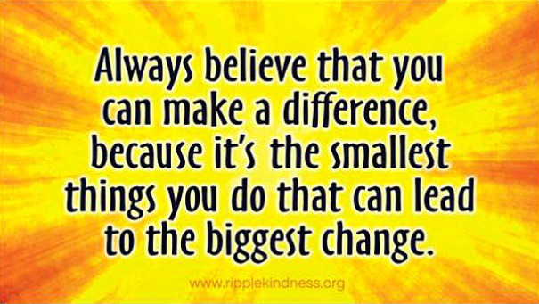

Slide 47
Questions
Image from Bing

Slide 48
References and Resources
Center for Disease Control (2019). ACEs. Retrieved from https://www.cdc.gov/violenceprevention/childabuseandneglect/acestudy/index.html
Cook, A., Blaustein, M. Spinazzola, J., & van der Kolk, B. (2003). Complex trauma in children and adolescents. Los Angeles: National Child Traumatic Stress Network. M. (2007). Promoting and protecting
National Center on Safe Supportive Learning Environments. (2019). Understanding trauma and its impact.
National Center on Safe Supportive Learning Environments (2019). Trauma sensitive schools training package. Retrieved from https://safesupportivelearning.ed.gov/trauma-sensitive-schools-training-package
The National Survey of Children’s Health (2011/2012) Retrieved from: https://www.childhealthdata.org/docs/nsch-docs/sas-codebook_-2011-2012-nsch-v1_05-10-13.pdf
Siegel, D.J. (2003). An interpersonal neurobiology of psychotherapy: the developing mind and the resolution of trauma. In M. Solomon & D.J. Siegel (Eds.), Healing trauma: Attachment, mind, body and brain (pp.1-56). New York: W.W. Norton & Company.
Souers, K. & Hall, P. (2016). Fostering resilient learners: Strategies for creating a trauma-sensitive classroom. Alexandria, VA: ASCD.
Statman-Weil, K. (2015). Creating trauma-sensitive classrooms. National Association for the Education of Young Children.

Slide 49
Disclaimer
This presentation was prepared for the Mountain Plains Mental Health Technology Transfer Center (TTC) Network under a cooperative agreement from the Substance Abuse and Mental Health Services Administration (SAMHSA). All material appearing in this presentation, except that taken directly from copyrighted sources, is in the public domain and may be reproduced or copied without permission from SAMHSA or the authors. Citation of the source is appreciated. Do not reproduce or distribute this presentation for a fee without specific, written authorization from the Mountain Plains Mental Health Technology Transfer Center. For more information on obtaining copies of this presentation, call 701-777-6367.
At the time of this presentation, Elinore F. McCance-Katz, served as SAMHSA Assistant Secretary. The opinions expressed herein are the views of Sarah Nielsen, PhD and do not reflect the official position of the Department of Health and Human Services (DHHS), SAMHSA. No official support or endorsement of DHHS, SAMHSA, for the opinions described in this document is intended or should be inferred.

