Slide 1
Disclaimer and Funding Statement
This presentation was prepared for the Mountain Plains Mental Health Technology Transfer Center under a cooperative agreement from the Substance Abuse and Mental Health Services Administration (SAMHSA). All material appearing in this presentation, except that taken directly from copyrighted sources, is in the public domain and may be reproduced or copied without permission from SAMHSA or the authors. Citation of the source is appreciated. Do not reproduce or distribute this presentation for a fee without specific, written authorization from the Mountain Plains Mental Health Technology Transfer Center. For more information on obtaining copies of this presentation please email gberry@wiche.edu.
At the time of this presentation, Elinore F. McCance-Katz served as SAMHSA Assistant Secretary. The opinions expressed herein are the views of Anne Marie Albano and Lauren Hoffman and do not reflect the official position of the Department of Health and Human Services (DHHS), or SAMHSA. No official support or endorsement of DHHS, SAMHSA, for the opinions described in this presentation is intended or should be inferred.
The work of the Mountain Plains MHTTC is supported by grant H79SM081792 from the Department of Health and Human Services, Substance Abuse and Mental Health Services Administration.

Slide 2
Strategies for Promoting Resilience, Wellness, and Coping Skills for the Campus Community
Anne Marie Albano, PhD, ABPP
Lauren Hoffman, PsyD
Youth Anxiety Center @ Columbia University Clinic for Anxiety and Related Disorders (CUCARD)
Columbia University Medical Center

Slide 3

“An abnormal reaction to an abnormal situation is normal behavior.”
—Viktor Frankl, 1959

Slide 4
COVID-19:
An unprecedented & unrelenting disaster
Features of pandemics as distinct phenomena:
Novelty, unfamiliar, mysterious
Potential for isolation and quarantine
Shortages and scarcity (e.g., PPE supplies)
Misinformation rapidly spread
Anger and scapegoating
Fear and uncertainty
From - Morganstein et al (2017). Pandemics: Health Care Emergencies. In Textbook of Disaster Psychiatry (2nd ed., pp 270 284. Cambridge University Press

Slide 5
What Can we Anticipate about Psychological Vulnerabilities In the COVID-19 Pandemic
Similar to the aftermath of other natural disasters such as earthquakes, hurricanes, tsunamis, or floods
  Increased rates of depression, anxiety, substance use, and PTSD symptoms & disorders
  People with pre-existing vulnerabilities to psychiatric disorders including anxiety, depression, obsessional symptoms, substance use, suicidal behavior, and impulse control disorders are likely to be especially vulnerable to stress-related symptoms
  Long after the physical threat of infection has subsided, psychological sequelae, and behavioral effects of persistent distress will likely be ongoing, particularly for vulnerable populations
Beaglehole B, Mulder RT, Frampton CM, et al. Psychological distress and psychiatric disorder after natural disasters: systematic review and meta-analysis. Br J Psychiatry. 2018;213:716-722

Slide 6
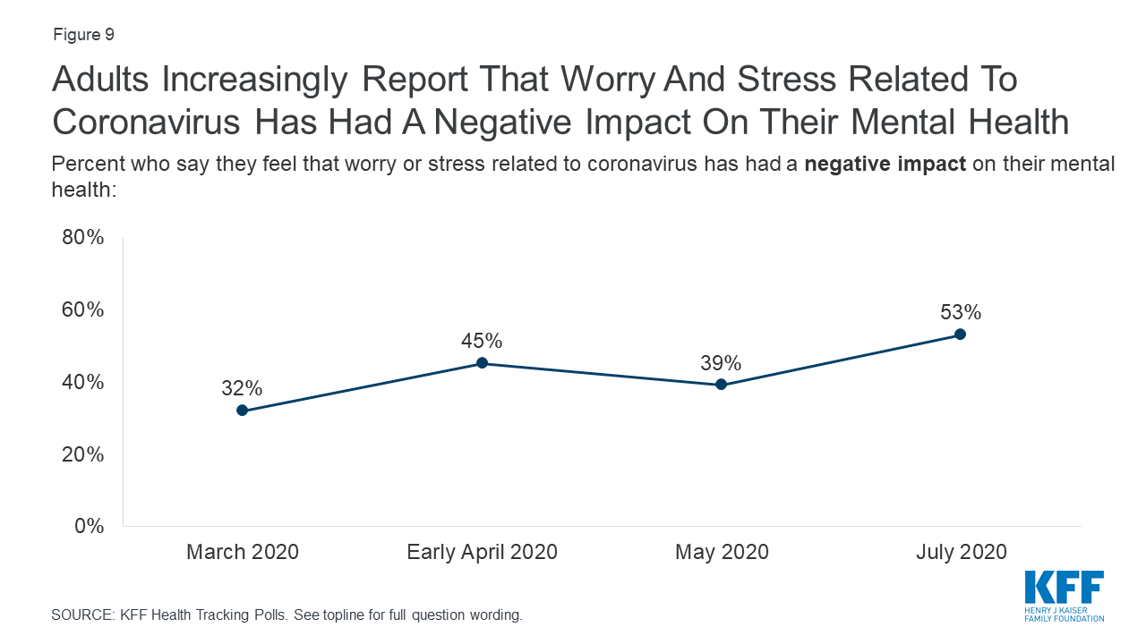
Kaiser Family Foundation Health Tracking Poll (Hamel et al. 7/20/2020)

Slide 7
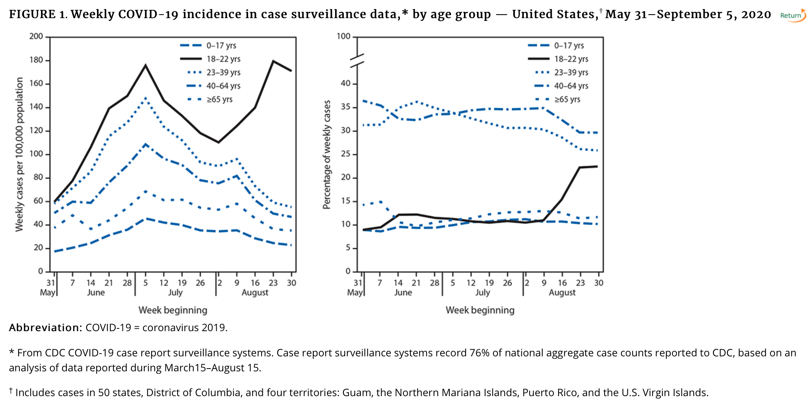
Cases of COVID-19 in College-Age Adults are Rising
Salvatore PP, Sula E, Coyle JP, et al. MMWR Morb Mortal Wkly Rep 2020;69:1419–1424.

Slide 8
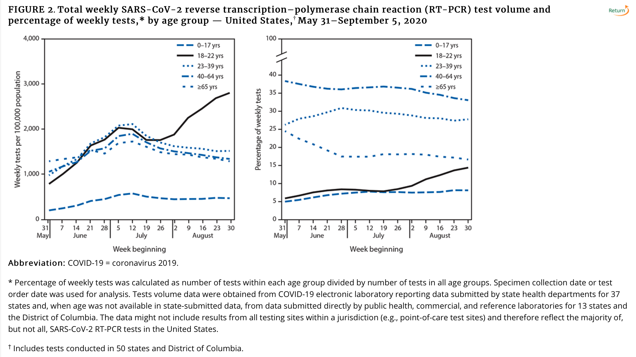
Testing for COVID-19 in College-Age Adults
Salvatore PP, Sula E, Coyle JP, et al. MMWR Morb Mortal Wkly Rep 2020;69:1419–1424.

Slide 9
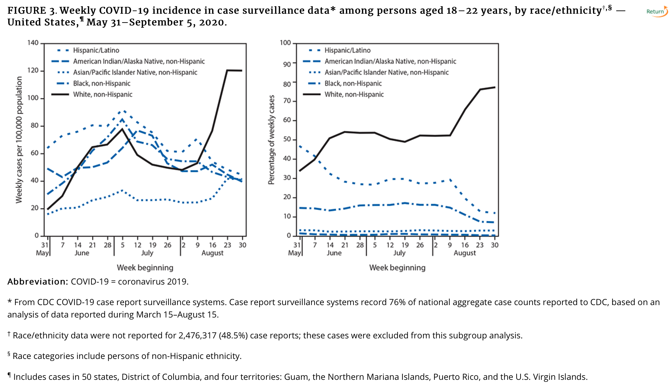
Incidence in 18-22 year olds by race/ethnicity
Salvatore PP, Sula E, Coyle JP, et al. MMWR Morb Mortal Wkly Rep 2020;69:1419–1424.

Slide 10

Silver linings
Most people should be resilient to stressors of COVID-19
Resilience is common and a fundamental feature of normal coping skills
Expressing positive emotions leads to greater resilience
Renewed purpose and meaning in life occurs in response to stress and trauma
(Bonanno, 2004; Mancini & Bonanno, 2010; Galatzer-Levy et al., 2018)

Slide 11
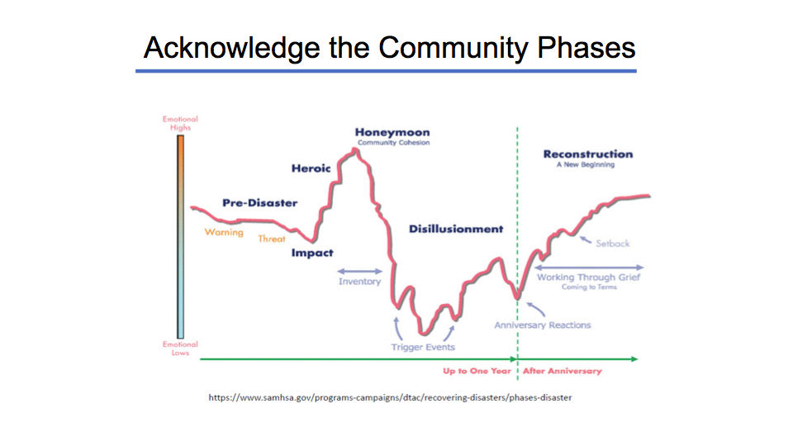
Promoting Resilience
Build
Resources
Understand & Work to Reduce Stressors
Coping strategies
Social isolation
Supportive relationships
Child care stress
Flexible expectations
Financial / housing instability
Stable housing for students
Loved one with COVID-19
Adapted from Baptista & Mellins (2020)

Slide 12
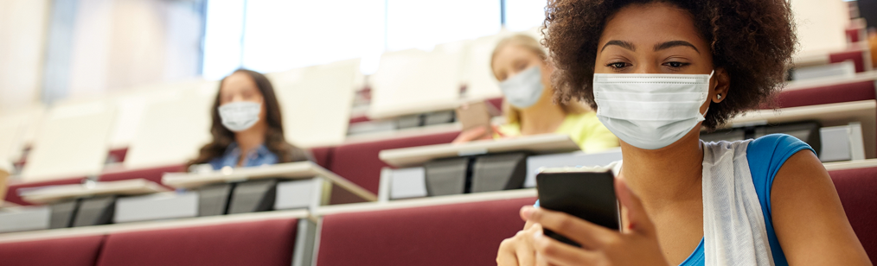
Reality Check:
Is a new surge coming?
Are we at the stage of “The New Normal”?
How do we greet people?
Should we hoard food and supplies?
Should we do more and more on-line as opposed to in-person (shopping, zoom happy hours, access the arts & culture, telemedicine, education)?
How do I get to campus safely via public transport & rush hours
What if I don’t feel ready to be in a class/on campus
I worry about getting sick or getting others sick
What if school opens up then close again, and repeat
What if you feel unsafe when in the dorm/class/dining hall
Staff worries about childcare or looking after elderly family members
Will college routines and classes ever normalize again?

Slide 13

Everyone Has Needs
Campus leaders, faculty, staff, and students are having to engage in a balancing act
Managing Work/School Expectations
Managing
Personal Stressors

Slide 14
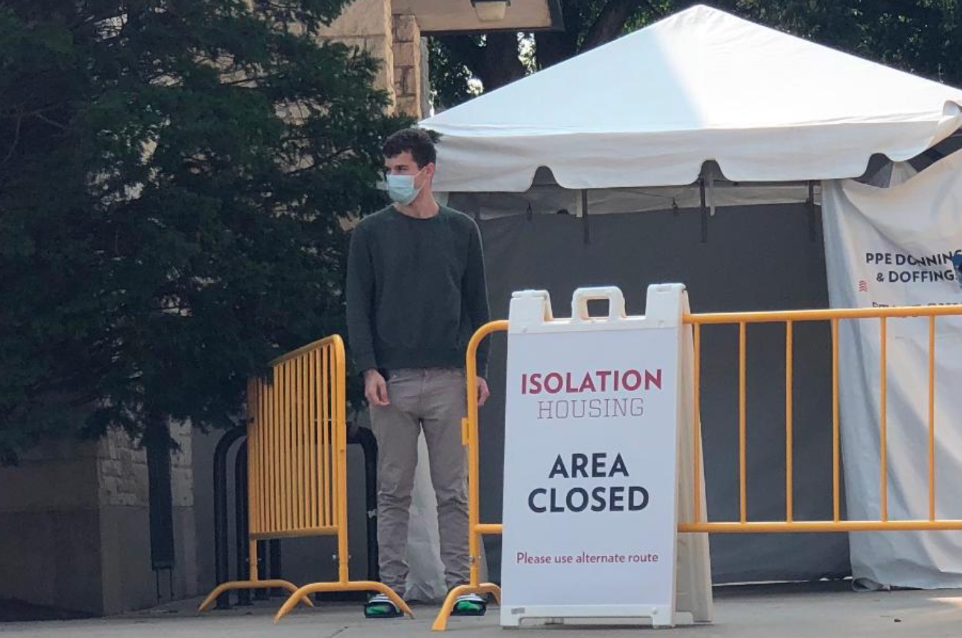
Campus-Wide COVID Prevention Strategies
Universal entry screening: testing all students before arrival on campus
2-phased universal screening: prearrival testing paired with a follow-up test, typically about 1 week after arrival
Scheduled screening, with repeated testing of the entire campus population (eg, weekly)
Random screening, with testing a random sample of the campus population
Testing on-demand, by making tests available to students on campus on demand but not requiring testing
Wastewater testing to detect virus in the sewage overall or for specific facilities (eg, residence halls)
Walke, Honein, Redfield. JAMA. Published online September 29, 2020

Slide 15

COVID-19 Risks to College Students, Staff & Surrounding Communities are Intertwined
Transmission could occur in college classroom settings especially if there is no mandatory use of face masks, insufficient physical distancing, or inadequate hand hygiene.
Social and residential settings outside of classrooms likely pose a significant risk as shown by a number of outbreaks tied to social events linked to campuses.
Coordination of mitigation measures including robust testing both on and near campuses will be essential for reducing or preventing transmission.
Closure of residence halls and campus housing in response to an outbreak could disproportionately affect students with lower socioeconomic status and might actually have minimal effects on the level of transmission on campus and in the surrounding community, especially if the majority of students live off-campus or if high-risk settings (eg, crowded indoor social settings) remain open.
A model response—both in planning for and responding to outbreaks—will involve a close partnership between communities and universities to join forces to reduce SARS-CoV-2 transmission.
Walke, Honein, Redfield. JAMA. Published online September 29, 2020

Slide 16
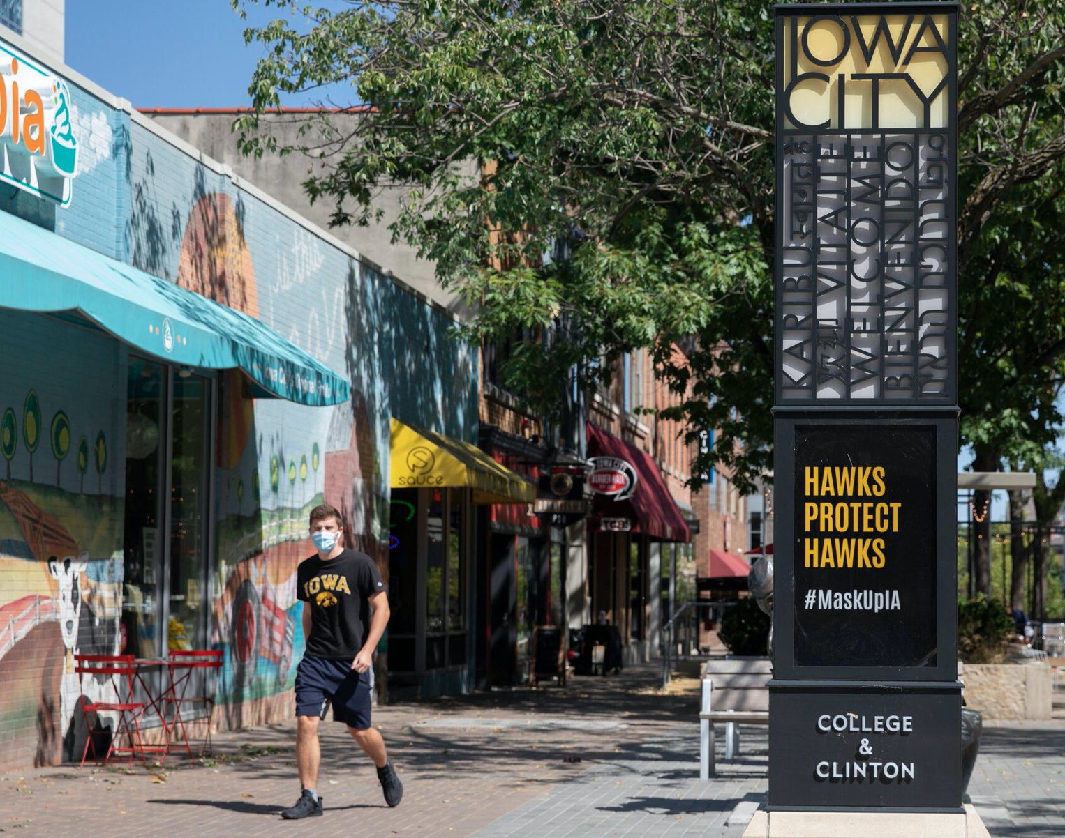
Promoting Mental Health & Wellbeing for All
Campus & Community Collaboration
  Consistent safety regulations & practices on and off campus
Student Voices & Ambassadors
  Addressing student concerns & needs; Foster cooperation & engagement
Community & College Essential Workers
  Give voice to their stories & experiences
Safety policies
  Tips for handling unsafe situations—specify on and off campus resources
  How to encourage others to follow safety policies—bystander training & intervention
Encourage & make opportunities for contributing to the mental & physical health and wellness of the broader campus & surrounding community

Slide 17










Ongoing Stressors: Similar & Intertwined
Virtual learning
Reduced support
Work/school from home
Family conflict/responsibilities
Financial stress
Reduced socialization
Worries about the future
Campus activities cancelled

Slide 18
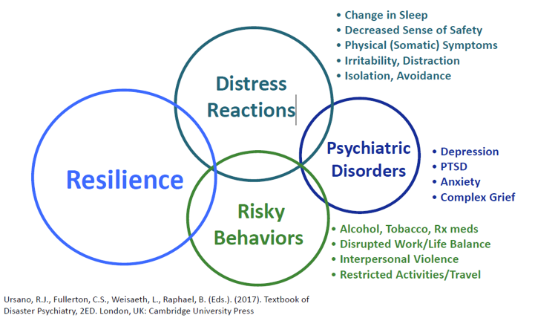
Adapted from Baptista & Mellins (2020)

Slide 19
Resilience
Resilience = the ability to absorb strain and preserve (or improve) functioning despite the presence of adversity.” (Sutcliffe & Vogus, 2003)
It does not have to mean “bouncing back” to how you were pre-pandemic
It does not mean you are unchanged
But rather learning to integrate the adverse experiences into who you are and growing with them (sometimes known as post-traumatic growth)
Applies to individuals as well as groups and communities

Slide 20
Promoting Resilience
Understand & Work to Reduce Stressors
Social isolation
Child care stress
Financial / housing instability
Loved one with COVID-19

Slide 21
Promoting Resilience
Build
Resources
Understand & Work to Reduce Stressors
Coping strategies
Social isolation
Supportive relationships
Child care stress
Flexible expectations
Financial / housing instability
Stable housing for students
Loved one with COVID-19

Slide 22


Step 1: Campus Temperature Check

Slide 23
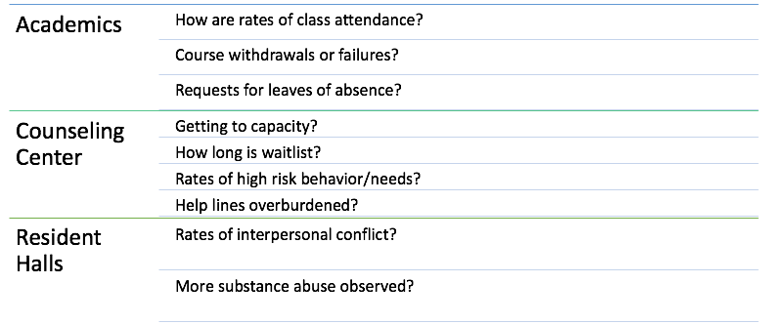
Temperature Check: Signs of Student Distress

Slide 24
Temperature Check: Signs of Faculty & Staff Distress
Is the HR department getting more requests for assistance?
Are sick days/leave of absences increasing?
Are Professors spending lots of time with IT challenges?
Are certain departments struggling more or less than others?
Are irritability, impatience, or frustration increasing within groups?
Is more stress being reported to supervisors?

Slide 25

Step 2: Listen, Validate, & Support Resilient Teams

Slide 26
Listen, Validate, & Support
Schedule regular “Town Hall” and smaller meetings with groups of faculty, staff, and students for regular “Check Ins”
Provide incentives for participation (particularly for students)
  Food, school “swag,” entertainment of some kind
Listen & validate, validate, validate!!
  Ensure an open, safe space to air concerns without judgment
    “What have you been experiencing?”
    “What has been stressful or challenging?”
  Label, normalize, and validate a range of emotions
Use Surveys to stay on top of changing concerns within the campus community

Slide 27

The Power of Listening
Listening is not a technique. It's an intention.
Listening Tips
Don’t multi-task – give your full focus and attention
Make eye contact (if in-person or on video)
Reflect back what you hear
Take notes
From Aaron Vieira, CopeColumbia

Slide 28
Listen, Validate, & Support
Prioritize concerns & form related task groups
  Brainstorm potential solutions to common challenges of the group
  Consult with outside experts if outside your scope of expertise (e.g., building Anti-Racism programming, supporting diversity & inclusion in hiring practices)
  Invite representatives from the key groups you’re trying to reach
Offer “Drop In” Groups for specific departments, groups of staff, and students
  Present self-care and coping strategies
  Facilitate social support and active problem solving
  Educate about other campus resources

Slide 29
Build Resilient Teams
Encourage leaders to model and prioritize openness and self-care
Department leaders should not just ask others to share, but should open by sharing themselves
Leaders should model importance of self-care and social support by incorporating related exercises into team meetings
Resilient Teams
Trust each other
Feel a strong sense of belonging (“We’re all in this together”)
Feel valued by leadership
Express gratitude to each other
Building Hope
Teams need hope to maintain energy and motivation
Encourage looking for small positives, sources of meaning, and local solutions

Slide 30

Taking Care of Your Campus “Team”
How do you take care of your team?
Emphasize team purpose to provide focus and inspire action
Communicate information frequently and transparently
Reframe to infuse positive energy and hope in team discussion
Build social connections
Express gratitude and appreciation regularly

Slide 31
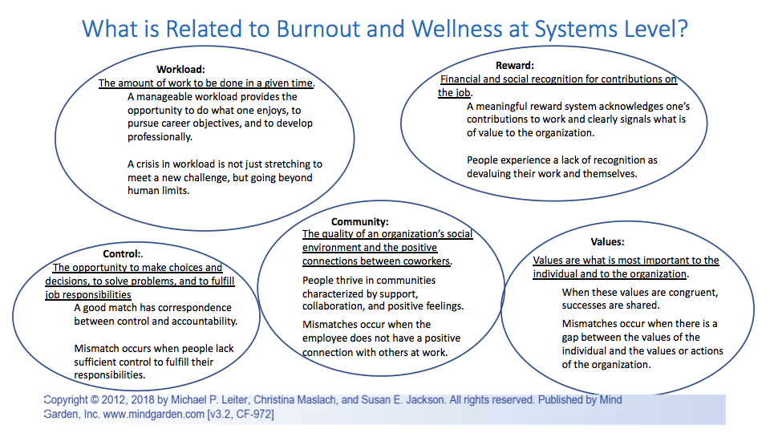
Step 2: Build Resilient Teams
  Encourage leaders to model and prioritize openness and self-care
    Department leaders should not just ask others to share, but should open by sharing themselves
    Leaders should model importance of self-care and social support by incorporating related exercises into team meetings
  Resilient teams:
    Trust each other
    Feel a strong sense of belonging (“We’re all in this together”)
    Feel valued by leadership
    Express gratitude to each other
  Building Hope
    Teams need hope to maintain energy and motivation
    Encourage looking for small positives, sources of meaning, and local solutions

Slide 32
Managing Trauma
This has been a traumatic time, particularly for those who have lost loved ones, and those who’ve witnessed or experienced bias, racism, or brutality
Grounding can help get us back to the present moment, adapt, and deal with the realities of what is happening right now
Sharing stories with others
Engage trauma response teams or counsellors to assist
Intentionally continue to offer & encourage pleasurable and soothing activities
Provide space to process and discuss lessons & growth learned from the event

Slide 33
Managing Grief and Loss
Loss may be especially complicated, as it can be accompanied by guilt and anger
Take time to mark your connection to the individual
Plan future remembrance & gatherings
Share stories with others who share your loss
Write – about your experiences, or send letters/notes to those in your community directly affected by loss
Intentionally continue to engage in soothing or pleasurable activities
Connect (or reconnect) with friends and important people in your life

Slide 34

Step 3: Reduce Stressors
Meet Basic Needs
Encourage Flexible Expectations

Slide 35




Reduce Stressors: Meet Basic Needs
Must start with basics: food, housing, health care, access to technology
  Assess student and staff member needs related to these issues
  Work with campus teams to increase access and stability
    Can devices, WiFi, more tech support be provided?
    Can the meal plan be subsidized?
    Can housing be provided for additional students?
    Can access to COVID-19 testing or other health care needs be supported?
  Provide relevant support agencies if University is not able to assist with these needs
  Engage with community to identify and access resources

Slide 36
Reduce Stressors: Flexible Expectations
Normalize childcare and family challenges on Zoom!
Encourage Professors to be more flexible with absences, need for extensions, etc.
Encourage broader use of accommodations
Consider flexible hours and increased remote work

Slide 37

Step 4: Build Resources
Build Supportive Relationships
Encourage Healthy Coping

Slide 38

Build Resources: Supportive Relationships
Consider ways to safely open large gathering places on campus (library, student center, arenas)
  Increase use of outdoor space
  Require masks
  Include signage for social distancing
  Identify monitoring system for safety

Slide 39
Build Resources: Supportive Relationships
Promote School Spirit & Connectedness
(with Office of Student Activities)
  Develop and distribute school “gear”
  Encourage virtual “watch parties” for school sports and other events
  Build Events Calendar with in-person and/or virtual social events (e.g., watching scary movie for Halloween; outdoor or virtual comedy night; hiking)
  Use social media to promote and celebrate events and milestones, spotlight individual students or student groups, etc.
  Encourage clubs and other extracurriculars to meet virtually

Slide 40
Build Resources: Supportive Relationships
How do you take care of your faculty & college staff?
Conduct periodic check-ins
    Ask how they’re feeling about the students, campus, continuing to telecommute, and/or managing home life
    If appropriate, offer college/university resources on child care, transportation and parking, HR contact or counseling
    Affirm their strengths and convey confidence in them
Listen to be supportive
From Aaron Vieira, CopeColumbia

Slide 41
Practical Tips to Build Social Connection
Establish “Check-in Meet Ups”
  Introduce this short ritual at the start of meetings
Encourage “Buddy System”
  Create opportunities for staff to support each other
Facilitate Collaboration
  Ask different departments to work together on a specific projects
Call for a Relational Pause
  Group shifts from task to relational focus to deal with anxiety
Plan Virtual Social Events
  Organize fun social events; make participation voluntary

Slide 42
Build Resources: Coping Skills
Campus Counseling Center
  Provide regular outreach to all students
    Send “Tip Sheets” with basic coping skills for particular stressors (e.g., mid-terms)
    Promote Counseling Center offerings, with clear instructions for how to access care
    Provide online resources for managing stress
  Consider specific outreach to more at-risk groups
    Pre-existing mental health difficulties, students with academic accommodations, international students, LGBTQ students
  Lead trainings with RAs, TAs, or groups of students in resident halls to provide information about coping and support options
  Consider Stepped Care approach to care

Slide 43
Stepped Care Approach
Self-Help Resources
Campus Support Networks
Group Treatment
Guided Self-Help
Individual Therapy
Higher Level of Care
Medication Management

Slide 44
Stepped Care Approach
Self-Help Resources
Apps
Campus Support Networks
Peer Support Groups
Group Treatment
Help Lines
Guided Self-Help
Individual Therapy
Higher Level of Care
Medication Management
Books

Slide 45
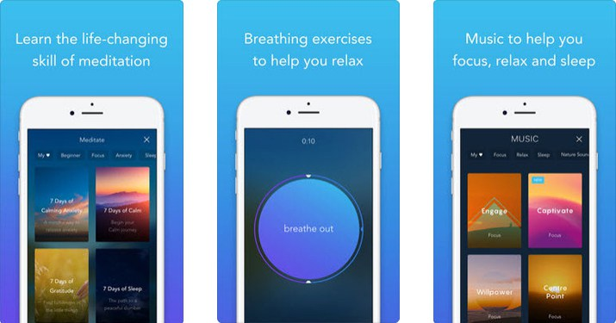
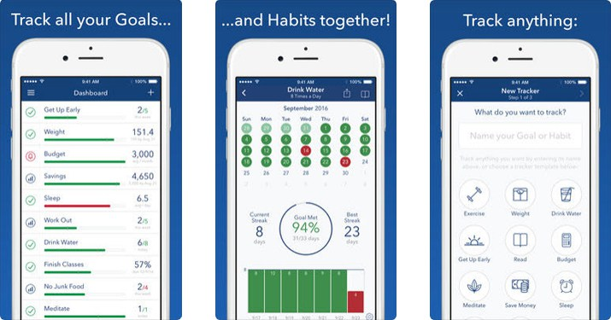
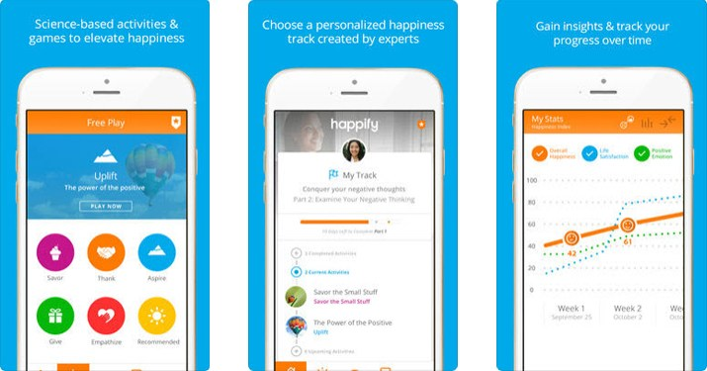
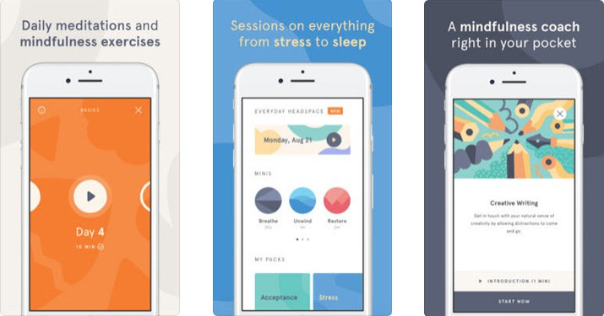
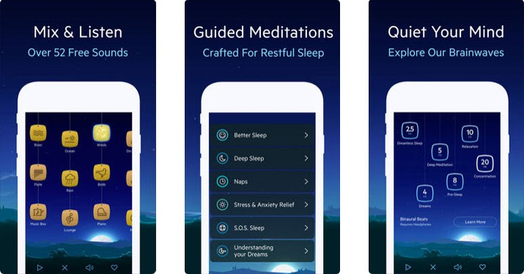
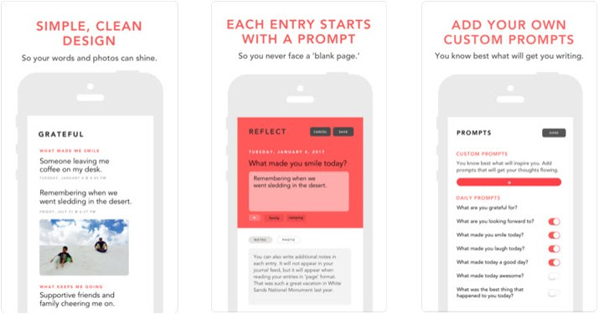
Self-Care Apps
Calm
Headspace
Strides Habit Tracker
Grateful: A Gratitude Journal
Happify
Relax Melodies
Source: Barnes and Noble College

Slide 46
Self-help, on-line & campus resources
Anxiety Canada
  https://www.anxietycanada.com/
Active Minds
  http://www.activeminds.org/
The Jed Foundation
  https://www.jedfoundation.org/
All For 1
  http://www.allfor1-us.org/

Slide 47
Stepped Care Approach
Self-Help Resources
Campus Support Networks
Group Treatment
Guided Self-Help
Individual Therapy
Higher Level of Care
Medication Management

Slide 48
Stepped Care Approach
Self-Help Resources
Campus Support Networks
Group Treatment
Guided Self-Help
Individual Therapy
Higher Level of Care
Medication Management

Slide 49
Stepped Care Approach
Self-Help Resources
Campus Support Networks
Group Treatment
Guided Self-Help
Individual Therapy
Higher Level of Care
Medication Management

Slide 50
Build Resources: Coping Skills
Focus on promoting a few key strategies for resilience
Get Active
Separate Work/ School and Home
Identify Values and Related Actions

Slide 51

Movement is Key!
  It’s easy to forget how much we move during a typical day
    Up and down stairs
    Walking to your car or to get lunch
    Going to the gym
  We’re all feeling much more confined and physically stiff
  We’ve got to move!

Slide 52
Move for your Mood

Slide 53
Move for your Mood
Getting active is hard at first…

Slide 54
5 Types of Activities
Physical
Fun
Service
Mastery
Social

Slide 55
Set Boundaries for Work/School/Home Balance
Physical boundaries
Set aside a specific space for work, where you can be comfortable AND productive
Schedule
Leave time for breaks, including a break for lunch
Set “work hours” for yourself – try to limit work to these hours
Personal boundaries
Prioritizing yourself is OK
Being able to say, "today is not the day" when someone comes to you with something you can't presently deal with

Slide 56
“Those who have a “why” to live can bear with almost any “how.”
—Viktor Frankl, 1959

Slide 57
Identifying Values
Values: qualities, characteristics, or ideas about which we feel strongly.
Resilient campuses and individuals understand their values and use them as standards to guide decisions, actions, and attitudes.
When we act in accordance with our values, we feel stronger sense of meaning, hope, and strength

Slide 58
Identifying Values
Clarify values:
  Simply ask, “What matters to us?” or “Why are we here?” and have an open discussion.
  Consider challenging questions such as:
    “If we were given 5 million dollars, how would we spend it?”
    “What do we want students/parents/ alumni/others to say about us?”
    “Consider you’re reflecting on your life when you’re 85 years old, what qualities or experiences will stand out as contributing to a life well lived?”
  Look at a list of values and select top 5

Slide 59
Identifying Values
Value | Importance (0-10) | Current Success (0-10) | Related Action or Attitude
Campus/Dept
Community
Social responsibility
Academic excellence
Personal
Kindness
Flexibility
Determination
Family

Slide 60


Summary
This is an extremely challenging time for all on campus.
Resilience does not mean you are unchanged, but rather working to integrate the adverse experiences into who you are and growing with them.
Listen, listen, listen to take the temperature of your campus.
Facilitate connection
Attend to basic needs and encourage flexibility
Promote use of active coping strategies
Identify values to encourage meaning making and strength

Slide 61

Thank you!

