Slide 1
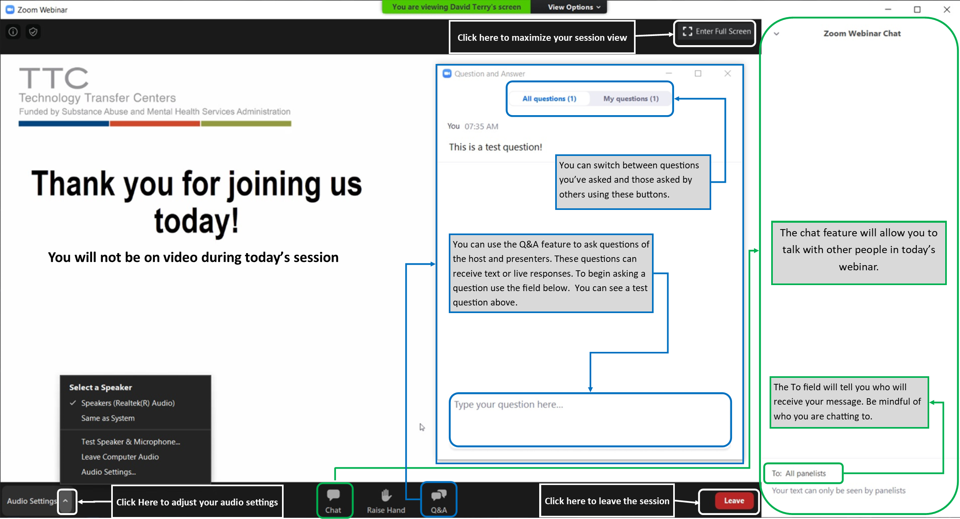
Please Note:
All attendees are muted
Today’s session will be recorded
Get to know the Zoom Webinar interface

Slide 2
Recordings for each session will be made available on our website:
https://bit.ly/mhttc-grief-sensitivity-training

Slide 3
Building Virtual Communities To Support Grieving Youth & Families During Uncertain Times
Thursday, November 13, 2020
9:30-11:00am PT/ 10:30-12pm MT/ 11:30-1pm CT/ 12:30-2pm ET
Lauren W. Schneider, LCSW
Talya Schlesinger, MSW
OUR HOUSE Grief Support Center

Slide 4
Housekeeping Items
We have made every attempt to make today’s presentation secure. If we need to end the presentation unexpectedly, we will follow-up using your registration information.
All attendees are muted and cannot share video.
Have a question for the presenters? Use the Q&A
Have a comment or link for all attendees? Use the Chat
At the end of today’s training please complete a brief survey about today’s training.
You will receive an email on how to access a certificate of attendance; must attend at least half of the session.
This event is closed captioned!
Follow us on social media: @MHTTCNetwork
Please Note:
Session recording and slide deck will be posted on our website within a week.

Slide 5
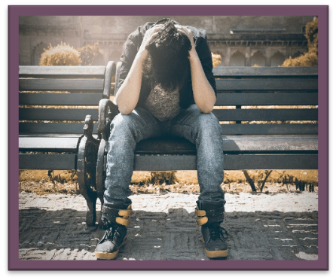
Additional Information on Grief
Fact Sheets
We have a series of fact sheets focused on addressing various grief-related topics
Defining Grief
Responses to Grief Across the Lifespan
Preventive Strategies and Protective Factors
Cultural Responsiveness
Evidence-Based Treatments for Grief
Webpage
Responding to COVID-19: Grief, Loss, and Bereavement - visit our webpage for events and resources
https://mhttcnetwork.org/centers/global-mhttc/responding-covid-19-grief-loss-and-bereavement

Slide 6
Grief and Self-Care
Be sensitive to your own grief and reactions throughout the Learning Institute. Take breaks, stretch, drink lots of water...
Helplines and Support
National Suicide Hotline - 1-800-273-8255
NAMI - 1-800-950-NAMI (6264) or info@nami.org
Mental Health America- 1-800-273-TALK (8255), text MHA to 741741
SAMHSA’s National Helpline - referral and information - 1-800-662-HELP (4357)
SAMHSA’s Disaster Distress Helpline - 1-800-985-5990 or text TalkWithUs to 66746

Slide 7
The MHTTC Network accelerates the adoption and implementation of mental health related evidence-based practices across the nation
Develops and disseminates resources
Provides free local and regional training and technical assistance
Heightens the awareness, knowledge, and skills of the mental health workforce
10 Regional Centers, a National American Indian & Alaska Native Center, a National Hispanic & Latino Center, and a Network Coordinating Office
www.mhttcnetwork.org

Slide 8
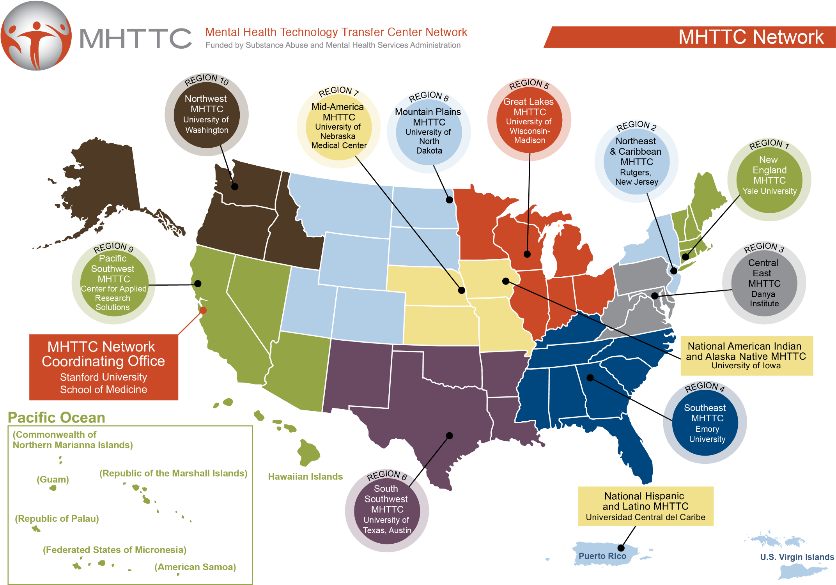

Slide 9
Disclaimer
This presentation was prepared for the MHTTC Network under a cooperative agreement from the Substance Abuse and Mental Health Services Administration (SAMHSA). All material appearing in this presentation, except that taken directly from copyrighted sources, is in the public domain and may be reproduced or copied without permission from SAMHSA or the authors. Citation of the source is appreciated. Do not reproduce or distribute this presentation for a fee without specific, written authorization from the MHTTC Network Coordinating Office. This presentation will be recorded and posted on our website.
At the time of this presentation, Elinore F. McCance-Katz served as SAMHSA Assistant Secretary. The opinions expressed herein are the views of the speakers, and do not reflect the official position of the Department of Health and Human Services (DHHS), or SAMHSA. No official support or endorsement of DHHS, SAMHSA, for the opinions described in this presentation is intended or should be inferred.
This work is supported by grants under Funding Opportunity Announcement (FOA) No. SM-18-015 from the DHHS, SAMHSA.

Slide 10
Building Virtual Communities To Support Grieving Youth & Families During Uncertain Times
Thursday, November 13, 2020
9:30-11:00am PT/ 10:30-12pm MT/ 11:30-1pm CT/ 12:30-2pm ET
Lauren W. Schneider, LCSW
Talya Schlesinger, MSW
OUR HOUSE Grief Support Center

Slide 11
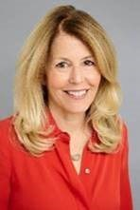
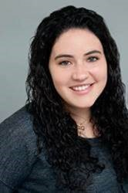
Presenters
Lauren Schneider, LCSW, Clinical Director of Child and Adolescent Programs, Our-House
Lauren, a nationally recognized authority on Children’s Grief, has provided trainings for mental health clinicians, educators, clergy, health care providers and graduate students throughout the community since 2000. Lauren is the author of “Children Grieve Too: A Handbook for Parents of Grieving Children”. She also created “My Memory Book…for grieving children” and contributing author for “You Can’t Do It Alone. A Widow’s Journey through Loss, Grief and Life After (2020) by Maria Quiban Whitesell as well as grief-related curricula for use at Camp Erin Los Angeles and in OUR HOUSE grief support groups. Lauren is the Associate Producer of “One Last Hug…and a few smooches” an Emmy award winning HBO documentary about Children’s Grief. She trains and supervises OUR HOUSE group leaders as well as MSW and MFT clinicians and students. Lauren maintains a private practice in Los Angeles specializing in grief and loss.
Talya Schlesinger, MSW, Associate Clinical Coordinator of Camp and Children’s Programs, Our-House
Talya is a clinical social worker dedicated to supporting children, adolescents and families. Talya completed her undergraduate studies in Biopsychology, Cognition and Neuroscience as well as Community Action and Social Change at the University of Michigan. She then received her MSW from the University of Michigan with a concentration in Children and Youth in Families and Society, and a minor in Human Services Management. Prior to joining the team at Our House Grief Support Center, Talya worked as a medical social worker at Children’s Hospital Los Angeles on the Bone Marrow Transplant team.

Slide 12
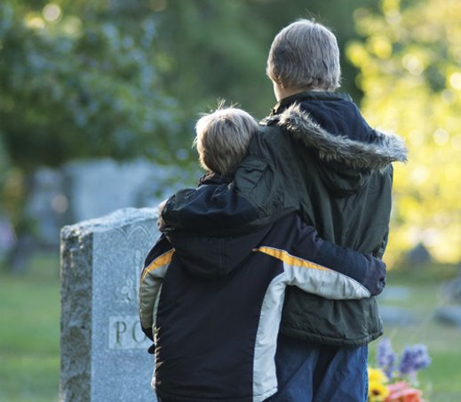
Building Virtual Communities To Support Grieving Youth & Families During Uncertain Times
Lauren W. Schneider, LCSW
Talya Schlesinger, MSW
Notes:
LAUREN
Who WE Are
Who are you?
Enter in chat
Clinician in an agency setting
Clinician in a school setting
Griever

Slide 13
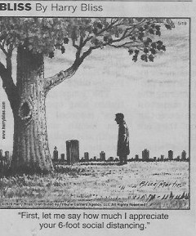
EXTRAORDINARY TIMES CALL FOR EXTRAORDI​ARY MEASURES
Notes:
LAUREN
Start:
Share Childhood Bereavement Estimation Model: 1:14 nationally (parent /sibling) vs. 1:18 in Cal.
Judishouse.org/cbem
Before COVID. How is COVID impacting our communities and us as professionals? This week 190,000 Americans=1.7 mil grieving kin
New language, behaviors, work places are now our new normal.

Slide 14
WHAT IS GRIEF:
1. Thoughts and feelings and behaviors when someone we love dies
2. All the feelings associated with the losses due to the pandemic
3. Reactions to those who lost their lives due to racial and social injustice
Notes:
TALYA
FAMILIES WALKING AROUND IN A HEIGHTENED STATE OF AROUSAL DUE TO CONSTANT REMINDERS OF THE DANGERS DUE TO COVID, THE DEATH DUE TO RACIAL AND SOCIAL INJUSTICE IN ADDITION TO THEIR OWN PERSONAL FAMILIAL DEATHS.

Slide 15
WHAT’S A SOCIAL WORKER TO DO?
OUR HOUSE Programs:
School-based grief groups
In-house grief groups
Camp Erin LA
Notes:
TALYA
CHILDRENGRIEVE.ORG- nagc website resource directory

Slide 16
Notes:
LAUREN
ASK: WHAT FEELINGS DOES THIS IMAGE EVOKE?
On March 15th we shared we are pausing the in-house groups… we reached out but heard silence and realized even though the children wanted to connect, parents were unable to manage learning remote learning and all the changes due to shelter at home. We knew the grief was still there and even more so longing for their person who died and imagining things would be better if that person was there to comfort them and problem solve with them. They were hurting even more because they were grieving more so than the non bereaved families.

Slide 17
Providing Grief Support and Community Via an On-line Platform
Notes:
LAUREN
Transition to teaching grief 101

Slide 18
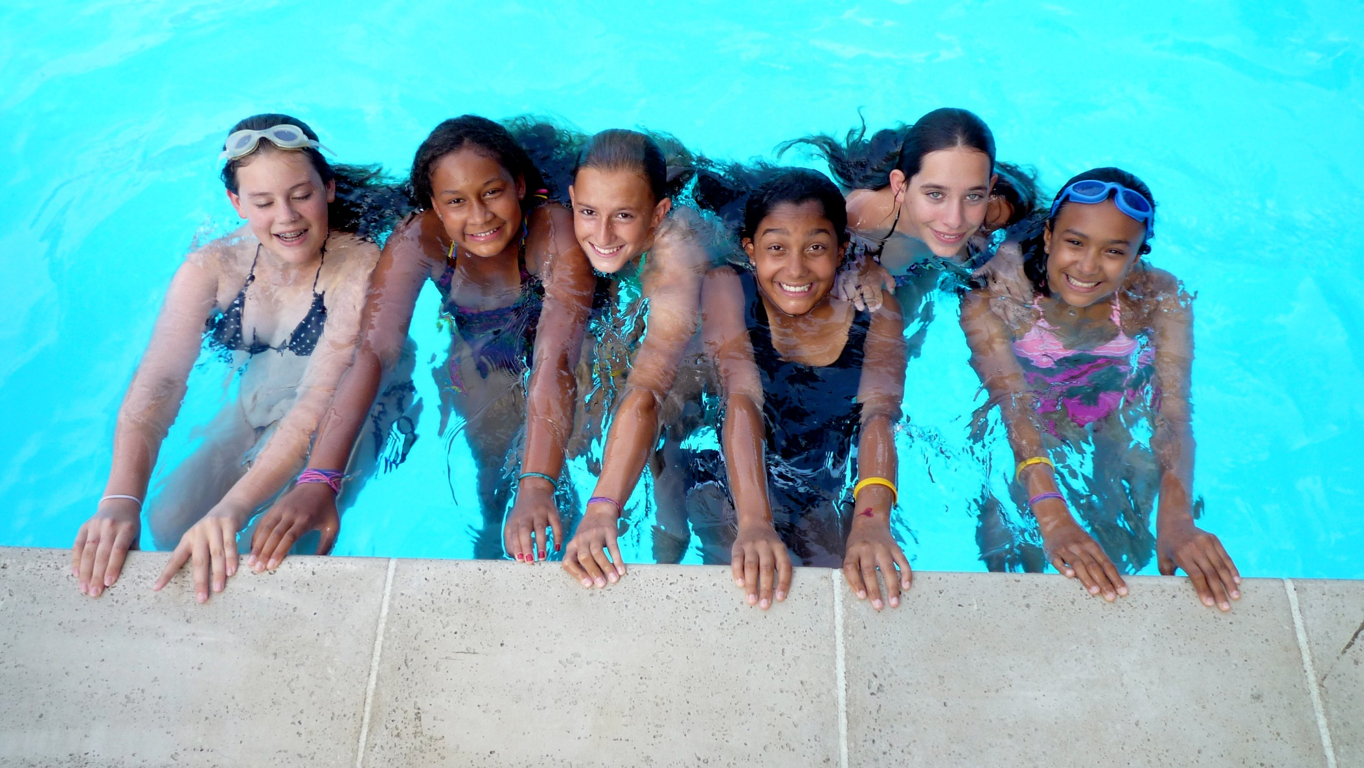
TTO CAMP OR NOT TO CAMP???
FAVORITE TIME OF YEAR
Notes:
TALYA
FAVORITE TIME OF YEAR
STATE OF DENIAL
DIALOGUE WITHIN THE NETWORK
SETTING DEADLINES FOR DECISION MAKING
CANCELLED FIRST SESSIONBEGRUDGINGLY
GRIEVED!
MEANWHILE WE KEPT ON-BOARDING CAMPERS HOPING NAIVELY FOR AN IN-PERSON CAMP IN AUGUST

Slide 19
Notes:
TALYA
DISAPPOINTMENT OF STAFF AND VOLUNTEERS< NOT JUST CAMPERS

Slide 20
Camp Erin LA
Cancellation of our June session of camp
Volunteer Summit; grieving our collective loss of camp
Redesigning programming to meet our clinical goals and standards in an online format
Training volunteers
Engaging campers via Zoom
Notes:
TALYA
Cancellation of camp
Losing the need for volunteers = loss of the valuable resource of our volunteer cohort
Engaging campers
Interview/orientation via zoom
Camp in a box
Camp program with cabin groups

Slide 21
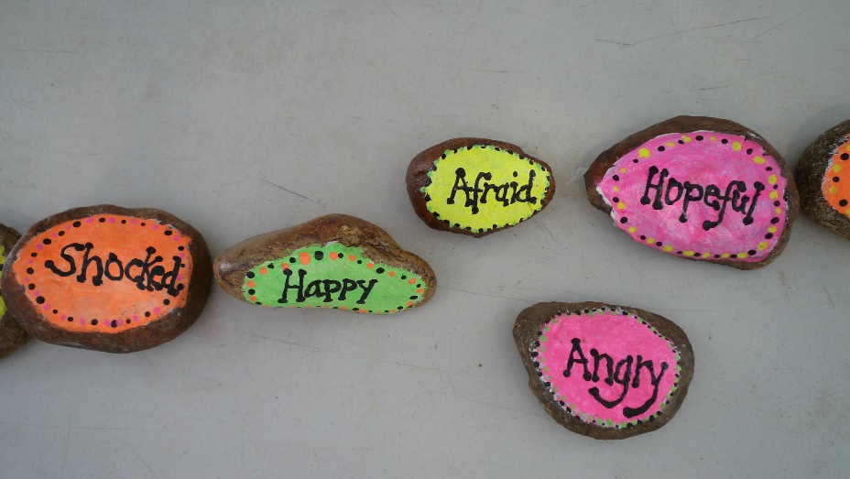
Check – In
M&M Game; building connection
Virtual Grief Hike
Teaching Coping Strategies
Luminary Ceremony
Notes:
Talya
- Important to start with rapport building (M&M game) with questions to find similarities with the group, to create safety and a space for them to do their grief work
Goals: reduce isolation, normalize feelings and provide fun from the grief at home and just be kids, Teach coping strategies
What will camp look like this year?

Slide 22
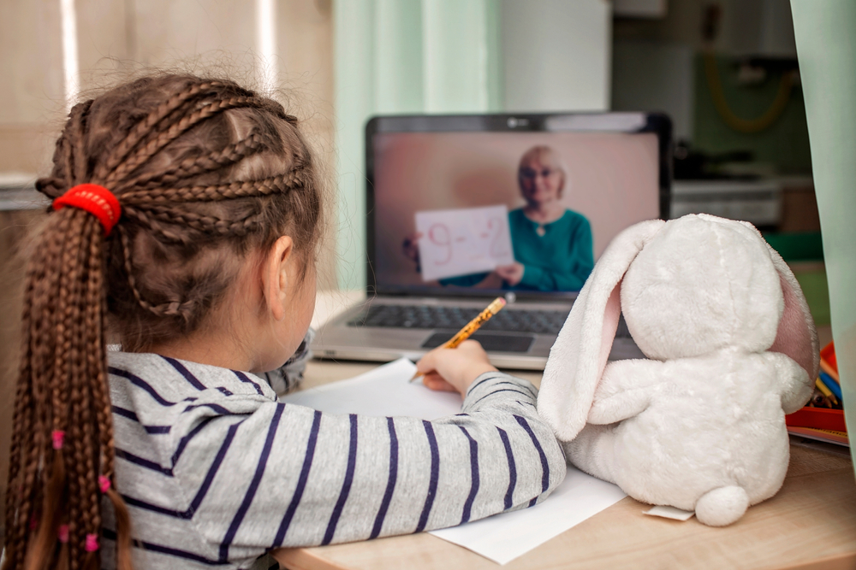
School-Based Grief Support
“Hope for the best and prepare for the worst” Maya Angelou
Overwhelmed schools
Packets
Permission slips
Adapted Curriculum
Notes:
Lauren

Slide 23
School Program Synopsis
Session 1: New Beginnings – Introduction and activities designed to promote group bonding and practice communicating on non-threatening topics.
Session 2: Memories & Your Relationship with the Person Who Died – Continue group bonding and begin to discuss the relationship with their person who died. Art activity designed to facilitate this discussion.
Session 3: Grief Reactions – Activity designed to facilitate discussion about group member’s reactions to their experience and how it feels now that their person is gone.
Session 4: Saying Goodbye – Art activity and discussion about the thoughts and memories of the day of the death.
Notes:
LAUREN

Slide 24
Session 5: What Happens After the Death – Art Activities designed to facilitate a discussion about the funeral and “what happens after death.”
Session 6: Sorting Out Your Feelings – Activity designed to facilitate further discussion of feelings.
Session 7: If You Could Change One Thing – Activity designed to identify thoughts that lead to guilt/regret and ways to address the flaws in their thinking.
Session 8: If Only I could talk with you one more time – Activities designed to explore un addressed feelings, and begin to look towards the future while retaining connection and memories of the person who died.
Session 9: Saying Goodbye – The OUR HOUSE Sweet Good-bye session including OUR HOUSE Rock Ceremony and party.
Notes:
LAUREN

Slide 25
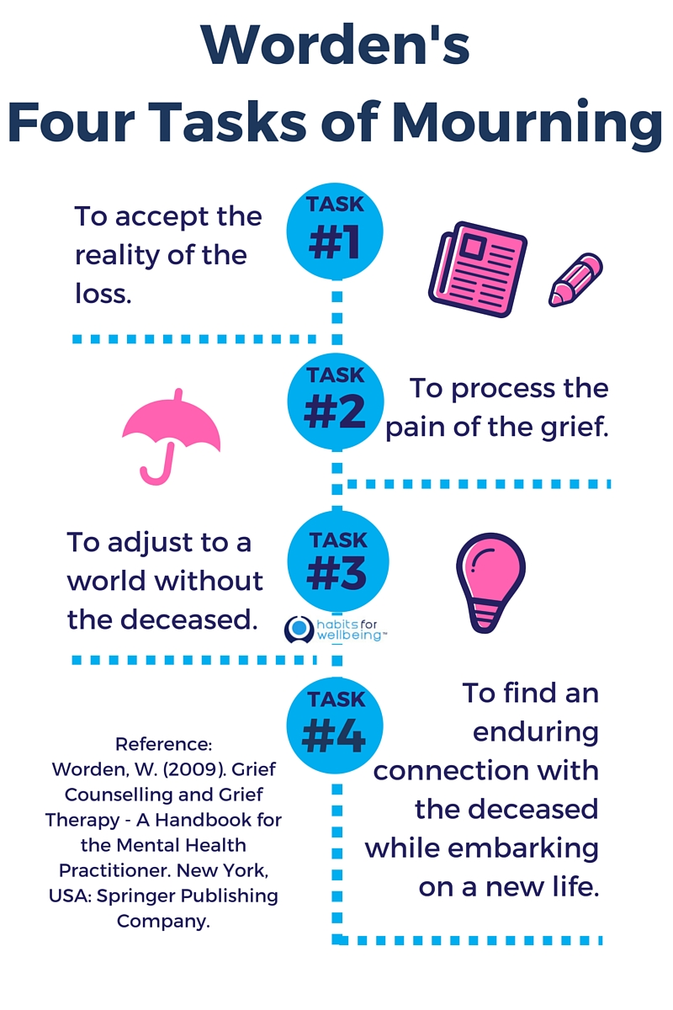
JW Worden’s Task Model & YOUR Treatment Plan
To assist Kids with accepting and understanding that their loved one has died
To support Kids while they experience the thoughts and feelings associated with grief
To help kids adjust to their new normal and get their needs met in a world without their loved one
To provide guidance as Kids finds ways to honor their loved one’s memory and to maintain the positive connection with the deceased
Notes:
LAUREN

Slide 26
GOAL #1 To Assist Kids with Accepting and Understanding that their Loved one has Died
Corresponds to Worden’s Task #1
1.Requires the ability to understand what death means
2.Dependent on:
a. Developmental level
b. Age of the child
c. Previous history of loss
Notes:
LAUREN
In some ways Zoom has become more accessible for some kids who were unable to drive to our office… but this poses a challenge for kids who are not enjoying or connecting via Zoom.

Slide 27
INFANTS
1. React to separation from their attachment figures
2. Sensitive to changes in the responses of caregivers
3. Need to be included in family conversations about the person who died until they develop language to participate
Notes:
LAUREN

Slide 28
TODDLER Pre-Operational (until age 5 or 6)
Magical Thinkers
Ego-centric- so think the death is their fault
Cognitively unable to understand death related concepts:
1. Irreversibility
2. Unpredictable
3. Universality
4. Causality leading to non-functionality
Notes:
LAUREN

Slide 29
WHAT CAN YOU DO?
Explain Cause Truthfully in Age-Appropriate Language
Notes:
LAUREN
Can always go back and retell the story truthfully and ask for forgiveness.

Slide 30
School Aged ( 6-10 years)
Piaget’s Operational Stage of Development
Concrete thinkers
Death is permanent
Somaticize or “act it out” their grief
“Short sadness span” (Nancy Boyd Webb) – especially on zoom
Can’t tolerate intensity so take breaks to play: ZOOM BREAKS!!!
Notes:
LAUREN
Something we're learning is that kids don't necessarily have a go-to person at school right now cuz of the virtual format and they need that when they are doing school on campus or virtually.
Need to discuss with their teachers how they take a break when they need it.

Slide 31
PRE-Adolescents and TEENS
PIAGET: FORMAL OPERATIONS
Lack emotional maturity to process grief like adults
Ego- centric - blame themselves
Magical- Cope in ways that can be dangerous
Compounded / Cumulative Grief
Notes:
LAUREN
THINK THEY ARE INVINCIBLE
Teens who have experienced several deaths by the time they get to high school may be experiencing PTSD = heightened state of arousal
May impact judgement and attachment

Slide 32
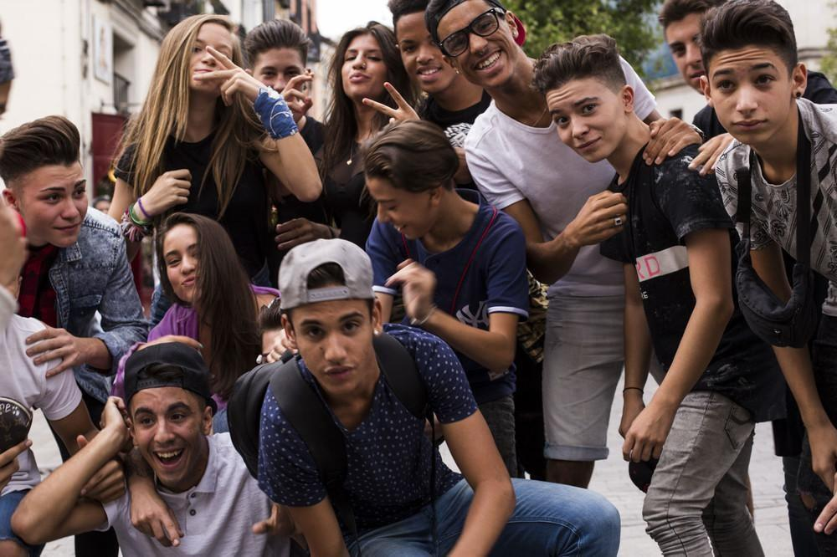
TEENS (cont.)
Identity vs. Role Confusion (Erickson)
May take on adult roles/worries
Work with families on balancing the needs of the teen and the needs of the family.
Acknowledge the role culture plays in determining the development role of the teen separation - individuation process
Notes:
LAUREN
NEED PEER GROUP TO IDENTIFY WITH. MAY JOIN A GANG IF NO OTHER AFFILIATION

Slide 33
Language for Talking about Death (cont.)
Avoid Euphemisms- will aid in understanding how the death occurred
Top 5 Euphemisms?
“lost”
“passed away”
“went to sleep”
“went to heaven”
“in a better place”
Notes:
LAUREN

Slide 34
Explaining Suicide to Children
Define Suicide in simple terms
Give honest, age-appropriate information about what actually caused the death
“I wish I could answer that question”.
Ask children to identify who they would go to for help if they ever felt so depressed they wanted to die they ever felt so depressed, they wanted to die
"I HAD PASTA LAST NIGHT" (TIK TOK)
Notes:
LAUREN
Tik tok code for: I’m depressed

Slide 35
Defining Homicide
“When someone ends someone else’s life”
Narrative Options: she……
……died from homicide
……got shot
……killed by a drunk driver
……a bad man shot her with a gun
Notes:
LAUREN

Slide 36
Defining Substance Related Death
Narrative : “Died from…. ….a disease called “addiction”
OR
….complications of alcoholism
….taking “too much drugs”
….taking too much medicine
….smoking cigarettes
Notes:
LAUREN

Slide 37
Defining Deaths from COVID-19
Narrative : “Died from…. ….a disease called COVID-19 or the Coronavirus which is a new disease that there is no treatment for yet or no vaccine that prevents people from getting this disease“
" Died from the virus“ OR “the germ”
Notes:
LAUREN

Slide 38
GOAL #1 Activities
1. When Dinosaurs Die; Brave Bart; My Memory Book for Grieving Children; Trinka and Sam Fight the Big Virus
2. Write or Draw about the day of death; day of the funeral or memorial service
3. Where your person is now?
4. The 5 Senses –see, hear, taste, smell, touch
5. Reduce isolation by referring to Grief groups and Grief camp
Notes:
LAUREN

Slide 39
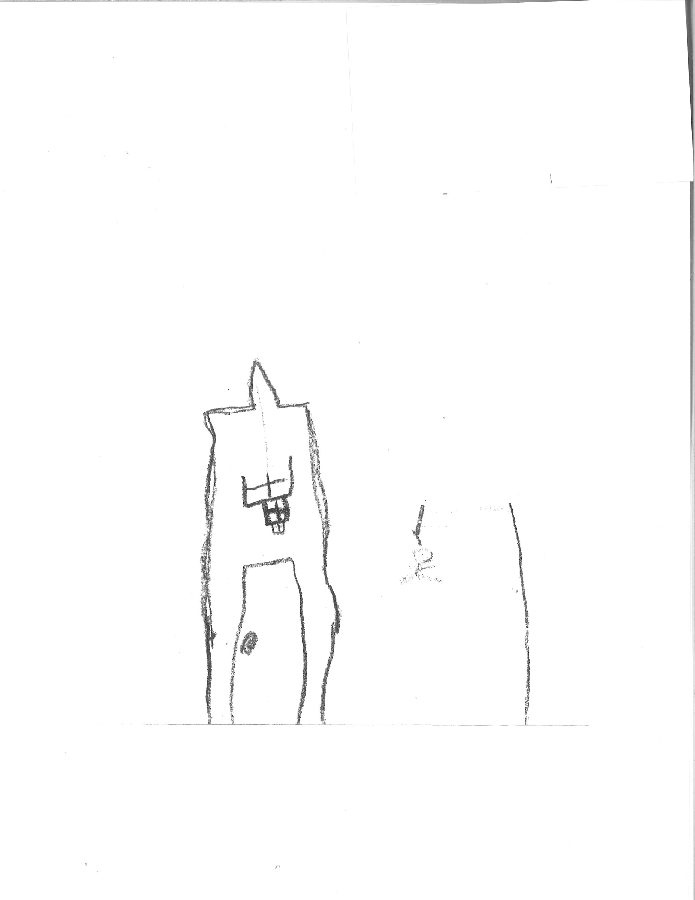
How did your parent die?
Notes:
LAUREN

Slide 40
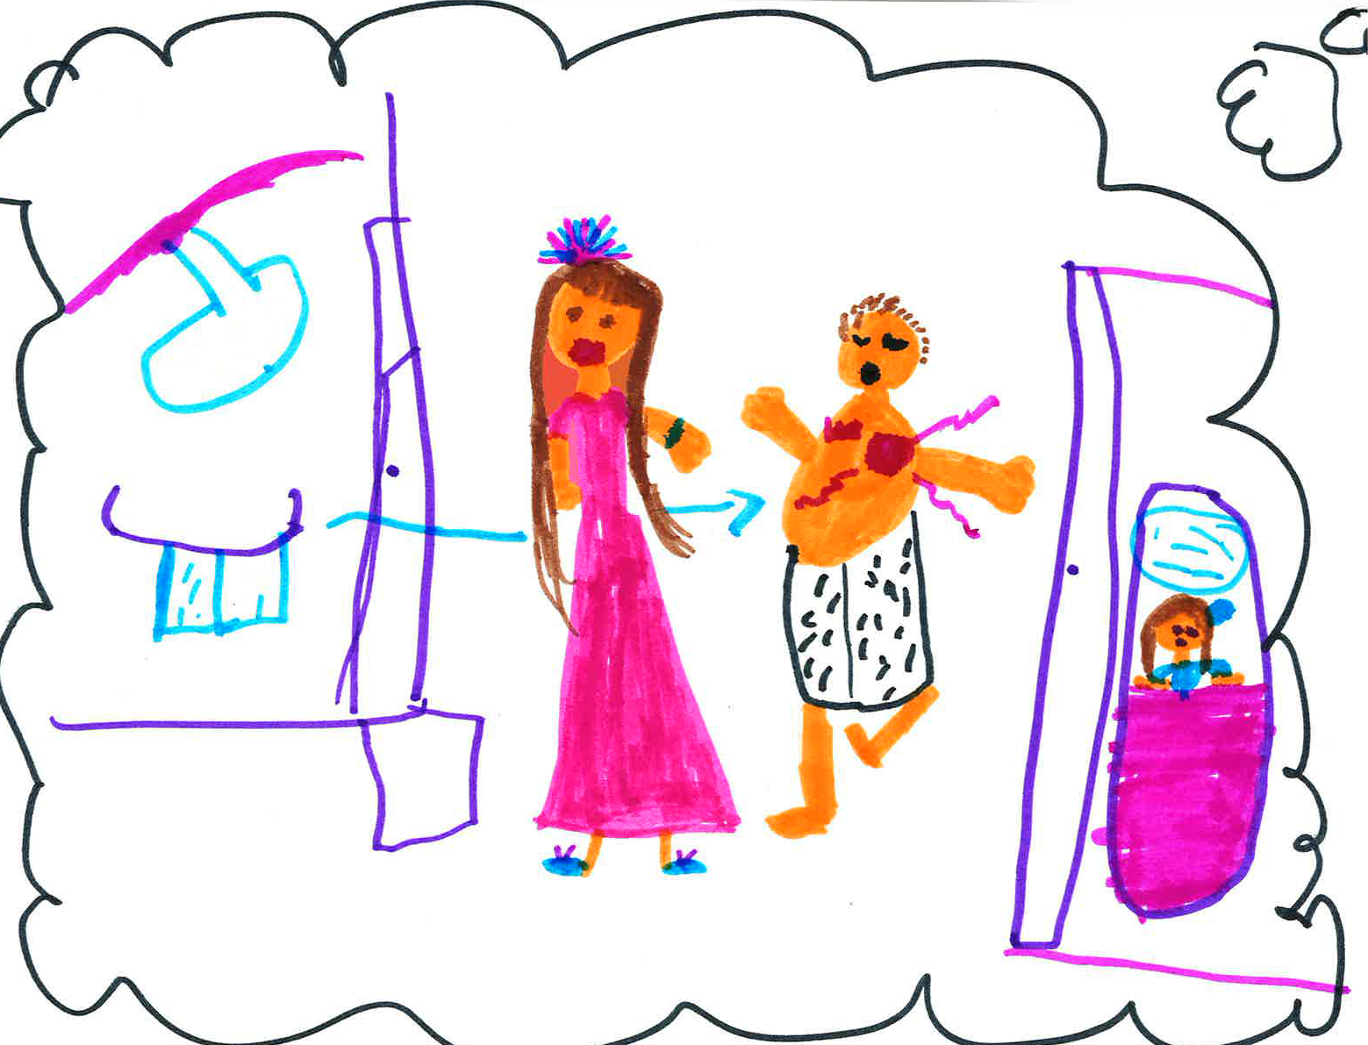
How did your Dad die?
Notes:
LAUREN

Slide 41
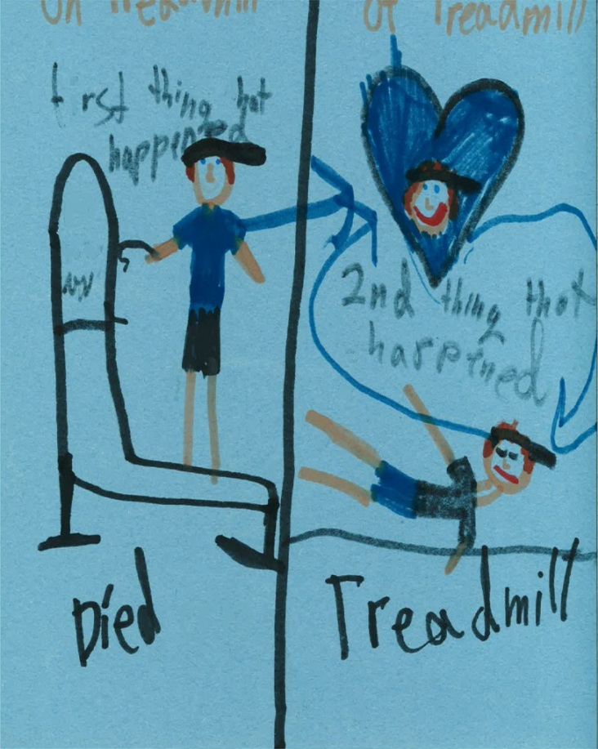
How did your Dad die?
Notes:
LAUREN

Slide 42
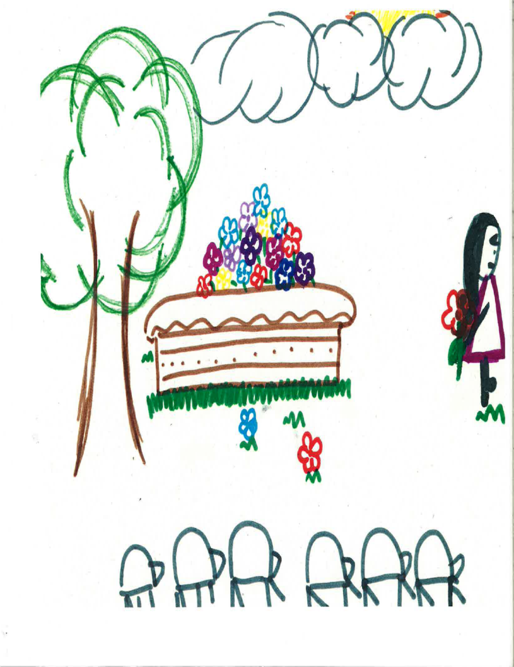
What Happened to their Body?
Notes:
LAUREN

Slide 43
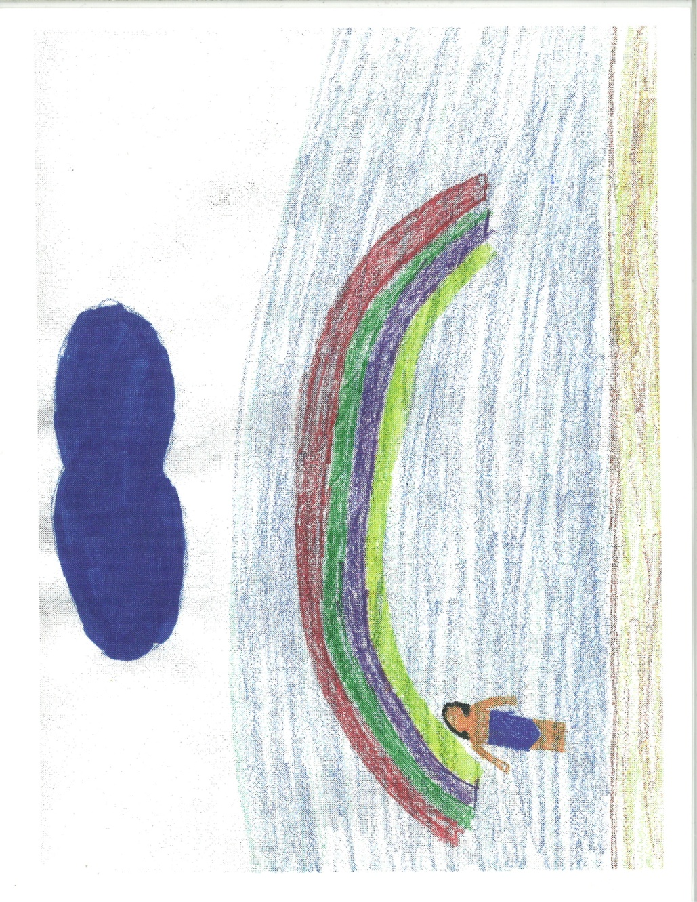
Where is she now?
Notes:
LAUREN

Slide 44
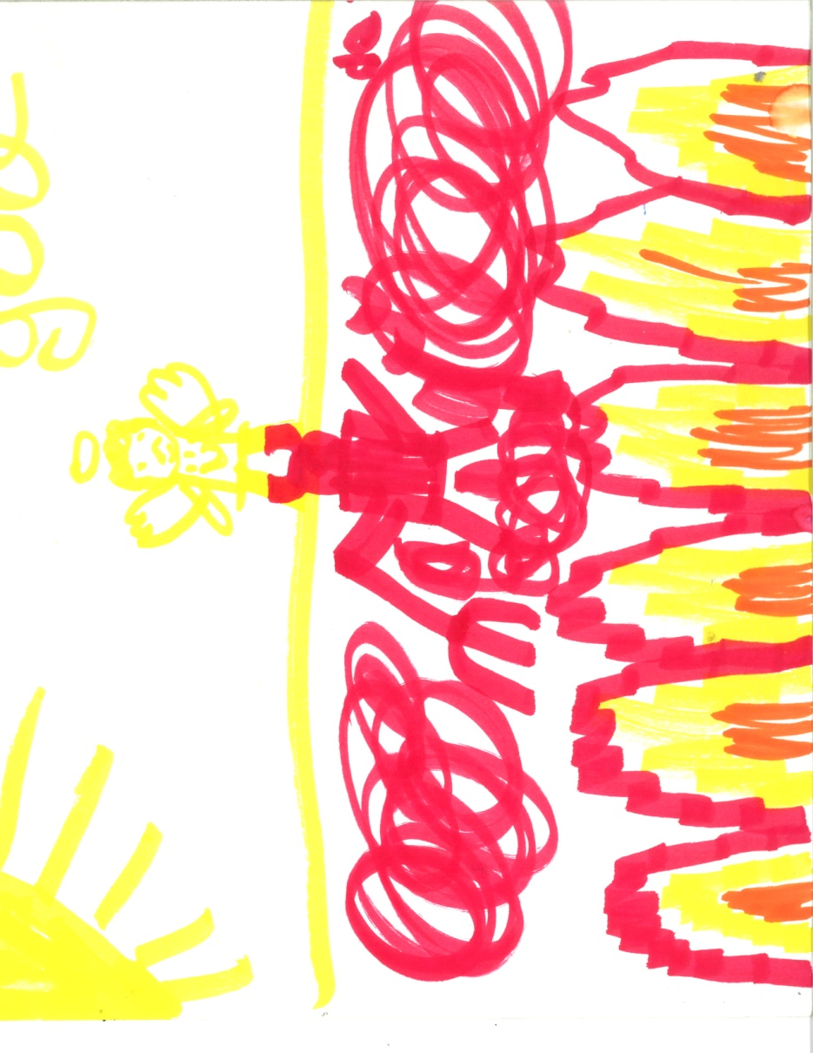
Where is your parent now?
Notes:
LAUREN

Slide 45
CHALLENGES
ZOOM FATIGUE
Restricted by the screen
- Keeping the room safe
- Keeping kids contained and engaged
Technology and internet connection
Notes:
Talya
What challenges are you facing when leading groups or working with children online?

Slide 46
GOAL #2: To Support Kids While they Experience the Thoughts and Feelings Associated with Grief
Corresponds to Worden’s Task #2
To Process the Pain of the Grief
SADNESS
ANGER
FEAR: COVID SPECIFIC
RELIEF OR HAPPINESS
GUILT
Notes:
TALYA
Covid specific fears : other’s catching it and losing their homes, not having $ for food, medicine etc.

Slide 47
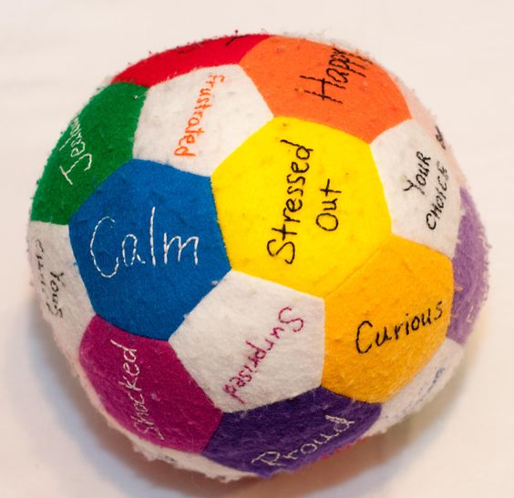
GOAL #2: Activities
1. Explore Thoughts Underlying their feelings
a. Feelings Pie
b. Feelings Ball
c. Angry Bags
Notes:
TALYA

Slide 48
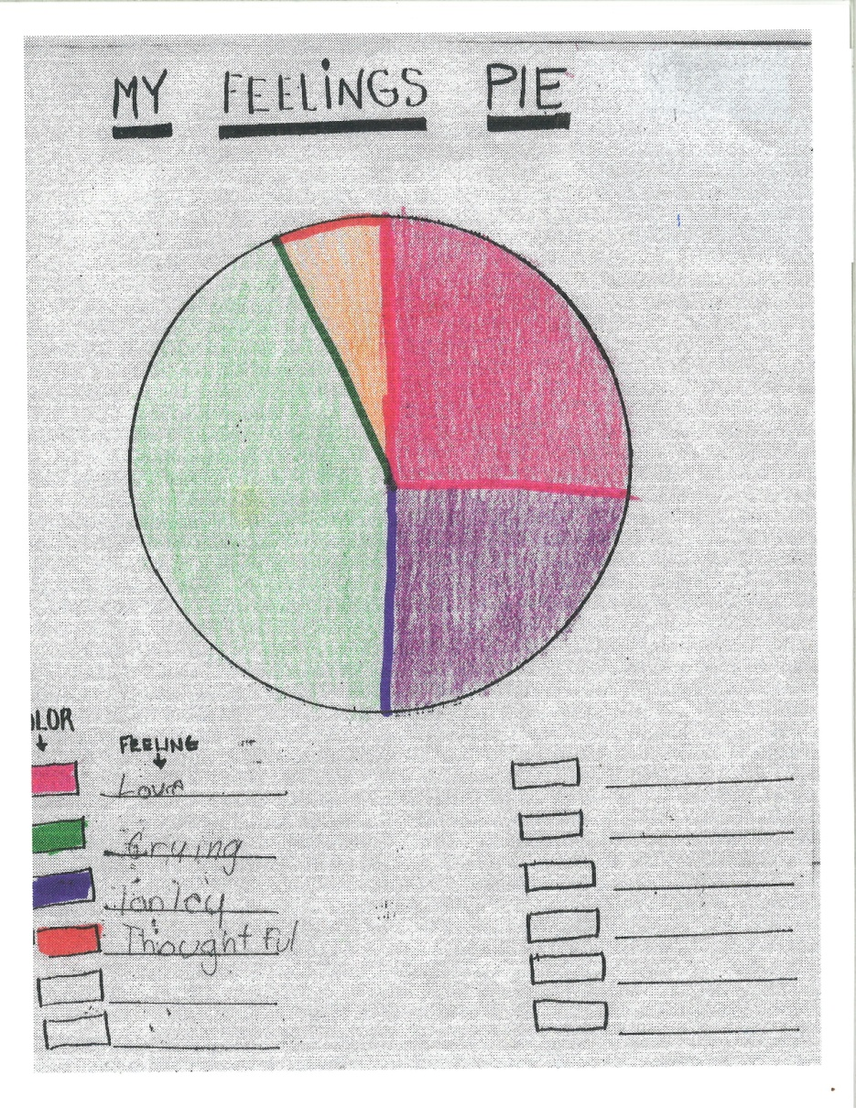
Notes:
TALYA

Slide 49
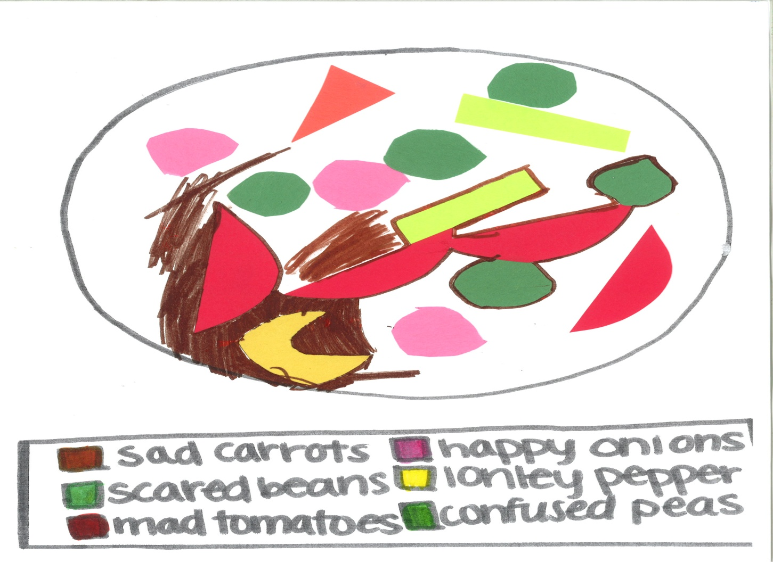
Feelings Soup
Notes:
TALYA
OTHERS: FEELINGS JENGA; FEELINGS BALL; WORRY BAGS OR WORRY DOLLS

Slide 50
GOAL #3: To Help Kids Adjust to their New Normal and Get Their Needs Met in a World Without their Loved One
Corresponds to Worden’s Task #3
To Adjust to a World Without the Deceased
“secondary losses”-housing, healthcare, income, food insecurity
Prepare child for special days
Collaborate with TEACHERS to make sure they understand how long grief lasts
NO SUCH THING AS A GRIEF CARD!
Notes:
LAUREN
ASK; WHAT ARE SECONDARY LOSSES???
NOT PLAYING THE GRIEF CARD.
AT TIMES IT'S HARD TO FOCUS IN CLASS. Birthdays, Anniversaries Deathdays are observed in many families.
Case management support – need help prepping for holidays and special days

Slide 51
To Learn Coping Strategies
1. Breathing Techniques
a. candle flower
b. pizza or spaghetti breath
c. butterfly breathing
2. Visualization
3. Releases emotions through movement
4. Comforting self with music, journaling, pets, etc.
Notes:
Lauren

Slide 52
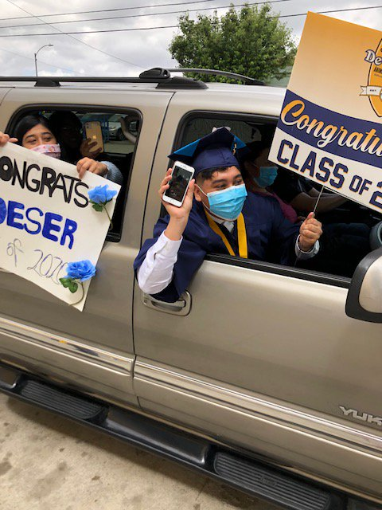
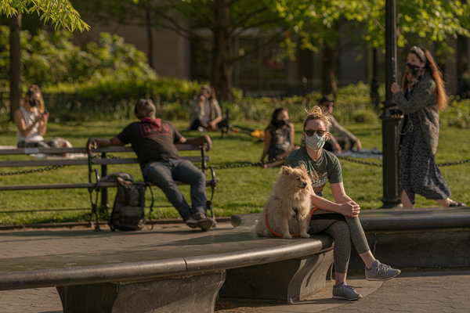
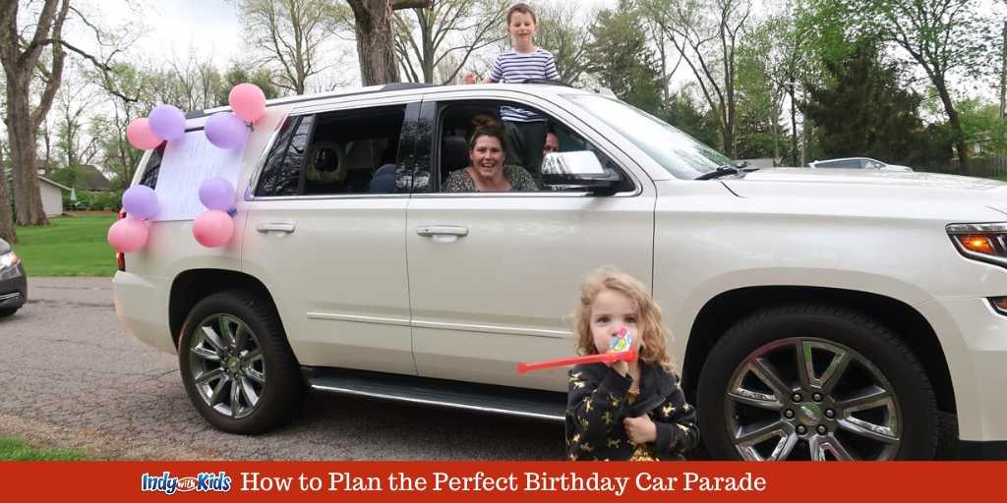
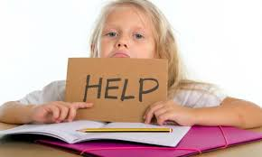
COVID-Related Losses
Notes:
LAUREN
Time with friends​,
coaches
mentors
Privacy
In person time with teachers
Time with other family​
Freedom to move freely about
outdoors

Slide 53
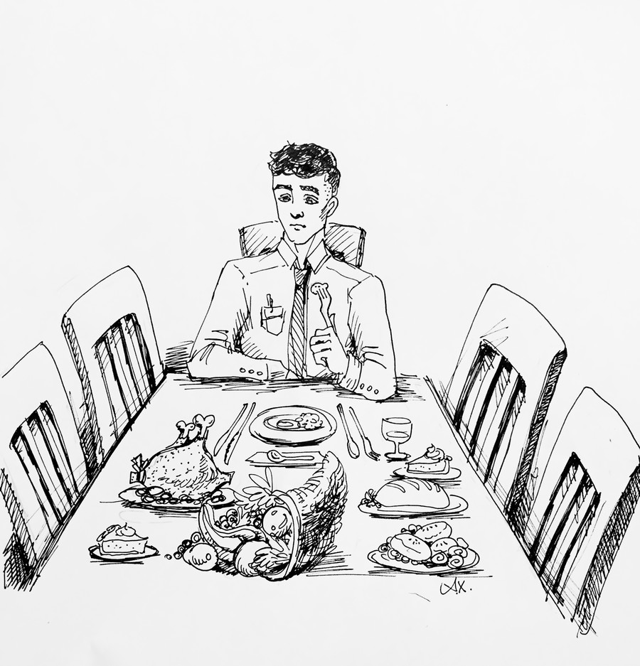
And What About the Holidays?
Notes:
Talya
WILL LOOK DIFFERENT DUE TO COVID
Prepare kids in advance for how holidays will be different and what they will need to be tolerated during the holidays.
They can do things completely different than when their person was alive – starting a new tradition if it is too hard for them to do it the way they used to with their person
Make decisions as a family!

Slide 54
GOAL #4: To Maintain The Bond And Find Ways To Memorialize
Engage in on-going rituals
Become more future oriented over time
Good News: Kids are resilient
Notes:
TALYA
85-90% do not go on to develop mental illness (anxiety, depression etc)
Suicide and cancer deaths are more likely to lead to depression or ptsd
Plan with the child how they will maintain the connection through ritual

Slide 55
Glee
Notes:
TALYA
Can do virtual memorials until in-person memorials are an option National Center for School Crisis and Bereavement (schoolcrisiscenter.org)

Slide 56
GOAL #4: Activities
Meaning Making Activities:
In memory Activities :Plant a tree, dedicate a plaque, MEMORY BOXES OR MEMORY BOOKS
2. Engage in on-going rituals:
a. Visits to cemetery or other special locations
b. Lighting candles on a shrine or alter etc.
Notes:
TALYA

Slide 57
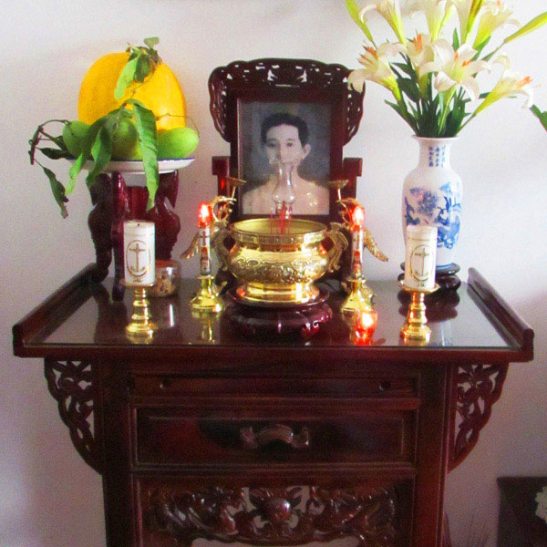
Engage In On-Going Rituals
Notes:
TALYA
KIDS GET TO SHARE LINKING OBJECT OR KEEPSAKES FROM THEIR HOMES.
Linking objects help them with Task 4

Slide 58
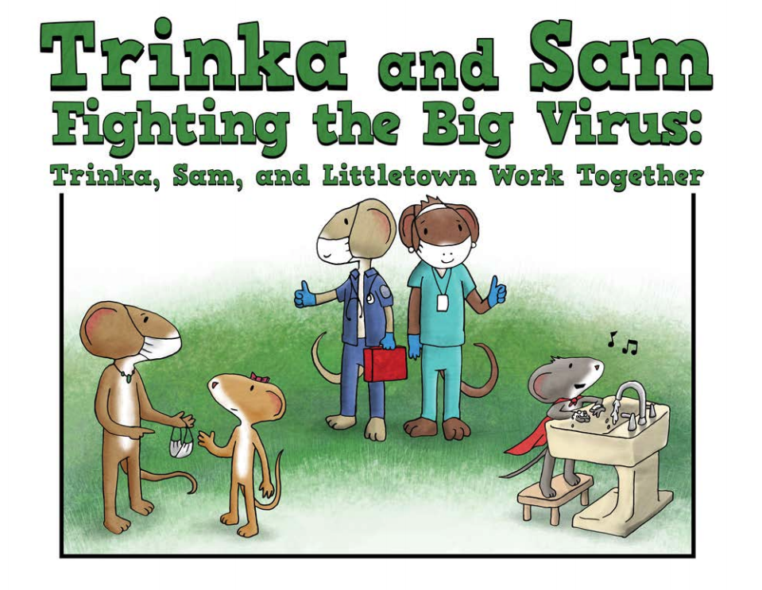
OUR HOUSE Family Bulletin Board:
https://www.ourhouse-grief.org/bulletinboard/
COVID SPECIFIC Resources
Notes:
LAUREN
(NAGC resource book: Responding to change and loss
National Center for School Crisis and Bereavement: Trinka and Sam )

Slide 59
Notes:
TALYA
Thank you! Take care of yourselves and others

Slide 60
Q&A with Presenters

Slide 61
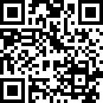
Evaluation Information
The MHTTC Network is funded through SAMHSA to provide this training. As part of receiving this funding we are required to submit data related to the quality of this event.
At the end of today’s training please take a moment to complete a brief survey about today’s training.
http://bit.ly/GSVLISchneiderEval

Slide 62
Up Next
Time | Session Title | Presenters | Zoom Link | Evaluation Link
11:15am-12pm PT 12:15-1pm MT 1:15-2pm CT 2:15-3pm ET | Day 1 lunch + break out discussion groups (Optional)
 | Grief Sensitivity Break Out Discussions | MHTTC | http://bit.ly/GSVLIgs3 No Passcode Needed | None
 | School Mental Health Break Out Discussions | MHTTC | http://bit.ly/GSVLIsmh3 Passcode: GriefC1*
 | Evidence Based Practices Break Out Discussions | MHTTC | http://bit.ly/GSVLIebp3 No Passcode Needed
12:15-1:45pm PT 1:15-2:45pm MT 2:15-3:45pm CT 3:15-4:45pm ET | Session 4
 | Grief & Trauma Sensitive Mindfulness: Taking It from Theory to Practice in Schools | Lisa Wobbe-Veit, MSW Kerry Doyle, LICSW, RYT-200 | http://bit.ly/GSVLIWobbe Passcode: 111220 | http://bit.ly/GSVLIWobbeEval
 | Pandemia: Restoring the Wounded Soul. Latino Reflections on the Meaning of Loss, Grief, and Rituals | Salvador Treviño, PhD Darice Orobitg, PhD | http://bit.ly/GSVLITrevino Passcode: 111220 | http://bit.ly/GSVLITrevinoEval
 | Collective Care in the Workplace | Carla Fernandez Iana Malcolm Justin Thongsavanh, MPA | http://bit.ly/GSVLIFernandez Passcode: 111220 | http://bit.ly/GSVLIFernandezEval
1:50-2:45pm PT 2:50-3:45pm MT 3:50-4:45pm CT 4:50-5:45pm ET | Closing Session
 | Listening & Loving: A Conversation with Youth Leaders about Grief and Healing | Latrinity Gulley Monica Tello Carizma Hughes | http://bit.ly/GSVLIClosing Passcode: 111220 | http://bit.ly/GSVLIClosingEval

