Slide 1
DSM-5 Diagnoses: Best Practices in a Community Health Center Environment (part 1 of a 2-part series)
Andrew J. McLean, MD, MPH
Clinical Professor and Chair
Department of Psychiatry and Behavioral Science
University of North Dakota School of Medicine & Health Sciences
1919 Elm St. N., Fargo, ND 58102
Phone: (701) 293-4113
Fax: (701) 293-4109
E-mail: andrew.mclean@und.edu

Slide 2
Objectives
After the presentation, the participant will:
1) identify primary elements in DSM-5 diagnoses
2) have an understanding of necessary documentation
3) be able to identify some differences in payer practices.

Slide 3
Why is this an issue?
67% of individuals with a behavioral health disorder do not get behavioral health treatment¹
30-50% of referrals to behavioral health from primary care don’t make first appt^{2,3}
Two-thirds of primary care physicians reported not being able to access outpatient behavioral health for their patients⁴ due to:
Shortages of mental health care providers
Health plan barriers
Lack of coverage or inadequate coverage
Depression goes undetected in >50% of primary care patients⁵
Only 20-40% of patients improve substantially in 6 months without specialty assistance⁶
Sources: ¹Kessler et al., NEJM. 2005;352:515-23. ²Fisher & Ransom, Arch Intern Med. 1997;6:324-333. ³Hoge et al., JAMA. 2006;95:1023-1032. ⁴Cunningham, Health Affairs. 2009; 3:w490-w501. ⁵Mitchell et al. Lancet, 2009; 374:609-619. ⁶Schulberg et al. Arch Gen Psych. 1996; 53:913-919

Slide 4
Meds
It’s been estimated that:
between 15-20% of Americans take a psychotropic medications
Between 75-80% of such medications are prescribed by non-psychiatric prescribers.

Slide 5
Meds
While clearly psychotropic medications can be helpful, anti-depressants should typically be reserved for moderate-severe depression
There are black box warnings for certain medications, including certain sleep medications, anti-psychotics in certain elderly populations, and antidepressants in youth.
For many individuals with depression and anxiety, one of the most useful treatments is cognitive behavioral therapy (CBT).

Slide 6
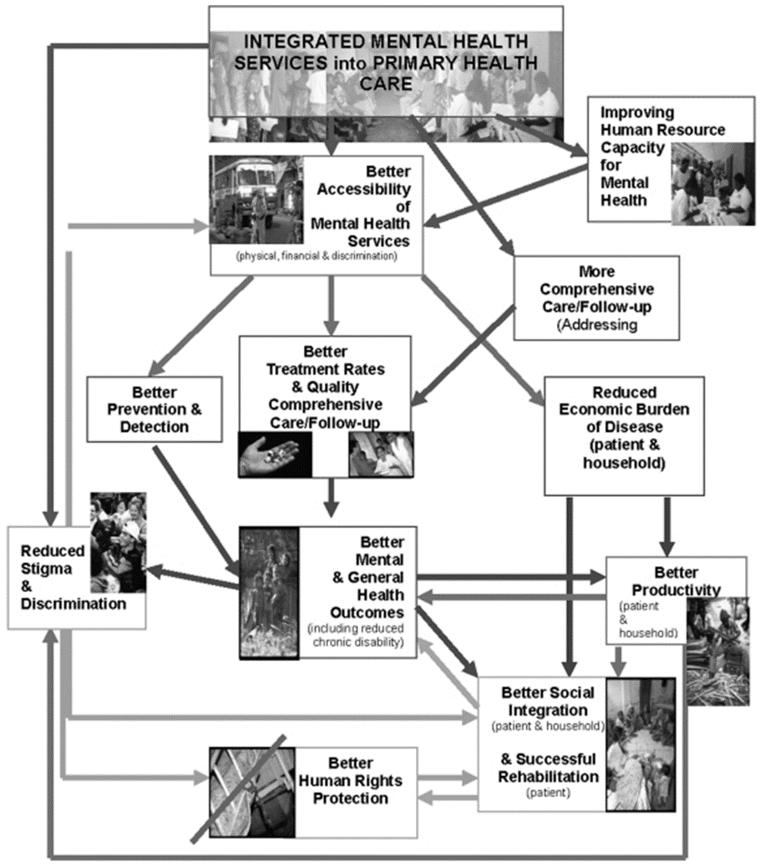

Slide 7
Variables re: behavioral health in primary care
Emergent
Urgent
Routine/Chronic Disease Management*
Illness/Behavior
Severity/Complexity
Supports

Slide 8
Clinician’s dilemma in a fast-paced setting:
Not over-diagnosing
Not under-diagnosing
Not missing what else this
might be…

Slide 9
Pressures
Payment pressures to firmly diagnose (on the first visit!)
Incentives to do what’s expeditious, vs. “right”.
In primary care, disincentive to open-up the behavioral health “can of worms”…

Slide 10
Many of Integrated Care Models-However…
Behavioral Health in Primary Care. (By far the most common)
Primary Care in Mental Health
Primary Care in Behavioral Health

Slide 11
Integration: An Evolving Relationship
Consultative Model
Psychiatrists sees patients in consultation in his/her office – away from primary care
Co-located Model
Psychiatrist sees patients in primary care
Collaborative Model
Psychiatrist provides caseload consultation about primary care patients; works closely with primary care providers (PCPs) and other primary care-based behavioral health providers (BHP)
Source: http://uwaims.org

Slide 12
Collaborative Care
Collaborative care optimizes all behavioral health resources
Source: http://uwaims.org

Slide 13
SBIRT(screening, brief intervention, referral to treatment)
SBIRT CONSISTS OF THREE MAJOR COMPONENTS:
Screening — a healthcare professional assesses a patient for risky substance use behaviors using standardized screening tools. Screening can occur in any healthcare setting
Brief Intervention — a healthcare professional engages a patient showing risky substance use behaviors in a short conversation, providing feedback and advice
Referral to Treatment — a healthcare professional provides a referral to brief therapy or additional treatment to patients who screen in need of additional services
http://www.integration.samhsa.gov/clinical-practice/SBIRT

Slide 14
Screening tools
Find one you are comfortable with, such as:
(For substance use/SBIRT):
AUDIT, MAST, CAGE-AID, ASSIST
For Depression: PHQ-2/9 Symptom Checklist
For generalized anxiety: GAD-7
For potential bipolar disorder: Mood Disorder Questionnaire
For physical side effects of anti-psychotic medication: AIMS

Slide 15
Remember
If you remember anything else from this talk, know that screening tools are just that:
Screens and tools support your assessment. They are not the diagnostic assessment!!

Slide 16
One of the issues….
We got lazy…
“Not otherwise specified” (NOS)

Slide 17
Risks of mis-diagnosis (even if they check most boxes…)
Wrong treatment
Delay in “right” treatment
Reimbursement issues
Other

Slide 18
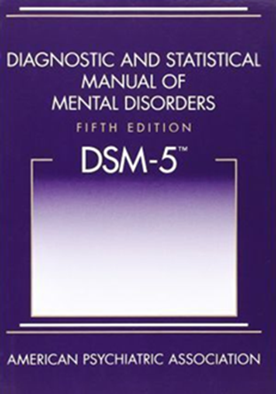
Psychiatric Disorders-general rules
Symptoms
Duration
Impact on functioning
Not better explained by something else…
Often have specifiers
Notes:
DSM 5-for most disorders, they are clusters of symptoms, with a particular time frame necessary (i.e., occurs this often and/or for this long…), must significantly impact functioning (significant distress or impairment).
In addition, there are severity levels noted (mild/moderate/severe) and specifiers—particularly noted in mood disorders—for example, “with seasonal pattern,” with mixed features,” “first episode,” etc…

Slide 19
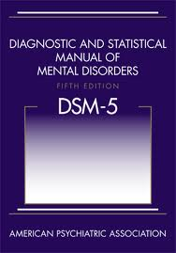
Major Categories:
Trauma and Stressor
Related Disorders
Dissociative Disorders
Somatic Symptom and Related Disorders
Feeding and Eating Disorders
Sleep-Wake Disorders
Sexual Dysfunctions
Gender Dysphoria
Disruptive, Impulse Control, and
Conduct Disorders
Paraphilic Disorders
Neurodevelopmental Disorders
Schizophrenia Spectrum and Other Psychotic Disorders
Bipolar and Related Disorders
Depressive Disorders
Anxiety Disorders
Obsessive Compulsive and Related Disorders
Personality Disorders
Neurocognitive Disorders
Addictions and Related Disorders

Slide 20
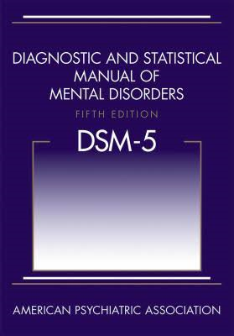
Depressive Disorders* (not all)
Major Depressive Disorder (Single/Recurrent episodes)
Persistent Depressive Disorder (Dysthymia)
Premenstrual Dysphoric Disorder
Disruptive Mood Dysregulation Disorder
Other (including medical conditions, bipolar depression…)
Perinatal Mood Disorders (including post-partum…)

Slide 21
Example: Major Depressive Disorder—Diagnostic Criteria
Five or more of the following symptoms are present most of the day, nearly every day, during a period of at least 2 consecutive weeks:
At least 1
of these 2 symptoms
1. Depressed mood
2. Loss of interest or pleasure in all, or almost all, usual activities (anhedonia)
3. Significant weight loss when not dieting, or weight gain
4. Insomnia or hypersomnia
5. Psychomotor agitation or retardation
6. Fatigue or loss of energy
7. Feelings of worthlessness or excessive or inappropriate guilt
8. Diminished ability to think or concentrate or indecisiveness
9. Recurrent thoughts of death or suicide
DSM-5.
Symptoms must cause clinically significant distress or impairment in social, occupational, or other important areas of functioning and are not attributable to another substance or medical condition
Notes:
Note that one doesn’t need to have “depressed mood” to actually meet criteria for Major Depressive Disorder…(if they have #2, “anhedonia”)

Slide 22
Severity and Course Specifiers
SEVERITY | COURSE
Mild | Single episode
Moderate | Recurrent episode
Severe
With psychotic features
In partial remission
In full remission

Slide 23
Notes:
Screening tool. Note-if a score of 4 or less is not considered problematic, conceivably a patient could score a 3 on the suicide question with only 1 other symptom and not raise flags if one looked only at the total score. Always look at question 9…

Slide 24
Summary of DSM-5 Classification of Bipolar Disorders
Bipolar I
Bipolar II
Cyclothymic
Bipolar Disorder Other
One or more manic or mixed episodes, usually accompanied by major depressive episodes
One or more major depressive episodes accompanied by at least one hypomanic episode
At least 2 years of numerous periods of hypomanic and depressive symptoms*
Substance induced, medical, unspecified, other specified…
Notes:
The first two categories are most common by far. Bipolar II is more common than bipolar one (perhaps 5% to 1% of population), but often more difficult to diagnose. Bipolar II is more common in women, and has a higher risk for suicide than Bipolar I

Slide 25
Example: Summary of DSM-5 Criteria for Manic Episodes in Bipolar Disorder
Abnormally and persistently elevated, expansive, or irritable mood fand abnormally and persistently increased goal-directed activity or energy for at least 1 week* with three of the below (four if irritable) present
Inflated self-esteem or grandiosity
Decreased need for sleep
Pressured speech
Flight of ideas or racing thoughts
Distractibility
Increase in goal-directed activity or psychomotor agitation
Excessive involvement in pleasurable activities that have a high potential for painful consequences
Social/Occupational impairment; Sxs not due to substance/medical condition
* This symptom must be present.
Diagnostic and Statistical Manual of Mental Disorders. 5th ed.
Washington, DC: American Psychiatric Association; 2013.
Notes:
https://www.youtube.com/watch?v=SsmVgoXDq2w
Summary of DSM-IV-TR Criteria for Manic Episodes in Bipolar Disorder
According to the American Psychiatric Association’s Diagnostic and Statistical Manual of Mental Disorders, 4th edition (DSM-IV-TR), in order to be diagnosed with a manic episode, a patient must have experienced at least the first symptom listed here—abnormally and persistently elevated, expansive, or irritable mood—for at least 1 week, or for any duration if he or she required hospitalization. In addition, during the mood disturbance, the patient must have 3 or more of the rest of the symptoms listed, or 4 of the symptoms if the mood is only irritable.
The inflated self-esteem or grandiosity of mania may reach delusional proportions. Patients may believe that they have expertise in areas about which they know little, that they have talents that they actually lack, or that they have a special relationship with God or some public figure.
Patients in the throes of a manic episode may sleep for just a few hours, or not at all, and still feel energized.
The speech of a manic individual is usually loud, pressured, rapid, and difficult to interrupt, and is frequently theatrical and dramatic.
Distractibility is manifested by an inability to stay on topic, as well as an inability to distinguish important stimuli from unimportant details.
The increase in goal-directed activity often involves excessive planning and participation in multiple activities.
The patient may become involved to excess in pleasurable activities that have a high potential for unpleasant or dangerous consequences. Examples include sexually promiscuous behavior, unrestrained shopping, or foolish business investments.
The impairment resulting from the disturbance must be severe enough to cause marked impairment in functioning or to require hospitalization as a means of protecting the individual from the negative consequences of actions that result from poor judgment.
First, ed. Diagnostic and Statistical Manual of Mental Disorders. 4th ed. Text Rev. Washington, DC: American Psychiatric Association; 2000:345-428.

Slide 26
Look at all the Specifiers!
With anxious distress
With mixed features
With rapid cycling
With melancholic features (note-early morning awakening)
With atypical features
With psychotic features
With catatonia
With peripartum onset
With seasonal pattern
Diagnostic and Statistical Manual of Mental Disorders. 5th ed. Washington, DC:
American Psychiatric Association; 2013.
Notes:
Rapid Cycling Specifier
Rapid cycling is defined as 4 or more individual episodes of depression, mania, mixed, or hypomania in the previous 12 months
Episodes are demarcated by either partial or full remission for at least 2 months or a switch to an episode of opposite polarity
Rapid cycling is generally difficult to treat
Individuals at increased risk are women, those exposed to antidepressant therapy, and those with hypothyroidism.
First, ed. Diagnostic and Statistical Manual of Mental Disorders. 4th ed. Text Rev. Washington, DC: American Psychiatric Association; 2000:345-428.

Slide 27
DSM 5 Anxiety Disorders
Specific Phobia
Social Anxiety Disorder (Social Phobia) Panic Disorder
Generalized Anxiety Disorder
Substance/Medication-Induced Anxiety Disorder
Agoraphobia | Separation Anxiety Disorder | Selective Mutism | Anxiety Disorder Due to Another Medical Condition | Other Specified Anxiety Disorder | Unspecified Anxiety Disorder
PTSD is now under Trauma-and Stressor-Related Disorders
OCD is now under Obsessive-Compulsive and Related Disorders

Slide 28
Example: Generalized Anxiety Disorder Good screening tool: GAD-7
Excessive anxiety/worry
Restless/keyed up
Fatigued
Concentration problems
Irritability
Muscle tension
Sleep disturbance
Time element: more days than not, > 6 months
Women > Men
> 3/6 symptoms
(1 in children)
Treatment-as per panic, social anxiety
Relaxation techniques helpful

Slide 29
Severity:
0-4 Minimal
5-9 Mild
10-14 Moderate
15-21 Severe

Slide 30
Acute or Post-traumatic Stress Disorders
Exposure to actual/threatened death, serious injury, or sexual violence via:
Directly experiencing the event
Witnessing, in person, the event
Learning that an event occurred to a close person
Repeated/extreme exposure to aversive details (media-only if work related)
So, you need not have directly experienced the trauma

Slide 31
Either Acute or Post Traumatic Stress Disorders
Clusters:
1) Intrusion symptoms(re-experiencing) by recollection, dreams, “re-living” the experience, dissociative reactions (“flashbacks”), psychological/physical distress at re-exposure
2) Avoidance
3) Negative cognitions/mood
4) Arousal increase (vigilance, startle, irritability, reckless behavior, etc…)

Slide 32
Stress Disorders
Acute Stress Disorder
PTSD
More immediate
Short-term
(from 3 days to 1 month)
Usually occurs within 3 months, and dissipates within months
Up to 30% may be “chronic”
Can also have “delayed expression” (6 months post)

Slide 33
Substance Use Disorders Continuum
Withdrawal Management
Treatment/ Rehabilitation
Maintenance
Relapse
Notes:
Withdrawal management is not considered addiction treatment; it is managing the withdrawal of a substance. However, it is often an opportunity to engage a person in treatment. The continuum of substance use disorders is analogous to any chronic disease management. Relapses or episodes of less “control” occur, and should be met with the same approach. In other words, if someone with IDDM was poorly adherent to their diet, and A1C was very high, you wouldn’t deny treatment-you would change your method of engagement/treatment.

Slide 34
General Categories
Depressants (alcohol, benzodiazepines, barbiturates, etc…)
Opioids (prescription pain meds, heroin, codeine, methadone, buprenorphine…)
Stimulants (amphetamines, cocaine, methylphenidate, as well as caffeine, nicotine, etc…)
Cannabinols
New Psychoactive Substances (Synthetics)
Hallucinogens
Inhalants

Slide 35
Differences between DSM-IV and DSM-5 re: substance use disorders
All: No longer “abuse vs. dependence”
Alcohol:
“More than once gotten arrested, been held at a police station, or had other legal problems because of your drinking?”
Added to DSM-5: “Wanted a drink so badly you couldn’t think of anything else…” (i.e., craving)
Severity: Mild (2-3 symptoms)
Moderate (4-5 symptoms)
Severe (> 6 symptoms)

Slide 36
Example-Substance X Pattern of use, number of concerns (>2), time-frame (within a 12-month period), length of remission/maintenance
Larger amounts used, or for longer than intended
Can’t cut down/control use
Focus/time spent on obtaining drug or recovering
Craving
Recurrent issue with fulfilling obligations/roles due to use
Using despite ongoing problems re: above
7. Important activities are given up/reduced (social, occupational, etc…)
8. Recurrent use despite physical hazards
9. Recurrent use despite medical/psychological impact from use
10. Tolerance
Withdrawal

Slide 37
Billing
I am not an expert. But…
Billing by CPT (current procedural terminology)
E/M codes-Evaluation and Management (Hx; P/E; Decision-Making)
Bundled, Fee for Service, Prospective Payments, etc…
Medicare, Medicaid, FQHCs, other 3rd party payers…

Slide 38
Documentation
In documenting the encounter (history, exam, decision)
one of the most helpful reminders is to consider the term,
“as evidenced by…
And, to also help the reader understand your decision-making: (i.e., there may be times where, for good reason, you were unable to do part of an examination, or made a decision that you might not have otherwise made, due to circumstances beyond your control) Don’t leave the reader guessing why...

Slide 39
Federally Qualified Health Centers (FQHCs)
Most bill daily prospective payment (PPS; bundled) for all CPT codes
Behavioral health and primary care billing may vary state by state
Behavioral health and primary care billing may be the same or different rates (i.e., BH-PPS; PC-PPS)
Some bill PC-PPS and BH as a fee for service (Medicaid)
Most now allow BH and PC billing on the same day (but usually not more than one BH provider…)

Slide 40
Medicaid and Medicare-they sound so much alike!
Medicaid (Title XIX)
Medicare (Title XVIII)
An “Entitlement” health insurance program (entitled, by tax contributions)
65+
Disabled
End-stage renal disease
Part A- Hospital Insurance
Part B- Supplemental Medical
(doc, ER, visits, outpatient surgery, labs, dialysis, etc…)
Part C- Medicare Advantage
Part D- Prescription Drug coverage
A “means-tested” health/insurance program to help the indigent obtain medical care
(qualify based on assets/income)
Jointly financed by state and federal governments
Administered by individual states

Slide 41
Medicaid Expansion
138% of federal poverty level
Previously was primarily for
pregnant women, children/families in
need
New eligible group (essentially, poor single men)
Rose to 90% federal matching in 2019

Slide 42
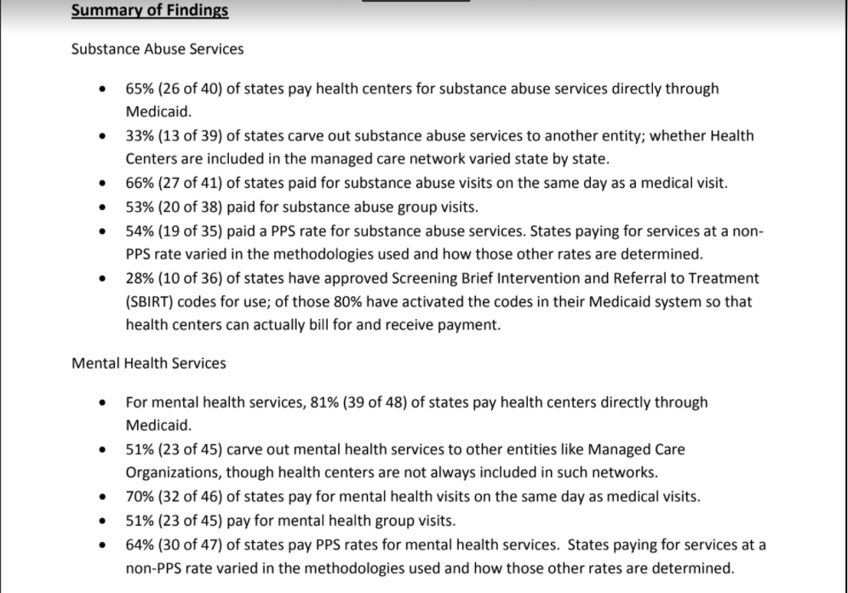

Slide 43
Medicare Billing during national emergency (Expansion of Telehealth via 1135 Waiver)
Providers:
Physicians
Nurse practitioners
Physician assistants
Nurse midwives
Certified nurse anesthetists
Clinical psychologists
Clinical social workers
Registered dietitians, and nutrition professionals
See G codes re: PT, OT, SLPT
https://www.cms.gov/newsroom/fact-sheets/medicare-telemedicine-health-care-provider-fact-sheet

Slide 45
Keys
Check with similar programs that have “figured it out.”
Focus on the locus of control
(some places you can make changes, re-negotiate, etc…)
Other places you have to lobby for change, particularly legislatively

Slide 46
Questions, thoughts?

