Slide 1
Well-Being Wednesdays: Cultivating Awareness Through Mindfulness-Based Practices
Trainers: Andrew Jordan Thayer, PhD
December 9, 2020

Slide 2
Disclaimer
This presentation was prepared for the MHTTC Network under a cooperative agreement from the Substance Abuse and Mental Health Services Administration (SAMHSA). All material appearing in this presentation, except that taken directly from copyrighted sources, is in the public domain and may be reproduced or copied without permission from SAMHSA or the authors. Citation of the source is appreciated. Do not reproduce or distribute this presentation for a fee without specific, written authorization from the MHTTC Network Coordinating Office. This presentation will be recorded and posted on our website.
At the time of this presentation, Elinore F. McCance-Katz served as SAMHSA Assistant Secretary. The opinions expressed herein are the views of the speakers, and do not reflect the official position of the Department of Health and Human Services (DHHS), or SAMHSA. No official support or endorsement of DHHS, SAMHSA, for the opinions described in this presentation is intended or should be inferred.

Slide 3
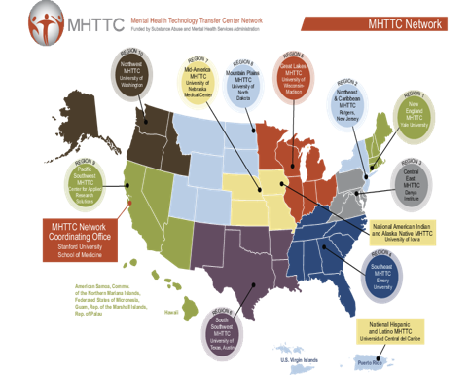
Established in 2018 with funding from the Substance Abuse and Mental Health Services Administration (SAMHSA)
10 Regional Centers
National Hispanic & Latino Center​
National American Indian and Alaska Native Center
Network Coordinating Office

Slide 4
Mid-America MHTTC Project Director: Dr. Brandy Clarke, PhD, LP
Serves to provide continuum of training and technical assistance in evidence-based practice and mental health services across MO, IA, NE, and KS.
SAMHSA grant awarded to Dr. Joseph Evans at the University of Nebraska Medical Center (Grant #: H79SM081769).

Slide 5
Sources of educator stress (pre & post COViD)
worries about loved ones
personal health concerns
frustrated parents
de-funding of schools
distance learning
efforts to improve educator wellbeing
educational inequities
insufficient funding & resources
policy & accountability measures
administrative demands
challenging student behaviors
not enough time!

Slide 6
Break Time
An Invitation
Notes:
I invite you to sit or stand wherever you feel most comfortable, with a drink or food of your choice. Maybe some light music playing in the background if you want while you listen and participate today alongside your colleagues.

Slide 7
The Adult Resilience Curriculum (ARC)
Notes:
We are continuing our path through the ARC. As a reminder, ARC is a research-supported collection of modules focusing on different skills, concepts, activities, and relationships important to adults to Thrive.

Slide 8
The ARC Modules
1: Understanding the psychobiology of stress and wellbeing (psychoeducation)
2: Creating safe and supportive environments (context)
3: Clarifying, aligning with, and committing to one’s values
(values)
4: Cultivating awareness through mindfulness-based practices (mindfulness)
5: Connecting meaningfully with others
(connection)
6: Fostering pleasant emotions and experiences
(positivity)
7: Coping with difficult thoughts, feelings, and experiences
(coping)
8: Feeling good physically through nutrition, movement, & sleep
(health)
9: Rejuvenating through relaxation, recreation, and routines
(three R’s)
10: Bringing it all together: A wellness plan for the future
(wellness plan)
Notes:
One of my favorite things about ARC is that it pulls from the best that we could find. Looking across different research efforts, theories, philosophies, and cultures, here are the common elements that lead to adults thriving in whatever situation they are in.
As we go through each module, we are laying the foundation for the next module so that each builds off one another. Last week we discussed a basic, yet powerful, driver of adult well-being, and one that is often forgotten about--values

Slide 9
Golden Circle
What
How
Why
Notes:
The Golden Circle
I think using the Golden Circle is a good way to summarize the point of values. We are conditioned in the United States, and have become quite good at it, to start with our whats. When we meet someone new, we often start with, “How do you know so and so? What do you do? How long have you lived here?” etc. We start at the surface and work our way in. And that’s often how we go through life. If I ask you, what did you do yesterday?, your first inclination is probably to say, “I got up, showered, at breakfast, went to work, delivered my lessons, spoke with some parents.” Etc. how different would it be if your answer was, instead, “I nurtured the growth of kids as they learn more about their world, themselves, and their friends and family”. I would love it if more conversations started that way.
This is leading with our why, or values, or meaning, or purposes, first. It gives us a sense of vitality that our what’s simply don’t. Our what’s are important for other things, but not necessarily in helping us whether difficulties. So how do we apply this? We regularly reminder ourselves of our values, clarify what is important, and affirm our commitment to them. We do this yearly, monthly, weekly, daily, minute-by-minute. It’s difficult to do, though, when stressed or overloaded. We need another tool to help us regularly connect with our values…

Slide 10
MODULE 4: Cultivating Awareness Through Mindfulness-Based Practices
Notes:
That tool is mindfulness.
By now, you have probably heard of mindfulness in someway. You may be familiar with it, practice it, or know it only as a hippy-dippy thing that some people do. You may think of meditation, lack of emotion, stoicism, a monk, a new fad that might stay or go away.
Well, to that last one, I can say mindfulness has been around in some form and by some name for thousands of years. It is certainly not knew, although we can say that our understanding of why it’s so dang good for us is new. As for the other things—the image of a monk, meditating, spirituality, and more—those are only window dressing. I want to boil down mindfulness to a very simply concept and with this core understanding, talk about how it can help you.

Slide 11
Notes:
Do the Dog mind vs Lion Mind metaphor

Slide 12
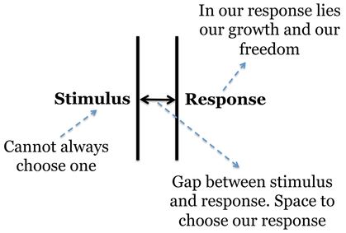
“
Between stimulus and response there is a space. In that space is our power to choose our response. In our response lies our growth and our freedom.
Vicktor E. Frankl
“
Notes:
At it’s most basic, mindfulness is creating space.
If you are not familiar with Frankl, he was a Jewish prisoner of war in Nazi concentration camps. And, despite the horrible conditions under which he and his peers lived in and experienced during this dark period of human history, Mr. Frankle was amazed to find that some people seemed to be thriving and doing well. He dedicated his life to understand why. And although he did not term it mindfulness, he did find that one of the secrets of these individuals who still seemed to be thriving was this:
*read quote*
In short, mindfulness is actually about giving you a bit of freedom back by preventing automatic thoughts and reactions from dictating your life, and allowing you to choose how to be.

Slide 13
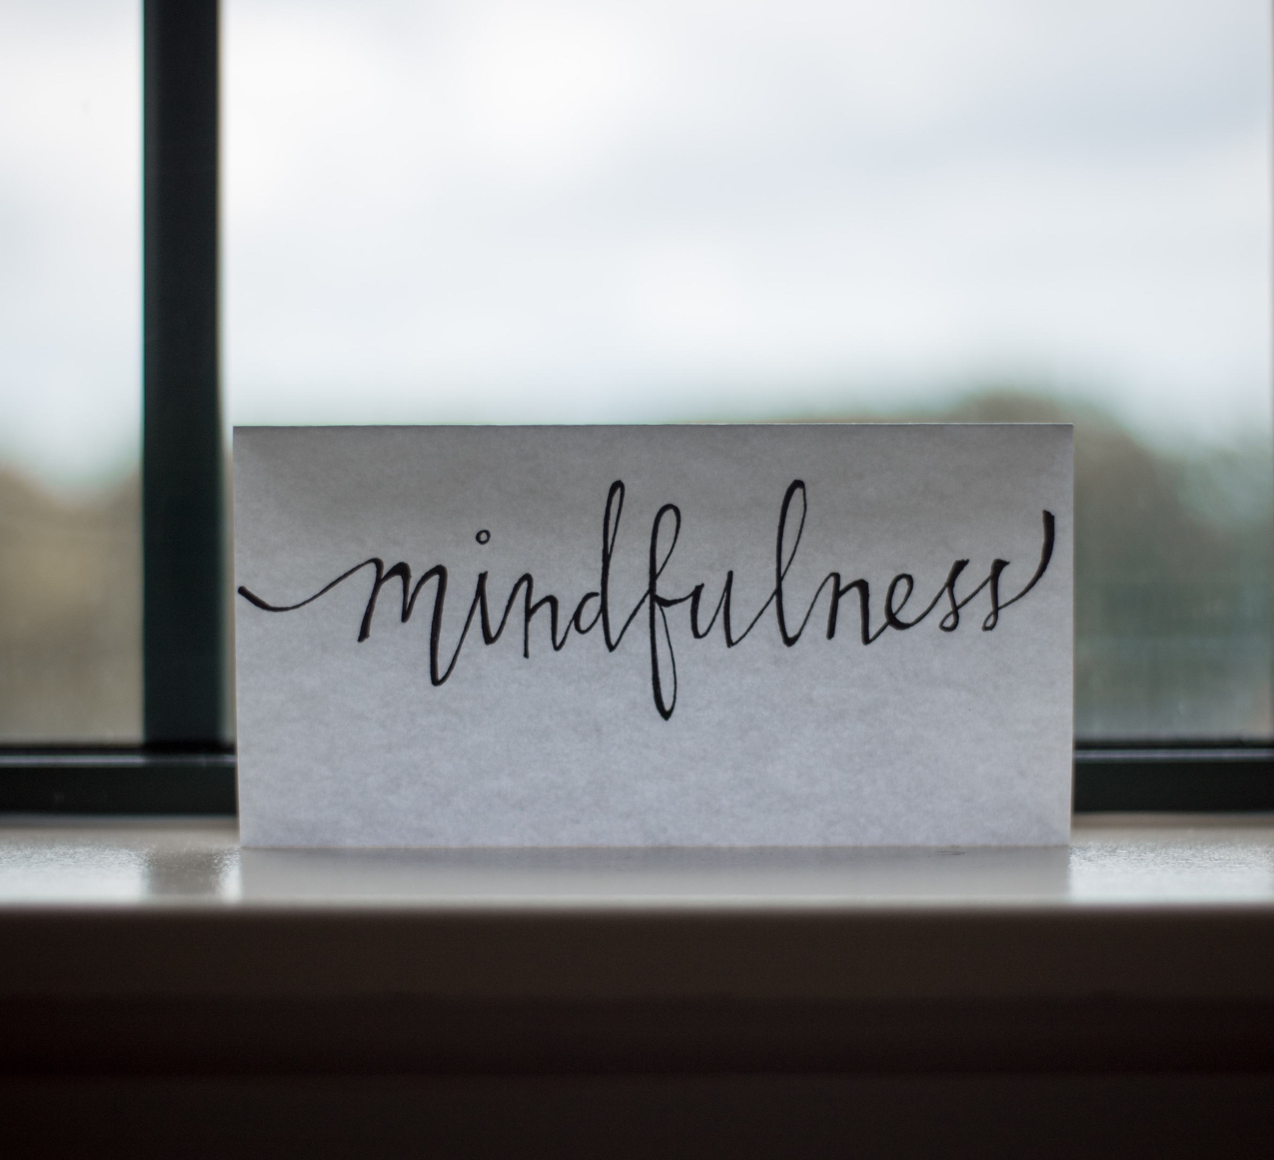
Mindfulness
Intentionality or agency
“
Purposeful awareness
Open & gentle attitude
Paying attention, on purpose, in the present moment, and non-judgmentally.
- Jon Kabat-Zinn
“
Notes:
We engage in mindful practice not through meditation but by practicing purposeful awareness of the moment, with agency, and with an openness to experience.
What does this look like in practice? Allow me to share a story with my tattoo artist. He naturally coaches and guides his clients through mindfulness practices while he works on there tattoos. Our first session together, he was asking me about my work and as I was explaining it he said, “Oh, that sounds really similar to what I have to do.” He went on to explain that many clients come in for their first session and are really nervous. They have all these thoughts and worries built up in their mind. What if the tattoo goes wrong? What if they change their mind? Will the needle hurt that much? How will they sit there for the whole things (some tattoo sessions can last several hours). They are wrapped up in their thoughts and worries. So when they sit down, the moment the needle touches their skin, they immediately react. They tense up, hold their breath, some may squirm a little. Some even end the session early. What my tattoo artist does is, when he notices this start to coach them. He says things like, “Yup, the needle does hurt a little bit. Try not to think about it hurting though, because that’s a judgment. Instead, be curious about what you are feeling. Can you describe the type of sensation? Is it poking or more like scratching? Can you feel your skin raise where the ink and scab start to go? Can you see the image in your head as I trace our sketch? Take a deep breath and let it out slowly. Does that change how the needle feels? Look at this painting I did. What do you see in it? Anything you find curious about it?”
Basically, what he does is help them fully embrace the moment and to eliminate judgments like “pain” (pain is subjective), or worries like “what if I don’t like it” and instead asks them to be curious about the very thing they are feeling or their immediate surroundings. Ever hear of guided meditation? Well, he does guided tattooing mindfulness.
You can find examples like this everywhere. Gone to a workout class and the instructor is saying “feel the burn”? They are encouraging us to be mindful of our sensations. Notice they say burn, not pain. It’s a nonjudgmental description of the experience.

Slide 14
LET’S APPLY IT!
Let’s do an activity called Washing a plate/thing.
Pick a dirty plate or some other object immediately next to you. Grab a rag or something soft.
For 3 minutes, do nothing other than clean that same object. doing that chore.
Notice what your immediate thoughts are to that direction.
Notice how your mind gets distracted. That is okay. Bring your attention back to the chore.
Check for Understanding
How would you define mindfulness?
Next steps
-Meditate 3-5 minutes 3x a week
-Active mindfulness 3-5 minutes daily
-Combine mindfulness with values clarification regularly
-Read on mindfulness (see handouts)

Slide 15
What questions do we have at this point?

Slide 16
Individual Action Planning
Complete Action Plan
Notes:
Action Planning is a critical step whenever we try to start something new for ourselves. It helps us identify our barriers, our strengths, and how we can recover from setbacks when they enevitably happen.
Please complete the Action Plan form that is linked with this lesson.
Take care,

Slide 17
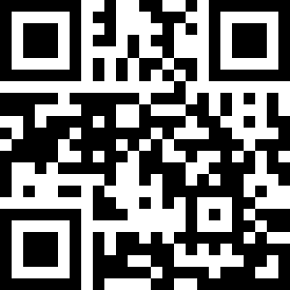
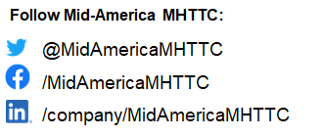
Complete the Evaluation
Scan QR code or follow the link
https://ttc-gpra.org/P?s=540500
Join our mailing list!
Contact Us:
Email: midamerica@mhttcnetwork.org
Phone: 402-552-7697
https://mhttcnetwork.org/centers/mid-america-mhttc/home
TEXT: MIDAMERICAMHTTC to 22828 to get started
*Message and data rates may apply

