Slide 1


Effective Supports for Students with Autism Participating in Remote Learning
Erin Briley, M.S., NCSP
Mountain Plains MHTTC Trainer

Slide 2
Disclaimer and Funding Statement
This presentation was prepared for the Mountain Plains MHTTC under a cooperative agreement from the Substance Abuse and Mental Health Services Administration (SAMHSA). All material appearing in this presentation, except that taken directly from copyrighted sources, is in the public domain and may be reproduced or copied without permission from SAMHSA or the authors. Citation of the source is appreciated. Do not reproduce or distribute this presentation for a fee without specific, written authorization from the Mountain Plains MHTTC. For more information on obtaining copies of this presentation please email swinfield@wiche.edu.
The opinions expressed herein are the views of Erin Briley and do not reflect the official position of the Department of Health and Human Services (DHHS), or SAMHSA. No official support or endorsement of DHHS, SAMHSA, for the opinions described in this presentation is intended or should be inferred.
The work of the Mountain Plains MHTTC is supported by grant H79SM081792 from the Department of Health and Human Services, Substance Abuse and Mental Health Services Administration.
Notes:
David

Slide 4

The Mountain Plains Mental Health Technology Transfer Center
The Mountain Plains Mental Health Technology Transfer Center (Mountain Plains MHTTC) provides training and technical assistance to individuals who serve persons with mental health concerns throughout Region 8 (Colorado, Montana, North Dakota, South Dakota, Utah and Wyoming).
We belong to the Technology Transfer Center (TTC) Network, a national network of training and technical assistance centers serving the needs of mental health, substance use and prevention providers. The work of the TTC Network is under a cooperative agreement by the Substance Abuse and Mental Health Service Administration (SAMHSA).
Notes:
David will cover to here

Slide 5
ASD & Unpredictability
Those with ASD tend to have difficulty with adaptability and prefer predictability
The unknown may result in behavioral difficulties signaling anxiety
Further complicated with difficulties understanding and using language, and understanding abstract concepts
The pandemic has resulted in significant changes for everyone
Additional supports needed to comprehend & adapt to current circumstances

Slide 6
Explaining Current Circumstances³
Reassure and normalize fears. Use clear and concise concrete language
Pair with a social narrative that provides clarification and possible responses
Social story examples:
https://carolgraysocialstories.com/wp-content/uploads/2020/03/COVID-19-I-Can-Help-1.pdf
https://afirm.fpg.unc.edu/sites/afirm.fpg.unc.edu/files/covid-resources/Support%20Understanding-Coronavirus.pdf

Slide 7
Explaining Current Circumstances³
Use visual supports to teach relevant “rules” (e.g., handwashing, social distancing, etc.)
Social narrative example: https://afirm.fpg.unc.edu/sites/afirm.fpg.unc.edu/files/covid-resources/Support%20Understanding-Greeting%20People.pdf
Task analysis example: https://afirm.fpg.unc.edu/sites/afirm.fpg.unc.edu/files/covid-resources/Support%20Understanding-Handwashing%20%28Photos%29.pdf
Use visual cues to explain & track the passage of time. Calendar favorite activities (e.g., TV shows, online meetups, etc.)
Consider bullet or video journals, art, create comic strips to facilitate expression

Slide 8

Coping Skills
Body Techniques ^{3,5}
  Belly breathing. E.g., smell the flower/blow out the candle with visual supports
Hume et al. (2020)
  Progressive Muscle Relaxation (PMR). Tensing & then relaxing various muscle groups
  Other: Squeeze/release a squeeze ball, blow pinwheels, sensory fidgets, deep pressure, rocking in a rocking chair, swinging, heavy work, movement. Establish an exercise routine!
  Example of calming routine. https://afirm.fpg.unc.edu/sites/afirm.fpg.unc.edu/files/covid-resources/Prioritize%20Coping%20and%20Calming%20Skills-Calming%20Routine.pdf

Slide 9
Coping Skills^{3,5}
2) Mind Techniques
  Relaxing Imagery, draw, color, journal, sing, listen to music with headphones; count to 20
3) Combination Techniques: Yoga & Tai Chi
Mindfulness/Meditation Apps: Calm, Headspace, Breathe2Relax, Pacifica, Rain Rain; Down Dog yoga

Slide 10
Coping Skills Modifications & Strategies^{3,5}
Justify. Explain how nervous system responds to stress & why relaxation techniques help
Use visual supports to demonstrate & cue
Use concise & concrete language (e.g., “expand your stomach like a balloon filling with air” vs “breathe in the light”)
Ensure student has access to established calming activities
Build into daily routine & visual schedule. Increase access during first few weeks of change & be strategic as to when this is built into the child’s routine
Generalize skill by cueing use in different environments & inform when/how to use
Be sensitive to signs of anxiety & depression. Consult with specialist as needed

Slide 11
Provide Physical Structure
Provide clear physical & visual boundaries for different areas of purpose
  Tape, bookshelves, carpet, cushions/bean bags for quiet time, etc. can be used to distinguish areas.
Structure learning with to-do lists or folders/bins with “to do” and “done”
Workspaces:
  Minimize auditory & visual distractions
  Keep materials out of view when not in use.
  Clearly label materials and place in the order in which they should be used
Key Players: Autism Specialist (AS), Behavioral Specialist (BS), School Psychologist (SP)

Slide 12
Accommodating for Sensory Needs¹
Hyper-sensitivities: Establish calming area. Weighted blankets, body sock, bean bags, dimmed lights, sunglasses or visor to block overhead lighting, ear plugs or noise cancelling headphones in noisy areas, avoiding strongly scented products; DIY sensory bottles; cozy corners with stuffed animals, comfy pillows, blanket forts, and books; request permission before touching
Hypo-sensitivities (movement seeking): Mini trampolines, wobble seats, kinetic sand, exercise/stability balls to sit on, chewies & fidget toys; opportunities to swing or rock; providing firm touch/pressure; weighted blankets; built in rigorous exercise; kinesthetic sand
Key Players: AS, BS, OT, SLP, SP

Slide 13
The Importance of Routines
Routines make settings predictable by helping children understand expectations.
Create clearly stated rules (about 3-5) and post in a place easily seen
Use the same school routine & pair with a visual schedule. Modify as needed.
Use the same materials from school (augmentative/alternative communication; visual schedule; work materials). Make a video for caregivers so they know how to implement if necessary

Slide 14
Visual Supports: Visual Schedules
Informs of what activities will occur and in what sequence. Makes abstract concepts
concrete.
Include: sleep/wake routines; chores/daily living tasks (pair with task analysis if necessary), breaks, days off, and fun activities (e.g., swimming pool day; family movie night).
Intersperse work with (movement) breaks
Incorporate impending changes into schedule & prep in advance
Review each morning and review for next day the day prior
Key Players: AS, BS, SP, Speech Language Pathologist (SLP)

Slide 15
Visual Supports: Social Narratives^{2,6,7,8}
Short descriptors of social situations. Includes specific information about what to expect, why, and appropriate behavioral expectations/responses/choices.
Provides information as to the thoughts and feelings of others involved
Individualized, written in the 1st person, and from the learner’s perspective
Simple verbiage and (often) pictures to supplement concepts
Written positively. Tells what TO DO instead of what NOT TO DO
Information is presented concretely to clarify ambiguous situations
Key Players: SLP, AS, BS, SP

Slide 16



Visual Supports: Visual Schedules
Example of written (checklist): https://afirm.fpg.unc.edu/sites/afirm.fpg.unc.edu/files/covid-resources/Build%20New%20Routines-Daily%20Schedule%20Example%20Using%20Stickie%20Notes.pdf
Example visual/written: https://afirm.fpg.unc.edu/sites/afirm.fpg.unc.edu/files/covid-resources/Build%20New%20Routines-Daily%20Schedule%20Example.pdf
Example of first/then:

Slide 17
Visual Supports: Social Narratives^{2,6,7,8}
Prepares for possibilities in advance & provides guidelines for behavior
Increases structure and decreases anxiety.
Use prior to situation of concern. Initially use more frequently.
Uses: perspective taking; self-care skills; coping with impending changes to routines; general coping skills, etc.
Types: Social StoriesTM , Cartooning, Comic Strip ConversationsTM, Power Cards, Social Autopsies
Best for those at a developmental level in which students can attend.
Please refer to resources at the end of this presentation for further training on details of how to implement
Example: https://teacch.com/resources/teacch-tips/5socialnarrativesexplainingchanges/

Slide 18
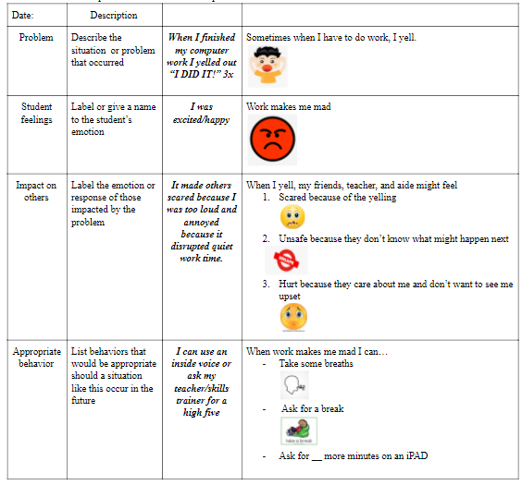
Shared with permission. Tami Yamamura, SLP

Slide 19
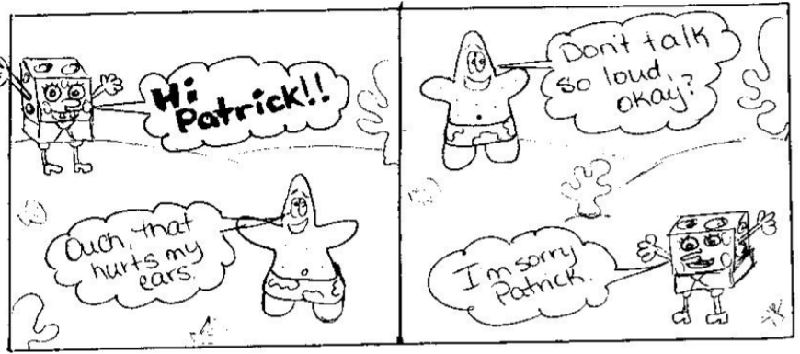
Visual Supports: Cartooning
Uses figures, thought & speech bubbles to model appropriate social exchanges.
Show what people may be thinking, their intentions, and feelings
Visualizing conversational elements make abstract aspects of social communication more concrete
Comic Book ConversationsTM
- Symbols represent interactions and colors represent feelings/emotional content.
Uses: convey important information, solve problems, teach expectations, fix misunderstandings
Retrieved from
Illinois Autism Training and Technical
Assistance Project (n.d.)
Key Players: SLP,AS, BS, SP

Slide 20
Challenging Behaviors
Be proactive. Maintain regulation. Respond to beginning signs of frustration & agitation.
Use natural rewards before tangible ones, & incentives more than punishments
Reward good behavior and selectively ignore inappropriate behavior
Consistently follow-through & reinforce immediately.
AVOID: providing incentives prior to expectations

Slide 21
Choice Making
Choice-making allows control over one’s environment.
Beneficial most to those who display problem behavior to escape participation.
Can be done with objects, pictures, or verbally.
Structured choices (e.g., “Which worksheet do you want to do first? This or ____?”) to empower & eliminate power struggles.

Slide 22
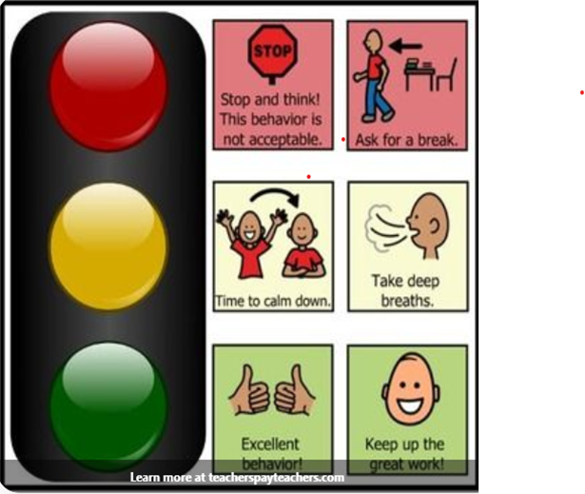



Check-In Ideas
Visual supports to identify emotions, their intensity, & self-regulation
Teacher or student initiated
Check-in at beginning of each class & periodically throughout/when needed.
Immediate reinforcement
Goal is to step in & address before student is red & implement coping skills
Traffic Light System
  Provide red, yellow, green cards & define what colors represent.
  E.g., (Green = I’m good; Yellow = I’m frustrated; Red = I’m angry).
  Pair color with pre-identified coping skills
2. Emotions Thermometer
Numbers/Mood Emojis

Slide 23
Poor Task Engagement
Increase structured choices
Arrange schedule so preferred activities follow nonpreferred tasks.
Teach how to request help or a break. Provide “break cards” or “I need help” cards as a substitute if unable to effectively verbalize. Agitation/stressors can adversely impact communication skills.
If already upset, consider temporarily reducing demands to improve compliance
Acknowledge efforts no matter how small.
Implement incentive system
AVOID ignoring task avoidant behaviors or giving time outs.

Slide 24


Difficulties Transitioning³
Cue to signal upcoming transition. Cue and use visual timers to structure time given/left.
Avoid transitions from high to low preference. Transition to neutral activity or transition objects/”finished box”
Structure transitions and down time
Pause card. A visual cue to indicate preferred activity is being “paused for now” but available later with a clear indication of when https://teacch.com/files/2020/05/pause_cards_small.pdf
Use timers, visual timers, or visual countdowns for work and breaks
Children’s Countdown Timer – Visual Timer for Kids
Visual Timer
Key Players: AS, BS, SP, SLP, OT

Slide 25
Incentive/Token Systems
Points earned for goals for specified time periods, accumulated, & exchanged for specified reward
Target <3-4 behaviors. Pair with pictures if needed
Gather baseline to create challenging yet achievable goals. Consider frustration levels & allow room for error. Do not expect 100% success unless related to physical aggression.
Consider how frequently reinforcer should be earned. At end of each assignment, class, day?
Give token as soon as child shows appropriate behavior. Pair with specific feedback.
Avoid fines for inappropriate behavior. Consult with specialist for this.

Slide 26
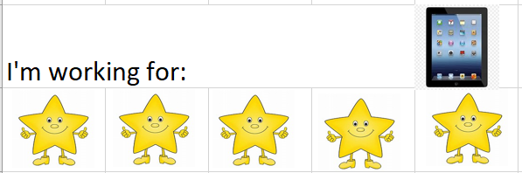
Token Boards
Or, have students color in 1 section of a picture each time they complete a task/problem. When the entire picture is colored in, they earn their incentive.
Virtual token boards: https://www.thetokenboard.com/
Downloadable boards: http://www.educateautism.com/free-materials-and-downloads.html/category/token-boards.html
Created by Erin Briley, M.S., NCSP

Slide 27
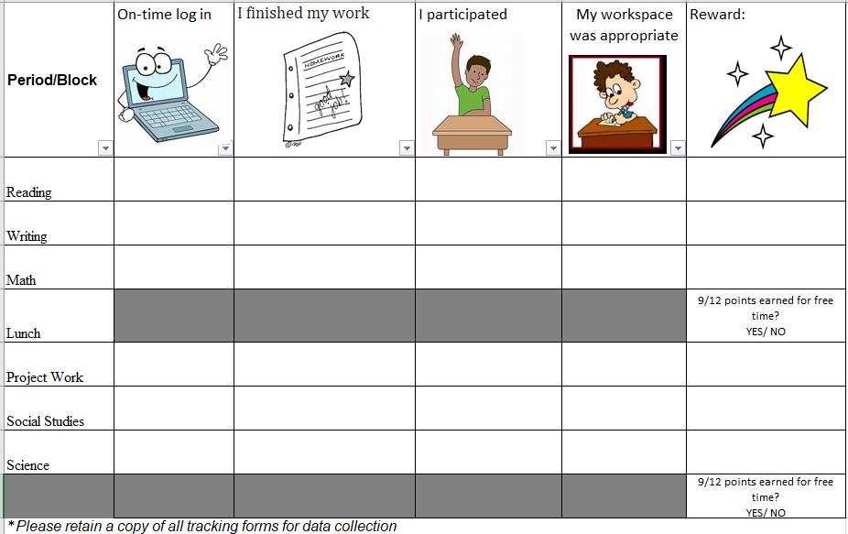
Token Economy Example #2
Created by Erin Briley, M.S., NCSP

Slide 28
Reinforcers for Remote Learning
Privileges
Activities
iPad/iOS Sensory Apps that double as brain breaks
homework pass
extra points
do only odd problems for math
display of student’s ARTWORK/picture as teacher’s virtual class background
student selection of virtual class background
student monitor of chat box
selection of class virtual fieldtrip
selection of class theme
wearing special outfits
go noodle
bubble pop
pocket pond
fluidity HD
Super Slime simulator
calm down yoga (https://www.youtube.com/watch?v=rWP4Xl4IDYA&app=desktop)
free time
drawing, reading, board games, Games on tablet/Phone
listen to music on headphones
Lunch date with you & selected friend (zoom, etc.)
virtual talent shows
telling class favorite jokes
decorating things
Extra break time
Verbal
iPad/iOS Educational Game Apps
Tangibles
pbs kids games
candy crush
certificates
teacher avatar messages
badges/awards
Specific Praise (privately/in front of others)
peer-recognition
Personalized video messages from teacher/Avatar

Slide 29
Social Connections³
Schedule time to connect with known individuals (FaceTime, Marco Polo, etc.) & online social groups, socially engaged gaming, telehealth, etc. Vary methods used.
Social engagement online shouldn’t replace direct engagement in the long-run.
Resources: local Autism Society chapters; Autism Speaks (autismspeaks.org);
Teach rules of virtual social engagement using visual tools (social stories, social narratives, comic strip communication), role-play social situations
Example: https://afirm.fpg.unc.edu/sites/afirm.fpg.unc.edu/files/covid-resources/Foster%20Connection-Calling%20with%20FaceTime.pdf

Slide 30
Back to School Preparations
Social narratives to prep for new routines & protocols (e.g., masks, social distancing)
Show a video of staff in the school wearing masks and engaging in expected protocols
Video chat with teacher
Provide walk-through prior to school returning
Role play
Visual countdowns for days back to school and add to visual schedule

Slide 31
Q&A

Slide 32
Resources
Coping Supports
- AFIRM. https://afirm.fpg.unc.edu/prioritize-coping-and-calming-skills
Expressive Communication Supports
AFIRM. https://afirm.fpg.unc.edu/offer-opportunities-expression
Sensory tools
Sensory University. www.sensoryuniversity.com
Ark Therapeutic Products. www.arktherapeutic.com
Social Narratives
Autism Focused Intervention Resources & Modules (AFIRM). https://afirm.fpg.unc.edu/Social-narratives
Carol’s Club: https://carolgraysocialstories.com/carols-club/clubhouse/ for social stories & pandemic-specific
National Autistic Society. https://www.autism.org.uk/advice-and-guidance/topics/communication/communication-tools/social-stories-and-comic-strip-coversations

Slide 33
Resources
Teaching Tips and Supports
TEACCH Autism Program. https://teacch.com/resources/teacch-tips/
Virtual Programs (e.g., social skills, social groups, support groups, etc.)
- Autism Speaks. https://www.autismspeaks.org/resource-guide
Virtual Trainings and Webinars
- TEACCH Autism Program. https://teacch.com/trainings/virtual-trainings/

Slide 34
References
Autism Speaks (2020). Sensory Issues. Retrieved from https://www.autismspeaks.org/sensory-issues
Carol Gray Social Stories (2021). Retrieved from https://carolgraysocialstories.com/
Hume, K., Waters, V., Sam, A., Steinbrenner, J., Perkins, Y., Dees, B., Tomaszewski, B., Rentschler, L., Szendrey, S., McIntyre, N., White, M., Nowell, S., & Odom, S. (2020). Supporting individuals with autism through uncertain times. Chapel Hill, NC: School of Education and Frank Porter Graham Child Development Institute, University of North Carolina at Chapel Hill. Retrieved from: https://afirm.fpg.unc.edu/supporting-individuals-autism-through-uncertain-times
Illinois Autism Training and Technical Assistance Project. Illinois State University. (n.d.). Comic Strip Conversations. Retrieved from https://education.illinoisstate.edu/downloads/asi/ComicStripConversations.pdf
Lynch, C.(2019, June 03) Relaxation Training for Kids on the Autism Spectrum. 5 Essential Modifications. Retrieved from https://www.psychologytoday.com/gb/blog/autism-and-anxiety/201906/relaxation-training-kids-the-autism-spectrum
Sam, A., & AFIRM Team. (2015). Social narratives. Chapel Hill, NC: National Professional Development Center on Autism Spectrum Disorder, FPG Child Development Center, University of North Carolina. Retrieved from http://afirm.fpg.unc.edu/Social-narratives
TEACCH Autism Program. (2021). TEACCH Tips. A collection of tips to provide supports for families on how to support those with ASD during times of change. Retrieved from https://teacch.com/resources/teacch-tips/
The National Autistic Society. Social stories and comic strip conversations. (2021). Retrieved from https://www.autism.org.uk/advice-and-guidance/topics/communication/communication-tools/social-stories-and-comic-strip-coversations

Slide 35
Thank you for joining!

